Slide 1
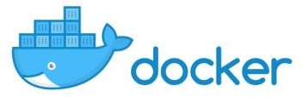
Introduction to Docker

Slide 2
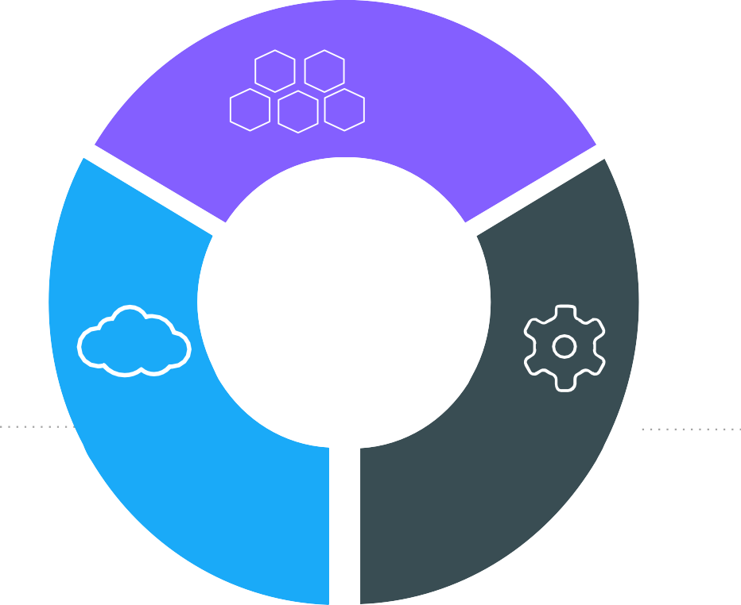
The IT Landscape is Changing
Apps
Cloud
DevOps

Slide 3














Applications are transforming
~2000
Today
Loosely Coupled Services
Monolithic
Rapidly updated
Slow changing
Many Small
Servers or devices
Big Servers

Slide 4
Application Modernization
Application Code
Developer Issues:
Microservices: Break application into separate operations
Minor code changes require full re-compile and re-test
Application becomes single point of failure
Application is difficult to scale
12-Factor Apps: Make the app independently scalable, stateless, highly available by design

Slide 5




The Way We Write Applications is changing
Customer/ Clients/ Users
Today
Apps are constantly developed
Newer version are deployed often
Built from loosely coupled components
Deployed to a multitude of servers
Data
Storage
Data Storage
Data
Storage

Slide 6









Continuous Integration and Delivery
1. Development 2. Test 3. Stage / Production
Version control
Sysadmin
Developer
QA / QE

Slide 7
Docker and Container Overview

Slide 8
History of Docker
2013
Solomon Hykes starts Docker as an internal project within dotCloud
Feb 2016
Docker introduces first commercial product – now called Docker Enterprise Edition
2008
Linux containers
(LXC 1.0)
introduced
2004
Solaris Containers / Zones technology introduced
Mar 2013
Docker released to open source
Today
Open source community includes:
- 3,300+ contributors
- 43,000+ stars
- 12,000+ forks

Slide 9
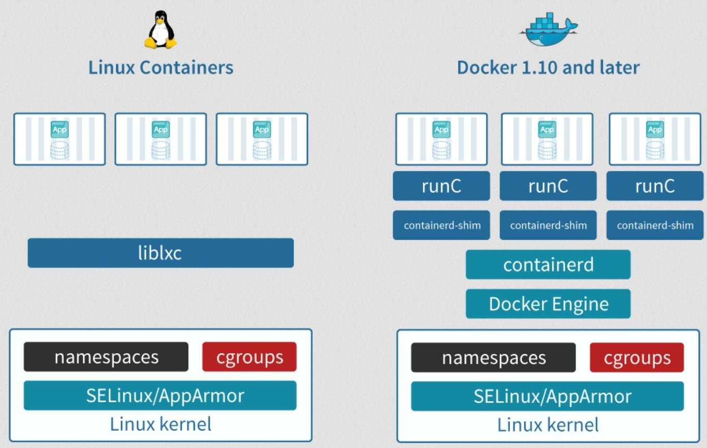
Docker Underlying Technology

Slide 10


The Docker Family Tree
Subscription-based, commercially supported products for delivering a secure software supply chain
Enterprise Edition
Intended for:
Production deployments + Enterprise customers
Open source framework for assembling core components that make a container platform
Free, community-supported product for delivering a container solution
Intended for:
Open source contributors + ecosystem developers
Community Edition
Intended for: Software dev & test

Slide 11
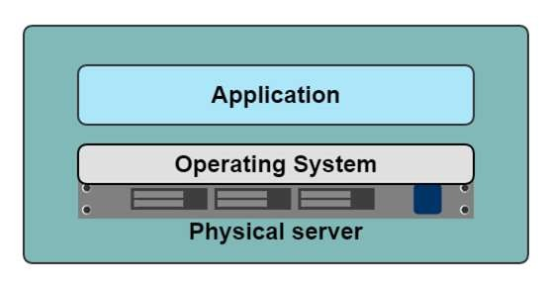
A History Lesson
In the Dark Ages
One application on one physical server

Slide 12
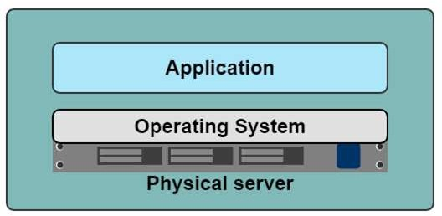
Historical limitations of application deployment
Slow deployment times
Huge costs
Wasted resources
Difficult to scale
Difficult to migrate
Vendor lock in
17

Slide 13
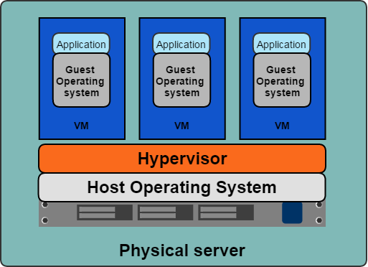
Hypervisor-based Virtualization
One physical server can contain multiple applications
Each application runs in a virtual machine (VM)

Slide 14



Benefits of VMs
Better resource pooling
One physical machine divided into multiple virtual machines
Easier to scale
VMs in the cloud
Rapid elasticity
Pay as you go model

Slide 15



Limitations of VMs
Each VM stills requires
CPU allocation
Storage
RAM
An entire guest operating system
The more VMs you run, the more resources you need
Guest OS means wasted resources
Application portability not guaranteed

Slide 16
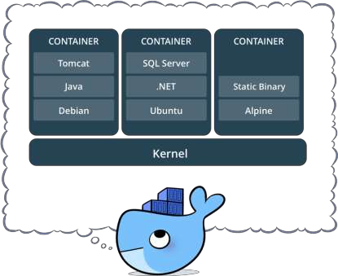
What is a container?
Standardized packaging for software and dependencies
Isolate apps from each other
Share the same OS kernel
Works with all major Linux and Windows Server

Slide 17
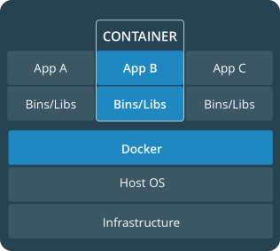
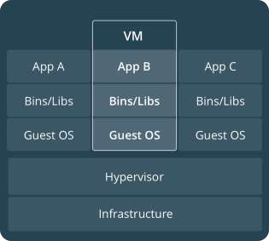
Comparing Containers and VMs
Containers are an app level construct
VMs are an infrastructure level construct to turn one machine into many servers

Slide 18
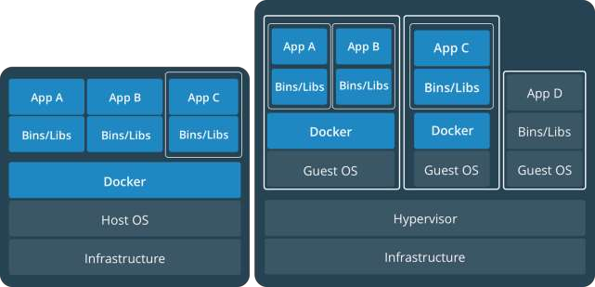
Containers and VMs together
PROD
DEV
Containers and VMs together provide a tremendous amount of
flexibility for IT to optimally deploy and manage apps.

Slide 19
Key Benefits of Docker Containers
Speed
No OS to boot = applications online in seconds
Portability
Less dependencies between process layers = ability to move between infrastructure
Efficiency
Less OS overhead
Improved VM
density

Slide 20
Docker containers are NOT VMs
It’s not quite like a VM
Uses the host kernel
Can’t boot a different OS
Can’t have its own modules
Doesn’t need init
Doesn’t need syslogd, cron.
It’s just a normal process on the host machine
Contrast with VMs which are opaque

Slide 21
VM Vs Docker - Similarity
Virtual Machines | Docker
Process in one VM can’t see processes in other VMs | Process in one container can’t see processes in other container
Each VM has its own root filesystem | Each container has its own root file system(Not Kernel)
Each VM gets its own virtual network adapter | Docker can get virtual network adapter. It can have separate IP and ports
VM is a running instance of physical files(.VMX and .VMDK) | Docker containers are running instances of Docker Image
Host OS can be different from guest OS | Host OS can be different from Container OS

Slide 22
VM Vs Docker - Difference
Virtual Machines | Docker
Each VM runs its own OS | All containers share the same Kernel of the host
Boot up time is in minutes | Containers instantiate in seconds
VMs snapshots are used sparingly | Images are built incrementally on top of another like layers. Lots of images/snapshots
Not effective diffs. Not version controlled | Images can be diffed and can be version controlled. Dockerhub is like GITHUB
Cannot run more than couple of VMs on an average laptop | Can run many Docker containers in a laptop.
Only one VM can be started from one set of VMX and VMDK files | Multiple Docker containers can be started from one Docker image
34

Slide 23

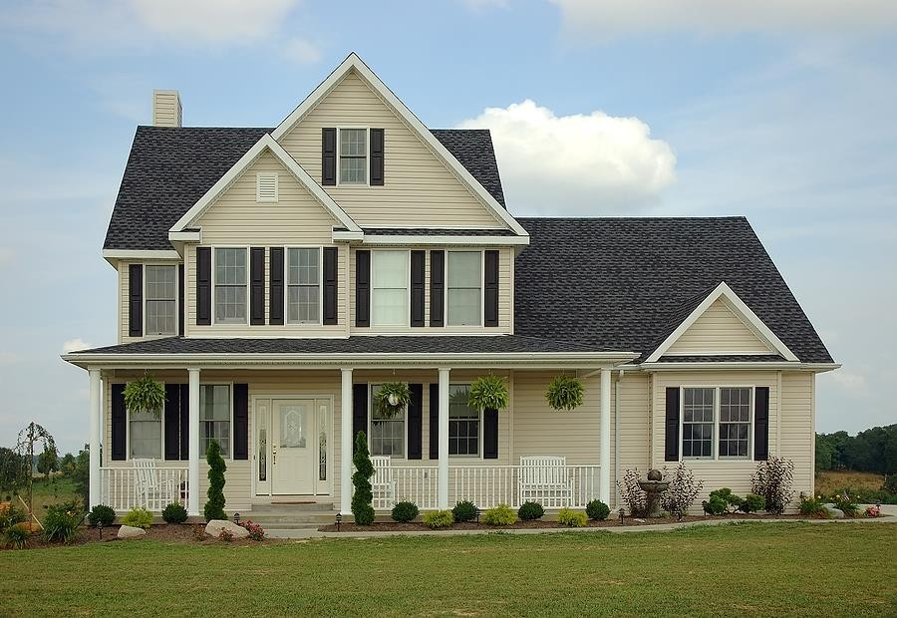
VMs

Slide 24

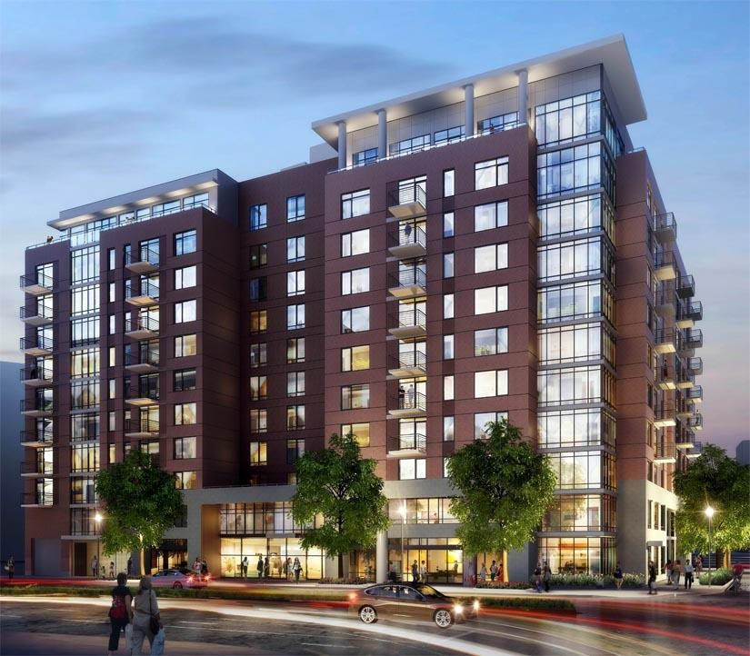
Containers

Slide 25
Container Solutions & Landscape

Slide 26
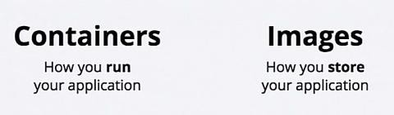




Some Docker vocabulary
Docker Image
The basis of a Docker container. Represents a full application
Docker Container
The standard unit in which the application service resides and executes
Docker Engine
Creates, ships and runs Docker containers deployable on a physical or virtual, host locally, in a datacenter or cloud service provider
Registry Service (Docker Hub or Docker Trusted Registry)
Cloud or server based storage and distribution service for your images
41

Slide 27
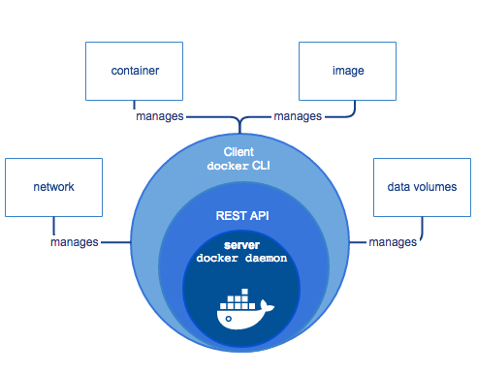
Docker Engine

Slide 28
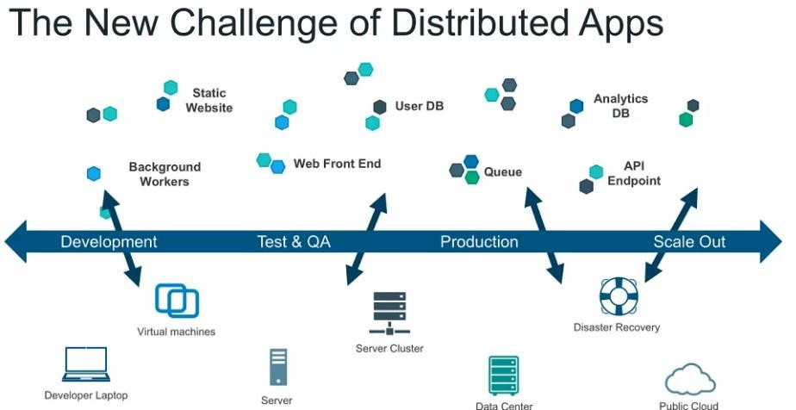

Slide 29
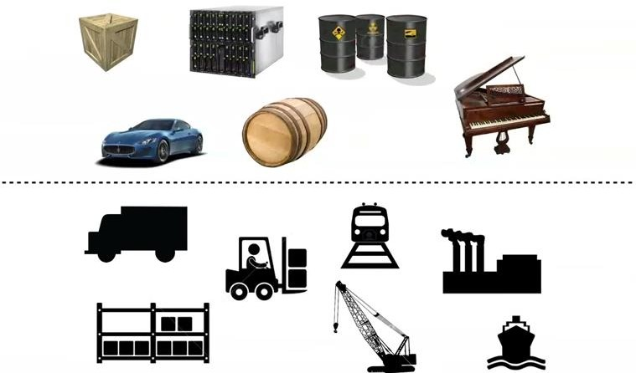
An Effort to solve the problem complexity…

Slide 30
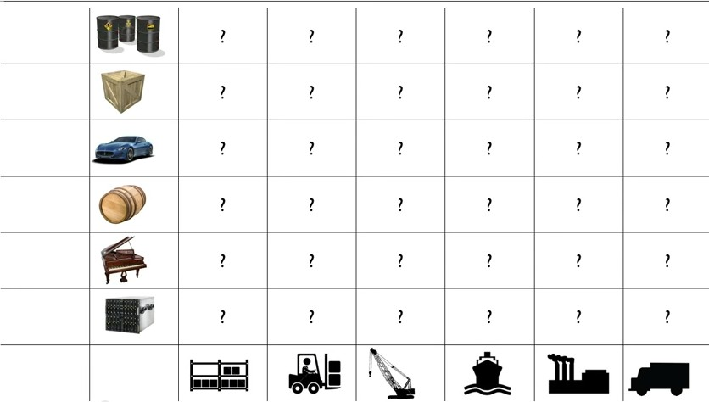
Every possible goods to ship X Every possible way to ship

Slide 31
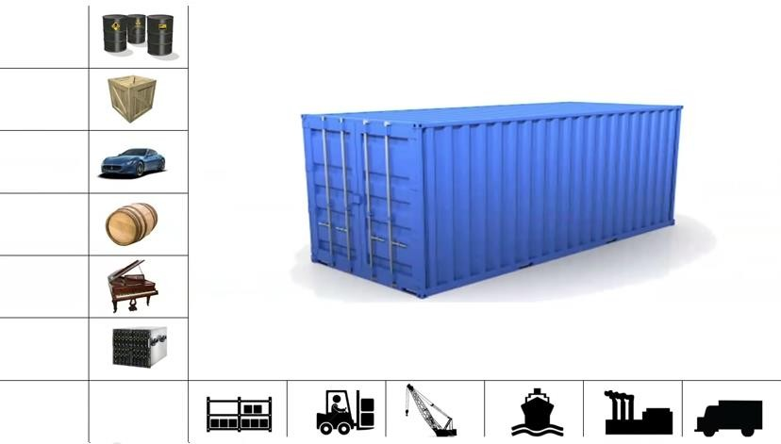
A Solution…

Slide 32
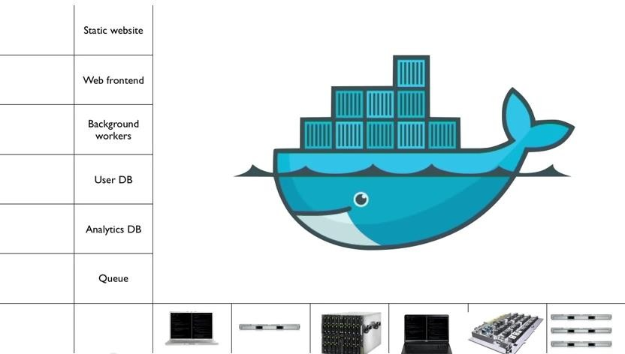
Docker ~ Brings standardization on packaging goods

Slide 33

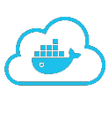

















Put it all together: Build, Ship, Run Workflow
Developers IT Operations
BUILD
Development Environments
SHIP
Create & Store Images
RUN
Deploy, Manage, Scale

Slide 34
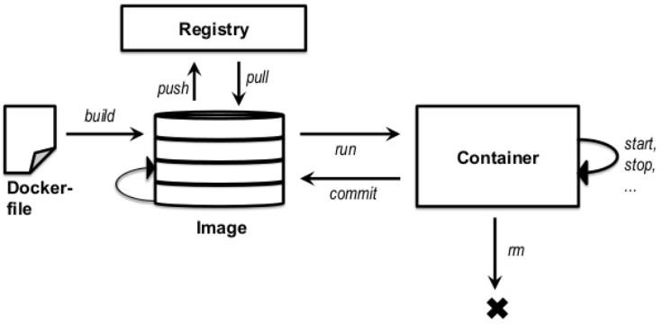
Basic Docker Commands
Pulling Docker Image
$ docker pull hello-world
Listing out Docker Images
$ docker image ls
Running Docker Containers
$ docker run hello-world
Stopping the container
$ docker container stop hello-world

Slide 35
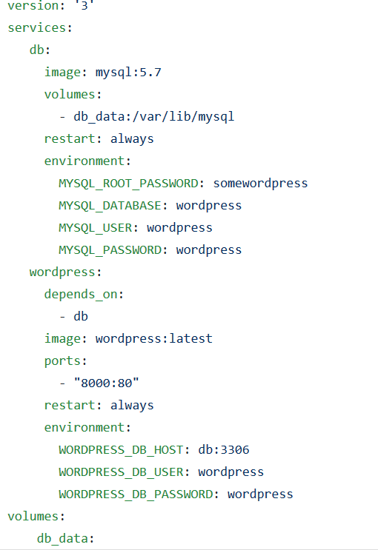
Docker Compose – Building Microservices in easy way
Backend Service
Specify Volumes/Network
Environmental variables Frontend Service
Specify Volumes/Network
Environmental variables

Slide 36
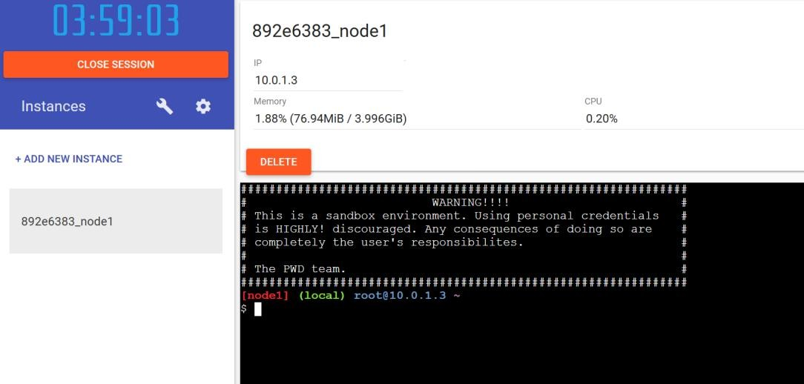
Demo
Docker Playground
www.play-with-docker.com
www.docs.docker.com

Slide 37


