Slide 1
Sobel Edge Detection on FPGA
California State University Northridge
ECE 524 - Fall 2022
Shahbaz Hassan Khan Malik

Slide 2
Order of presentation
Edge detection
Edge detection
Sobel Edge detection
Convolution
Image processing on FPGA
Line buffers
Implementation and results
Future

Slide 3
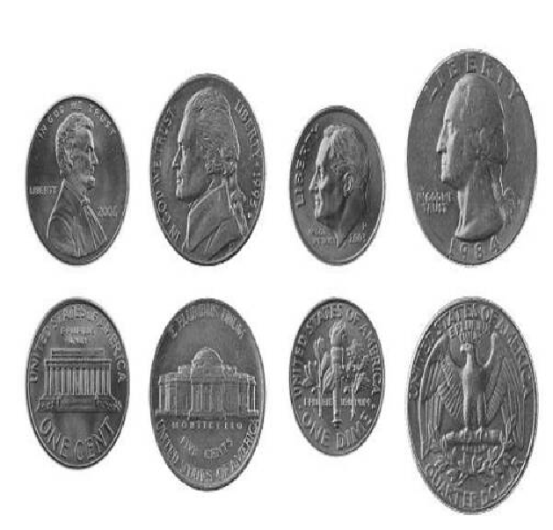
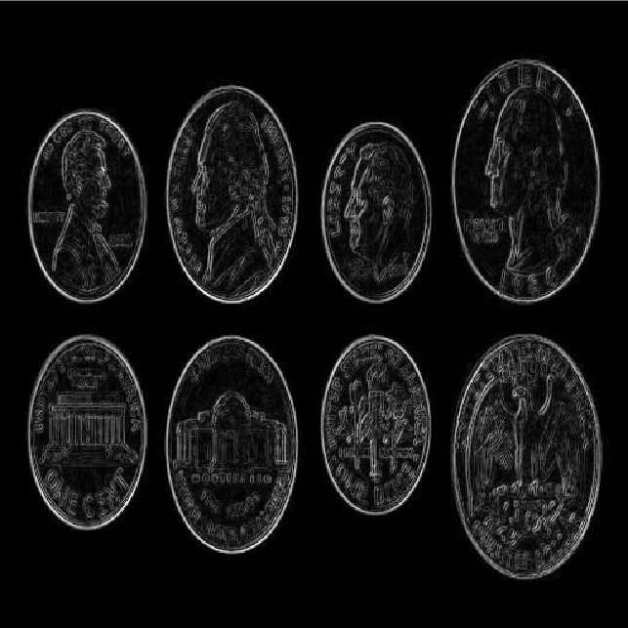
Edge Detection
It is used in Image Processing for enhancing boundaries of an image
Edges in image are areas where there is a sudden change in intensity

Slide 4
Edge Detection
There are various Edge detection methods (Laplacian, Sobel, Roberts, Canny)
We will be using Sobel Edge Detection for this project

Slide 5
Sobel Edge Detection
It uses two matrices to find the gradient of the image intensity at each pixel
These kernels find vertical and horizontal edges
We perform 2D convolution on the image
-1 | 0 | +1
-2 | 0 | +2
-1 | 0 | +2
-1 | -2 | -1
0 | 0 | 0
+1 | +2 | +1

Slide 6
Convolution
Image Kernel
100 | 100 | 100 | 100
100 | 100 | 100 | 100
100 | 100 | 200 | 100
100 | 100 | 100 | 100
100 | 100 | 100 | 100
-1 | 0 | 1
-2 | 0 | 2
-1 | 0 | 1
*

Slide 7
Convolution
Image Kernel Convolution
100 | 100 | 100 | 100
100 | 100 | 100 | 100
100 | 100 | 200 | 100
100 | 100 | 100 | 100
100 | 100 | 100 | 100
-1*100 | 0*100 | 1*100 | 100
-2*100 | 0*100 | 2*100 | 100
-1*100 | 0*100 | 1*200 | 100
100 | 100 | 100 | 100
100 | 100 | 100 | 100
-1 | 0 | 1
-2 | 0 | 2
-1 | 0 | 1
*
→

Slide 8
Convolution
Image Kernel Convolution
100 | 100 | 100 | 100
100 | 100 | 100 | 100
100 | 100 | 200 | 100
100 | 100 | 100 | 100
100 | 100 | 100 | 100
-1*100 | 0*100 | 1*100 | 100
-2*100 | 0*100 | 2*100 | 100
-1*100 | 0*100 | 1*200 | 100
100 | 100 | 100 | 100
100 | 100 | 100 | 100
-100
100
-200
200
-100
200
+------
100
-1 | 0 | 1
-2 | 0 | 2
-1 | 0 | 1
*
→

Slide 9
Convolution
Convolution Output Image
-1*100 | 0*100 | 1*100 | 100
-2*100 | 0*100 | 2*100 | 100
-1*100 | 0*100 | 1*200 | 100
100 | 100 | 100 | 100
100 | 100 | 100 | 100
-100
100
-200
200
-100
200
+------
100
 | 100

Slide 10
Convolution
Convolution Output Image
100 | 100 | 100 | 100
100 | 100 | 100 | 100
100 | 100 | 200 | 100
100 | 100 | 100 | 100
100 | 100 | 100 | 100
New Value

Slide 11
Convolution
Convolution Output Image
100 | 100 | 100 | 100
100 | 100 | 100 | 100
100 | 100 | 200 | 100
100 | 100 | 100 | 100
100 | 100 | 100 | 100
New Value | New Value

Slide 12
Convolution
Convolution Output Image
100 | 100 | 100 | 100
100 | 100 | 100 | 100
100 | 100 | 200 | 100
100 | 100 | 100 | 100
100 | 100 | 100 | 100
New Value | New Value | New Value

Slide 13
Convolution
Convolution Output Image
100 | 100 | 100 | 100
100 | 100 | 100 | 100
100 | 100 | 200 | 100
100 | 100 | 100 | 100
100 | 100 | 100 | 100
New Value | New Value | New Value | New Value

Slide 14
Convolution
Convolution Output Image
100 | 100 | 100 | 100
100 | 100 | 100 | 100
100 | 100 | 200 | 100
100 | 100 | 100 | 100
100 | 100 | 100 | 100
New Value | New Value | New Value | New Value
 |  |  | New Value

Slide 15
Convolution
Convolution Output Image
100 | 100 | 100 | 100
100 | 100 | 100 | 100
100 | 100 | 200 | 100
100 | 100 | 100 | 100
100 | 100 | 100 | 100
New Value | New Value | New Value | New Value
 |  | New Value | New Value

Slide 16
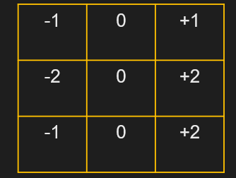
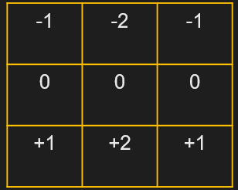



Sobel Edge Detection Process
Image
*
$$G_{x}$$
$$\left|G\right|= \sqrt{G_{x}^{2}+G_{y}^{2}}$$
$$G_{y}$$
*

Slide 17
Image Processing in FPGA
We are working with 512x512 image, but we cannot have an i/o port that is 512x512 (two dimension)
It is also not practical to just send all the 262144 pixels of the image to the FPGA at once.
Storing the entire image on FPGA will utilize a lot of resources, which is not efficient. Unless the image is very small like 12x12

Slide 18

Image Processing in FPGA
We will need to transform our design into some kind of a streaming algorithm
We can use a small memory to “buffer” the image
This small memory is known as a “Line Buffer” which stores one line of image
We will just send just enough pixels for processing the image instead of pushing the entire image at once
Image pixels go in
Reference: Image Processing using FPGA by Donald G. Bailey

Slide 19
Image Processing in FPGA
Image
100 | 100 | 100
100 | 100 | 100
100 | 100 | 200
100 | 100 | 100
W9
W8
W7
Line Buffer
W6
W5
W4
Line Buffer
Line Buffer
W3
W2
W1
Line Buffer
Reference: Image Processing using FPGA by Donald G. Bailey

Slide 20
Image Processing in FPGA
Sampling Window
Image
100 | 100 | 100
100 | 100 | 100
100 | 100 | 200
100 | 100 | 100
W1 | W2 | W3
W4 | W5 | W6
W7 | W8 | W9
W9
W8
W7
Line Buffer
*
W6
W5
W4
K1 | K2 | K3
K4 | K5 | K6
K7 | K8 | K9
Line Buffer
Line Buffer
W3
W2
W1
Line Buffer
Reference: Image Processing using FPGA by Donald G. Bailey

Slide 21
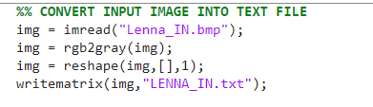

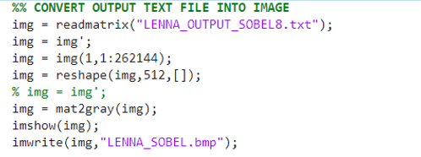
Results
MATLAB: Convert image into 1D array → write the array into a text file
Vivado: Read the intensity values in test bench as the input to the design
MATLAB: Convert output text file back into an image

Slide 22
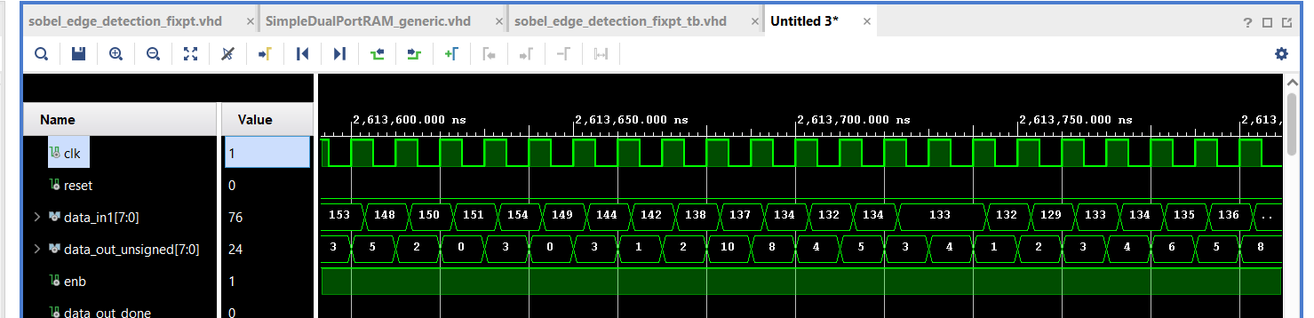
Results

Slide 23
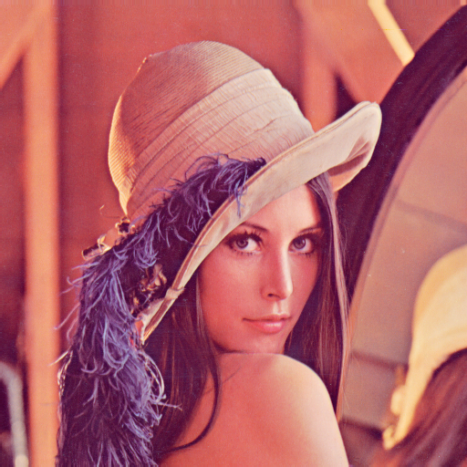
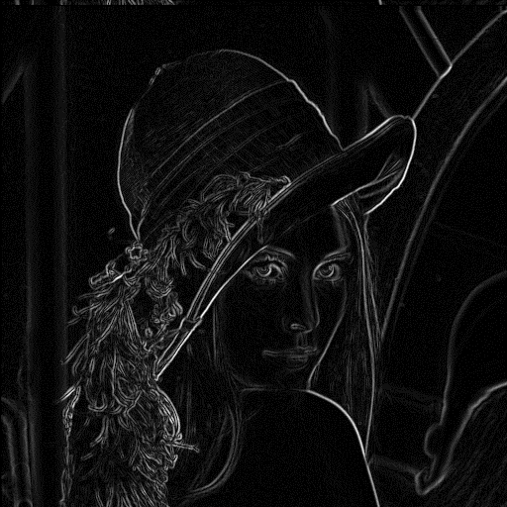
Results

Slide 24
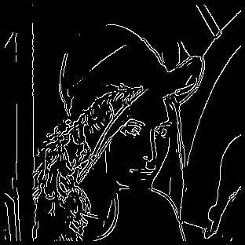
Results
Sobel Canny

Slide 25
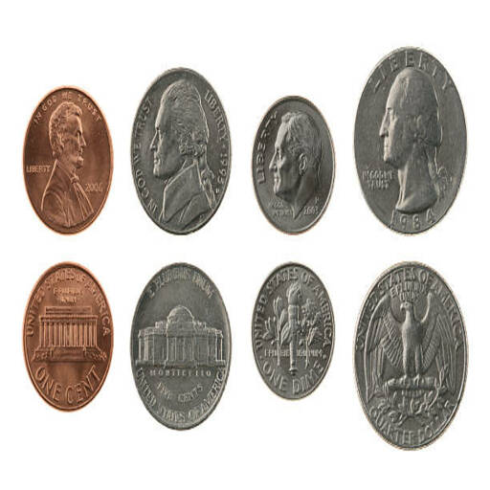
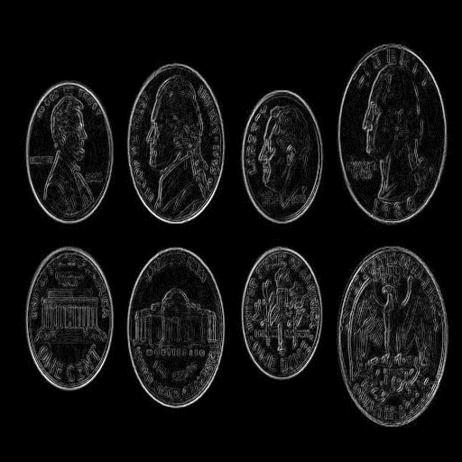
Results

Slide 26
Conclusion
Results can be improved by first applying a Gaussian low pass filter to remove noise and then applying the Sobel kernels
Design can be exported as an AXI IP and connected with DMA and Zynq SoC to create a fully hardware accelerated Sobel Edge Detection system [ECE 520]

Slide 27
Thank You

