Slide 1
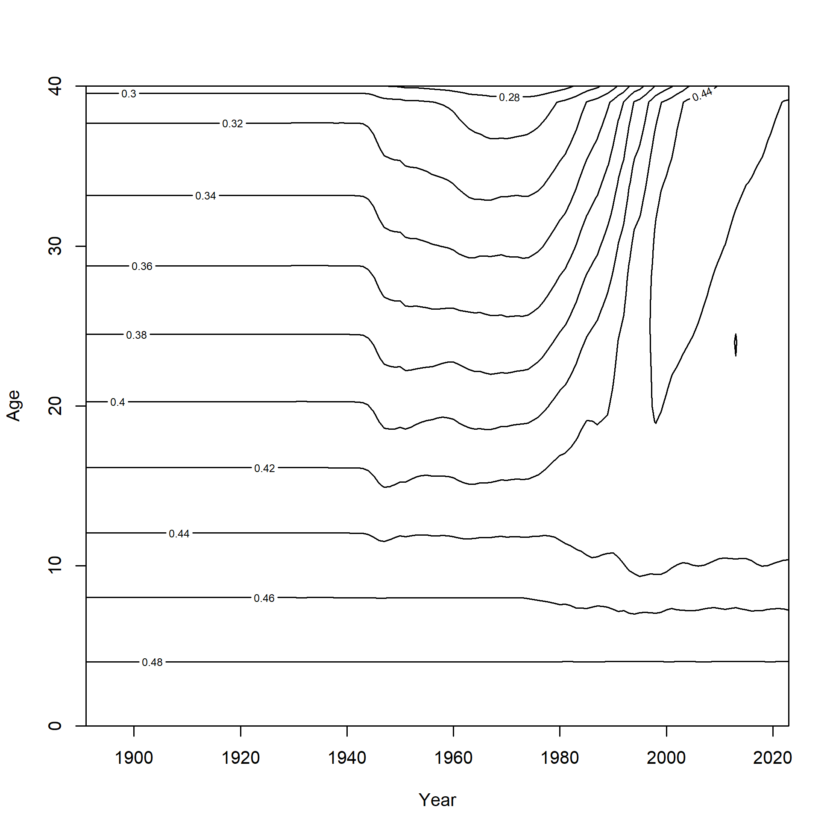
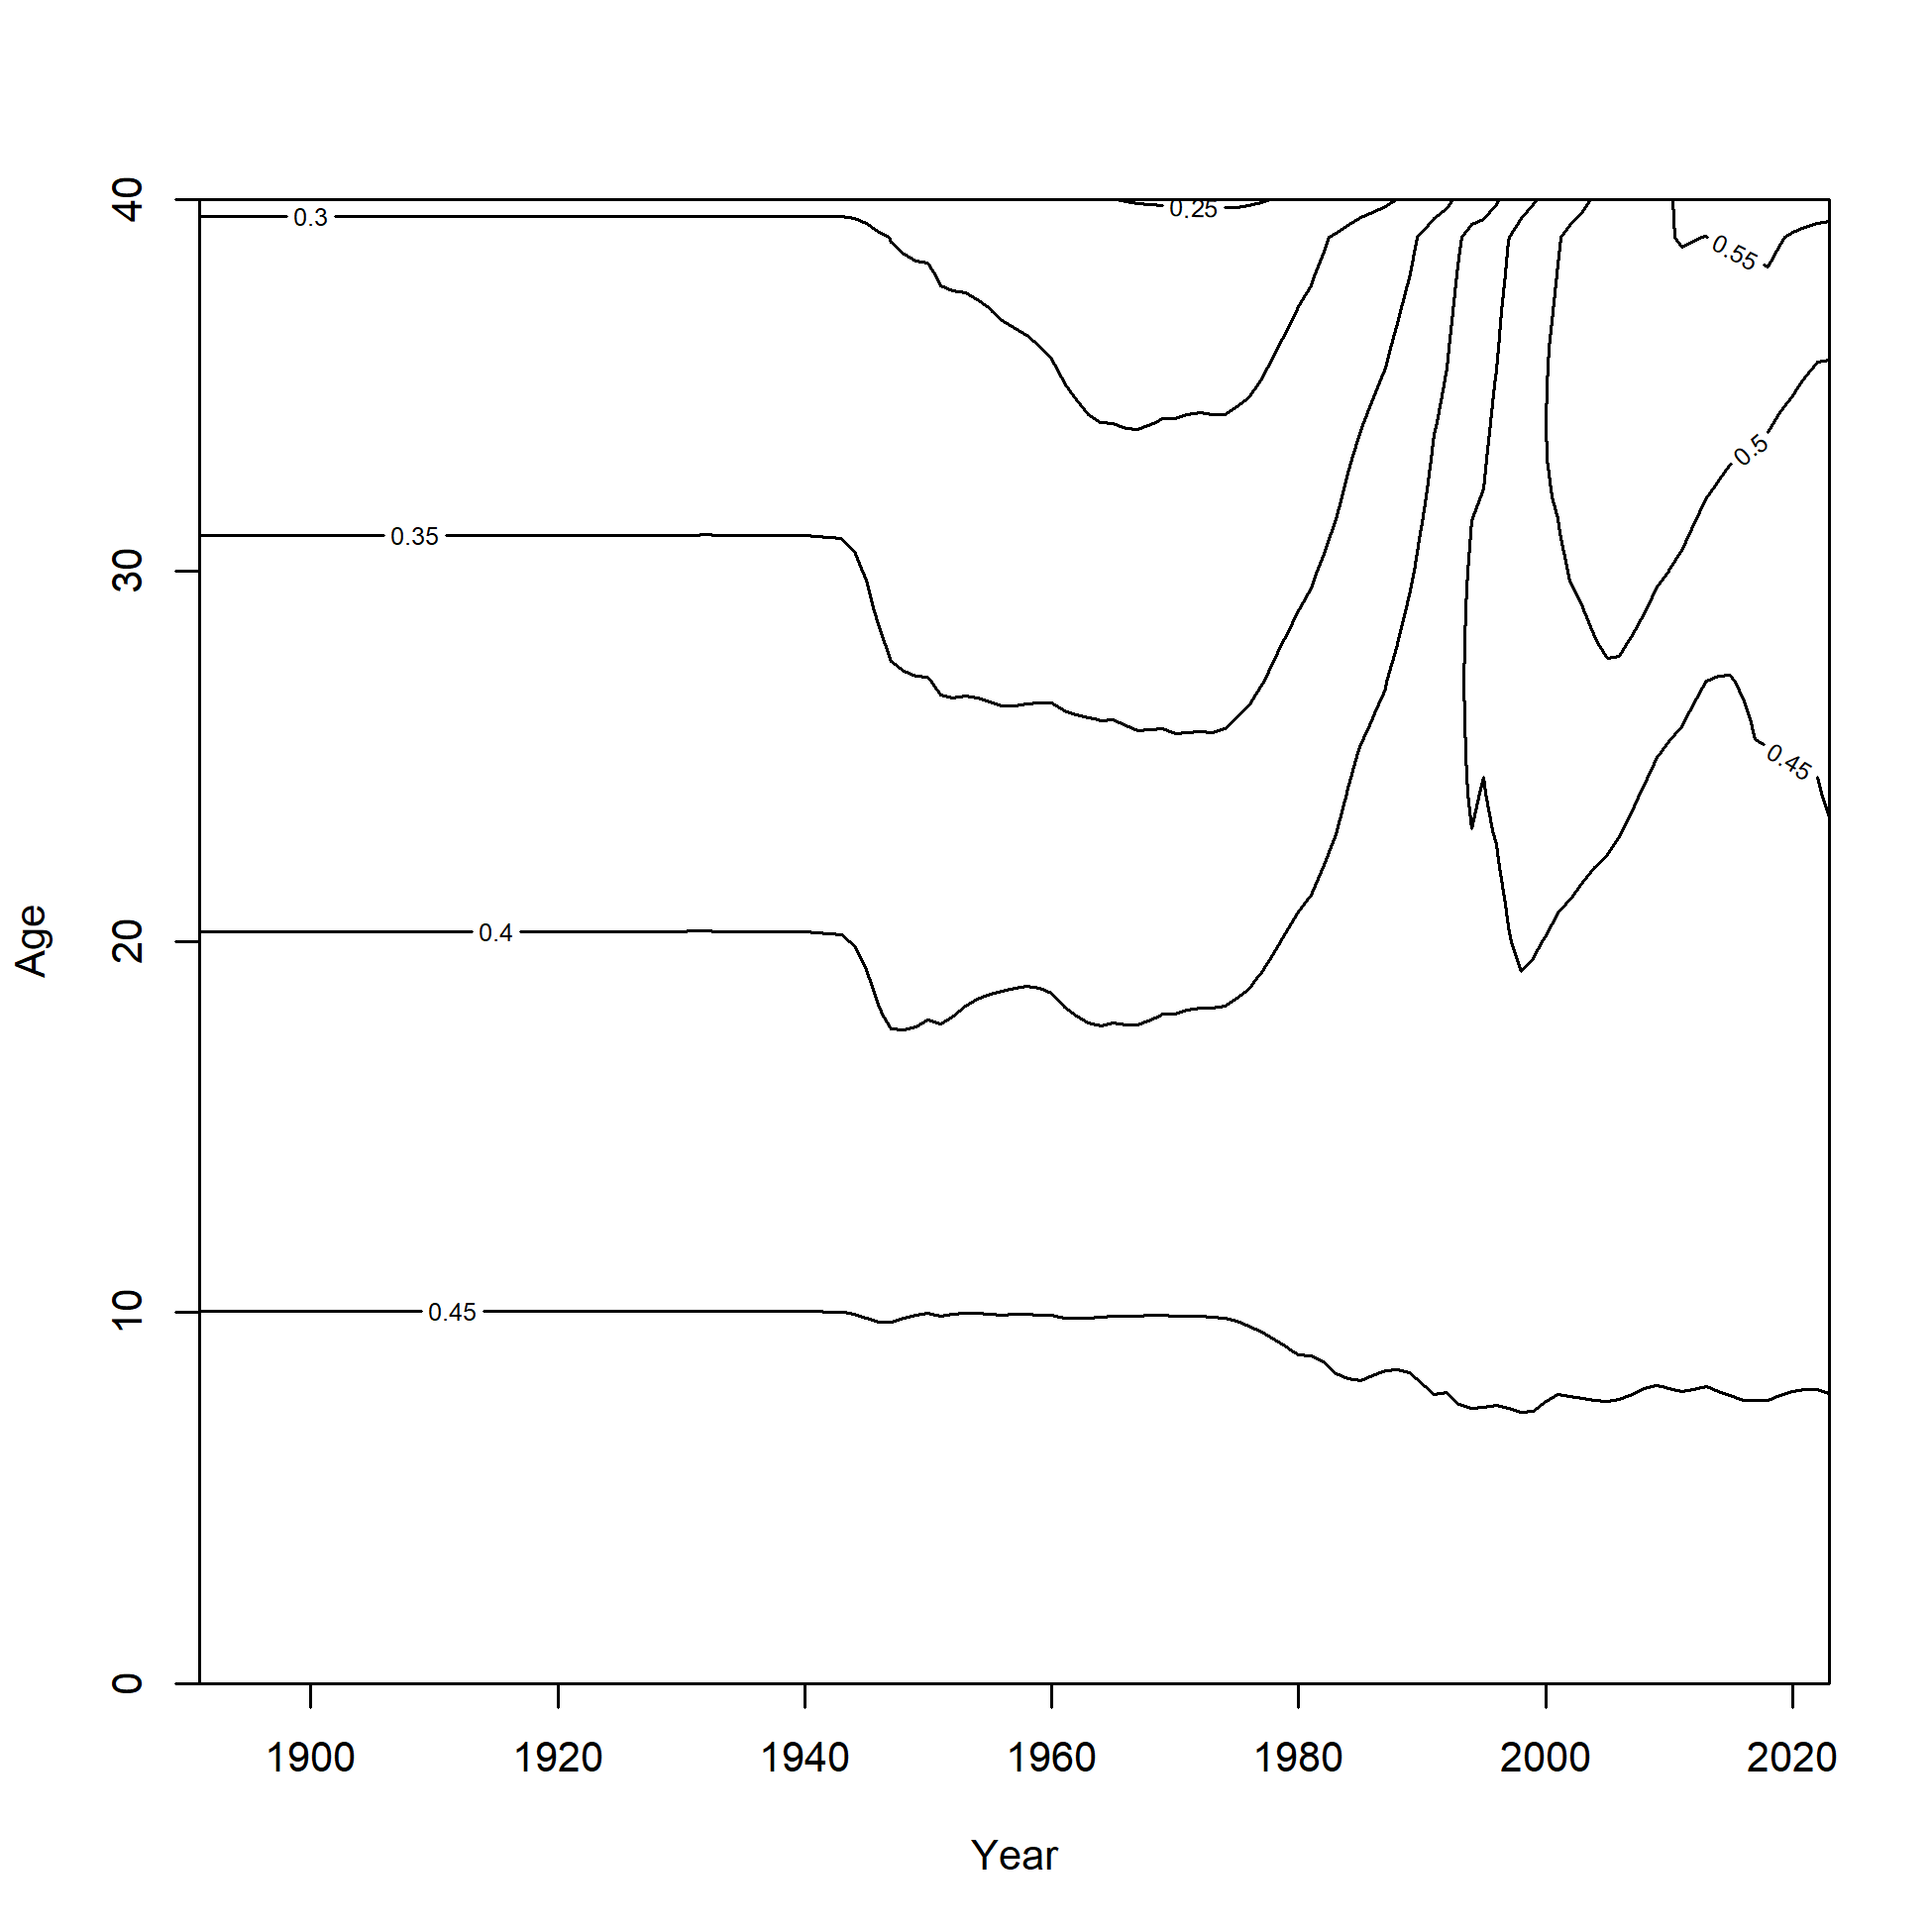
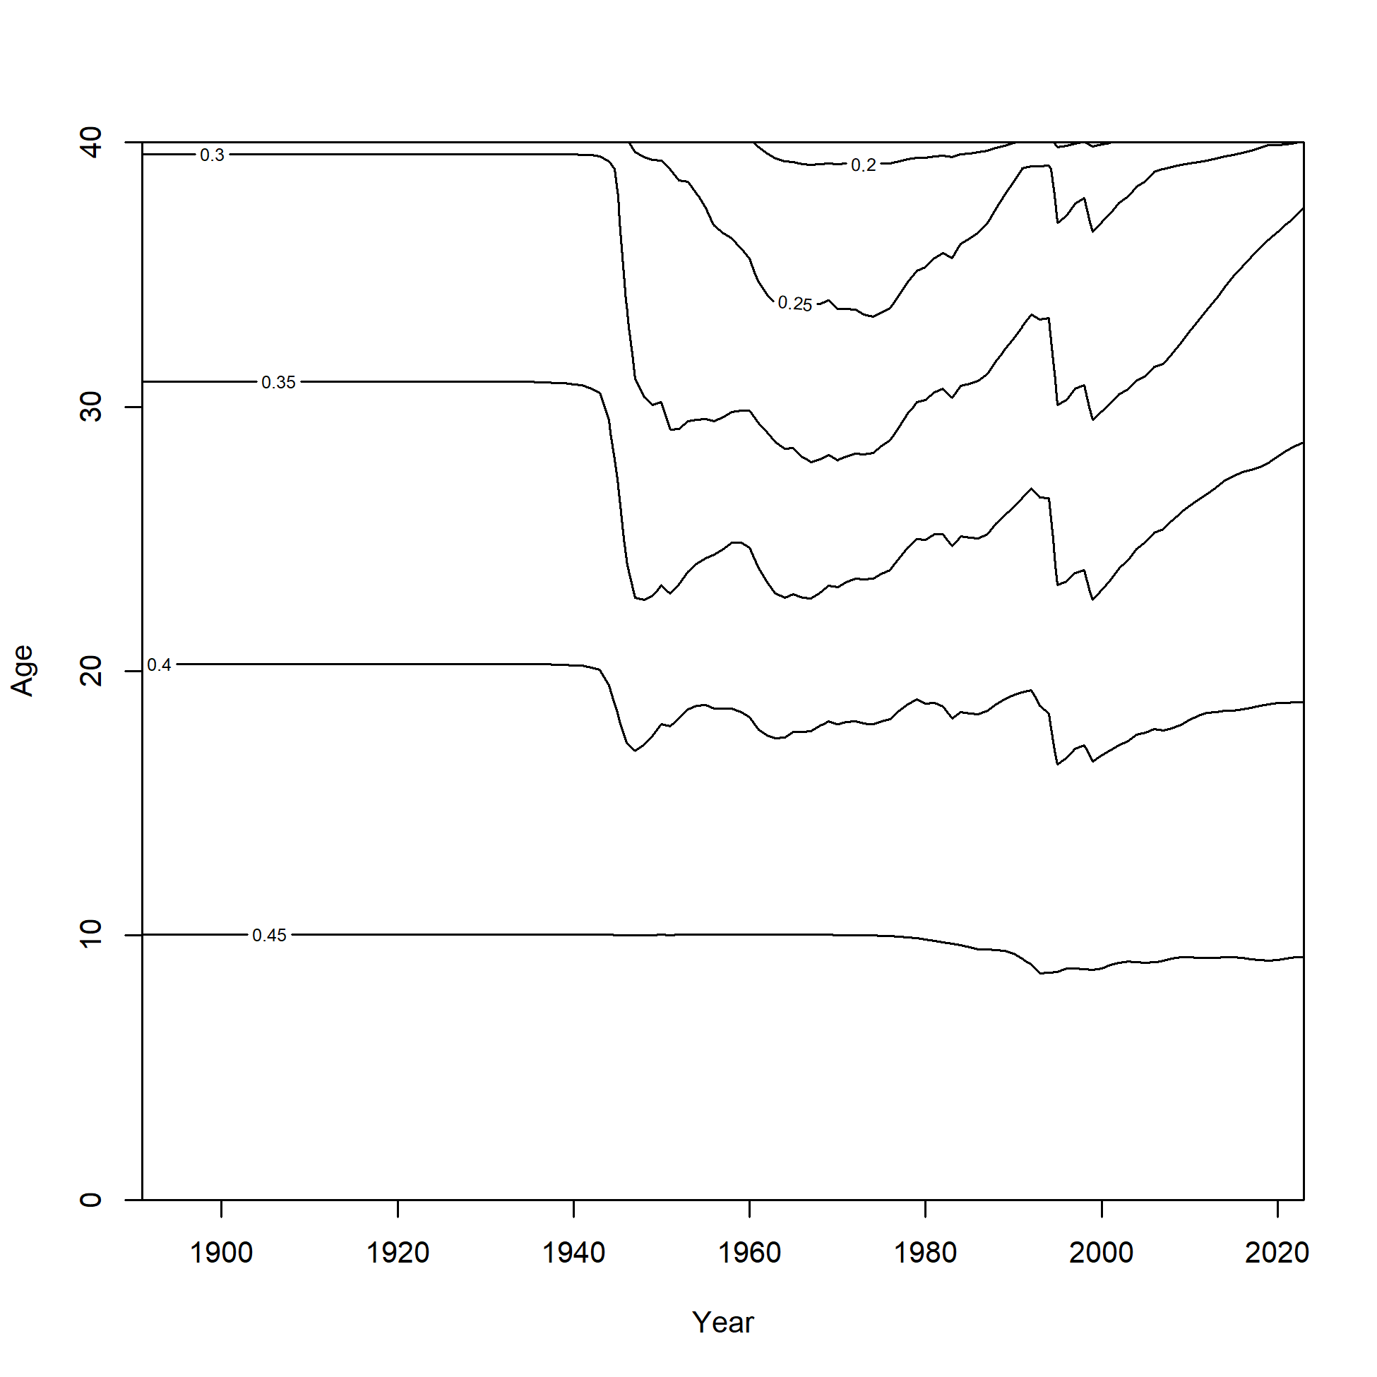
a) Sex option 1 & 2, domed
b) Sex option 3, domed
c) Sex option 1 & 2, logistic

