Slide 1
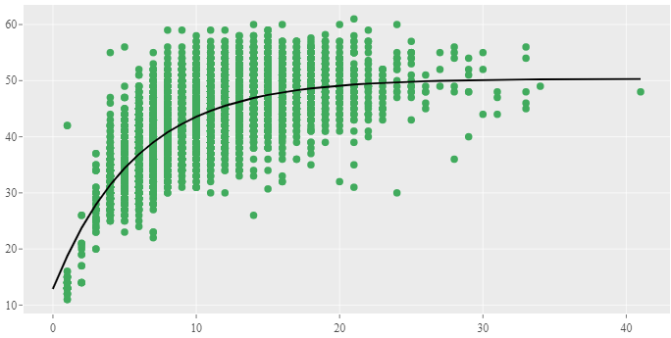
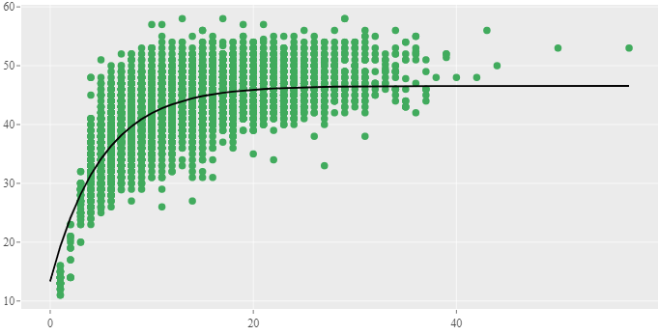
Females
Fork length (cm)
Males
Males
Age (year)

