Slide 1


Slide 4


Slide 5
Size
Time

Slide 6
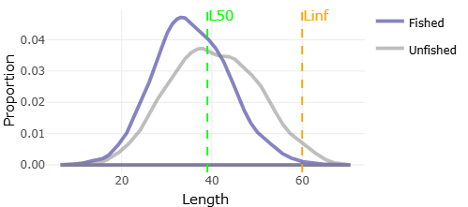

Slide 7
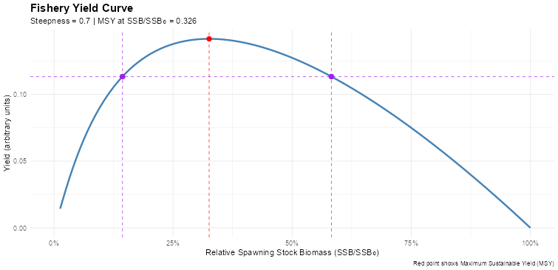

Slide 8
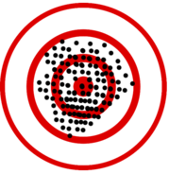

Slide 11


