Slide 1
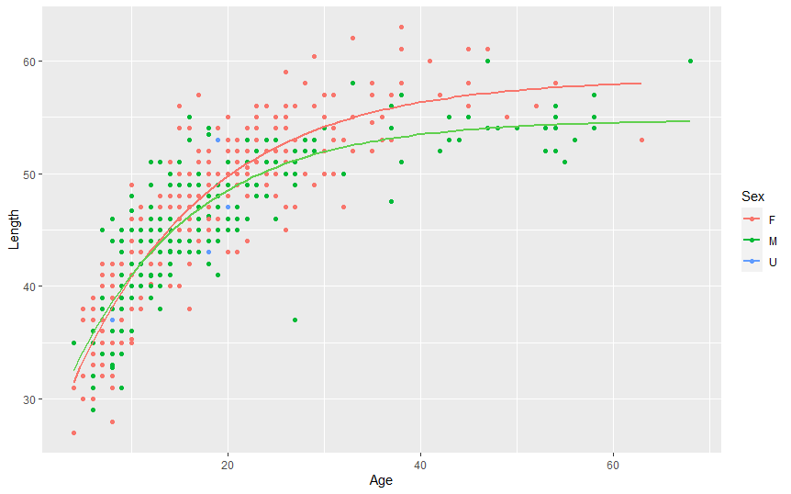
F: L∞ = 53.87; k = 0.115 ; t₀ = -2.4
M: L∞ = 51.20; k = 0.134 ; t₀ = -1.95

