Slide 1
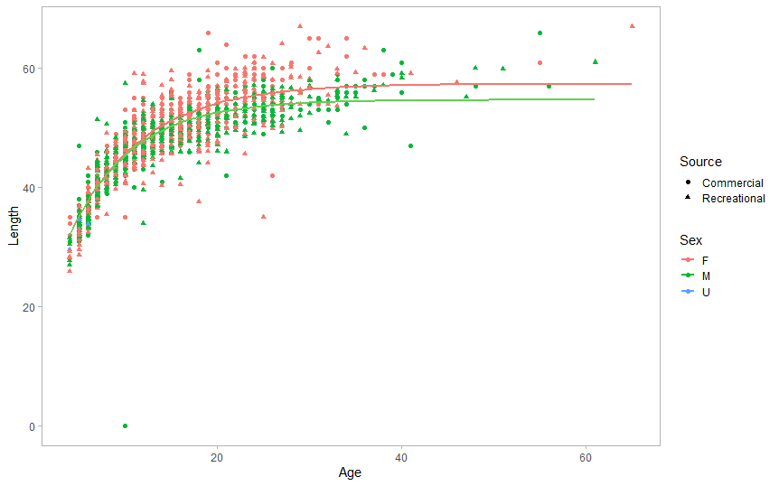
F: L∞ = 57.38; k = 0.128 ; t₀ = -2.44
M: L∞ = 54.67; k = 0.149 ; t₀ = -1.95

