Slide 1
Sequence-to-Sequence Models and Attention
CS 780/880 Natural Language Processing Lecture 18
Samuel Carton, University of New Hampshire

Slide 2
Last lecture
RNNs for language modeling
Generating text
Greedy decoding
Random sampling
Beam search decoding
Training RNNs
Teacher forcing
Exposure bias
Alternatives
Minimum risk, reinforcement learning, GANs

Slide 3
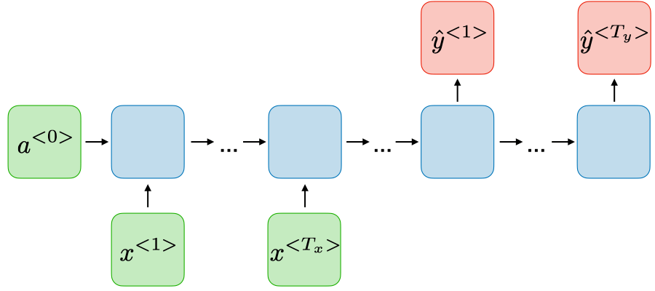
Sequence-to-sequence models
Basic idea: run an entire sequence through an RNN (the encoder), and then give the final vector it makes (the context) to another RNN (the decoder) to generate a new text sequence with
https://stanford.edu/~shervine/teaching/cs-230/cheatsheet-recurrent-neural-networks

Slide 4
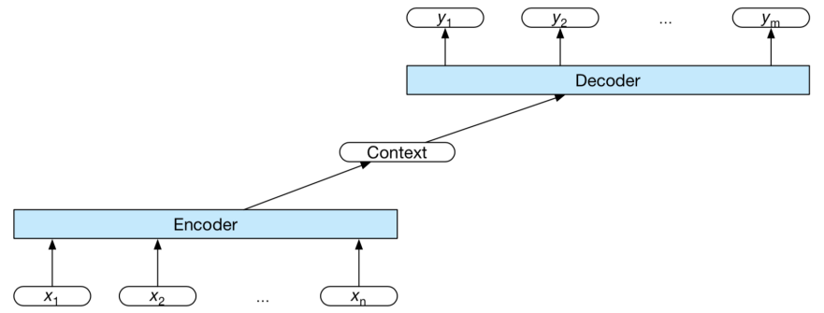
Sequence-to-sequence models
https://courses.engr.illinois.edu/cs447/fa2020/Slides/Lecture12.pdf

Slide 5
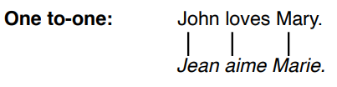
Machine translation
Sequence tagging will work
https://courses.engr.illinois.edu/cs447/fa2020/Slides/Lecture13.pdf

Slide 6
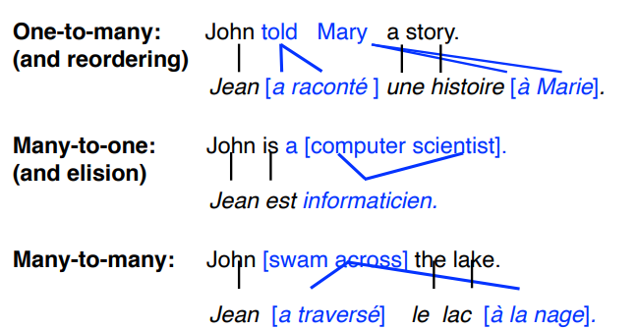
Machine translation
Sequence tagging won’t work!
https://courses.engr.illinois.edu/cs447/fa2020/Slides/Lecture13.pdf

Slide 7
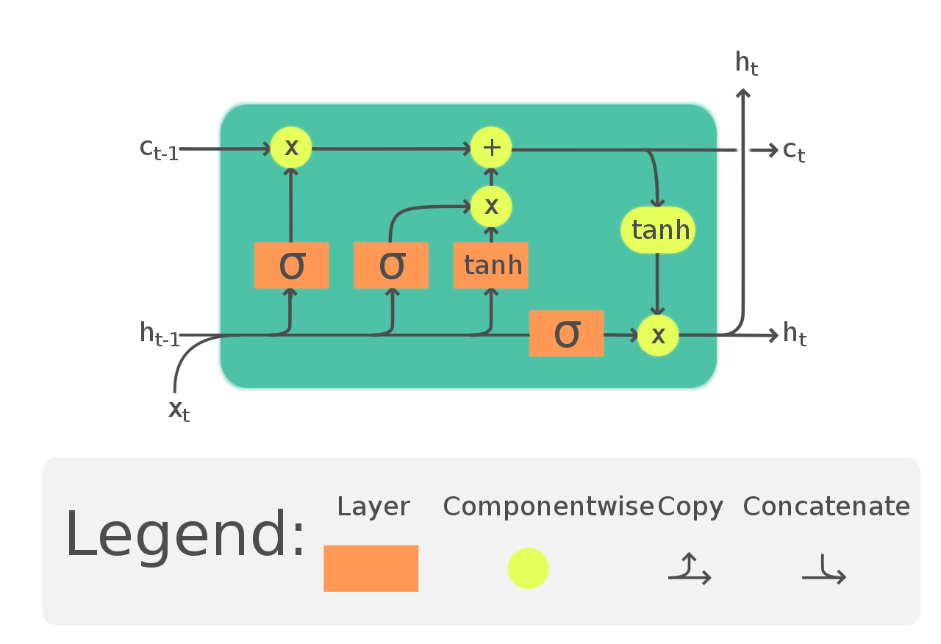
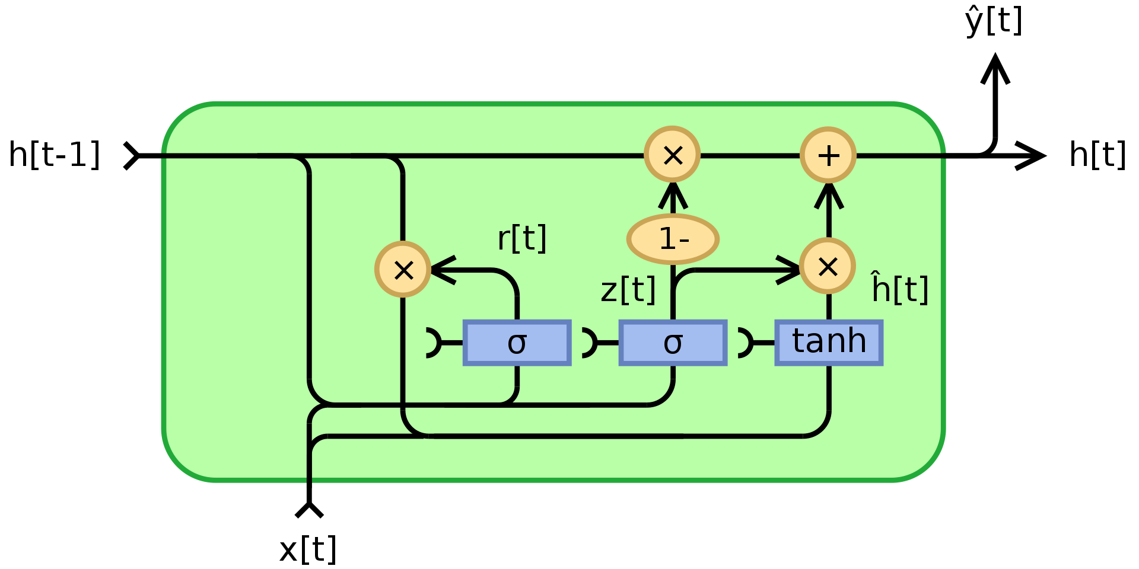
Gated Recurrent Unit (GRU)
GRU
LSTM
https://en.wikipedia.org/wiki/Gated_recurrent_unit
https://en.wikipedia.org/wiki/Long_short-term_memory

Slide 8
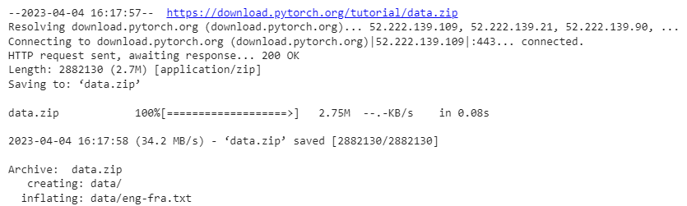
Downloading the translation dataset

Slide 9
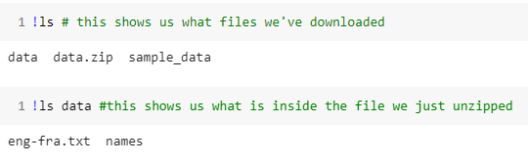
Downloading the translation dataset

Slide 10
Seq2Seq tutorial
https://pytorch.org/tutorials/intermediate/seq2seq_translation_tutorial.html
A little different from what I’ve been showing you
GRU instead of LSTM
Manual training loop
Incorporates modeling decisions into training loop
I think this is terrible
Very “from scratch”
No word embeddings
No NLTK

Slide 11
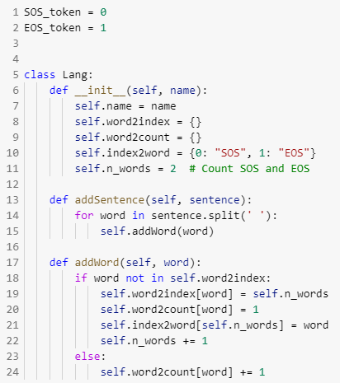
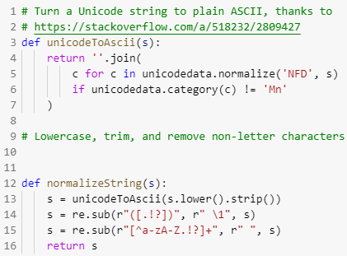
Text preprocessing

Slide 12
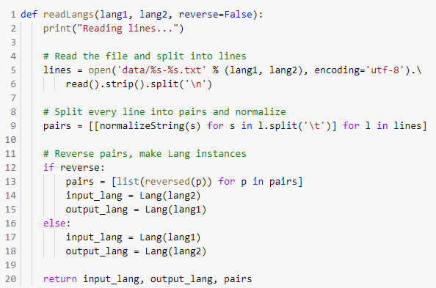
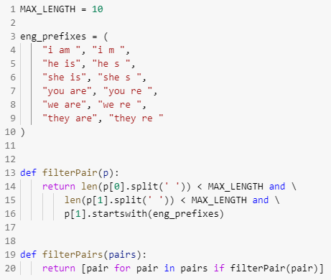
Text preprocessing

Slide 13
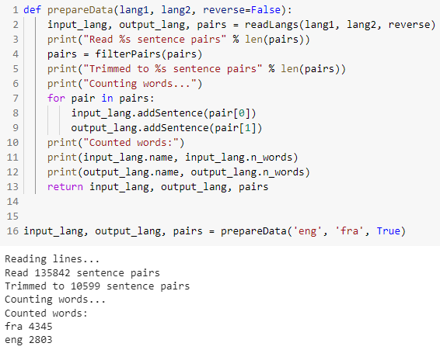
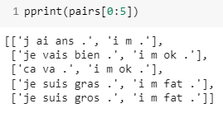
Text preprocessing

Slide 14
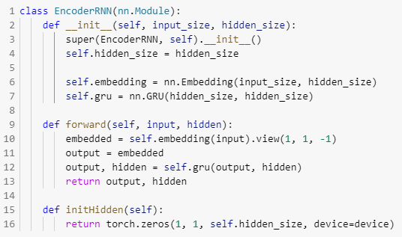
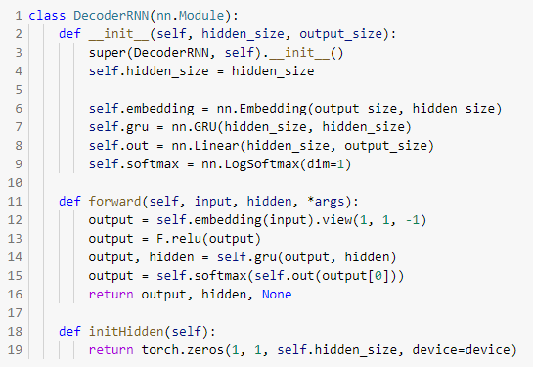
Model classes

Slide 15
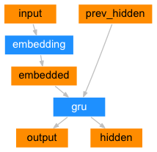
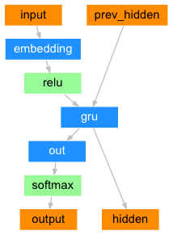
Sequence-to-sequence components
Encoder
Decoder

Slide 16
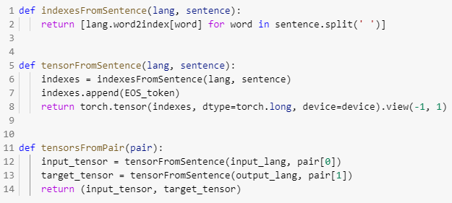
Training code

Slide 17
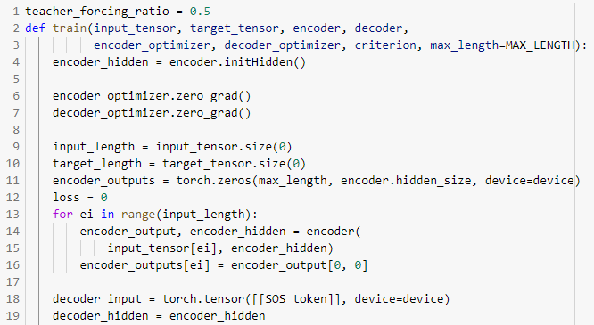
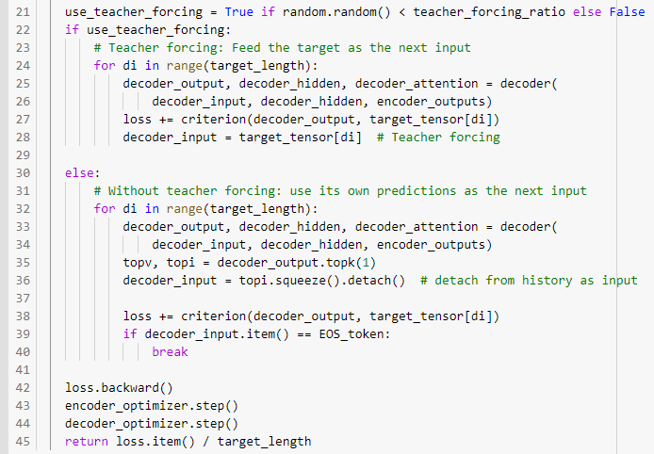


Training code

Slide 18
Training code

Slide 19
Training code

Slide 20
Training code

Slide 21
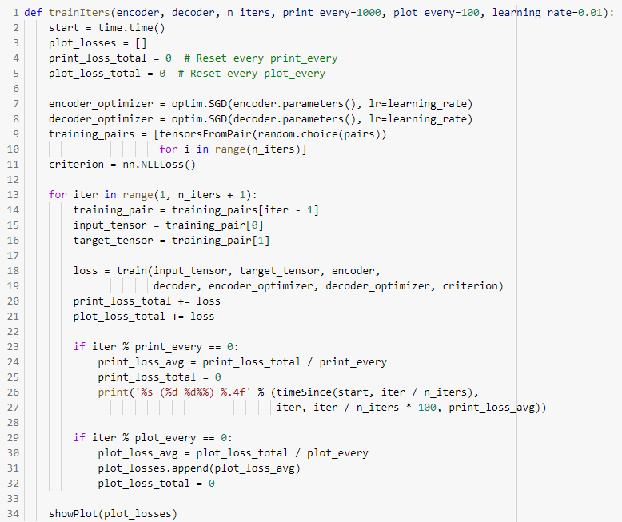
Training code

Slide 22
Training code

Slide 23
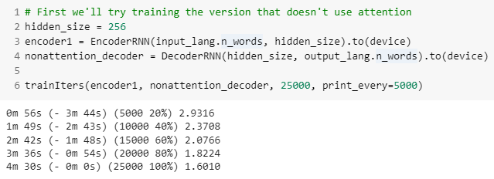
Model training

Slide 24
Improving naïve seq2seq
Big problem here: we’re expecting a lot out of that final encoder context vector.
Essentially we’re asking it to save up everything it needs to know to then go ahead and spit out the text we want.
That’s a lot of info to squeeze into a 100-element vector
Idea: What if we also let the decoder look at the original input while it is decoding the context?
But it would need to be able to learn which parts of the original input were pertinent to what it was trying to do at any given point
Solution: Attention

Slide 25
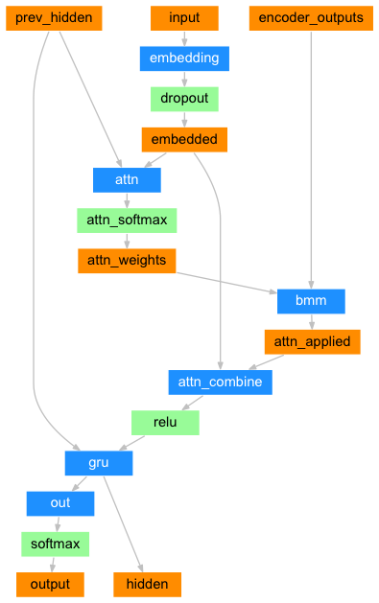

Attention in sequence-to-sequence
Decoder (with attention)
Basic idea: The decoder will have access to all the output from the encoder (not just the final output), but will learn a weighting function for how important any individual output is at a given timestep.
Encoder
Decoder (no attention)

Slide 26
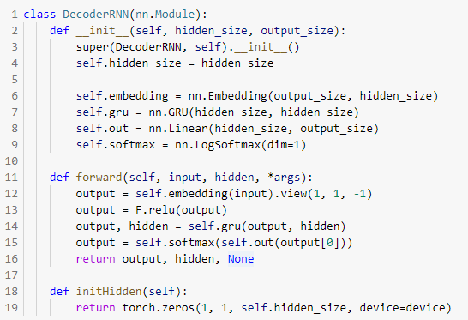
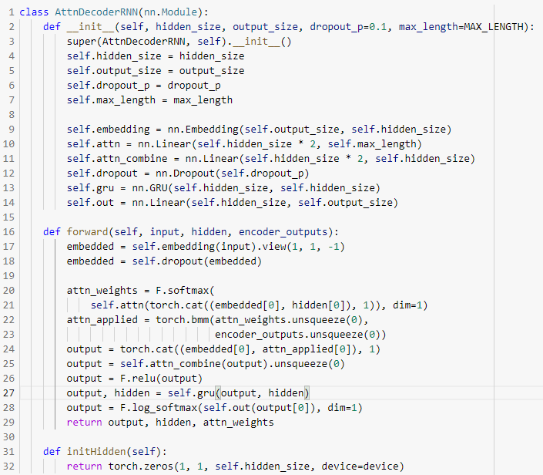
Model classes

Slide 27
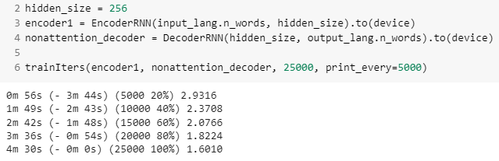
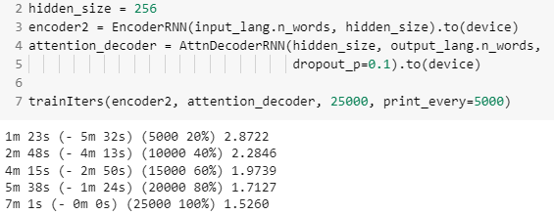
Model training
Without attention
With attention

Slide 28
Classification with attention
Prediction
Basic idea: Use one RNN (attender) to generate attention weights over a sequence, then a second RNN (predictor) to make predictions from the attention-weighted sequence
Dual training objective which encourages attention weights to be sparse, but predictor to be accurate.
In theory, leads to only important information (stuff needed for prediction) to be attended to.
Predictor
You are a huge jerk
0 0 0 1 1
Attender
You are a huge jerk

Slide 29
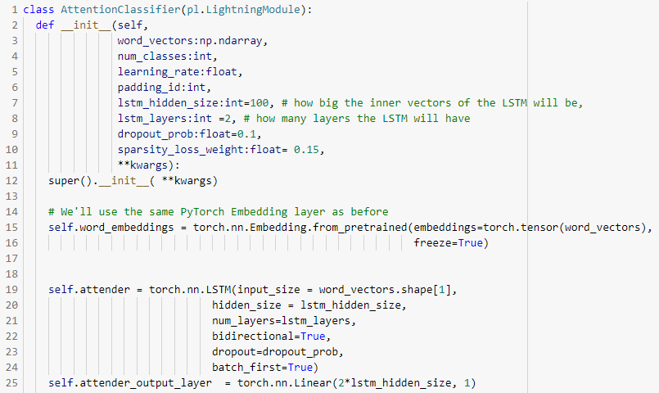
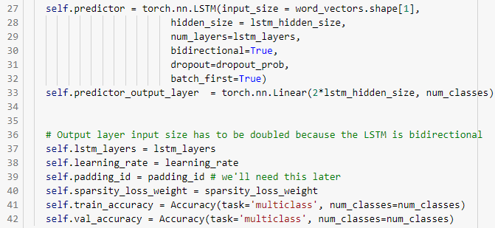
Attention classification model

Slide 30
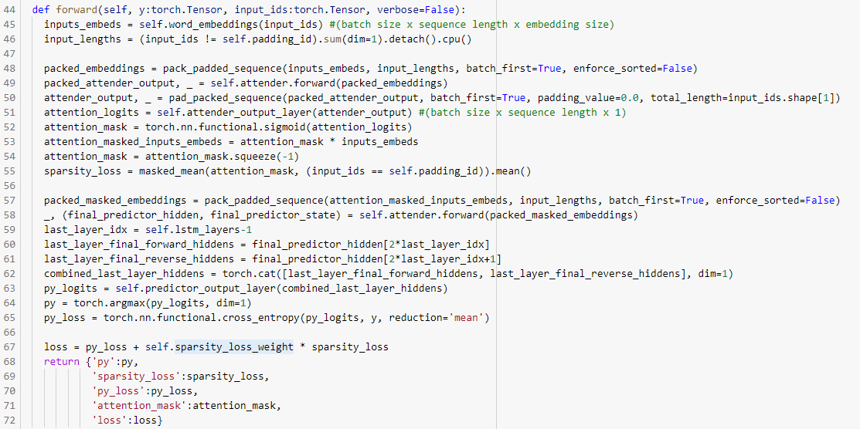
Attention classification model

Slide 31
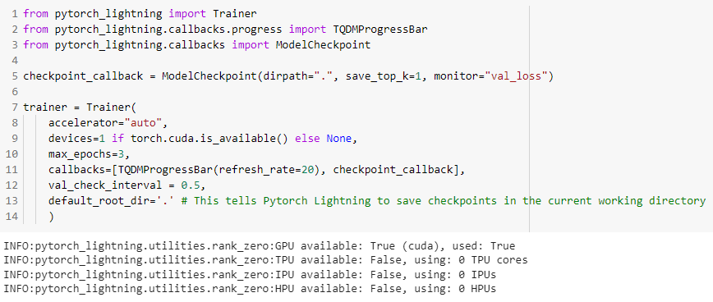
Trainer

Slide 32
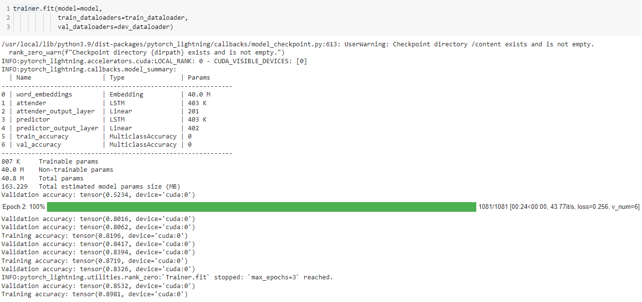
Trainer

Slide 33
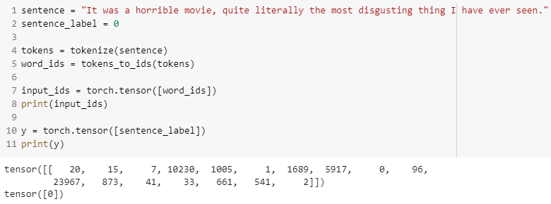
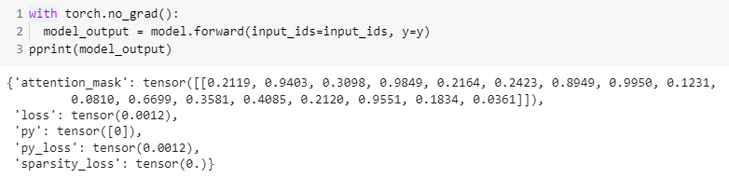
Visualizing model output

Slide 34
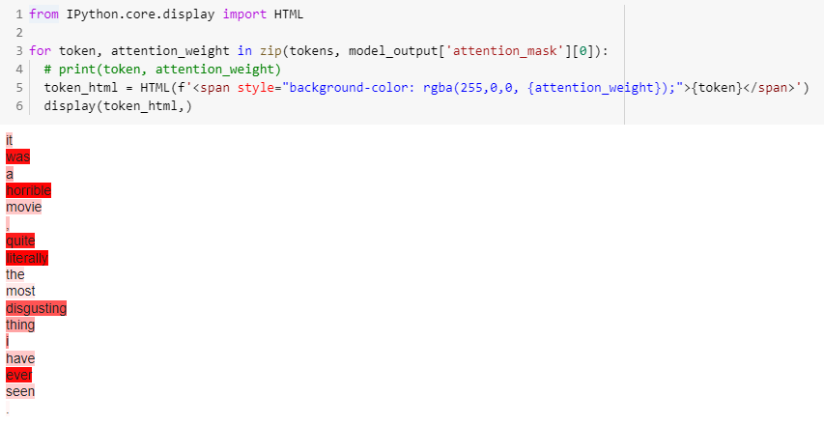
Visualizing model output

Slide 35
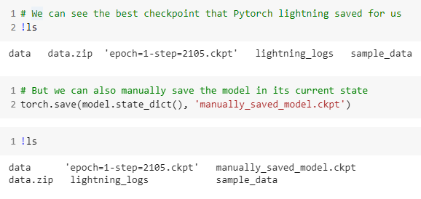
Saving and loading the model

Slide 36
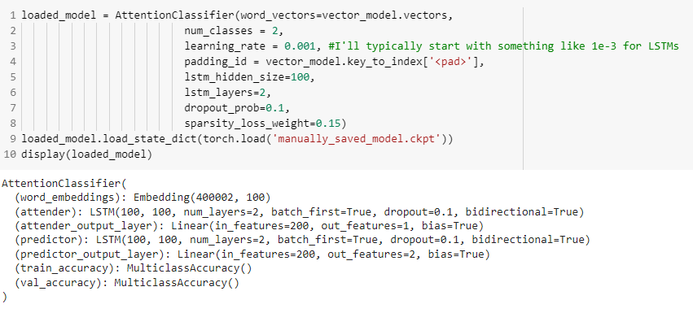
Saving and loading the model

Slide 37
Concluding thoughts
Sequence-to-sequence models
Main application: translation
Attention
Improves performance of sequence-to-sequence models
Improves interpretability of classifiers
Model saving/loading

