Slide 1
Zero- and Few-Shot Learning
CS 780/880 Natural Language Processing Lecture 21
Samuel Carton, University of New Hampshire

Slide 2
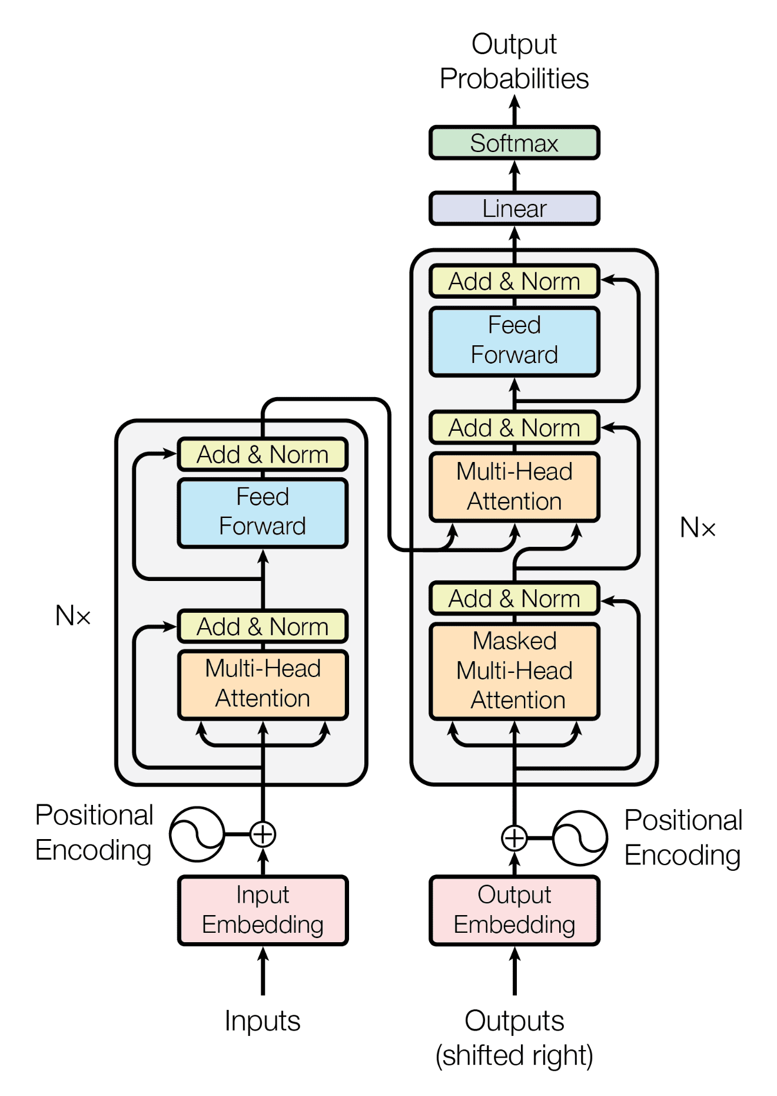
Last lecture
Pretrained transformer models
BERT, RoBERTa, XLNet, RoBERTa, DistilBERT, T5, GPT-X
Encoder-decoder, encoder-only, decoder-only
How to choose?
Generally, use the biggest you can train efficiently
But use domain-specific models if appropriate
SciBERT
MatSciBERT
Galactica

Slide 3
Basic model training procedure
Pick your favorite model (BERT, T5, DistilBERT, etc.)
Download pretrained version of it from HuggingFace
Build an appropriate LightningModule around it
Text classification, sequence tagging, translation, etc.
Find or construct a training/test dataset and preprocess it appropriately
Train the model using gradient descent
Evaluate the model
Profit

Slide 4
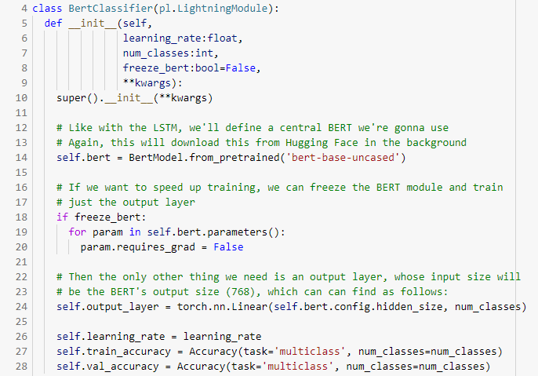
Transformer-using LightningModule

Slide 5
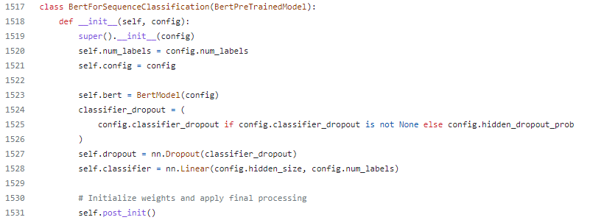
Hugging Face model classes
Not only does HuggingFace make base models available, but they also have variants of each model for different kinds of tasks
E.g. BertForSequenceClassification
https://github.com/huggingface/transformers/blob/v4.28.0/src/transformers/models/bert/modeling_bert.py

Slide 6
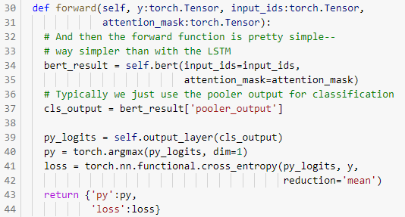
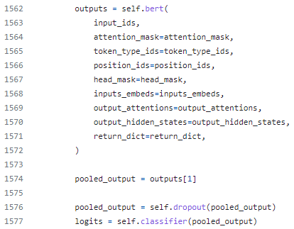
Hugging Face model classes
My forward function
Their forward function

Slide 7
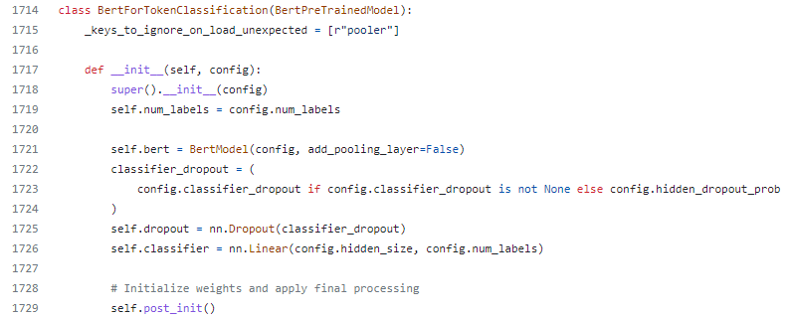
Hugging Face model classes
E.g. BertForTokenClassification
__init__ pretty much identical to BertForSequenceClassification

Slide 8
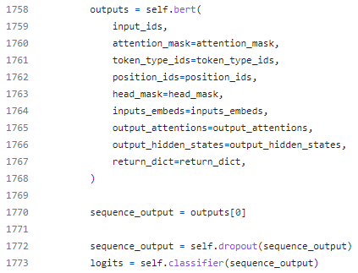
Hugging Face model classes
Difference is in forward functions.
BertForSequenceClassification output layer operates on [CLS] token hidden vector, while BertForTokenClassification operates on all hidden vectors
BertForSequenceClassification
BertForTokenClassification

Slide 9
Hugging Face
Hugging Face (as accessed through the transformers Python library) is a fantastic resource.
It’s never been easier to grab powerful NLP models and begin customizing them to suit your own needs
BUT.
The whole concept of “training” NLP models is beginning to go out the window in favor of zero- and few-shot learning with massive pretrained large language models (GPT-3, ChatGPT, GPT-4, etc.)

Slide 10
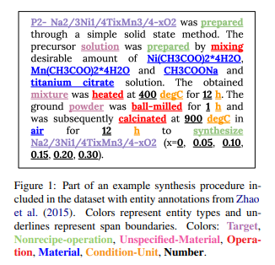
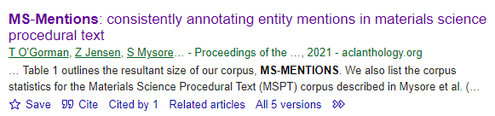
Example: Materials information extraction
O’Gorman et al., 2021 collect a nice dataset for entity extraction from the text of materials science papers
595 papers, 160k tokens
Took a PhD student and 2 postdocs 3 months to do
Trained BERT gets 89% token-by-token accuracy
(You’d use BertForTokenClassification for this)
Would probably work even better with a Matsci-specific BERT variant
E.g. MatBERT, MatSciBERT, etc.

Slide 11
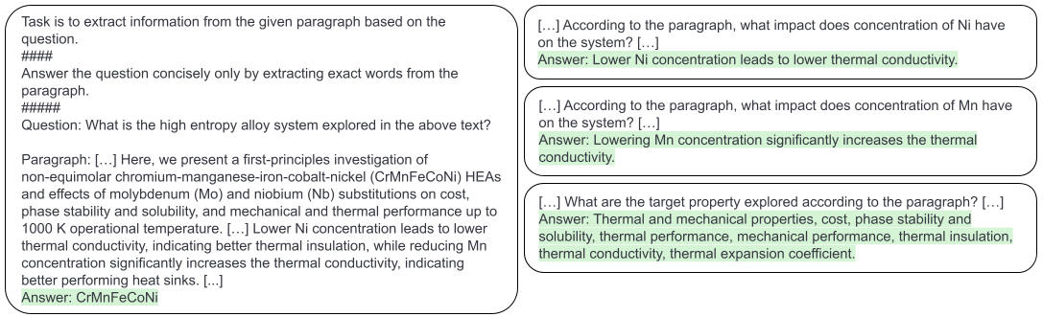
Example: Materials information extraction
Compare and contrast that with a prompt that Satanu came up with for getting GPT-3 to extract information from the abstract of a paper about alloys

Slide 12
How is this possible?
Think back to why BERT & co turn out to be a good starting point for fine-tuning NLP models to do specific things (like information extraction)
Analogous to teaching someone English before teaching them to do specific task
But what happens if you teach someone to be really good at English before teaching them to do the specific task?
Then maybe you don’t actually need to “teach” them to do the task, maybe you can just ask them to do it

Slide 13
Example: Materials information extraction
No real materials-science knowledge needed to do this task—just reading comprehension

Slide 14

Language modeling versus world knowledge
And these language models can pick up world knowledge as well!
Remember that the training objective for language modeling is: given words {w0, w1, …,wt-1}, predict word wt.
So what happens when we apply our own internal language model to the following prompt:

Slide 15
Language modeling versus world knowledge
And these language models can pick up world knowledge as well!
Remember that the training objective for language modeling is: given words {w0, w1, …,wt-1}, predict word wt.
So what happens when we apply our own internal language model to the following prompt:
GPT-3 got it right! So… is that language modeling or is it world knowledge?
Both!

Slide 16
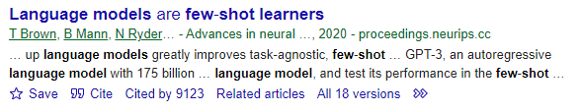
GPT-3
Published in 2020
Decoder-only transformer model (same architecture as GPT-1 and 2)
Trained on Common Crawl
40 TB of text scraped from the web
175 billion parameters
Blew a bunch of NLP benchmarks out of the water, particularly in zero and few-shot settings

Slide 17
Zero-shot learning
Basic idea: rather than fine-tune a language model to do a specific task (the way we would do with BERT, XLNet, etc.), we just ask it to do what we want and rely on its intrinsic capability to do it correctly.

Slide 18
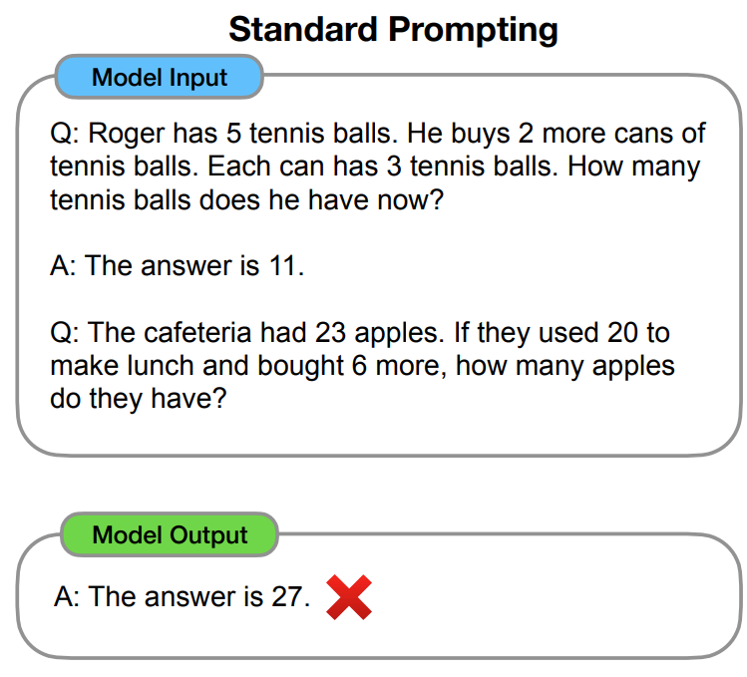
Few-shot learning
Basic idea: for even better performance than zero-shot learning, we give the model one or more examples of what we want it to do as part of the prompt
Popularized by Brown et al., (2020)
https://arxiv.org/pdf/2201.11903.pdf

Slide 19
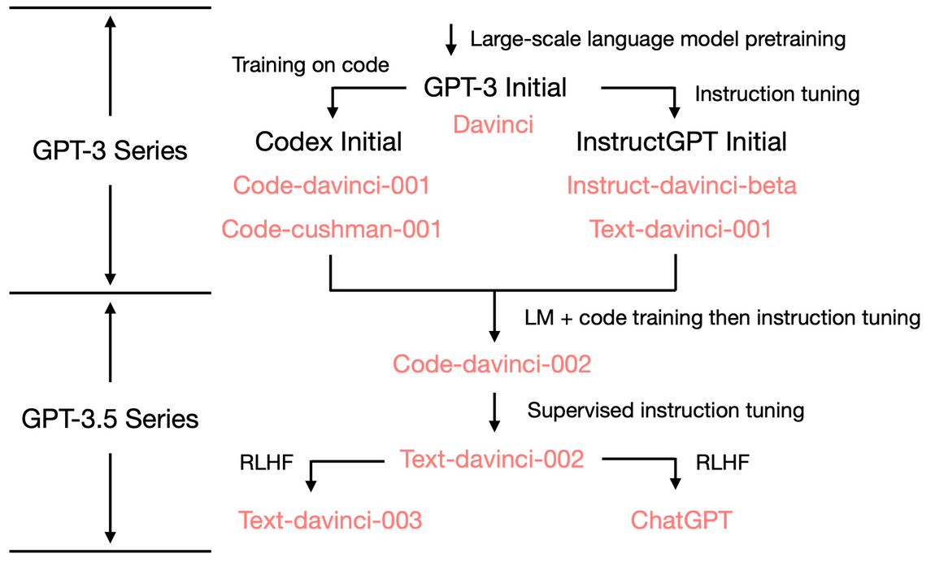
ChatGPT
ChatGPT is now based on GPT-4
But when it was first released, it was based on a version of GPT-3 that had been additionally trained with:
Code
Instruction tuning
Reinforcement Learning from Human Feedback (RLHF)

Slide 20
Concluding thoughts
GPT-3, ChatGPT, GPT-4
Traditional model training versus zero- and few-shot learning

