Slide 1
Prompt engineering
CS 780/880 Natural Language Processing Lecture 21
Samuel Carton, University of New Hampshire

Slide 2
Last lecture
Hugging Face model variants
Contemporary LLMs: GPT-3, ChatGPT, GPT-4
Paradigm shift in machine learning:
Moving away from gradient descent (a lot of the time)
Moving toward in-context learning
Zero-shot learning: tell the model to do stuff
Few-shot learning: give a few examples first
Is there more to it? (yes)

Slide 3
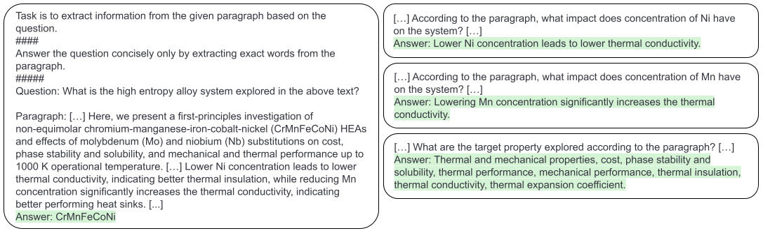
Zero-shot learning

Slide 4
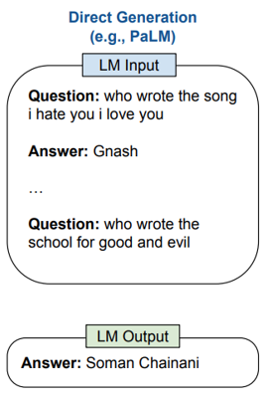
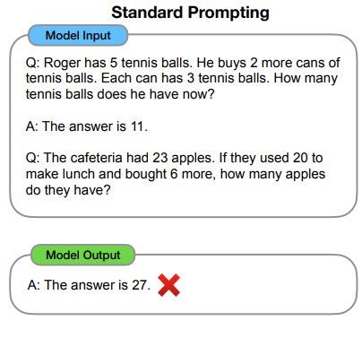
Few-shot learning
A few examples from papers we’re talking about today

Slide 5
Problems with in-context learning
Ultimately, LLMs produce output that is linguistically likely regardless of what’s actually true, interesting or reasonable.
This leads to a few key issues:
Hallucination
Reasoning errors
Ungrounded outputs
Problem for robotics
Boring outputs
Biased outputs

Slide 6
Prompt engineering
The field of prompt engineering is emerging surrounding how to correctly prompt LLMs in order to avoid these kinds of issues.
What kind of information can we include in the prompt to the LLM (and how do we format that information) to get it to more reliably do what we want it to?
Avoid hallucination
Avoid reasoning mistakes
Produce more interesting output
Etc.
Very important to get a handle on this right now (2023)
This lecture: overview of a few recent prompt engineering papers tackling different problems.

Slide 7


Hallucination
When a model “hallucinates”, it makes up fake information which is linguistically likely but not actually true.
Important note: the whole point of Reinforcement Learning with Human Feedback (RLHF) is to get GPT to avoid these kinds of mistakes by training it to respond to certain kinds of inputs with non-answers.
OpenAI playground; text-davinci-002
OpenAI playground; text-davinci-003

Slide 8
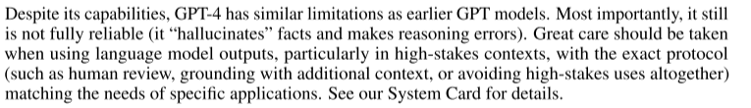
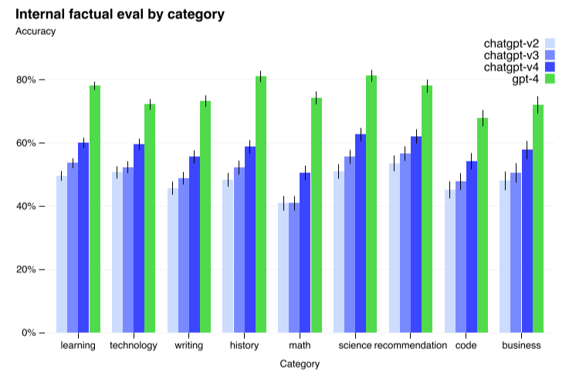
Hallucination
But even GPT-4 suffers from hallucination, and these models probably always will.
What other tools do we have in our toolbelt for alleviating the issue of hallucination?
https://arxiv.org/abs/2303.08774

Slide 9
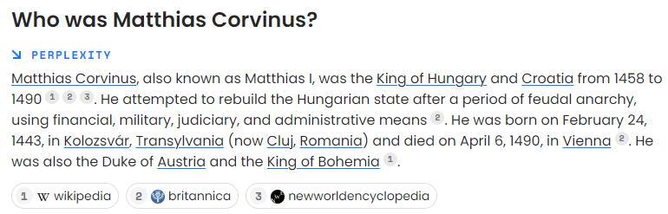
Retrieval-augmented generation
Basic idea: Rather than just querying the LLM for information (which it can hallucinate):
Retrieve relevant documents or snippets
Give them to LLM as part of prompt
Ask LLM to generate response based on that information
OpenAI already has a prototype system that does this in a basic way: https://www.perplexity.ai/

Slide 10
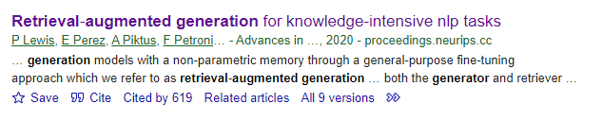
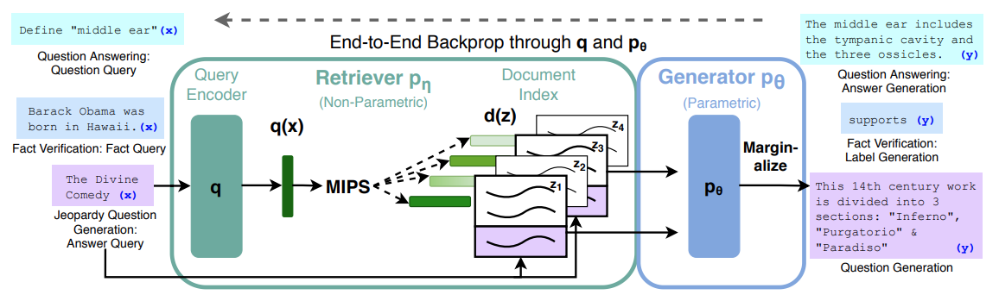
Retrieval-augmented generation
The original paper about this idea is a few years old
Assumes you can actually train the generator (not possible currently)

Slide 11
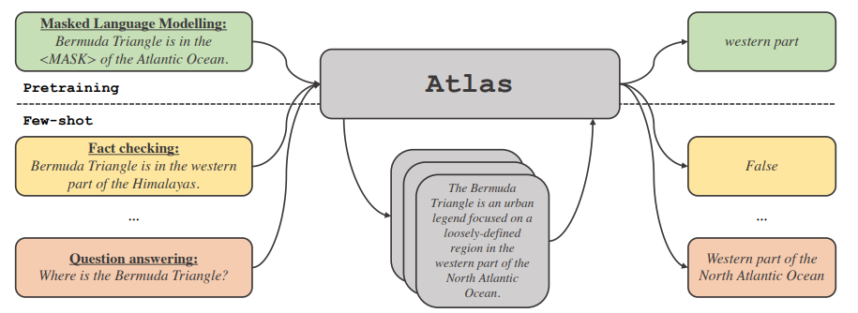
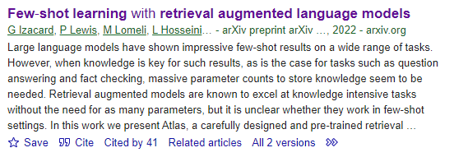
Atlas: Retrieval + few-shot learning
A more recent model is Atlas, which combines retrieval augmentation with few-shot learning
Still involves actual fine-tuning of the generator though
Uses “dense retrieval” (Contriever) to find relevant documents
Then fine-tunes text-to-text model (T5) to generate correct answers given retrieved info

Slide 12
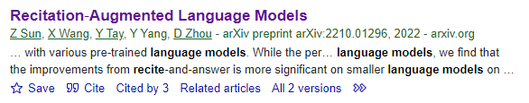
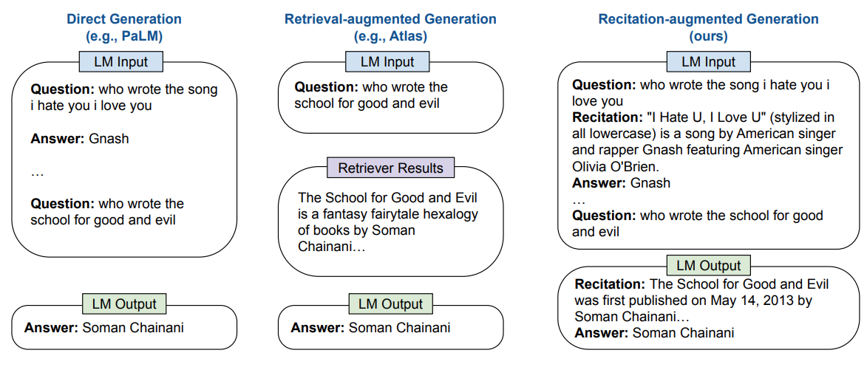
Recitation-augmented language models
Basic idea: Ask the model to recite facts it thinks it knows about a topic, then ask it to choose between them

Slide 13
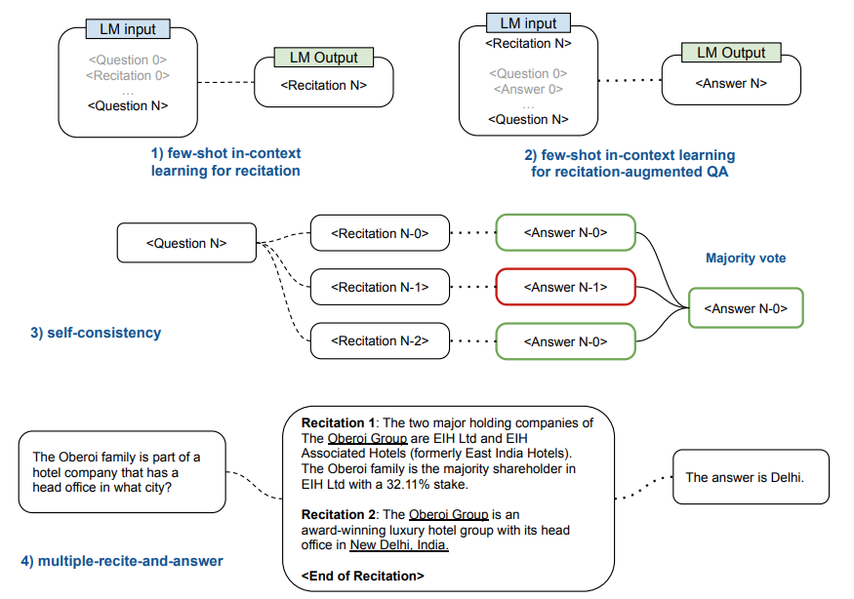
Recitation-augmented language models

Slide 14
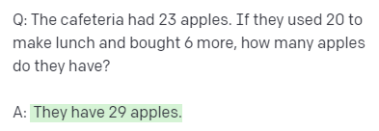
Reasoning errors
LLMS also tend to make reasoning errors when you ask them questions that require multiple logical steps
Again, this is because they are language models, not logic engines
Can you see what mistake the model made here?
OpenAI playground; text-davinci-003

Slide 15
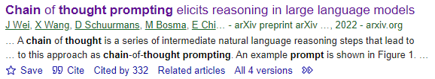
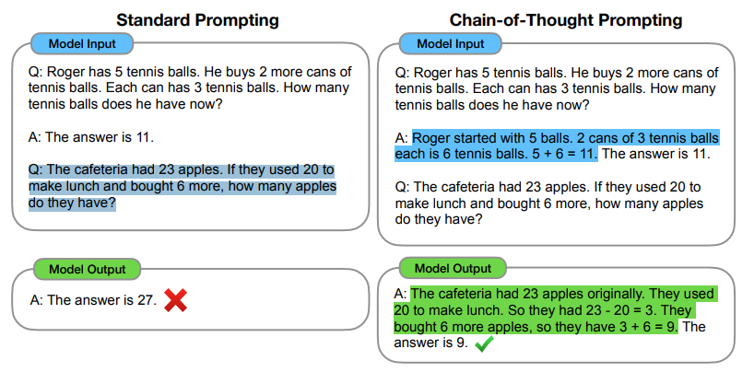
Chain-of-thought prompting
Basic idea: Give few-shot examples of not just the solution, but the intermediate steps for solving the problem

Slide 16
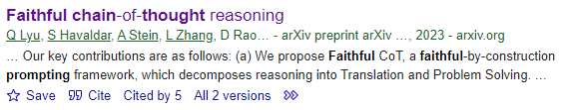
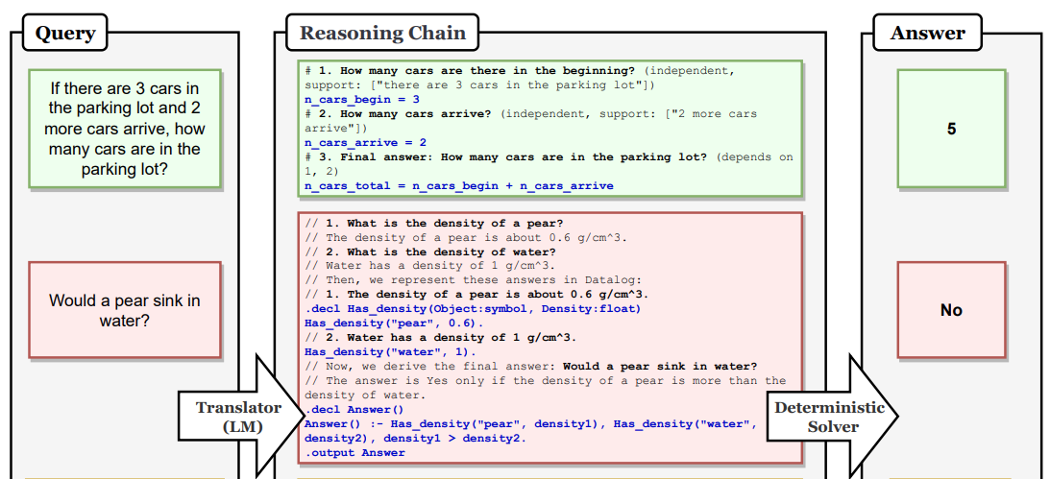
Faithful chain-of-thought prompting
Basic idea: Give few-shot examples of not just the intermediate steps, but structured language for solving the problem

Slide 17
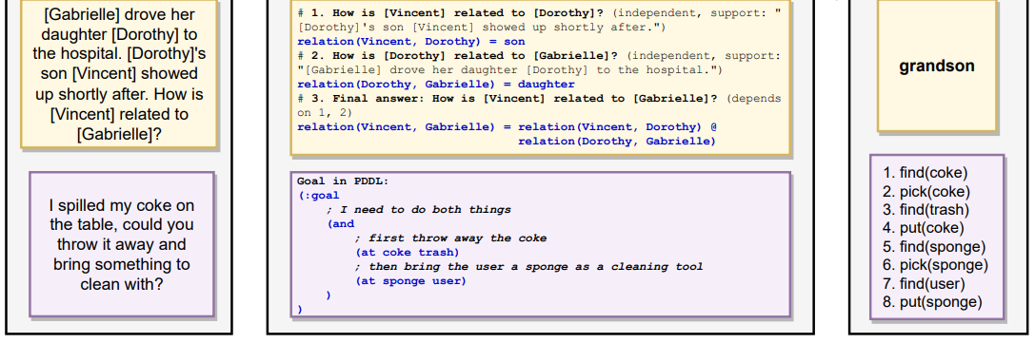
Faithful chain-of-thought prompting
Basic idea: Give few-shot examples of not just the intermediate steps, but structured language for solving the problem

Slide 18
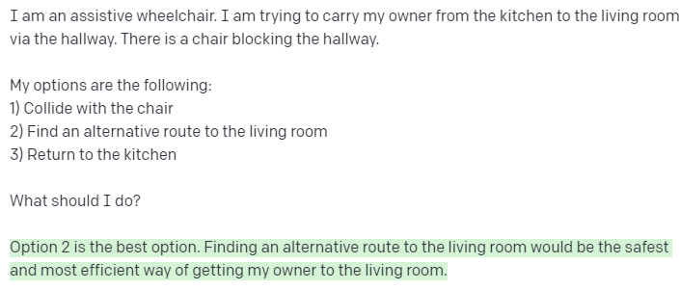
Real-world grounding for LLMs
A pretty cool thing about LLMs is that they can capture a notion of common sense that could be useful for e.g. assistive robotics.
OpenAI playground; text-davinci-003

Slide 19
Real-world grounding for LLMs
A pretty cool thing about LLMs is that they can capture a notion of common sense that could be useful for e.g. assistive robotics.
But it can be difficult to figure out how to convert physical, real-world problems into linguistic problems an LLM can tackle.

Slide 20
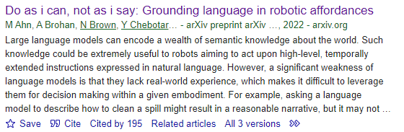
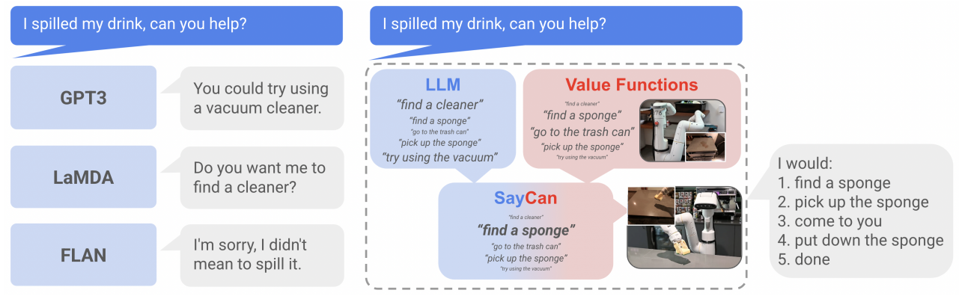
Do as I Can, Not as I Say
Basic idea: Use the LLM to rank the possible actions a robot can do, based on verbal description of those actions (and the situation).

Slide 21
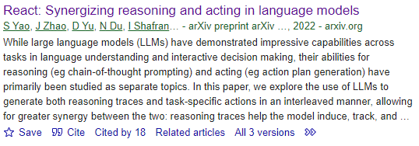
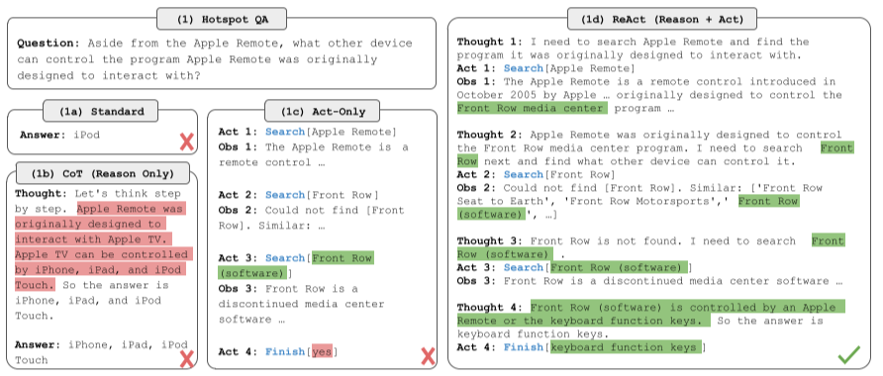
ReAct
Basic idea: Use something like chain-of-thought prompting to show the robot how to ask questions about its environment and then take actions based on the answers.

Slide 22
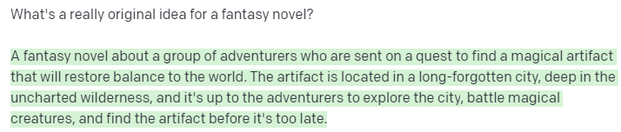
Boring output
Another flaw of LLMs is that they produce boring output a lot of the time.
Because, again, they are designed for linguistic likelihood, not interestingness!
OpenAI playground; text-davinci-003

Slide 23

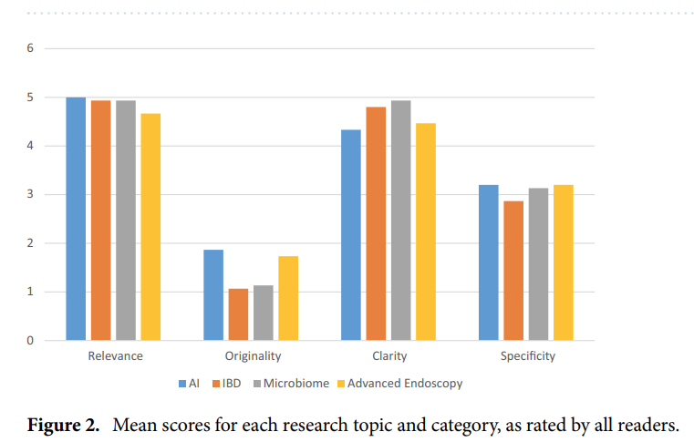
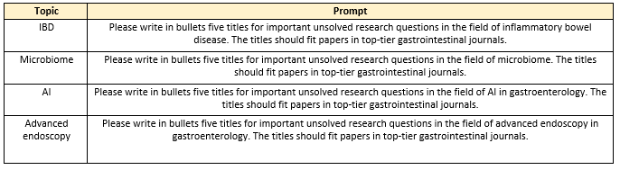
Scientific innovation in biomedicine
Basic idea: Ask ChatGPT to create research ideas for gastroenterology
Ideas were relevant and coherent… but unoriginal!

Slide 24
Biased output
Large language models are known to encode bias.
It’s a whole thing that merits its own discussion (which we’ll get to).

Slide 25
Concluding thoughts
Various problems:
Hallucination
Reasoning errors
Ungrounded outputs
Problem for robotics
Boring outputs
Biased outputs
This is the research/business frontier!
Various approaches:
Retrieval-augmented generation
Atlas
Recitation-augmented generation
Chain of thought prompting
Faithful chain of thought prompting
Do as I Can, not as I Say
ReAct

