Slide 1
Introduction to Microsoft Purview
Unified data governance service for efficient data management
Notes:
Microsoft Purview is a unified data governance service that helps organizations discover, understand, and manage their data. In this presentation, we will explore the major solutions and features of Purview.

Slide 2
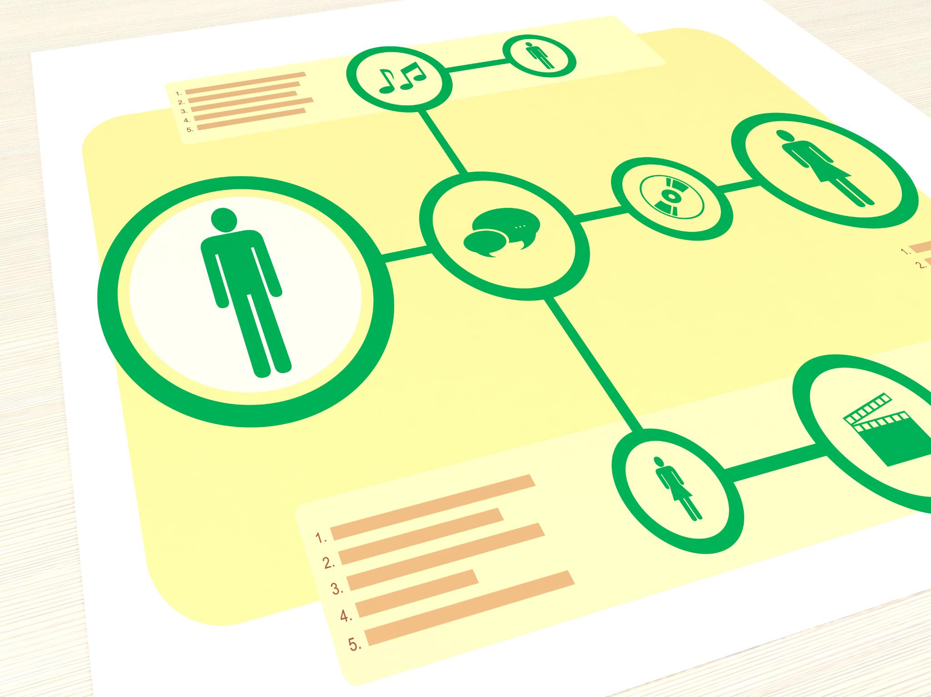
Overview of Microsoft Purview
  Microsoft Purview provides a unified view of data assets across multiple sources and environments, making it easier for users to discover, understand, and manage data more effectively.
Notes:
Microsoft Purview is designed to help organizations address the challenges of managing data across multiple sources and environments. It provides a unified view of data assets, making it easier for users to discover, understand, and manage data more effectively.

Slide 3
Major Solutions in Purview
Notes:
Microsoft Purview offers various solutions to help organizations manage their data effectively. These include Data Discovery, Data Classification, and Data Governance.

Slide 4

Data Discovery
  Data Discovery helps organizations locate data across their environment, making it easier to understand where data is stored and how it is being used. This can help organizations improve their data management processes and optimize their data usage.
Notes:
Data Discovery helps organizations locate data across their environment, making it easier to understand where data is stored and how it is being used.

Slide 5

Data Classification
Data Classification
  Data Classification is a process of organizing and labeling data based on its sensitivity and other criteria. This helps ensure that data is handled in accordance with relevant policies and regulations.
Automatic Classification
  Automatic Classification tools can help organizations classify data based on predefined criteria, saving time and reducing the risk of human error.
Notes:
Data Classification provides a way for organizations to automatically classify and label data based on sensitivity and other criteria. This helps ensure that data is handled in accordance with relevant policies and regulations.

Slide 6

Data Governance
  Data Governance provides a framework for organizations to manage their data more effectively. It enables organizations to enforce policies, track data lineage, and monitor data usage.
Notes:
Data Governance provides a framework for organizations to manage their data more effectively, including the ability to enforce policies, track data lineage, and monitor data usage.

Slide 7
Key Features in Purview
Notes:
In addition to its solutions, Microsoft Purview offers several key features that help organizations manage their data more effectively. These include Data Map, Data Catalog, and Data Lineage.

Slide 8
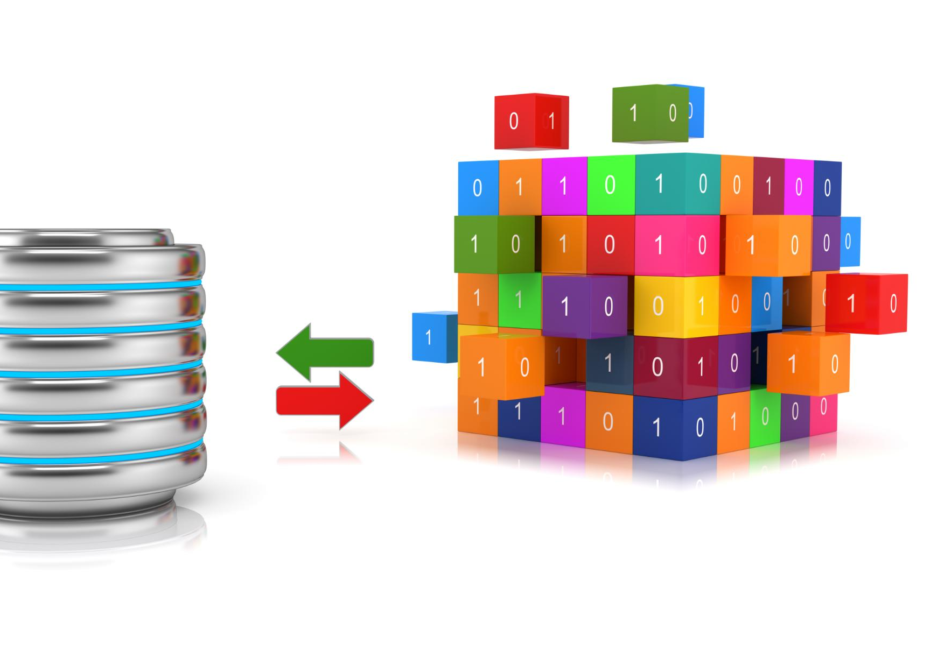
Data Map
  Data Map is a visual representation of an organization's data landscape, providing a clear picture of how data is stored and used across different environments. This makes it easier to make informed decisions about data management and governance.
Notes:
Data Map provides a visual representation of an organization's data landscape, making it easier to understand how data is stored and used across different environments.

Slide 9

Data Catalog
  Data Catalog provides a centralized repository for metadata and other information about an organization's data assets, making it easier to discover, understand, and manage data more effectively.
Notes:
Data Catalog provides a centralized repository for metadata and other information about an organization's data assets, making it easier to discover, understand, and manage data more effectively.

Slide 10
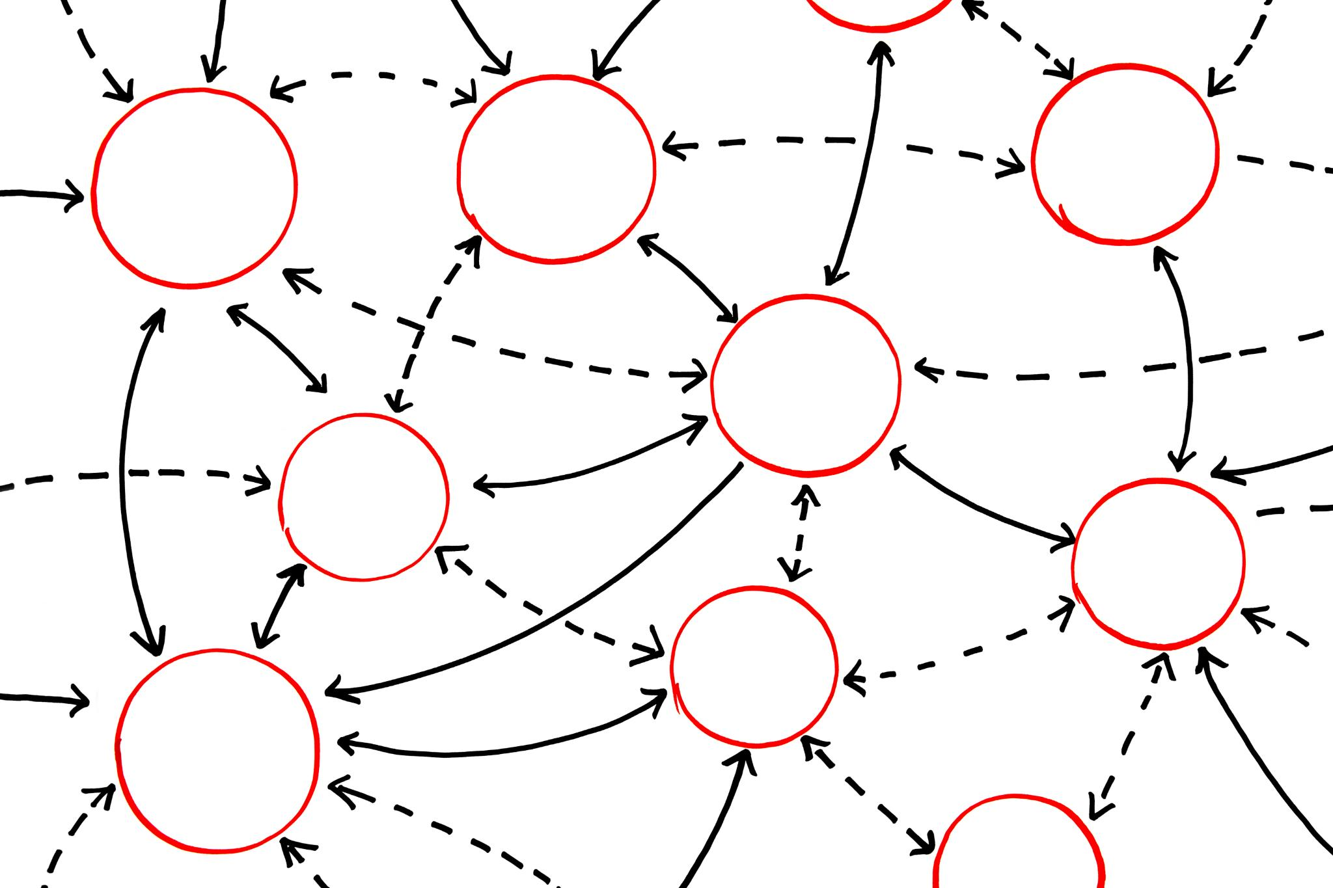
Data Lineage
  Data Lineage helps organizations understand the origin and history of their data, making it easier to track how data has been transformed and where it has been used.
Notes:
Data Lineage helps organizations understand the origin and history of their data, making it easier to track how data has been transformed and where it has been used.

