Slide 1
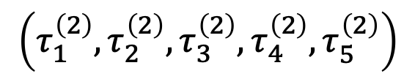
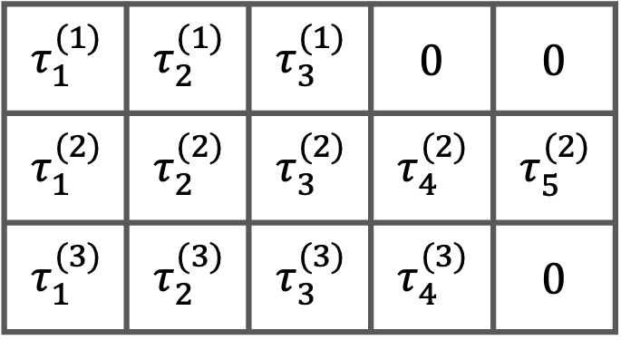
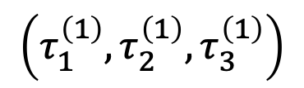
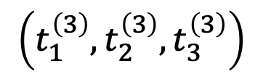
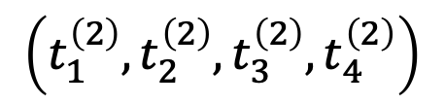
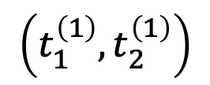
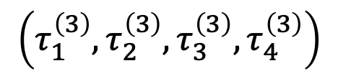
Arrival times
Inter-event times
Padded inter-event times
$$\left(t_{1}^{\left(1\right)},t_{2}^{\left(1\right)}\right)$$
$$\left(τ_{1}^{\left(1\right)},τ_{2}^{\left(1\right)},τ_{3}^{\left(1\right)}\right)$$
$$τ_{1}^{(1)}$$ | $$τ_{2}^{(1)}$$ | $$τ_{3}^{(1)}$$ | $$0$$ | $$0$$
$$τ_{1}^{(2)}$$ | $$τ_{2}^{(2)}$$ | $$τ_{3}^{(2)}$$ | $$τ_{4}^{(2)}$$ | $$τ_{5}^{(2)}$$
$$τ_{1}^{(3)}$$ | $$τ_{2}^{(3)}$$ | $$τ_{3}^{(3)}$$ | $$τ_{4}^{(3)}$$ | $$0$$
$$\left(t_{1}^{\left(2\right)},t_{2}^{\left(2\right)},t_{3}^{\left(2\right)},t_{4}^{\left(2\right)}\right)$$
$$\left(τ_{1}^{\left(2\right)},τ_{2}^{\left(2\right)},τ_{3}^{\left(2\right)},τ_{4}^{\left(2\right)},τ_{5}^{\left(2\right)}\right)$$
$$\left(t_{1}^{\left(3\right)},t_{2}^{\left(3\right)},t_{3}^{\left(3\right)}\right)$$
$$\left(τ_{1}^{\left(3\right)},τ_{2}^{\left(3\right)},τ_{3}^{\left(3\right)},τ_{4}^{\left(3\right)}\right)$$

Slide 2









$$τ_{1}$$
$$τ_{2}$$
$$τ_{3}$$
$$τ_{4}$$
$$0$$
$$t_{1}$$
$$t_{2}$$
$$t_{3}$$
$$T$$
time

Slide 3
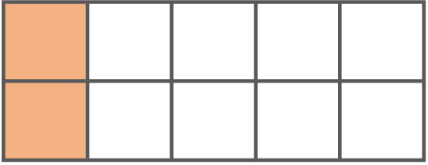
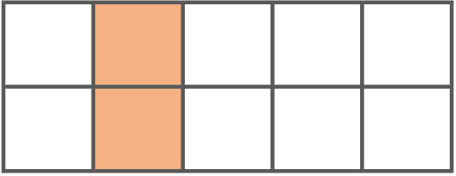

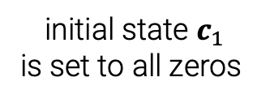

RNN hidden state after
processing event #1
is used to predict event #2
context_size
padded_length
batch_size
$$c_{1}$$ | $$c_{2}$$ | $$c_{3}$$ | $$c_{4}$$ | $$c_{5}$$
initial state $c_{1}$
is set to all zeros
rnn_output
context

Slide 4
seq_lengths
log_pdf
log_surv
log_like
2
4
3

Slide 5



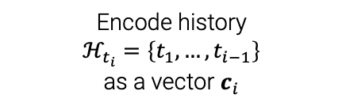









Encode history
$ℋ_{t_{i}}=\left\{t_{1},…,t_{i−1}\right\}$
as a vector $c_{i}$
$$c_{i}$$
$$θ_{i}$$
PDF of the next
inter-event time
$$⋯$$
$f_{i}^{∗}\left(τ_{i}\right)=f\left(τ_{i} | θ_{i}\right)$
$$y_{1}$$
$$y_{2}$$
$$y_{i−1}$$
$$0$$
$$t_{1}$$
$$t_{2}$$
$$t_{i−1}$$
$$T$$
time

Slide 6
Encode history
$ℋ_{t_{i}}=\left\{t_{1},…,t_{i−1}\right\}$
as a vector $c_{i}$
$$c_{i}$$
$$θ_{i}$$
PDF of the next
inter-event time
$$⋯$$
$f_{i}^{∗}\left(τ_{i}\right)=f\left(τ_{i} | θ_{i}\right)$
$$y_{1}$$
$$y_{2}$$
$$y_{i−1}$$
$$0$$
$$t_{1}$$
$$t_{2}$$
$$t_{i−1}$$
$$T$$
time

