Slide 1
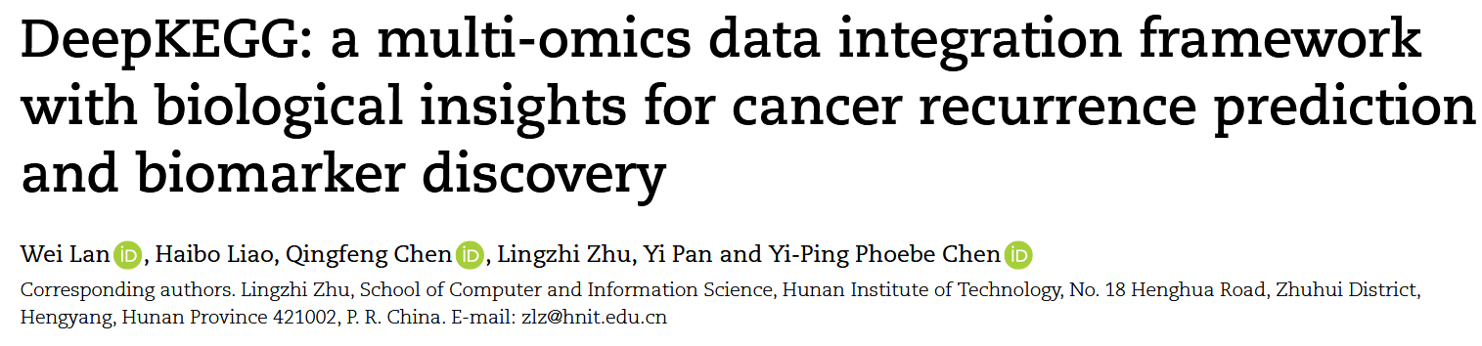
BiB 2024
Notes:
weilan：广西大学副教授 laiohaibo 广西大学硕士生研三 chenqingfeng广西大学亚热带农业生物资源保护与利用国家重点实验室教授 zhulingzhi 湖南工业大学副教授 panyi中科院深圳先进制造学院院长 Chenyiping 澳大利亚lachoubo大学计算机工程系系主任

Slide 2
Abstract
Deep learning-based multi-omics data integration methods have the capability to reveal the mechanisms of cancer development, discover cancer biomarkers and identify pathogenic targets. However, current methods ignore the potential correlations between samples in integrating multi-omics data. In addition, providing accurate biological explanations still poses significant challenges due to the complexity of deep learning models. Therefore, there is an urgent need for a deep learning-based multi-omics integration method to explore the potential correlations between samples and provide model interpretability. Herein, we propose a novel interpretable multi-omics data integration method (DeepKEGG) for cancer recurrence prediction and biomarker discovery. In DeepKEGG, a biological hierarchical module is designed for local connections of neuron nodes and model interpretability based on the biological relationship between genes/miRNAs and pathways. In addition, a pathway self-attention module is constructed to explore the correlation between different samples and generate the potential pathway feature representation for enhancing the prediction performance of the model. Lastly, an attribution-based feature importance calculation method is utilized to discover biomarkers related to cancer recurrence and provide a biological interpretation of the model. Experimental results demonstrate that DeepKEGG outperforms other state-of-the-art methods in 5-fold cross validation. Furthermore, case studies also indicate that DeepKEGG serves as an effective tool for biomarker discovery. The code is available at https://github.com/lanbiolab/DeepKEGG.
多组学数据整合：同时分析同一个生物样本的多种类型的数据，如miRNA、DNA
样本之间的潜在联系：不同病人，有类似的病症，则其分子数据可能表现出相似之处。
深度学习方法可解释性差。

Slide 3
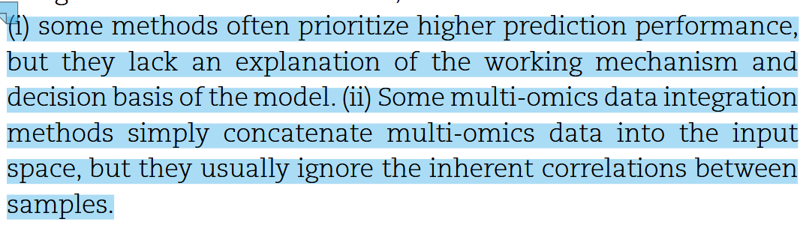
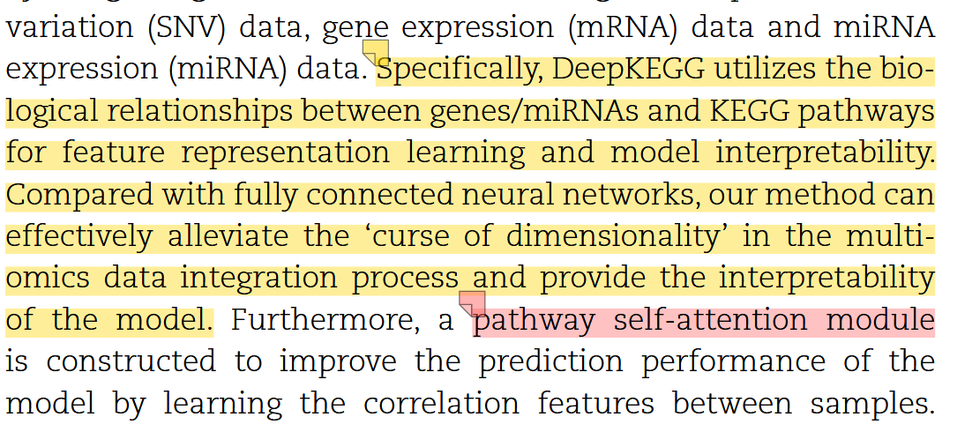
Introduction
1. 现有模型缺乏对机制的解释
2. 一些模型忽视了样本相关性
KEGG：
Kyoto Encyclopedia of Genes and Genomes - 京都基因与基因组百科全书
主要存储的是关于生物通路 (pathway) 的信息
维度诅咒：维度数量大于样本数量，导致一系列问题比如过拟合，聚类困难等等
SNV:Single Nucleotide Variation - 单核苷酸变异 ATCG 比如A在某个个体中变成G
mRNA：转录序列
miRNA：非编码RNA，用于微调mRNA的行为。

Slide 4
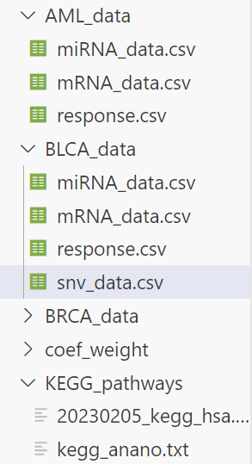

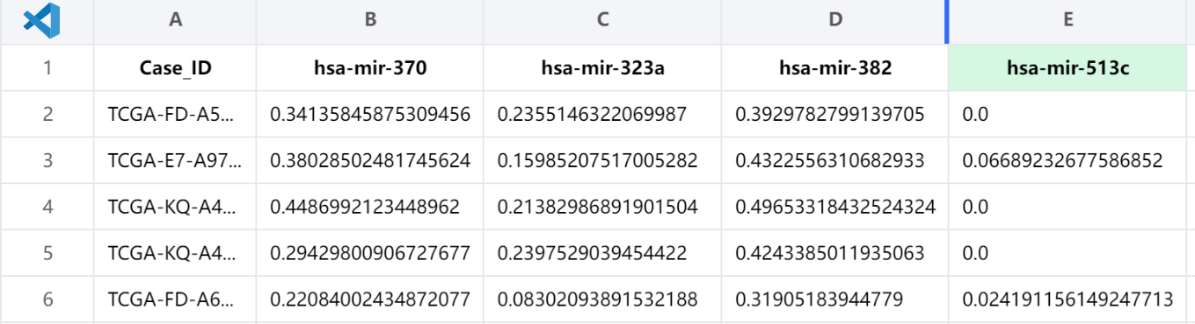
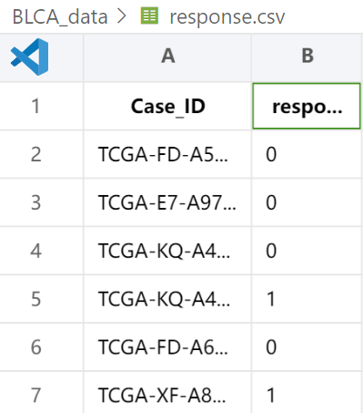
Introduction
0-1之间的浮点数
0-1之间的浮点数
mRNA
基因
miRNA
SNV
0或1
For example：
response.csv
浮点数应该经过了归一化处理
BLCA：膀胱癌
response.csv: 样本的标签（患者真实状态）

Slide 5
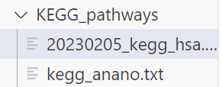
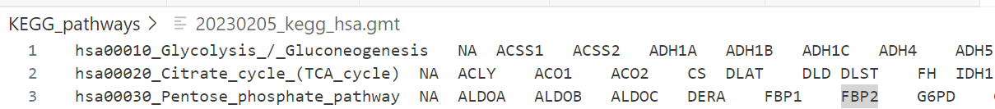
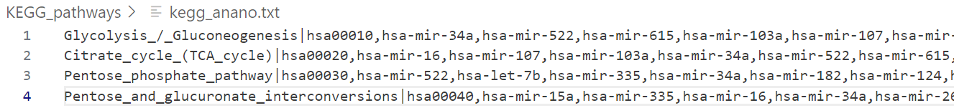
Introduction
每一行代表一个基因集（NA原本是对应基因的解释，没有就Not Available）
也就是一条基因通路。 hsa00010表示糖酵解/糖异生通路 后面是其对应相关基因
每一行代表一个miRNA集也就是一条基因通路。
hsa00010表示糖酵解/糖异生通路 后面是其对应相关miRNA

Slide 6
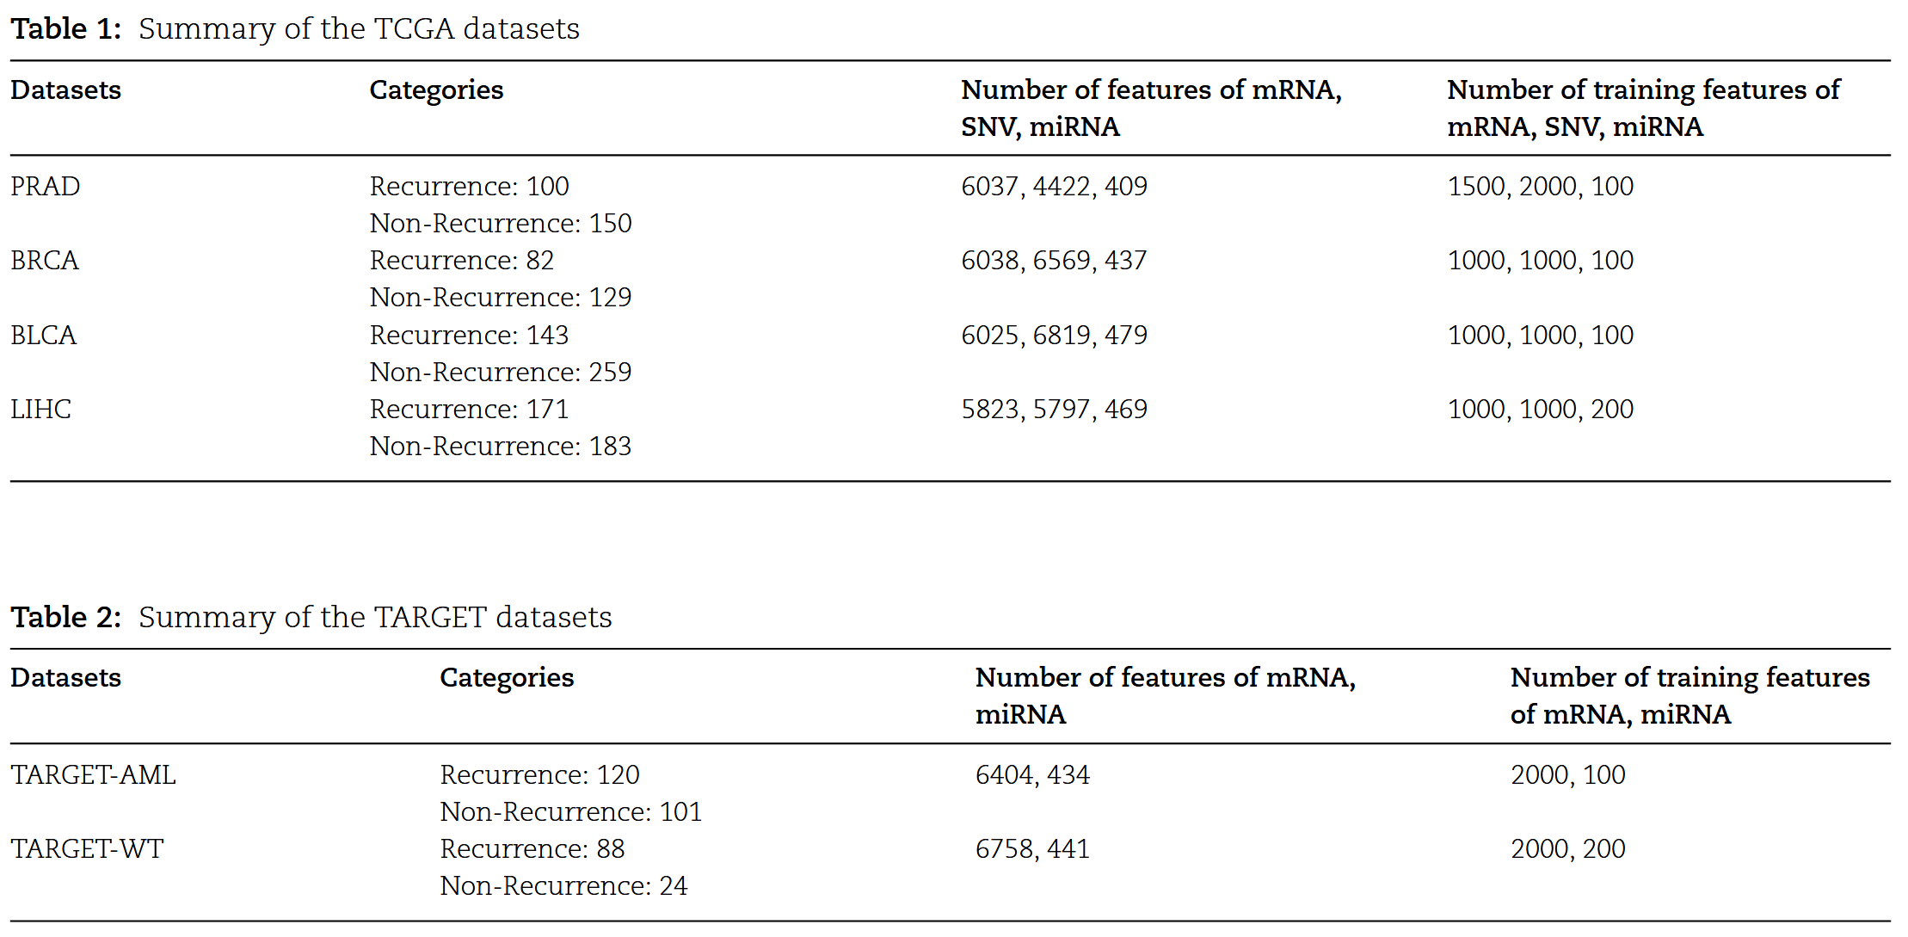
Model
非端到端

Slide 7
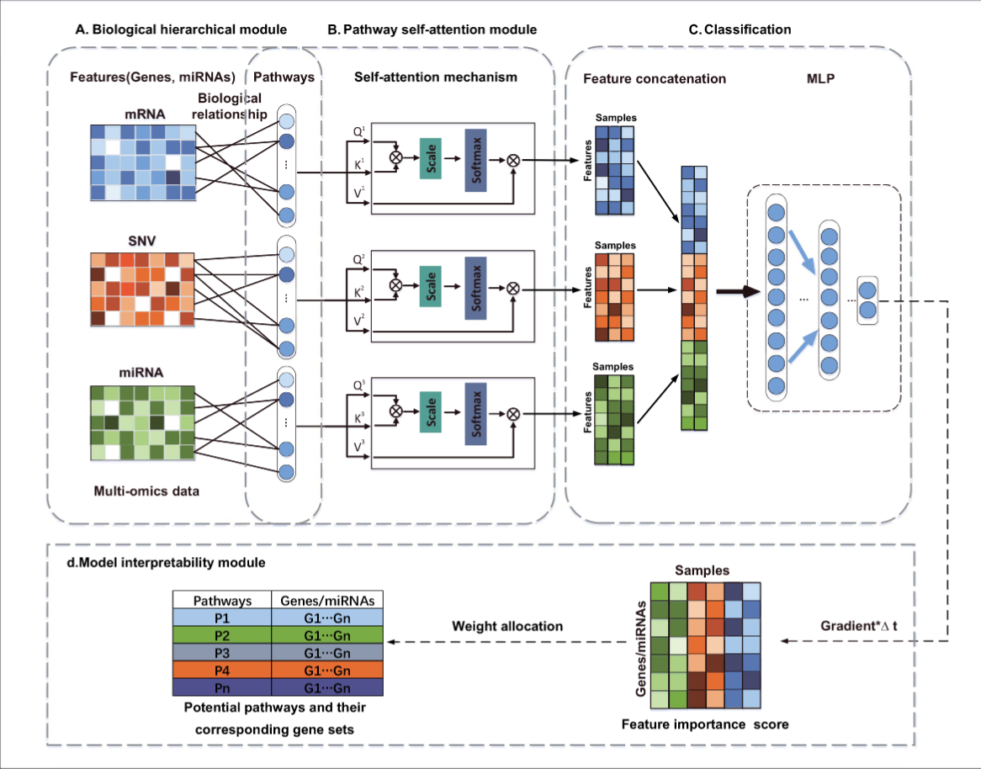
Model

Slide 8
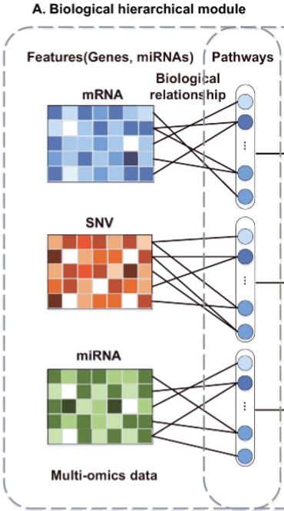


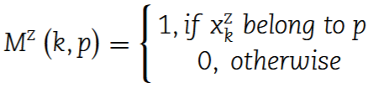


Model
样本及其对应特征表达程度
特征与对应通路的关系（0-1矩阵）
可创新点1
不同基因的影响性不同。
注意 这三个矩阵不一样大，与上一幅图有关。
但是H^z是一样大的，因为通道数固定了。

Slide 9
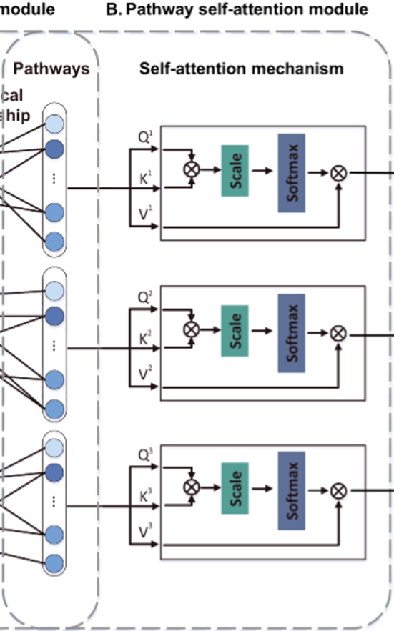
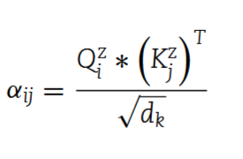
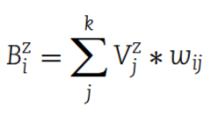
Model

Slide 10
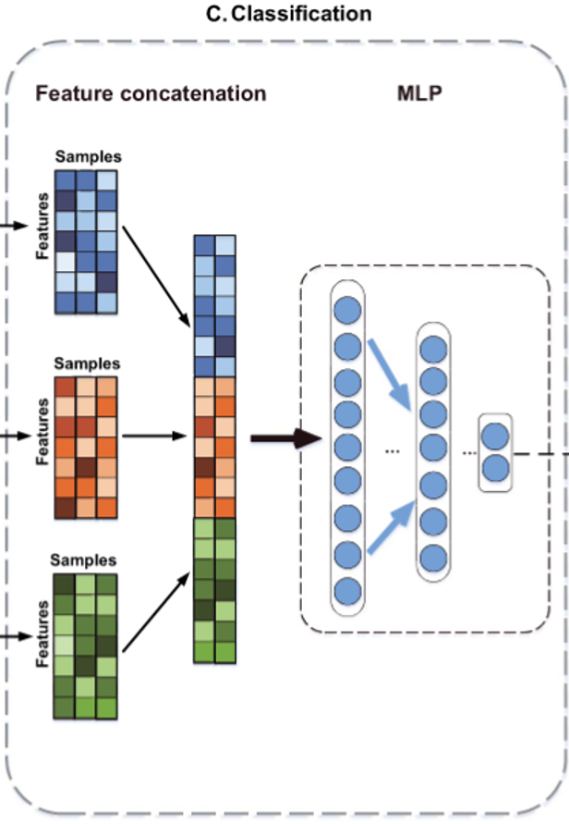
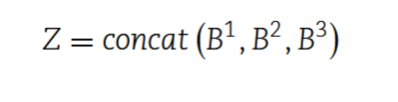

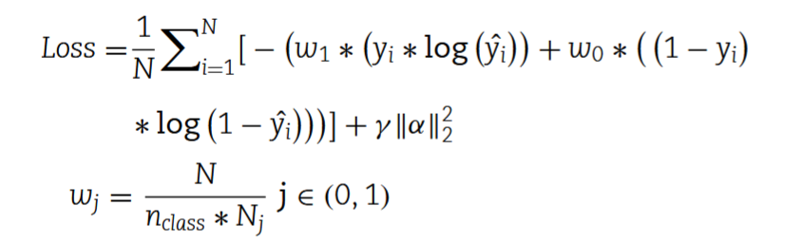
Model

Slide 11
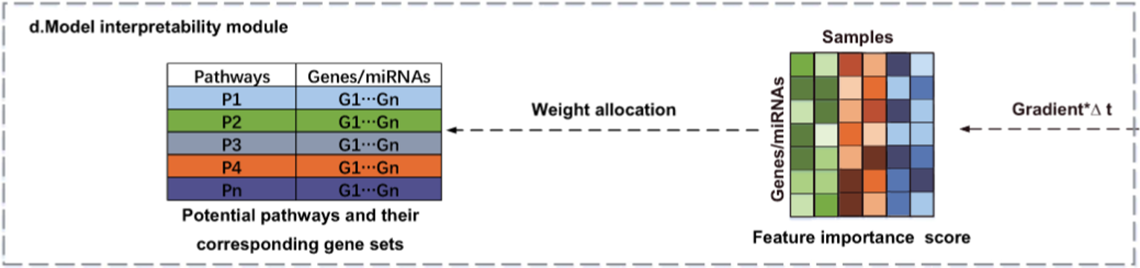
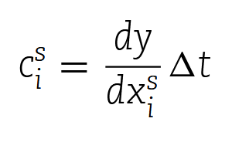
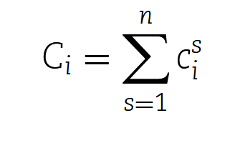


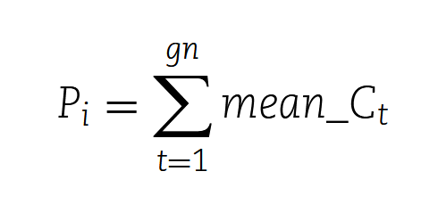
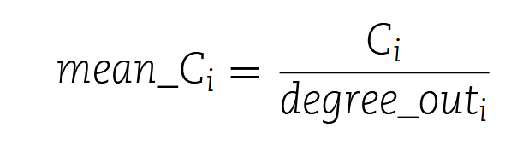
Model
计算单个样本 中，单个输入特征 （基因/miRNA 值）对最终预测结果 y 的贡献度 。

Slide 12
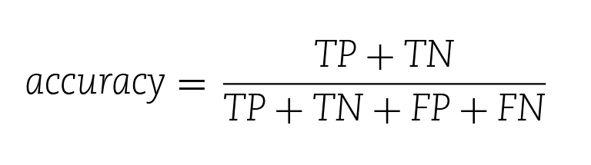
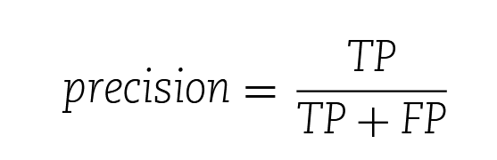
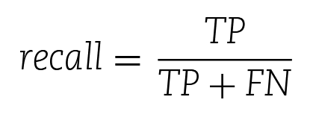
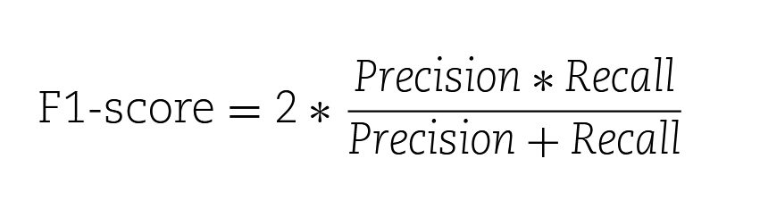


Experiments

Slide 13
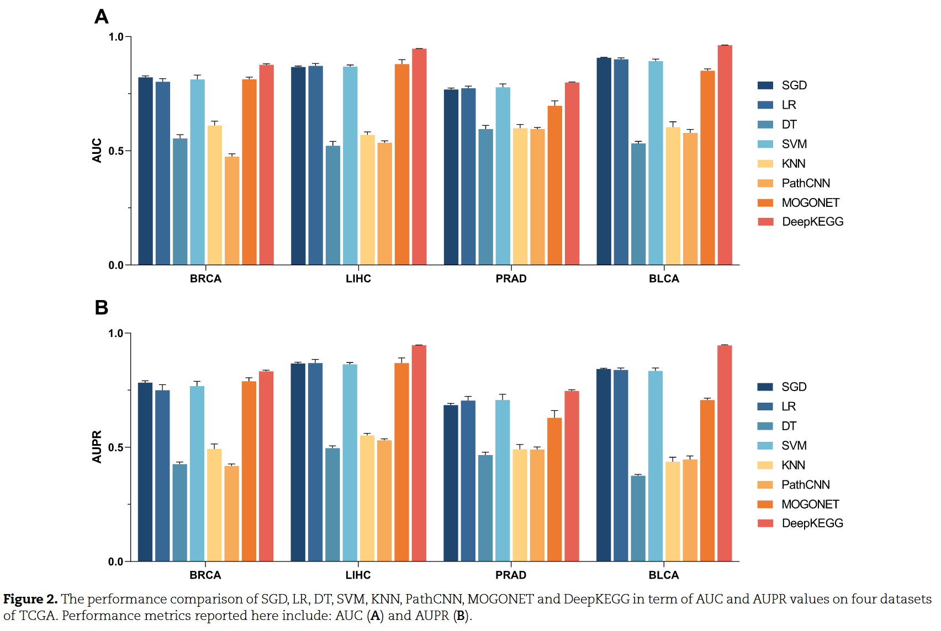
Experiments

Slide 14
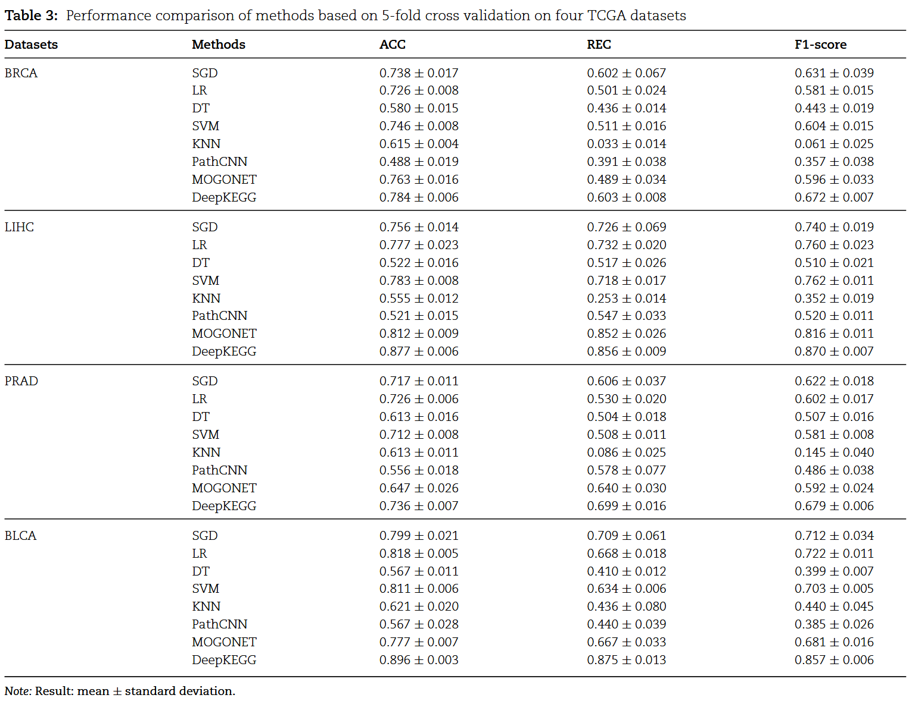
Experiments

Slide 15
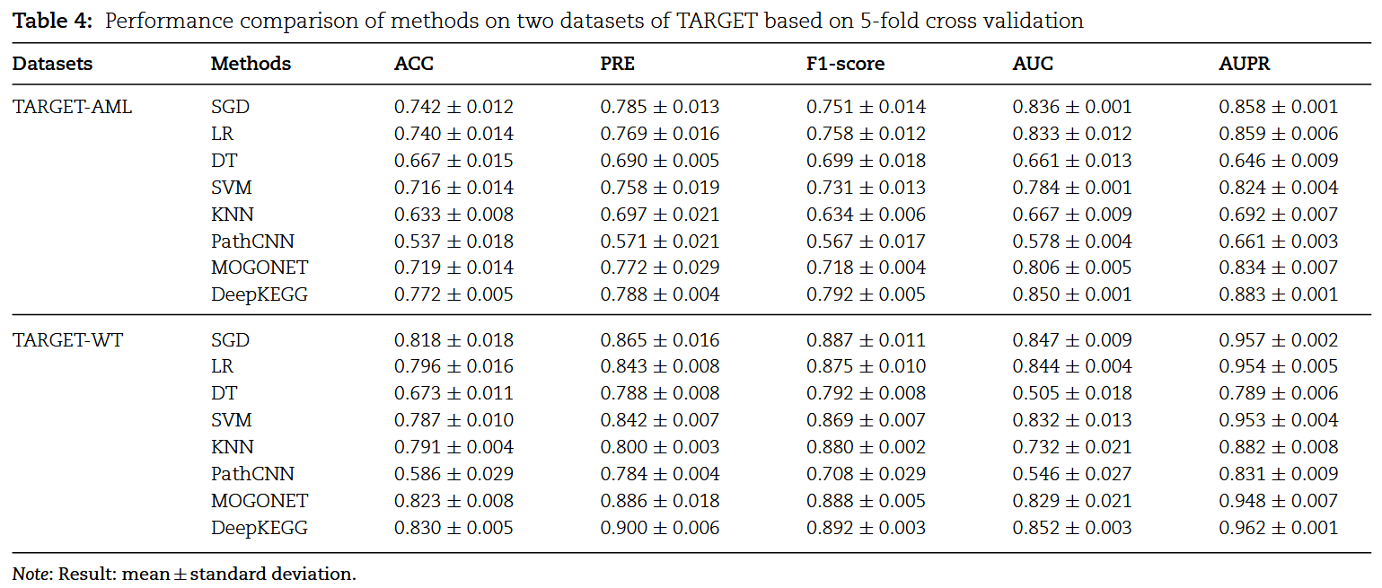
Experiments

Slide 16
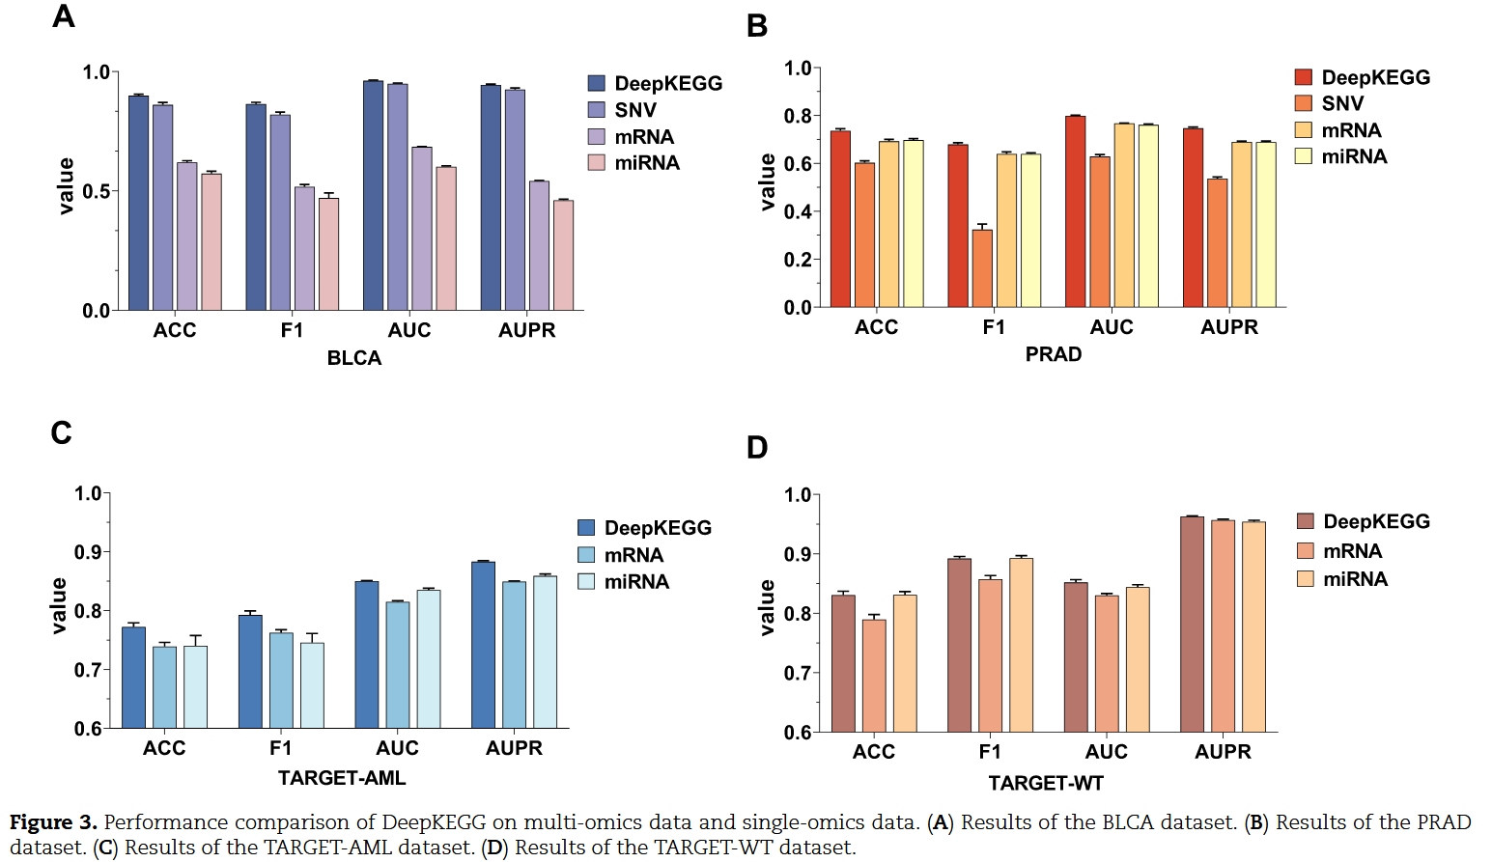
Experiments
Notes:
这个实验做的是：比较 DeepKEGG 模型在整合多种组学数据 和 只使用单一组学数据 时的性能差异。

Slide 17
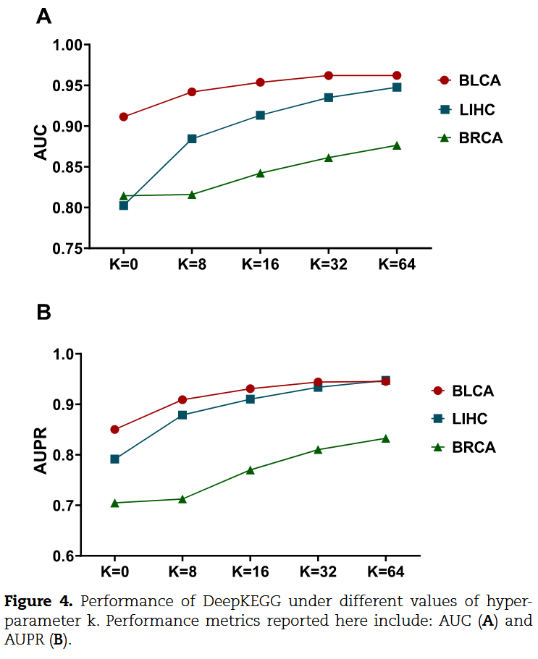
Experiments

Slide 18


Model

Slide 19
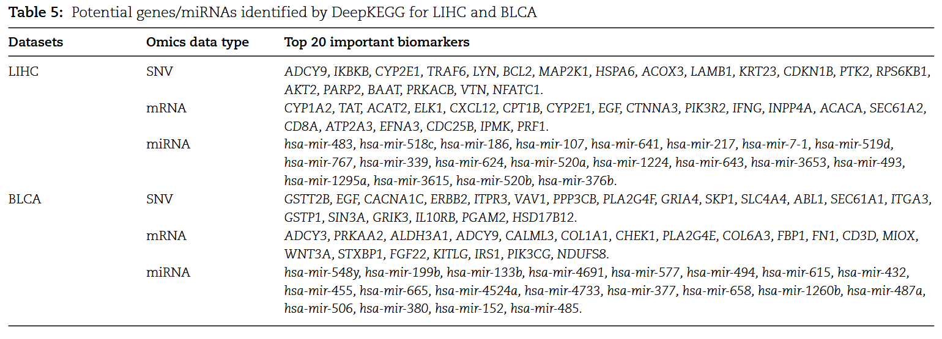
Experiments

Slide 20
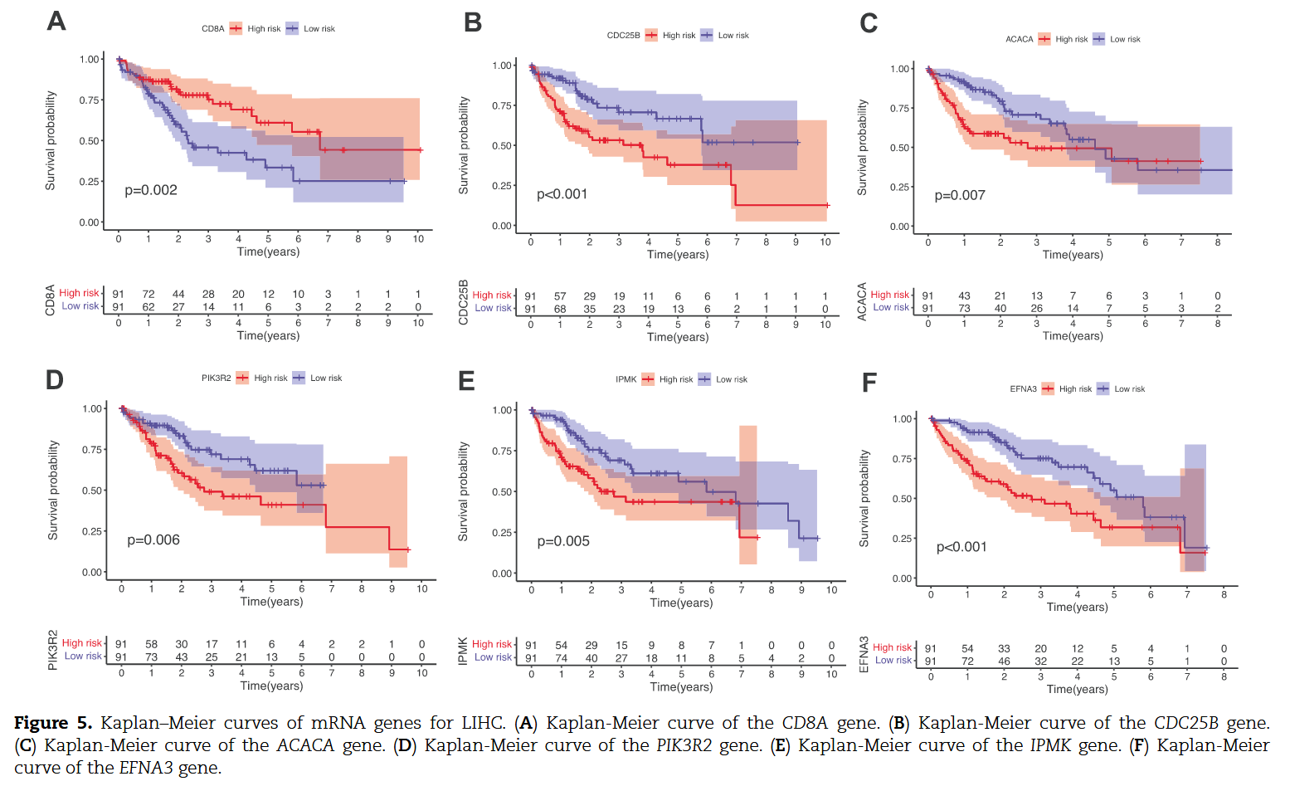
Experiments
High Risk表示高表达 。 验证了 DeepKEGG 发现的这些生物标志物的潜在临床意义。

Slide 21
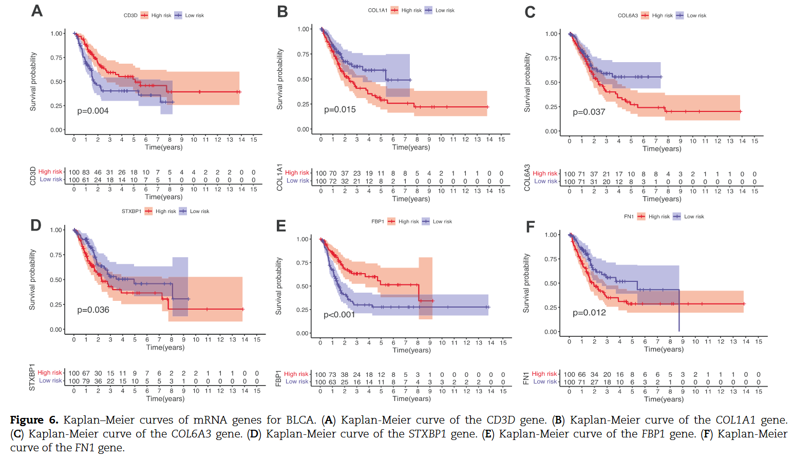
Experiments

Slide 22
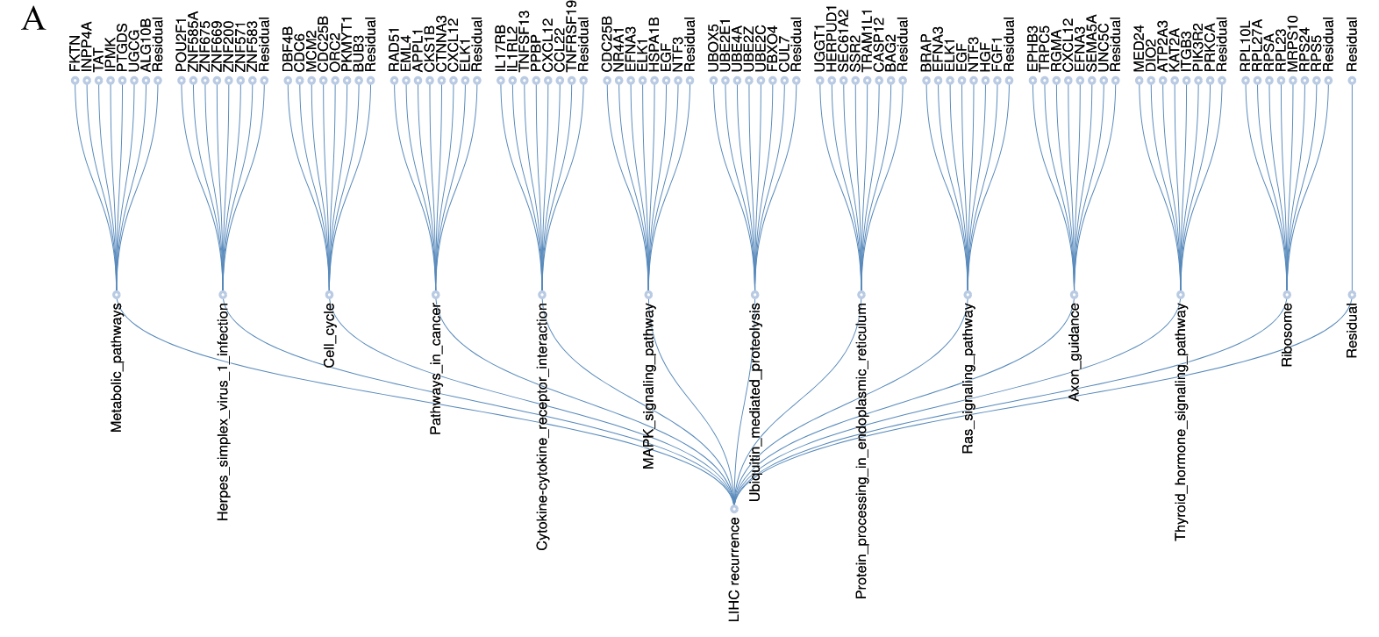
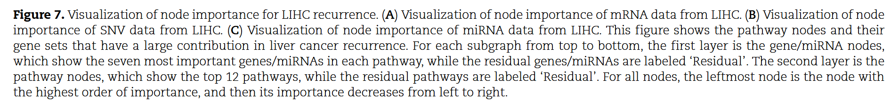
Experiments

Slide 23
Experiments
谢谢大家！

