Slide 1
Bird Call Detection
Deepa Sharma
(W0754736)

Slide 2
Introduction
Detecting bird from their call helps scientists to identify population diversity
and is considered important for preservation of ecosystem health.
Many CNN-based model have been proposed.(e.g BirdNET) but are having
issues in long run.
Many competition has been hosted with the goal of identifying bird through
audio recordings using bioacoustic monitoring.

Slide 3






BirdCLEF 2022 competitions hosted by Kaggle

Slide 4
Dataset
152 categories of bird species audio recording file of bird found in Hawaii.
Each audio_file in ogg format.
Uneven length and number of audio recording in each categories.
Folder are named with species code.
Taxonomy is proved in csv format with all the detail of bird species along with
their common name and scientific name.

Slide 5
Data Pre-processing
I took 4 categories of birds.
Dataset have 240 file for each class with 30 second long audio.
Converted .ogg file in .wav format. (MediaHuman Audio Converter).
Converted waveforms to spectrograms.
Again converted spectrogram into MFCC(Mel-Frequency Cepstral Coefficients).
Saved 13 coefficients of MFCC into json file along with it labels.

Slide 6
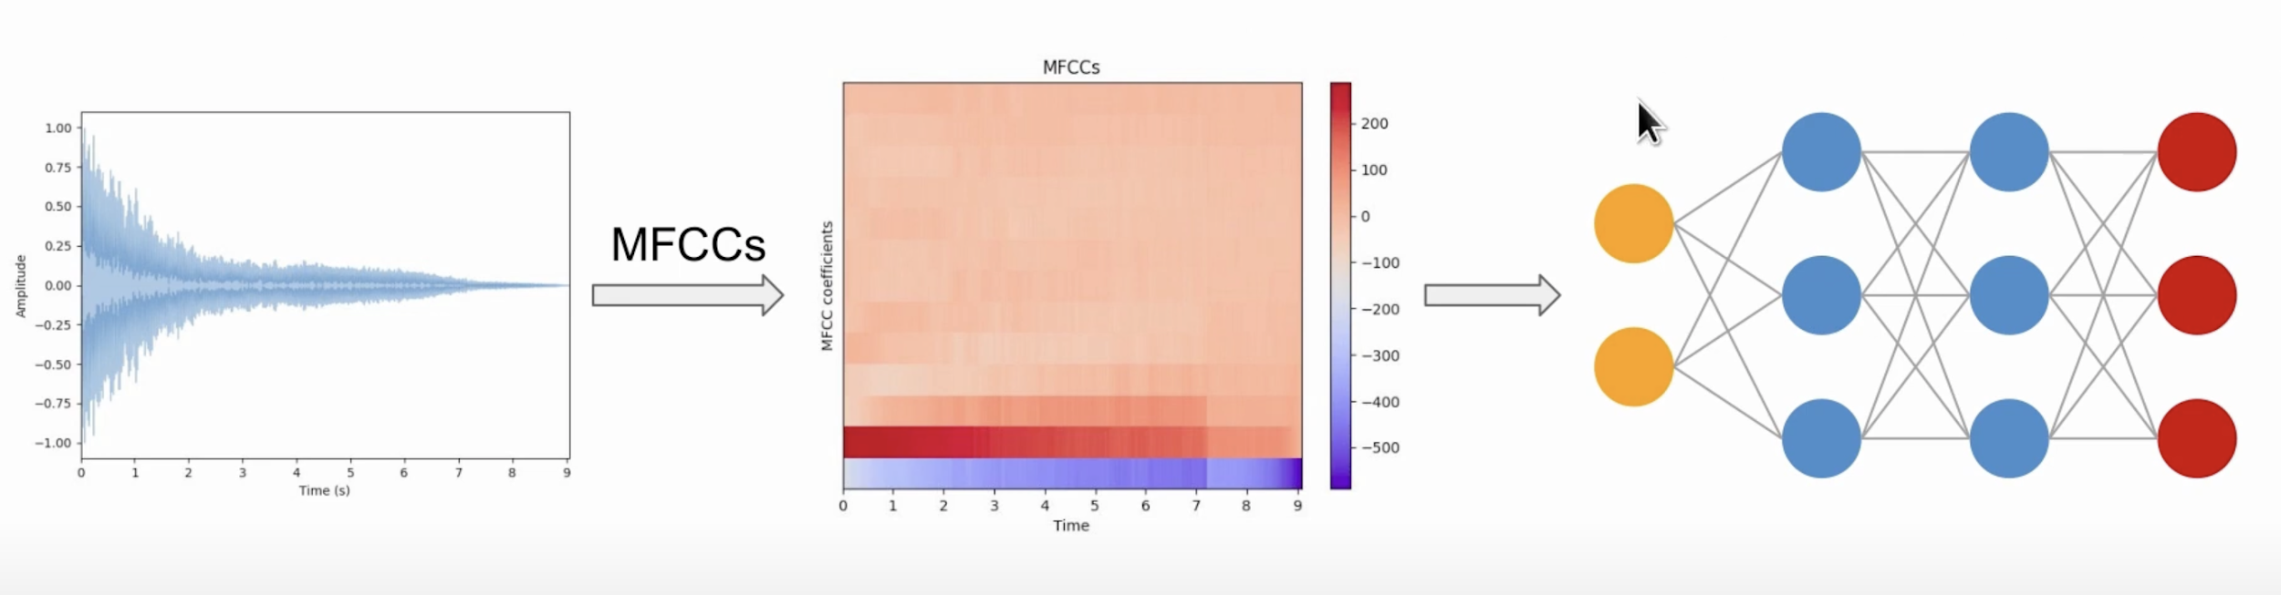
MFCC (Mel-Frequency Cepstral Coefficient

Slide 7
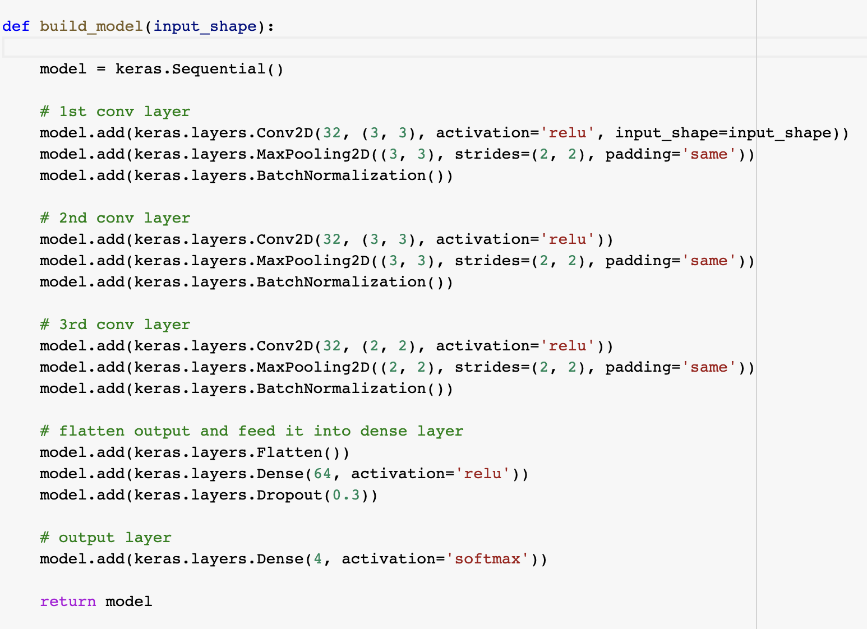
Proposed Model (CNN-Network)

Slide 8
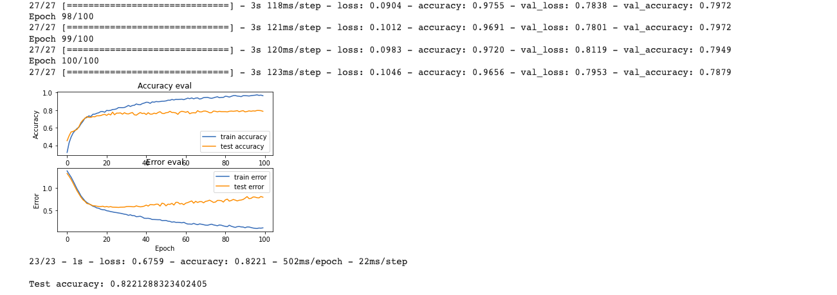
Result while taking 5 sec of audio segment.

Slide 9
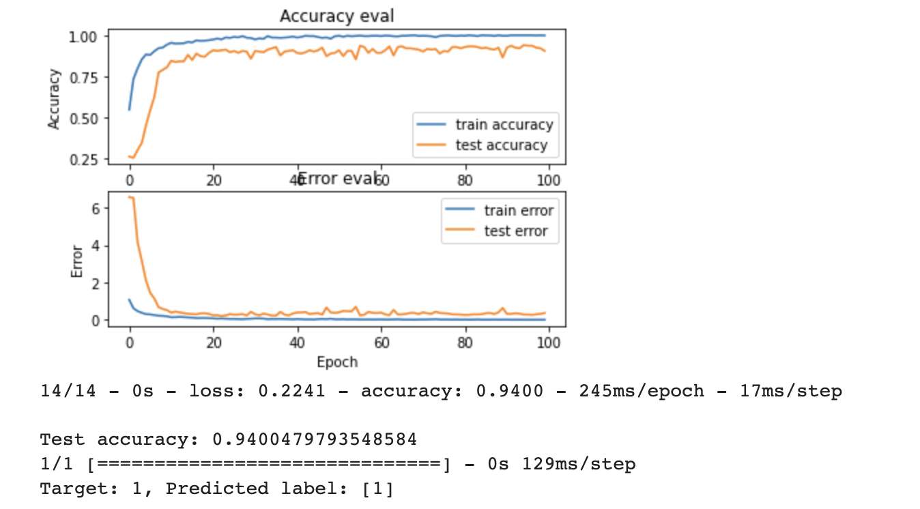
Result while taking 10 second of audio segment.

Slide 10
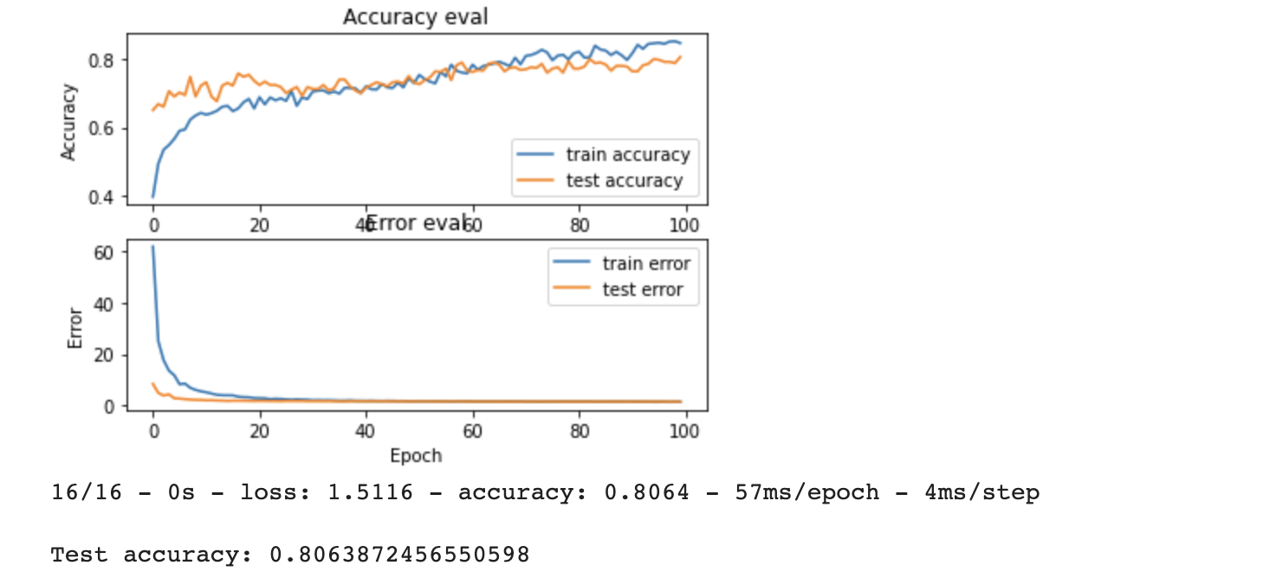
Output From Multipercepton neural Network

Slide 11
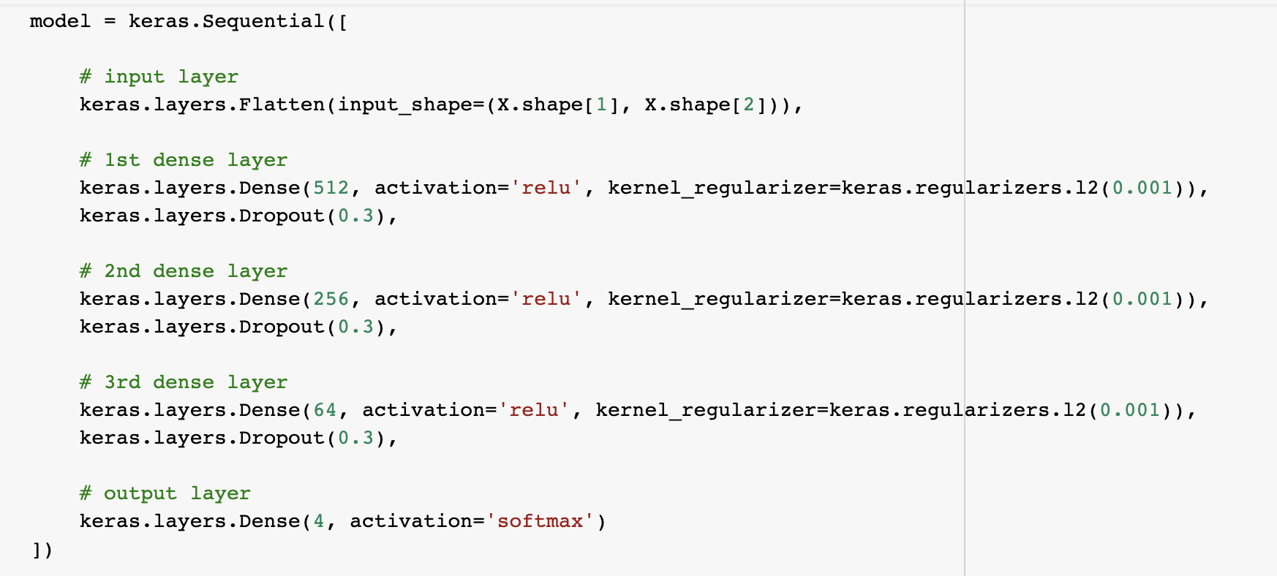
Multi-perceptron Neural Network

Slide 12
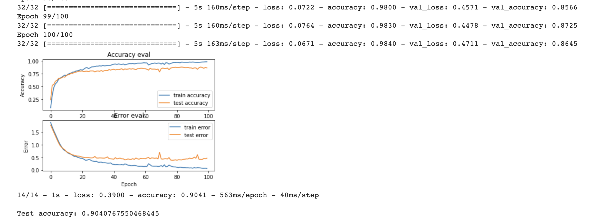
Output from RNN-LSTM Network

Slide 13
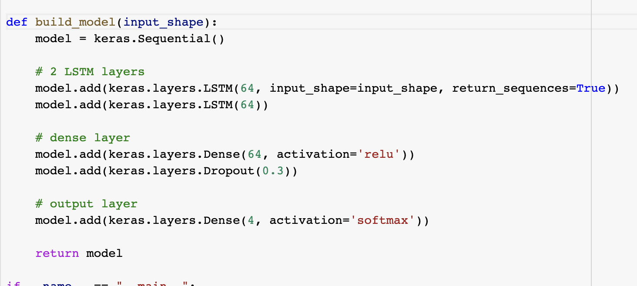
RNN-LSTM network

Slide 14
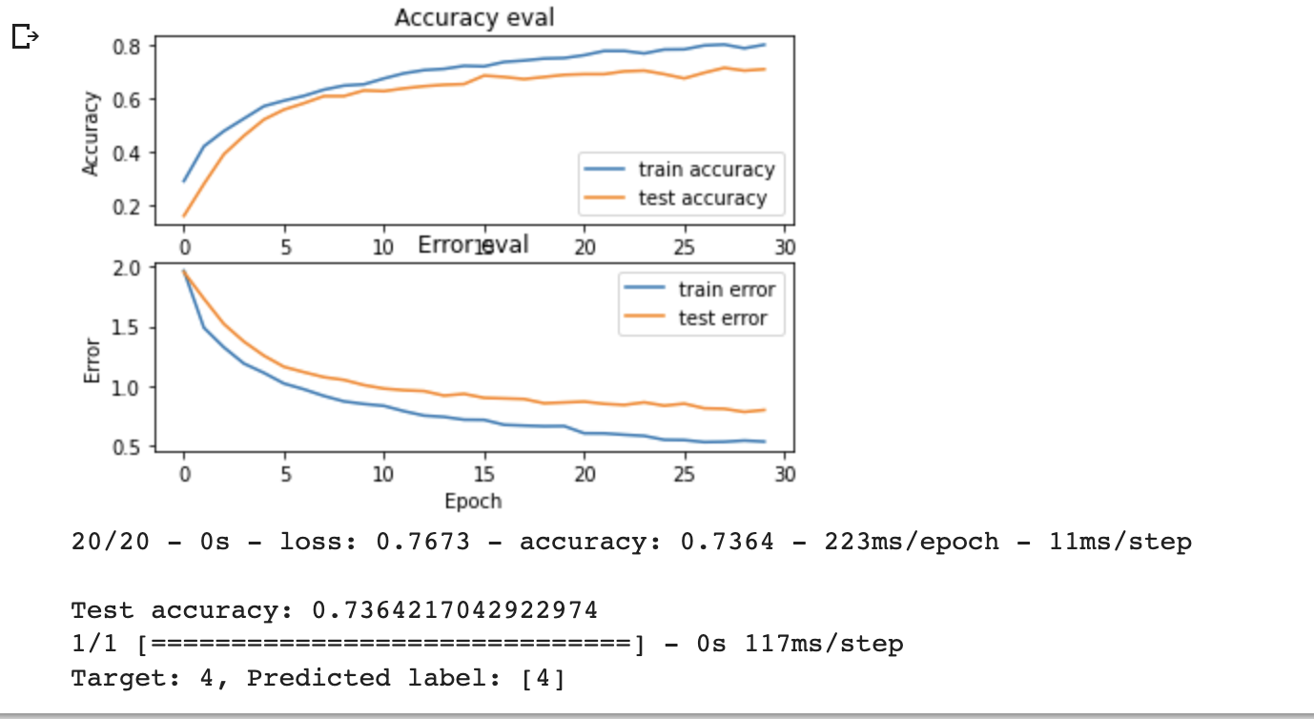
Future goal
Add new classes of bird along with data augmentation (time stretching).
Output after adding two more classes.

Slide 15
Thank You

