Slide 1
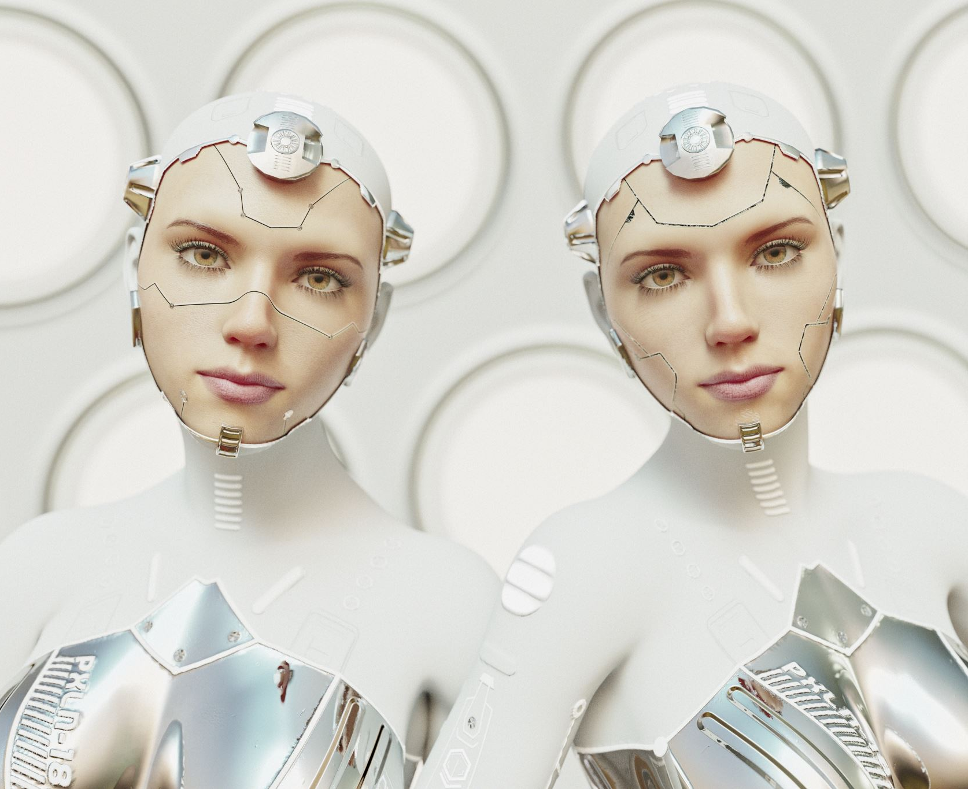
Face Detection With SIFT
Deepa Sharma
W0754736

Slide 2

Face Features Detection
My goal is to extract the distinctive features from the face images with scale change, addition of noise and change in illumination.

Slide 3

About The Research Paper
I read the paper by author David G.Lowe on topic (Distinctive Image Features from Scale-Invariant Keypoints)
This paper presents a method to extract highly distinctive features of objetcs from clutter and occlusion images:
- Firstly, by matching individuals features from database
- Secondly, using Hough Tranform to identify clusters.
- Finally, using least square solution for verification

Slide 4

Related Research
1981
(Moravec) Image matching by using local interest points.
1992
(Harris and Stephens) Harris corner detector.
1995
(Zhang et al) Correlation window along with Second moment matrix.
1997
(Schmid and Mohr) Introduced invariant local feature matching.
1999
(David G. Lowe) Extended local features approach to achieve scale invariant.

Slide 5
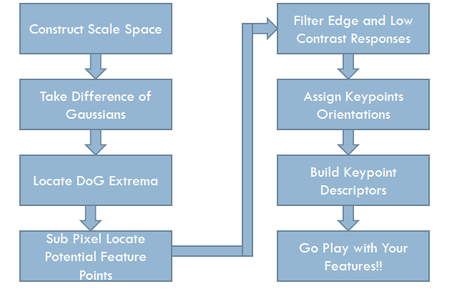
SIFT Algorithm

Slide 6
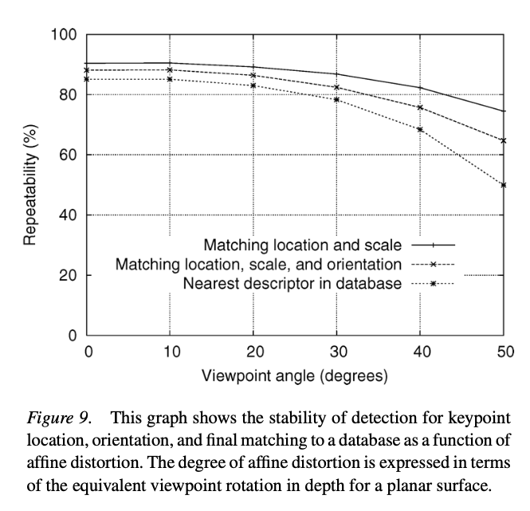
Descriptors Testing (Affine change)

Slide 7
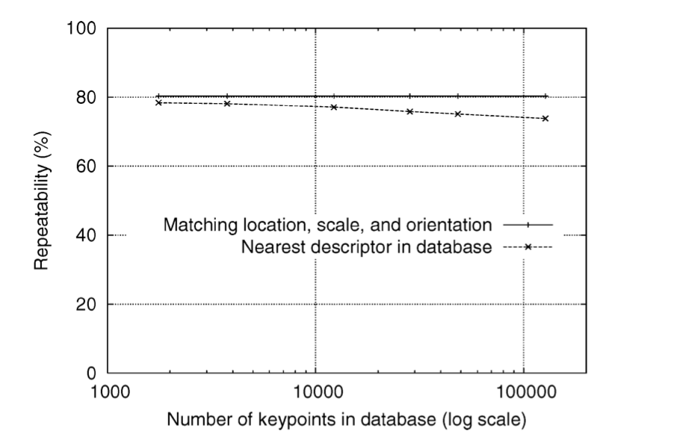
Matching to Large Database
Increase number of image from 32 with 40,000 keypoints into 112 images.

Slide 8
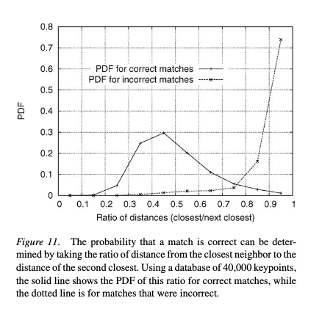
Keypoint Matching

Slide 9
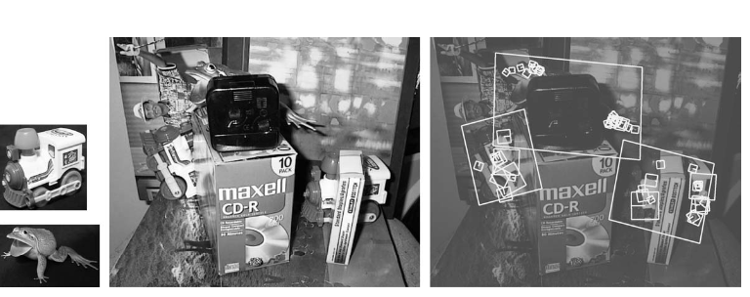
Result in cluttered image with occlusion.

Slide 10
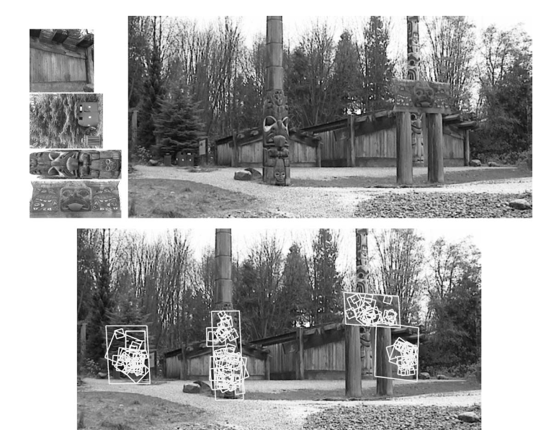

Slide 11
Process for face detection
Imported 2 images.
Converted images from BGR to RGB.
Again, Converted images from RGB to Grayscale
Applied SIFT function to find keypoints.
KNN match function
Detected the number of feature.
Applied condition to check if image is match or not

Slide 12
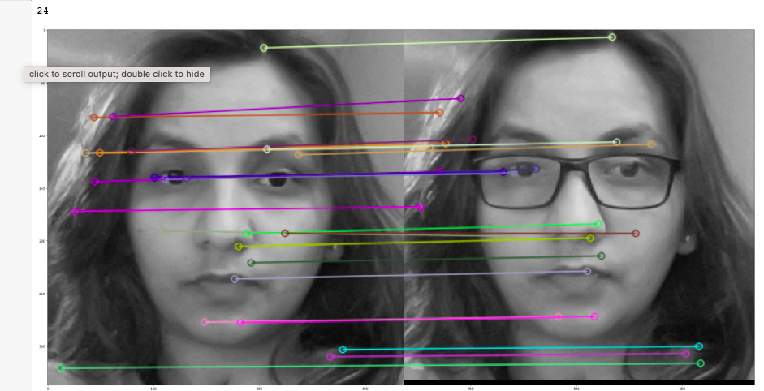

Slide 13
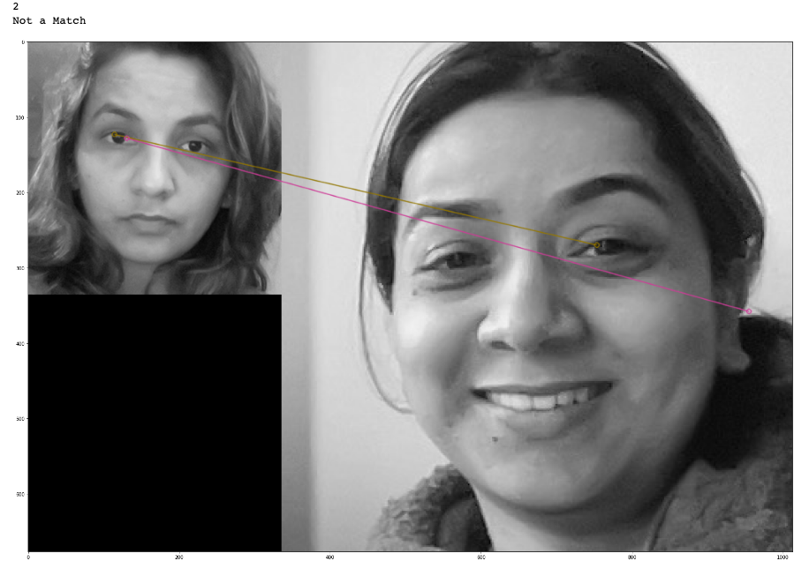

Slide 14
Thank You

