Slide 1
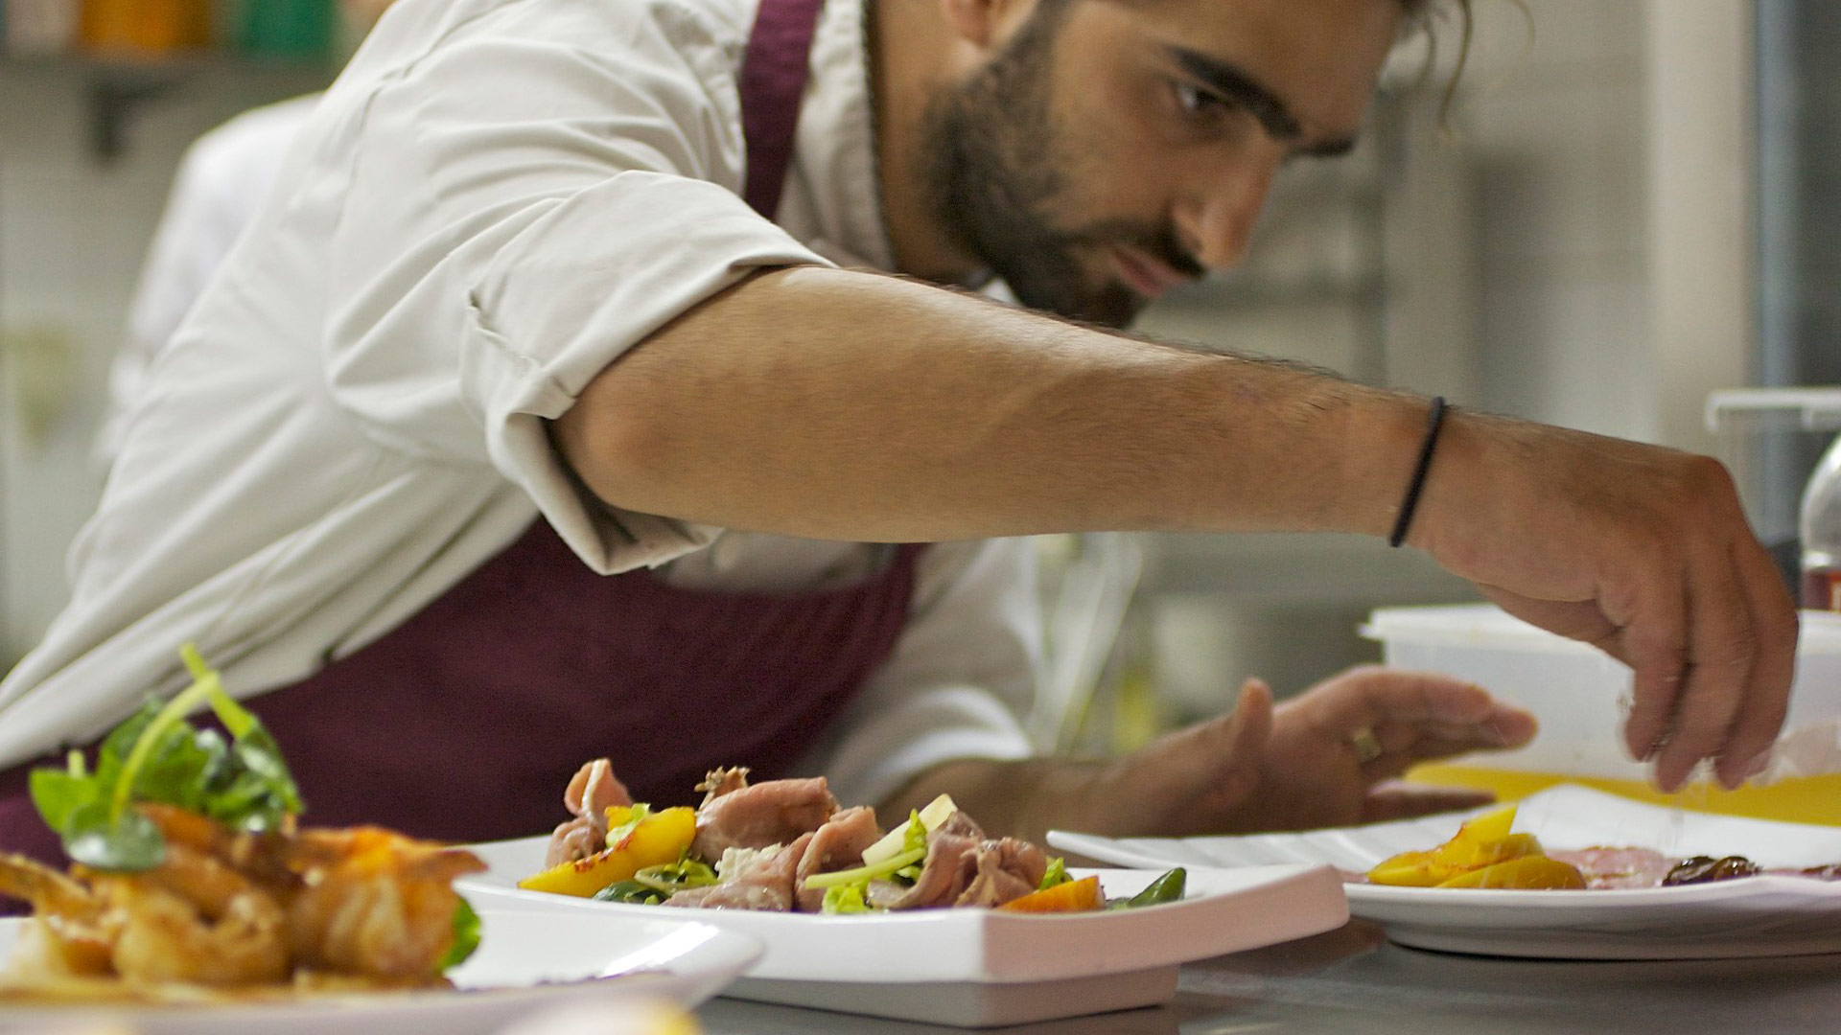



DopeChefs
A RECIPE
HAS NO SOUL.
YOU
MUST BRING
SOUL TO THE RECIPE
AS THE COOK

Slide 2
DopeChefs
A RECIPE
HAS NO SOUL.
YOU
MUST BRING
SOUL TO THE RECIPE
AS THE COOK

Slide 3
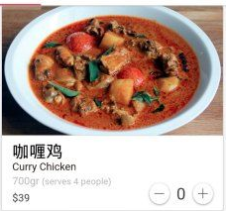
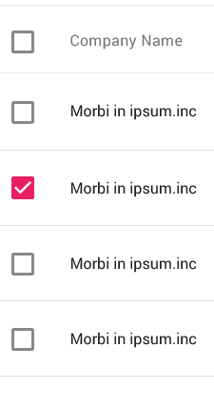

DopeChefs
ADD Recipe

Slide 4

DopeChefs
Ingredients
asdsadasdas
asddsad
asdasdasd
asdasd
asdasdasd
asdasdasd
asd
Steps
Asdas
Asdasda
Asdasd
Asdasd
Asdasd
Asdasd
asdasdasdasd
START
ADD Recipe

Slide 5

DopeChefs
Cut potatoes. …. Adasdlabala alabal asdasdasdasddddddddddddddddddddd, do something
Ashdkasjdkajsk aksdjkasjdkajskdjaksdjkasjdkajskd
ADD Recipe
Go

