Slide 1
House Prices: Adv Regression Techniques
The Ames Housing Data Set and Our First Kaggle
Presentation by Skewed Kurtosis
Ken Colangelo
Sheetal D
Marissa Joy
Merle Strahlendorf

Slide 2
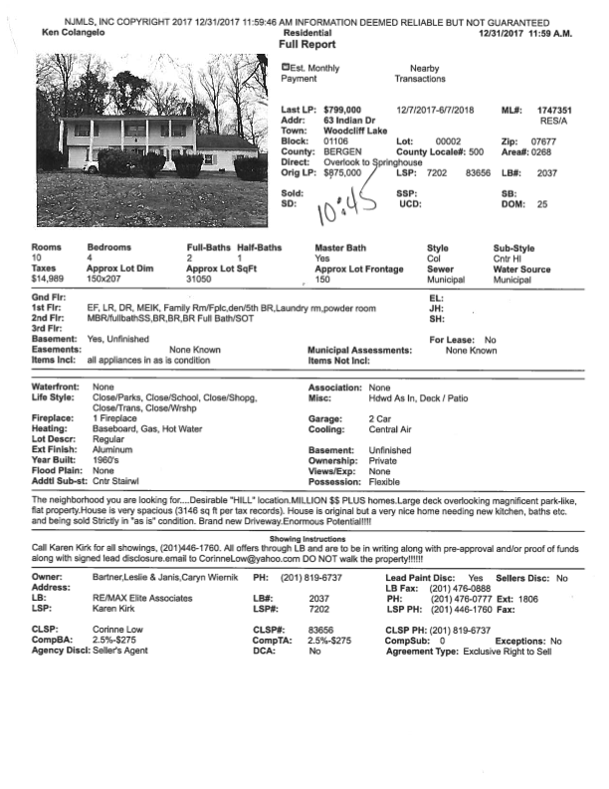
Understanding our Data The Pre Plan
Set up a Git repository
Kept a Slack Channel
Read Journal of Statistics Education
Dean De Cock’s article on the origin of the Ames data
NJ Multiple Listing Example for Pertinent Variables
Started a Google Sheet to work cooperatively
Communication and Ideas are Key!!!

Slide 3
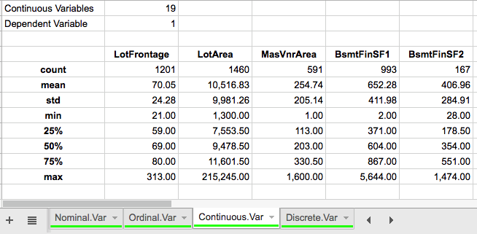
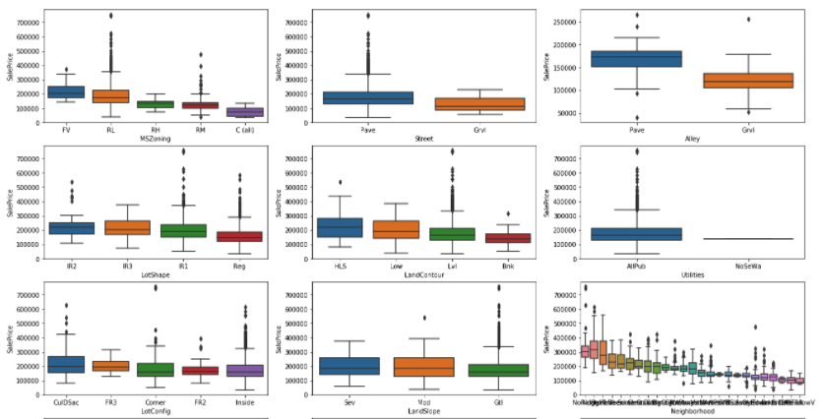
Understanding our Data Exploratory Data Analysis
Graphically representing the raw situation
Understanding what kind of variables we have (i.e. Nominal, Ordinal, Continuous, Discrete)

Slide 4
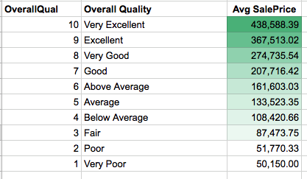
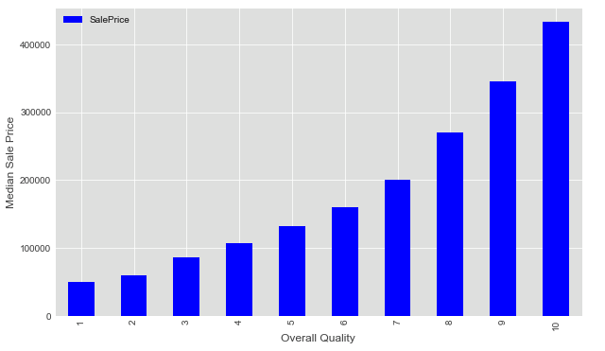
Understanding our Data Exploratory Data Analysis
Making sure these relationships intuitively make sense
Seeing if what relationships exist

Slide 5
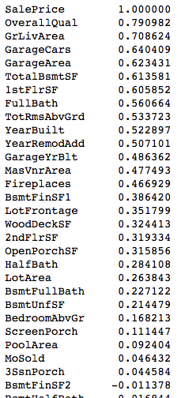
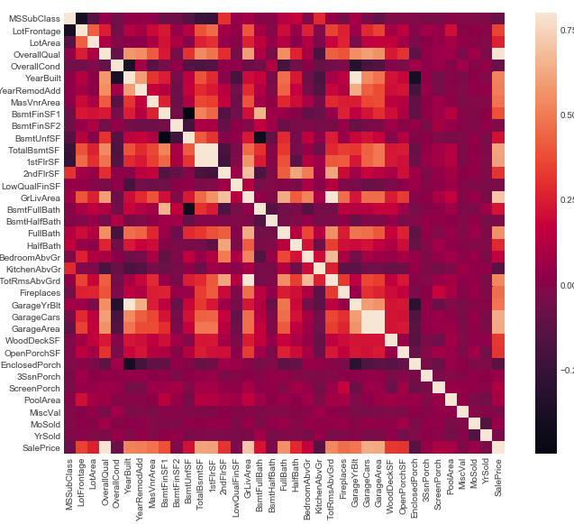
Understanding our Data Exploratory Data Analysis
Looking for high correlations (i.e. TotalBsmntSF and 1stFlrSF, or GrLivArea and TotRmsAbvGrnd)
Focusing in on variables most correlated with SalePrice
Do these correlations make sense?
This helps guide us as to which variables we should focus on
As we saw previously, OverallQual stands out

Slide 6
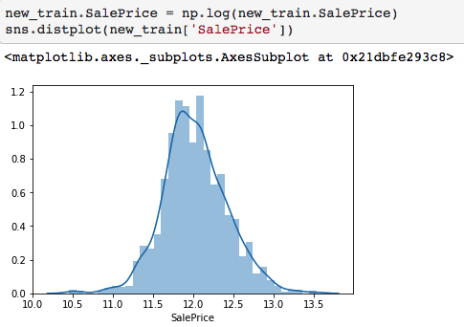
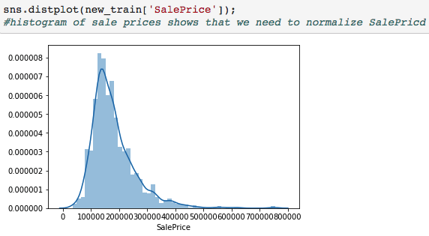
Transforming our Dependent
Skewed Variables Must be Transformed!
Right Skew = 1.883
Log Transformation to Normalize Plot
Skew = 0.121 MUCH BETTER!

Slide 7
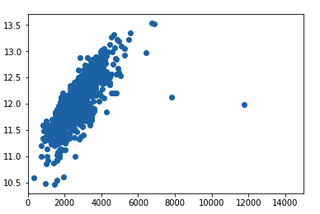
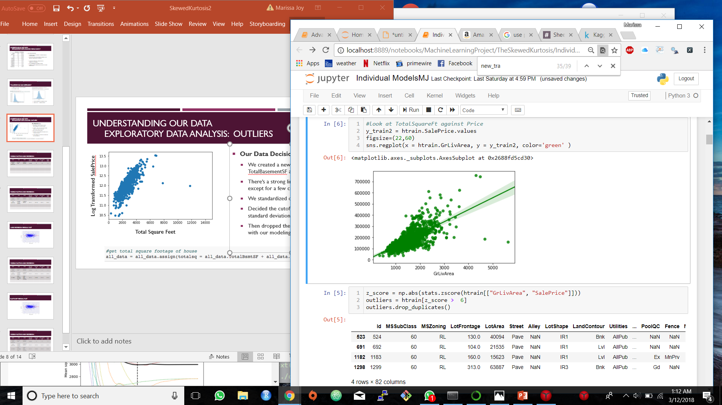
Understanding our Data Exploratory Data Analysis: Outliers
Our Data Decisions:
We plotted Ground Living Area versus the Log-transformed SalePrice
There’s a strong linear relationship here, except for a few crazy outliers!
We standardized our points
Decided the cutoff would be greater than 5 standard deviations
Then dropped the five outliers to continue with our modeling
Log Transformed SalePrice
Total Square Feet

Slide 8
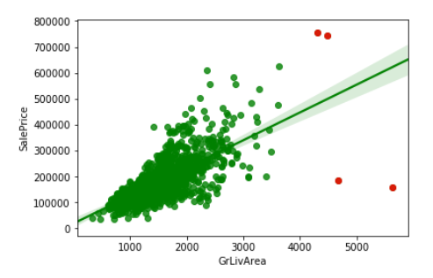
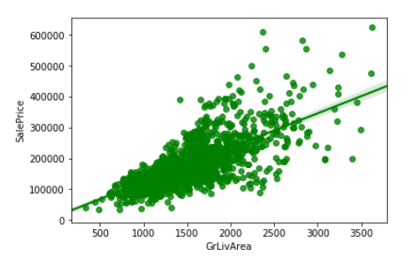
Outliers continued
Outliers:
After Removal of Outliers:

Slide 9
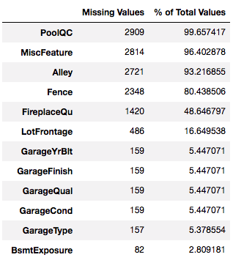
Understanding our Data Exploratory Data Analysis: Missing Data???
Our Data Decisions:
Categorical Values that have Na as a selection should be changed to None
Ordinal Values need to be be mapped to numerical values We used 9 separate ordinal dictionaries!
Variables near zero, such as Street, Id, Utilities, LowQualFinSF are dropped
Using get_dummies for categorical variables
Dropping the houses (observations) with missing variables, quick and dirty

Slide 10
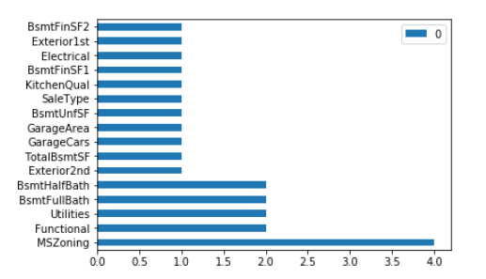
Handling Missing Data
Filled in certain categorical variables where NA actually means “None”
Filled in the rest of the categorical missing values with either median or mode
Used LotArea and Neighborhood to impute missing LotFrontage values
Created new column LotAreaCut to categorize LotArea and then filled in LotFrontage with median
Filled in rest of missing values with KNN

Slide 11
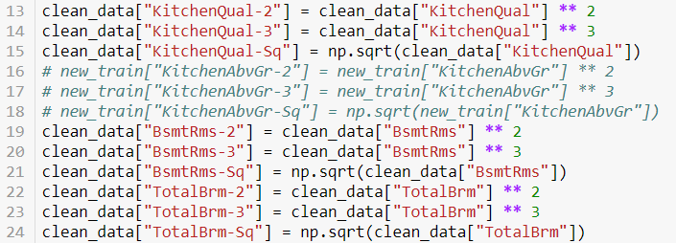
Feature Engineering
Encoded ordinal categorical variables
Created new variables with different combinations and polynomial features
Used get_dummies for the non-ordinal categorical values

Slide 12
Models: Multiple Linear Regression
Model | Pros | Cons | Own CV function | For loop CV | Grid Search CV | Kaggle score
Multiple Linear Regression | Easy to apply | Simplifies problem | 0.1280 | – | – | –

Slide 13
Models: Multiple Linear Regression
Model | Pros | Cons | Own CV function | For loop CV | Grid Search CV | Kaggle score
Multiple Linear Regression | Easy to apply | Simplifies problem | 0.1280 | – | – | –
Lasso Regression | Performs variable selection | Automatic method | 0.1171 | 0.1154 | 0.1153 | 0.1251

Slide 14
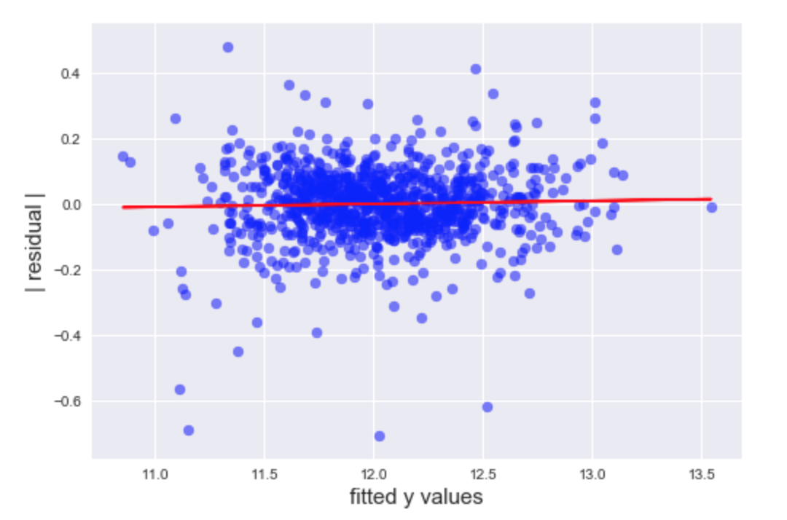
Lasso Regression Residual Plot

Slide 15
Models: Multiple Linear Regression
Model | Pros | Cons | Own CV function | For loop CV | Grid Search CV | Kaggle score
Multiple Linear Regression | Easy to apply | Simplifies problem | 0.1280 | – | – | –
Lasso Regression | Performs variable selection | Automatic method | 0.1171 | 0.1154 | 0.1153 | 0.1251
ElasticNet | Solves limitation of lasso & ridge | Suffers from double shrinkage | 0.1175 | 0.1144 | 0.1138 | 0.1235

Slide 16
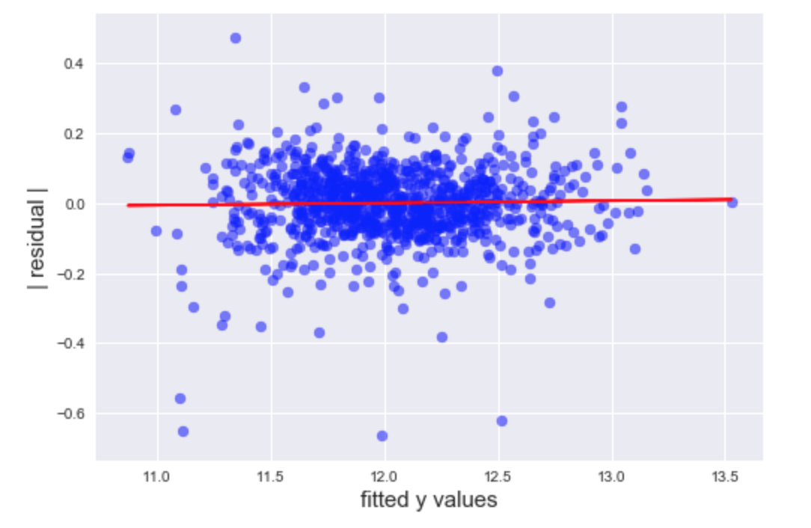
ElasticNet Residual Plot

Slide 17
Models: Multiple Linear Regression
Model | Pros | Cons | Own CV function | For loop CV | Grid Search CV | Kaggle score
Multiple Linear Regression | Easy to apply | Simplifies problem | 0.1280 | – | – | –
Lasso Regression | Performs variable selection | Automatic method | 0.1171 | 0.1154 | 0.1153 | 0.1251
ElasticNet | Solves limitation of lasso & ridge | Suffers from double shrinkage | 0.1175 | 0.1144 | 0.1138 | 0.1235
Gradient Boost | High accuracy | overfitting | – | 0.1170 | 0.1167 | 0.1270

