Slide 1
test viz
Elizabeth Josephine

Slide 2
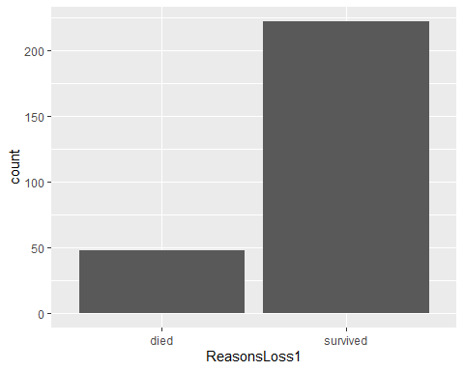
Data visualisation
#Bar graphs
#geom_bar() library(tidyverse)
## ── Attaching core tidyverse packages ──────────────────────── tidyverse 2.0.0 ── ## ✔ dplyr 1.1.2 ✔ readr 2.1.4 ## ✔ forcats 1.0.0 ✔ stringr 1.5.0 ## ✔ ggplot2 3.4.2 ✔ tibble 3.2.1 ## ✔ lubridate 1.9.2 ✔ tidyr 1.3.0 ## ✔ purrr 1.0.1 ## ── Conflicts ────────────────────────────────────────── tidyverse_conflicts() ── ## ✖ dplyr::filter() masks stats::filter() ## ✖ dplyr::lag() masks stats::lag() ## ℹ Use the conflicted package (<http://conflicted.r-lib.org/>) to force all conflicts to become errors
ideal <- read_csv("https://raw.githubusercontent.com/ThumbiMwangi/R_sources/master/ideal3a.csv")
## Rows: 270 Columns: 26 ## ── Column specification ──────────────────────────────────────────────────────── ## Delimiter: "," ## chr (8): CalfID, sublocation, CADOB, Education, Distance_water, VisitID, V... ## dbl (16): CalfSex, ReasonsLoss, RecruitWeight, Weight, ManualPCV, Theileria... ## date (2): VisitDate1, CADOB1 ## ## ℹ Use `spec()` to retrieve the full column specification for this data. ## ℹ Specify the column types or set `show_col_types = FALSE` to quiet this message.
ggplot(data=ideal, aes(x=ReasonsLoss1)) + geom_bar()

Slide 3
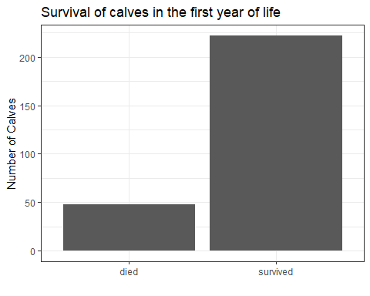
## Compare animals from the dataset that died and those that survived ggplot(data=ideal, aes(x = ReasonsLoss1)) + # add the data geom_bar() + # choose the geom that you want to use to visualise your work theme_bw() + # background theme for your graphic. You can try changing the different themes to see the changes labs(x="", y ="Number of Calves", # renaming your x and y axis title = "Survival of calves in the first year of life") # adding a title to your graph

Slide 4
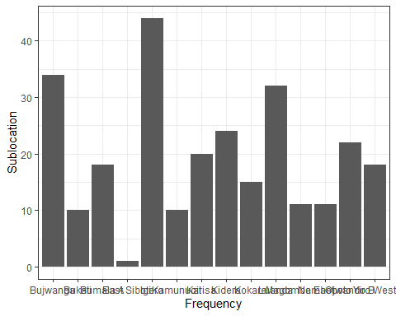
# Try change to the following themes ## theme_dark() ## theme_void() ## theme_classic()
#geom_col() #We will first summarise the ideal dataset and do a tally of how many calves were recruited in each sublocation. calves_recruited<- ideal%>% select(sublocation)%>% group_by(sublocation)%>% dplyr::summarise(freq=n()) ggplot(calves_recruited, aes(x=sublocation, y=freq))+ geom_col()+ theme_bw()+ labs(x="Frequency", y="Sublocation")

Slide 5
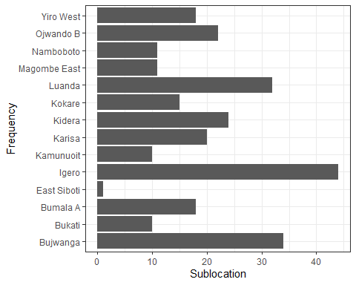
#When we look at our graph, it has given us the frequencies for each location and we were able to add the x and y axis. However, the sublocations in the x axis seem to be overlapping and so we can use the coordinate system, to flip our graph such that the x axis appears where the y axis is and vice versa ggplot(calves_recruited, aes(x=sublocation, y=freq))+ geom_col()+ theme_bw()+ labs(x="Frequency", y="Sublocation")+ coord_flip() # flip our graph

Slide 6
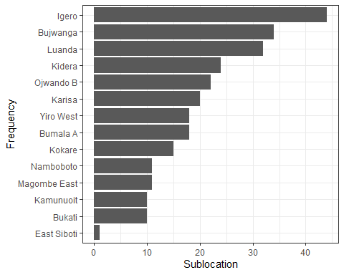
Much better! We are now able to read the sublocations pretty well. But it would make it easier if we were able to arrange the bars in descending order. We can use the reorder() function.
We will add this function in the x axis as we want to reorder out sublocations. Remember, the axis has been flipped so do not confuse the x and y axis.
ggplot(calves_recruited, aes(x=reorder(sublocation, freq), y=freq))+ # reorder function used here. geom_col()+ theme_bw()+ labs(x="Frequency", y="Sublocation")+ coord_flip() # flip our graph

Slide 7
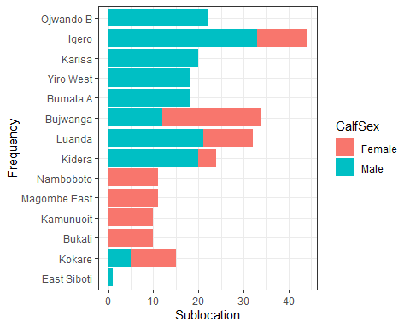
Now, let us say we wanted to know which calves were recruited in each sublocation, based on gender, and enable one to visualise that in the graphic.
We will first summarise our data based on how many calves were recruited in each village, based on gender.
calves_recruited1<- ideal%>% select(sublocation, CalfSex)%>% mutate(CalfSex=recode(CalfSex, "1"="Male", "2"="Female"))%>% group_by(sublocation, CalfSex)%>% dplyr::summarise(freq=n())
## `summarise()` has grouped output by 'sublocation'. You can override using the ## `.groups` argument.
# visualise the data using a bar graph ggplot(calves_recruited1, aes(x=reorder(sublocation,freq), y=freq, fill=CalfSex))+ # color the graph by sex geom_col()+ theme_bw()+ labs(x="Frequency", y="Sublocation")+ coord_flip() # flip our graph

Slide 8
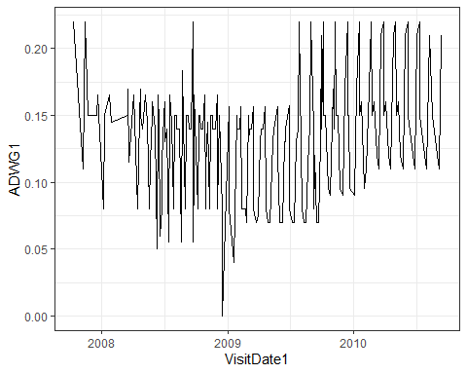
# Line graphs Like bar graphs, line graphs are also used to track changes over a time period. They can also be used to compare groups over time.
Line graphs require both x and y axis though both axis can only be a numeric variable (continuous or discrete) or a date.
To visualise this, we will use the visit date and calculate the average daily weight gain for the calves (using ADWG column).
# Survival by CalfSex - use color to add dimension of CalfSex ideal_data <- ideal %>% select(VisitDate1, ADWG)%>% group_by(VisitDate1)%>% mutate(ADWG1=mean(ADWG))%>% ungroup()%>% select(-ADWG)%>% distinct() ggplot(ideal_data, aes(x = VisitDate1, y=ADWG1)) + geom_line()+theme_bw() # customise the x and y axis labels

Slide 9
The graph has shown us the trend over time, but it is diffult for us to understand the trend in the daily weight gain. Also, we would want shorter breaks in our x axis. In the next step, we will introduce the geom_smooth() graph

Slide 10
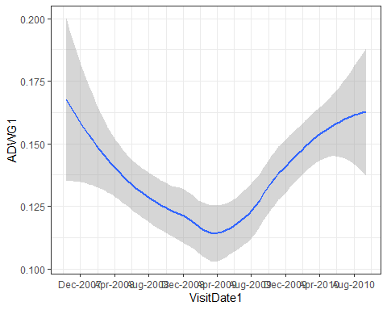
geom_smooth()
As the name suggests, this graph “smoothens” the patterns in your data to aid the eye in seeing patterns. It used the generalised additive model if the observations are more than 1000 and changes to the loess smoothing method if they are less than 1000.
ggplot(ideal_data, aes(x = VisitDate1, y=ADWG1)) + geom_smooth()+theme_bw()+ scale_x_date(date_breaks = "4 months", date_labels = "%b-%Y") # customise the x axis
## `geom_smooth()` using method = 'loess' and formula = 'y ~ x'

Slide 11
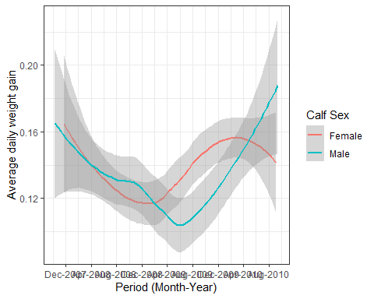
# customise the x and y axis labels We can now visualise the trend in the average weight gain of the calves. Similarly, we have customised the x axis to give us better date breaks and in an easy to read format. The grey ribbon represents the 95% confidence interval of the trend. You can change the smoothing of the graph by changing the span which is added in the geom_smooth().
In the above graph, try geom_smooth(span=0.2) and see how the visualisation of the graph changes.
Suppose we wanted to compare the average weight gain of the calves based on sex, we can do this by first getting the average weight per visit date and visualising this.
ideal_data1 <- ideal %>% select(VisitDate1, ADWG, CalfSex)%>% mutate(CalfSex=recode(CalfSex, "1"="Male", "2"="Female"))%>% group_by(VisitDate1, CalfSex)%>% mutate(ADWG1=mean(ADWG))%>% ungroup()%>% select(-ADWG)%>% distinct() ggplot(ideal_data1, aes(x = VisitDate1, y=ADWG1, color=CalfSex)) + geom_smooth()+theme_bw()+ scale_x_date(date_breaks = "4 months", date_labels = "%b-%Y")+ labs(x= "Period (Month-Year)", y="Average daily weight gain", color="Calf Sex")# color is used to change the title of the legend
## `geom_smooth()` using method = 'loess' and formula = 'y ~ x'

Slide 12
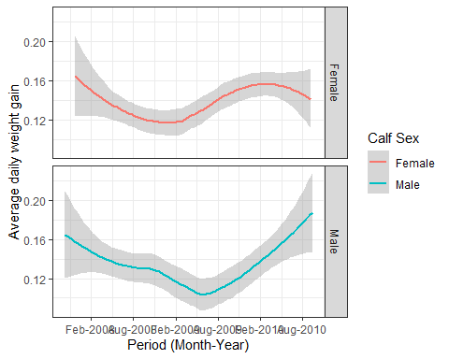
#Faceting Another interesting function in ggplot2 package is faceting which allows you to have two graphs in the same panel. If in the above graphic we wanted to have a separate line graph of male and female calves, we can use facet functions
##facet_grid()
It forms a matrix of panels defined by rows or columns.
ggplot(ideal_data1, aes(x = VisitDate1, y=ADWG1, color=CalfSex)) + geom_smooth()+theme_bw()+ scale_x_date(date_breaks = "6 months", date_labels = "%b-%Y")+ labs(x= "Period (Month-Year)", y="Average daily weight gain", color="Calf Sex")+facet_grid(rows=vars(CalfSex))
## `geom_smooth()` using method = 'loess' and formula = 'y ~ x'

Slide 13
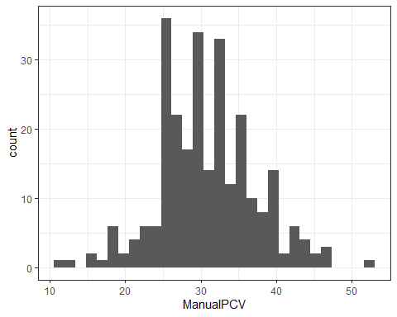
replace facet_grid with facet_wrap and see how your graph looks like
#Histograms Similar to bar graphs, they are used to show distribution of variables. They usually take one variable and calculate the frequency, before visualising. The variable should be continuous or discrete. ##5.1.3.1 geom_histogram We can visualise the packed cell volume of the calves (manualPCV column) in the ideal dataset.
ggplot(ideal, aes(ManualPCV)) + theme_bw() + geom_histogram()+ labs() # customize the x and y axis
## `stat_bin()` using `bins = 30`. Pick better value with `binwidth`.
## Warning: Removed 1 rows containing non-finite values (`stat_bin()`).

Slide 14
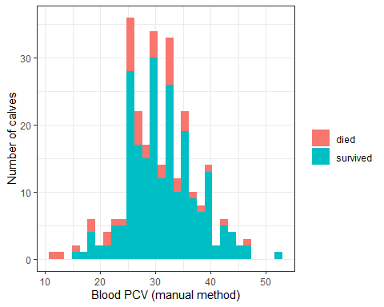
You can change the range of values in your histogram by adding the bins By default, geom_histogram sets bins of 30, but this can change when you specify. Try this in your graph above and see how the visualisation changes geom_histogram(bins=20)
We can even compare two variables in a histogram , as seen below
ggplot(ideal, aes(x = ManualPCV, fill=ReasonsLoss1)) + theme_bw() + geom_histogram() + labs(y = "Number of calves", x = "Blood PCV (manual method)", fill="")
## `stat_bin()` using `bins = 30`. Pick better value with `binwidth`.
## Warning: Removed 1 rows containing non-finite values (`stat_bin()`).

Slide 15
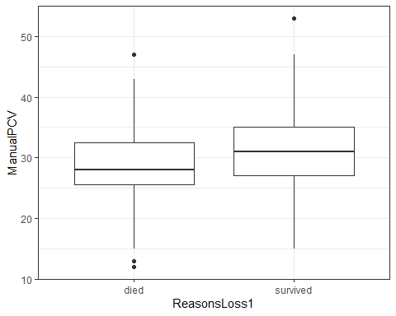
### Boxplots
Boxplots are often used in explanatory data analysis and aid in showing the shape of the distribution of the data, the central value and variability, while highlighting the outliers.
Source: visualoop.com
The image above explains the anatomy of a boxplot. Observations that are 1.5 times more or less than the interquartile range are termed as outliers. #geom_boxplots We use the geom_boxplot() function to visualise boxplots in ggplot2.
ggplot(ideal, aes(ReasonsLoss1, ManualPCV)) + theme_bw() + geom_boxplot()
## Warning: Removed 1 rows containing non-finite values (`stat_boxplot()`).

Slide 16
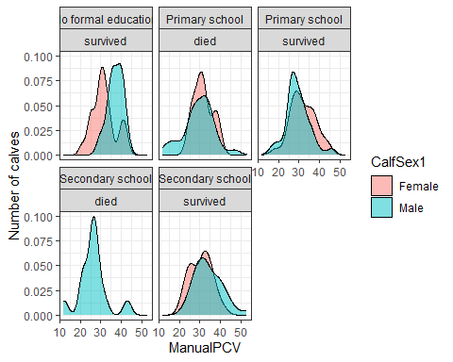
# Density plots These plots are used to observe the distribution of a variable. To visualise them, you require to input one variable, the x axis.
In our case, we will use the density plots to visualise the pack cell volume of the calves per sex.
We will also create an object called niceplot1 that containes the graphic.
ideal<- ideal%>% mutate(CalfSex1=recode(CalfSex, "1"="Male", "2"="Female")) niceplot1 <- ggplot(ideal, aes(x=ManualPCV, fill=CalfSex1)) + theme_bw() + #geom_histogram() + facet_wrap(Education~ReasonsLoss1) + geom_density(alpha = 0.5) + labs(y = "Number of calves", x = "ManualPCV") niceplot1 # object containing the graphic
## Warning: Removed 1 rows containing non-finite values (`stat_density()`).

Slide 17
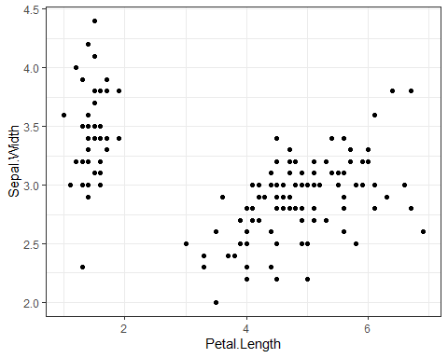
# Scatter plots These plots are used when one has two or more variables that pair well together.
To visualise scatter plots, we will sue the inbuilt dataset iris. You can type this on your console to learn more about this dataset ?iris
5.1.5.1 geom_point
data(iris) # import the data to your global environment ggplot(iris, aes(x = Petal.Length, y = Sepal.Width)) + geom_point()+theme_bw() # cusomtize your x and y axis

Slide 18
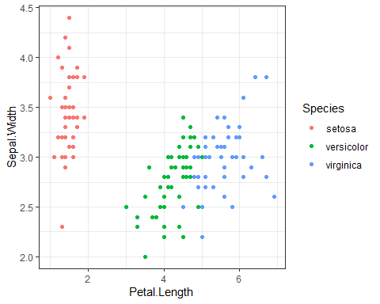
We can also add color to our scatter plot
ggplot(iris, aes(x = Petal.Length, y = Sepal.Width, colour = Species)) + geom_point()+theme_bw()

Slide 19
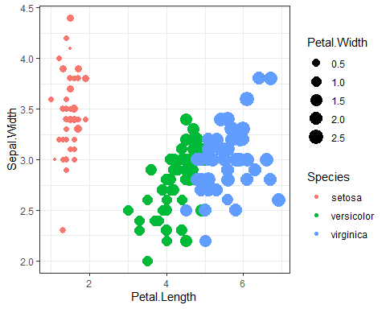
Or even change the size of the points
ggplot(iris, aes(x = Petal.Length, y = Sepal.Width, col = Species, size = Petal.Width)) + geom_point()+theme_bw()

Slide 20
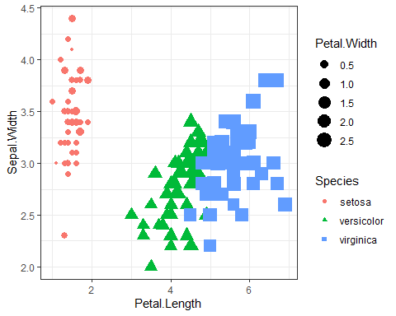
And the shape of the points
ggplot(iris, aes(x = Petal.Length, y = Sepal.Width, col = Species, size = Petal.Width, shape = Species)) + geom_point()+theme_bw()

Slide 21
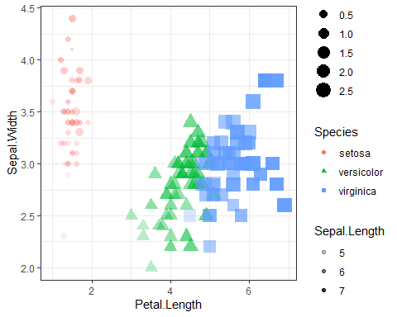
Or the color intensity
ggplot(iris, aes(x = Petal.Length, y = Sepal.Width, col = Species, size = Petal.Width, shape = Species, alpha = Sepal.Length)) + geom_point()+theme_bw()

Slide 22
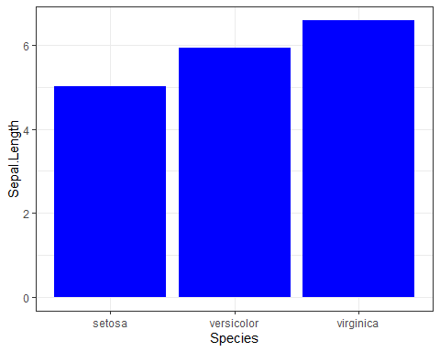
You can even add statics on your graphics, as seen in the graphs below
ggplot(iris, aes(Species, Sepal.Length)) + geom_bar(stat = "summary", fun.y = "mean", fill="blue")+theme_bw()
## Warning in geom_bar(stat = "summary", fun.y = "mean", fill = "blue"): Ignoring ## unknown parameters: `fun.y`
## No summary function supplied, defaulting to `mean_se()`

Slide 23
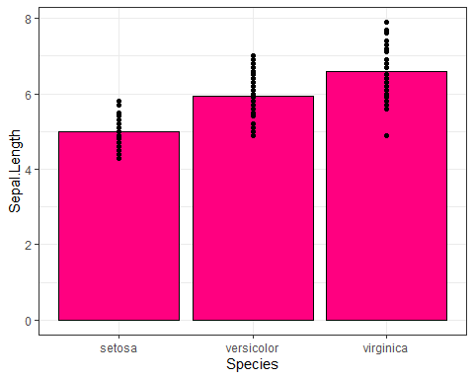
And even combine more than one visualisation
ggplot(iris, aes(Species, Sepal.Length)) + geom_bar(stat = "summary", fun.y = "mean", fill = "#ff0080", col = "black") + geom_point()+theme_bw()
## Warning in geom_bar(stat = "summary", fun.y = "mean", fill = "#ff0080", : ## Ignoring unknown parameters: `fun.y`
## No summary function supplied, defaulting to `mean_se()`

Slide 24
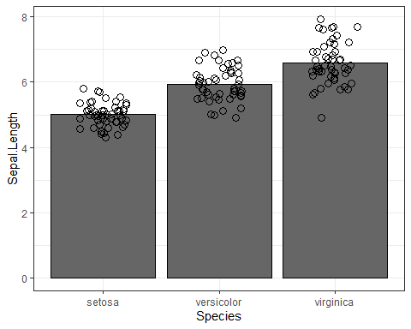
ggplot(iris, aes(Species, Sepal.Length)) + geom_bar(stat = "summary", fun.y = "mean", fill = "gray40", col = "black") + #geom_point() + geom_point(position = position_jitter(0.2), size = 3, shape = 21)+theme_bw()
## Warning in geom_bar(stat = "summary", fun.y = "mean", fill = "gray40", col = ## "black"): Ignoring unknown parameters: `fun.y`
## No summary function supplied, defaulting to `mean_se()`

Slide 25
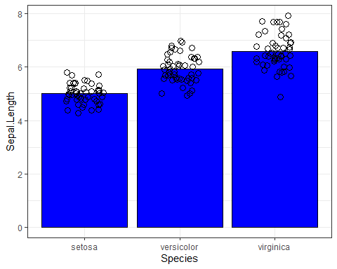
#More graphic customization ggplot2 package gives the user the power to customise the graphics to their own liking. This is especially where one would like to change the position of the legend, the size of the text, bolding the text etc.
The theme() function has alot of capability and I would urge you to go to your console and type ?theme to see how much power you have in your hands.
We can try to first change the color of the background of out graphics and the size of the panel border.
niceplot <- ggplot(iris, aes(Species, Sepal.Length)) + geom_bar(stat = "summary", fun.y = "mean", fill = "blue", col = "black") + geom_point(position = position_jitter(0.2), size = 3, shape = 21)+theme_bw()
## Warning in geom_bar(stat = "summary", fun.y = "mean", fill = "blue", col = ## "black"): Ignoring unknown parameters: `fun.y`
niceplot
## No summary function supplied, defaulting to `mean_se()`

Slide 26
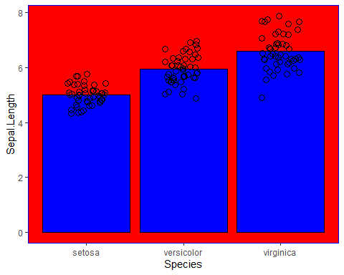
niceplot + theme(panel.grid = element_blank(), panel.background = element_rect(fill = "red"), panel.border = element_rect(colour = "blue", fill = NA, size = 0.2))
## Warning: The `size` argument of `element_rect()` is deprecated as of ggplot2 3.4.0. ## ℹ Please use the `linewidth` argument instead. ## This warning is displayed once every 8 hours. ## Call `lifecycle::last_lifecycle_warnings()` to see where this warning was ## generated.
## No summary function supplied, defaulting to `mean_se()`

Slide 27
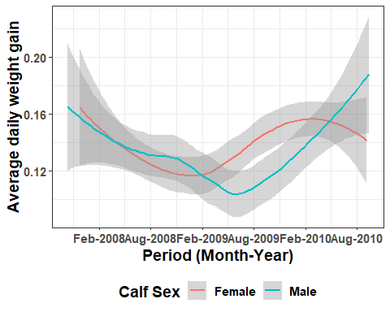
We can also try and increase the font size of the text and bold them.
ggplot(ideal_data1, aes(x = VisitDate1, y=ADWG1, color=CalfSex)) + geom_smooth()+theme_bw()+ scale_x_date(date_breaks = "6 months", date_labels = "%b-%Y")+ labs(x= "Period (Month-Year)", y="Average daily weight gain", color="Calf Sex")+ theme(text=element_text(size=14, face="bold"))+ # increase the font and bold the text theme(legend.position = "bottom")
## `geom_smooth()` using method = 'loess' and formula = 'y ~ x'

Slide 28
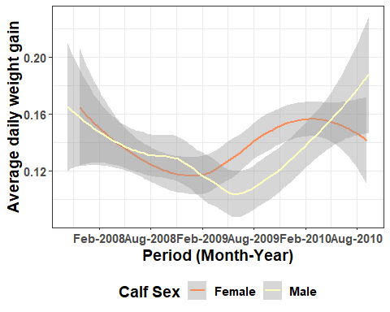
# Color customisation in graphics If you look at the graphics above, we have been using the primary colors, as R understands them. However, you may be bold and want to explore more color options. R understands colors in hexagon format and you can use this website called !https://colorbrewer2.org/#type=sequential&scheme=BuGn&n=3 that helps you get the hexagon value of a color while enabling you choose color schemes that are colorblind safe, printer friendly or photocopy safe. These colors are also supported in R and we will try to use them in the visualisation below.
We will use the graph above and change the colors. To see the different color palettes, type this in your console ?scale_color_brewer() or ?scale_fill_brewer()
ggplot(ideal_data1, aes(x = VisitDate1, y=ADWG1, color=CalfSex)) + geom_smooth()+theme_bw()+ scale_x_date(date_breaks = "6 months", date_labels = "%b-%Y")+ labs(x= "Period (Month-Year)", y="Average daily weight gain", color="Calf Sex")+ theme(text=element_text(size=14, face="bold"))+ theme(legend.position = "bottom")+ scale_color_brewer(palette="RdYlBu")
## `geom_smooth()` using method = 'loess' and formula = 'y ~ x'

Slide 29
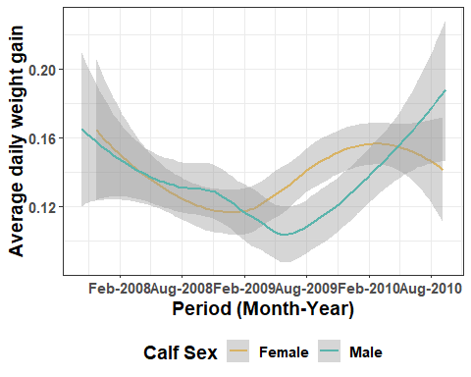
If you want to add your own colors, yoi can do that manually using the function scale_color_manual() or scale_fill_manual()
ggplot(ideal_data1, aes(x = VisitDate1, y=ADWG1, color=CalfSex)) + geom_smooth()+theme_bw()+ scale_x_date(date_breaks = "6 months", date_labels = "%b-%Y")+ labs(x= "Period (Month-Year)", y="Average daily weight gain", color="Calf Sex")+ theme(text=element_text(size=14, face="bold"))+ theme(legend.position = "bottom")+ scale_color_manual(values=c("#d8b365", "#5ab4ac"))
## `geom_smooth()` using method = 'loess' and formula = 'y ~ x'

