Slide 1
Chapter 7
Structured Query Language (SQL)
Database Systems: Design, Implementation, and Management
7th Edition
Peter Rob & Carlos Coronel

Slide 2
SQL
Standardized
Data Manipulation and Data Definition
Can be embedded into general programming languages
Statements specify what is to be done, NOT how to do it
Notes:
- Standardized (ANSI,ISO) - Its standardization is possibly one of the biggest reasons for the success of relational databases (standards - SQL2 or SQL-92, and SQL3 or SQL 99 with OO concepts)
It is commercial, practical, not theoretical - supported by many different DBMSs - it provides all of the capabilities of Relational Algebra - plus (takes ideas from relational algebra, (tuple) relational calculus, plus practical needs)
My emphasis here is on the key features of SQL; it is a big language - whole books have been written about it (personally I probably have 50 pages of notes that I could use)
- provides BOTH Data Manipulation (insert, update, delete and retrieve data) and Data Definition (create tables and other items) . Can also define views, specifying security, define integrity constraints
- Can be embedded into general programming languages like C, COBOL, Pascal, PL/I,Ada,Fortran ...
- Statements specify what is to be done, NOT how to do it (no detailed step-by-step procedure – “nonprocedural”) - thus it can be considered a 4GL - and can be easier to write code (and write it more quickly)

Slide 3
DML - Retrieval
SELECT statement - can do MANY different things
  List whole table
  SELECT * FROM STUDENT
  Relational Algebra PROJECT
    SELECT StdID,LNAME,FNAME
    FROM STUDENT
    Unlike RA, duplicates aren’t (automatically) removed. E.g.
    SELECT MAJOR
    FROM STUDENT
    If we want duplicates removed, specify DISTINCT after SELECT SELECT DISTINCT MAJOR
    FROM STUDENT
Notes:
Skip defining schema and database and tables - organization of db
(e.g. CREATE SCHEMA university AUTHORIZATION redmond; )
– to get first to more interesting data manipulation (section 6.3)
Retrieval is done using SELECT statement
(BTW, SQL is not case sensitive)
(in section 6.6.2 “listing unique values”)

Slide 4
DML - RESTRICT
Relational Algebra RESTRICT/SELECT
  e.g. list all students who are freshmen
    SELECT *
    FROM STUDENT
    WHERE YEAR = ‘Fr’
PROJECT and RESTRICT together
    SELECT StdID,LNAME,FNAME
    FROM STUDENT
    WHERE YEAR = ‘Fr’
Notes:
-
- NOTE - in SQL, there is no specifying whether this is a restriction of a projection, or a projection of a restriction - there is less emphasis on order/procedure. The DBMS figures out the best/most efficient way to carry out the query

Slide 5
More Retrieval
WHERE condition can be as complicated as you need it to be. E.g. freshmen with poor grades
    SELECT StdID,LNAME,FNAME
    FROM STUDENT
    WHERE YEAR = ‘Fr’ AND GPA < 2.5
Notes:
… can use < <= > >= <> (or != in some DBs), AND, OR, NOT
“arbitrarily complex” – make as complex combination as you like
(can even use < etc on character attributes – alphabetical)

Slide 6
Ordering
With a little extra complexity, we can get our output in order by some particular attribute(s) E.g. order students by major
    SELECT StdID,LNAME,FNAME, MAJOR
    FROM STUDENT
    ORDER BY MAJOR DESC
Notes:
Results of any query can be ordered (section 6.6 “advanced select queries” (6.6.1))
DESC stands for descending
ASC (ascending) is the default
ONLY changes the order of display of output – the actual table is unchanged !!!
Can list multiple attributes e.g.
ORDER BY MAJOR,LNAME,FNAME
ordered first by major, then within a major, ordered by last name. If anybody with the same lname and major, they are ordered by first name
(ORDER BY has to be the last clause in the SELECT statement)

Slide 7
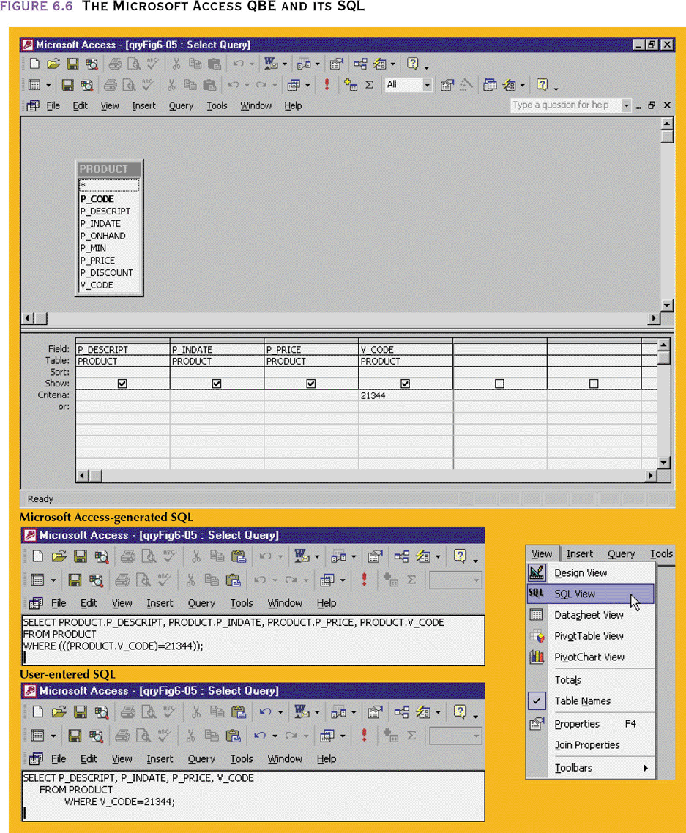
The Microsoft Access QBE and its SQL
Notes:
Access uses its own slightly different SQL – isn’t it just like Microsoft to ignore standards

Slide 8
Joining Tables
As you know, an important task with relational databases is relating info from more than one table (for instance, natural join in RA) E.g. show all students with the class indices of enrollments
    SELECT StudID,LNAME,FNAME, INDEX
    FROM STUDENT, ENROLLMENTS
    WHERE StudID = Enrollments.Student
Notes:
(book has in section 6.8 – way late!!!)
Here, FROM lists two tables, info will be combined from both
WITHOUT A WHERE condition checking for matching FK with PK (StudID = Enrollments.Student), this would be a CARTESIAN PRODUCT!!! - all possible combinations between the two tables.
(BTW, this isn’t exactly a natural join - it is a projection of a natural join - some attributes are not included
(again, in SQL, there is no step-by-step, just specify WHAT you want)
BTW, here, to be careful I specified tablename.attributename (Enrollments.Student ) – this is to avoid ambiguity. I think I would have gotten away without it, since a attributename is expected in that place. However, sometimes there are attributes with the same name in both tables, - they can be disambiguated by specifying tablename.attributename (e.g. STUDENT.StdID). This can also always be done anyway for clarity
SELECT STUDENT. StdID, STUDENT. LNAME, STUDENT. FNAME, ENROLLMENTS. INDEX
FROM STUDENT, ENROLLMENTS
WHERE STUDENT. StdID= ENROLLMENTS. Student
(particularly useful for WHERE condition)
if you want all fields from a table, you can use * e.g
SELECT STUDENT.*, ENROLLMENTS. INDEX

Slide 9
Restrict with Join
Sometimes you don’t want the entire join - you might want to restrict the results (sometimes called select-project-join) E.g. show all students enrolled in a particular section
    SELECT StdID,LNAME,FNAME
    FROM STUDENT, ENROLLMENTS
    WHERE STUDENT. StdID = ENROLLMENTS.Student
    AND ENROLLMENTS.INDEX = 70238
Notes:
Here, we left off the classindex on the SELECT part since all results will have the same value
and we added another condition to the WHERE
THAT IS ALL. This is powerful
(could use ORDER BY here (as well as anywhere else)

Slide 10
Multi-way Join
We can join more than two tables together (which is a good thing; joining students with enrollments was a little unsatisfying because we didn’t see any info about the section. Let’s show all students with the section info for sections they enrolled in
    SELECT STUDENT.*, SECTION.*
    FROM STUDENT, ENROLLMENTS, SECTION
    WHERE STUDENT.StdID = ENROLLMENTS.Student
    AND ENROLLMENTS.INDEX = SECTION.INDEX
Notes:
Here, FROM lists three tables, info will be combined from all three
In joining 3 tables, need two join conditions in WHERE

Slide 11
Alias
Alternate name (for a table)
SELECT STUDENT.*, SECTION.*
FROM STUDENT A, ENROLLMENTS B, SECTION C
WHERE A.StdID = B.student AND B.index = C.index;
Here A,B, and C are aliases
Used as a convenience, not necessary
Notes:
(necessary for queries involving recursive relationships – refer to each version
// find manager info for a particular employee – made up attributes – don’t have this table available
SELECT B.empID, B.last, B.first
FROM EMPLOYEE A, EMPLOYEE B
WHERE A.empID = B.mgr
AND A.empID = ‘1111’;

Slide 12
Queries
Special Operators
  BETWEEN - used to define range limits.
  IS NULL - used to check whether an attribute value is null
  LIKE - used to check for similar character strings.
  IN - used to check whether an attribute value matches a value contained within a (sub)set of listed values.
  EXISTS - used to check whether an attribute has a value. In effect, EXISTS is the opposite of IS NULL.
    Can also be used to check if a subquery returns any rows
Notes:
31
<discussed in upcoming slides>

Slide 13
Queries
Special Operators
BETWEEN is used to define range limits.
  SELECT *
  FROM STUDENT
  WHERE GPA BETWEEN 2.0 AND 2.1;
Notes:
31
… to receive a friendly warning note
… slightly easier than what you’re used to if you’ve used most 3GLs

Slide 14
Queries
Special Operators
  IS NULL is used to check whether an attribute value is null.
  SELECT INDEX, DEPT, CLASS, TIME
  FROM SECTION
  WHERE ROOM IS NULL;
Notes:
32
.. For trying to deal with room scheduling problems

Slide 15
Queries
Special Operators
  LIKE is used to check for similar character strings.
  SELECT * FROM CATALOG_CLASS
  WHERE TITLE LIKE ‘%Lang%’;
  % stands for 0 or more char wildcard
  _ stands for a one char wildcard
  e.g. WHERE TITLE LIKE ‘%Network%’ finds classes whose title includes the substring ‘Network’
  NOTE: While SQL commands are not case-sensitive, SQL strings are
Notes:
33
… looking for a class about computer languages but don’t know the exact title
Oracle – to avoid getting messed up by mismatching case – can do
WHERE UPPER(TITLE) LIKE ‘%NETWORK%’
Where UPPER converts (in memory, not disk) the attribute to upper case so we know we can match against all upper case

Slide 16
Queries
Special Operators
  IN is used to check whether an attribute value matches a value contained within a (sub)set of listed values.
  SELECT * FROM ENROLLMENT
  WHERE INDEX IN (66415, 66421);
  EXISTS is used to check whether an attribute has value.
  SELECT * FROM SECTIONs
  WHERE PROFESSOR EXISTS;
Notes:
35
… get enrollments for particular sections – maybe a schedule conflict to be resolved?
(class indexes would be in single quotes if that is a char attribute)
IN Frequently used with subqueries
… get sections where the professor is known

Slide 17
Queries
- Can do computation
e.g. SELECT SECTION.*,stop - enroll
FROM SECTION
gives for all sections, the number of remaining seats
E.g. SELECT room.*, capacity / NumbStudentWorkstations AS StdPerComp
FROM room
Gives number of students per computer in the rooms
Usual mathematical operators ➔ + - * / ^
Notes:
… uses alias so you have a label for the calculation – and can use it elsewhere (e.g. order by)
* is multiplication ^ is raised to the power

Slide 18
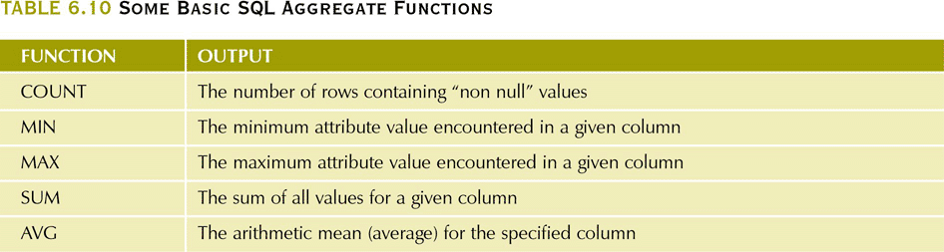
Some SQL Numeric Aggregate Functions
Some Basic SQL Numeric Functions
Notes:
53
We can also get summary data as a result of a query (Section 6.6.3)
(everything we have done so far has returned a regular table, many of the following produce a degenerate table - 1 row, 1 column)
Some aggregates: COUNT, SUM, MAX, MIN, AVG
… examples to follow

Slide 19
Aggregate Functions - AVG
e.g. find ave GPA for all students
  SELECT AVG(GPA)
  FROM STUDENT
What is the average GPA of all freshmen
SELECT AVG(GPA)
  FROM STUDENT
  WHERE YEAR = ‘Fr’
Notes:
NOTE that if we want the average of distinct values (probably not), we could
SELECT AVG (DISTINCT GPA) ...
sum,max, and min are like avg
SELECT MAX(GPA)
FROM STUDENT
WHERE Major = ‘CS’;
SELECT MIN (enroll)
FROM SECTIONS
WHERE Dept = ‘CS’;
SELECT SUM(enroll)
FROM SECTIONS
WHERE Dept = ‘CS’;
- but count acts a little different …

Slide 20
COUNT
How many sections are offered
  SELECT COUNT(*)
  FROM SECTION
How many computer science majors are there?
  SELECT COUNT(*)
  FROM STUDENT
  WHERE MAJOR = ‘CS’
How many distinct classes are being offered
SELECT COUNT(DISTINCT DEPT,CLASS)
  FROM SECTION
Notes:
COUNT(*) counts the rows
COUNT(DISTINCT attribute(s) ) counts the number of distinct values for the attribute(s) - with two here, we are getting the distinct dept,class combinations
(if we leave off the DISTINCT, and there are no NULL values in the data, then we get the same result as COUNT(*) because duplicate values will not be eliminated, so the number of values = the number of tuples)

Slide 21
Group By - Subtotals
Total Enrollments by Dept
  SELECT DEPT, SUM(enroll)
  FROM SECTION
  GROUP BY DEPT
Notes:
Section 6.6.4
Sometimes, what we really want are sub-totals. E.g. instead of total enrollments for all classes, we might want total enrollments for each dept - (useful for deans in judging depts) - we do this by grouping tuples by attribute(s) (grouping attribute(s))
- this query gives results such as
DEPT
CS 1098
Bio 817
Eng 1356
…
NOTE - the items in the SELECT clause must have a single value per group, otherwise the result would have a repeating group. Here - the group is dept. All records with a given dept will have the same dept - so that is a single value. And the SUM(enroll) is going to get a single sum of enrollments for each dept. (SELECT clause would normally be filled with aggregate functions like SUM,AVG,MIN etc)
(you could ORDER BY DEPT )
(To see how this works you could think of the DBMS sorting the tuples by the group by attribute(s), and then doing the calculation on each grouped section of the table (however, the DBMS is free to do it however it wants to))
SELECT year, SUM(balanceDue)
FROM Students
GROUP BY year

Slide 22
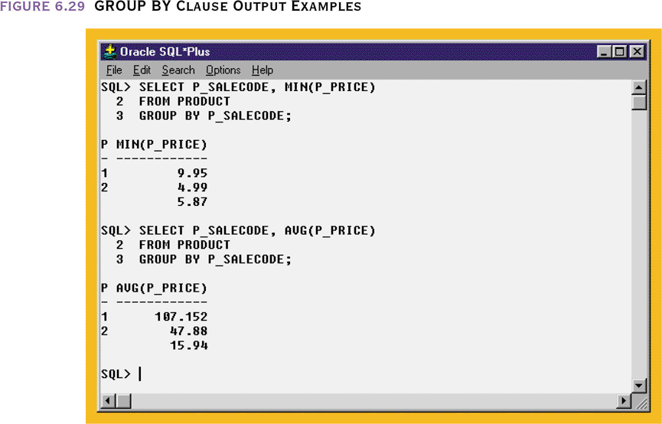
Grouping Data
  GROUP BY
Notes:
58
<maybe skip>

Slide 23
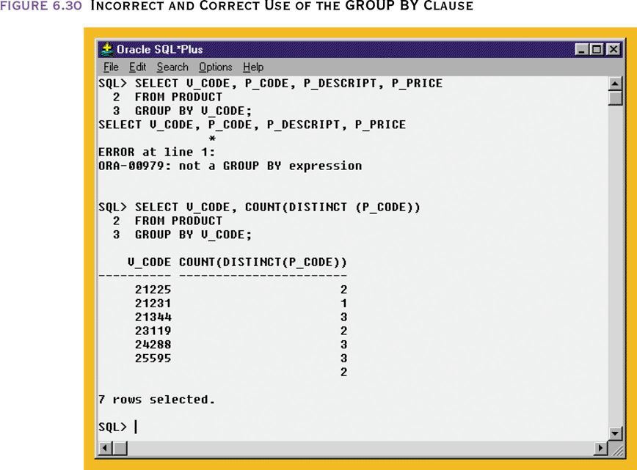
Improper Use of the GROUP BY Clause
Notes:
57
VERY common mistake

Slide 24
Having
Total Enrollments by Dept for depts offering more than 10 sections
  SELECT DEPT, SUM(enroll)
  FROM SECTION
  GROUP BY DEPT
  HAVING COUNT(*) > 10
Average Evening Enrollments by Depts with low ave enrollment
  SELECT DEPT, AVG(enroll)
  FROM SECTION
  WHERE Sect >= 40
  GROUP BY DEPT
  HAVING AVG(enroll) < 15
Notes:
<My Oracle DB doesn’t have enroll attribute, so if working in Oracle, skip this and do next>
Sometimes, we might want info on groups, but only certain groups. For instance - lets see total enrollments for depts - but lets only look at depts offering more than 10 sections)
-
HAVING clause limits the groups being considered (just as the WHERE clause limits regular tuples being considered). The expression should produce a single value per group in order for the expression to filter groups.
- WHERE clause does its job before HAVING
e.g Average Evening Enrollments by Depts with low ave enrollment
SELECT DEPT, AVG(enroll)
FROM SECTION
WHERE Sect >= 40
GROUP BY DEPT
HAVING AVG(enroll) < 15
here - we’re using section # >= 40 to indicate evening classes (at LaSalle, it would be an alpha section (a little harder to do, but I think we could do it). All non-evening sections are tossed out first. Then the sections are grouped by dept and avg enrollment calculated. Any depts that don’t have a low ave enrollment are then tossed by the HAVING clause. The remaining ones are displayed. The DBMS can actually do this any way it wants, but the effect has to be of the WHERE clause having impact before the HAVING

Slide 25
Having
Total Enrollments by Dept for depts offering more than 10 sections
  SELECT DEPT, SUM(credits)
  FROM CATALOGCOURSE
  GROUP BY DEPT
  HAVING COUNT(*) > 10
Average Highest Enrollment (capacity) for upper division courses by Depts – for depts with many upper division sections
  SELECT DEPT, AVG(MaxEnroll)
  FROM SECTIONS
  WHERE Course >= 200
  GROUP BY DEPT
  HAVING COUNT(*) >= 10
Notes:
Sometimes, we might want info on groups, but only certain groups. For instance - lets see total credits listed in the catalog for depts - but lets only look at depts offering more than 10 courses)
-
HAVING clause limits the groups being considered (just as the WHERE clause limits regular tuples being considered). The expression should produce a single value per group in order for the expression to filter groups.
- WHERE clause does its job before HAVING
here - we’re using course # >= 200 to indicate upper division classes. All non-upper-division sections are tossed out first by the WHERE. Then the sections are grouped by dept and number of sections (COUNT) calculated. Any depts that don’t have 10 upper division courses are then tossed by the HAVING clause. The remaining ones are displayed. The DBMS can actually do this any way it wants, but the effect has to be of the WHERE clause having impact before the HAVING

Slide 26
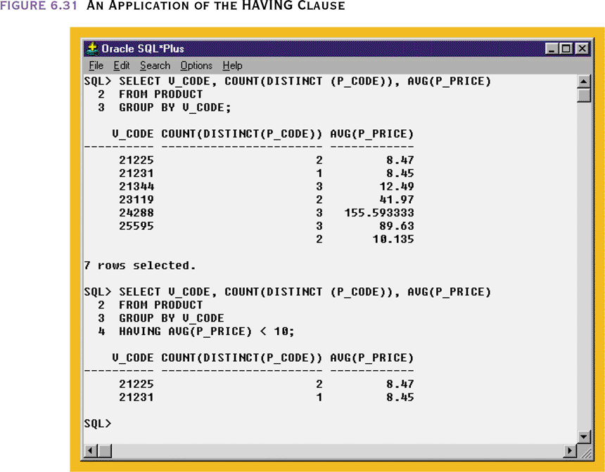
An Application of the HAVING Clause
Notes:
57
<SKIP>
First part here – shows vendors, the number of products we buy from them and the average prices
The second one adds a having clause – limiting the results to only those vendors whose ave price is below $10

Slide 27
Nested Queries
Sometimes the result of one query can be used in another query - thus we can have nested queries
e.g. find students whose GPA is above average
  SELECT *
  FROM STUDENT
  WHERE GPA > ( SELECT AVG(GPA)
  FROM STUDENT )
Notes:
<Section 7.3>
Here - the outer query depends on the inner query getting a result - and then the result is used in the outer query
other e.g.s Find student with the highest GPA

Slide 28
Nested Queries
If is fairly common for a nested query to use the set operation IN - which tests whether a value is a member of a set of values. So for instance, suppose we want to know all sections in which there are any freshman
  SELECT DISTINCT CLASSINDEX
  FROM ENROLLMENTS
  WHERE STDSSN IN ( SELECT SSN
  FROM STUDENT
  WHERE YEAR = ‘Fr’ )
Notes:
Here - the inner query finds ssns of all freshmen. The outer query uses that result on each enrollment tuple to see if the enrollment is of a freshman.
(lastly, since duplicates are eliminated (DISTINCT) each class index with a freshman enrolled will only be listed once)
(Nested queries using IN can also be expressed as a join query
e.g.
SELECT DISTINCT CLASSINDEX
FROM STUDENT,ENROLLMENTS
WHERE ENROLLMENTS.STDSSN = STUDENT.SSN AND STUDENT.YEAR = ‘Fr’

Slide 29
Left Outer Join
SELECT P_CODE, VENDOR.V_CODE, V_NAME
FROM VENDOR LEFT JOIN PRODUCT ON VENDOR.V_CODE = PRODUCT.V_CODE

Slide 30
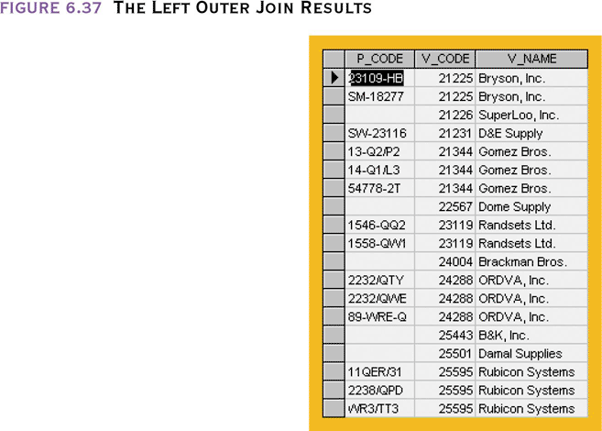
The Left Outer Join Results

Slide 31
Right Outer Join
SELECT PRODUCT.P_CODE, VENDOR.V_CODE, V_NAME
FROM VENDOR RIGHT JOIN PRODUCT ON VENDOR.V_CODE = PRODUCT.V_CODE

Slide 32
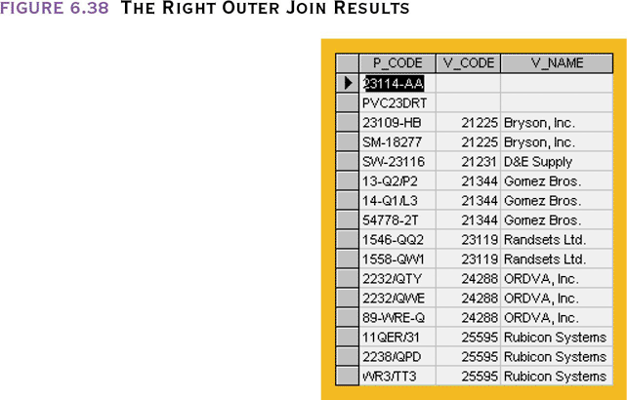
The Right Outer Join Results

Slide 33
End Queries – Next - Updates

