Slide 1
When and where to sell historic homes in King County
Seán Healy
13.11.2026

Slide 2

Client Overview - Zachary Brooks
Type: Seller
Characteristics: Invests in historical houses, best neighborhoods, high profits, best timing within a year, should renovate?
Business Question: Where can the client sell older houses in good neighbourhoods for large returns, and when should they sell?
Secondary Question: Are older houses worth renovating?

Slide 3

What was tested
Older houses sell for less than new ones
and
certain zip codes have much higher prices than others.
Renovated houses sell for more.
Prices are higher in spring than in winter

Slide 4
The Data
Approximately 21,600 house sales cross 70 zip codes in King County from May 2014 to May 2015, with prices ranging from $ 78k all the way up to $ 7.7M
Key Definitions for the client
Older house: built before 1940 (pre-war housing stock).
Price per sqft (ppsf): sale price ÷ living area, used to compare houses of different sizes fairly.
Good neighbourhood: a zip code in the top quartile of median price per sqft.
Major Limitation of the data
Only sale prices, no purchase prices or renovations costs, so price is the stand-in for profit.

Slide 5
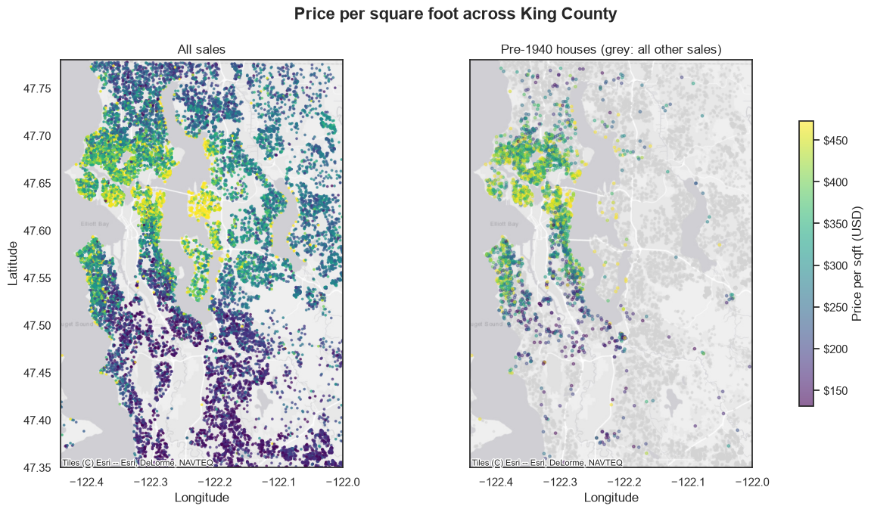
Older homes cluster primarily northern and central Seattle, with the most expensive of those found in the centre and on the western shore of Lake Washington.

Slide 6
+9% per sq ft
How much pre-1940 homes sell for compared to newer homes in the same area

Slide 7
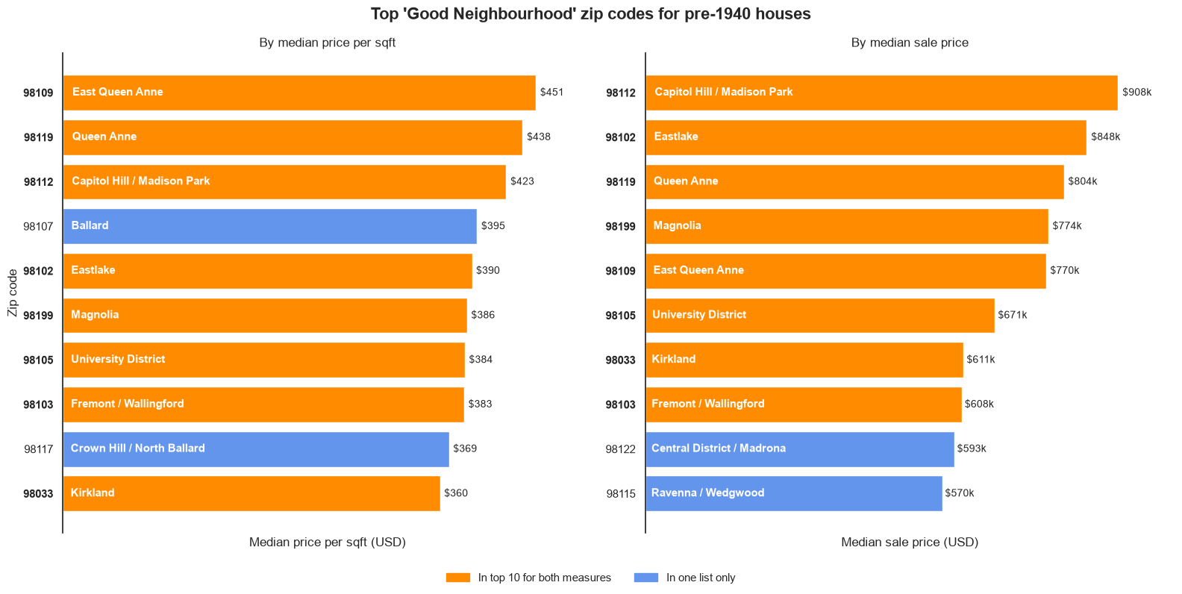
Where to sell: Eight zip codes are top in both price per sq ft and total sale price and should be the client’s focus.

Slide 8

+10.2%
How much more recently renovated houses sell for compared to unrenovated houses.
Where renovation costs are less than 10% of the expected sale price, renovation is recommended.
3.

Slide 9
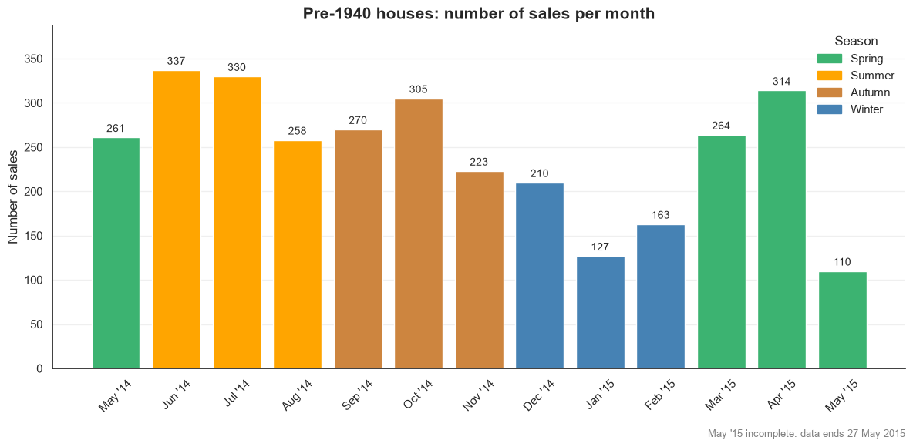
When to sell: Spring and early summer bring twice as many buyers as winter. This also coincides with higher prices which is partly due to a rising market

Slide 10
Outcomes of what was tested
Older houses sell for less than new ones
and
certain zip codes have much higher prices than others.
Renovated houses sell for more.
Prices are higher in spring than in winter
(low confidence)

Slide 11
Recommendations
Sell in the top 8 zip codes.
Renovate, if it costs under 10%.
List in spring or early summer.

