Slide 1


SIDDHARTHA
INSTITUTE OF ENGINEERING AND TECHNOLOGY
(Approved by AICTE, Accredited by NBA & NAAC A+ affiliated To JNTU, Hyderabad)
Vinobha nagar (V), Ibrahimpatnam (M), R. R. Dist. 501506.
DEPRESSION DETECTION FROM TEXT, IMAGE AND SPEECH USING DEEP LEARNING ALGORITHMS
PRESENTED BY
SHENIGARAPU ANUSRI - 21TP1A6745
KODAM SUPRIYA - 21TP1A6726
RONTE VISHNU - 21TP1A6740
KANNEKANTI UDWIKA - 21TP1A6752
BYAGARI VYSHNAVI - 21TP1A6708
UNDER THE GUIDANCE OF
MRS.SAKSHI SHUKLA
BTech, MTech(PH.D)

Slide 2

ABSTRACT
INTRODUCTION
OBJECTIVE
EXISTING SYSTEM
PROPOSED SYSTEM
SYSTEM REQUIREMENTS
SYSTEM ARCHITECTURE
SYSTEM DESIGN
IMPLEMENTATION
TESTING
OUTPUT SCREENSHOTS
CONCLUSION
FUTURE ENHANCEMENT
REFERENCES
CONTENTS

Slide 3

ABSTRACT
Depression is a prevalent sickness, spreading worldwide with potentially serious implications. Timely recognition of emotional responses plays a pivotal function at present, with the profound expansion of social media and users of the internet. Mental illnesses are highly hazardous, stirring more than three hundred million people. Moreover, that is why research is focused on this subject. With the advancements of machine learning and the availability of sample data relevant to depression, there is the possibility of developing an early depression diagnostic system, which is key to lessening the number of afflicted individuals.

Slide 4
INTRODUCTION
Depression is a risk indicator of Dementia. People suffering from Dementia tend to notice a decline in their cognitive abilities such as thinking and remembering. Depression is one of the major causes of mental disorder, or incapability. Early recognition and treatment of depressive symptoms can significantly improve the chances of controlling the disease of depression and minimize the negative impact of depression on the well-being, health and the social–economic life of a person. Artificial Intelligence (AI)- and Natural language Processing (NLP)-based processing techniques help machine learning identify depression from sentiments or emotions. Among the different approaches, machine learning has been widely utilized to examine humans’ physical and mental conditions from various data sources.

Slide 5
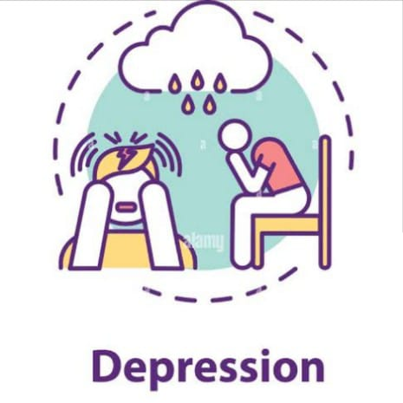
OBJECTIVE
The aim of depression detection using text, speech, and image analysis with deep learning algorithms is to develop a more accurate, efficient, and accessible system identifying individuals who may be experiencing depression.

Slide 6
EXISTING SYSTEM:
In the past many algorithms were introduced to predict depression but all those algorithms were working on single data format like Text, Face or speech but not all. Main intention of developing this application to detect user depression from all formats as humans are very sensitive and caring and will not show is depression to closed family member in order to avoid giving tension to them but often their depression can be identify either from face or his social media comments or in his speech. So we can detect depression in humans in all 3 multimodal format.
DISADVANTAGE:
Accuracy Less
More Time Taking

Slide 7
PROPOSED SYSTEM
In propose work we deployed advanced deep learning algorithm called Convolution Neural Network (CNN2D) to detect depression from faces and voices. CNN consider best to classify data from images and speech. To identify depression from TEXT we employ Random Forest algorithm as in ML Random Forest is most accurate compare to other algorithms.
ADVANTAGE:
Accuracy more.
Less Time Taking.

Slide 8

SYSTEM REQUIREMENTS
HARDWARE REQUIREMENTS:
Processor - Intel i3 (min)
Speed - 1.1 GHz
RAM - 4GB(min)
Hard Disk - 500 GB
SOFTWARE REQUIREMENTS:
Operating System - Windows 10(min)
Programming Language - Python

Slide 9
SYSTEM ARCHITECTURE
Start
Upload Depression Dataset
Pre-process Dataset
Train Facial Depression CNN Algorithm
Train Speech Depression CNN Algorithm
Train Text Depression Random Forest Algorithm
Accuracy Comparison Graph
Predict Facial Depression
Predict Speech Depression
Predict Text Depression
End

Slide 10
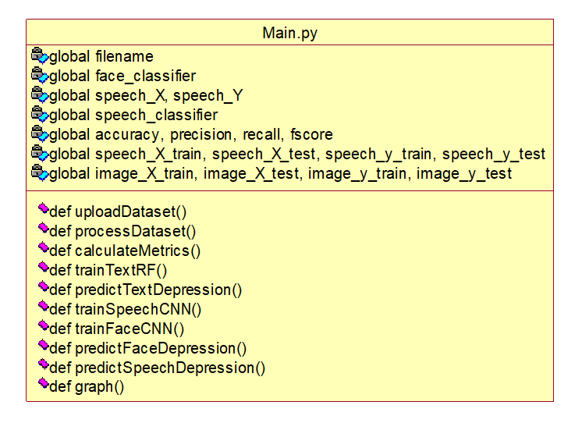
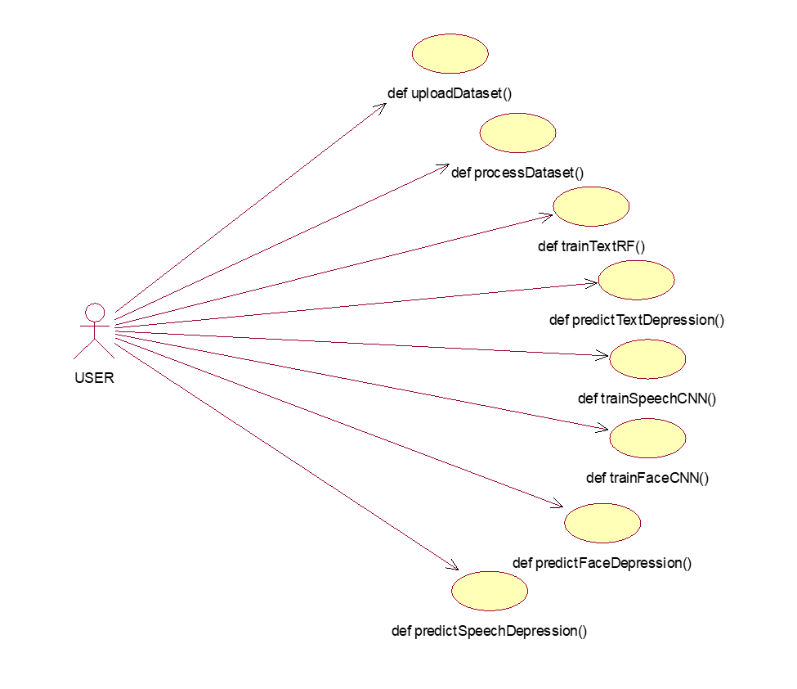
SYSTEM DESIGN
Class Diagram Use Case Diagram

Slide 11
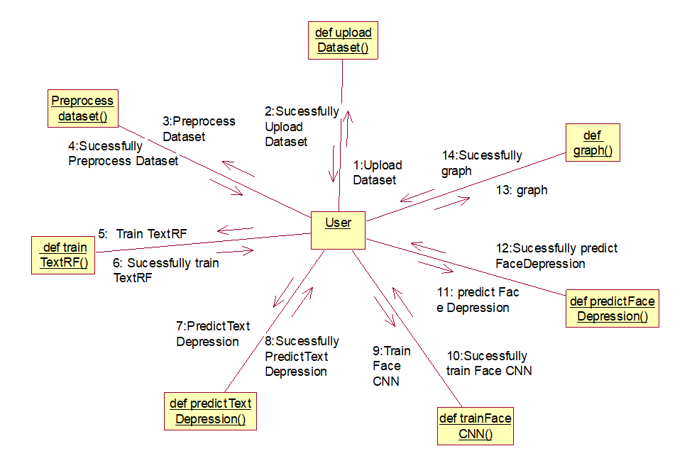
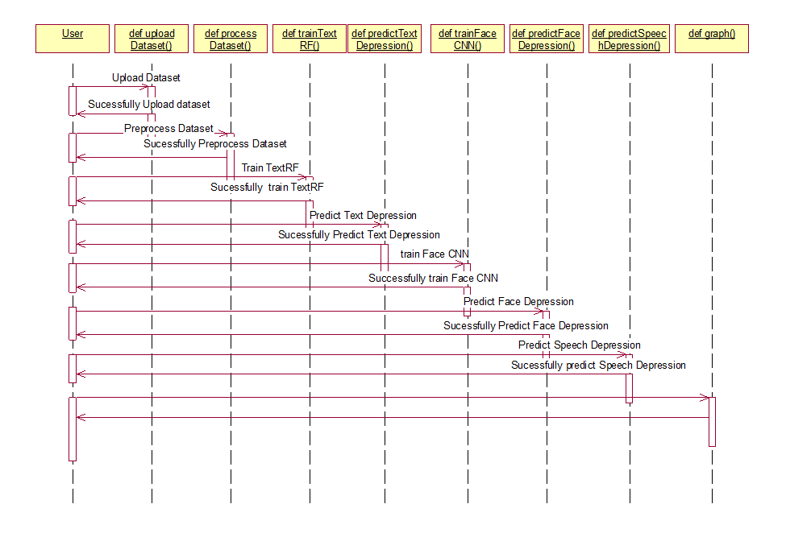
Sequence Diagram Collaboration Diagram

Slide 12
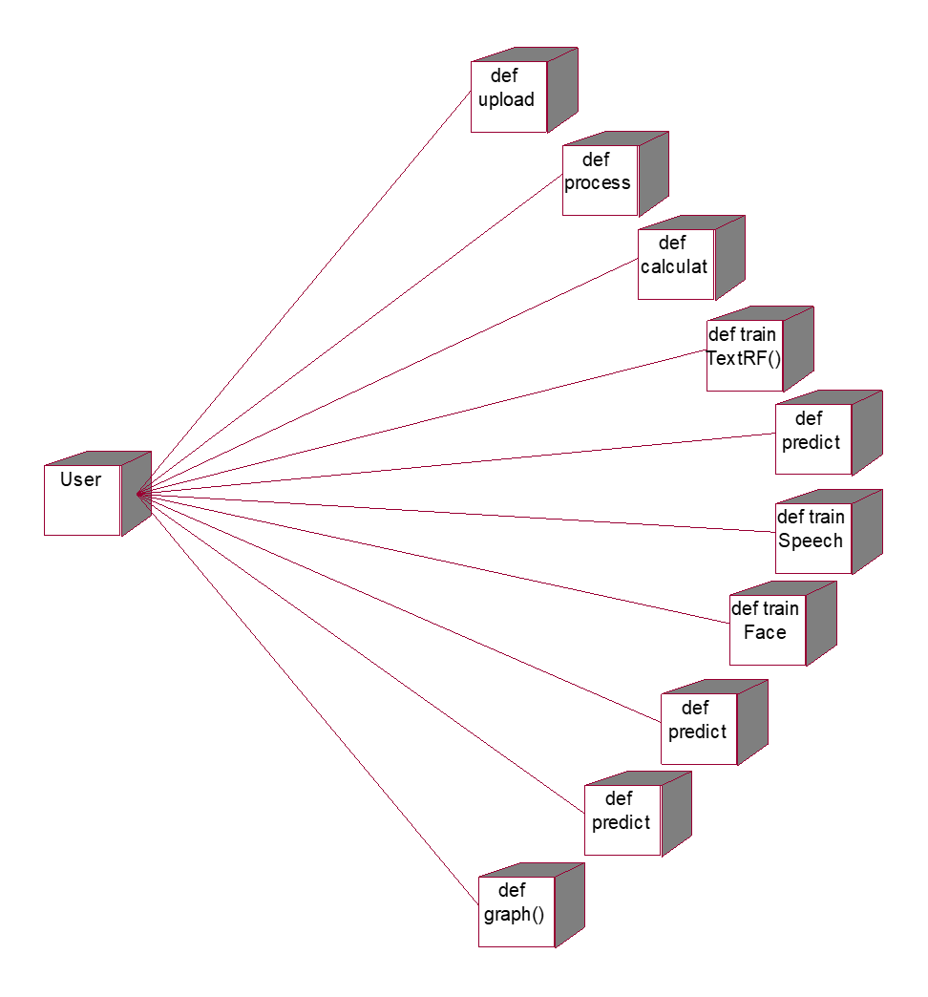
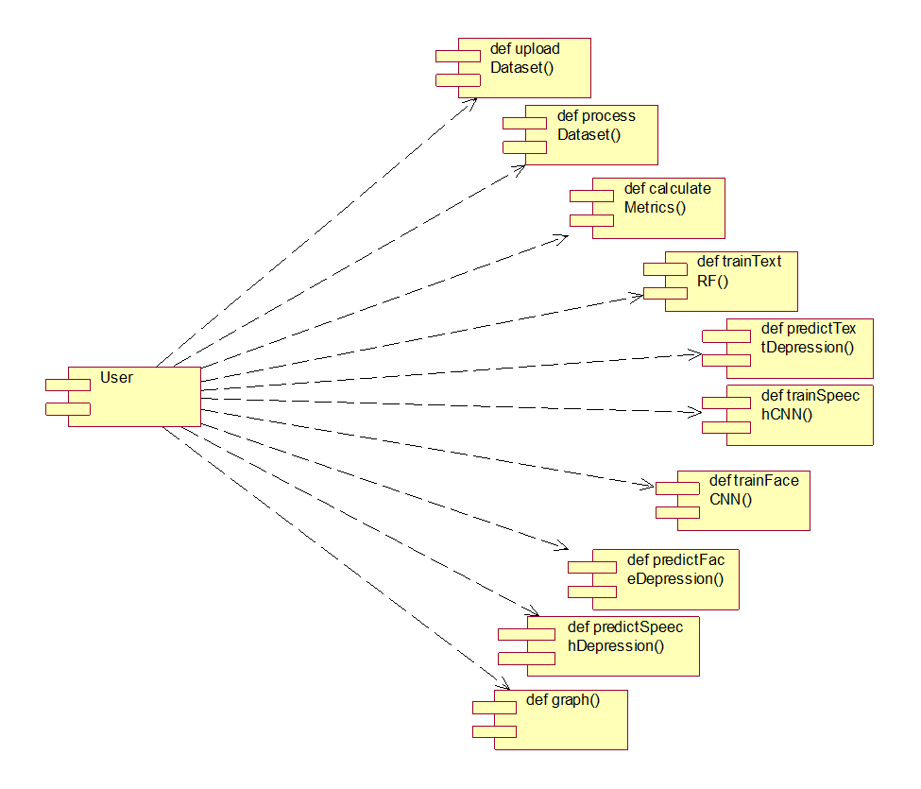
Component Diagram Deployment Diagram

Slide 13
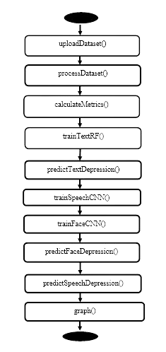
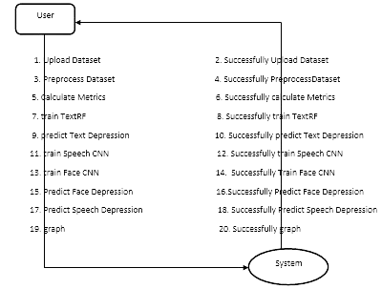
Activity Diagram Data Flow Diagram

Slide 14
IMPLEMENTATION
PYTHON
One of the most popular languages is Python. Guido van Rossum released this language in 1991. The syntax of Python is simple and identical to that of English. When compared to Python, it was seen that the other language requires a few extra lines.
FEATURES
Readability
Versatility
Large community
Cross-platform
Powerful libraries
High-level
Object-oriented

Slide 15
LIBRARIES
numpy
pandas
matplotlib
keras
tensorflow
scikit-learn
LIBRARIES

Slide 16
ALGORITHMS
Random Forest Algorithm
The Random Forest algorithm is a powerful machine learning technique that combines multiple decision trees to improve accuracy and reduce overfitting. Random Forest algorithm using text features and then trained a model and this model will be applied on 20% test text features to calculate prediction accuracy.
Convolutional Neural Network
Convolutional Neural Networks (CNNs) are a type of deep learning algorithm specifically designed for processing grid-like data, such as images. CNN algorithm using facial images and speech features and then trained a model and this model will be applied on 20% test images and speech to calculate prediction accuracy.

Slide 17
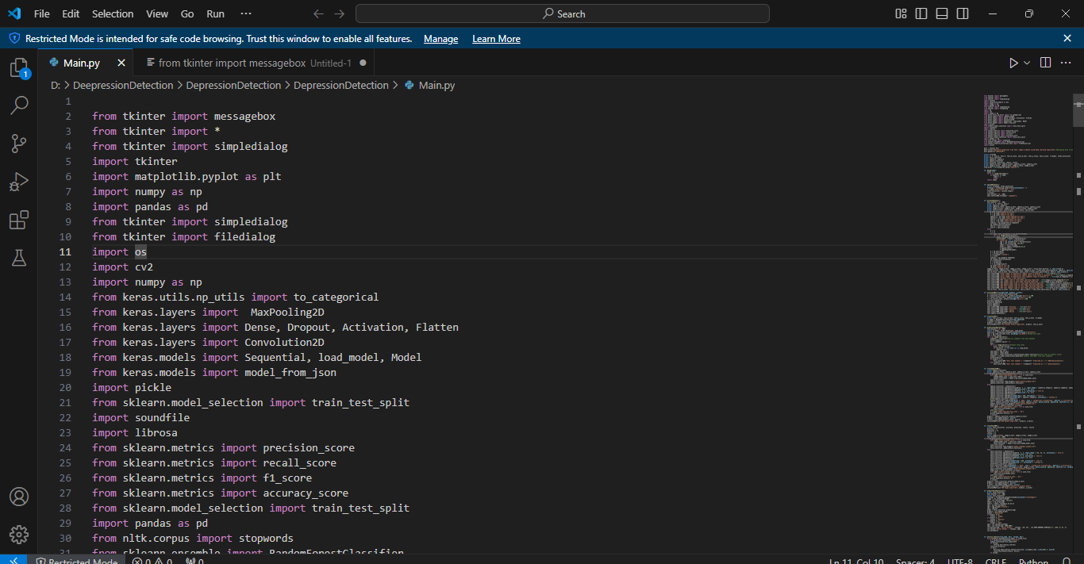
SAMPLE CODE

Slide 18
TESTING
System Testing
System Testing is a crucial phase in software development that evaluates the overall functionality and performance of a complete and fully integrated software system. It's like a final check-up before the software is ready for release to end-users.
Module Testing
Module Testing (also known as Unit Testing or Component Testing) is a crucial stage in software development where individual units or components of the software are tested in isolation.

Slide 19
Integration Testing
Integration Testing is a level of software testing where individual units or components of an application are combined and tested as a group. It focuses on verifying the interactions and data exchange between different parts of the software to ensure they work together correctly.
Acceptance Testing
Acceptance Testing is the final stage of software testing before a system is released to production. It's conducted to determine if the software meets the business requirements and user needs.

Slide 20
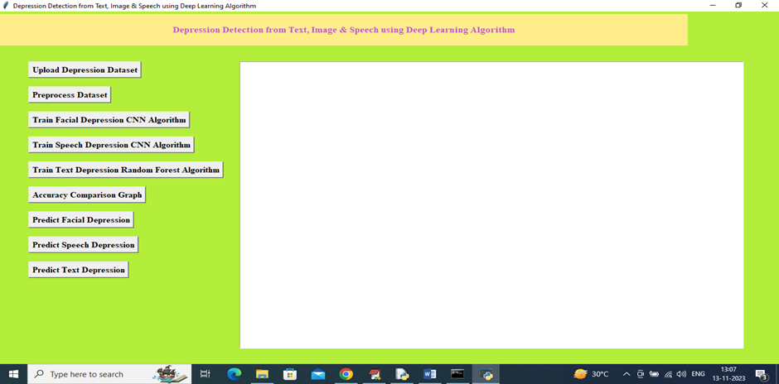
OUTPUT SCREENSHOTS
Upload Depression Dataset

Slide 21
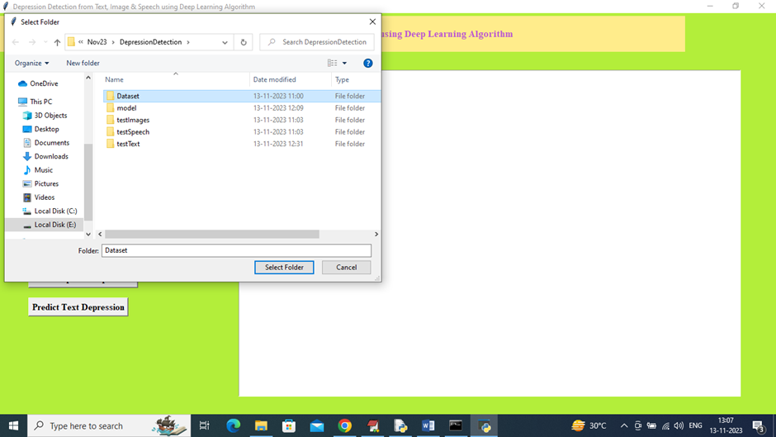
In above screen selecting and uploading all dataset folder and then click on ‘Select Folder’ button to load speech, image and text dataset and then will get below output

Slide 22
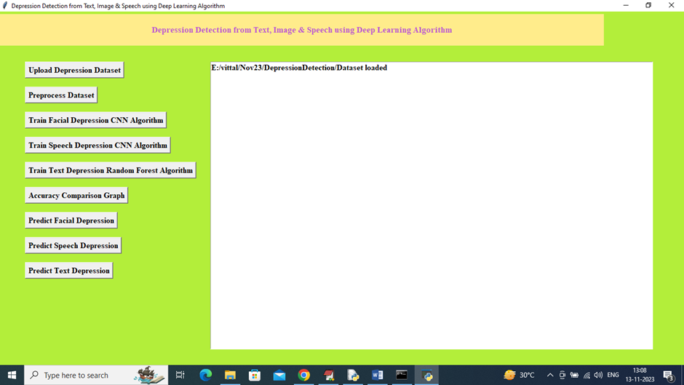
In above screen dataset loaded and now click on ‘Pre-process Data Set’ button to read, shuffle, normalize and split into train and test and then will get below output

Slide 23
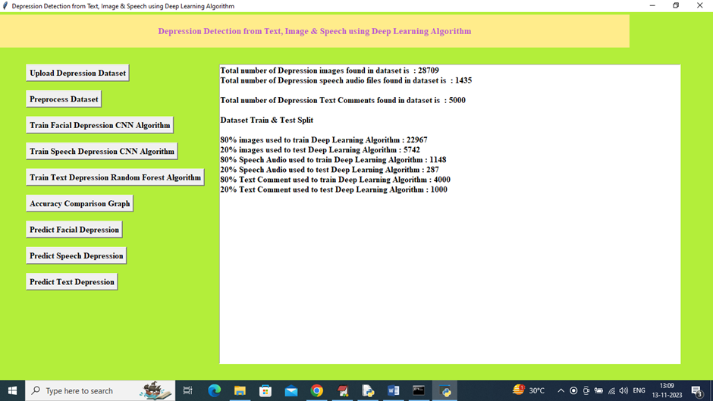
In above screen can see total images loaded, speech loaded and text commented loaded a then can see train and test size of each dataset format and now train and test data is ready and now click on ‘Train Facial Depression CNN Algorithm’ button to train algorithm and get below output.

Slide 24
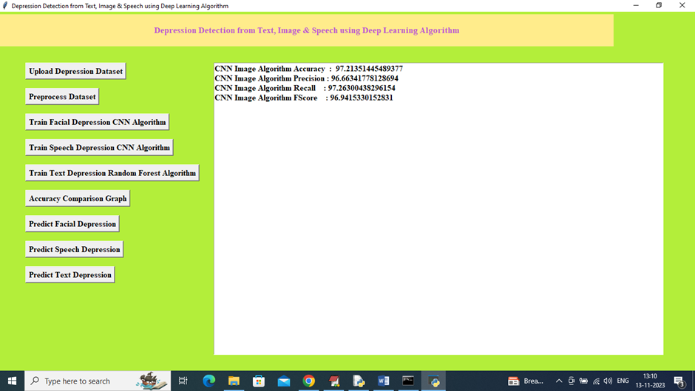
In above screen CNN on Facial images trained and it got test prediction accuracy as 97.21% and can see other metrics like precision, recall and FSCORE and now click on ‘Train Speech Depression CNN Algorithm’ button to train model and get below output

Slide 25
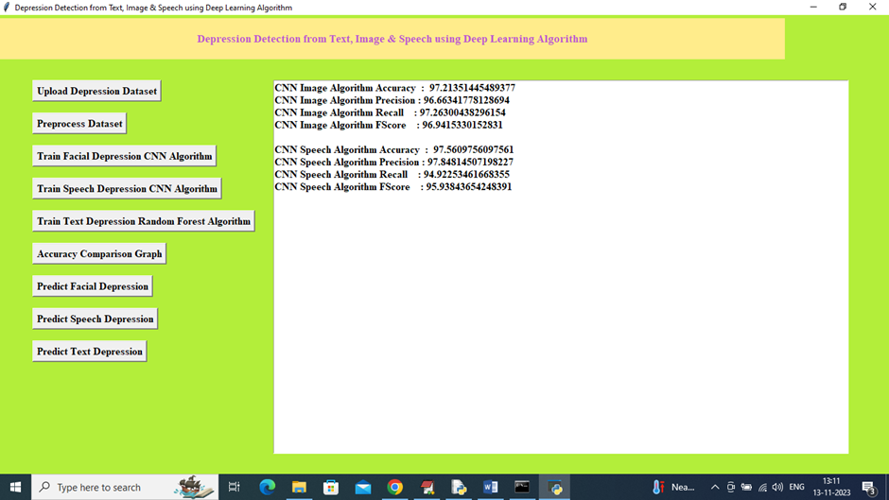
In above screen speech CNN got 97.56% accuracy and now click on ‘Train Text Depression Random Forest Algorithm’ button to get below output

Slide 26
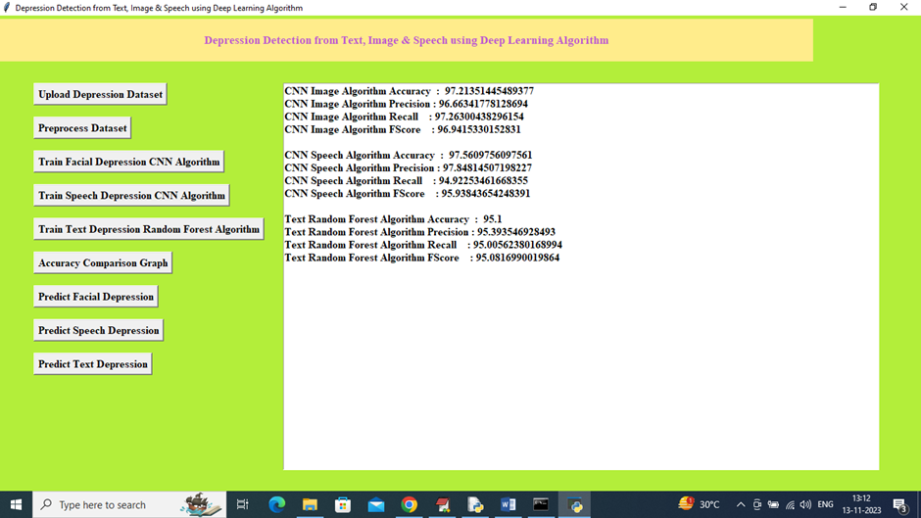
In above screen TEXT depression detection model got 95% accuracy and now click on ‘Accuracy Comparison Graph’ button to get below output

Slide 27
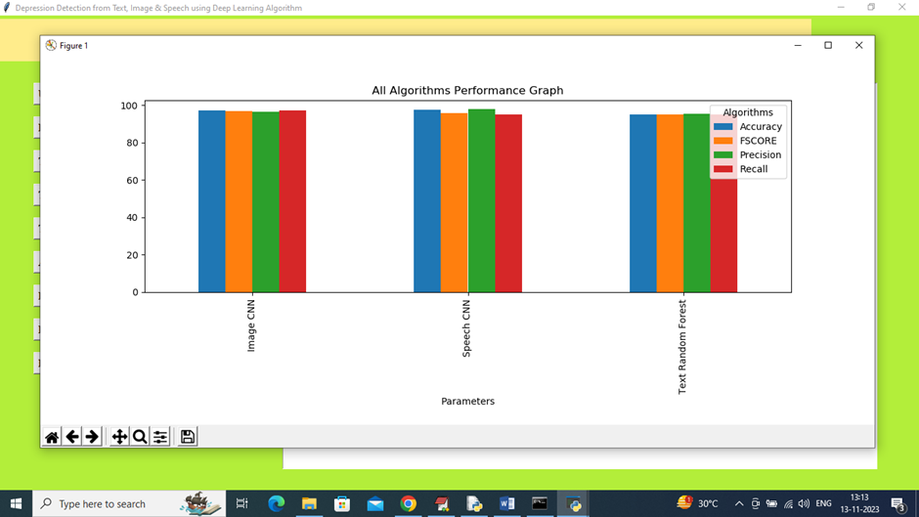
The graph x-axis represents algorithm names and y-axis represents accuracy and other metrics in different colour bar and in above graph can see all algorithms accuracy is more than 95%

Slide 28
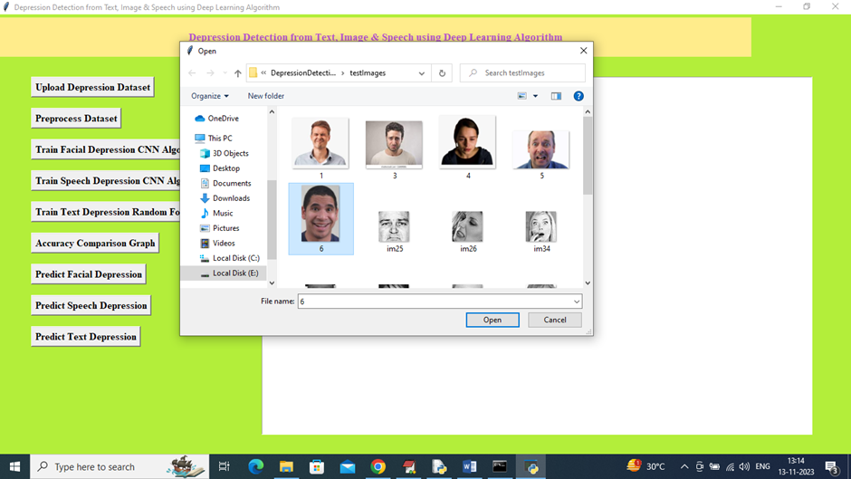
Close above graph and then click on ‘Predict Facial Depression’ button to upload test image and get below output

Slide 29
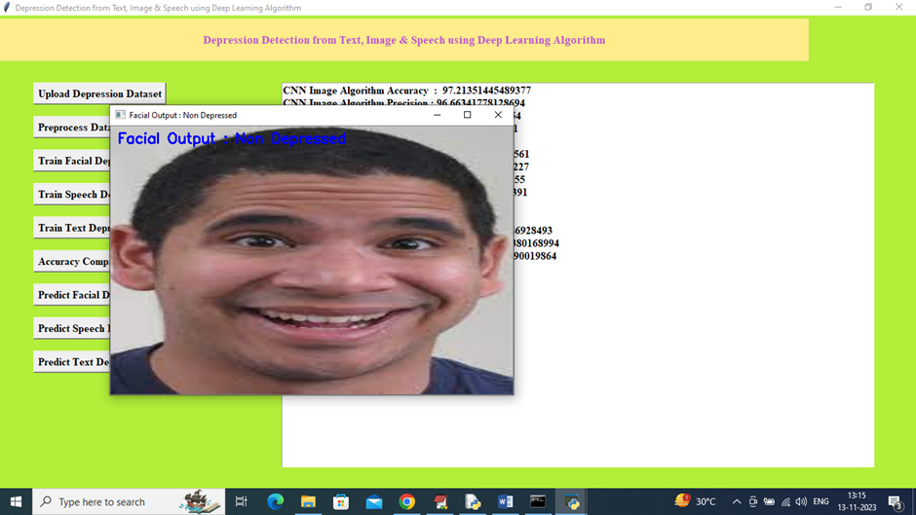
In above screen selecting and uploading 6.jpg image and then click on ‘Open’ image to get below output

Slide 30
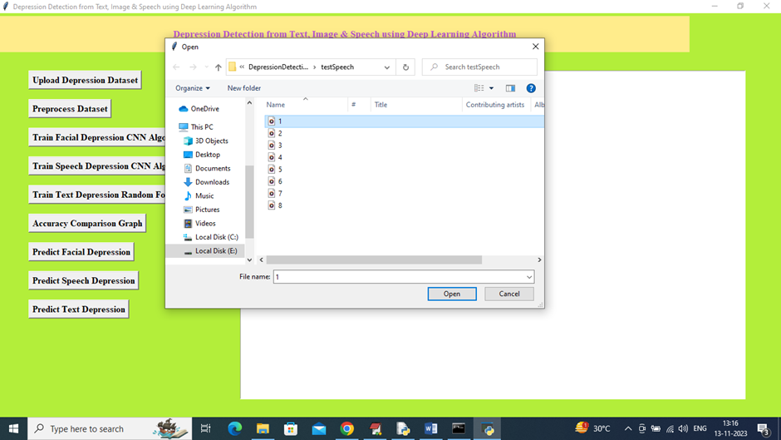
In above screen facial features detected as depressed and now close above image and then click on ‘Predict Speech Depression’ button to upload voice file

Slide 31

In above screen selecting and uploading 1.wav audio file and then click on ‘Open’ button to get below output

Slide 32
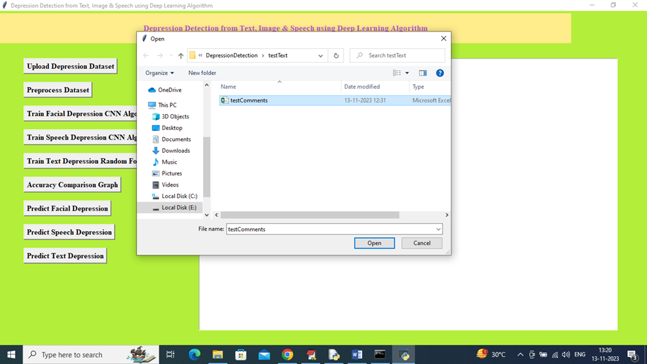
Click on ‘Predict Text Depression’ button to upload TEST TEXT comments like below screen

Slide 33
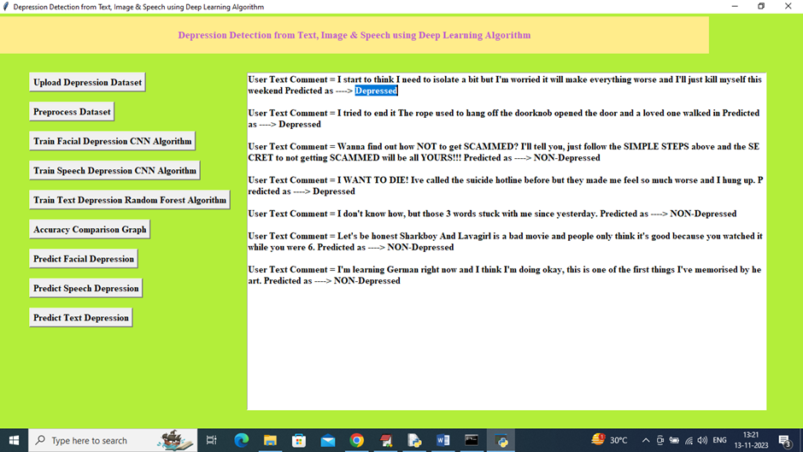
In above screen selecting and uploading ‘Test Comments.csv” file and then click on ‘Open’ button to get below output
In above screen first displaying TEXT Comment and then after =è symbol displaying predicted output as ‘Depressed or Non-depressed’.

Slide 34
CONCLUSION
Image-based detection: Deep learning models can achieve high accuracy in detecting depression from facial images, surpassing traditional methods. However, the generalizability of these models to diverse populations and real-world settings remains an area of ongoing research.
Text-based detection: Deep learning models can effectively analyze textual data, such as social media posts and clinical notes, to identify patterns associated with depression. However, the interpretation of these patterns and their clinical significance require careful consideration.
Speech-based detection: Deep learning models can extract subtle acoustic features from speech that are indicative of depression. However, the reliability and generalizability of these models across different accents and speaking styles need further investigation.

Slide 35
FUTURE ENHANCEMENT
Future enhancements to depression detection using deep learning will focus on:
More advanced models: Utilizing transformers (like BERT, GPT) for better language understanding and multi-modal fusion for combining text, image, and speech data effectively.
Improved data: Larger, more diverse datasets, advanced data augmentation techniques, and robust privacy measures.
Enhanced user experience: Explainable AI, personalized models, and integration with telehealth platforms.
Addressing ethical concerns: Mitigating bias, ensuring responsible AI practices, and incorporating human oversight.
Continuous improvement: Longitudinal studies, continuous learning, and collaboration with mental health professionals.
These advancements aim to create more accurate, reliable, and user-friendly systems for early depression detection and improved mental healthcare access.

Slide 36
REFRENCES
Dong, Y.; Yang, X. A hierarchical depression detection model based on vocal and emotional cues. Neurocomputing 2021, 441, 279–290. [Google Scholar] [CrossRef]
Javed, A.R.; Fahad, L.G.; Farhan, A.A.; Abbas, S.; Srivastava, G.; Parizi, R.M.; Khan, M.S. Automated cognitive health assessment in smart homes using machine learning. Sustain. Cities Soc. 2021, 65, 102572. [Google Scholar] [CrossRef]
Javed, A.R.; Sarwar, M.U.; ur Rehman, S.; Khan, H.U.; Al-Otaibi, Y.D.; Alnumay, W.S. PP-SPA: Privacy preserved smartphone-based personal assistant to improve routine life functioning of cognitive impaired individuals. Neural Process. Lett. 2021, 1–18. [Google Scholar] [CrossRef]

Slide 37

Thank you

