Slide 1
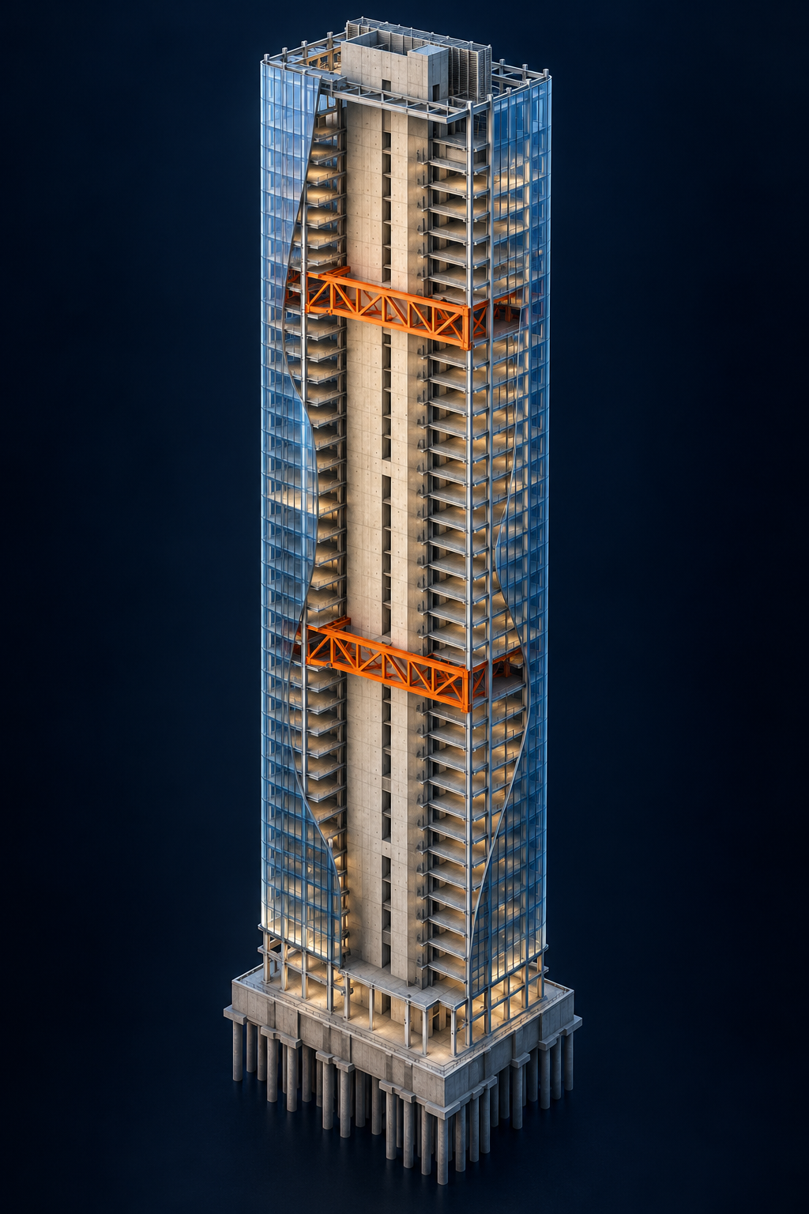

NCSEA HACKATHON
27 October, 2026
01
Notes:
Arthur
TARGET TIME: 10 seconds.
Introduce SWOOP and expand the acronym. Opening line: SWOOP explores shear wall and outrigger layouts using architectural floor plans and cost/material objectives. Adjust this to match the prototype.
The tower is a temporary AI-generated concept illustration, not a project photograph or analysis result. Replace it with your preferred tower image when ready.
Presenter: [Name]
Presentation notes: [Add your speaking notes]
Image / evidence sources: [Add where relevant]

Slide 2






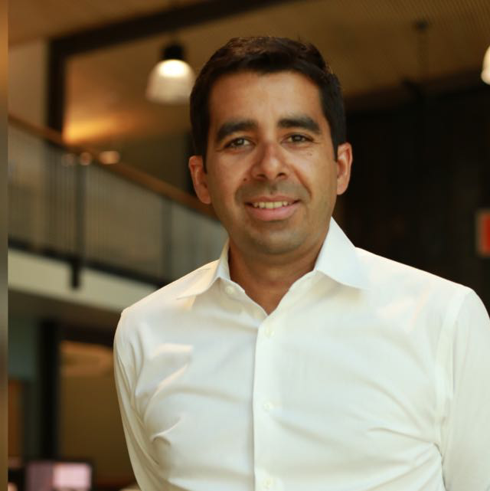


The SWOOP Team
Srikrishnan Madhavan
Patrick Nieman
Frank Fang
Wyeth Binder
Atishay Lahri
Jeffery Lew
Jose Sanchez
Kelsey Taylor
Arthur Tsang
02
Notes:
Arthur
TARGET TIME: 15 seconds.
Introduce the nine members briefly, or acknowledge the whole team while names and roles remain on screen. Replace all nine photos, names, and roles. Keep roles to one or two short lines.
Presenter: [Name]
Presentation notes: [Add your speaking notes]
Image / evidence sources: [Add where relevant]

Slide 3
Motivating Problem
Tall towers w/ indeterminate system under lateral loads
Current Practices:
Approximate hand calcs with guess and check.
Optimization routines that can employ material optimization for a given floor plate layout.
Time-intensive and imprecise.
Inability to consider topological optimization due to multitude of variables.
Computationally challenging to develop tools that employ multivariable optimization.
03
Notes:
Arthur
Current approaches uses approximate hand calcs w/ trial and error methods
Optimization routines typically employ material optimization but not toplogical optimization as it's much more difficult to build due to explosion of variables
Competing variables (multiple load patterns such as wind and seismic which have very different distribution) and constraints introduce additional complexity in traditional unimodal optimization (optimizing for one target metric)
Goal: Try and tackle this problem with Agentic AI workflow
Workflow building with AI agents flatten/reduces the effort involved in setting up complex workflows such as this
Traditionally challenging mathematical and computational problem
Gives ability to get to faster schematic, more optimal designs at early stage
$ saved
Future/tangential thoughts:
Such an approach can extend to other optimization of indeterminate systems with competing variables

Slide 4
Motivation / Problem
Motivation / Problem
Every new layout starts the cycle again
01
Propose a wall and outrigger layout
03
02
Analyze
the quantities
Model it
in software like ETABS
A repetitive, time-intensive process
04
Notes:
Arthur
TARGET TIME: 20 seconds.
Describe one concrete decision that currently requires repeated manual exploration. Explain the architectural restrictions and the cost/material tradeoffs. Replace the image with a relevant tower, schematic, or project photo. State a measured pain point only if supported.
Presenter: [Name]
Presentation notes: [Add your speaking notes]
Image / evidence sources: [Add where relevant]

Slide 5
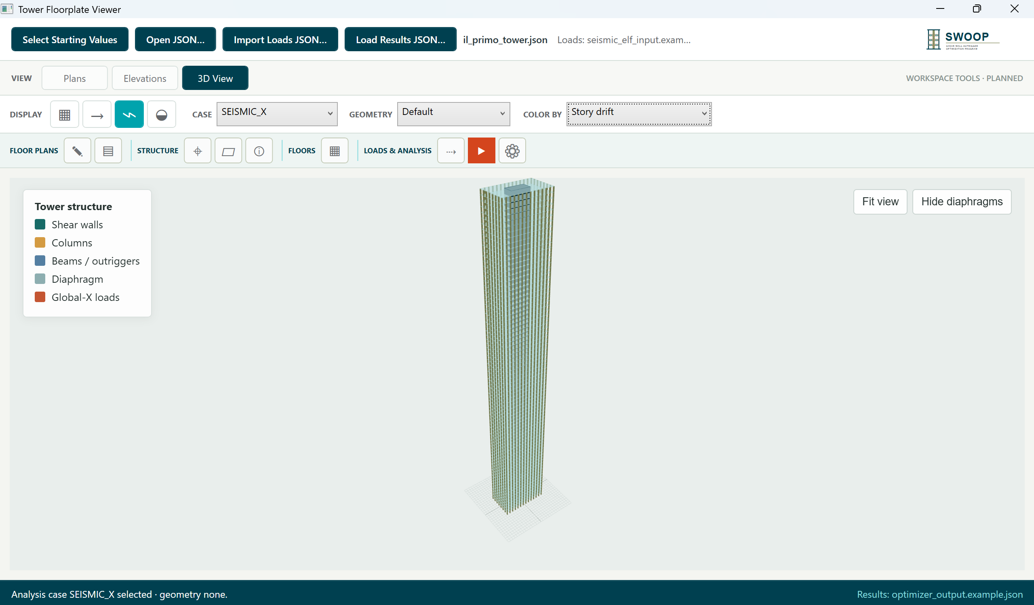

Let's SWOOP in!
Tech Stack (built with Codex):
Three.js/.NET
Python
Opensees
Optional Output files:
Rhino
Blender
Desktop application that provides the optimization output of geometry and sizing.
05
Notes:
TARGET TIME: 30 seconds.
Presenter: [Name]
Presentation notes: [Add your speaking notes]
Image / evidence sources: [Add where relevant]

Slide 6
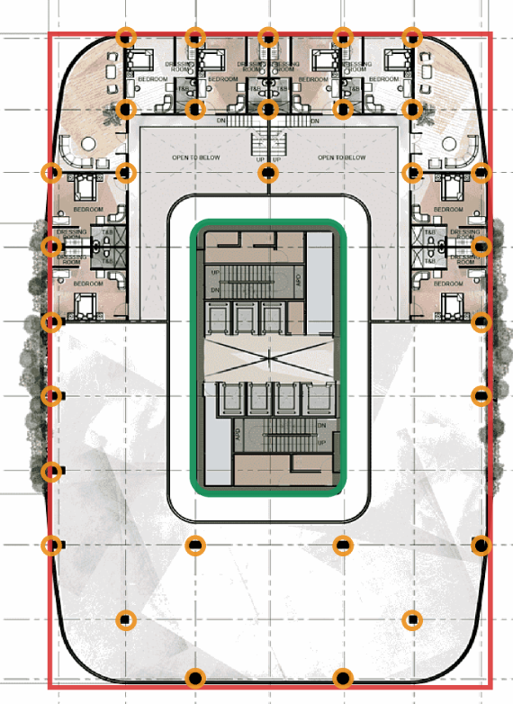
Architectural Floor Plan Input Module
.Json File
File contains geometry and locations of the structural walls and columns
06
Notes:
Wyeth
TARGET TIME: 15 seconds.
Show the actual architectural plan at a readable scale. Point out the core, allowable wall regions, openings, or other relevant constraints. Mention accepted file formats and manual preparation only if implemented. Keep the explanation to one clear point.
Presenter: [Name]
Presentation notes: [Add your speaking notes]
Image / evidence sources: [Add where relevant]

Slide 7
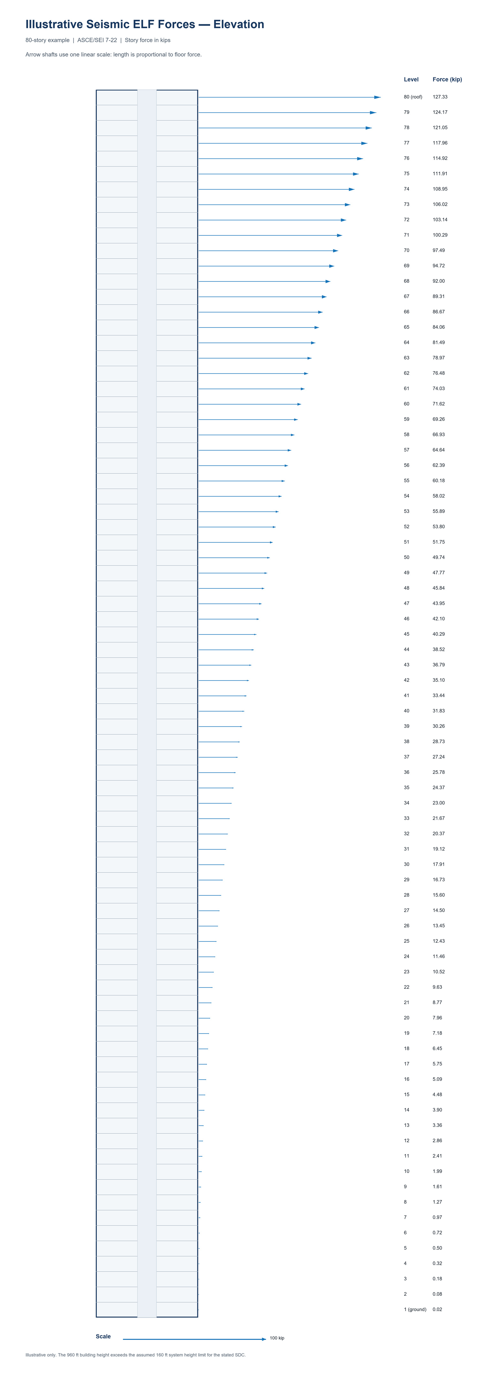
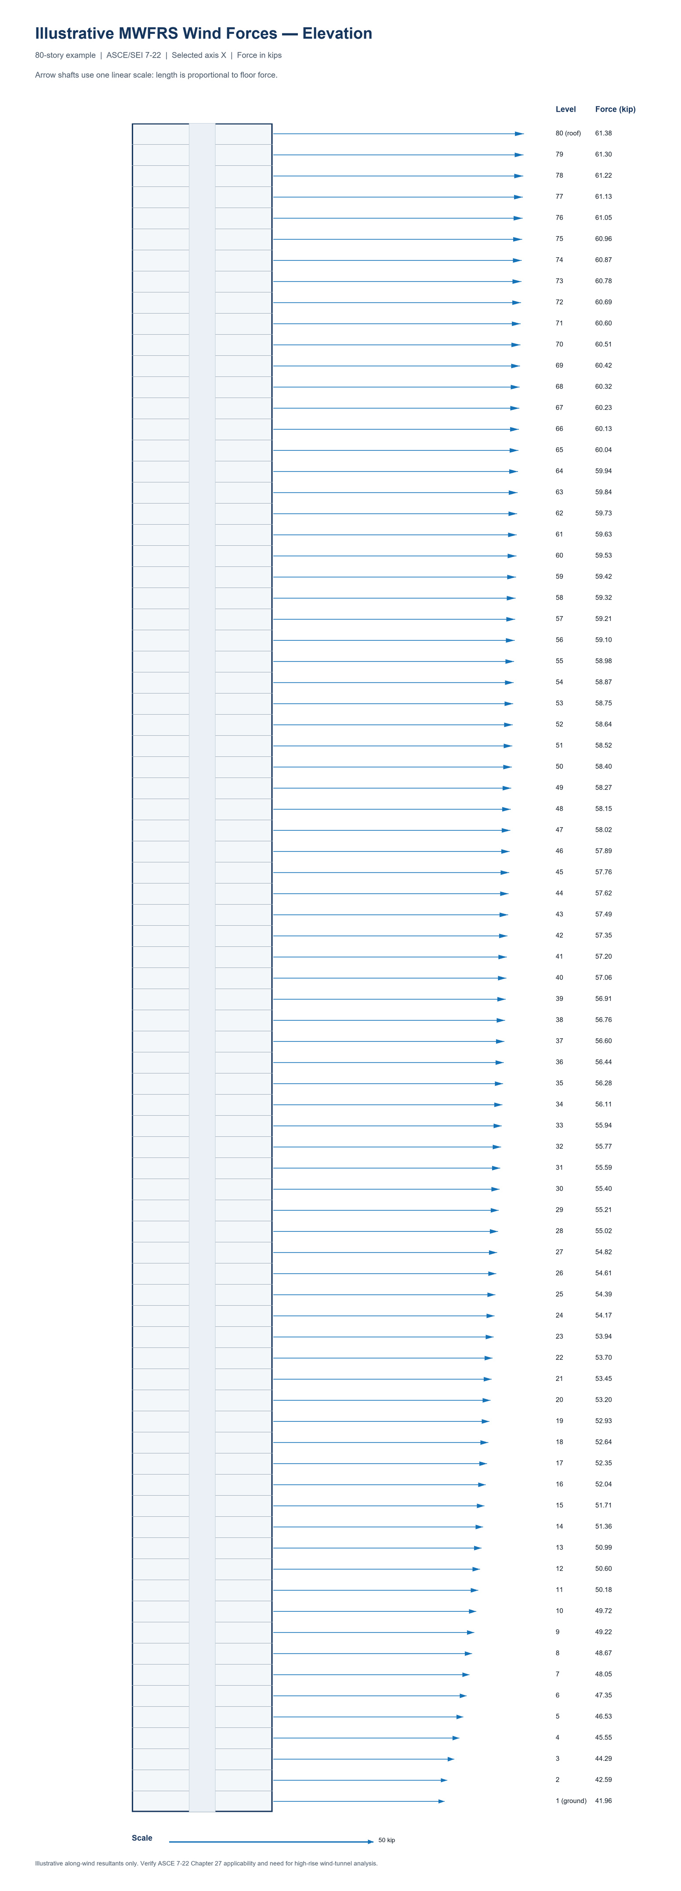
Load Input Module
.json File
File contains loads that will be used in agentic optimizer
07
Notes:
Frank
TARGET TIME: 15 seconds.
Show the actual architectural plan at a readable scale. Point out the core, allowable wall regions, openings, or other relevant constraints. Mention accepted file formats and manual preparation only if implemented. Keep the explanation to one clear point.
Presenter: [Name]
Presentation notes: [Add your speaking notes]
Image / evidence sources: [Add where relevant]

Slide 8
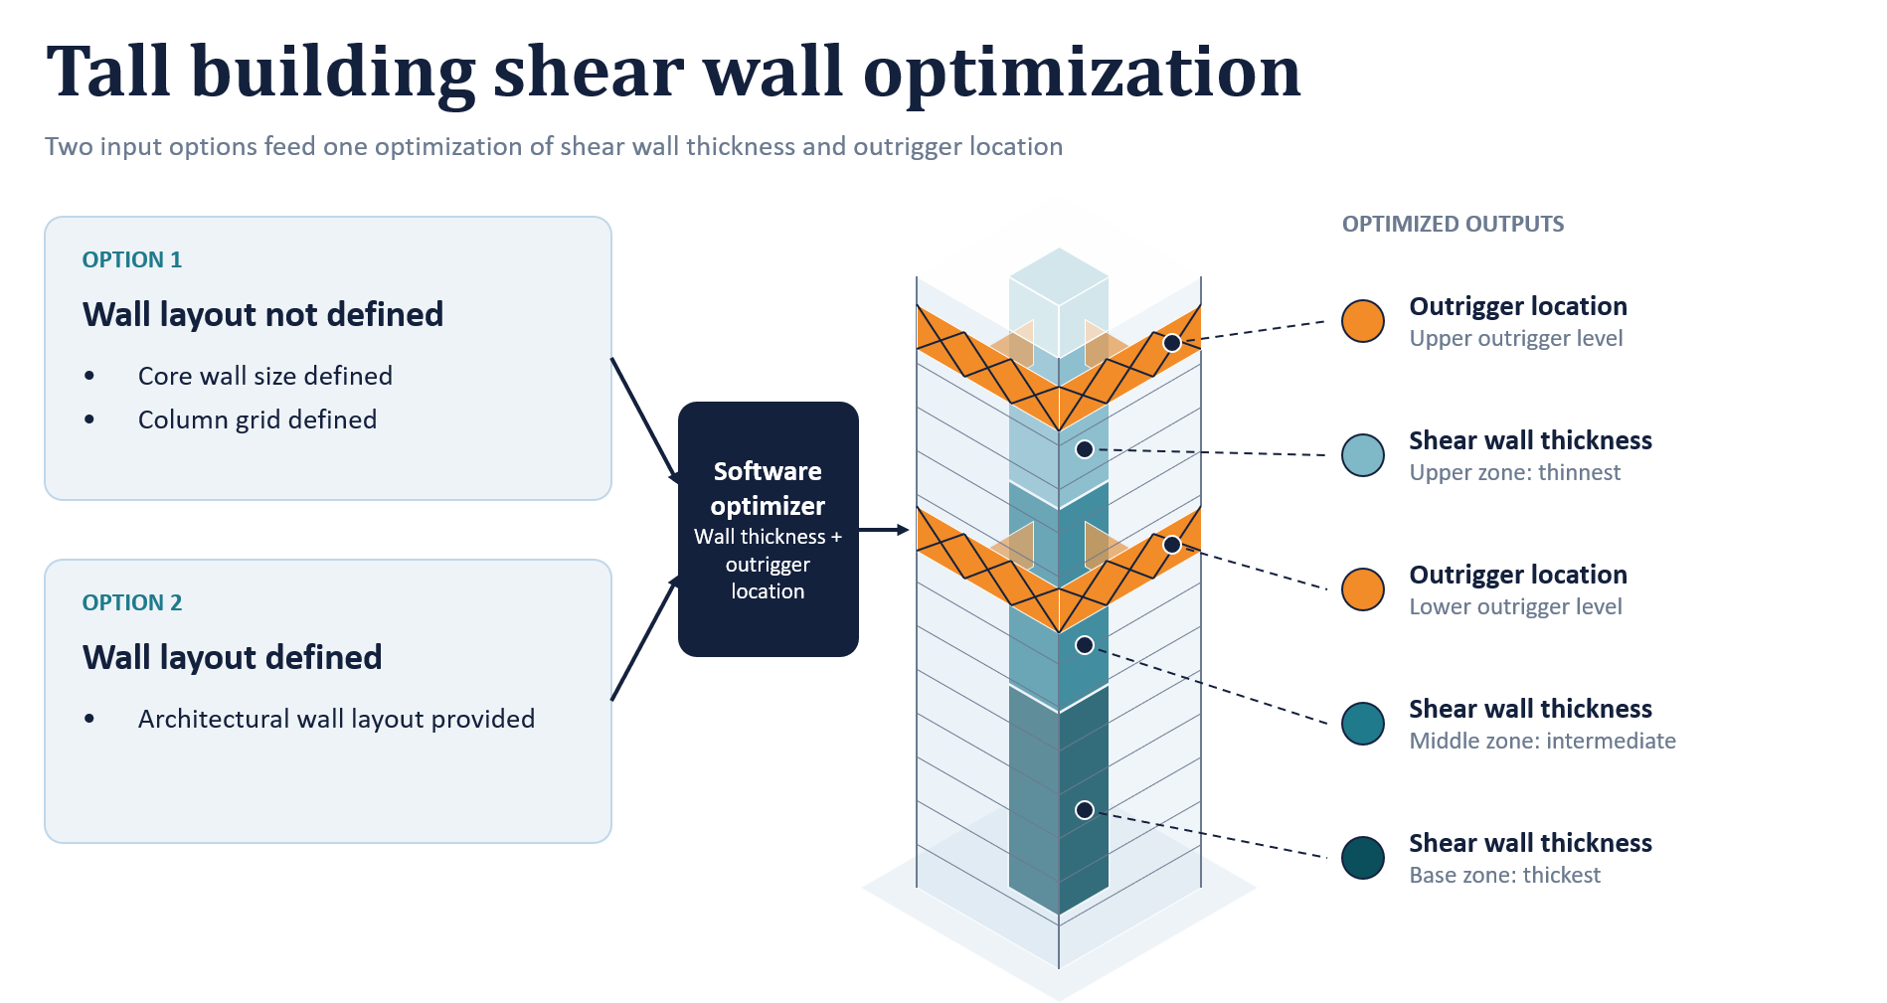
Tall point tower – shear wall + outrigger optimization
Original Inputs
Initial Wall Geometry
Loads
Deflection Limits
Optimizer Variables
Number of Outriggers
Outrigger wall thickness
Outrigger wall height
08
Notes:
Atishay
The aim is to put structural material where it contributes most, while meeting the deflection limits.”
TARGET TIME: 20 seconds.
Change to “wall and outrigger optimization”
Presenter: [Name]
Presentation notes: [Add your speaking notes]
Image / evidence sources: [Add where relevant]

Slide 9
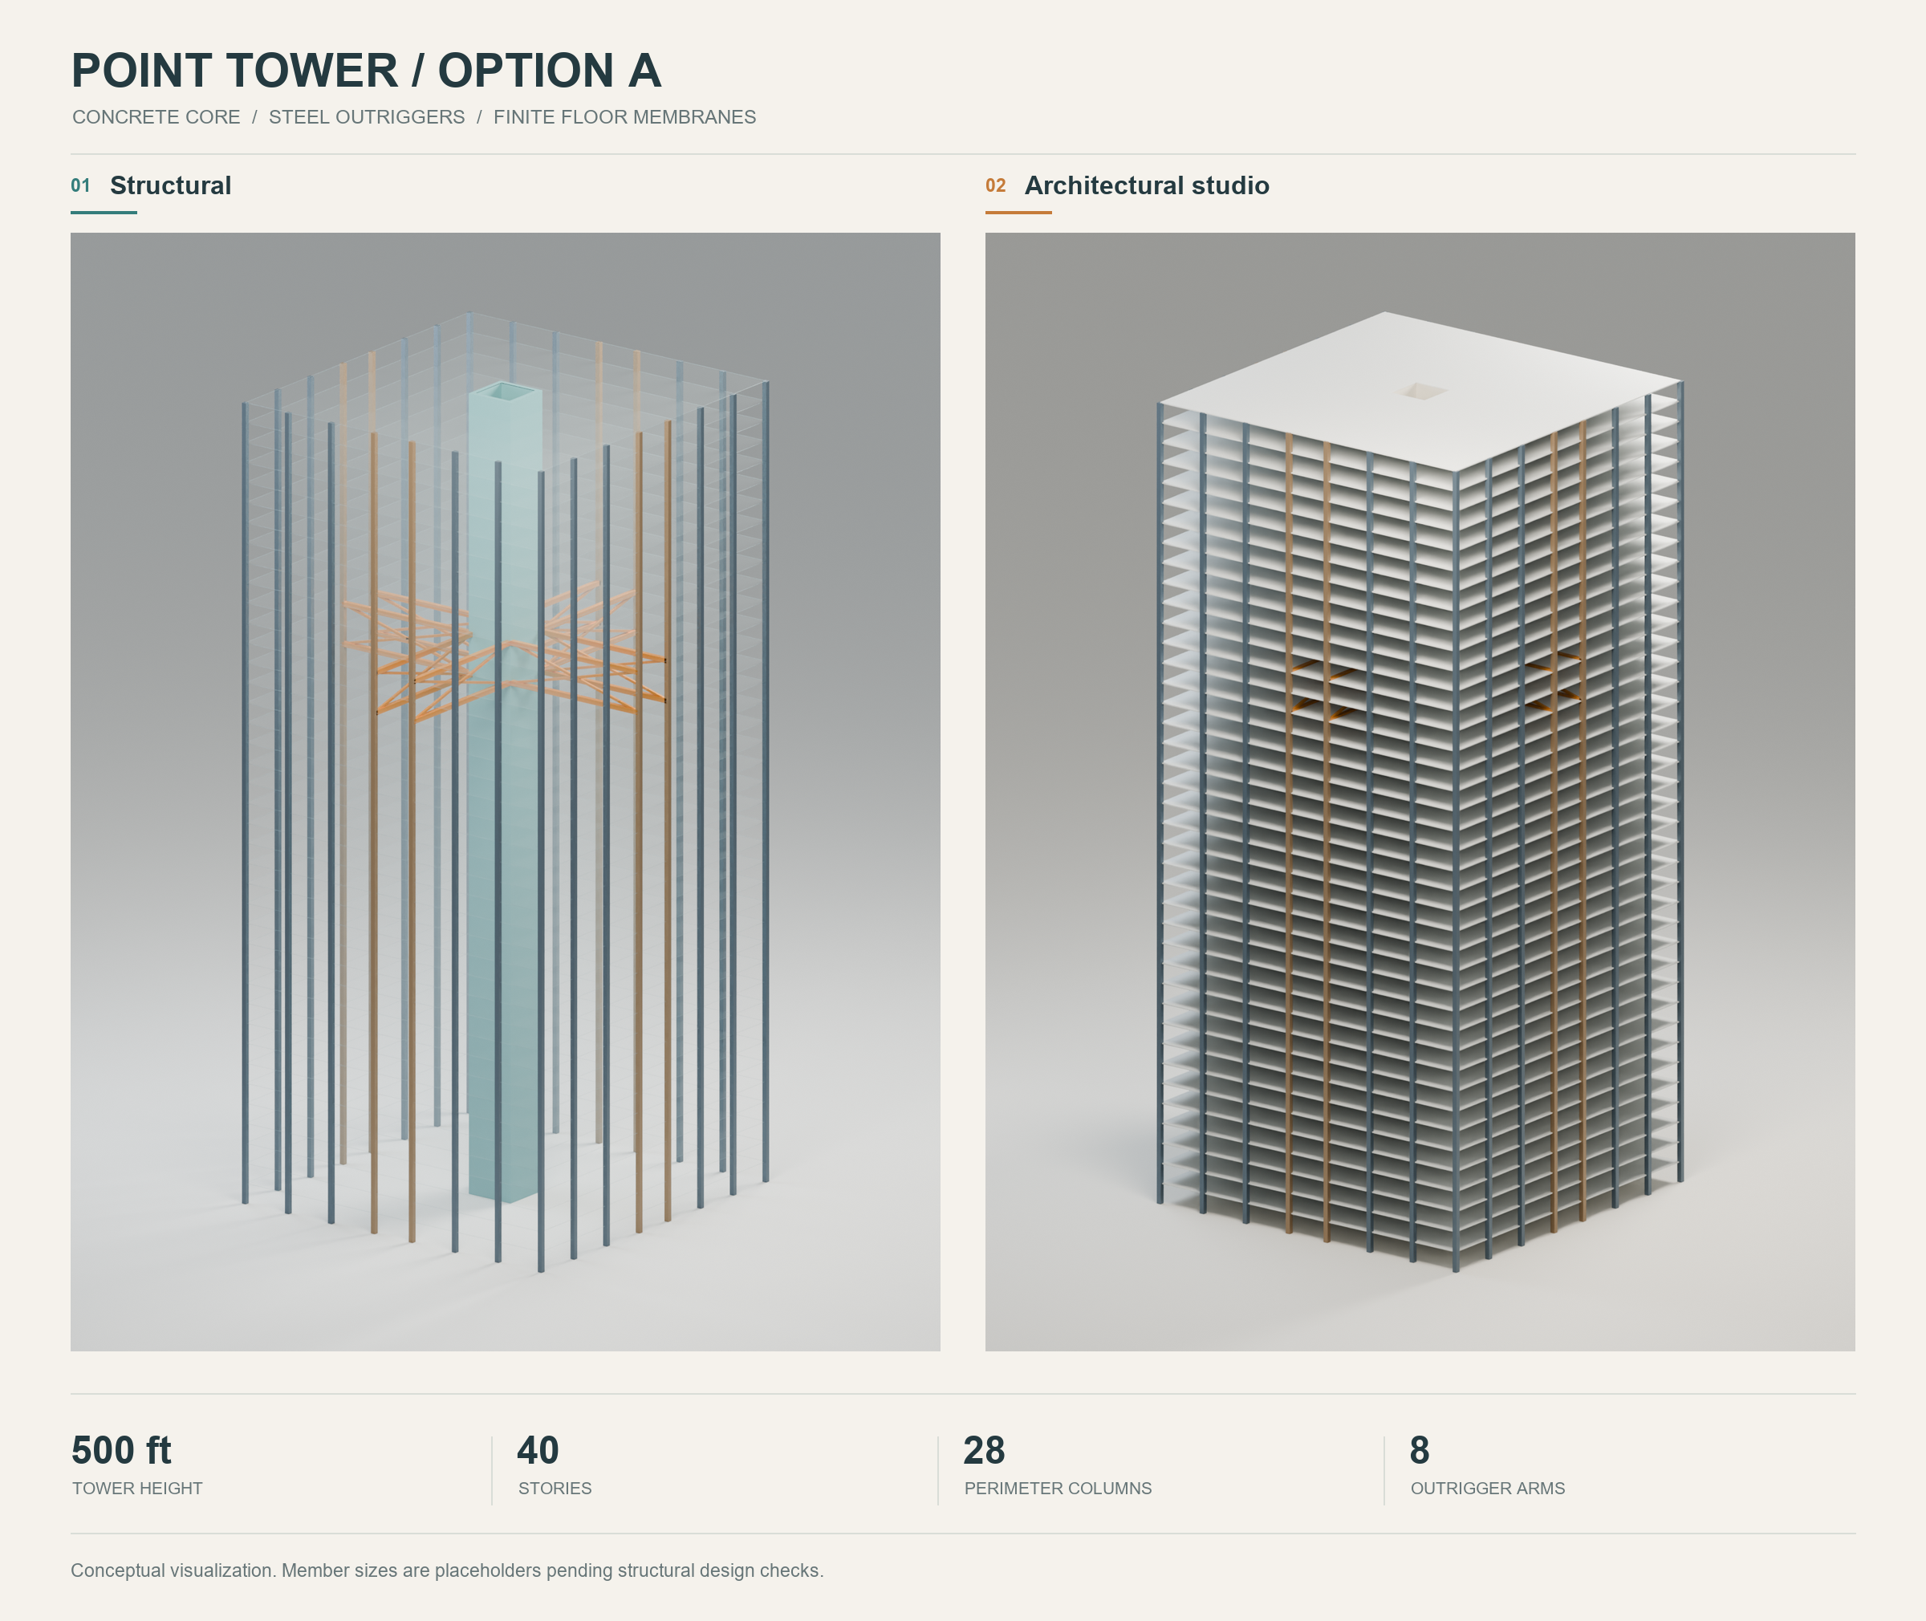
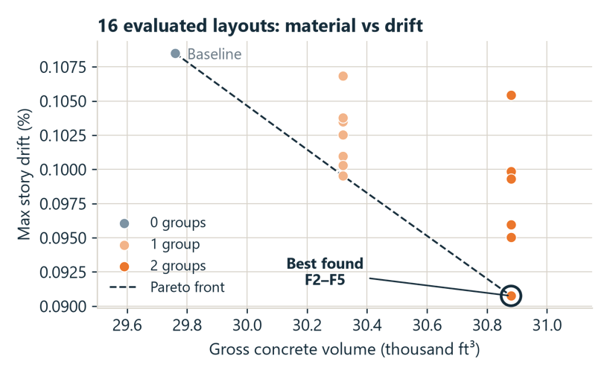
Output
[Output: Analysis]
09
Notes:
Sri
TARGET TIME: 30 seconds.
Show outputs from an actual application run. Explain the selected shear wall layout and outrigger levels. Give one measured result with its baseline, units, assumptions, and cost scope. Replace the placeholder takeaway. State the main limitation if it affects interpretation.
Presenter: [Name]
Presentation notes: [Add your speaking notes]
Image / evidence sources: [Add where relevant]

Slide 10
Future Steps/Improvements
01
Building non-AI verification routines to verify robustness of generated output
02
Integrate with analysis software such as ETABS and SAP.
03
Export elements to visualization tools such as Blender for communication with architects.
10
Notes:
Sri
TARGET TIME: 30 seconds.
Describe the actual implemented method in plain language. What model evaluates each layout? What checks reject candidates? What objective and search method rank candidates? Name key simplifications. Use best candidate found unless you can substantiate a global optimum. Insert actual analysis evidence.
Presenter: [Name]
Presentation notes: [Add your speaking notes]
Image / evidence sources: [Add where relevant]

Slide 11

Explore SWOOP
GITHUB
shearload/se-hackathon-point-tower: NCSEA Hackathon project
11
Notes:
TARGET TIME: 10 seconds.
Close with one sentence about the intended benefit and invite questions. Replace the link prompts with final URLs and add hyperlinks. Insert a real QR code after choosing the project URL, and test it from the projected slide.
PACING: Cover 10s, team 15s, motivation 20s, functionality 30s, floor plan 15s, parameters 20s, analysis 30s, output 30s, links 10s. Total 180 seconds.
TEMPLATE USE: Replace bracketed text, insert photos/screenshots over shaded frames, remove unused prompts, and add speaking notes.
Presenter: [Name]
Presentation notes: [Add your speaking notes]
Image / evidence sources: [Add where relevant]

