Slide 1

Regulate
A privacy-first Android tracker for users who have irregular and heavy periods
Understanding rather than simply predicting
Android project outline · Health & Fitness

Slide 2



Predicting isn't enough
Irregular and heavy cycles
2 of 3
Two of our three-person team live with them, which is where the idea came from.
team members with lived experience
Predictions fall flat
0
Most trackers centre on the next date, which breaks when cycles vary.
accounts or servers required
11
Privacy is personal
Reproductive health data is sensitive: no account, no server.
weeks of development, Weeks 5–15

Slide 3
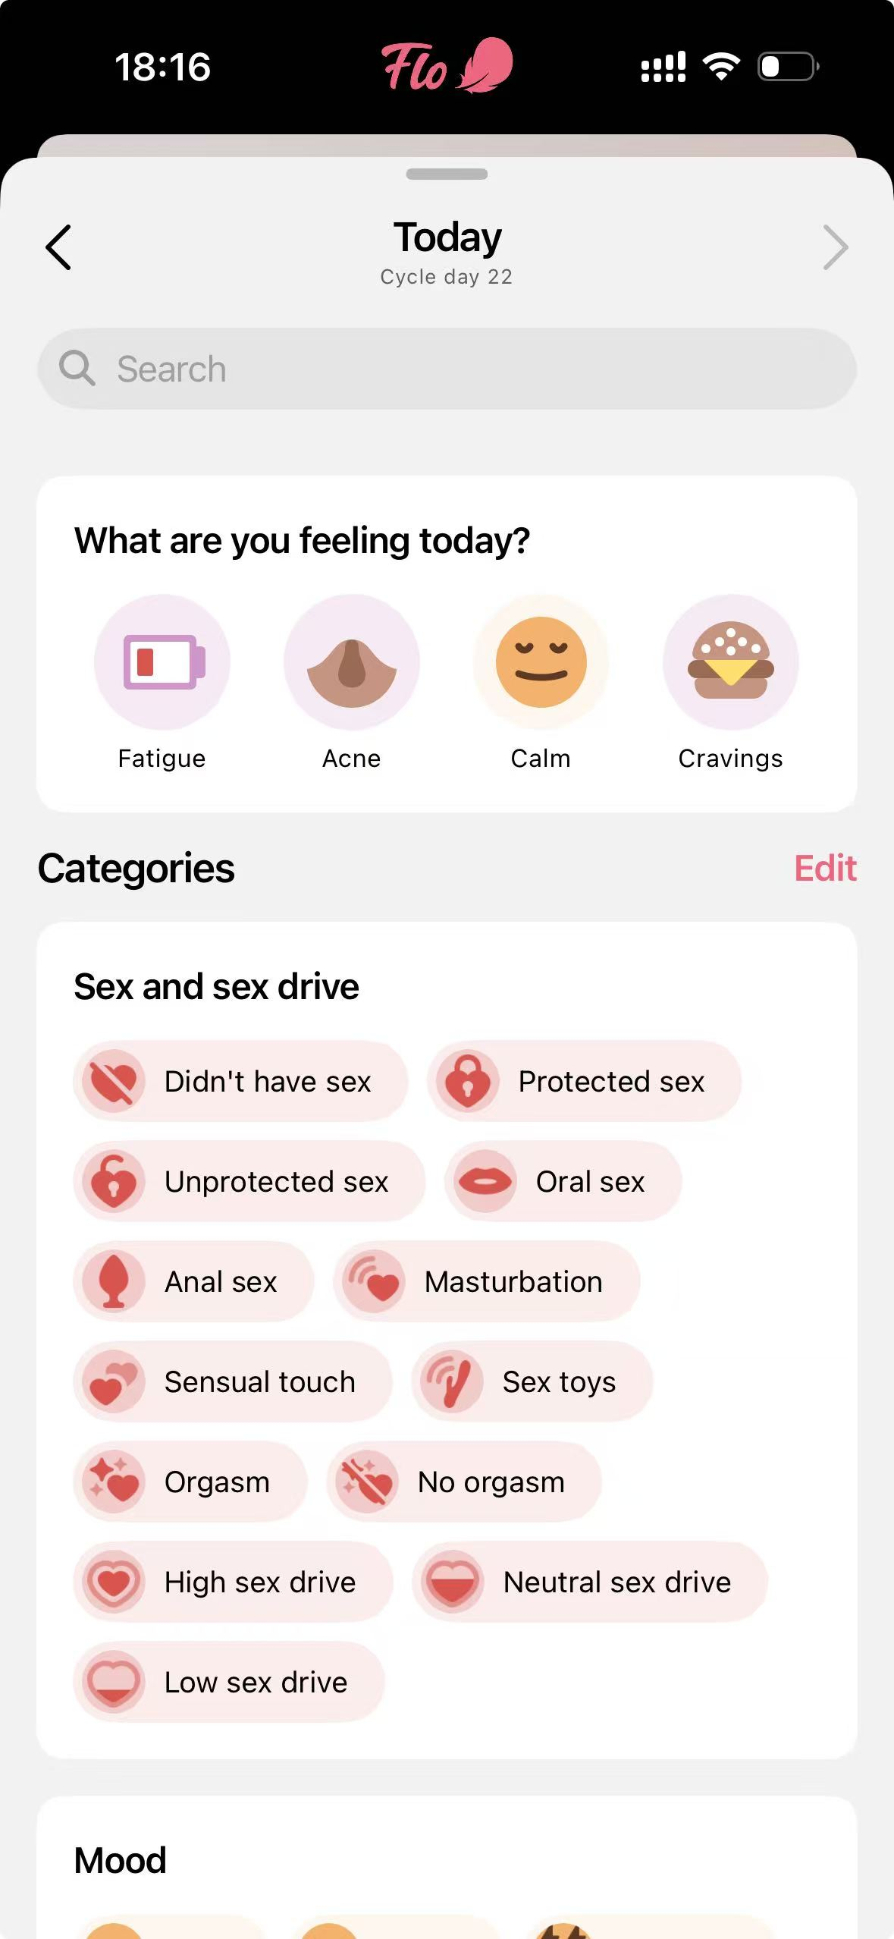
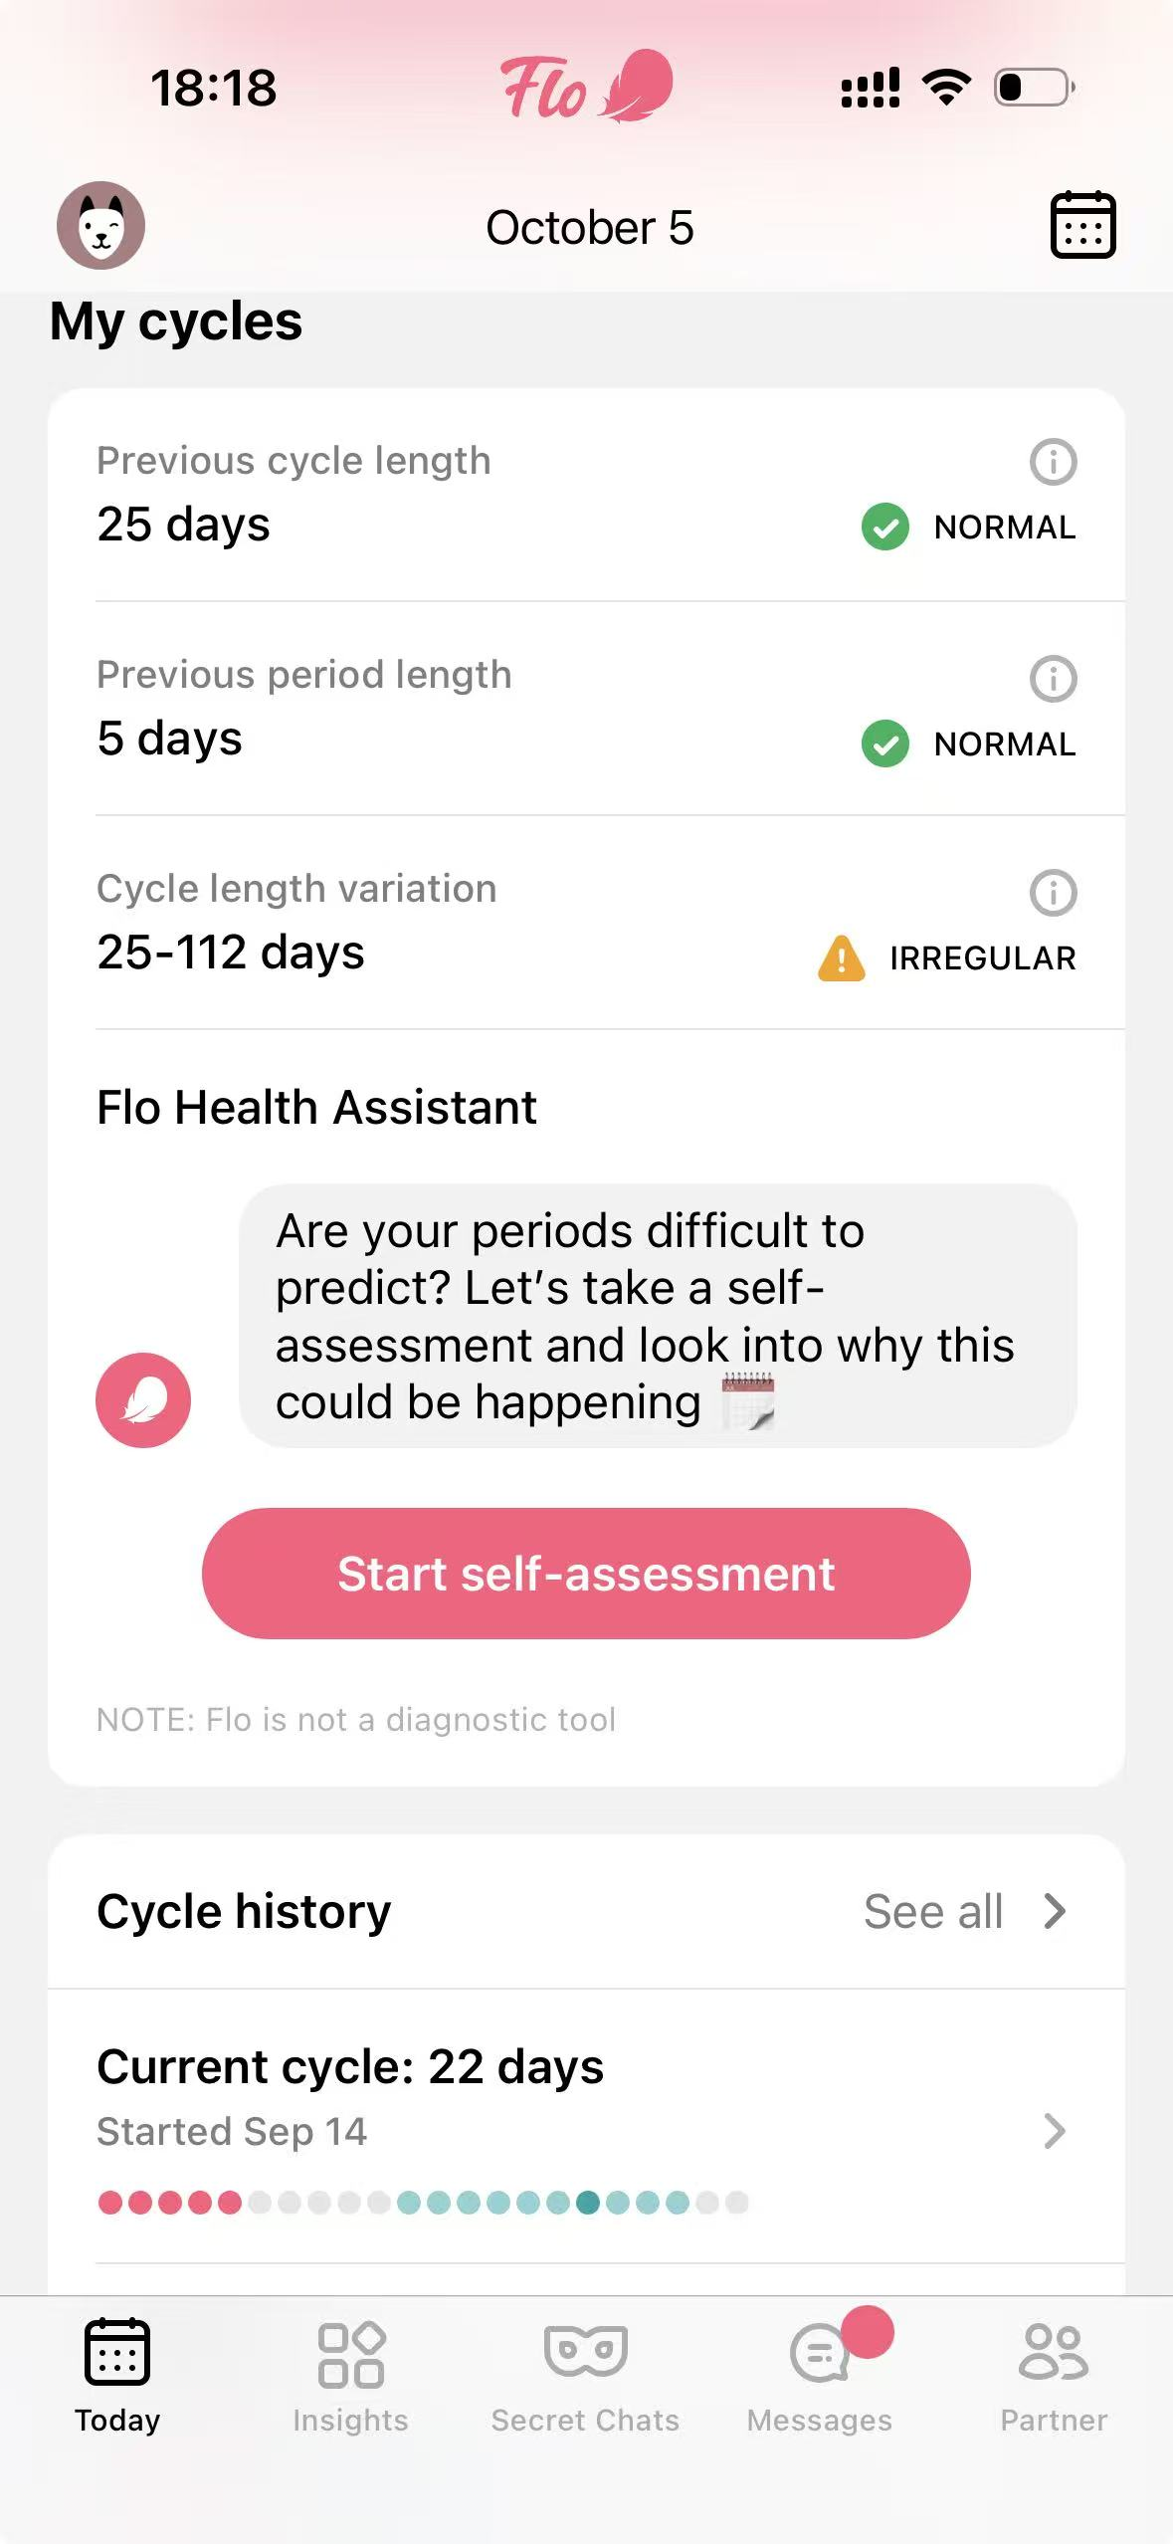
Where existing apps fall short
Flo
Clue
Euki
Anonymous Mode, predictions, reminders
Graphs and analysis beyond a calendar
No account, on-device data, PIN, offline
Feature | Flo | Clue | Euki | Regulate
Cycle prediction is the main feature | Yes | Yes | No | No
Personal baseline, not population norm | Partial | Partial | No | Yes
Irregular-cycle-specific analysis | No | No | No | Yes
Symptom–cycle correlation insights | No | Partial | No | Yes
Detailed bleeding (clots, flooding, products) | Partial | Partial | No | Yes
Healthcare appointment summary | No | No | No | Yes
Local-only storage, no account | No | No | Yes | Yes
Discreet mode (notifications, icon, lock) | Partial | Partial | Partial | Yes

Slide 4






What Regulate does
Detailed bleeding
Symptoms and impact
Log today · Day 4
Intensity, products, clots, flooding, spotting
Pain, mood, sleep and what you missed
Bleeding
Light
Medium
Heavy
Products
4 pads · changed every 2 h
My Pattern
Personal insights
Clots
Flooding
Your own shortest, longest and average cycle
Plain-language observations from your data
Symptoms
Cramps
Fatigue
Nausea
Impact on your day
Appointment report
Privacy first
Missed work
Stayed in
Exportable summary for your clinician
On-device data, PIN or biometrics, discreet alerts
Save entry

Slide 5
My Pattern: your own baseline
34
52
78
Shortest (days)
Average (days)
Longest (days)
Example insight
Your current period is longer than your previous six periods.
Example insight
Fatigue has been recorded on 5 of your last 6 heavy-flow days.

Slide 6
Local-first by design
ON-DEVICE ONLY · NO SERVER
Room entity (illustrative)
@Entity(tableName = "period_log")
data class PeriodLog(
@PrimaryKey val date: LocalDate,
val flow: Int, // 0 none .. 3 heavy
val products: Int,
val clots: Boolean,
val flooding: Boolean
)
Insight rule (illustrative)
fun isLongerThanUsual(
cur: Int, hist: List<Int>
) = hist.size >= 3 &&
cur > hist.average() + hist.stdDev()
UI: Calendar · Log · My Pattern
ViewModel + Repository
Room / SQLite
Analytics engine
PDF report
PIN / biometric lock · discreet alerts

Slide 7
Eleven weeks to an MVP
Wk 5
Wk 6–7
Wk 8–9
Wk 10
Wk 11–12
Wk 13
Wk 14–15
1
2
3
4
5
6
7
Finalise idea, research apps, agree scope
Project setup, navigation, calendar logging
Bleeding and symptom tracking, My Pattern
Core features done: Alpha build
Appointment summary, PIN, discreet alerts
Stretch: data export and backup
User testing, accessibility, final fixes
Understanding rather than simply predicting
Core MVP first; encrypted backup and advanced analysis only if the app is stable

