Slide 1
MY STORE
Automation testing - demo
Presented by sheba
An ecommerce application

Slide 2

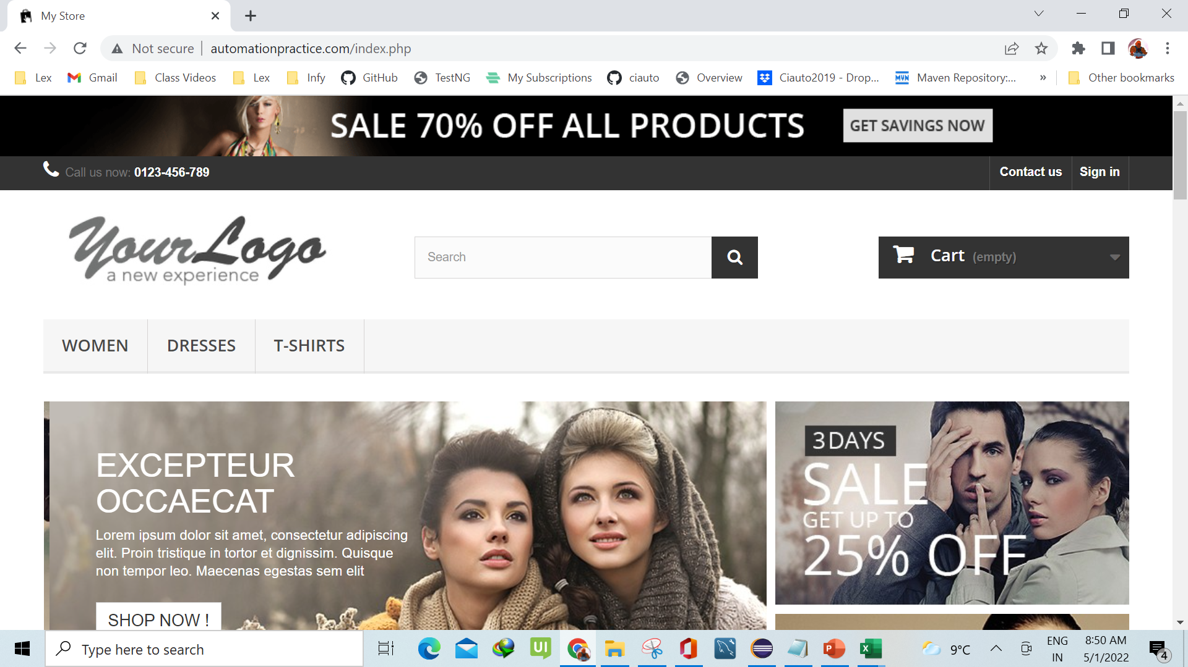
APPLICATION Overview
My Store is ecommerce website for automation testing practice
Register a Customer
Login as a Registered Customer
Order Products and accessing Order History Page
Browsing social media platforms
Contacting the company via Contact Us Page

Slide 3



Application flow
Login
Enter Email address & password
Product Search
Add / Remove Cart items
Check out
Support
Register/Sign In ONLY IF not registered/logged in
Address Update
Payment Options
Order confirmation
Registered user
Guest
Contact Help Desk

Slide 4

Business Value due to automation
FREQUENT RELEASES DUE TO FASTER DEPLOYMENT
BETTER UI EXPERIENCE TO END USERS
COMPETITIVE EDGE IN THE MARKET
INCREASE IN SALES AND REVENUE

Slide 5
TECHNOLOGIES USED
TECHNOLOGIES/TOOLS | VERSIONS
Eclipse IDE | 2018-12
Java JDK | 8u271
Selenium Web Driver | 3.141.59
TestNG | 6.14.3
Maven | 3.8.4
Git, Github | 2.35.1
Jenkins | 2.332.2 LTS
Extent Reports | 2.42.2

Slide 6
Testcases
TESTCASE ID | PAGE CLASSES USED BY TESTCASES | VALIDATIONS | STATUS
TC002_MS_RegistrationPageTest | Landing Page Login Page Register Page MyAccount Page | Validated Successful Registration Asserted the Title of My Account Page and Registered Customer name | Pass
TC003_MS_MyPersonalInfoPageTest | Account Page My Personal Information Page Identity Page Login Page | Changed password from My Personal Information Page Logged in again with changed password Asserted successful login by validating the Page title of My Account Page | Pass
TC004_MS_OrderPageTest | Identity Page Order Page | Added a product(T-Shirt) in the cart Navigated to Shopping Cart Navigated until Order Confirmation in the Order Page Asserted the Order Confirmation Page Title and Order Confirmation text | Pass
TC005_MS_ContactUsPageTest | Order Page Contact Us Page | Give details in the Contact Us page clicked on Send button Asserted the Contact Us Text Logged out | Pass
TC006_MS_CreateAnAccountFailedTest | Contact Us Page Landing Page | Clicked on Sign In Button in Contact Us Page Provided the email address and clicked on Create an Account button Asserted the Error message displayed Clicked on Your Logo image and landed on Landing Page | Fail
TC001_MS_LandingPageTest | Landing Page | Validate Landing Page Title Clicked on Follow Us Links Navigated to different windows Asserted the child windows and Closed the Childwindows | Pass

Slide 7
Integration
Eclipse- Maven
TestNG
Create Maven Project
Github
Push Source code to git hub using git
Jenkins
Add JDK & Maven installation details
Extent Report
Report generation providing Pass / Fail status
Create Test Scripts in Page Object Model Framework
Update POM
Create a Job. Provide Git repository URL & credentials
Trigger build
Incorporate TestNG
Convert to TestNG xml
Publish HTML Reports

Slide 8
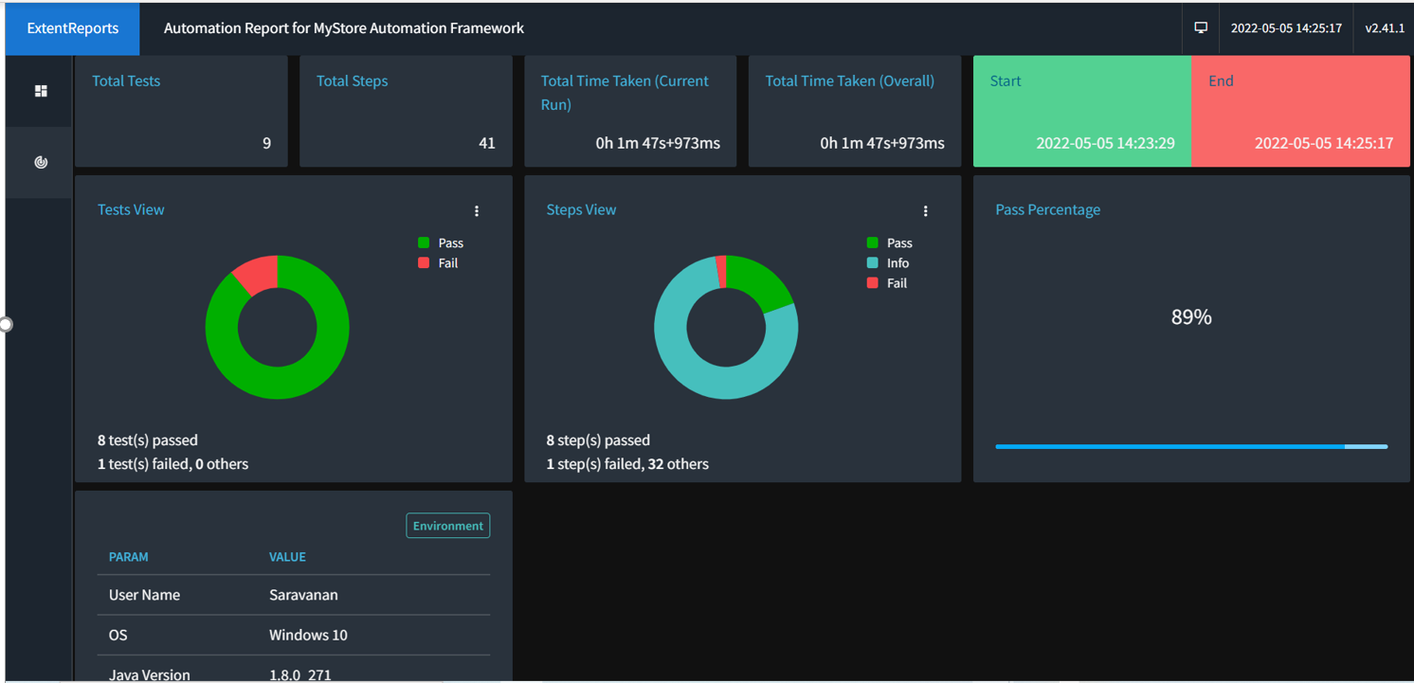
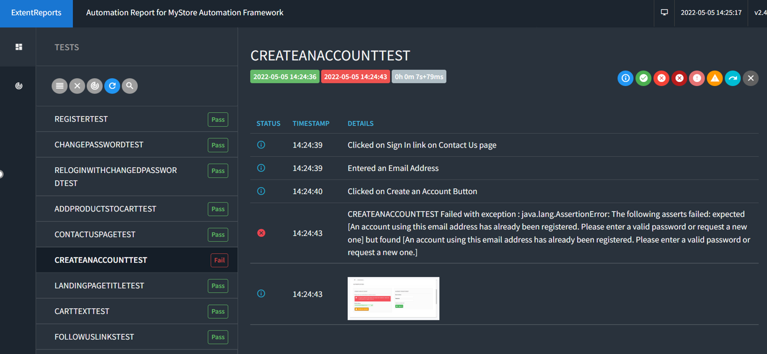
JENKINS EXTENT REPORT

Slide 9
Thank You!

