Slide 1

PhiloRead
Batsheva Schiff
The objective of this algorithm is to make the process of learning and reading philosophy books easier and more accessible to the everyday reader.
The importance of this algorithm is to inspire readers and to encourage them to learn and read complex texts.
Notes:
שם הפרוייקט והשם שלכם + מטרת הפרוייקט ולמה הוא חשוב

Slide 2
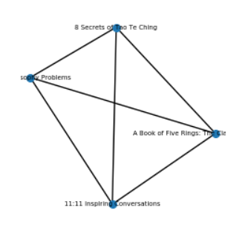
Graph definition & data collection
The vertices in the graph are philosophy book.
The edges are formed between all vertices and are weighed by the amount of philosophical terms shared by the connected vertices.
The data I used to build the graph is from the website www.goodreads.com.
Notes:
הגדרת הגרף ואיסוף נתונים

Slide 3
Weight function
Deciding on a list of introductory books to philosophy such that all path must start at an introductory level book and make its way to the book chosen by the user.
Books that mention an author in their summary are “closer” to books written by that author.
If two vertices shared a philosophical term that appear in more then one attribute they are considered “closer”.
Notes:
הסבר על היוריסטיקות שעשיתם בהם שימוש

Slide 4
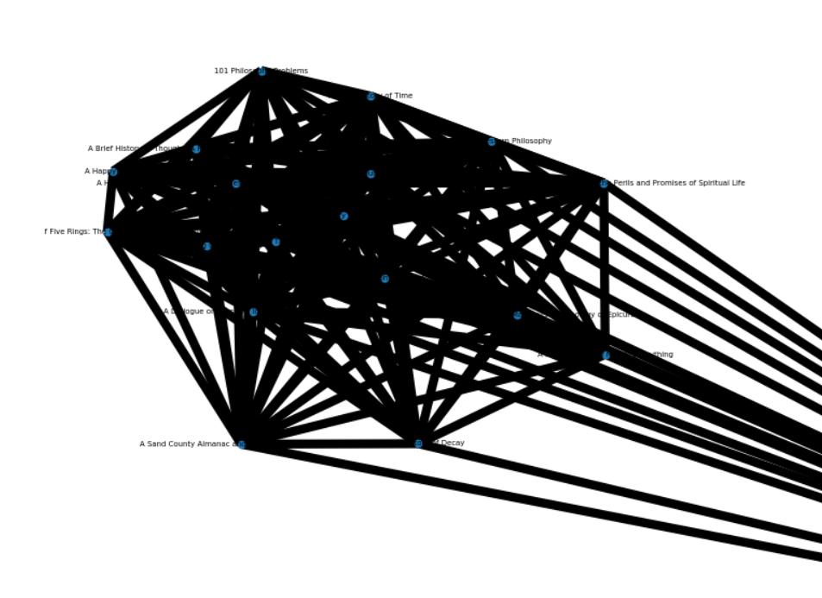
Results
My data base had over 9000 books, with a matching number of nodes. When creating the graph if two nodes are very incompatible then they will not have a connecting edge between them.
Notes:
תוצאות: כמה יעיל יותר היה החיפוש היוריסטי

Slide 5

Ideas for follow-up projects
Academic book summaries will yield better results
Develop the algorithm to include all genres of books and not just philosophy.
Add heuristic function to make the search more accurate, currently all similar terms have the same weight, a heuristic function should add less weight if the word is uncommon.
Notes:
כיווני המשך לפרוייקט

Slide 6
Code packages
My algorithm was written in python and uses these packages:
networkx– for modeling graphs
os- to glean information from html links
json – reading and making json files
sys – creating maximum values
tkinter – for building the GUI
re- regular expression for list manipulation
requests – for links downloading
Webbrowser – for connecting GUI with the internet
Notes:
נספח עם פרטי מימוש (חבילות קוד / עיבוד נתונים וכו)

