Slide 1



HerStory
Reading with gender awareness
Batsheva Schiff

Slide 2
Demo

Slide 3
Motivation / Goal:
To study the correlation between gender and the use of specific verbs.
To raise awareness to the sexist way authors treat female protagonists.
Creation of a program that will help determine if a book is unbiased towards women.

Slide 4
Data collection/data processing:
Database: classic literature books.
Labels: feminist / chauvinistic [1,0].
Data pre-processing: stemming and removing common words.
Categories: verbs that appear at least over 10 times in a book.
Vectorization: bag of words and using the tf-idf transformation.
“she walked into the dark park as he looked on into the distance, she knew that she would never see him again…”
book | walk | look | … | … | knew | would
 | 0.056 | 0.432 | 0.. | 0… | 0.032 | 0.465
`

Slide 5
Machine Learning Setup
- Preprocessing the data.
- Labeling and categorizing.
- Finding the best classifier (K-nearest Neighbors).
- Testing results.
Input example: | is feminist?
Around the world in 80 days | 0
Alice’s Adventures in Wonderland | 0
Romeo and Juliet | 0
Anne of green gables | 1
Ulysses | 1
The wavs - Virginia Woolf | 1

Slide 6
Results
Classification rate: 83.35%
Returns:
If the book is feminist or chauvinistic.
The percentage of similarity between this book to its neighbors.
Conclusion: the indication for if the book is feminist is the number of times that the pronoun “she” appears and the action that fallows.

Slide 7
Summary / What I’ve learned:
The basic of machine learning
Bag-of-word theory
Tdi-idf
Html

Slide 8
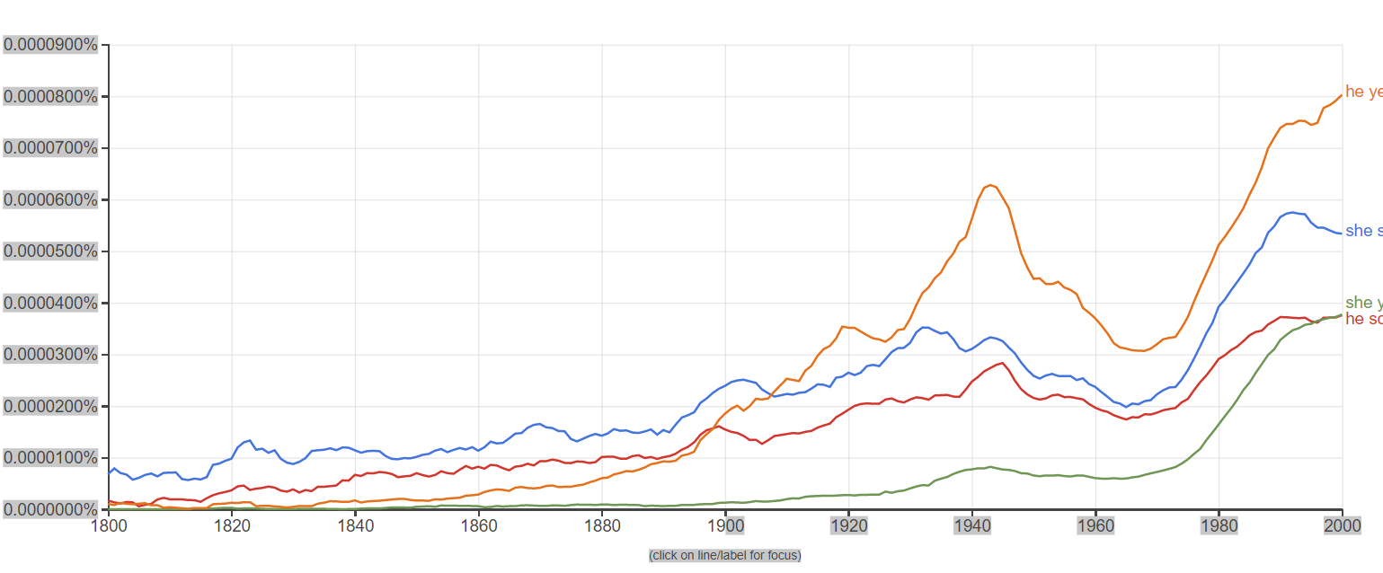



Future work:
Offering alternative verbs to writers while writing (unbiased auto-correct).
Taking into account the year a book was written.
Using the data from Google’s Ngram:

Slide 9
Appendix -implementation details:
Re
Os
Nltk
Json
Numpy
Sys
Sklearn
Flask
Html

