Slide 1





CS/SE Instructors Can Improve
Student Writing without Reducing Class Time Devoted to Technical Content:
Experimental Results
Paul V. Anderson, Elon University
Sarah Heckman, Mladen Vouk, David Wright, Michael Carter, NC State University
Janet E. Burge, Wesleyan University
Gerald C. Gannod, Miami University
21/05/2015
Joint SE Education and Training Track

Slide 2
Agenda
Problem
Background to our experiment
Hypotheses
Research Design
Results
Threats to validity
Applications
Future work
21/05/2015
Joint SE Education and Training Track

Slide 3
The Problem – In a Nutshell
  Employers report CS/SE graduates are technically strong, but lack needed communication skills
  Most CS/SE programs are reluctant to increase domain- specific communication instruction
    Not trained to teach communication
    Don’t want to lose time for technical instruction
21/05/2015
Joint SE Education and Training Track

Slide 4
CPATH Project
NSF-funded project to find ways to incorporate communication learning outcomes into undergraduate CS/SE classes
Co-PIs from Miami University (Ohio) and NC State University
Participants from 12 other institutions
Fundamental outcome: Integrate technical and communication work—as the two are integrated in the workplace
21/05/2015
Joint SE Education and Training Track

Slide 5
Reader-oriented Integrated Technical and Communication Instruction (RITCI)
Scenario
  Person performing technical work must communicate results to someone else who needs to use the result to perform his or her own work
Genre
  Conventional ways of communicating in recurring situations
  Guide writers to address readers’ recurring communication needs
  CS/SE educators are experts at writing in these genres
Scenarios + Genres = Legitimate Peripheral Participation
21/05/2015
Joint SE Education and Training Track

Slide 6
Research Hypotheses
Using RITCI in a CS/SE course without taking class time away from technical instruction will have a positive impact on the quality of students’ communication abilities.
Using RITCI in a CS/SE course without taking class time away from technical instruction will have a positive impact on the quality of students’ technical abilities.
21/05/2015
Joint SE Education and Training Track

Slide 7
CSC216 @ NC State
Software Engineering Intensive CS1.5
  Advanced OO
  Software Engineering
    Requirements
    Design
    Testing
  Linear Data Structures
  Recursion
  Finite State Machines
  Searching
  Sorting
CSC116
Intro to Programming
CSC216
Programming Concepts
CSC316
Data Structures
21/05/2015
Joint SE Education and Training Track

Slide 8
Course Context
Three 2-part projects
  Part 1: Design Proposal and Rationale and Black Box Test Plan
  Part 2: Implementation and Unit Test
Genre: Black Box Test Plan
  Introduces testing of the system
  Models system or acceptance tests for project use cases
  Provides a test plan template, which was our focus
Test ID | Description | Expected Results | Actual Results
21/05/2015
Joint SE Education and Training Track

Slide 9
Control and Treatment
 | Control | Treatment
Semester | Fall 2011 | Fall 2012
# Students | 115 | 134
# Sections | 2 | 2
# Distinct Instructors | 2 | 1
Project Development | All Paired | Solo, Solo, Paired
# Assignments Evaluated | 31 | 14
The other instructor in Fall 2011 used different materials for technical instruction in black box
testing.
21/05/2015
Joint SE Education and Training Track

Slide 10
For Treatment Sections:
Three Interventions
Included in the printed assignment a scenario that focused on the reader’s need
Created a model test plan that showed strategies for helping the reader
Modified the grading rubric to emphasize the readers’ perspective
Used these interventions
without taking any class time beyond
telling students that the model test plan was available online
21/05/2015
Joint SE Education and Training Track

Slide 11
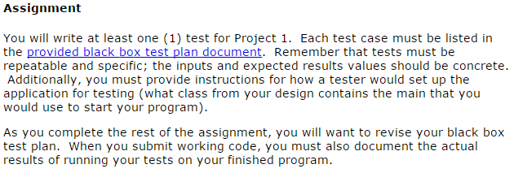
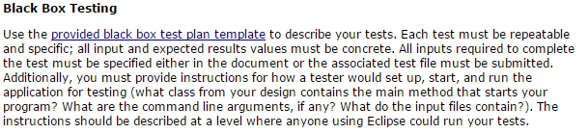
Intervention 1:
Reader-Oriented Scenario
But control suggests that the student is the real user of his or her test plan.
Both assignments clarify tests are repeatable and specific with concrete values.
Treatment indicates that the test plan must enable someone else to conduct the test
Tells what that reader knows
Tells what reader needs to start and conduct the test
21/05/2015
Joint SE Education and Training Track

Slide 12

Control Sections
Test Plan Template – Introduction
Students were only provided a template document
Introduction suggests students are writing for themselves or instructor
21/05/2015
Joint SE Education and Training Track

Slide 13
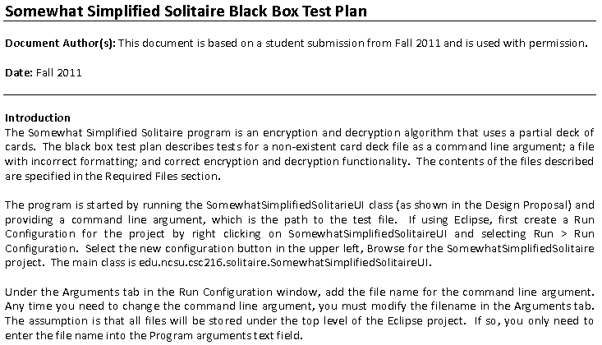
Intervention 2: Treatment Sections
Model Test Plan – Introduction
Use of imperative mood
Instructions to reader
21/05/2015
Joint SE Education and Training Track

Slide 14
Control Sections
Test Plan Template – Test Grid
Students were only provided a template document
Test grid only suggests a level of detail – no mention of
reader needs
21/05/2015
Joint SE Education and Training Track

Slide 15
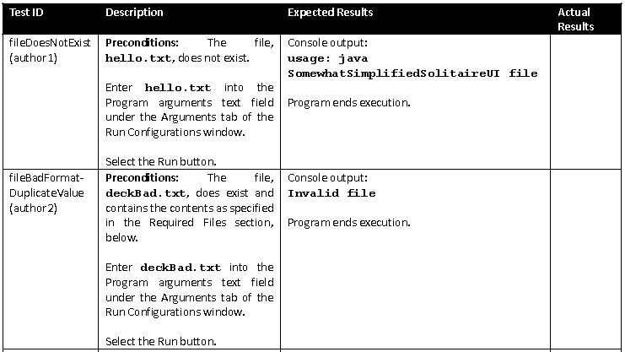
Intervention 2: Treatment Sections
Model Test Plan – Test Cases
Text user enters in bold monotype
Instructions are in imperative mood
Clarifying details provided to tester
21/05/2015
Joint SE Education and Training Track

Slide 16
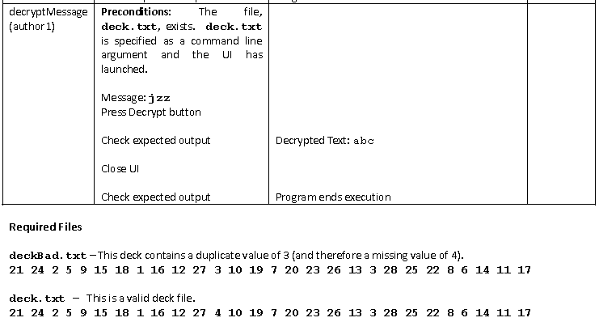
Intervention 2: Treatment Sections
Model Test Plan – Test Cases
Expected results correspond to the step generating the result (with reminder to check).
Blank lines separate steps
Examples of required files for test
21/05/2015
Joint SE Education and Training Track

Slide 17
Intervention 3:
Reader-Oriented Rubric
Six criteria: 4 related to content; 2 related to presentation
Three levels of performance: Excellent, Adequate, Inadequate
Adequate/Inadequate levels moved from general characteristics to what the tester needs to conduct the test
Expected Results Rubric Item
Performance Level | Control | Treatment
Adequate
Inadequate
are mostly fully specified, but some output values may be missing or have unspecific values.
One or two outputs missing, but test
results are clear.
are incomplete or have no specific output values.
Missing critical output values.
21/05/2015
Joint SE Education and Training Track

Slide 18
Evaluation of Student Test Plans
External Evaluation
  Three CS/SE faculty from other universities
  Over 30 years of combined CS/SE teaching experience
  Used 10 main criteria and 30 sub-criteria, all from perspective of scenario’s readers – manager & tester
  Two-day training and norming conducted by external evaluation team
IRR “fair” to “excellent”: ICC >0.40
  Except for sub-criteria under Style
High internal consistency: Cronbach’s alpha > 0.80
21/05/2015
Joint SE Education and Training Track

Slide 19
Results 1
Treatment Section – Significantly Better on Communication
Introduction | p<.04
Usability of the test descriptions | p<.001
Comprehensibility | p<.01
Accessibility | p<.001
Style (low IRR) | p<.001
Overall Effectiveness | p<.001
Joint SE Education and Training Track
21/05/2015

Slide 20
Results 2
No Significant Difference on Technical Skills
  Test Coverage
  Test IDs
  Expected Results
  Actual Results
21/05/2015
Joint SE Education and Training Track

Slide 21
Results 3
  Treatment section rated significantly higher on OVERALL communication AND technical skills
  OVERALL, the communication will ENABLE . . .
ENABLE the MANAGER to EVALUATE the test plan EFFICIENTLY | p< 0.001
ENABLE the TESTER to CONDUCT the test EFFICIENTLY and ACCURATELY | p< 0.001
PERSUADE the MANAGER and the TESTER that the writer is a SKILLED COMMUNICATOR | p< 0.003
PERSUADE the MANAGER and the TESTER that the writer is a SKILLED COMPUTER SCIENTIST / SOFTWARE ENGINEER | p< 0.001
21/05/2015
Joint SE Education and Training Track

Slide 22
Discussion
Possible for CS/SE instructors to increase domain-specific writing
  Without knowledge of writing pedagogy
  Without diminishing technical content
  (at least in a software engineering-intensive CS1.5 course)
Replication materials
  Some available online
  Assignments and solutions are available by request
21/05/2015
Joint SE Education and Training Track

Slide 23
Threats to Validity
Internal Validity
  Used Fall sections for both control and treatment
  Control students paired, Treatment students solo/paired depending on project
  Different programs in each offering
  No check on other confounding factors (GPA, grades, etc.)
External Validity
  Results may not generalize beyond the courses studied
Construct Validity
  Evaluation rubric evaluated by team of CS/SE, technical writing, and measurement specialist
21/05/2015
Joint SE Education and Training Track

Slide 24
Application
Use RITCI to help move students to roles as software engineers – legitimate peripheral participation
  Frame assignments in meaningful scenarios with specific readers who need to use results of students’ technical work
  Use readers’ perspective in rubric
  Provide examples – preferably with annotations
    The ones in the slides are a good starting point (we’ll be adding that to our example in the Fall!)
Begin in a first or second semester course! Don’t wait for an SE course!
21/05/2015
Joint SE Education and Training Track

Slide 25
Future Work
Replicate the study in other classes with other instructors
Add annotations to example Black Box Test Plan
Increase focus on the needs of manager/tester
Use Writing-in-the-Discipline Strategies, such as drafts, peer review, etc.
Explore the extent (and limits) to the RITCI approach
Measure how well the skills transfer to other courses in the curriculum
21/05/2015
Joint SE Education and Training Track

Slide 26
Acknowledgements
Other CSC216 Instructors
Other members of the CPATH team
External Reviewers
Ohio’s Evaluation Assessment Center for Mathematics and Science Education
Yue Li
Funded by NSF CPATH II Award CCF-0939122 and CCF-0939081
  Any opinions, findings, and conclusions or recommendations expressed in this material are those of the author(s) and do no necessarily reflect the views of the National Science Foundation
21/05/2015
Joint SE Education and Training Track

