Slide 1
Adaptive Ranking Model for Ranking Code-Based Static Analysis Alerts
Sarah Smith Heckman
Advised by Laurie Williams
Department of Computer Science
North Carolina State University

Slide 2
Contents
Motivation
Research Objective
Related Work
Adaptive Ranking Model
  Key Concepts
  Research Theories
  Alert Ranking Factors
  Limitations
Research Methodology
Current Research Results
Future Work

Slide 3
Motivation
Developers tend to make the same mistakes that lead to software faults
Automated static analysis (ASA) is useful for finding indications (alerts) of these recurring mistakes
ASA generates a high number of false positives (FP)
Notes:
Developers tend to make the same mistakes when developing software that can lead to software faults. Automated static analysis can find these recurring mistakes like a possible null pointer without execution of the source code. Another benefit of static analysis is that ASA can be run repeatedly throughout the development lifecycle. However, ASA must use approximations and make assumptions about the code under analysis to run in an efficient manner. Because of this, ASA reports a high number of false positives, as many as 50 for every true positive or fault uncovered.
The term fault is used to describe anomalies identified by static analysis because of the potential that these anomalies may never surface as failures in operational use of the product
An alert is a notification to the programmer, in the form of a warning message, of a potential problem, or fault, in the source code that has been identified via static analysis

Slide 4
Research Objective
To create and validate an adaptive ranking model to rank alerts generated from automated static analysis by the likelihood a static analysis alert is an indication of a fault in the system.
Increase the number of alerts that indicate a fault at the top of an alert listing.
Notes:
Therefore my research objective is to create and validate an adaptive ranking model to rank alerts generated from ASA by the likelihood a static analysis alert is a fault in the system.

Slide 5
Related Work
Kremenek et al. [1]
  Adaptive feedback on ASA alerts
  Use location of alert in code
Kim and Ernst [2]
  Investigate the lifetime of an ASA alert
Brun and Ernst [3]
  Use machine learning to rank program properties by the likelihood they will reveal faults
  “Learning from fixes”
Boogerd and Moonen [4]
  Prioritize alerts by execution likelihood

Slide 6
Adaptive Ranking Model (ARM)
True
Positive (1)
Static Analysis
Alerts
ARM
Developer
Feedback
Undeterminable (0)
Historical Data
False
Positive (-1)
Notes:
The ARM ranks each provides a continuously-updated ranked listing of ASA alerts based on the population of generated ASA alerts, developer feedback in the form of suppressing false positives and closing true positives, and historical data about ASA from previous releases of the product or from literature about the ASA. The ranking of an alert is on a continuum from -1 to 1 where a value of -1 implies that an alert is likely to be a false positive while a value of 1 implies that an alert is likely an indication of a fault. A value of 0 means that the ARM was unable to determine the likelihood an alert was a true or false positive either due to a lack of historical information about the alert or due to the pertinent populations of the alert being a split of true or false positives. Essentially we’re using yesterdays weather to predict today’s. The more information the developer puts back into the ARM the better the prediction of future alerts will be.

Slide 7
Key ARM Concepts
Alert Suppression – an explicit action on the part of the developer to remove an alert from the listing
  Alert does not indicate a fault that exists in the source code – false positive (FP)
  Developer chooses not to fix the alert
Alert Closure – an alert is no longer identified by ASA
  A fault was fixed – true positive (TP)
  Configuration change
Notes:
When using ASA, the software engineer is presented with a listing of alerts to examine. The listing of alerts may be ranked or prioritized such that alerts more likely to be true positives are at the top of the list or the order may be determined by the ASA without such a ranking scheme. A software engineer selects an alert and inspects the associated source code to determine if the alert is a fault in the software. If the developer determines an alert is a false positive, ASA may allow him or her to suppress the alert from future listings. Once an alert is closed or suppressed, the alert will no longer appear in future alert listings.
Suppressing an alert is an explicit action on the part of the software engineer to indicate that he or she does not want to see that particular alert in future ASA runs. A software engineer will suppress an alert found to be a false positive. A software engineer may also choose to suppress alerts that are an indication of a fault that he or she does not elect to fix. An example of this is a style alert such as the capitalization of a field.
An alert is closed when ASA no longer identifies an alert, usually after an alert has been fixed. An alert may be fixed by an explicit action on the part of the software engineer at the alert location or surrounding code or an alert can be fixed implicitly by related changes or fixes to code unrelated to the alert. An alert may also be closed due to changes in the configuration of the ASA (e.g. the alert type is no longer selected).

Slide 8
Research Theories
The ARM improves the fault detection rate of automated static analysis when compared to other ranking or ordering techniques.
Each of the ranking factors in the ARM contribute in predicting the likelihood an alert is an indication of a fault.
Notes:
Currently, I’m investigating the following theories. These theories will be revised and added to as research progresses.
The first theory is that each ranking factor in the ARM will contribute to predicting the likelihood an alert is a TP. A ranking factor predicts the likelihood an alert is a true positive on one or more characteristics about that alert. An alert is ranked based on developer feedback on the population of alerts that share that characteristic. For example, the historical true positive rate of a particular type of alert, like a null pointer, can be predictive of the likelihood that other null pointers would also be true positives. In the current version of the ARM, we consider two alert ranking factors: alert type accuracy and code locality.
The second theory is that the ARM will present the developer with more TP alerts at the top of the alert listing than a random ordering, or tool ordering of the same alerts.

Slide 9
Current Alert Ranking Factors
Alert Type Accuracy (ATA): the likelihood an alert is an indication of a fault based on developer feedback and historical data about an alert type
Code Locality (CL): the likelihood an alert is an indication of a fault based on the developer feedback about the alert’s location in the source code

Slide 10
Alert Ranking Calculation
Ranking(α) = (β_{ATA} ∙ ATA(α)) + (β_{CL} ∙ CL(α))
where β_{ATA} + β_{CL} = 1
Ranking is the weighted average of the ranking factors, ATA and CL
Currently, β_{ATA} = β_{CL} = 0.5, implying each factor contributes equally to the ranking

Slide 11
Adjustment Factor
The adjustment factor (AF) represents the homogeneity of an alert population of based on developer feedback
An alert population (p) is a subset of reported alerts that share some characteristic
AF_{p}(α) = (#closed_{p} - #suppressed_{p}) / (#closed_{p} + #suppressed_{p})

Slide 12
Alert Type Accuracy
ATA is the weighted average of:
  Historical data from observed TP rates (initial ATA value – τ_{type})
  Actions a developer has taken to suppress and close alerts (AF_{ATA})
ATA(α) = (x ∙ τ_{type}) + (y ∙ AF_{type}(α))
where x + y = 1
Currently, x = y = 0.5, implying each factor contributes equally to the ranking
Ranking(α) = (β_{ATA} ∙ ATA(α)) + (β_{CL} ∙ CL(α))

Slide 13
Code Locality
CL is the weighted average of the actions a developer has taken to suppress and close alerts at the method (m), class (c), and source folder (s) locations
CL(α) = (β_{m} ∙ AF_{m}(α)) + (β_{c} ∙ AF_{c}(α)) +(β_{s} ∙ AF_{s}(α))
where β_{m} + β_{c} + β_{s} = 1
Currently, β_{m} = 0.575, β_{c} = 0.34, and β_{s} = 0.085^{[1]}
Ranking(α) = (β_{ATA} ∙ ATA(α)) + (β_{CL} ∙ CL(α))

Slide 14
Limitations
Limitations
  The initial ranking values for the current version of the ARM are provided through literature
    Some alert types have no initial value
    Alert types were summarized to a parent alert type
  All coefficients are set to default values
  Rely on the assumptions that alert populations are likely to be homogeneous

Slide 15
Research Methodology
Developing and evolving the ARM via a literature search, intellectual work, and formative case studies
  Comparison of the fault detection rate [5] for the ARM with other static analysis alert detection techniques
  Investigate contribution of current factors to the ranking
  Consider other factors to improve the ranking

Slide 16
Current Research Results
Case Study
  iTrust
    Web-based, role-based medical records application
    Developed as part of undergraduate software engineering class and graduate testing and reliability class
  ARM v0.4
  FindBugs static analyzer
  1964 LOC source, 3903 LOC test
  163 alerts, 27 true positives

Slide 17
Research Questions
Q1: Can the ranking of static analysis alerts by the likelihood an alert is a fault improve the rate of fault detection by automated static analysis?
Q2: What are the contributions of each of the alert ranking factors (in the form of homogeneity of ranking populations) in predicting the likelihood an alert is a fault?

Slide 18
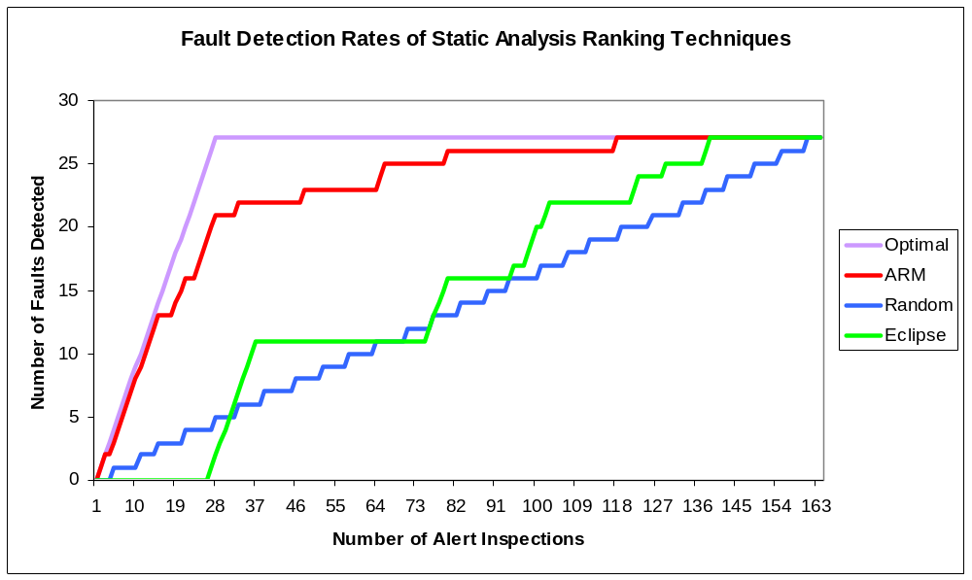
Fault Detection Rates

Slide 19
Ranking Factor Contributions
Population | # Pops | # TP | # FP | # Mixed
Alert Type | 18 | 4 | 11 | 3
Method | 78 | 19 | 53 | 6
Class | 36 | 7 | 18 | 11
Source Folder | 5 | 0 | 3 | 2

Slide 20
Research Results
ARM was able to find 81.5% (22) of the true positive alerts after investigating 20% (33) of the generated alerts
  Random found 22.2% (6) true positive alerts
  Eclipse found 30% (8) true positive alerts
However, the remaining alerts were more difficult to find due to non-homogeneous populations

Slide 21
Future Work
Research Theories
  The ARM improves the fault detection rate of automated static analysis when compared to other ranking or ordering techniques.
  Each of the ranking factors in the ARM contribute in predicting the likelihood an alert is an indication of a fault.
Future Work
  Continue evaluating ARM on open source and industrial applications
  Incorporate additional factors into the ARM
  Investigate the contribution of each factor and the effect of the coefficients on the overall ranking of ASA alerts
  Improve the ranking of non-homogeneous populations

Slide 22
References
[1] T. Kremenek, K. Ashcraft, J. Yang, and D. Engler, "Correlation Exploitation in Error Ranking," in 12th ACM SIGSOFT International Symposium on Foundations of Software Engineering, Newport Beach, CA, USA, 2004, pp. 83-93.
[2] S. Kim and M. D. Ernst, "Prioritizing Warning Categories by Analyzing Software History," in International Workshop on Mining Software Repositories, to appear, Minneapolis, MN, USA, 2007.
[3] Y. Brun and M. D. Ernst, "Finding Latent Code Errors via Machine Learning Over Program Executions," in 26th International Conference on Software Engineering, Edinburgh, Scotland, 2004, pp. 480-490.
[4] C. Boogerd and L. Moonen, "Prioritizing Software Inspection Results using Static Profiling," in 6th IEEE Workshop on Source Code Analysis and Manipulation, Philadelphia, PA, USA, 2006, pp. 149-160.
[5] G. Rothermel, R. H. Untch, C. Chu, and M. J. Harrold, "Prioritizing Test Cases For Regression Testing," IEEE Transactions on Software Engineering, vol. 27, no. 10, pp. 929-948, October 2001.

Slide 23
Questions?
Sarah Heckman: sarah_heckman@ncsu.edu

