Slide 1
On Establishing a Benchmark for Evaluating Static Analysis Prioritization and Classification Techniques
Sarah Heckman and Laurie Williams
Department of Computer Science
North Carolina State University

Slide 2
Contents
Motivation
Research Objective
FAULTBENCH
Case Study
  False Positive Mitigation Models
  Results
Future Work

Slide 3
Motivation
Static analysis tools identify potential anomalies early in development process.
  Generate overwhelming number of alerts
  Alert inspection required to determine if developer should fix
    Actionable – important anomaly the developer wants to fix – True Positive (TP)
    Unactionable – unimportant or inconsequential alerts – False Positive (FP)
FP mitigation techniques can prioritize or classify alerts after static analysis is run.
Notes:
Verbalize the definition of alert: An alert is a possible program anomaly identified by a static analysis tool like FindBugs, PMD, etc.

Slide 4
Research Objective
Problem
  Several false positive mitigation models have been proposed.
  Difficult to compare and evaluate different models.
Research Objective:
to propose the FAULTBENCH benchmark to the software anomaly detection community for comparison and evaluation of false positive mitigation techniques.
http://agile.csc.ncsu.edu/faultbench/
Notes:
Give examples of models:
Ruthruff et al. – Linear regression model of many alert characteristics - FindBugs
Kim and Ernst – Alert Lifetime and fix history – FindBugs and PMD
Williams and Hollingsworth – source code repo history and current status – their own static analysis tools
Kremmeck et al. – Alert location and Metal static analysis tools for C
Other static analysis tools: Klocwork, Fortify
Other benchmarks:
Siemens – C/C++ code – for testing
BugBench – C/C++ applications
Chord – static analysis race detection – Java – programs are large
Promise – no project source, just metrics about the project – require the source to make an oracle and static analysis alert do not always tie directly to program faults
Other large open-source programs – https, Wine, JDK, Columba, etc. - Difficult to compare models b/c different sample programs and different evaluation metrics.
Current benchmarks insufficient for three reasons:
Lacking detialed, repeatable process for use and evaluation
Most in C/C++ which doesn’t allow for evaluation of models for Java
Adaptive alert prioritization research requires changing source code to fix alerts, which takes a long time for large programs.

Slide 5
FAULTBENCH Definition^{[1]}
Motivating Comparison: find the static analysis FP mitigation technique that correctly prioritizes or classifies actionable and unactionable alerts
Research Questions
  Q1: Can alert prioritization improve the rate of anomaly detection when compared to the tool’s output?
  Q2: How does the rate of anomaly detection compare between alert prioritization techniques?
  Q3: Can alert categorization correctly predict actionable and unactionable alerts?
Notes:
Definition from Sim, Easterbrook, and Holt “Using Benchmarking to Advance Research: A Challenge to Software Engineering”
Motivating Comparison
Task Sample
Evaluation Measures

Slide 6
FAULTBENCH Definition^{[1]} (2)
Task Sample: representative sample of tests that FP mitigation techniques should solve.
  Sample programs
  Oracles of FindBugs alerts (actionable or unactionable)
  Source code changes for fix (adaptive FP mitigation techniques)

Slide 7
FAULTBENCH Definition^{[1]} (3)
Evaluation Measures: metrics used to evaluate and compare FP mitigation techniques
Prioritization
  Spearman rank correlation
Classification
  Precision
  Recall
  Accuracy
  Area under
  anomaly detection
  rate curve
Actual
 | Actionable | Unactionable
Actionable | True Positive (TP_{C}) | False Positive (FP_{C})
Unactionable | False Negative (FN_{C}) | True Negative (TN_{C})
Predicted
Notes:
Spearman rank correlation: compares two orderings of alerts by measuring the distance between the rank or location of each alert in each ordering. We compare with the optimal ordering.
Precision: the percentage of alerts classified as actionable that were actionable
Recall: the percentage of correctly classified actionable alerts
Accuracy: percentage of correctly classified actionable and unactionable alerts.
Area under anomaly detection rate curve: cumulative percentage of alerts detected after each inspection.
Anomaly detection rate curve is similar to a ROC curve. However, the axes are different. The ROC curve is the % of FPs versus the % of TPs. The anomaly detection rate curve is the number of inspected alerts versus the % of TPs. While the axes may be different, the ideas are similar in that you want the curve to grow quickly.

Slide 8
Subject Selection
Selection Criteria
  Open source
  Various domains
  Small
  Java
  Source Forge
  Small, commonly used libraries and applications

Slide 9
FAULTBENCH v0.1 Subjects
Subject | Domain | # Dev. | # LOC | # Alerts | Maturity | Alert Dist. | Area
cvsobjects | Data format | 1 | 1577 | 7 | Prod. | 0.64 | 5477
import scrubber | Software dev. | 2 | 1653 | 35 | Beta | 0.31 | 26545
iTrust | Web | 5 | 14120 | 110 | Alpha | 0.61 | 703277
jbook | Edu | 1 | 1276 | 52 | Prod. | 0.28 | 29400
jdom | Data format | 3 | 8422 | 55 | Prod. | 0.19 | 211638
org.eclipse. core.runtime | Software dev. | 100 | 2791 | 98 | Prod. | 0.30 | 239546
Notes:
Alert distribution – value describing how many unique alert types FindBugs identified in a subject program. The sum of the number of alerts of the same type in a subject program divided by the number of subjects that contain at least one alert of that type which is then divided by the number of alerts the subject contains.
Talk about two highlighted examples

Slide 10
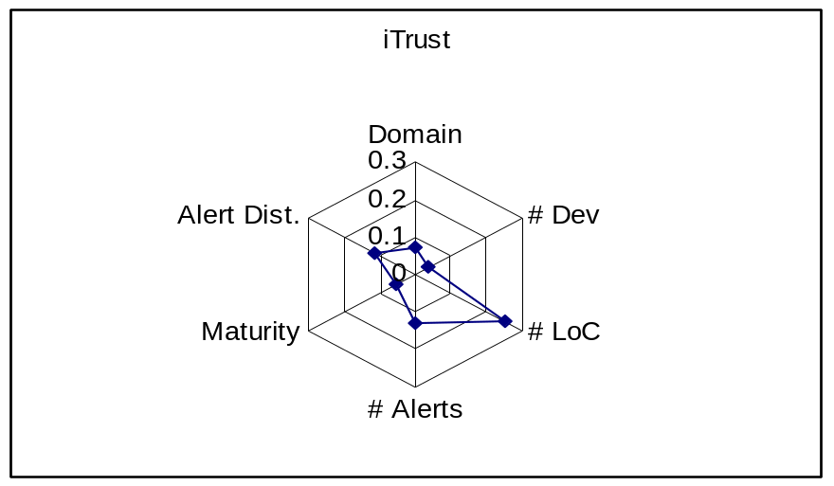
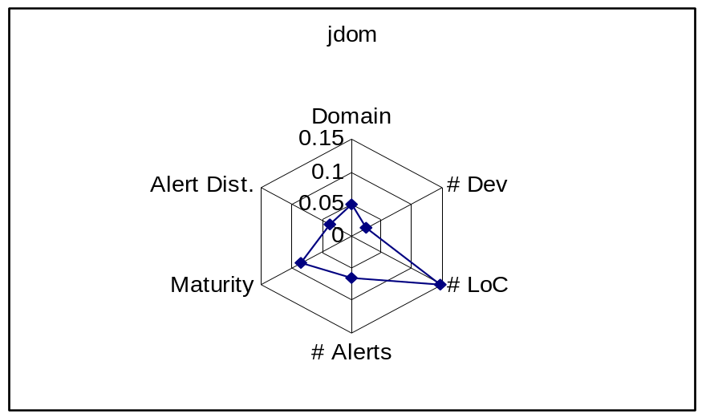
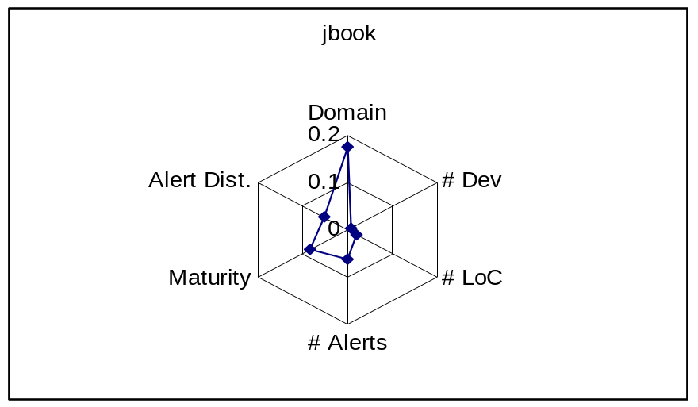
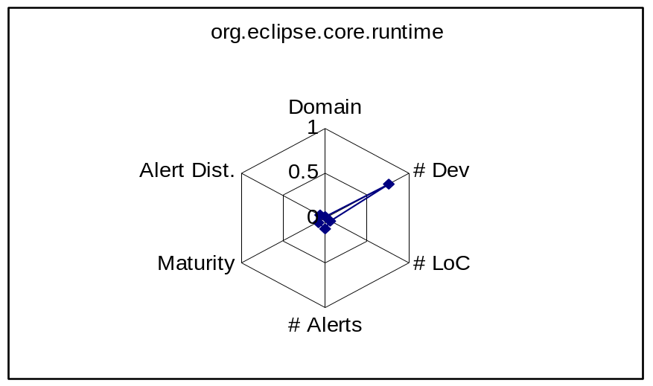
Subject Characteristics Visualization
Notes:
We also visualized the subject characteristics on radar charts which demonstrate how the subjects vary from one another.

Slide 11
FAULTBENCH Initialization
Alert Oracle – classification of alerts as actionable or unactionable
  Read alert description generated by FindBugs
  Inspection of surrounding code and comments
  Search message boards
Alert Fixes
  Changed required to fix alert
  Minimize alert closures and creations
Experimental Controls
  Optimal ordering of alerts
  Random ordering of alerts
  Tool ordering of alerts
Notes:
When discussing alert oracle mention that the justification of actionable or unactionable is in alert oracle spreadsheet. Also mention that I tended to err on the side of FP, especially in the cases where alerts were style issues.

Slide 12
FAULTBENCH Process
For each subject program
  Run static analysis on clean version of subject
  Record original state of alert set
  Prioritize or classify alerts with FP mitigation technique
Inspect each alert starting at top of prioritized list or by randomly selecting an alert predicted as actionable
  If oracle says actionable, fix with specified code change.
  If oracle says unactionable, suppress alert
After each inspection, record alert set state and rerun static analysis tool
Evaluate results via evaluation metrics.
Notes:
Need to mention that the process is for adaptive FP mitigation techniques, which are techniques that take the developer action about an alert into account when prioritizing or classifying alerts.

Slide 13
Case Study Process
Open subject program in Eclipse 3.3.1.1
  Run FindBugs on clean version of subject
  Record original state of alert set
  Prioritize alerts with a version of AWARE-APM
Inspect each alert starting at top of prioritized list
  If oracle say actionable, fix with specified code change.
  If oracle says unactionable, suppress alert
After each inspection, record alert set state. FindBugs should run automatically.
Evaluate results via evaluation metrics.
Notes:
Use the prior slide as an introduction to the specifics of the case study. Particularly, ran everything in Eclipse 3.3.1.1, the models were versions of AWARE-APM, FindBugs set to run automatically. Those items highlighted are the specifics of the case study.

Slide 14
AWARE-APM
Adaptively prioritizes and classifies static analysis alerts by the likelihood an alert is actionable
Uses alert characteristics, alert history, and size information to prioritize alerts.
0
Unknown
-1
Unactionable
1
Actionable
Notes:
Brief overview of AWARE-APM and how it both prioritizes and classifies alerts which fits the motivating comparison of FAULTBENCH. Additionally, we evaluate the three versions of AWARE-APM with the FAULTBENCH research questions.
Q1: Can alert prioritization improve the rate of anomaly detection when compared to the tool’s output?
Q2: How does the rate of anomaly detection compare between alert prioritization techniques?
Q3: Can alert categorization correctly predict TP and FP alerts?

Slide 15
AWARE-APM Concepts
Alert Type Accuracy (ATA): the alert’s type
Code Locality (CL): location of the alert at the source folder, class, and method
Measure the likelihood alert is actionable based on developer feedback
  Alert Closure: alert no longer identified by static analysis tool
  Alert Suppression: explicit action by developer to remove alert from listing
Notes:
Alert Closure – an alert is no longer identified by ASA
A fault was fixed – true positive (TP)
Configuration change of static analysis tool
Alert Suppression – an explicit action on the part of the developer to remove an alert from the listing
Alert does not indicate a fault that exists in the source code – false positive (FP)
Developer chooses not to fix the alert

Slide 16
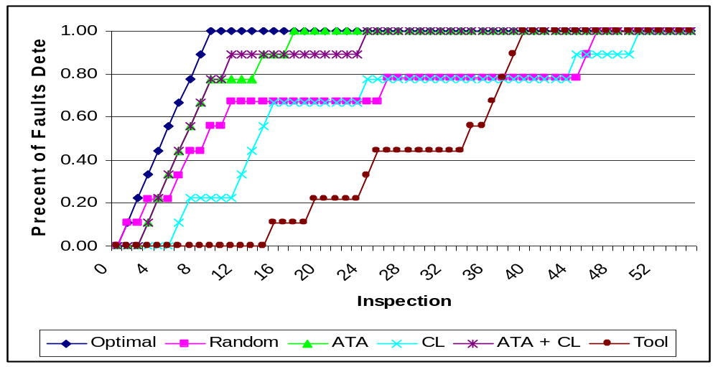
Rate of Anomaly Detection Curve
jdom
Subject | Optimal | Random | ATA | CL | ATA+CL | Tool
jdom | 91.82% | 71.66% | 86.16% | 63.54% | 85.35% | 46.89%
Average | 87.58% | 61.73% | 72.57% | 53.94% | 67.88% | 50.42%
Notes:
There were 9 faults considered actionable for jdom
Research Question 1 and 2.

Slide 17
Spearman Rank Correlation
 | ATA | CL | ATA +CL | Tool
csvobjects | 0.321 | -0.643 | -0.393 | 0.607
importscrubber | 0.512** | -0.026 | 0.238 | 0.203
iTrust | 0.418** | 0.264** | 0.261** | 0.772**
jbook | 0.798** | 0.389** | 0.599** | -0.002
jdom | 0.675** | 0.288* | 0.457** | 0.724**
org.eclipse.core.runtime | 0.395** | 0.325** | 0.246* | 0.691**
* Significant at the 0.05 level ** Significant at the 0.01 level
Notes:
Research Question 1 and 2
A positive correlation implies that the specified prioritization is similar to optimal, while a negative correlation shows an ordering opposite of optimal.
Cvsobjects is not significant b/c so few alerts (7). Importscrubber only had 35 alerts, so not completely significant.
Would have different values for different optimal orderings.
The tool ordering is over .6 for four of the six projects b/c the tool ordering can be very similar to the particular way that optimal was crafted. Optimal ordered the actionable alerts by project, package, file, method names, alert type, and then description. This ordering can be very similar to the ordering by location that the visitor pattern used by FindBugs takes when find alerts. However, you can see that while the spearman rank correlation may look good for the tool ordering, the area under the rate of anomaly detection curve for tool is much lower than the other treatments.

Slide 18
Classification Evaluation Measures
Subject | Average Precision |  |  | Average Recall |  |  | Average Accuracy
 | ATA | CL | ATA +CL | ATA | CL | ATA +CL | ATA | CL | ATA +CL
csvobjects | 0.32 | 0.50 | 0.39 | .038 | .048 | 0.38 | 0.58 | 0.34 | 0.46
import-scrubber | 0.34 | 0.20 | 0.18 | 0.24 | 0.28 | 0.45 | 0.62 | 0.43 | 0.56
iTrust | 0.05 | 0.02 | 0.05 | 0.16 | 0.15 | 0.07 | 0.97 | 0.84 | 0.91
jbook | 0.22 | 0.27 | 0.23 | 0.65 | 0.48 | 0.61 | 0.68 | 0.62 | 0.66
jdom | 0.06 | 0.09 | 0.06 | 0.31 | 0.07 | 0.29 | 0.88 | 0.86 | 0.88
org.eclipse. core.runtime | 0.05 | 0.04 | 0.03 | 0.17 | 0.05 | 0.11 | 0.92 | 0.94 | 0.95
Average | 0.17 | 0.19 | 0.16 | 0.42 | 0.25 | 0.32 | 0.76 | 0.67 | 0.74
Notes:
Research question 3.
Compare the two rows to bring out how FAULTBENCH allows for results to be generalized.
The precision and recall was averaged for each inspection for a project and AWARE-APM treatment. The precision and recall are low because both went to 0 after all of the alerts were inspected. It may be better to graph precision and recall over time rather than look at the average for each inpsection.

Slide 19
Case Study Limitations
Construct Validity
  Possible closure and alert creation when fixing alerts
  Duplicate alerts
Internal Validity
  External variable, alert classification, subjective from inspection
External Validity
  May not scale to larger programs

Slide 20
FAULTBENCH Limitations
Alert oracles chosen from 3rd party inspection of source code, not developers.
Generation of optimal ordering biased to the tool ordering of alerts.
Subjects written in Java, so may not generalize to FP mitigation techniques for other languages.

Slide 21
Future Work
Collaborate with other researchers to evolve FAULTBENCH
Use FAULTBENCH to compare FP mitigation techniques from literature
http://agile.csc.ncsu.edu/faultbench/

Slide 22
Questions?
FAULTBENCH: http://agile.csc.ncsu.edu/faultbench/
Sarah Heckman: sarah_heckman@ncsu.edu

Slide 23
References
[1]S. E. Sim, S. Easterbrook, and R. C. Holt, “Using Benchmarking to Advance Research: A Challenge to Software Engineering,” ICSE, Portland, Oregon, May 3-10, 2003, pp. 74-83.

