Slide 1

Open Course Resources as Part of the OpenSeminar in Software Engineering
 | Michael Rappa Sarah E. Smith Alex Yacoub

Slide 2
Contents
Motivation
OpenSeminar in Software Engineering
Monopoly Example > RealEstate Example
  Requirements
  Design
  Implementation and Test
  Software Engineering Education Knowledge (SEEK)
  Use
  Where to Find

Slide 3
Motivation
Online course resources are vital for sharing cutting-edge knowledge with students
Searching for, creating, and maintaining online course resources is time consuming
Software engineering professors can benefit from sharing openly available software engineering course resources
Notes:
In today’s connected world, online course resources are expected by students and necessary for sharing cutting-edge or emerging knowledge with students. Knowledge, especially in the computer related fields, is being generated quickly, and we rely on digital resources to keep our students up to date.
However, at an individual level, searching for, creating, and maintaining online course resources is time consuming. Every semester requires a reevaluation of digital materials for a class. Because of the wealth of information available it is overwhelming to find course materials that have already been created, and these materials will most likely require tailoring to fit the needs of a professor’s class.
What is needed is a repository of exemplary course resources, endorsed by experts in a field, that software engineering professors can trust to use in their classrooms.

Slide 4
OpenSeminar in Software Engineering
Open-source, web-based application
Expert maintained repository of links to openly available course resources
Professors can select a subset of resources to present to students in a customizable web interface
Notes:
To help meet this need, we have created the OpenSeminar in Software Engineering. The OS is an open-source, web-based application, and the OS/SE is the first operational OS. OS/SE is a repository of links to openly available course resources in the field of software engineering. Professors can then create courses around subsets of the materials they wish to show their students.

Slide 5
OpenSeminar in Software Engineering (2)
Links to online course resources are organized into modules of content area
  Requirements
  Design
  Test
  RealEstate Example

Slide 6
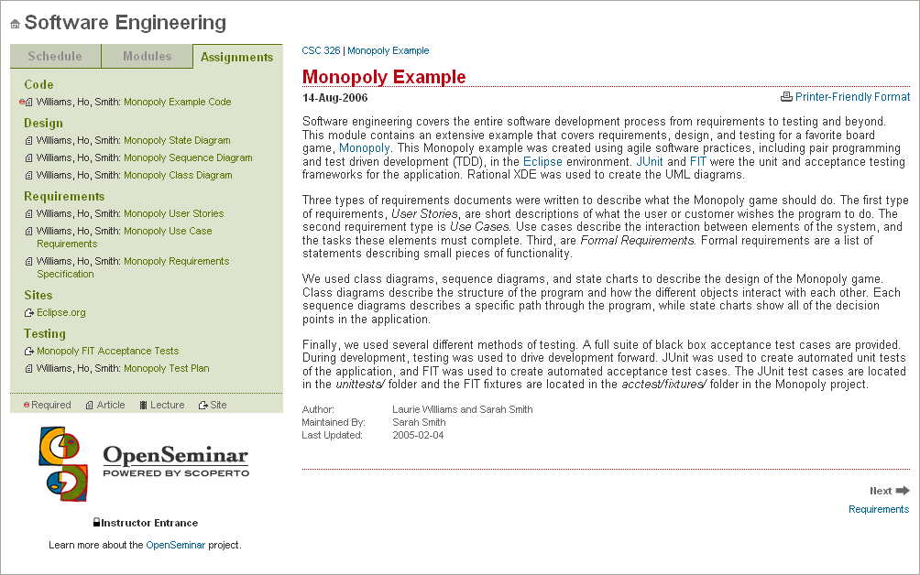
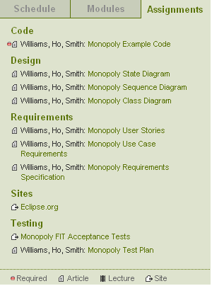
RealEstate Module
Notes:
The module will be changed online to RealEstate soon…

Slide 7
RealEstate Example
Illustrative example of software development practices in a basic Java implementation of a Monopoly-like game
Traditional and agile software practices are illustrated via appropriate documentation
Developed using test-driven development by two graduate students in Eclipse
Used in undergraduate software engineering classes @ NCSU
Notes:
As part of the initial creation of OpenSeminar, several course resources were created for the site. The main resource is the RealEstate Example. The RE is a illustrative example of software development practices encompassed in a basic Java implementation of a Monopoly game. Traditional and agile software practices are illustrated via appropriate documentation.
This example was developed using test driven development by myself and another graduate student and is used in undergraduate software engineering classes @ NCSU.
I’m going to briefly go through the resources available as part of the Monopoly example. All of these resources are available online.

Slide 8
RealEstate Requirements
Traditional Requirements Specification
Use case requirements
User stories
Notes:
First, we have the requirements. There are three requirements documents, traditional, use case, and user stories, that were written to cover all of the requirements of the RealEstate example. This is particularly useful in illustrating the similarities and differences between the types of requirements documents.

Slide 9
Traditional Requirements
FR3.7. Build Houses
  A player has a color series if she or he owns all the property cells in the color group. During a player’s turn, before she or he rolls the dice, the player shall have a chance to buy houses for the series she or he owns. A player shall not build more than five houses on one cell.
  Origin: Interview with Mr. Gegick on May 1, 2004 (Interview #I03SC01)
  Priority: 1
  Implementation Completed Date: July 14, 2004

Slide 10
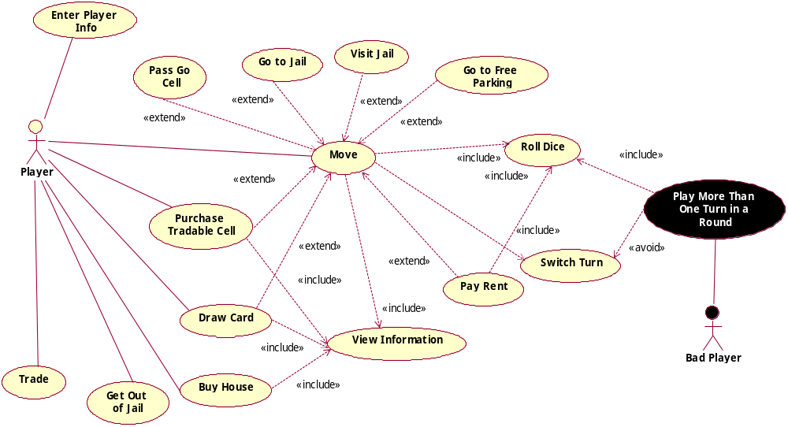
Use Case Requirements

Slide 11
Use Case Requirements (2)
UC8 Flow of Events for the Buy House Use Case
8.1 Preconditions:
It is the player’s turn.
The player has not rolled the dice.
The player has a color series on one or more color groups.
8.2 Main Flow:
When a player has all the tradable cells in a color group, this player is said to have a color series on the color group. A player may build house(s) in the property cells in the color groups the player has a series on by pressing the Buy House button before he or she rolls the dice [S1] [E1 – E2]. The price of the house is determined by the cell. After buying the house(s), the status of the player is updated and displayed on the game board [UC13].
8.3 Subflows:
[S1] When the Buy House button is clicked, the Buy House dialog shows up. The player selects the color series name and the number of houses from that dialog. After clicking on OK in the dialog box, the player pays the fee, and the houses are created. All the property cells in the selected color group have the same number of houses.
8.4 Alternative Flows:
[E1] Nothing happens if the player does not have enough money.
[E2] The player can build at most five houses in a cell.

Slide 12
User Stories
Title: Buy House
Acceptance Test: buyHouse1 | Priority: 1 | Story Points: 2
A player has a color series when he or she purchases all the properties of a color group. When a player has a series of a color group, he can buy houses for those properties at the beginning of his turn. Player cannot purchase more than 5 houses on any given color series.

Slide 13
Class Exercise Ideas
Validate the requirements documents
Compare/contrast the different requirements documents types
  In what situations would you use traditional requirements, use cases, or user stories?
Add/modify requirements to incorporate house rules
  Three tries to roll doubles to get out of jail for free
  Player wins the kitty when landing on free parking

Slide 14
RealEstate Design
Class Diagram
Sequence Diagram
State Diagram
Diagrams available online, but are easily created using Eclipse UML or other UML tools

Slide 15
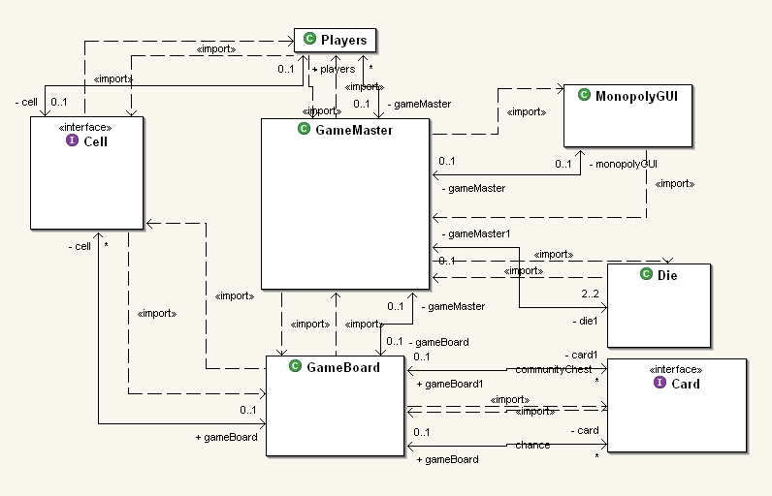
Class Diagram

Slide 16
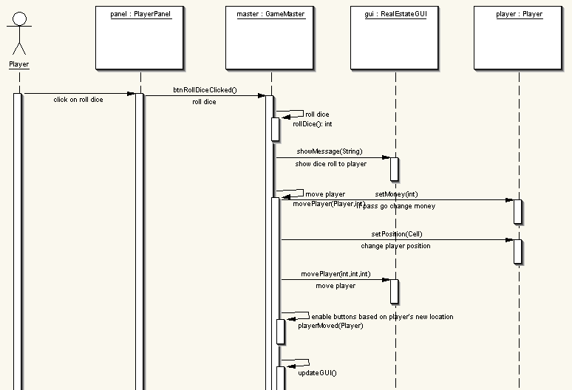
Sequence Diagram
Notes:
This sequence diagram models a standard player turn in the RealEstate game. The player selects the Roll Dice button on the player panel, causing the GameMaster to roll the dice. A message with the dice roll is displayed to the user. The GameMaster then asks the GameBoard what cell is at the end of the number of spaces from where the player is. The player money and position is updated (if the player passes go money will be added to their account). Then the buttons are enabled depending on the cell that the player lands on.

Slide 17
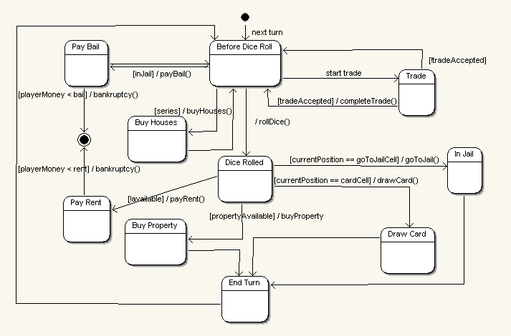
State Diagram
Notes:
The state diagram follows the decision points in a player turn, and covers all of the possible options available to a player depending on the cell the player is on, the money the player has, etc.

Slide 18
Class Exercise Ideas
Reverse engineer the class diagram of the logic code in the RealEstate Example
Create a new sequence diagram based on an alternative scenario in the system
Create a state chart for the overall game play

Slide 19
RealEstate
Implementation and Test
Full implementation and test suite are available
  Black Box Test plan
  JUnit: automated unit test cases
    41 test cases
    87% overall coverage
  Framework for Integrated Test (FIT): automated acceptance test cases
    217 test cases
Notes:
There is a full implementation of the RealEstate example complete with automated test suites. There is a black box test plan provided as part of the documentation. There are 41 JUnit test cases, for 87% overall coverage. Areas not covered are random generation of the dice roll and the interface between the logic and the GUI.
FIT, the framework for integrated test is used to automate acceptance test cases. FIT is a tool for enhancing communication and collaboration between programmers and customers. Customers and testers can use simple web editing tools to create HTML tables of test cases without having to know how to program. FIT uses fixtures, written by programmers, to check the tables against the code base.

Slide 20
JUnit
public void testPurchaseHouse() {
gameMaster.setNumberOfPlayers(2);
gameMaster.movePlayer(0, 1);
Player player = gameMaster.getPlayer(0);
player.purchase();
gameMaster.movePlayer(0, 1);
player.purchase();
gameMaster.movePlayer(0,1);
player.purchase();
player.purchaseHouse("blue",2);
assertEquals(2, ((PropertyCell)gameMaster.getGameBoard().
getCell(1)).getNumHouses());
}

Slide 21
Framework for Integrated Test
Used to facilitate communication between customers and programmers
Customers can create tests or expectations of the system in HTML tables
Programmers create fixtures that connect the tables to the code
Passing test cases are green, failing are red, and exceptions are yellow

Slide 22
fit.ActionFixture
start | edu.ncsu.realestate.BuyHouse
press | initialize game board
enter | number of players | 2
enter | player 1 name | 1
enter | player 2 name | 2
enter | player dice roll | 7
press | purchase property
press | end turn
enter | player dice roll | 2
press | end turn
enter | player dice roll | 7
press | purchase property
press | end turn
enter | player dice roll | 2
press | end turn
check | player can buy house | false
enter | player dice roll | 7
press | purchase property
press | end turn
enter | player dice roll | 2
press | end turn
check | player series | blue
check | player can buy house | true
enter | player chooses series | blue
enter | number of houses | 1
press | purchase house
check | houses on blue 1 | 1
check | houses on blue 2 | 1
check | houses on blue 3 | 1
check | player money | 1630

Slide 23
Class Exercise Ideas
Calculate test coverage
Create a new FIT HTML table for one of the requirements testing an alternative flow
Create a new FIT HTML table for a new/modified requirement, and have students create a fixture for the table
Write more JUnit test cases to increase coverage

Slide 24
Software Engineering Education Knowledge (SEEK)
Computing Essentials: example of fundamental computing concepts – error handling, user interface design, testing
Software Modeling and Analysis: design diagrams and requirements documents
Software Design: object-oriented design
Software Verification and Validation: automated test cases and black box test plan
Notes:
The RealEstate Example applies to several software engineering education knowledge areas: Computing essentials, software modeling and analysis, software design, and software verification and validation.

Slide 25
Use of RealEstate Example
Provides students with a complete program, related documentation, and automated tests
Used in the classroom to teach fundamental software engineering concepts or as a reference
May be adapted for more interactive use
Notes:
The RealEstate example provides students with a complete program, most likely larger than other applications they have written in earlier classes (2306 lines of source code), related documentation so they can compare requirement types, and automated tests.
The RealEstate example may be used in the classroom to teach or highlight fundamental software engineering concepts
This example may also be adapted for more interactive use. We have only provided one of many sequence diagrams. A professor could show the provided sequence diagram and then ask students to create a sequence diagram for another scenario.

Slide 26
Where to Find?
The RealEstate Example is part of the larger repository of software engineering resources on the OpenSeminar in Software Engineering
The RealEstate Example may also be found at http://open.ncsu.edu/se/realestate
Copy on Flash Disk and CD after session
Notes:
The RealEstate example is part of the OpenSeminar in Software Engineering, and we invite professors to join the collaboration to create courses based on the RealEstate example and other high quality software engineering content. The example is also located online at the following address. Please download and use. Let me know of any problems that you may have so that they can be corrected and everyone can benefit.

Slide 27
Questions?
Sarah Smith: sarah_smith@ncsu.edu
OS/SE: http://openseminar.org/se
RealEstate Example: http://open.ncsu.edu/se/realestate

