Slide 1
Expediting Programmer AWAREness of Anomalous Code
Sarah E. Smith
Laurie Williams
Jun Xu
November 11, 2005

Slide 2
Contents
Motivation
Research Objective
AWARE
  Functional Organization
  Alert Ranking and Filtering
  Ranking Metrics
Evaluation Metrics
Progress & Future Work
Conclusions

Slide 3
Motivation
Faults are detected during testing, code analysis, or after code release.
Long fix latency could increase the cost of fault fix.
Test-driven development (TDD) involves a programmer writing tests and code in rapid cycles
Incorporating static analysis into TDD unit test cycles will increase the scope of faults detected.

Slide 4
Research Objective
To enhance test-driven development feedback loops to automatically and continuously provide ranked, prioritized, and filtered alerts to the software engineer on the correctness and security of their code implementation during development.

Slide 5
AWARE
Automated Warning Application for Reliability Engineering
Builds on Continuous Testing - running test cases using spare processor cycles while programmer continuous development.
Combines compilation errors and warnings, static analysis warnings, and test case failures into a ranked listing.

Slide 6
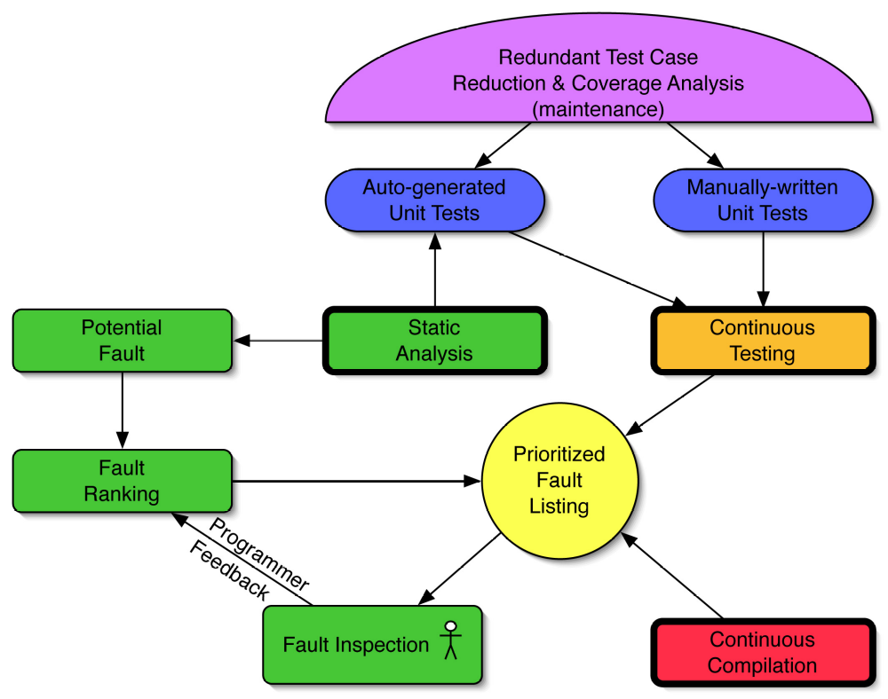
Functional Organization

Slide 7
Alert Ranking and Filtering
Rank static analysis and generated test case alerts based on the probability the alert is a true positive
Internal ranking adjusted based on programmer feedback
  Spam filters

Slide 8
Ranking Metrics
Type Accuracy: Categorization of alerts based on observed accuracy of alert type
Redundancy Factor: Number of tools that report the same alert
Code Locality: Alerts reported by static analysis tools cluster by locality
Test Coverage: Areas of high test coverage will have fewer true alerts

Slide 9
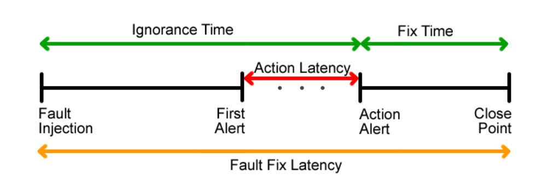
Evaluation Metrics

Slide 10
Progress
Current Work:
  Development of AWARE tool for Eclipse IDE
Future Work:
  Feasibility study of efficacy of AWARE
AWARE plug-in site:
  http://arches.csc.ncsu.edu/smith/

Slide 11
Conclusions
Enhancing TDD should reduce ignorance time and therefore fix time on a larger number of faults than traditional TDD

Slide 12
Questions?
Sarah Smith: sarah_smith@ncsu.edu

