Slide 1
Artificial Intelligence
CSC 401
Dr. I. O. Akinyemi

Slide 2
Introduction
AI - one of the newest sciences
It encompasses a huge subfields
  General-purpose areas
      learning and perception
    Specific tasks
      Game playing (chess)
      proving mathematical theorems
      writing poetry, and
      diagnosing diseases.

Slide 3
AI systematizes and automates intellectual tasks
Potentially relevant to any sphere of human intellectual activity.
It is truly a universal field.

Slide 4
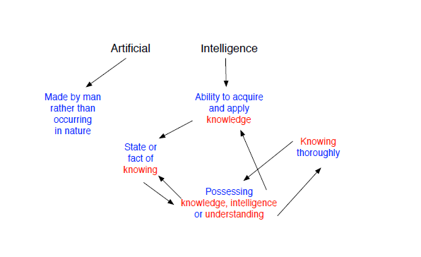
Defining AI

Slide 5
Practical Definitions of AI
Systems that think like humans
"The exciting new effort to make computers think . . . machines with minds, in the full and literal sense." (Haugeland, 1985)
"[The automation of] activities that we associate with human thinking, activities such as decision-making, problem solving, learning . . ." (Bellman, 1978)
Systems that think rationally
"The study of mental faculties through the use of computational models." (Chamiak and McDermott, 1985)
The study of the computations that make it possible to perceive, reason, and act.“ (Winston, 1992)

Slide 6
Practical Definitions of AI
Systems that act like humans
"The art of creating machines that perform functions that require intelligence when performed by people." (Kurzweil, 1990)
"The study of how to make computers do things at which, at the moment, people are better." (Rich and Knight, 1991)
Systems that act rationally
"Computational Intelligence is the study of the design of intelligent agents." (Poole et al., 1998)
"A1 . . .is concerned with intelligent behavior in artifacts." (Nilsson, 1998)

Slide 7
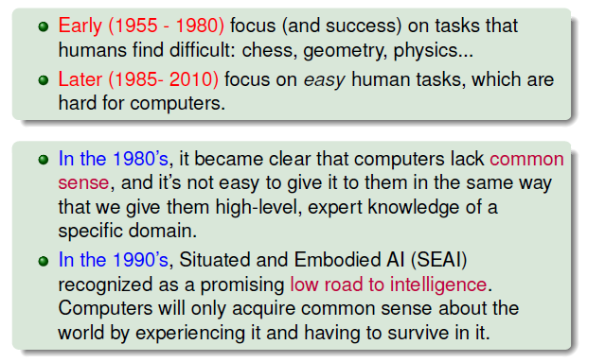
A brief History of AI

Slide 8
Some task Domain in A.I.
Mundane Tasks
  perception (vision, speech)
  Natural Language processing (understanding, generation, translation)
  Commonsense reasoning
  Robot control
Formal tasks
  Games (Checkers, Chess, Ayo, etc.)
  Mathematics (Geometry, Logic, Calculus, Proving properties of Program)
  Expert Tasks
Engineering (Design, fault finding, manufacturing planning)
Scientific analysis
Medical analysis
Financial analysis

Slide 9
Developments in AI
1. Problem Solving and Planning: This deals with systematic refinement of goal hierarchy, plan revision mechanisms and a focused search of important goals.
2. Expert Systems: This deals with knowledge processing and complex decision-making problems.
3. Natural Language Processing: Areas such as automatic text generation, text processing, machine translation, speech synthesis and analysis, grammar and style analysis of text etc. come under this category.
4. Robotics: This deals with the controlling of robots to manipulate or grasp objects and using information from sensors to guide actions etc.
5. Computer Vision: This topic deals with intelligent visualisation, scene analysis, image understanding and processing and motion derivation.
6. Learning: This topic deals with research and development in different forms of machine learning.

Slide 10
7.Genetic Algorithms: These are adaptive algorithms which have inherent learning capability. They are used in search, machine learning and optimization.
8. Neural Networks: This topic deals with simulation of learning in the human brain by combining pattern recognition tasks, deductive reasoning and numerical computations.
Application Areas of AI
Autonomous Planning and Scheduling, Game Playing, Autonomous Control, Diagnosis, Logistics Planning, Robotics, Language Understanding and Problem Solving

Slide 11
    Some Pertinent Questions in A.I.
    What are our underlying assumptions about intelligence?
    What kinds of technique will be useful for solving AI problems?
    At what level of detail, if at all, are we trying to model human intelligence?
    How will we know when we have succeeded in building an intelligent program?

Slide 12
A.I. Techniques
An AI technique is a method that exploits knowledge in solving a problem.
Nature of Knowledge
  It is voluminous
  It is hard to characterize accurately
  It is constantly changing
  It differs from data by being organized in a way that corresponds to the way it will be used.
Questions
  Are there techniques that are appropriate for the solution of a variety of AI problems?
  Can these techniques be useful in solving other problems?

Slide 13
An AI technique must exploit knowledge in such a way that:
The knowledge captures generalization
It can be understood by people who must provide it
It can easily be modified to correct errors and reflect changes in the world and in our world view
It can be used in a great many situations even it is not totally accurate or complete
It can be used to help overcome its own sheer bulk by helping to narrow the range of possibilities that must be considered.
Note: that it is possible to solve AI problems using non-AI techniques (although the solution are not likely to be very good). It is also possible to apply AI techniques to the solution of non-AI problems

Slide 14
Characteristics of AI Techniques
Search – provides a way of solving important problems for which no more direct approach is available as well as a framework into which any direct techniques that are available can be embedded
Use of Knowledge – Provides a way of solving complex problems by exploiting the structures of the objects that are involved.
Abstraction – Provides a way of separating important features and variations from the many unimportant ones that would otherwise overwhelm any process.

Slide 15
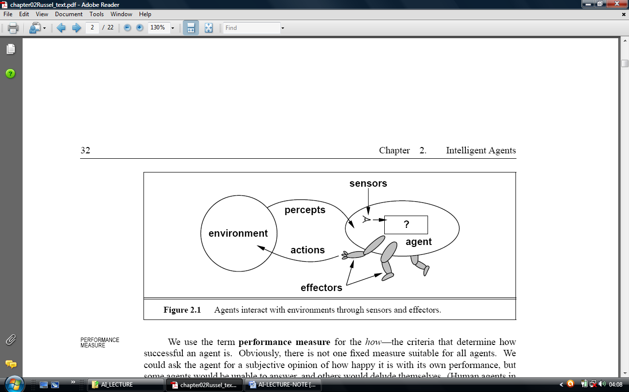
Intelligent Agent
An agent is anything that can perceive (sensors) its environment and
take action upon that environment (effectors)
A human agent has eyes, ears, and other organs for sensors, and
hands, legs, mouth, and other body parts for effectors.
A rational agent is one that does the right thing.
A rational agent takes action it believes will achieve its goals
  RAIN & UMBRELLA
.

Slide 16
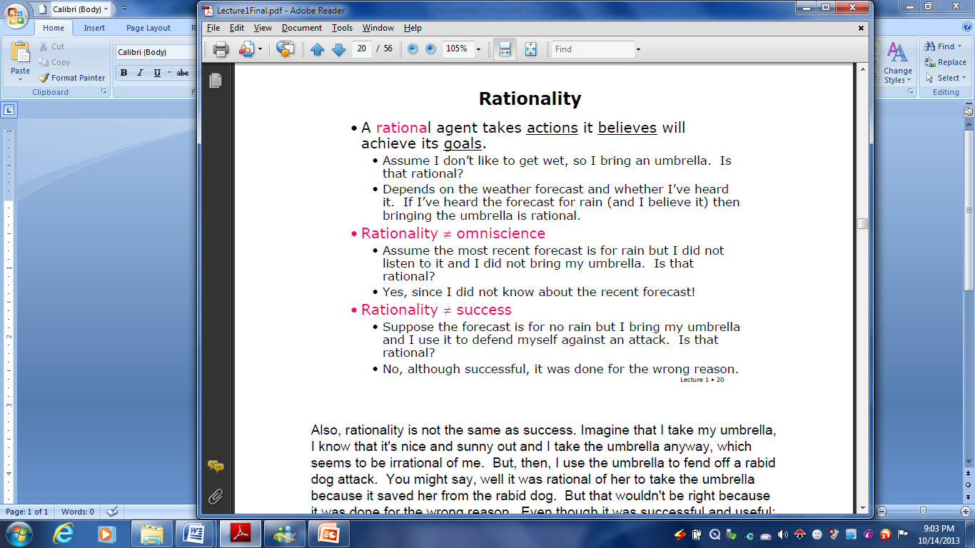

Slide 17
Classes of Environments
Accessible (vs. Inaccessible)
• Can you see the state of the world directly?
2. Deterministic (vs. Non-Deterministic)
• Does an action map one state into a single other state?
3. Static (vs. Dynamic)
• Can the world change while you are thinking?
4 Discrete (vs. Continuous)
• Are the percepts and actions discrete (like integers) or continuous (like reals)?

