Slide 1
Data Dimensional Modeling
[UNIT 2]
[Inside Dimension table, Inside Fact table, Star schema keys]
Sambhaji S M

Slide 2
Principles of Dimensional Modeling
S.Sambhaji

Slide 3
Objectives
Understand how requirements definition determines data design
Introduction of dimensional modeling /contrast with E-R modeling
Basics of star schema
Contents of fact/dimension tables
Advantages of star schema for DW

Slide 4
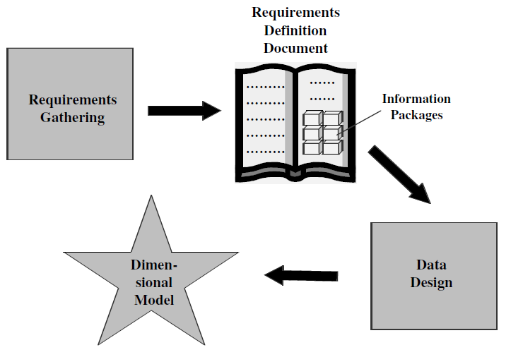
Requirements to Design

Slide 5
Design decisions to be taken
Choosing the process:-deciding subjects
Choosing the grain
Identifying and confirming dimensions
Choosing the facts
Choosing the duration of the database

Slide 6
Agenda
Information package
Information package to dimension table
Information package to fact table
Inside dimension table
Inside fact table
Star schema keys
  Primary keys
  Surrogate Keys
  Foreign keys

Slide 7
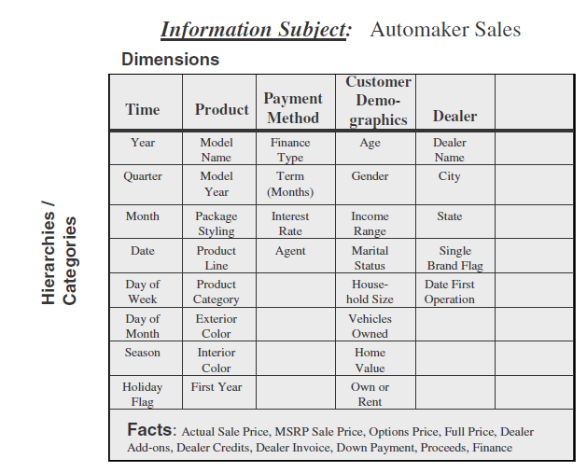
Information package : Automaker

Slide 8
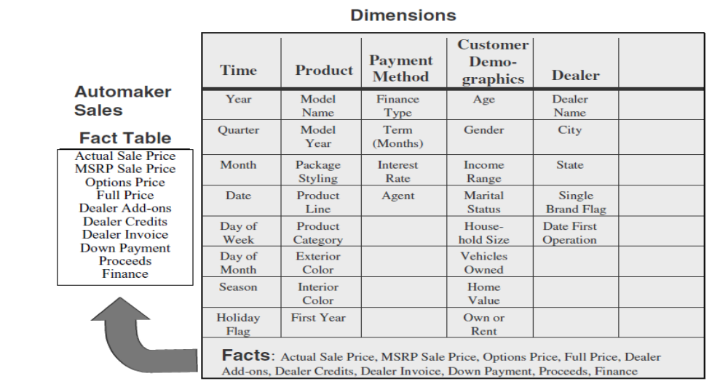
Formation of the automaker sales fact table

Slide 9
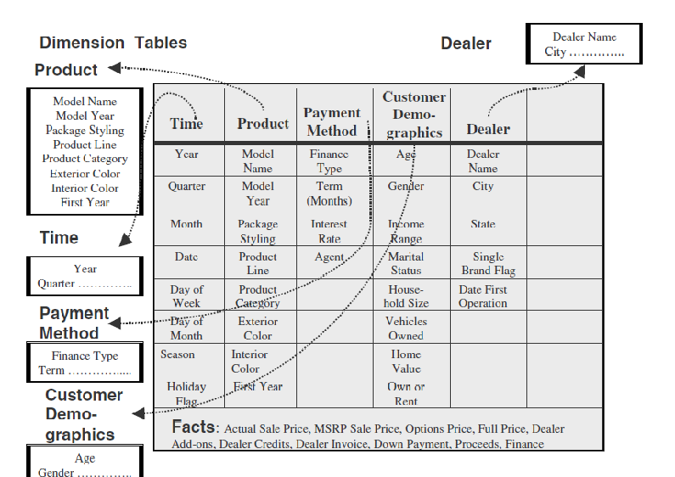
Information package to dimension table

Slide 10
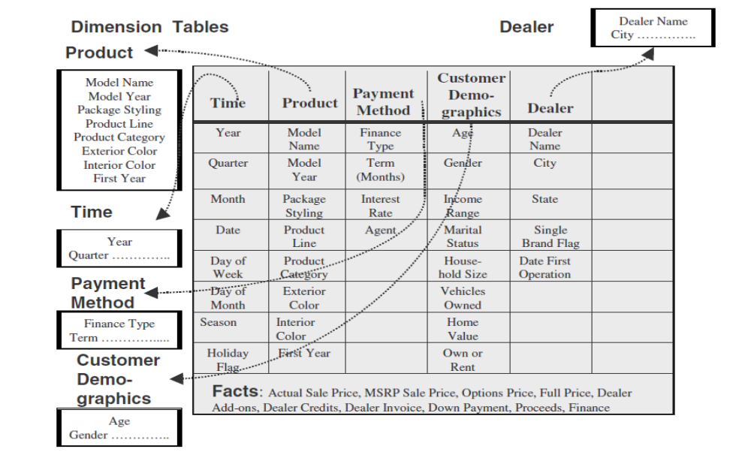
Formation of the automaker dimension tables
How much sales proceeds did the jeep tata mahindra, 2005 model with vxi options, generate in january 2000 at spectra auto dealership for buyers who owned their homes, financed by icici prudential financing?

Slide 11
Tips for combining data into dimensional model
  Provide best data access
  Model should be query-centric
  Model should be optimized for queries and analyses
  Model should reveal the interactions between the dimension and fact tables
  There should be drilling down or rolling up along dimension hierarchies

Slide 12
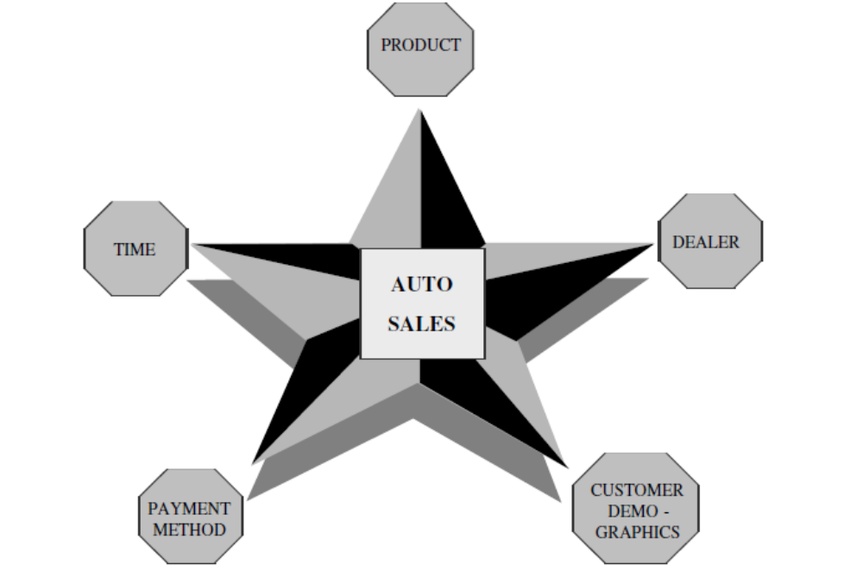
STAR SCHEMA for automaker sales

Slide 13
ER Model v/s Dimension Model
ER diagram is a complex diagram, used to represent multiple processes. A single ER diagram can be broken down into several DM diagrams.
In DM, we prefer keeping the tables de-normalized, whereas in a ER diagram, our main aim is to remove redundancy
ER model is designed to express microscopic relationships between elements. DM captures the business measures
DM is designed to answer queries on business process, whereas the ER model is designed to record the business processes via their transactions.

Slide 14
Entity-Relationship vs. Dimensional Models
E-R DIAGRAM
One table per entity
Minimize data redundancy
Optimize update
The Transaction Processing Model
DIMENSIONAL MODEL
One fact table for data organization
Maximize understandability
Optimized for retrieval
The data warehousing model

Slide 15
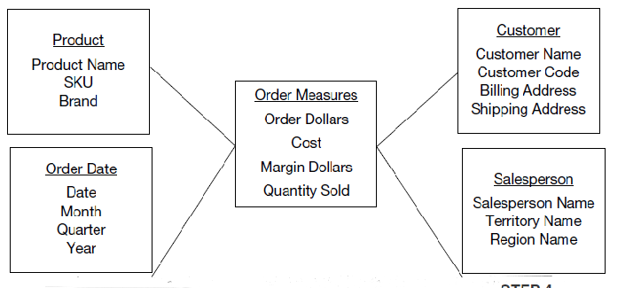
E.g. : STAR schema

Slide 16
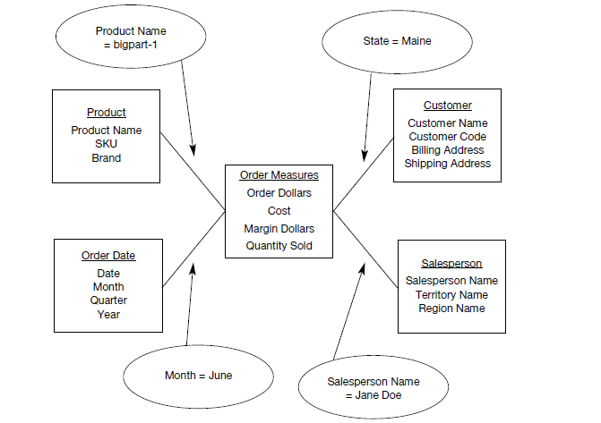
Understanding query from the star schema

Slide 17
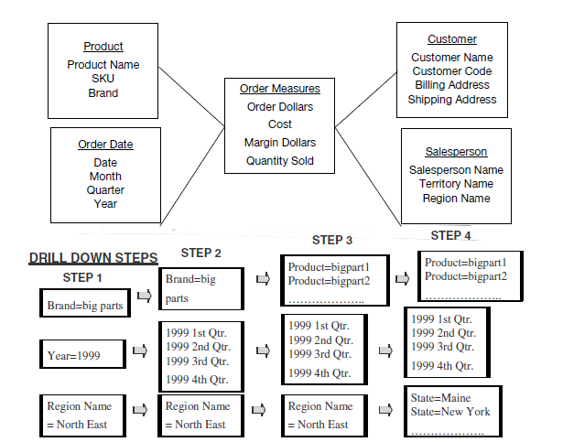
Understanding drill down analysis from the star schema

Slide 18
Inside the dimension table
Dimensional table key
Table is wide
Textual Attributes
Attributes not directly related.
Not normalised
Drilling and rolling up analysis.
Multiple hierarchies
Fewer number of records,

Slide 19
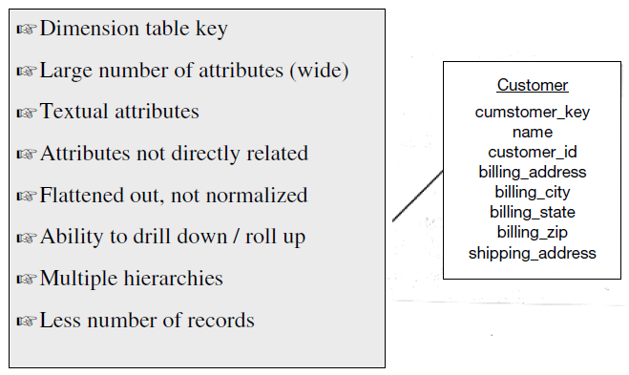
Inside the dimension table : picture

Slide 20
Dimensional table (cont.)
Dimensional table key :
  The primary key of the dimension table uniquely identifies each row of the table.
Table is wide :
  Generally the no. of attribute for the dimension table will be more.
Textual attribute :
  The numerical value of these dimensional table is very less (or) we can see it very rarely.
  Eg, for the customer table, customer name, location, address.

Slide 21
Dimensional table (cont.)
Attributes not directly related:
  Some of the attribute in the dimension table not directly related other attributes on the table.
Not Normalized :
  Extremely used for query and analysis purpose.
  An attribute is taken constraint in the query and directly applied to fact table.
  If you go with the higher normalization, that will break the dimensional table to form the inter mediatory table. Again this will affect our query performance.

Slide 22
Dimensional table (cont.)
Drilling down and Rolling up analysis
  The attribute in the dimension table, ability to provide the information from higher level to very lower level.
  Eg, total sales happened on state, then drill down to sales happened on city and again drill down to sales on specific zip.

Slide 23
What is fact table ?
Basic defn:
Some fact table may just contain the summary of data, these are called aggregate fact table.
It refers to measures or metrics.

Slide 24
Facts
Numeric measurements (values) that represent a specific business aspect or activity
Stored in a fact table at the center of the star scheme
Contains facts that are linked through their dimensions
Can be computed or derived at run time
Updated periodically with data from operational databases

Slide 25
Fact table
Contains primary information of the warehouse
  Concatenated key
  Data grain
  Fully additive measures
  Semi-additive measures(derived attributes)
  Table deep, not wide
  Sparse data
  Degenerate dimensions(attributes which are neither fact or a dimension)

Slide 26
Inside the fact table
Concatenated key.
Data grain.
Fully additive measures.
Semi additive measures.
Table deep, Not wide
Sparse data
Degenerate dimensions

Slide 27
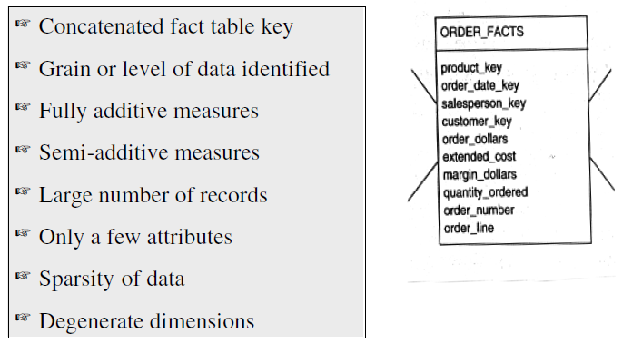
Inside the fact table : picture

Slide 28
Inside Fact table cont.
Concatenated keys :
  A row in the FACT table, relates to combinations of row from all the dimensional table.
Customer
Sales Rep
Lowest level : specific customer
Lowest Level : Specific Sales Rep
Time
Product
Lowest Level : Specific Calendar date
Lowest Level : Specific Product
This means, A row in the fact table is identified by the four primary key of dimension table

Slide 29
Inside Fact table (cont)
Data grain :
  Level of detail for the measurement or metrics.
  Eg: The quantity ordered relates to quantity of particular product on a single order, on certain date, specific to customer which procured by specific Sales Rep.
Fully Additive measures :
  Additive facts are facts that can be summed up through all of the dimensions in the fact table.
  Total number of sales happened on a specific date with customer locating on specific zip procured by Sales Rep.

Slide 30
Inside Fact table (cont)
Semi additive :
  Semi-additive facts are facts that can be summed up for some of the dimensions in the fact table, but not by all.
  Eg: Daily balances fact can be summed up through the customers dimension but not through the time dimension.
Table is deep, not wide :
  Fewer attribute than the dimension table.
  Usually 10 attributes or less, but it has very large number of rows to process.

Slide 31
Inside Fact table (cont)
Sparse data :
  A single row in the fact table may relate particular row in data table, customer table and an individual sales rep.
  For a particular product, and for specific calendar date and by specific sales rep with a specific customer there is row in FACT table.
  What if there is no rows in table ?
  What happens the sale date requested is on holiday, no-orders received and processed.
  This types of data are called sparse data.
  Fact table may contain sparse value (ie., it could have some gaps).

Slide 32
Star schema for a retail chain
Time Dimension Table
Time key
Year
Quarter
Month
Week
Date
Sales Fact Table
Time key
Product key
Customer key
Store key
Mode key
Actual sales
Forecast sales
Price
Discount
Customer Dimension Table
Customer key
Name
Age
Income
Gender
Marital status
Store Dimension Table
Store key
Name
City
State
Op from year
Product Dimension Table
Product key
Name
Brand
Category
Colour
Price
Payment Mode Dimension Table
Mode key
Payment mode
Interest rate

Slide 33
Star Schema characteristics
Star schema is a relational model with one-to-many relationship between the fact table and the dimension tables.
De-normalized relational model
Easy to understand. Reflects how users think. This makes it easy for them to query and analyse the data.
Optimizes navigation.
Enhances query extraction.
Ability to drill down or roll up.

Slide 34
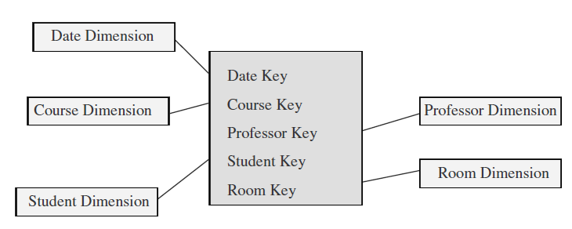
Factless fact table
A fact table is said to be empty if it has no measures to be displayed. Fact table represents events
Contains no data, only keys.

Slide 35
Data Granularity
When fact table at the lowest grain, the users can as well drill down to the lowest grain of details
But when data is kept till the lowest level of data, we have to compromise on the storage and maintenance of DW
Advantages
  Easier to extract from operational data and load into DW
  Can be feed directly to the DM application

Slide 36
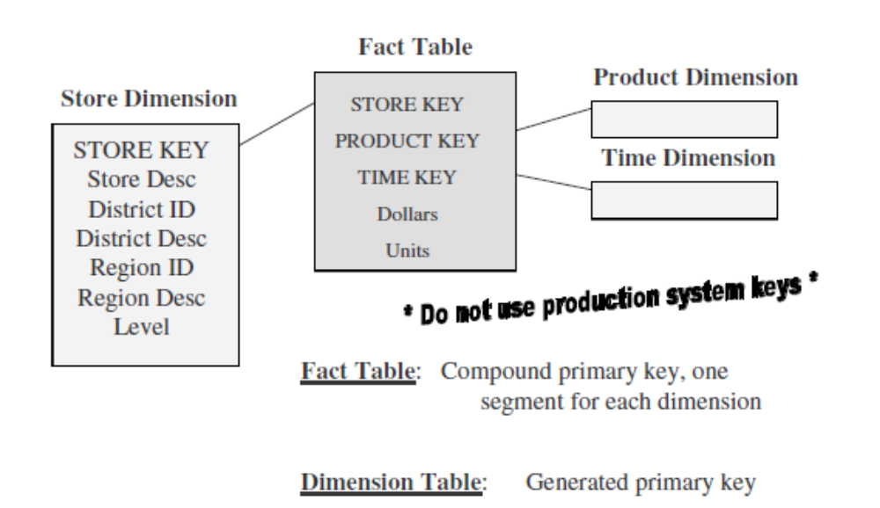
Star Scheme Keys

Slide 37
Star schema Keys
Primary Keys
Surrogate keys
Foreign Keys
Primary keys :
Each row in the dimension table which is uniquely identified by a attribute called
Primary key. E.g.: prodcut_key identifes unique product in the product dimension table.
Surrogate Keys:
Surrogate keys are unique, generally created artificially for the internal use, end user
may not know this.
Foreign Keys:
A attribute in a table uniquely identifies the rows in another table called Foreign key

Slide 38
Star schema keys contd…
Primary keys: should not be same as production system
Surrogate keys: System generated sequence numbers having no built-in meanings
Foreign keys: primary key of each dimension table must be a foreign key in the fact table.

Slide 39
Star schema keys – Primary keys
Take for an Eg., 8 position code which is used in Operational systems, 2of which relates to warehouse code where product stored and 2 which relates to product category.
What is the problem to use this 8 position code as PK in product dimension table ?
Assume that product code change in the middle of the year, because now its using different warehouse.
Now we have to change the PK, because two same product will be listing different PKs in data warehouse.
Its our Problem, that we have decided to use Operational system key as PKs.

Slide 40
Schema Keys : Primary Keys,Surrogate keys
The following are the principles of choosing Primary keys:
  Avoid built-in meaning in the primary key of the dimension table.
  Do not use production system keys as primary key for the dimension table.
  Eg : In some companies, few customer will not exist. May be they are not active. It is possible that the customer number may be re-assigned to new customer. So for all aggregations and summarization we will using the old customer data.
Hence we can use surrogate keys, they are simply system generated sequence number. Does not have any meaning in it.

Slide 41
Schema keys – Foreign Key
Each dimension table has 1:M relation ship with central fact table.
So the primary key of the each dimension table will be foreign key of fact table.
List of possible PK for the fact table.
  .
  A single compound primary key whose length is the total length of the keys of individual dimension tables.
  Concatenated PK that is the concatenation of all primary keys of dimension table.
  A generated PK independent of the keys of the dimension table

Slide 42
Advantages of the star schema
Easy for users to understand
Optimizes navigation
Most suitable for query processing

Slide 43
Starjoin and Starindex
Star join:- high-speed, single pass parallelizable, multitable join.
  Boots query performance
Star index:- specialized index to accelerate join performance
  Speed up joins between the dimension tables and fact tables

Slide 44
References
Fact table type : http://www.1keydata.com/datawarehousing/fact-table-types.html
Keys :
  Wikipedia
Text book:
Refer chapter 10, From page 211 in Data warehousing fundamentals: A Comprehensive Guide for IT Professionals, Paulraj Ponniah

