Slide 1
Data Warehousing and Business Intelligence
UNIT – I [Session 2] Dimensional analysis, information packages, requirements

Slide 2
Agenda
Warehouse
Data warehouse
Definition
Overview components
Data warehouse vs OLTP
Business requirements
Information package
Requirement definition
summary
Recap session

Slide 3
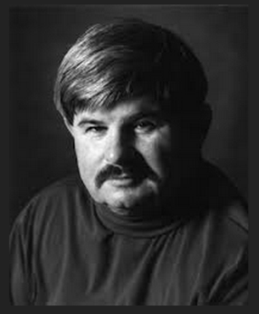

Definition of Data warehouse
Data warehouse is a subject-oriented, Integrated, time-variant and non-volatile collection of data in support of decision making.
Bill Innom
Data warehouse is a copy of transactional data specially
structured for query and analysis.
Ralph Kimball

Slide 4
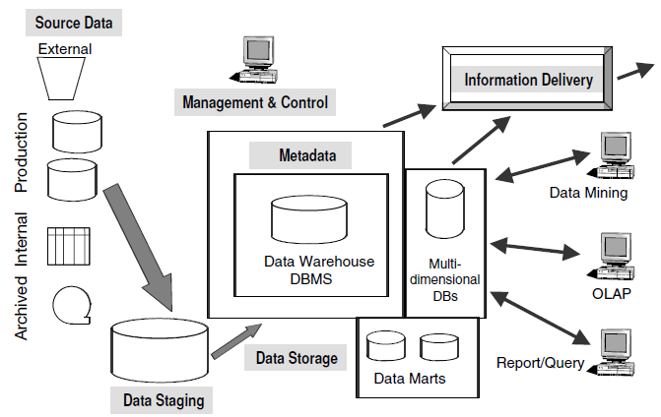
Data warehouse components

Slide 5
DW component –cont(2)
Source Data:
External
E.g., the data warehouse of a car rental company contains data on the current production schedules of the leading automobile manufacturers.
Internal
E.g. Profiles of individual customers become very important for consideration. When your account representatives talk to their assigned customers or when your marketing department wants to make specific offerings to individual customers.
Production
E.g. we want Name of single Specified Customer. Or, you may need the orders placed by a single customer in a single week.

Slide 6
DW component – cont(3)
Archived
Many different methods of archiving exist. There are staged archival methods.
At the first stage, old recent data is archived to a separate archival database that may still be online.
At the second stage, older data is archived to flat files on disk storage.
At the next stage, the oldest data is archived to tape cartridges or microfilm and even kept off-site.

Slide 7
DW component – cont(4)

Slide 8
DW component – cont(5)
Extract the data, (E)
Transform the data (T), and then
load the data (L)
Data staging provides a place and an area with a set of functions to clean, change, combine, convert, de-duplicate, and prepare source data for storage and use in the data warehouse.

Slide 9
DW component – cont(6)
Extraction | Transformation | Loading
It deals with various data source, We have to go for correct Technique to extract | Cleansing Standardization Semantic Standardization | Initial Loading
Because some sources Hierarchical, Legacy some may be with flat files | Cleaning : misspellings, or resolution of conflicts between state codes and zip Standardization : data types and field lengths Semantic : Synonyms and Homonyms | Incremental Loading
Notes:
Homonyms – a word that sounds the same or is spelled the same as another but has different meaning. Eg No vs Know and Bow( Weapon) vs Bow (bend to waist).
Synonyms - a word or phrase that has the same or nearly the same meaning as anther word or phrase in the same language. Eg Small Vs little

Slide 10
DW component – cont(7)
Metadata is similar to data dictionary.
In the data dictionary, you keep the information about the logical data structures, the information about the files and addresses, the information about the indexes, and so on.
Meta data classified into :
Operational Metadata (contains info abt operational data source)
Extraction and Transformation Metadata (information about data stage/extraction method/extraction frequencies)
End-User Metadata (info about business Terminology)

Slide 11
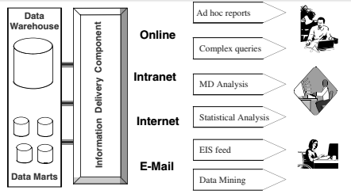
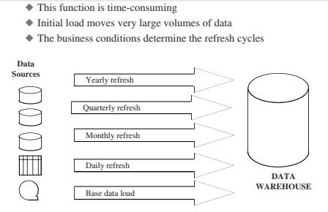
DW component – cont(7)

Slide 12
Data warehouse and OLTP
Data warehouse :
Is an Information delivery system.
Its not about technology.
Its about solving the users problem and providing strategic information to user.
OLTP :
It is primarily data capture systems.
Its purely operational system stores the current value not the historic data.

Slide 13
Data Warehouse Vs OLTP
 | Data warehouse | OLTP
Workload | Data warehouses are designed to accommodate ad hoc queries. You might not know the workload of your data warehouse in advance, | OLTP systems support only predefined operations. Your applications might be specifically tuned or designed to support only these operations.
Data modifications | A data warehouse is updated on a regular basis by the ETL process (run nightly or weekly) using bulk data modification techniques. The end users of a data warehouse do not directly update the data warehouse. | In OLTP systems, end users routinely issue individual data modification statements to the database. The OLTP database is always up to date, and reflects the current state of each business transaction.

Slide 14
Data Warehouse Vs OLTP (cont)
 | Data warehouse | OLTP
Schema design | Data warehouses often use de- normalized or partially de-normalized schemas (such as a star schema) to optimize query performance. | OLTP systems often use fully normalized schemas to optimize update/insert/delete performance, and to guarantee data consistency.
Typical Operations | A typical data warehouse query scans thousands or millions of rows. For example, "Find the total sales for all customers last month." | A typical OLTP operation accesses only a handful of records. For example, "Retrieve the current order for this customer."
Historical data | Data warehouses usually store many months or years of data. This is to support historical analysis. | Always current values

Slide 15
Because of this Reasons, The Business Requirements were different.

Slide 16
Dimensional analysis
How and why Defining the requirements for DW.
Roles for Business Dimensions
Usage of information Unpredictable.
Dimensional nature of business data.

Slide 17
Business Requirements - OLTP
For Designing the Operational systems
User are able to Precise the Requirements.
They can easily say what are the various elements needed in GUI.
For E.g. : Order Processing Department
They can easily list all the functions.
Orders
Check stock
Shipping
Customers verifications
Routing
Price

Slide 18
What I want ?
They know only business
How tough the Business Requirement Process for Data Warehouse ?

Slide 19
Business Requirements - DW
Users really don’t know what they want.
The users are familiar with operational systems, because they use in their daily work so they can easily visualize.
So generally take all the best data, then we have to summarize in DW.

Slide 20
Dimensional nature of Business Data
Even though the users cannot fully describe what they want in data warehouse. They can relate everything with business terms.
Provide the insights, how they think about business.
They can tell you measurement units, how they measure each department.
So our aim is to convert all the business term into query-able data.

Slide 21
Dimension thinking w.r.t business
Job Role | What they want
Marketing Vice President | How much did my new Product generate ?
Marketing Manager | Give me Sales Statistics
Financial Controller | Show me the expenses
If your users of data warehouse think in terms of business dimensions for
Decision making, you should also think of business dimensions while collecting
the requirements.

Slide 22
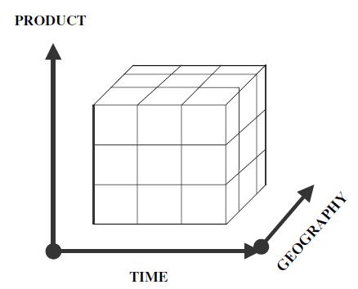
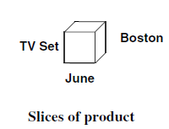
3D of Business data for Sales unit
Product, time and Geography are dimensions
If there are more than 3d, we go with hypercubes to visualize the data.
The concept of business dimensions is
fundamental to the requirements for a data warehouse

Slide 23
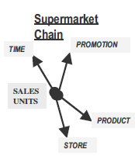
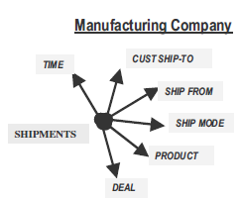
Business Dimensions
E.g.: Supermarket chain, as Marketing manager I will look for sales broke down by product, at each store w.r.t time sequence.
Here Business Dimensions used for analysis is SHIPMENTS, Here the dimensions are time, ship to, ship from, product etc.,
One thing is common., time

Slide 24
Information package
Determining and Recording information requirements for a data warehouse.
Users unable to define the requirements, they don’t know the usage patterns.
By the help of information package,
you can develop the DW and move it to next phase

Slide 25
Information package (cont)
Define the common subject areas.
Design key business metrics.
Decide how data must be presented.
Determine how users will aggregate or roll up.
Decide the data quantity for user analysis or query.
Decide how data will be accessed.
Establish data warehouse size.
Determine the frequency for data refreshing.

Slide 26
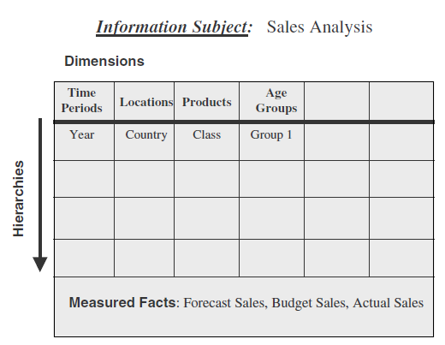
Information package for sales
What we are measuring ?
Forecast Sales
Budget Sales
Actual Sales
Business Dimensions, along which these measurements are to be analyzed that will be our column heading, like time, locations.
Here the subject is sales
Hence our goal is requirement definition phase is to compile the information package for all the subjects for the data warehouse.

Slide 27
Hierarchies
Our decision are based on the number, than the summary(various details).
Traverse hierarchical levels of business, and then getting the various details.
E.g.. :
Total Sales of the entire year
Quarterly sales
Monthly sales
So our dimension hierarchies are the paths for drilling down (or) rolling up in our analysis.

Slide 28
Categories
In the time dimension, we want to include sales on holidays.
And in product dimension, we want to include packaging.
These two does not help us for drilling up/down.
We can’t say it is hierarchy, but it is important to our analysis.
Such data element within business dimension may be called categories.

Slide 29
Business metrics or Facts
So by the help of Business dimension, categories and hierarchies what we are getting ?
So it should answer
What exactly users analyzing ?
What numbers they are analyzing?
The numbers the users analyze are the measurements or metrics that measure the success of the department.
Like actual sales, options price, dealer price etc.,

Slide 30
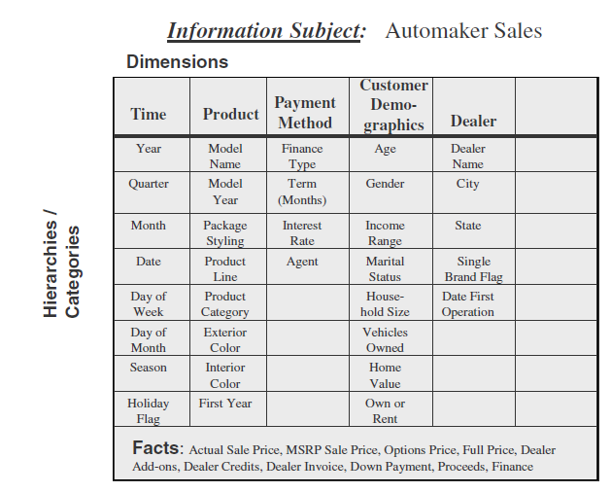
Information package : Automaker

Slide 31
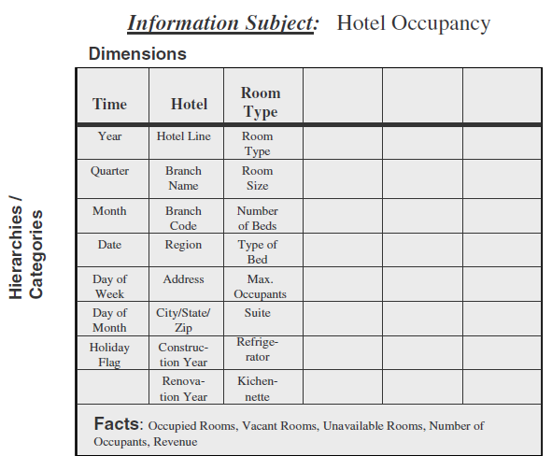
Information pack: where is what
subject
Dimensions
Hierarchies
categories
What are we
Measuring ?

Slide 32
Requirements gathering methods
Who are the users that can make use of the information in the data warehouse.
Users of data warehouse.
Senior executives (sense and scope for you DW)
Departmental managers (they report to executives)
Business analysts (Prepare the reports and analyses)
Operational DBAs, IT (they manages DW)
Others nominated by the above

Slide 33

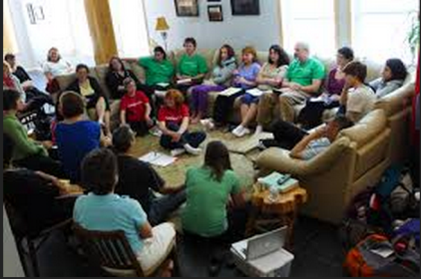
Meeting with group of people
Interviews, 1to1 or in small group:
2 or 3 persons at a time
Easy to schedule
Good approach when details
Always conduct pre-interview research
Group Sessions
Groups of twenty or lesser
Not good for initial gathering
Need to be well organized
Useful for confirming requirements.

Slide 34
Requirements Definition
Requirement Definition document, is the basis for next phase.
If somebody leaves the company, this will help us.
The type of information this doc must contain
Data sources
Data Transformation
Data Storage
Information Delivery
Information package diagram

Slide 35
Requirements Definition (cont)
Data sources
Include all details you have gathered about the source system.
You will collect data from source system, merge, integrate, transform the data appropriately.
Requirement definition document include
Available data sources.
Location of the data sources.
Data extraction procedures.
Availability of historical data.

Slide 36
Requirements Definition (cont)
Data transformation
How the data will be populated to DW
Mapping of source data in the DW
Describe merging, conversion and splitting.
Data storage
Level of detailed data need to keep in the DW
Details of the metrics and the business dimensions
Details about storage requirements.
How much historical and archived data need to be in DW

Slide 37
Requirements definition (cont)
Information Delivery: drill down analysis,
roll-up analysis,
slicing
and ad hoc reports
Information package diagrams:
Data warehouse design purely dependent on the accuracy and adequacy of information package diagrams.
Try for completed and accuracy.

Slide 38
Requirements Definition Doc (outline)
Introduction.(purpose and scope )
General requirements description.(interview summaries)
Specific requirements.(list data transformation and storage requirements)
Information package.(information package diagram)
Other requirements.(data extraction frequencies, loading methods and locations)
User expectations.(list the expectation)
User participation.(task and activities per user)
General implementation plan.(high level plan)

Slide 39
Summary
Dimensions
Business dimensions
Information package
Interview and group discussion
Requirement definition
Refer chapter 5, From page 111 in Data warehousing fundamentals: A Comprehensive Guide for IT Professionals, Paulraj Ponniah

