Slide 1
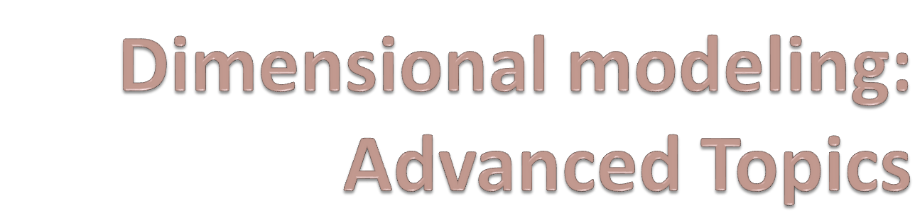
Sambhaji M Shedole

Slide 2
Objectives
Slowly changing dimensions
Large dimensions
Snowflake schema
Aggregate tables
Family of starts and their applications

Slide 3
Updating the Dimension table
Dimension tables are non-volatile and mostly read-only.
More rows are added to the Dimension tables over time.
Changes to certain attributes of a row become eminent at times.
There are many types of changes that affect the dimension tables.

Slide 4
Slowly changing dimensions
Most dimensions are generally constant over time
Many dimensions change slowly
Though the key does not change other description and attributes change slowly over time
Dimension table attributes are not overwritten
The ways changes are made in dimension tables depend on the types of changes and what information must be preserved.

Slide 5
Type 1: Correction of errors
Usually relate to correction of errors in the source systems.
E.g., spelling error in customer names; change of names of customers;
There is no need to preserve the old values here.
The old value in the source system needs to be discarded.
The changes made need not be preserved or noted.

Slide 6
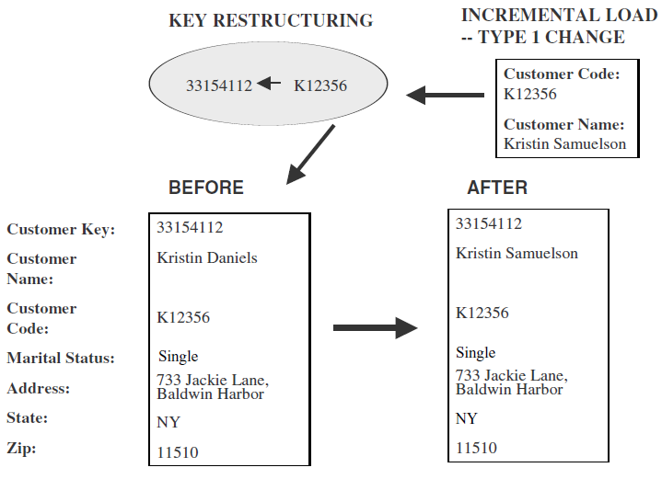
Type 1.. continued
Overwrite attribute value in the dimension table row with new value
No other changes are made to the dimension table row.
The key is not disturbed
Easiest type of change to implement.

Slide 7
Type 2: preservation of history
True changes in the source systems.
E.g., change of marital status; change of address
There is a need to preserve history
This type of changes partition the warehouse
Every change for the same attribute must be preserved.
Applying these changes:
  Add a new dimension table row with new value of the changed attribute
  No changes are made to the existing row.
  New rows are inserted with a new surrogate key.

Slide 8
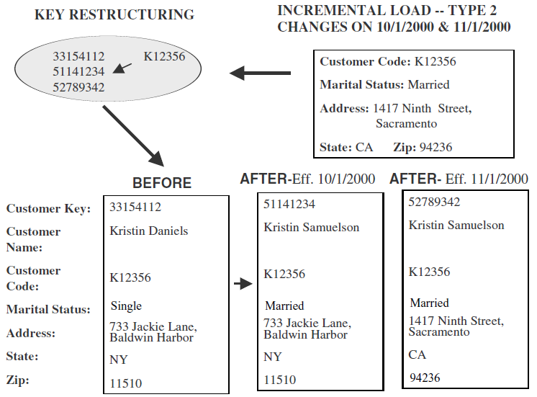
Type 2.. continued

Slide 9
Type 3: tentative soft revision
Tentative changes in the source system
E.g., if an employee will get posted for a short period to a different location
Need to keep track of history with old and new values
Used to compare performances across the transition
Applying these changes
  An “old” field is added in the dimension table
  Push existing value of attribute from “current” to “old”
  Update the “current” field with the new value with effective date

Slide 10
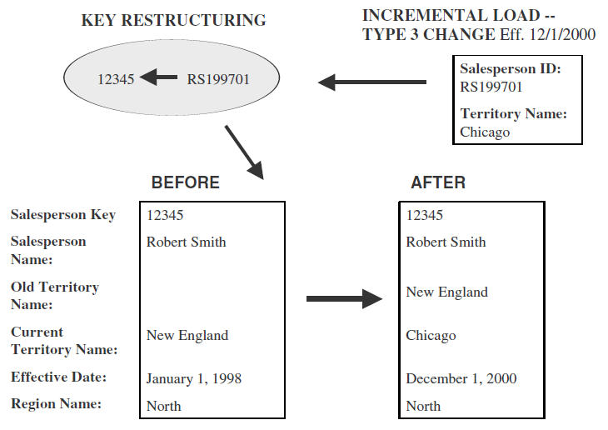
Type 3.. continued

Slide 11
Large dimensions
Very deep(large number of rows)
Very wide(large number of attributes)
Have multiple hierarchies
Rapidly changing dimensions
Junk dimensions

Slide 12

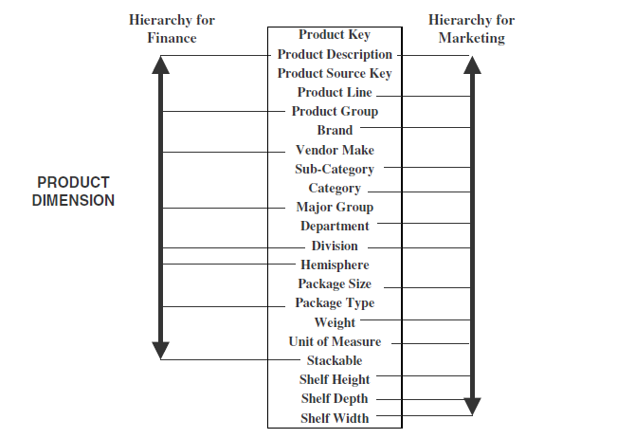

Slide 13
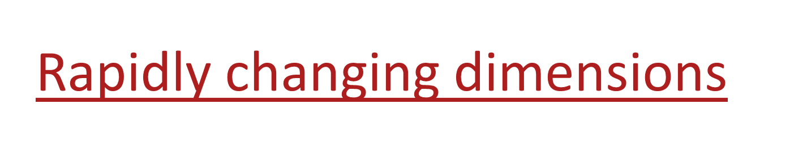
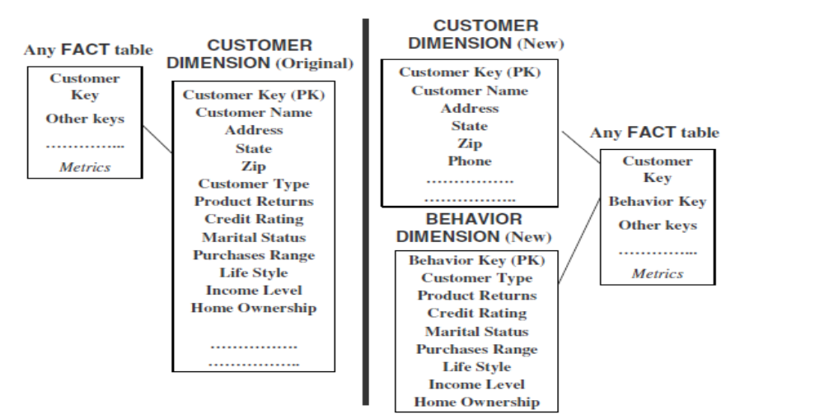

Slide 14
Snowflake schema
A variation of the star schema, in which all or some of the dimension tables may be normalized.
Eliminates redundancy
Generally used when a dimension table is wide.
Saves space
Complex querying is required.

Slide 15

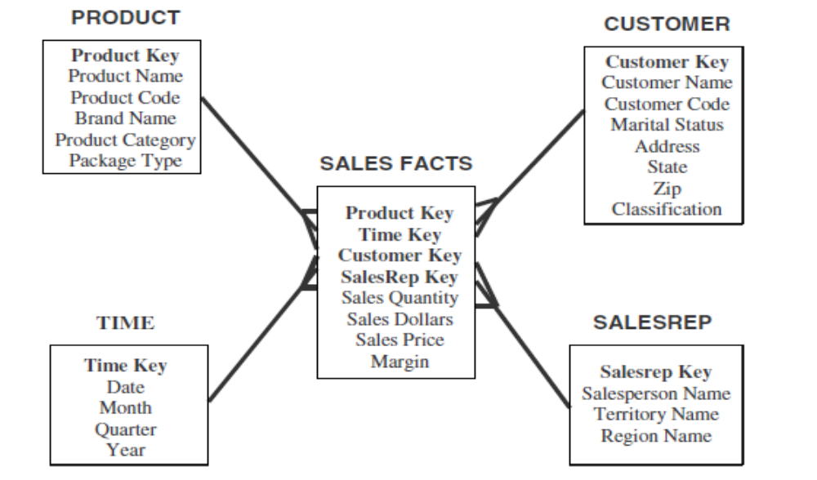

Slide 16
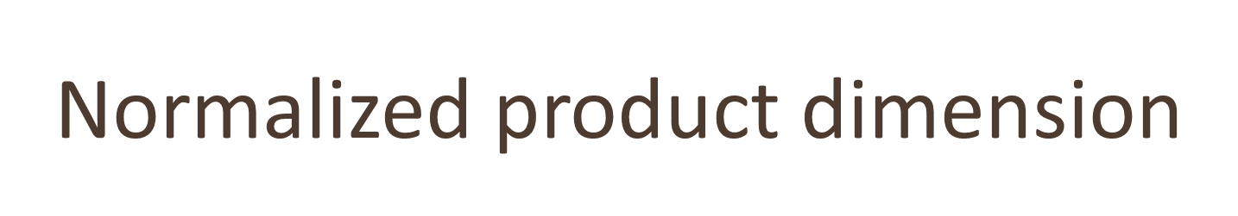
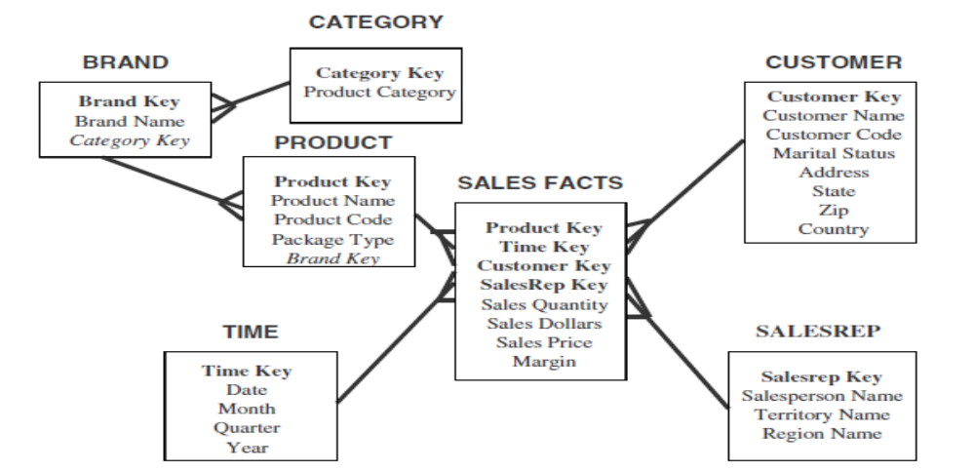

Slide 17

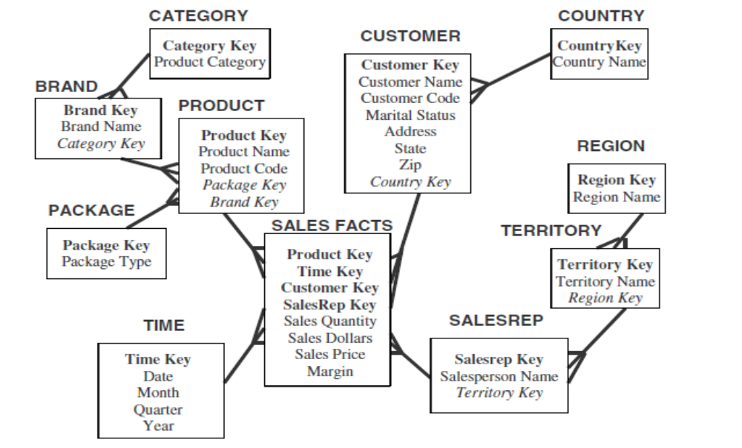

Slide 18
Advantages and disadvantages
Advantages
  Small savings in storage space
  Normalized structures are easier to update and maintain
Disadvantages
  Schema is less intuitive
  Browsing becomes difficult
  Degraded query performance because of additional joins

Slide 19

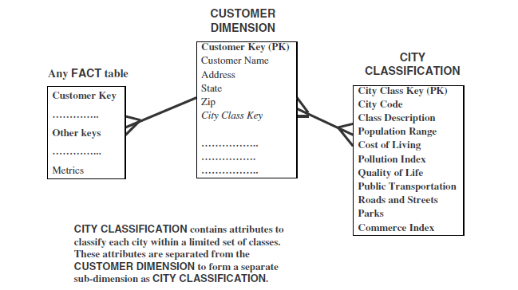

Slide 20
Aggregate fact tables
Contain pre-calculated summaries derived from the most granular (detailed) fact table.
Created as a specific summarization across any number of dimensions.
Reduces runtime processing.

Slide 21
Why need aggregate fact tables?
Large size of the fact table
To speed up query extraction
Limitations
  Must be re-aggregated each time there is a change in the source data
  Do not support exploratory analysis
  Limited interactive use.

Slide 22
Fact Constellation
Multiple fact tables share dimension tables.
This schema is viewed as collection of stars hence called galaxy schema or fact constellation.
Sophisticated application requires such schema.

Slide 23
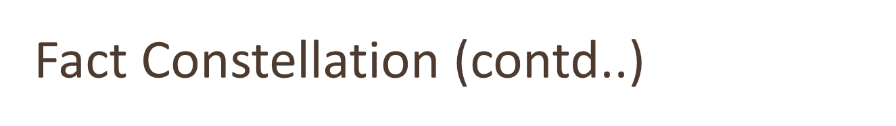
Sales
Fact Table
Shipping
Fact Table
Store Key
Product Key
Period Key
Units
Price
Product Dimension
Shipper Key
Store Key
Product Key
Period Key
Units
Price
Product Key
Product Desc
Store Dimension
Store Key
Store Name
City
State
Region

Slide 24
Fact Constellation
Multiple fact tables share dimension tables.
This schema is viewed as collection of stars hence called galaxy schema or fact constellation.
Sophisticated application requires such schema.

Slide 25
Sales
Fact Table
Shipping
Fact Table
Store Key
Product Key
Period Key
Units
Price
Product Dimension
Shipper Key
Store Key
Product Key
Period Key
Units
Price
Product Key
Product Desc
Store Dimension
Store Key
Store Name
City
State
Region

