Slide 1
DATAWARE HOUSING AND BUSSINESS INTELLIGENCE Prof. Sambhaji M Shedole VIT University, Vellore, Chennai

Slide 2
Objective:
The data warehousing part of module aims to give students a good overview of the ideas and techniques which are behind recent development in the data warehousing
Business Intelligence and online analytical processing (OLAP) fields, in terms of data models and storage techniques in Business Intelligence.

Slide 3
Expected Outcome:
Students will be able to Capture the business and technical requirements for BI project lifecycle and Business Intelligence solution architecture
Prerequisite: ITY305 (Database Management System)

Slide 4
Unit – I Data warehouse building Blocks

Slide 5
Contents
Data warehouse - The building Blocks:
Defining Features,
data warehouses and data marts,
overview of the components,
metadata in the data warehouse
-Defining the business requirements:
Dimensional analysis,
information packages - a new concept,
requirements gathering methods, requirements

Slide 6
A producer wants to know….
Which are our lowest/highest margin customers ?
Who are my customers and what products are they buying?
What is the most effective distribution channel?
What product prom- -otions have the biggest impact on revenue?
Which customers are most likely to go to the competition ?
What impact will new products/services
have on revenue and margins?

Slide 7
Data, Data everywhere yet . ..
I can’t find the data I need
data is scattered over the network
many versions, subtle differen
ces
I can’t get the data I need
need an expert to get the data
I can’t understand the data I found
available data poorly documented
I can’t use the data I found
results are unexpected
data needs to be transformed from one form to other

Slide 8
What is a Data Warehouse?
A single, complete and consistent store of data obtained from a variety of different sources made available to end users in a what they can understand and use in a business context.

Slide 9
What are the users saying...
Data should be integrated across the enterprise
Summary data has a real value to the organization
Historical data holds the key to understanding data over time
What-if capabilities are required

Slide 10
What is Data Warehousing?
A process of transforming data into information and making it available to users in a timely enough manner to make a difference
[Forrester Research
Information
Data

Slide 11
Evolution
60’s: Batch reports
hard to find and analyze information
inflexible and expensive, reprogram every new request
70’s: Terminal-based DSS and EIS (executive information systems)
still inflexible, not integrated with desktop tools
80’s: Desktop data access and analysis tools
query tools, spreadsheets, GUIs
easier to use, but only access operational databases
90’s: Data warehousing with integrated OLAP engines and tools

Slide 12
Warehouses are Very Large Databases
35%
30%
25%
20%
15%
10%
5%
0%
Respondents
Initial
Projected 2Q96
Source: META Group, Inc.
5GB
10-19GB
50-99GB
250-499GB
5-9GB
20-49GB
100-249GB
500GB-1TB

Slide 13
Very Large Data Bases
Terabytes -- 10^12 bytes:
Petabytes -- 10^15 bytes:
Exabytes -- 10^18 bytes:
Zettabytes -- 10^21 bytes:
Zottabytes -- 10^24 bytes:
Walmart -- 24 Terabytes
Geographic Information Systems
National Medical Records
Weather images
Intelligence Agency Videos

Slide 14

Data Warehousing -- It is a process
Technique for assembling and managing data from various sources for the purpose of answering business questions. Thus making decisions that were not previous possible
A decision support database maintained separately from the organization’s operational database

Slide 15
Data Warehouse
A data warehouse is a
subject-oriented
integrated
time-varying
non-volatile
collection of data that is used primarily in organizational decision making.
-- Bill Inmon, Building the Data Warehouse 1996

Slide 16
Explorers, Farmers and Tourists
Tourists: Browse information harvested by farmers
Farmers: Harvest information
from known access paths
Explorers: Seek out the unknown and previously unsuspected rewards hiding in the detailed data

Slide 17
Summary of Topics
The Nature of the Data in the Data Warehousing
Operational Data Store vs. Data Warehouse Technology
Typical Architecture of A Data Warehouse
Major Building Blocks (Components) of the Data Warehouse
Data Warehouse Information Flows
Data Warehousing Tools and Technologies
Business Issues for Middleware
Decision Processing—Four Tasks
Reasons for Creating a Data Mart

Slide 18
The Nature of the Data in the Data Warehousing
A subject-oriented, integrated, time-variant, and non-volatile collection of data in support of management’s decision-making process (Inmon, 1993).
9

Slide 19
Subject-Oriented Data
The warehouse is organized around the major subjects of the enterprise (e.g. customers, products, and sales) rather than the major application areas (e.g. customer invoicing, stock control, and product sales).
This is reflected in the need to store decision-support data rather than application-oriented data.
10

Slide 20
Integrated Data
The data warehouse integrates corporate application-oriented data from different source systems, which often includes data that is inconsistent.
The integrated data source must be made consistent to present a unified view of the data to the users.
11

Slide 21
Time-Variant Data
Data in the warehouse is only accurate and valid at some point in time or over some time interval.
Time-variance is also shown in the extended time that the data is held, the implicit or explicit association of time with all data, and the fact that the data represents a series of snapshots.
12

Slide 22
Non-Volatile Data
Data in the warehouse is not updated in real-time but is refreshed from operational systems on a regular basis.
New data is always added as a supplement to the database, rather than a replacement.
13

Slide 23
Data Granularity
Data in the warehouse is summarized at different levels.
Granularity levels are based on the data types and the expected system performance for queries.

Slide 24
Data Warehouse Data
The data should be well-defined, consistent, and nonvolatile in nature.
The quantity of data should be large enough to support data analysis, querying, reporting, and comparisons of historical data over a longer period of time.
The data warehouse must be user driven.

Slide 25
Data Warehouse Architecture
Relational Databases
Extraction Cleansing
Optimized Loader
ERP
Systems
Data Warehouse Engine
Analyze Query
Purchased Data
Legacy Data
Metadata Repository

Slide 26
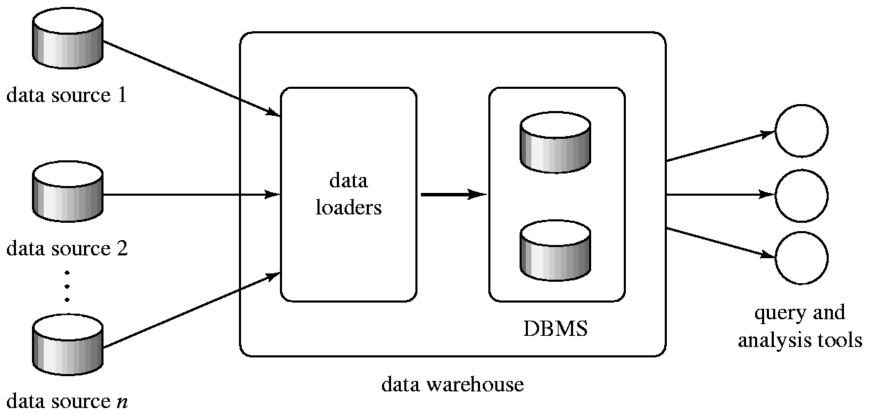
Data Warehousing

Slide 27
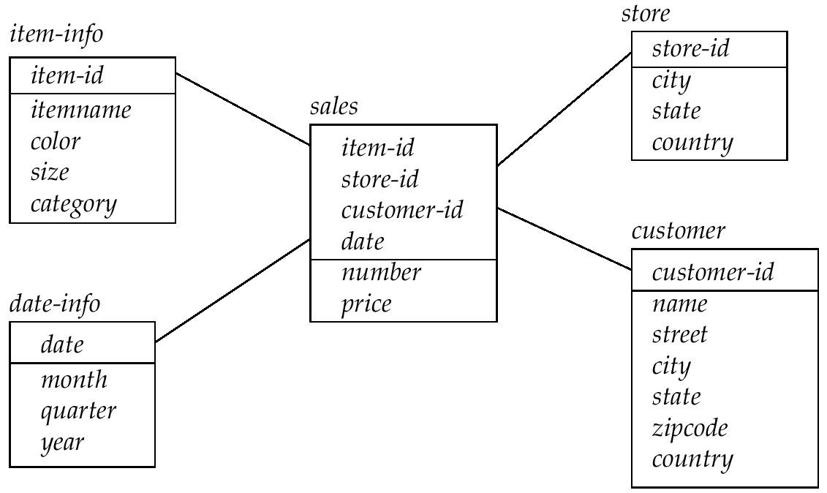
Data Warehouse Schema

Slide 28
Typical Architecture of A Data Warehouse
18

Slide 29
Architecture In Three Major Areas
The structure that brings all the components of a data
warehouse together is known as the architecture.
Data Acquisition
Data Storage
Information Delivery

Slide 30
Data Warehouse Architecture
Monitoring &
Administration
OLAP Servers
Metadata
Repository
Extract Transform Load Refresh
Reconciled data
Analysis
External
Sources
Serve
Operational
Dbs
Query/Reporting
Data Mining
DATA SOURCES
TOOLS
Information Delivery
Data Acquisition
DATA MARTS
Data Storage

Slide 31
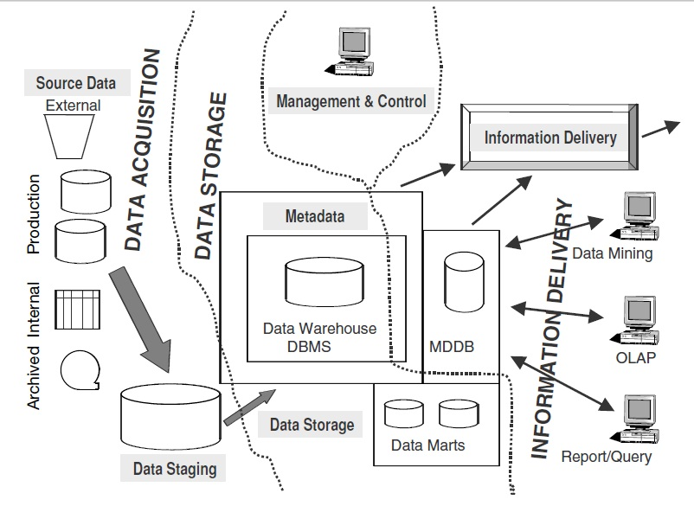
Architectural Framework

Slide 32
Data Marts
Small Data Stores
More manageable data sets
Targeted to meet the needs of small groups within the organization
Small, Single-Subject data warehouse subset that provides decision support to a small group of people

Slide 33
OLAP
Online Analytical Processing Tools
DSS (E-Data Storage Software ) tools that use multidimensional data analysis techniques
Support for a DSS data store
Data extraction and integration filter
Specialized presentation interface

Slide 34
Components of the Warehouse
Data Extraction and Loading
The Warehouse
Analyze and Query -- OLAP Tools
Metadata
Data Mining tools

Slide 35
Major Building Blocks (Components) of the Data Warehouse
Source data component (operation data store)
Data staging component
Data storage component
Information delivery component
Metadata component
Management and control component

Slide 36
1. Source Data Component - Operational Data Store
An operational data store (ODS) provides the basis
for operational processing and may be used to feed
the data warehouse. It consists of the following:
Production data (persistently stored and essential to completing day to day business tasks and processes)
Internal Data (info created by operation of an organ. that includes sales, orders)
Archived data (process of moving data that is no longer actively used )
External Data(Marketing and Web, that originate outside the world)

Slide 37
Operational Data Sources (Structure & Environment)
Mainframe first generation hierarchical and network databases.
Departmental propriety file systems (e.g. VSAM(Virtual Storage access method), RMS(Record Management Service)) and relational DBMSs (e.g. Informix, Oracle).
Private workstations and servers.
External systems such as the internet, commercially available databases, or databases associated with an organization’s suppliers or customers.
19

Slide 38
2. Source Staging Component
Three major functions need to be performed for getting the data ready. You have to extract the data, transform the data, and then load the data into the data warehouse storage. Data staging provides a place and an area with a set of functions to clean, change, combine, convert, duplicate, prepare source data for storage and use in the data warehouse.

Slide 39
Extraction, Cleansing, and Transformation Tools
Tasks of capturing data from source systems, cleansing and transforming it, and loading the results into a target system can be carried out either by separate products, or by a single integrated solution.
Integrated solutions include
Code Generators
Database Data Replication Tools
Dynamic Transformation Engines

Slide 40
EAI & ETL
EAI (Enterprise Application Integrator) tools provide a foundation for these models that address an enterprise’s tactical data requirements by efficiently moving data between applications with few integration challenges. EAI also preprocess and stage targeted data for enterprise data warehousing
ETL stands for Extract-transform-load.

Slide 41
Performs ETL
Extraction
Select data sources, determine filters
Automatic replicate
Create intermediary files
Transformation
Clean, merge, de-duplicate data
Covert data types
Calculate derived data
Resolve synonyms and homonyms
Loading
Initial loading
Incremental loading

Slide 42
Load Manager
Performs all the operations associated with the extraction and loading of data into the warehouse.
Size and complexity will vary between data warehouses and may be constructed using a combination of vendor data loading tools and custom-built programs.
20

Slide 43
3. Data Storage Component- Detailed Data
The foundation of the warehouse consists of detailed data at its most basic level.
Stores all the detailed data in the database schema.
In most cases, the detailed data is not stored online but aggregated to the next level of detail.
On a regular basis, detailed data is added to the warehouse to supplement the aggregated data.

Slide 44
Data Warehouse Data Storage
External Data
Archived
Data
Multidimensional Data
Summary 1
Level 1
Summary 4
Level 2
Detail
Data
Summary 2
Level 1
Summary 5
Level 2
Summary 3
Level 1
Summary 6
Level 3

Slide 45
Data Storage Component- Lightly and Highly Summarized Data
Stores all the pre-defined lightly and highly aggregated data generated by the warehouse manager.
Transient as it will be subject to change on an on-going basis in order to respond to changing query profiles.

Slide 46
Data Storage Component- Lightly and Highly Summarized Data (cont’d)
The purpose of summary information is to speed up the performance of queries.
Removes the requirement to continually perform summary operations (such as sort or group by) in answering user queries.
The summary data is updated continuously as new data is loaded into the warehouse.

Slide 47
Data Storage Component- Archive / Backup Data
Stores detailed and summarized data for the purposes of archiving and backup.
May be necessary to backup online summary data if this data is kept beyond the retention period for detailed data.
The data is transferred to storage archives such as magnetic tape or optical disk.

Slide 48
Warehouse Manager
Performs all the operations associated with the management of the data in the warehouse.
Constructed using vendor data management tools and custom-built programs.

Slide 49
Warehouse Manager - Operations
Analysis of data to ensure consistency.
Transformation and merging of source data from temporary storage into data warehouse tables.
Creation of indexes and views on base tables.
Generation of denormalizations, (if necessary).
Generation of aggregations, (if necessary).
Backing-up and archiving data.

Slide 50
Warehouse Manager
In some cases, also generates query profiles to determine which indexes and aggregations are appropriate.
A query profile can be generated for each user, group of users, or the data warehouse and is based on information that describes the characteristics of the queries such as frequency, target table(s), and size of results set.

Slide 51
4. Information Delivery Component
Functionality: Provide information to the wide community of data warehouse users via
Online access
Intranet
Internet
E-mail
For Ad hoc reports, complex queries, MD (multi-dimension) analysis, Statistical analysis, EIS feed and Data Mining.

Slide 52
End-User Access Tools
The principal purpose of data warehousing is to provide information to business users for strategic decision-making.
These users interact with the warehouse using end-user access tools.
The data warehouse must efficiently support ad hoc and routine analysis.

Slide 53
End-User Access Tools
High performance is achieved by pre-planning the requirements for joins, summations, and periodic reports by end-users (where possible).
There are five main groups of access tools
Data reporting and query tools (crystal reporting)
Application development tools
Executive Information System (EIS) tools
Online Analytical Processing (OLAP) tools
Data mining tools

Slide 54
Query Manager
Performs all the operations associated with the management of user queries.
Typically constructed using vendor end-user data access tools, data warehouse monitoring tools, database facilities, and custom-built programs.
Complexity determined by the facilities provided by the end-user access tools and the database.

Slide 55
Query Manager (cont’d)
The operations performed by this component include directing queries to the appropriate tables and scheduling the execution of queries.
In some cases, the query manager also generates query profiles to allow the warehouse manager to determine which indexes and aggregations are appropriate.

Slide 56
5. Metadata Component
This area of the warehouse stores all the metadata (data about data) definitions used by all the processes in the warehouse.

Slide 57
What’s Metadata
THE DATA WAREHOUSE PROVIDES A MEANS FOR IMPLEMENTING AN EFFECTIVE DECISION
SUPPORT ENVIRONMENT BY BUILDING EXISTING DATA FROM DISPARATE SOURCES SCATTERED
ALL OVER AN ORGANIZATION. METADATA (META MODEL) COULD BE COMPARED TO AN
INFORMATION DIRECTORY, CONTAINING THE “YELLOW PAGES,” ROAD MAP FOR NAVIGATING
A DATA WAREHOUSE.

Slide 58
What’s Metadata
METADATA IS DEFINED AS DATA ABOUT DATA.
FOR EXAMPLE:
6.33 HAS LITTLE MEANING.
6.33 % MEANS MORE.
6.33 % BIRTH REDUCTION RATE FROM A NATIONAL CAMPAIGN.

Slide 59
Why Metadata –(cont’d)
THE DATA WAREHOUSING IS GROWING PHENOMENON. (THE WAREHOUSE SOFTWARE
PRODUCTS ARE EXPECTED TO GROW AT AN ANNUAL RATE OF 24% TO REACH A $2.2 BILLION
MARKET BY 1998). WITHOUT METADATA, INFORMATION IS REDUCED TO A MEANINGLESS DATA
REPOSITORY.

Slide 60
Types of Metadata
Extraction and Transformation Metadata--Extraction and loading processes - metadata is used to map data sources to a common view of information within the warehouse.
Operational Metadata-- Warehouse management process - metadata is used to automate the production of summary tables.
End-User Metadata -- Query management process - metadata is used to direct a query to the most appropriate data source.

Slide 61
Metadata Views
BUSINESS USER’S VIEW FROM A BUSINESS USER’S VIEW, METADATA
SHOULD CONTAIN THE FOLLOWING SIX ELEMENTS:
1. TABLE OF CONTENTS
2. ORIGIN OF THE DATA FOR THE WAREHOUSE
3. TRANSFORMATION SEQUENCE
4. ACCESS LEVEL
5. TIMELINE OF THE JOURNEY
6. ACCESS ESTIMATES

Slide 62
Metadata Views
DATA WAREHOUSE ADMINISTRATOR'S VIEW
1. VERSION CONTROL
2. PROFILE AND GROWTH METRICS – FOR PURGING
PURPOSE

Slide 63
Metadata Views
DSS (DECISION SUPPORT SYSTEM)
DEVELOPER’S VIEW
1. TRANSFORMATION AND BUSINESS RULES
2. DATA MODELS
3. AVAILABLE OPERATION DATA

Slide 64
Metadata Views
CORPORATE VIEW
METADATA IS A LOGICAL COLLECTION OF METADATA FROM VARIOUS SOURCES,

Slide 65
Metadata Views
1. LEGACY SYSTEM METADATA
CONSISTING OF A DATA DICTIONARY CONTAINING INFORMATION ABOUT PROGRAM LIBRARIES, DATABASE CATALOGS AND FILE LAYOUTS.
2. OPERATIONAL CLIENT/SERVER SYSTEMS – CONSISTING OF DISTRIBUTED SOFTWARE COMPONENTS FROM A VARIETY OF VENDORS.
3. ENTERPRISE MODELS –THEY ARE THE FIRST STAGE IN THE ULTIMATE GOAL OF BUILDING CORPORATE METADATA.

Slide 66
Metadata Example
Assume your user wants to know about the table or entity called Customer in your data warehouse before running any queries on the customer data. What’s the information content about Customer in your metadata repository? Let’s review the metadata elements for the Customer entity as shown on next slide.

Slide 67
Entity Name: Customer; Alias Names: Account, Client
Definition: A person or an organization that purchases goods or services from the company.
Remarks: Customer entity includes regular, current, and past customers.
Source Systems: Finished goods orders; Maintenance contracts; Online sales.
Create Date January 15,1999
Last update date January 21,2001
Update Cycle weekly
Last full refresh date December 20, 2000
Data quality review January 25, 2001
Planned archival Every six months
Responsible user Jim Brown

Slide 68
6. Management and Control Component --Warehouse Manager
Performs all the operations associated with the management of the data in the warehouse.
Constructed using vendor data management tools and custom-built programs.

Slide 69
Warehouse Manager - Operations
Analysis of data to ensure consistency.
Transformation and merging of source data from temporary storage into data warehouse tables.
Creation of indexes and views on base tables.
Generation of denormalizations, (if necessary).
Generation of aggregations, (if necessary).
Backing-up and archiving data.

Slide 70
Warehouse Manager
In some cases, also generates query profiles to determine which indexes and aggregations are appropriate.
A query profile can be generated for each user, group of users, or the data warehouse and is based on information that describes the characteristics of the queries such as frequency, target table(s), and size of results set.

Slide 71
Data Warehouse Information Flows
36

Slide 72
Data Warehouse Information Flows
Inflow - Processes associated with the extraction, cleansing, and loading of the data from the source systems into the data warehouse.
Upflow - Processes associated with adding value to the data in the warehouse through summarizing, packaging, and distribution of the data.
37

Slide 73
Data Warehouse Information Flows
Downflow - Processes associated with archiving and backing-up/recovery of data in the warehouse.
Outflow - Processes associated with making the data available to the end-users.
Metaflow - Processes associated with the management of the metadata.
38

Slide 74
Data Flow Across the Corporation
Personal
Data
Warehouse
Production Systems
Data Marts
Operational
Data Store
Extract,transform
& Load Processing
Data
Warehouse
Metadata/Data Dictionary

Slide 75
Data Warehousing Tools and Technologies
Building a data warehouse is a complex task because there is no vendor that provides an ‘end-to-end’ set of tools.
Necessitates that a data warehouse is built using multiple products from different vendors.
Ensuring that these products work well together and are fully integrated is a major challenge.
39

Slide 76
Tools for your Data Warehouse
Data Acquisition
Data Storage
Information Delivery
Source
Systems
OLAP
Data Modeling
DW/
Data Marts
Extraction
Report Writer
Data Loading
Transformation
Staging
Ara
Quality
Assurance
Load Image Creation
Alert
Systems
Data
Mining

Slide 77
Front End Tools
Production queries
Access for existing tools
Ad hoc queries
“Intelligent” global optimization
Query governor – preset limit
Predictive governor – estimates cost (CPU, I/O)
Tool connectivity to all databases

Slide 78
Accessing DW Databases
Heterogeneous DBs, linking data marts
Gateways
Database gateway (requires DBMS)
Independent gateway
Aspects
Point-to-point, point-to-many-points
Data location transparency
Global metadata catalog
Access to distributed databases
Heterogeneous joins
Global optimizer
SMP

Slide 79
Data Warehouse DBMS Requirements
Load performance
Load processing
Data quality management
Query performance
Terabyte scalability
Mass user scalability
Networked data warehouse
Warehouse administration
Integrated dimensional analysis
Advanced query functionality
41

Slide 80
Structuring/Modeling Issues

Slide 81
Data -- Heart of the Data Warehouse
Heart of the data warehouse is the data itself!
Single version of the truth
Corporate memory
Data is organized in a way that represents business -- subject orientation

Slide 82
Data Warehouse Structure
Subject Orientation -- customer, product, policy, account etc... A subject may be implemented as a set of related tables. E.g., customer may be five tables

Slide 83
Data Warehouse for Decision Support & OLAP
Putting Information technology to help the knowledge worker make faster and better decisions
Which of my customers are most likely to go to the competition?
What product promotions have the biggest impact on revenue?
How did the share price of software companies correlate with profits over last 10 years?

Slide 84
Decision Support
Used to manage and control business
Data is historical or point-in-time
Optimized for inquiry rather than update
Use of the system is loosely defined and can be ad-hoc
Used by managers and end-users to understand the business and make judgements

Slide 85
Data Mining works with Warehouse Data
Data Warehousing provides the Enterprise with a memory
Data Mining provides the Enterprise with intelligence

Slide 86
We want to know ...
Given a database of 100,000 names, which persons are the least likely to default on their credit cards?
Which types of transactions are likely to be fraudulent given the demographics and transactional history of a particular customer?
If I raise the price of my product by Rs. 2, what is the effect on my ROI?
If I offer only 2,500 airline miles as an incentive to purchase rather than 5,000, how many lost responses will result?
If I emphasize ease-of-use of the product as opposed to its technical capabilities, what will be the net effect on my revenues?
Which of my customers are likely to be the most loyal?
Data Mining helps extract such information

Slide 87
Application Areas
Industry
Application
Finance
Credit Card Analysis
Insurance
Claims, Fraud Analysis
Telecommunication
Call record analysis
Transport
Logistics management
Consumer goods
promotion analysis
Data Service providers
Value added data
Utilities
Power usage analysis

Slide 88
Data Mining in Use
The US Government uses Data Mining to track fraud
A Supermarket becomes an information broker
Basketball teams use it to track game strategy
Cross Selling
Warranty Claims Routing
Holding on to Good Customers
Weeding out Bad Customers

Slide 89
What makes data mining possible?
Advances in the following areas are making data mining deployable:
data warehousing
better and more data (i.e., operational, behavioral, and demographic)
the emergence of easily deployed data mining tools and
the advent of new data mining techniques.
-- Gartner Group

Slide 90
Why Separate Data Warehouse?
Performance
Op dbs designed & tuned for known txs & workloads.
Complex OLAP queries would degrade perf. for op txs.
Special data organization, access & implementation methods needed for multidimensional views & queries.
Function
Missing data: Decision support requires historical data, which op dbs do not typically maintain.
Data consolidation: Decision support requires consolidation (aggregation, summarization) of data from many heterogeneous sources: op dbs, external sources.
Data quality: Different sources typically use inconsistent data representations, codes, and formats which have to be reconciled.

Slide 91

What are Operational Systems?
They are OLTP systems
Run mission critical applications
Need to work with stringent performance requirements for routine tasks
Used to run a business!

Slide 92
RDBMS used for OLTP
Database Systems have been used traditionally for OLTP
clerical data processing tasks
detailed, up to date data
structured repetitive tasks
read/update a few records
isolation, recovery and integrity are critical

Slide 93
Operational Systems
Run the business in real time
Based on up-to-the-second data
Optimized to handle large numbers of simple read/write transactions
Optimized for fast response to predefined transactions
Used by people who deal with customers, products -- clerks, salespeople etc.
They are increasingly used by customers

Slide 94
Examples of Operational Data
Data
Industry
Usage
Technology
Volumes
Customer
All
Track
Legacy application, flat
Small-medium
File
Customer
files, main frames
Details
Account
Finance
Control
Legacy applications,
Large
Balance
account
hierarchical databases,
activities
mainframe
Point-of-
Retail
Generate
ERP, Client/Server,
Very Large
Sale data
bills, manage
relational databases
stock
Call
Telecomm-
Billing
Legacy application,
Very Large
Record
unications
hierarchical database,
mainframe
Production
Manufact-
Control
ERP,
Medium
Record
uring
Production
relational databases,
AS/400

Slide 95

So, what’s different?

Slide 96
Application-Orientation vs. Subject-Orientation
Application-Orientation
Subject-Orientation
Operational Database
Data
Warehouse
Credit
Card
Loans
Customer
Vendor
Product
Trust
Savings
Activity

Slide 97
OLTP vs. Data Warehouse
OLTP systems are tuned for known transactions and workloads while workload is not known a priori in a data warehouse
Special data organization, access methods and implementation methods are needed to support data warehouse queries (typically multidimensional queries)
e.g., average amount spent on phone calls between 9AM-5PM in Pune during the month of December

Slide 98
OLTP vs Data Warehouse
OLTP
Application Oriented
Used to run business
Detailed data
Current up to date
Isolated Data
Repetitive access
Clerical User
Warehouse (DSS)
Subject Oriented
Used to analyze business
Summarized and refined
Snapshot data
Integrated Data
Ad-hoc access
Knowledge User (Manager)

Slide 99
OLTP vs Data Warehouse
OLTP
Performance Sensitive
Few Records accessed at a time (tens)
Read/Update Access
No data redundancy
Database Size 100MB -100 GB
Data Warehouse
Performance relaxed
Large volumes accessed at a time(millions)
Mostly Read (Batch Update)
Redundancy present
Database Size 100 GB - few terabytes

Slide 100
OLTP vs Data Warehouse
OLTP
Transaction throughput is the performance metric
Thousands of users
Managed in entirety
Data Warehouse
Query throughput is the performance metric
Hundreds of users
Managed by subsets

Slide 101

To summarize ...
OLTP Systems are used to “run” a business
The Data Warehouse helps to “optimize” the business

Slide 102
Operational Data Store vs. Data Warehouse Technology
Issue | Operational | Data Warehouse
How built Critical to Data access Data volume | One application at a time in the legacy environment or one subject area at time in the ODS Daily business operation Smaller numbers of rows retrieved in a single call Volume needed for daily operation | One or more subject areas at a time Management decisions that may affect profitability Large sets of data scanned to retrieve results Larger volume needed to support statistical analysis, forecasting, ad hoc reporting, and querying

Slide 103
Operational Data Store vs. Data Warehouse Technology
Issue | Operational | Data Warehouse
Data retention Data currency Data Availability | Data retained to meet daily requirements Must be up to minute High availability may be needed | Data retained longer to support historical reporting, comparison, analysis, etc. Usually represents a static point in time; usually important that data does not change minute by minute Usually does not require as high availability as the production environment unless worldwide access is necessary

Slide 104
Comparison of OLTP Systems and Data Warehousing From Data Contents
15

Slide 105
Thank You

