Slide 1
Dimensional Modeling

Slide 2
Dimensional Models
A denormalized relational model
  Made up of tables with attributes
  Relationships defined by keys and foreign keys
Organized for understandability and ease of reporting rather than update
Queried and maintained by SQL or special purpose management tools.

Slide 3
Entity-Relationship vs. Dimensional Models
One table per entity
Minimize data redundancy
Optimize update
The Transaction Processing Model
One fact table for data organization
Maximize understandability
Optimized for retrieval
The data warehousing model

Slide 4
Fact Tables
Contains two or more foreign keys
Tend to have huge numbers of records
Useful facts tend to be numeric and additive

Slide 5
Dimension Tables
Contain text and descriptive information
1 in a 1-M relationship
Generally the source of interesting constraints
Typically contain the attributes for the SQL answer set.

Slide 6
Strengths of the Dimensional Model (according to Kimball)
Predictable, standard framework
Respond well to changes in user reporting needs
Relatively easy to add data without reloading tables
Standard design approaches have been developed
There exist a number of products supporting the dimensional model

Slide 7
Design Issues
Relational and Multidimensional Models
Denormalized and indexed relational models more flexible
Multidimensional models simpler to use and more efficient

Slide 8
Star Schemas in a RDBMS
In most companies doing ROLAP, the DBAs have created countless indexes and summary tables in order to avoid I/O-intensive table scans against large fact tables. As the indexes and summary tables proliferate in order to optimize performance for the known queries and aggregations that the users perform, the build times and disk space needed to create them has grown enormously, often requiring more time than is allotted and more space than the original data!

Slide 9
The Business Model
Identify the data structure, attributes and constraints for the client’s data warehousing environment.
Stable
Optimized for update
Flexible

Slide 10
Business Model
As always in life, there are some disadvantages to 3NF:
Performance can be truly awful. Most of the work that is performed on denormalizing a data model is an attempt to reach performance objectives.
The structure can be overwhelmingly complex. We may wind up creating many small relations which the user might think of as a single relation or group of data.

Slide 11
The 4 Step Design Process
Choose the Data Mart
Declare the Grain
Choose the Dimensions
Choose the Facts

Slide 12
Building a Data Warehouse from a Normalized Database
The steps
Develop a normalized entity-relationship business model of the data warehouse.
Translate this into a dimensional model. This step reflects the information and analytical characteristics of the data warehouse.
Translate this into the physical model. This reflects the changes necessary to reach the stated performance objectives.
Notes:
Designing the Perfect Data Warehouse (the paper formerly known as: Data Modeling for Data Warehouses), Frank McGuff , http://members.aol.com/fmcguff/dwmodel/

Slide 13
Structural Dimensions
The first step is the development of the structural dimensions. This step corresponds very closely to what we normally do in a relational database.
The star architecture that we will develop here depends upon taking the central intersection entities as the fact tables and building the foreign key => primary key relations as dimensions.

Slide 14
Steps in dimensional modeling
Select an associative entity for a fact table
Determine granularity
Replace operational keys with surrogate keys
Promote the keys from all hierarchies to the fact table
Add date dimension
Split all compound attributes
Add necessary categorical dimensions
Fact (varies with time) / Attribute (constant)

Slide 15
Converting an E-R Diagram
Determine the purpose of the mart
Identify an association table as the central fact table
Determine facts to be included
Replace all keys with surrogate keys
Promote foreign keys in related tables to the fact table
Add time dimension
Refine the dimension tables

Slide 16
Choosing the Mart
A set of related fact and dimension tables
Single source or multiple source
Conformed dimensions
Typically have a fact table for each process

Slide 17
Fact Tables
Represent a process or reporting environment that is of value to the organization
It is important to determine the identity of the fact table and specify exactly what it represents.
Typically correspond to an associative entity in the E-R model

Slide 18
Grain (unit of analysis)
The grain determines what each fact record represents: the level of detail.
For example
  Individual transactions
  Snapshots (points in time)
  Line items on a document
Generally better to focus on the smallest grain

Slide 19
Facts
Measurements associated with fact table records at fact table granularity
Normally numeric and additive
Non-key attributes in the fact table
  Attributes in dimension tables are constants. Facts vary with the granularity of the fact table

Slide 20
Dimensions
A table (or hierarchy of tables) connected with the fact table with keys and foreign keys
Preferably single valued for each fact record (1:m)
Connected with surrogate (generated) keys, not operational keys
Dimension tables contain text or numeric attributes

Slide 21
PRODUCT
SKU (PK)
description
brand
category
CUSTOMER
customer_ID (PK)
customer_name
purchase_profile
credit_profile
address
ERD
ORDER
order_num (PK)
customer_ID (FK)
store_ID (FK)
clerk_ID (FK)
date
ORDER-LINE
order_num (PK) (FK)
SKU (PK) (FK)
promotion_key (FK)
dollars_sold
units_sold
dollars_cost
STORE
store_ID (PK)
store_name
address
district
floor_type
CLERK
clerk_id (PK)
clerk_name
clerk_grade
PROMOTION
promotion_NUM (PK)
promotion_name
price_type
ad_type

Slide 22
DIMENSONAL
MODEL
PRODUCT
product_key (PK)
SKU
description
brand
category
TIME
time_key (PK)
SQL_date
day_of_week
month
FACT
time_key (FK)
store_key (FK)
clerk_key (FK)
product_key (FK)
customer_key (FK)
promotion_key (FK)
dollars_sold
units_sold
dollars_cost
STORE
store_key (PK)
store_ID
store_name
address
district
floor_type
CUSTOMER
customer_key (PK)
customer_name
purchase_profile
credit_profile
address
CLERK
clerk_key (PK)
clerk_id
clerk_name
clerk_grade
PROMOTION
promotion_key (PK)
promotion_name
price_type
ad_type

Slide 23
Snowflaking & Hierarchies
Efficiency vs Space
Understandability
M:N relationships

Slide 24
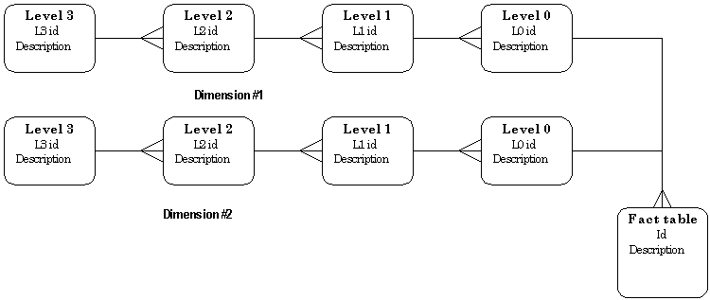
Simple DW hierarchy pattern.

Slide 25
Good Attributes
Verbose
Descriptive
Complete
Quality assured
Indexed (b-tree vs bitmap)
Equally available
Documented

Slide 26
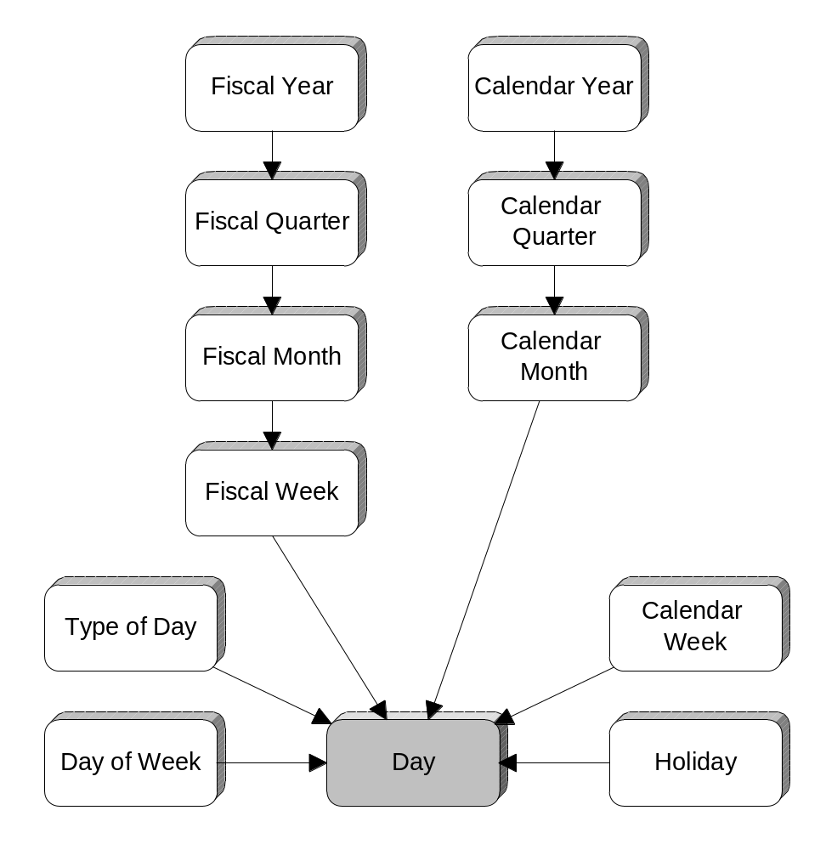
Date
Dimensions

Slide 27
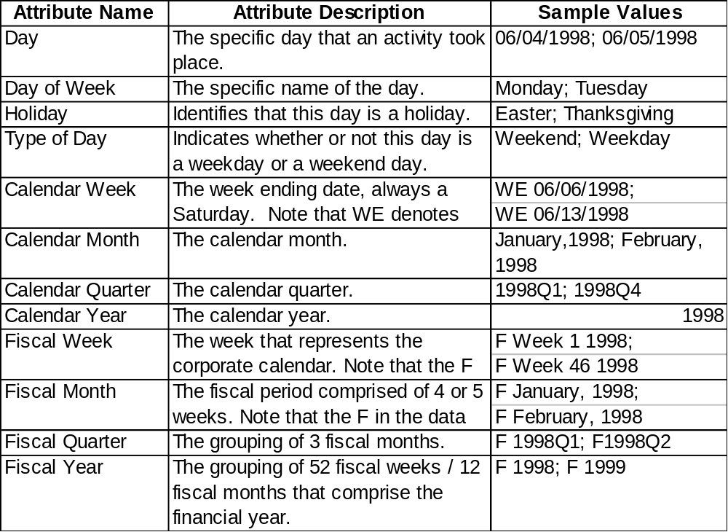

Slide 28
Slowly Changing Dimensions
(Addresses, Managers, etc.)
Type 1: Store only the current value
Type 2: Create a dimension record for each value (with or without date stamps)
Type 3: Create an attribute in the dimension record for previous value

Slide 29
Many to many
Use a Bridge Table
Add a weighting factor to correct fact addition
Fact (Acct Bal)
Bridge
acct-key (PK)
customer-key (PK)
weighting-factor
Dimension (Customer)

Slide 30
Recursive
Use a Bridge Table
Add a level count and bottom flag
Fact (Employee)
employee-key (FK)
Navigation (Supervise)
employee-key (PK)
supervises-key
number-levels-down
bottom-most-flag
Dimension (Employee)

