Slide 1

Chapter 33
Data Warehousing Design
Transparencies
Notes:
September 98
1
Chapter Name

Slide 2
Chapter Objectives
The activities associated with initiating a data warehouse project.
The two main methodologies, which incorporate the development of a data warehouse: namely Inmon’s Corporate Information Factory (CIF) and Kimball’s Business Dimensional Lifecycle.
The main principles and stages associated with Kimball’s Business Dimensional Lifecycle.

Slide 3
Chapter Objectives
The concepts associated with dimensionality modeling, which is a core technique of Kimball’s Business Dimensional Lifecycle.
The Dimensional Modeling stage of Kimball’s Business Dimensional Lifecycle.
The step-by-step creation of a dimensional model (DM) using the DreamHome case study.
The issues associated with the development of a data warehouse.

Slide 4
Designing Data Warehouses
To begin a data warehouse project, we need to find answers for questions such as:
  Which user requirements are most important and which data should be considered first?
  Which data should be considered first?
  Should the project be scaled down into something more manageable?
  Should the infrastructure for a scaled down project be capable of ultimately delivering a full-scale enterprise-wide data warehouse?

Slide 5
Designing Data Warehouses
For many enterprises the way to avoid the complexities associated with designing a data warehouse is to start by building one or more data marts.
Data marts allow designers to build something that is far simpler and achievable for a specific group of users.

Slide 6
Designing Data Warehouses
Few designers are willing to commit to an enterprise-wide design that must meet all user requirements at one time.
Despite the interim solution of building data marts, the goal remains the same: that is, the ultimate creation of a data warehouse that supports the requirements of the enterprise.

Slide 7
Designing Data Warehouses
The requirements collection and analysis stage of a data warehouse project involves interviewing appropriate members of staff (such as marketing users, finance users, and sales users) to enable the identification of a prioritized set of requirements that the data warehouse must meet.

Slide 8
Designing Data Warehouses
At the same time, interviews are conducted with members of staff responsible for operational systems to identify, which data sources can provide clean, valid, and consistent data that will remain supported over the next few years.

Slide 9
Designing Data Warehouses
Interviews provide the necessary information for the top-down view (user requirements) and the bottom-up view (which data sources are available) of the data warehouse.
The database component of a data warehouse is described using a technique called dimensionality modeling.

Slide 10
Data Warehouse Development Methodologies
There are two main methodologies that incorporate the development of an enterprise data warehouse (EDW) and these are proposed by the two key players in the data warehouse arena.
  Kimball’s Business Dimensional Lifecycle (Kimball, 2008)
  Inmon’s Corporate Information Factory (CIF) methodology (Inmon, 2001).

Slide 11
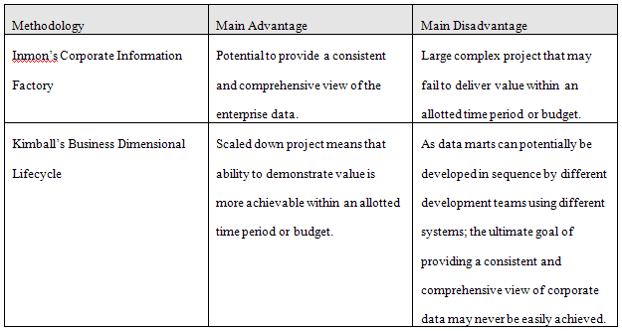
Data Warehouse Development Methodologies

Slide 12
Kimballs’ Business Dimensional Lifecycle
Ralph Kimball is a key player in DW.
About creation of an infrastructure capable of supporting all the information needs of an enterprise.
Uses new methods and techniques in the development of an enterprise data warehouse (EDW).

Slide 13
Kimballs’ Business Dimensional Lifecycle
Starts by identifying the information requirements (referred to as analytical themes) and associated business processes of the enterprise.
This activity results in the creation of a critical document called a Data Warehouse Bus Matrix.

Slide 14
Kimballs’ Business Dimensional Lifecycle
The matrix lists all of the key business processes of an enterprise together with an indication of how these processes are to be analysed.
The matrix is used to facilitate the selection and development of the first database (data mart) to meet the information requirements of a particular department of the enterprise.

Slide 15
Kimballs’ Business Dimensional Lifecycle
This first data mart is critical in setting the scene for the later integration of other data marts as they come online.
The integration of data marts ultimately leads to the development of an EDW.
Uses dimensionality modeling to establish the data model (called star schema) for each data mart.

Slide 16
Kimballs’ Business Dimensional Lifecycle
Guiding principle is to meet the information requirements of the enterprise by building a single, integrated, easy-to-use, high-performance information infrastructure, which is delivered in meaningful increments of 6 to 12 month timeframes.
Goal is to deliver the entire solution including the data warehouse, ad hoc query tools, reporting applications, advanced analytics and all the necessary training and support for the users.

Slide 17
Kimballs’ Business Dimensional Lifecycle
Has three tracks:
  technology (top track),
  data (middle track),
  business intelligence (BI) applications (bottom track).
Uses incremental and iterative approach that involves the development of data marts that are eventually integrated into an enterprise data warehouse (EDW).

Slide 18
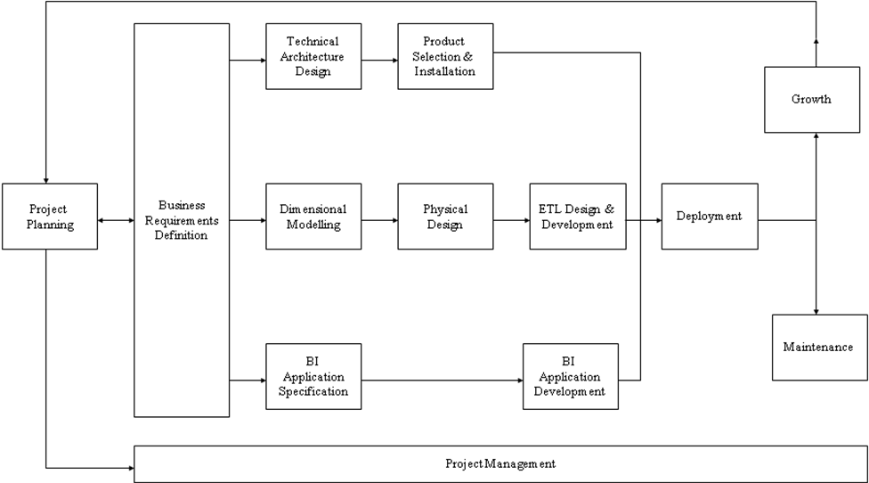
Kimballs’ Business Dimensional Lifecycle

Slide 19
Dimensionality modeling
A logical design technique that aims to present the data in a standard, intuitive form that allows for high-performance access
Every dimensional model (DM) is composed of one table with a composite primary key, called the fact table, and a set of smaller tables called dimension tables.

Slide 20
Dimensionality modeling
Each dimension table has a simple (non-composite) primary key that corresponds exactly to one of the components of the composite key in the fact table.
Forms ‘star-like’ structure, which is called a star schema or star join.

Slide 21
Dimensionality modeling
All natural keys are replaced with surrogate keys. Means that every join between fact and dimension tables is based on surrogate keys, not natural keys.
Surrogate keys allows the data in the warehouse to have some independence from the data used and produced by the OLTP systems.

Slide 22
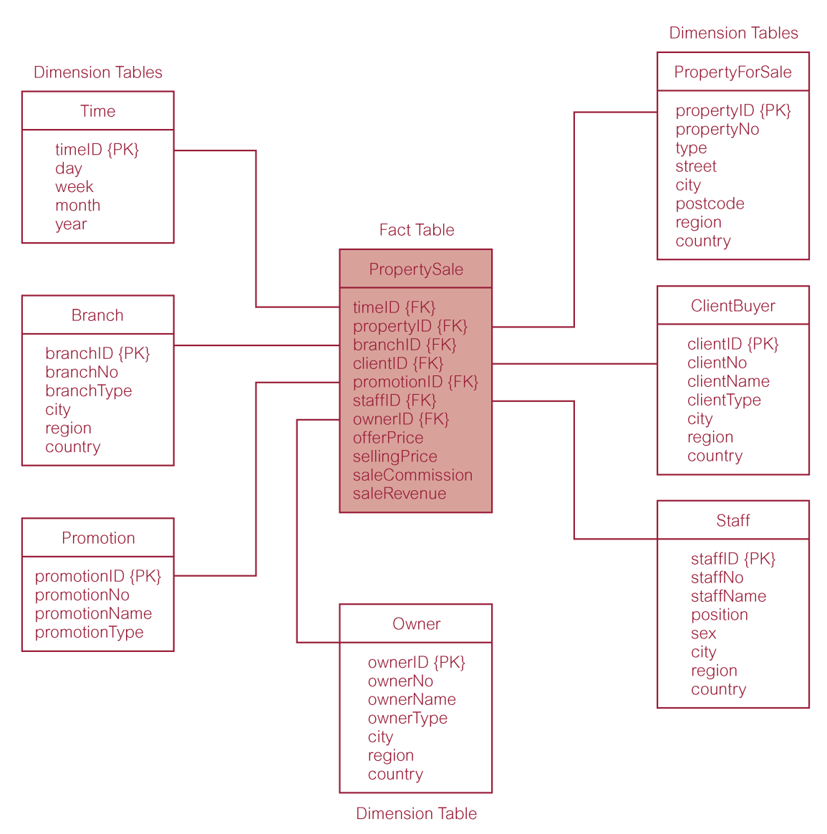
Star schema (dimensional model) for property sales of DreamHome

Slide 23
Dimensionality modeling
Star schema is a logical structure that has a fact table (containing factual data) in the center, surrounded by denormalized dimension tables (containing reference data).
Facts are generated by events that occurred in the past, and are unlikely to change, regardless of how they are analyzed.

Slide 24
Dimensionality modeling
Bulk of data in data warehouse is in fact tables, which can be extremely large.
Important to treat fact data as read-only reference data that will not change over time.
Most useful fact tables contain one or more numerical measures, or ‘facts’ that occur for each record and are numeric and additive.

Slide 25
Dimensionality modeling
Dimension tables usually contain descriptive textual information.
Dimension attributes are used as the constraints in data warehouse queries.
Star schemas can be used to speed up query performance by denormalizing reference information into a single dimension table.

Slide 26
Dimensionality modeling
Snowflake schema is a variant of the star schema that has a fact table in the center, surrounded by normalized dimension tables .
Starflake schema is a hybrid structure that contains a mixture of star (denormalized) and snowflake (normalized) dimension tables.

Slide 27
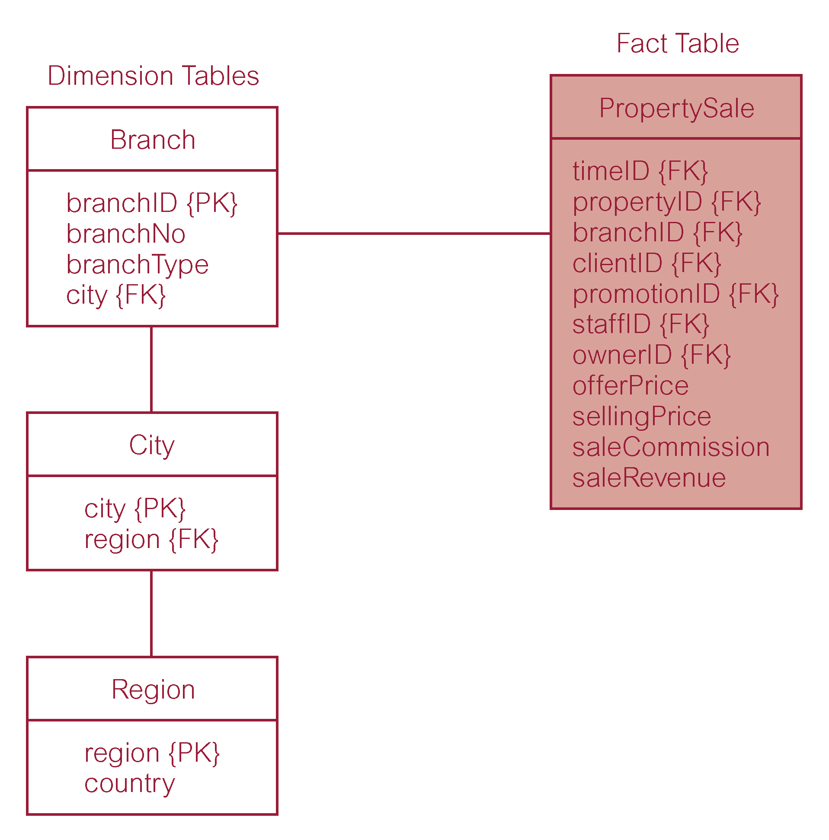
Property sales with normalized version of Branch dimension table

Slide 28
Dimensionality modeling
Predictable and standard form of the underlying dimensional model offers important advantages:
  Efficiency
  Ability to handle changing requirements
  Extensibility
  Ability to model common business situations
  Predictable query processing

Slide 29
Comparison of DM and ER models
A single ER model normally decomposes into multiple DMs.
Multiple DMs are then associated through ‘shared’ dimension tables.

Slide 30
Dimensional Modeling Stage of Kimball’s Business Dimensional Lifecycle
Begins by defining a high-level dimension model (DM), which progressively gains more detail and this is achieved using a two-phased approach.
The first phase is the creation of the high-level DM and the second phase involves adding detail to the model through the identification of dimensional attributes for the model.

Slide 31

Dimensional Modeling Stage of Kimball’s Business Dimensional Lifecycle
Phase 1 involves the creation of a high-level dimensional model (DM) using a four-step process.

Slide 32
Step 1: Select business process
The process (function) refers to the subject matter of a particular data mart.
First data mart built should be the one that is most likely to be delivered on time, within budget, and to answer the most commercially important business questions.

Slide 33
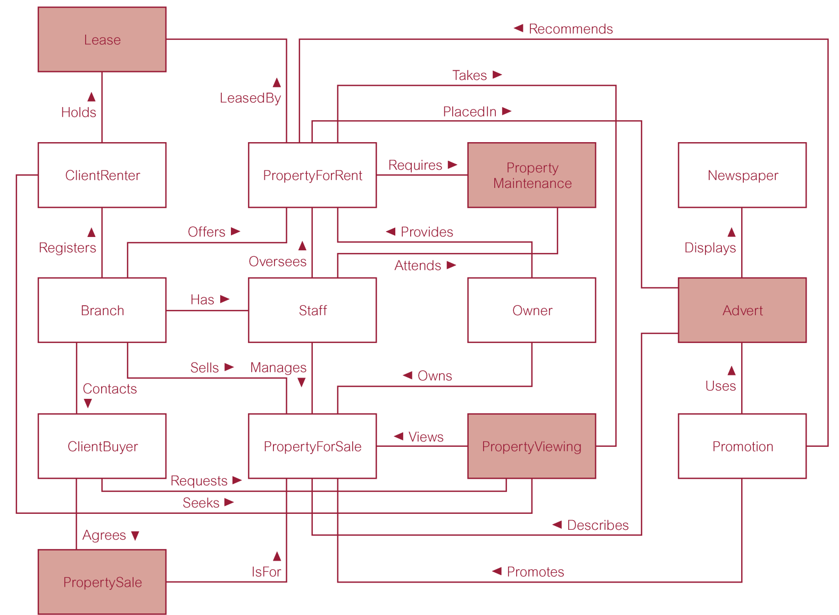
ER model of an extended version of DreamHome

Slide 34
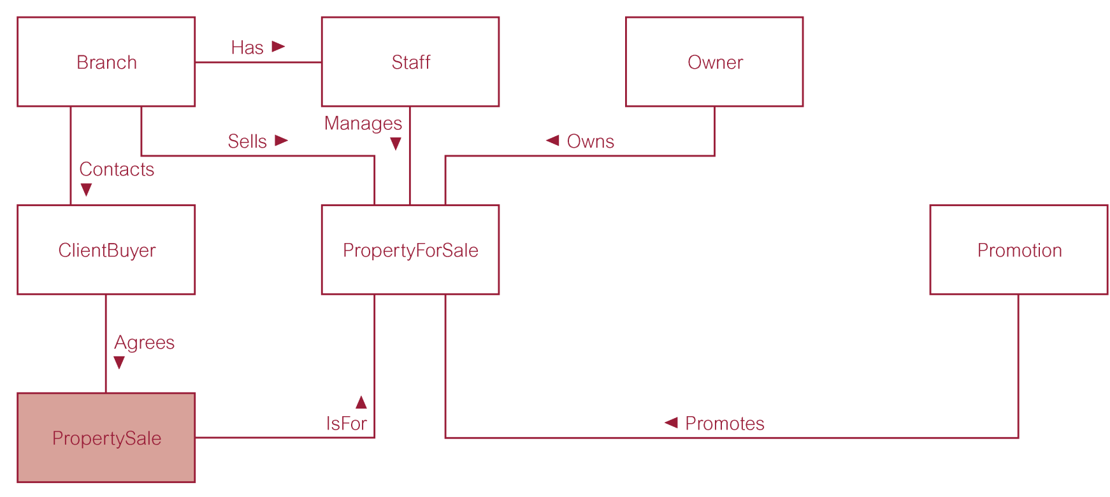
ER model of property sales business process of DreamHome

Slide 35
Step 2: Declare grain
Decide what a record of the fact table is to represents.
Identify dimensions of the fact table. The grain decision for the fact table also determines the grain of each dimension table.
Also include time as a core dimension, which is always present in star schemas.

Slide 36
Step 3: Choose dimensions
Dimensions set the context for asking questions about the facts in the fact table.
If any dimension occurs in two data marts, they must be exactly the same dimension, or one must be a mathematical subset of the other.
A dimension used in more than one data mart is referred to as being conformed.

Slide 37
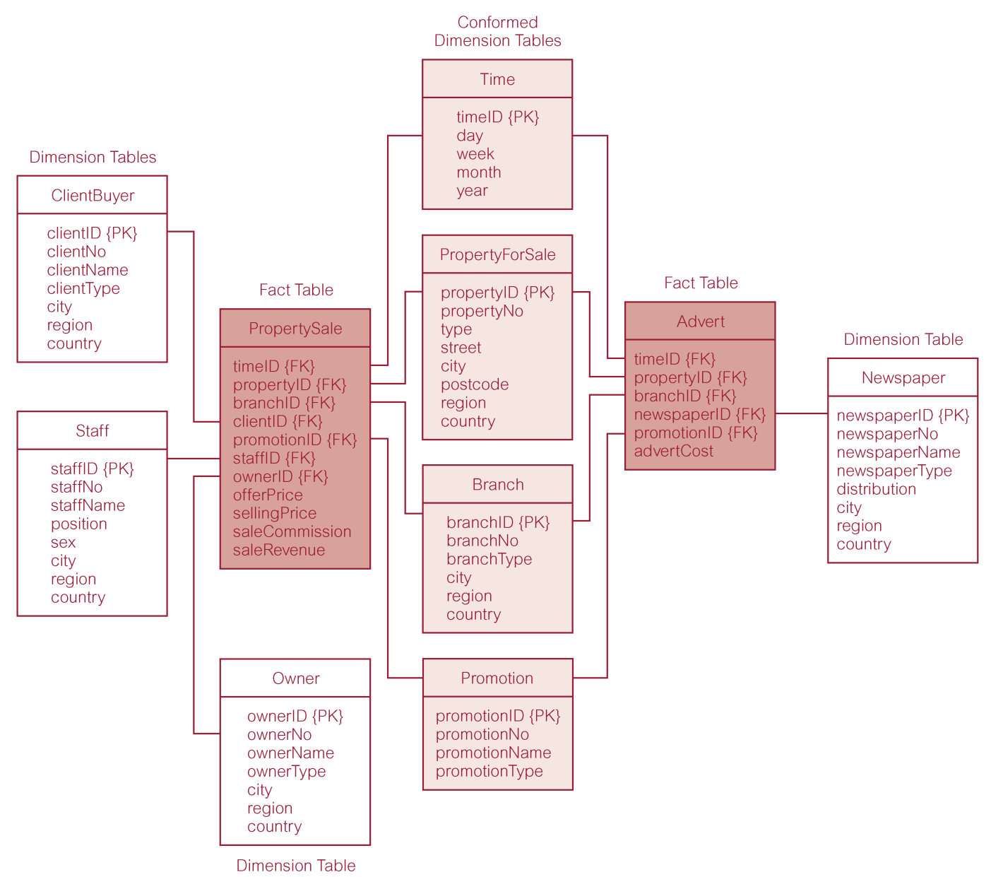
Star schemas for property sales and property advertising

Slide 38
Step 4: Identify facts
The grain of the fact table determines which facts can be used in the data mart.
Facts should be numeric and additive.
Unusable facts include:
  non-numeric facts
  non-additive facts
  fact at different granularity from other facts in table

Slide 39
Step 4: Identify facts
Once the facts have been selected each should be re-examined to determine whether there are opportunities to use pre-calculations.

Slide 40
Dimensional Modeling Stage of Kimball’s Business Dimensional Lifecycle
Phase 2 involves the rounding out of the dimensional tables.
Text descriptions are added to the dimension tables and be as intuitive and understandable to the users as possible.
Usefulness of a data mart is determined by the scope and nature of the attributes of the dimension tables.

Slide 41
Additional design issues
Duration measures how far back in time the fact table goes.
Very large fact tables raise at least two very significant data warehouse design issues.
  Often difficult to source increasing old data.
  It is mandatory that the old versions of the important dimensions be used, not the most current versions. Known as the ‘Slowly Changing Dimension’ problem.

Slide 42
Additional design issues
Slowly changing dimension problem means that the proper description of the old dimension data must be used with the old fact data.
Often, a generalized key must be assigned to important dimensions in order to distinguish multiple snapshots of dimensions over a period of time.

Slide 43
Additional design issues
There are three basic types of slowly changing dimensions:
  Type 1, where a changed dimension attribute is overwritten
  Type 2, where a changed dimension attribute causes a new dimension record to be created
  Type 3, where a changed dimension attribute causes an alternate attribute to be created so that both the old and new values of the attribute are simultaneously accessible in the same dimension record

Slide 44
Kimball’s Business Dimensional lifecycle
Lifecycle produces a data mart that supports the requirements of a particular business process and allows the easy integration with other related data marts to form the enterprise-wide data warehouse.
A dimensional model, which contains more than one fact table sharing one or more conformed dimension tables, is referred to as a fact constellation.

Slide 45
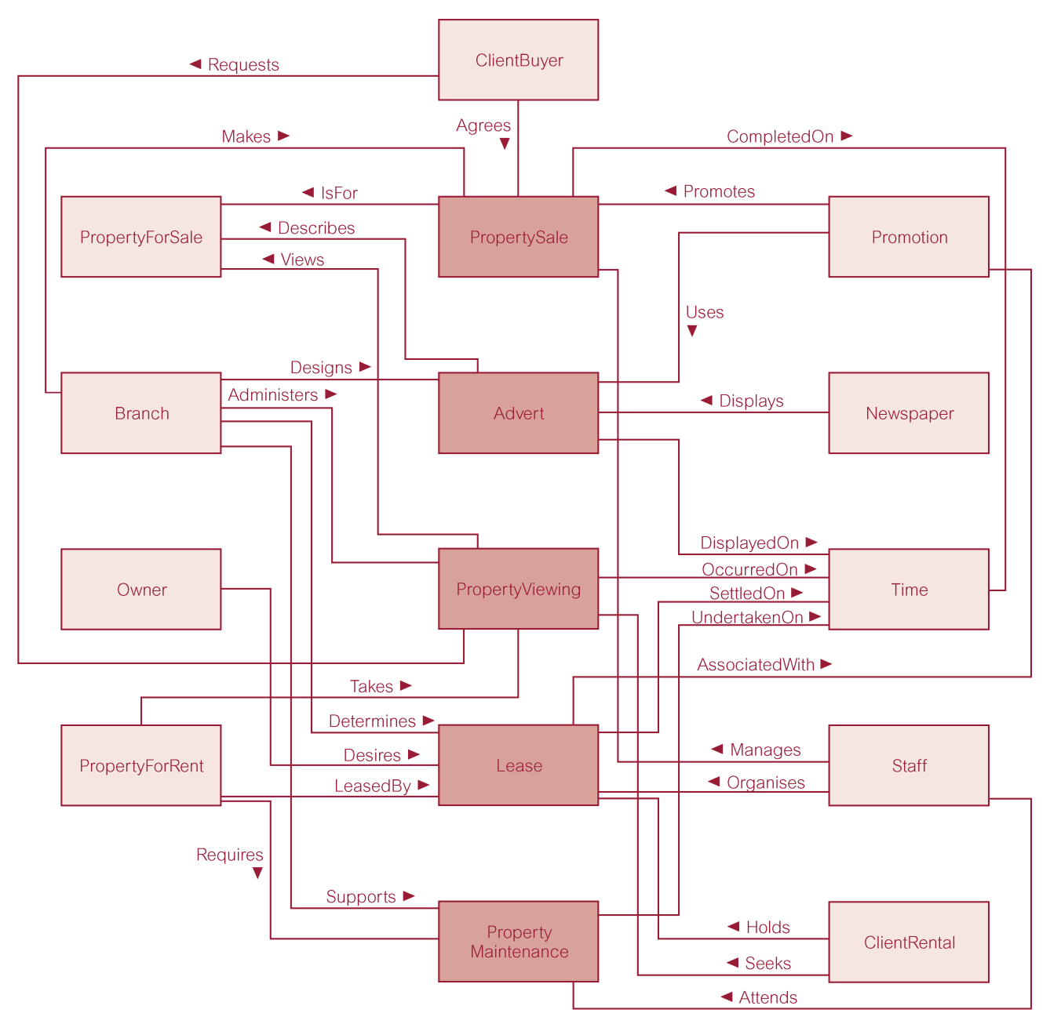
Dimensional model (fact constellation) for the DreamHome data warehouse

Slide 46
Data Warehouse Development Issues
Selection development methodology.
Identification of key decision-makers to be supported their analytical requirements.
Identification of data sources and assess the quality of the data.
Selection of the ETL tool.
Identification of strategy for meta-data be management.

Slide 47
Data Warehouse Development Issues
Establishment of characteristics of the data e.g. granularity, latency, duration and data lineage.
Establish storage capacity requirements for the database.
Establishment of the data refresh requirements.
Identification of analytical tools.
Establishing an appropriate architecture for the DW/DM environment .
Deal with the organisational, cultural and political issues associated with data ownership.

