Slide 1
Chapter 7: Principles of Dimensional Modeling and Data Warehousing Database Design
Data Warehouse Fundamentals
Paul Chen
www.cs522.com (containing Seattle U teaching materials )
www.cie-sea.org
(“Principles & Techniques For Data Warehousing Design”)

Slide 2
Topics
Levels of Modeling
Data Warehouse Modeling: What, Why
The General Approach --The Star Schema Development
The Database Component of a Data Warehouse – Fact Table and Dimension Table
Designing Data Mart
A Case Study

Slide 3
Databases & Modeling
Databases & Modeling
Type of
Database
Constructs
New
Trend
Characteristics
Relational
Database
ERD & EER
Row/
Column
Multi-dimensional
Database
Dimensional
Modeling
Cube
OLAP
DW
Distributed
Database
Distributed
Component
Object Model
Client
Object
(DCOM)
XML
Object-Oriented
Database
Class
Diagram
Object
UML
Object = Data + Operations(Services);
Entity = Data only

Slide 4
Topic 1: Level of Modeling
Descriptive: The dealer sold 200 cars last month.
Operational
(OLTP)
Primarily Two Dimensional
Database System
Explanatory: For every increase in 1 % in the interest,
auto sales decrease by 5 %.
Traditional DW
Star Schema Cube
(OLAP)
Predictive: predictions about future buyer behavior.
Data Mining
Cube + sophisticated
analytical
tools

Slide 5
Level of Analytical Processing
Explanatory
“WHAT IF”
PROCESSING
ANALYZE WHAT
HAS PREVIOUSLY
OCCURRED TO
BRING ABOUT THE
CURRENT STATE
OF THE DATA
Predictive
Descriptive
SIMPLE QUERIES
& REPORTS
DETERMINE IF
ANY PATTERNS
EXIST BY REVIEWING
DATA RELATIONSHIPS
Statistical Analysis/Expert System/
Artificial Intelligence
Normalized
Tables
Dimensional
Tables
+
Query
Roll-up; Drill Down
Classification & Value Prediction

Slide 6
DESCRIPTIVE MODELING
Relational Data Modeling using ER Diagram
Conceptual Data Model (Analysis - Requirements Gathering; What’s it?)
Logical Data Model (Design-How is it?)
Physical Data Model (Implementation)

Slide 7
EXPLANATORY MODELING
Also called Dimensional Modelling
Ways to derive the database component of a data warehouse
Every dimensional model (DM) is composed of one table with a composite primary key, called the fact table, and a set of smaller tables called dimension tables.

Slide 8
PREDICTIVE MODELING
Similar to the human learning experience
  Uses observations to form a model of the important characteristics of some phenomenon.
Uses generalizations of ‘real world’ and ability to fit new data into a general framework.
Can analyze a database to determine essential characteristics (model) about the data set.

Slide 9
Statistical Analysis of Actual Sales (dollars and quantities) relative To these Signage Variables-a predictive modeling example.
Content
Frequency
Depth
Focus
Depth
Scale
Length
Location
Statistical Analysis : Correlation, Regression, Experiment Design,
Optimization. Now it goes into real time analysis.

Slide 10

Signage

Slide 11

Signage

Slide 12
PREDICTIVE MODELING
There are two techniques associated with predictive modeling: classification and value prediction, which are distinguished by the nature of the variable being predicted.

Slide 13
PREDICTIVE MODELING-classification
Used to establish a specific predetermined class for each record in a database from a finite set of possible, class values.
Two specializations of classification: tree induction and neural induction.

Slide 14
Example of Classification using tree Induction
Customer renting property
> 2 years
No
Yes
Rent property
Customer age>45
No
Yes
Rent property
Buy property

Slide 15
Retina Scan
“That recent Tom Cruise movie, Minority Report, shows
advertising that targets each individual consumer as they pass by the signage. That’s the extreme, but I can
see it going that way,” said St. Denis.

Slide 16
A Little Perspective
Assigned to work as a team member of a major data warehouse
project at the Boeing Company from 1996 to 1998 . The purpose of
the project is to re-engineer the company-wide product definitions
residing in various legacy systems and consolidate them into a
single source data warehouse to be accessed within as well as
outside of the Company (such as, airplane customers and
suppliers) globally. My responsibilities were to develop data and
process modeling of the airplane BOM (bill of material) using
Excellarator and later Designer/2000 tools.

Slide 17
Primary Concerns
Replaceable & exchangeable parts
AOG (Airplane on ground) – how to get the part in the shortest time and at a minimum cost
The volumes of the queries for parts were running at 250,000 / day.

Slide 18
Topic 2: Data Warehouse Modeling- What and Why?
Also called Dimensional Modelling
Ways to derive the database component of a data warehouse
Every dimensional model (DM) is composed of one table with a composite primary key, called the fact table, and a set of smaller tables called dimension tables.

Slide 19
Why Do I Need a DW Data Model?
Completeness of Scope – needed to achieve integration throughout. The data model serves as a road map guiding development over a long time.
Interlocking Parts – because of the complex of large data warehouse. The model keeps track of the intertwining parts.
Future Additions- want a foundation to build upon. Without a model, how and where additions are to be made is open to question.
Redundancy Recognition – because integration strives to remove redundancy. The DW data model provides a vehicle to recognize and control redundancy.
Note: Without the model, it is questionable whether the data warehouse should be built.

Slide 20


Completeness of Scope
Recognition of Antonyms (Same name, different object)
Financial Accounting Subsystem
Customer Tracking Subsystem
Account_id
Account_name
Account_balance
Account_id
Account_name
Account_balance
Are these the same?

Slide 21
Completeness of Scope
Recognition of Synonyms (Same object, different name)
Customer Tracking Subsystem
Customer Billing Subsystem
Account_id
Account_name
Account_balance
Account_address
Account_start_date
Customer_number
Customer _name
Customer _address
Customer_credit_rating
Customer_bill_date
Are these the same?

Slide 22
Interlocking Parts- because of the multidimensional flavor of the data warehouse, the model is needed to reflect and control the numerous relational tables
Hotel
Times
Fact Table
Hotel_No Key
Hotel Desc
Hotel name
Sales
time key
day of week
quarter
year
Hotel_No Key
Guest Key
Time Key
YTD_Sales_dollars_by_hotel
YTD_Sales_dollar_by_Type
YTD_Sales_By_Business
YTD_Sales_by_non-business
Room_no key
Single
Double
Family
Guest Profile
Demographics
Profile key
Profile desc
Territory
Demographic Key
Cluster 1 Population
Age category
Cluster 2 Population
Income category

Slide 23
Future Additions
Additional attributes:
Penthouse
season
Where should these go?
Hotel
Fact Table
Times
Hotel_No Key
Hotel Desc
Hotel name
Sales
time key
day of week
quarter
year
Hotel_No Key
Guest Key
Time Key
YTD_Sales_dollars_by_hotel
YTD_Sales_dollar_by_Type
YTD_Sales_By_Business
YTD_Sales_by_non-business
Room_no key
Single
Double
Family
Guest Profile
Demographics
Profile key
Profile desc
Territory
Demographic Key
Cluster 1 Population
Age category
Cluster 2 Population
Income category

Slide 24
Redundancy Recognition
The DW Data Model is used to control the placement of redundant data.
Hotel
Hotel_No Key
Hotel Desc
Hotel name
Hotel_Location_Id
Hotel_Location_Name

Slide 25
What the Dimensional Model Needs to Achieve and What its Purposes are?
The model should provide the data access.
The whole model should be query-centric.
It must be optimized for queries and analysis.
The model must show that dimension tables must interact with the fact table.
It should also be constructed in such a way that every dimension can interact equally with the fact table.
The model should allow drilling down or rolling up along dimension hierarchy.

Slide 26
Topic 3: The General Approach
Create the high level enterprise ERD
Develop logical data model for subject area only
Create data warehouse data model from LDM
Develop physical data model
The above is an iterative process; user reviews are
critical.

Slide 27
Data Warehousing Modeling
Source System Layer
Conceptual
By subject area
Analysis - Requirements Gathering; What’s it?
Integrated Data System Layer
Design-How is it?
Logical
(Normalized to third form)
Physical
Implementation
Data Warehousing Layer
(Denormalized)
Fact Table
Dimension Table
Denormalization is generally the only way to improve query performance
after all the normal tuning options have been employed

Slide 28
Relationship Between the Data Models
Conceptual DM
Logical DM
Physical
DM
Dimensional
Modeling
Supporting
OLAP
Operational DM (supporting OLTP)
Data Warehouse DM

Slide 29
Logical Data Model vs. DW Data Model -Table
Normalized
Organized around business rules
Element of time
Maybe specified
Repeating group
Shown only once
Denormalized;
Organized around usage and stability
Must be specified
Can contain data arrays

Slide 30
Dimensional Modelling
Modelling technique that aims to present the data in a standard, intuitive form that allows for high-performance access.
Uses the concepts of ER modelling with some important restrictions.
Every dimensional model (DM) is composed of one table with a composite primary key, called the fact table, and a set of smaller tables called dimension tables.

Slide 31
TRANSFORM THE LOGICAL DATA MODEL INTO DW DATA MODEL
Remove purely operational data
Add an element of Time to the key structure
Accommodate multiple hierarchies and classes
Add derived data
Add summarization schemes

Slide 32
Data Classification Examples
Data Category Example | Decision Support | Operational
Total loan amount | x
Average defaulted loan amount | x
John Doe’s outstanding loan balance | x | x
Payment received date |  | x
Loan officer’s phone # | x | x
Household income | x
Update indicator |  | x
Loan date | x

Slide 33
Dimensional Modelling
Each dimension table has a simple (non-composite) primary key that corresponds exactly to one of the components of the composite key in the fact table.
Forms ‘star-like’ structure, which is called a star schema or star join.

Slide 34
Star Schema vs. Snowflake Schema
Star Schema (or Star Joint Schema)
“A specific organization of a database in which a fact table with a composite key is joined to a number of single-level dimension tables, each with a single, primary key”
Snowflake Schema
A variant of the star schema where each dimension can have its dimensions. Starflake schema is a hybrid structure that contains a mixture of star (denormalized) and snowflake (normalized) schemas. Allows dimensions to be present in both forms to cater for different query requirements.
-- Kimball Ralph, Data Warehouse Toolkit ---

Slide 35

A STAR SCHEMA for Auto Sales
Product
Time
Auto
Sale
Dealer
Payment
method
Customer
Demographics

Slide 36
Facts: Actual sale price, Options price, Full price, Dealer add-on, Dealer credit, Dealer invoice, Down payment , Proceeds, Finance vs. Dimension Tables below
Time | Product | Payment Method | Customer Demographics | Dealer
Year | Model Name | Finance Type | Age | Dealer name
Quarter | Model Year | Term (months) | Gender | City
Month | Package styling | Interest rate | Income range | State
Date | Product category | Agent | Marital status | Zone
Day of week | Exterior color |  | Household size
Day of month | Interior color |  | Home value
Season |  |  | Own or rent
Holiday flag

Slide 37
A Star Join Schema For A Food Cooperative
Fact Table
Food Item
Times
Food Item Key
Food Item Desc
Qty
Sales
time key
day of week
quarter
year
Food Item Key
Profile Key
Time Key
YTD_Sales_dollars
YTD_Sales_qty
Dimension tables
Time-series
Dimension
table
Member Profile
Profile key
Profile desc
Territory
Demographics
Demographic Key
Age category
Cluster 1 Population
Income category

Slide 38
Star Schema for Property Sales
Time
Fact Table
PropertySale
PropertyforSale
Time Id
(PK)
Day
week
Quarter
year
TimeId key
Propertyid key
Branchid key
Clinetid key
Promotionid key
Staffid key
Ownerid key
Propertyid
(PK)
Branch
Client
Branchid (PK)
Clientid
(PK)
Staff
Promotion
Owner
Staffid
(PK)
Promotionid
(PK)
Ownerid (PK)

Slide 39
Star Schema Keys- Fact Table
Compound primary key, one segment for each dimension.
Each dimension table is in a one-to-many relationship with the central fact table. So the primary key of each dimension must be a foreign key in the fact table.
If we use concatenated primary key that is the concatenation of all the primary keys of the dimension tables, then we do not need to keep the primary keys of the dimension tables as additional attributes to serve as foreign keys (such as the options below). The individual parts of the primary keys themselves will serve as the foreign keys.
Vs. Two other two options below
A single compound primary key whose length is the total length of the keys of individual dimension table.
Or
A generated primary key independent of the keys of the dimension tables.

Slide 40
Fact and Dimension Tables for each Business Process of Property Sales
Business Process | Fact Tables | Dimension Tables
Property Sales | Propertysale | Time, Branch Staff, PropertyForSale, owner, ClientBuyer, Promotion
Property Rentals | Lease | Time, Branch, Staff, PropertyForRent, owner, ClientRenter, Promotion
Property Viewing | Propertyviewing | Time,Branch, PropertyForSale PropertyForRent, ClientBuyer ClientRenter
Property Advertising | Advert | Time,Branch, PropertyForSale PropertyForRent, Promotion, Newspaper
Property Maintenance | Propertymaintenance | Time, Branch Staff, PropertyForRent

Slide 41
Comparison of DM and ER Models
A single ER model normally decomposes into multiple DMs.
Multiple DMs are then associated through ‘shared’ dimension tables.

Slide 42
Shared Dimension Tables
Time
Newspaper
owner
Fact Table
Fact Table
PropertySale
Branch
Advertisement
Promotion
Property
For sale

Slide 43
Dimensional Modelling
All natural keys are replaced with surrogate keys (branch Id instead of branch #). Means that every join between fact and dimension tables is based on surrogate (intelligence) keys, not natural keys.
Surrogate keys allows data in the warehouse to have some independence from the data used and produced by the OLTP systems.

Slide 44
Dimensional Modelling
Bulk of data in data warehouse is in fact tables, which can be extremely large.
Important to treat fact data as read-only reference data that will not change over time.
Most useful fact tables contain one or more numerical measures, or ‘facts’ that occur for each record and are numeric and additive.

Slide 45
Dimensional Modelling
Dimension tables usually contain descriptive textual information.
Dimension attributes are used as the constraints in data warehouse queries.
Star schemas can be used to speed up query performance by denormalizing reference information into a single dimension table.

Slide 46
Inside A Dimension Table
Dimension table key. Primary key uniquely identifies each row in the table.
Table is wide. Typically, a dimension table has many columns or attributes.
Textual attributes. Dimension tables usually contain descriptive textual information.
Attributes not directly related. Frequently you will find that some of the attributes are not directly related to the other attributes in the table.

Slide 47
Inside A Dimension Table (Cont’d)
Not normalized. For efficient query performance, it is best that the query picks up an attribute directly the dimension table.
Drilling down, rolling up. The attributes in a dimension table provide the ability to get to the details from high levels of aggregation to lower levels of details.
Multiple Hierarchies. Dimension tables often provide for multiple hierarchies, so that drilling down may be performed along any of the multiple hierarchies.
Few number of record. A dimension table typically has fewer number of records or rows than the fact table.

Slide 48
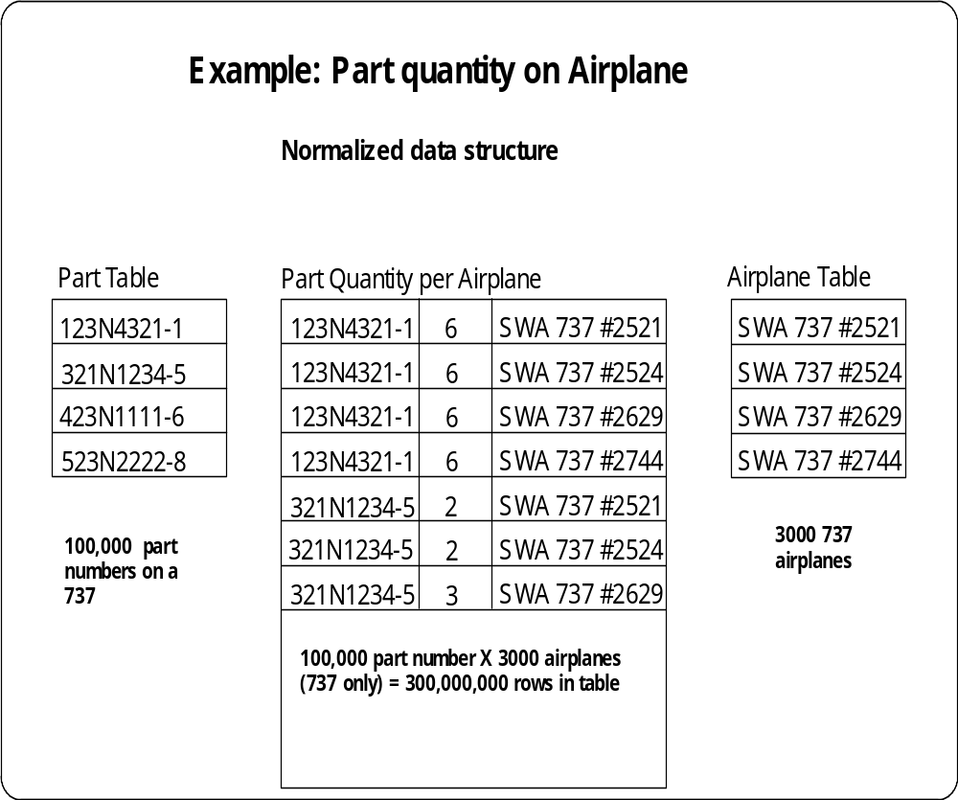
An Index on this table is nearly as large as the table itself (table = 9GB, Index = 7.2GB)

Slide 49
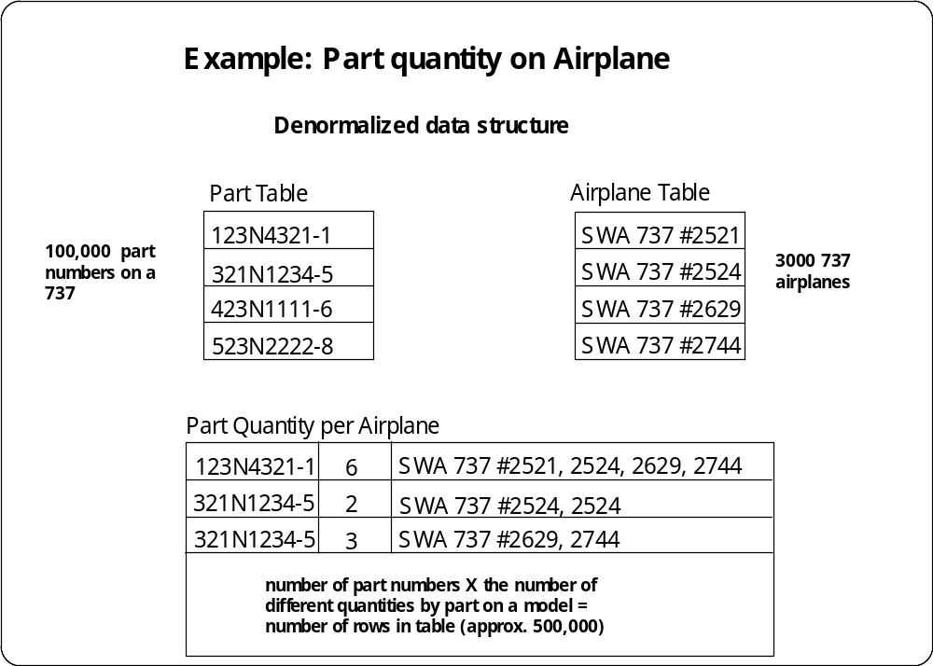
Number of rows in the table and any indexes are dramatically less - 1/600th

Slide 50
Accommodate Multiple Hierarchies and Classes
DIMENSIONS: are roughly equivalent to Fields in a relational database. In the relational table, there are fields called “Product” and “Region.”. In the dimensional data, “Product” and “region” are both Dimension.
The single biggest factor in determining how many dimensions you’ll need for a particular database is the existence of multiple hierarchies and classes.

Slide 51
Accommodate Multiple Hierarchies and Classes
If your OLAP server supports multiple hierarchies and
classes within one dimension, store them in one
dimension.
Classes are typically attributes such as “size” “color” and
other characteristics that define a subset of the members
of a dimension.

Slide 52
Accommodate Multiple Hierarchies and Classes
For example
A common use for multiple hierarchies is in the
geographic dimension. (Sales Territory might roll up into
City, State and Region.)
For Classes, A car line might be defined by Model, Make,
and Series.

Slide 53
Simple Hierarchies (Roll up) & Classes Within Dimensions --Dimension Hierarchies
Region Total
East
West
Central
Chevrolet
make
model
Series

Slide 54
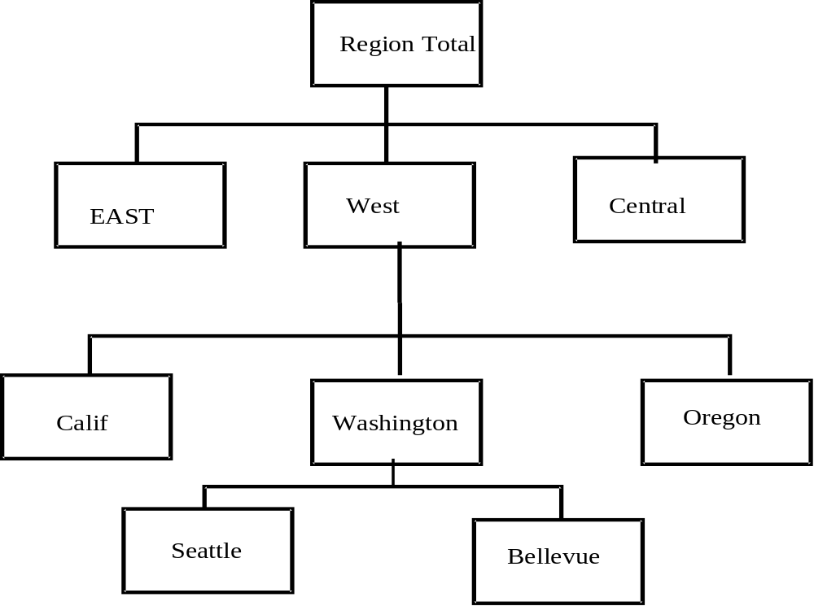
Multiple Levels of Hierarchies

Slide 55
Some OLAP servers support multiple hierarchies within one dimension. One child can have many parents.
State
Sales
Region
City
Sales
Zone
Dealer

Slide 56
Roll up
Without multiple hierarchies, the previous
database would have to be represented with
separate dimensions for each roll-up.
Region
Zone
Dealer
State
City
Dealer

Slide 57
Inside The Fact Table
Concatenated Key. A row in the fact table relates to a combination of rows from all the dimension tables.
Data Grain. Data grain is the level of detail for the measurement or metrics.
Fully Additive Measures. The values of the attributes can be summed up by simple additions.
Semi-additive Measures. Derived attributes such as percentages are not additive. They are known as semiadditive measures.

Slide 58
Inside The Fact Table
Table Deep, not Wide. Typically a fact table has fewer attributes than a dimension table. But the number of records in a fact table is very large in comparison.
Sparse Data. There are rows with null measures such as the date representing a closed holiday. In this case, there is no need to keep these rows.
Degenerate Dimensions. Examples of such attributes are reference numbers like order numbers, invoice numbers, order line numbers, and so on.

Slide 59
Topic 4: The Database Component of a Data Warehouse–Fact Table and Dimension Table
Fact Table: A Fact Table is a table in a relational
database with a multi-part key. Each element of the key is itself a foreign key to a single dimension tale.
Dimension Tables
They are the constraints used in forming the fact table.

Slide 60
Star Schema– Fact Table
Consists of the numeric measurement of interest to the business analysts
Represents the natural dimensions found in business and facts associated with them
Quantifies data described by the Dimension Tables
Key is unique concatenation of values of dimension keys
Must contain time dimension
Numeric values should be additive (Aggregations of quantities or amounts from atomic level; Be careful with percentages or averages)

Slide 61
Star Schema– Dimension Table
Consists of the constraints used in forming the fact table
Contains mostly textual elements used to describe the dimensions
Start with the most detailed aggregation level necessary (e.g. State vs. Zip Code), if possible
May have to develop surrogate keys
They will increase maintenance effort required
Use them when they make sense
Maintain a manageable number of aggregation levels in each dimension

Slide 62
Star Schema– Dimension Table
Consists of the constraints used in forming the fact table
Contains mostly textual elements used to describe the dimensions
Start with the most detailed aggregation level necessary (e.g. State vs. Zip Code), if possible
May have to develop surrogate keys
They will increase maintenance effort required
Use them when they make sense
Maintain a manageable number of aggregation levels in each dimension

Slide 63
Add An Element Of Time To The Key Structure
Time is probably the most common dimension in a multidimensional databases. It is used to project trends-sales trends, market trends, and so forth.
A series of numbers representing a particular variable (such as sales) over time is called a time series. (for ex. 52 weekly sales numbers for auto is a time-series).
Do not mix different periodicities in one dimension (A time series always has a particular periodicity, such as weekly, monthly, quarterly, yearly, and so on).

Slide 64
When do we keep time- series data?
When trends and patterns are desired
When comparisons are needed (e,g., last quarter to this quarter)
For example, Auto Sales information by month or by calendar year.

Slide 65
When to Snowflake ‘Snowflaking’ is a method of normalizing the dimension tables in a Start schema.
Customer Dimension table
City
Classification
table
Customer Key
Customer name
address
Zip
City class key
City class key (pk)
City code
Class description
Population range
Cost of living
Pollution index
Public trans
Customer indes
Fact Table
Customer key
Other keys
metrics
If the customer dimension is
Very large, the savings in storage could be substantial.
2. Users may now browse the demographic attributes more than others in the dimension table.

Slide 66
Advantages of the Start Schema
Easy for users to understand: Unlike OLTP, the Start Schema reflects exactly how the users think and need data for query and analysis. They think in terms of significant business metrics. The fact table contains the metrics. The users think in terms of business dimensions for analyzing the metrics.
Optimizes navigation: The joint paths between dimension tables and fact tables are simple and straightforward, your navigation is optimized and becomes faster. The Star schema optimizes the navigation through the databases.
Allows data warehouse queries to drill down and roll up: Drill down is a process of further selection of the fact table rows. Going the other way, rolling up is a process of expanding the selection of the fact table rows.

Slide 67
A Few Definitions
OLAP
“On-Line Analytical Processing (OLAP) is a category of software technology that enables analysts, managers and executives to gain insight into data through fast, consistent, interactive access to a wide variety of possible views of information that has been transformed from raw data to reflect the real dimensions of the enterprise as understood by the user”
-- DBMS Magazine, April, 1995
Multidimensional Analysis
The manipulation of data by a variety of categories or “dimensions”,
facilitating analysis and an understanding of the data-also known as
“Drill-around” and “slice and dice”
Multidimensional Database
Proprietary, non-relational database that stores and manages data in a multidimensional manner, with limited dimensional information.

Slide 68
Some Design Issues
Too Few Dimensions
Dimensions Are Lacking Aggregate Level
Too Many Dimensions-
One Possibility Combine Dimensions
Overly Complex Dimensions
One Possibility: Split Dimensions
Another Possibility: The Snowflake Schema
Distinct Time Period Fact Table To Improve Overall Performances (load as well as access)
Another Possibility: Multiple Fact tables

Slide 69
Vertical Segmentation
Separate attributes into other tables
Branch_id PK
School_id PK
Month_yr
School_name
School_Address
Ref School Branch
Branch_id PK
School_id PK
Month_yr
School_name
School_Address Number_of_Graduates
Number_of_underGraduate Semaster_Tuition
Branch_id PK
School_id PK
Month_yr
Number_of_Graduates
Number_of_underGraduates
Semaster_Tuition

Slide 70
Shared Dimension Tables
Time
Newspaper
owner
Fact Table
Fact Table
PropertySale
Branch
Advertisement
Promotion
Property
For sale

Slide 71
Property Sales With Normalized Version of Branch Dimension Table
PropertySale
Branch Id (PK)
Branch no
Branch type
City (FK)
timeId key
propertyid key
branchid key
Clinetid key
Promotionid Key
Staffid key
Ownerid key
City
City ID(PK)
Region ID (FK)
Region
Roll Up (Dimension Hierarchies)
Region ID
(PK)

Slide 72
Vertical Segmentation
Separate attributes in other tables
Overhead of shared locks may be reduced
Table scans can be faster
Could cause excessive joins

Slide 73
Horizontal Segmentation
Separate subset of data to another table
For example, separate yearly sales data into tables
containing only monthly data
Using UNION to query multiple tables.

Slide 74
Horizontal Segmentation
Separate subsets of data to another table (Jan, Feb, ..)
Multiple queries of multiple tables (UNION)
Breaking up tables will speed table scans

Slide 75
Topic 5: Designing Data Mart
A subset of a data warehouse that supports the requirements of a particular department or business function.
Characteristics include
  Focuses on only the requirements of one department or business function.
  Do not normally contain detailed operational data unlike data warehouses.
  More easily understood and navigated.

Slide 76
Reasons for Creating a Data Mart
To give users access to the data they need to analyze most often.
To provide data in a form that matches the collective view of the data by a group of users in a department or business function area.
To improve end-user response time due to the reduction in the volume of data to be accessed.

Slide 77
Reasons for Creating a Data Mart (cont’d)
To provide appropriately structured data as dictated by the requirements of the end-user access tools.
Building a data mart is simpler compared with establishing a corporate data warehouse.
The cost of implementing data marts is normally less than that required to establish a data warehouse.

Slide 78
Reasons for Creating a Data Mart (cont’d)
The potential users of a data mart are more clearly defined and can be more easily targeted to obtain support for a data mart project rather than a corporate data warehouse project.

Slide 79
Data Warehouse vs. Data Mart –In Terms of Data Granularity
Data Warehouse
Data Mart
Corporate/Enterprise-wide
Union of all data marts
Data received from staging area
Queries on presentation source
Structure for corporate view of data
Organized on E-R Model
Departmental
A single business process
Star-join (facts & dimensions)
Technology optimal for data access and analysis
Structure to suit the departmental view of data

Slide 80
Data Mart –From Data Granularity
A subset of a data warehouse that supports the requirements of a particular department or business function.
Characteristics include
  Focuses on only the requirements of one department or business function.
  Do not normally contain detailed operational data unlike data warehouses.
  More easily understood and navigated.

Slide 81
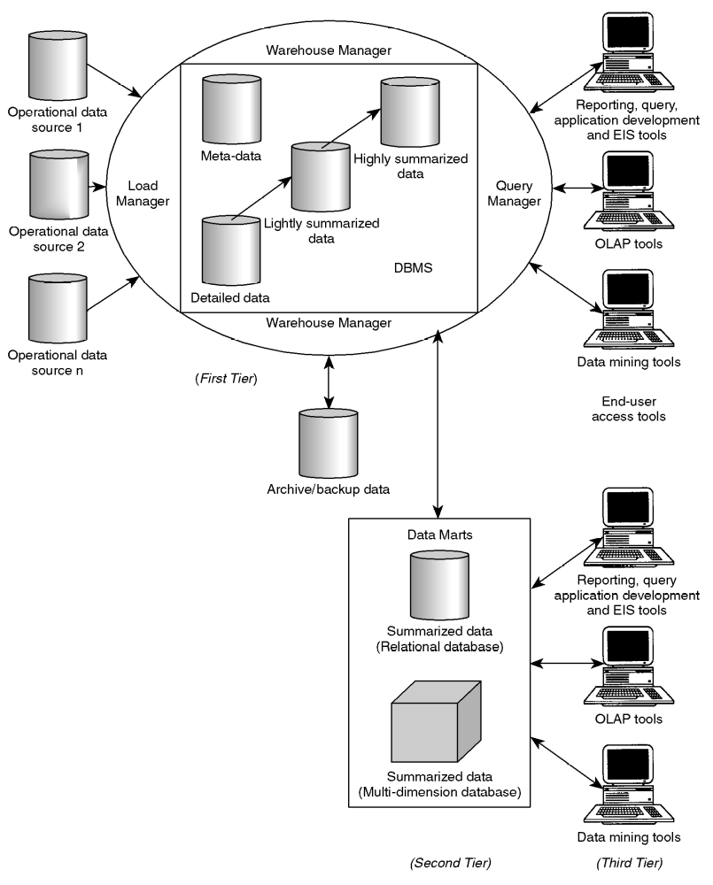
Typical Data Mart Architecture Relative to Data Warehouse

Slide 82
Data Warehousing-Fact & Dimension Tables
Hotel
Times
Fact Table
Hotel_No Key
Hotel Desc
Hotel name
Sales
time key
day of week
quarter
year
Hotel_No Key
Guest Key
Time Key
YTD_Sales_dollars_by_hotel
YTD_Sales_dollar_by_Room_Type
YTD_Sales_By_Guest_profile
Room_no key
Single
Double
Family
Guest Profile
Demographics
Profile key
Profile desc
Territory
Demographic Key
Cluster 1 Population
Age category
Cluster 2 Population
Income category

Slide 83
A Typical Data Warehousing System Architecture
Operational
Data store
End-user
Access tools
Load Manager
Warehouse manager
Subject
Data
Convert Data
Maintain
Data
Change
Inf
BOM
Verified
Data
BOM
Application
Subject
Data
Bill of
Material
Data Warehouse data
Query
Results
Data
Update
Data
Update
Maintain
On-line
Update
Access
Data
User
User
Query
Request
System Security
Data
Manage
Security
Applications
Manage
System
Query
manager
Meta data manager

Slide 84
Final Words
Transform data into information by understanding the process
Transform information into decisions with knowledge
Transform decisions into results with actions

Slide 85
Topic 6: A Case Study
Study User Requirements
Matching User Requirements to DW Data Requirements
Develop Dimension and Fact Tables

Slide 86
A Case Study
Suppose that The GM Car Company manufactures two car lines, Chevrolet and Pontiac. GM car lines are described by Make, Models, and Series. The Make is either Chevrolet or Pontiac. The Model is type of car made within the Chevrolet or Pontiac car lines.

Slide 87
Chevrolet (Make)
Model
Chevrolet Suburban—a sports utility for the young.
Chevrolet Cavalier— a compact for the economy-mined consumer.
Chevrolet Caprice— a median size for the older driver
Three series within each model are available:
Loaded
Somewhat loaded
No frills

Slide 88
Pontiac (Make)
Model
Pontiac Firebird -- a sports car for the young.
Pontiac Sunfire -- a compact for the economy-mined consumer.
Pontiac Grand AM -- a median size for the older driver
Three series within each car line are available:
Loaded
Somewhat loaded
No frills

Slide 89
Independent Dealer
All of GM’s cars are sold through independent dealers.
To qualify for GM car dealers, they must follow GM’s rules, e.g., they must send in their financial statements on a monthly basis. They must adhere to the car quality GM stipulates. Dealers are located within Sales Territory. (A group of adjacent towns or A major metropolis, such as Seattle).

Slide 90
Sales Territories
Sales Territories are grouped into Sales Zone (A Sales Zone is a group of counties grouped by GM sales organization). Sales Zone areas are grouped into Sales Region (A Region may consist of several states, such as Northwest).
The cars destined for dealers are based on the Sales Territory.

Slide 91
Simple Hierarchies (Roll up) & Classes Within Dimensions --Dimension Hierarchies
Region Total
East
West
Central
Chevrolet
Suburban
Loaded
Somewhat loaded
No frills
Cavalier
Caprice
make
model
Series

Slide 92
User Requirements
1. What’s is the sales trend in quantity and dollar amounts sold for each Make, Model, Series (MMS) for a specific dealer, for each Sales Territory, Sales Zone and Sales Region?
2. What is the trend in actual sales (Dollars and quantities) of MMS for a specific dealership, by Sales Territory, Sales Zone and Sales Region compared to their objectives? Both by monthly totals and year-to-date(YTD)?
3. What are the dollars sales and quantities by MMS this year-to-date as compared to the same time period last year for each dealer?

Slide 93
User Requirements associated with promotional signage and graphic
1 What are the dollar sales and quantities by MMS associated with promotional signage and graphic this year-to-date as compared to the same time last year for each quarter?
2 What is the trend in actual sales (dollars and quantities) of MMS for a specific digital signage, by Sales Territory, Sales Zone and Sales Region compared to their objectives? Both by monthly totals and year-to-date(YTD)?

Slide 94
Your Assignments
Matching User Requirements to DW Data
Requirements to:
Develop fact table(s).
Determine required dimensions and attributes.
3. Draw a STAR JOIN SCHEMA to show the
relationships between the fact table and
the dimension tables.

Slide 95
Matching User Requirements to DW Data Requirements (Develop Fact Table)
Primary Key
dealer_id
month_year
sales_area_id
make
model
series

Slide 96
Matching User Requirements to DW Data Requirements (Develop Fact Table)
DW User Requirements to Data Attributes Matrix
 |  | 1 | 2 | 3 | 4 | 5
Primary keys
dealer_id
Dimensions
month_year
Data Attributes
Make Model Series

Slide 97
Determine Dimensions & Attributes
Dimensions
sales_area_dim
sales_time_dim
dealer_dim
Attributes
dealer_mmm_sales_qty
dealer_mmm_sales_dollar_amt
dealer_ytd_mmm_sales_qty
dealer_yts_mmm_sales_amt
dealer_inventory_qty

Slide 98
A STAR JOIN SCHEMA
Dimension Tables
Fact Table
Product
Times
Sales
product desc
product key
size
time key
day of week
quarter
year
Product Key
Market Key
Time Key
Dollar sales
Market
market key
market desc
territory
Demographics
Demographic Key
Cluster 1 Population
Cluster 2 Population

