Slide 1
Data Warehousing: Data Models and OLAP operations
By
Kishore Jaladi
kishorejaladi@yahoo.com

Slide 2
Topics Covered
1. Understanding the term “Data Warehousing”
2. Three-tier Decision Support Systems
3. Approaches to OLAP servers
4. Multi-dimensional data model
5. ROLAP
6. MOLAP
7. HOLAP
8. Which to choose: Compare and Contrast
9. Conclusion

Slide 3
Understanding the term Data Warehousing
Data Warehouse:
The term Data Warehouse was coined by Bill Inmon in 1990, which he defined in the following way: "A warehouse is a subject-oriented, integrated, time-variant and non-volatile collection of data in support of management's decision making process". He defined the terms in the sentence as follows:
Subject Oriented:
Data that gives information about a particular subject instead of about a company's ongoing operations.
Integrated:
Data that is gathered into the data warehouse from a variety of sources and merged into a coherent whole.
Time-variant:
All data in the data warehouse is identified with a particular time period.
Non-volatile
Data is stable in a data warehouse. More data is added but data is never removed. This enables management to gain a consistent picture of the business.

Slide 4
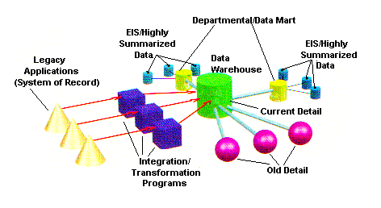
Data Warehouse Architecture

Slide 5
Other important terminology
Enterprise Data warehouse
collects all information about subjects (customers,products,sales,assets, personnel) that span the entire organization
Data Mart
Departmental subsets that focus on selected subjects
Decision Support System (DSS)
Information technology to help the knowledge worker (executive, manager, analyst) make faster & better decisions
Online Analytical Processing (OLAP)
  an element of decision support systems (DSS)

Slide 6
Three-Tier Decision Support Systems
Warehouse database server
  Almost always a relational DBMS, rarely flat files
OLAP servers
  Relational OLAP (ROLAP): extended relational DBMS that maps operations on multidimensional data to standard relational operators
  Multidimensional OLAP (MOLAP): special-purpose server that directly implements multidimensional data and operations
Clients
  Query and reporting tools
  Analysis tools
  Data mining tools

Slide 7
The Complete Decision Support System
Information Sources
Data Warehouse
Server
(Tier 1)
OLAP Servers
(Tier 2)
Clients
(Tier 3)
e.g., MOLAP
Semistructured
Sources
OLAP
Data
Warehouse
serve
extract
transform
load
refresh
etc.
Query/Reporting
serve
e.g., ROLAP
Operational
DB’s
serve
Data Mining
Data Marts

Slide 8
Approaches to OLAP Servers
Three possibilities for OLAP servers
(1) Relational OLAP (ROLAP)
  Relational and specialized relational DBMS to store and manage warehouse data
  OLAP middleware to support missing pieces
(2) Multidimensional OLAP (MOLAP)
  Array-based storage structures
  Direct access to array data structures
(3) Hybrid OLAP (HOLAP)
  Storing detailed data in RDBMS
  Storing aggregated data in MDBMS
  User access via MOLAP tools

Slide 9
The Multi-Dimensional Data Model
“Sales by product line over the past six months”
“Sales by store between 1990 and 1995”
Store Info
Key columns joining fact table
to dimension tables
Numerical Measures
Prod Code Time Code Store Code Sales Qty
Fact table for
measures
Product Info
Dimension tables
Time Info
. . .

Slide 10
ROLAP: Dimensional Modeling Using Relational DBMS
Special schema design: star, snowflake
Special indexes: bitmap, multi-table join
Proven technology (relational model, DBMS), tend to outperform specialized MDDB especially on large data sets
Products
  IBM DB2, Oracle, Sybase IQ, RedBrick, Informix

Slide 11
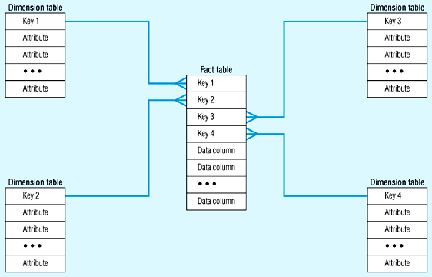
Star Schema (in RDBMS)

Slide 12
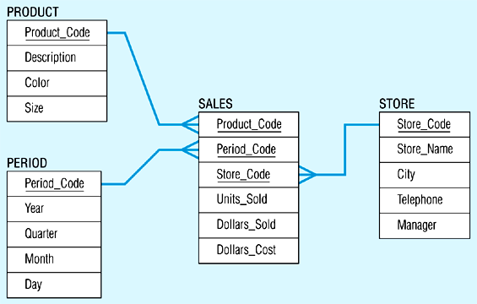
Star Schema Example

Slide 13
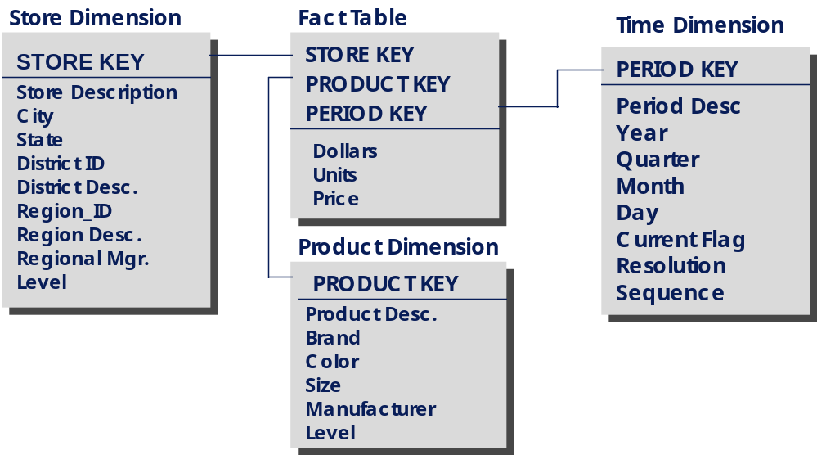
The “Classic” Star Schema
A single fact table, with detail and summary data
Fact table primary key has only one key column per dimension
Each key is generated
Each dimension is a single table, highly de-normalized
Benefits: Easy to understand, easy to define hierarchies, reduces # of physical joins, low maintenance, very simple metadata
Notes:
7
The Star is built for simplicity and speed. Forget everything you learned about designing relational databases. The Star Schema makes no excuses for the rules it breaks. The assumption behind it is that the database is static or ìquiet,î meaning that no updates are performed on-line.
Remember that most of the rules of relational database design are derived from the need to maintain atomicity, consistency and integrity (the ìACIDî test) in an On-Line Transaction Processing (OLTP) environment. Since the data warehouse is quiet, these constraints can be relaxed.

Slide 14
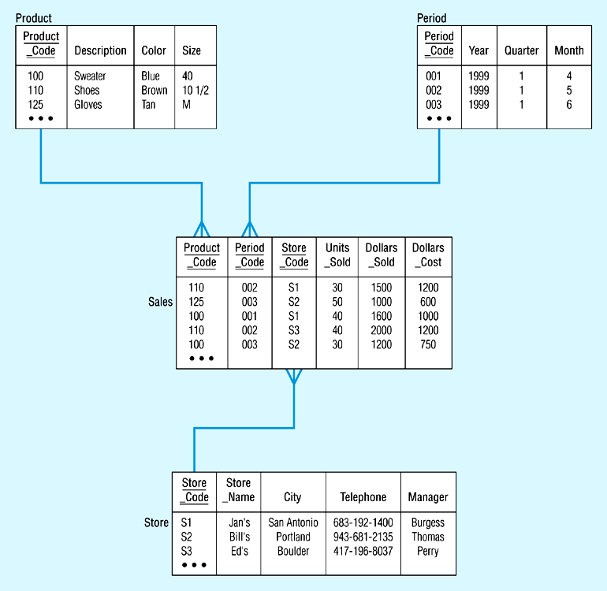
Star Schema with Sample Data

Slide 15
The “Snowflake” Schema
Store Dimension
STORE KEY
District_ID
Region_ID
Store Description
City
State
District ID
Region_ID
Regional Mgr.
District Desc.
Region_ID
Region Desc.
Regional Mgr.
Store Fact Table
STORE KEY
PRODUCT KEY
PERIOD KEY
Dollars
Units
Price
Notes:
13
Notice how the Store dimension table generates subsets of records. First, all records from the table (where level = ìDistrictî in the Star) are extracted, and only those attributes that refer to that level (District Description, for example) and the keys of the parent hierarchy (Region_ID) are included in the table. Though the tables are subsets, it is absolutely critical that column names are the same throughout the schema.
The diagram above is a partial schema - it only shows the ìsnowflakingî of one dimension. In fact, the product and time dimensions would be similarly decomposed as follows:
Product - product -> brand -> manufacturer (color and size are extended attribute characteristics of the attribute ìproduct,î not part of the attribute hierarchy)
Time - day -> month -> quarter -> year

Slide 16
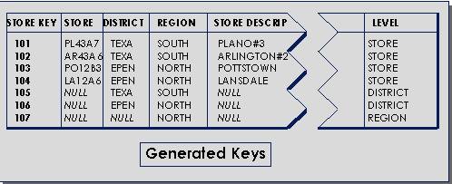
Aggregation in a Single Fact Table
Drawbacks: Summary data in the fact table yields poorer performance for summary levels, huge dimension tables a problem
Notes:
7
The Star is built for simplicity and speed. Forget everything you learned about designing relational databases. The Star Schema makes no excuses for the rules it breaks. The assumption behind it is that the database is static or ìquiet,î meaning that no updates are performed on-line.
Remember that most of the rules of relational database design are derived from the need to maintain atomicity, consistency and integrity (the ìACIDî test) in an On-Line Transaction Processing (OLTP) environment. Since the data warehouse is quiet, these constraints can be relaxed.

Slide 17
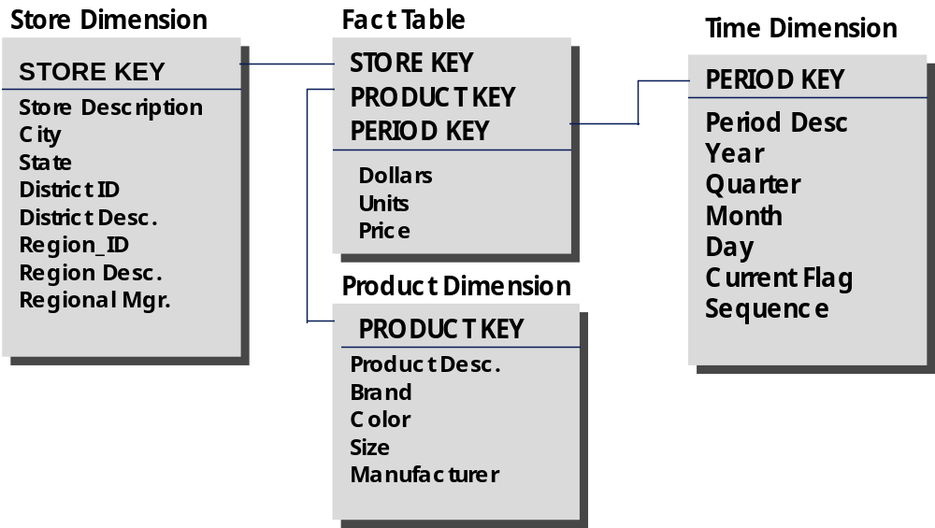
The “Fact Constellation” Schema
District Fact Table
District_ID
PRODUCT_KEY
PERIOD_KEY
Region Fact Table
Region_ID
PRODUCT_KEY
PERIOD_KEY
Dollars
Units
Price
Dollars
Units
Price
Notes:
10
The chart above is composed of all of the tables from the Classic Star, plus aggregated fact tables. For example, the Store dimension is formed of a hierarchy of store-> district -> region. The base fact table contains detail data by store. The District fact table contains ONLY data aggregated by district, therefor there are no records in the table with STORE_KEY matching any record for the Store dimension at the store level. Therefor, when we scan the Store dimension table, and select keys that have district = ìTexas,î they will only match STORE_KEY in the District fact table when the record is aggregated for stores in the Texas district. No double (or triple, etc.) counting is possible and the Level indicator is not needed.
These aggregated fact tables can get very complicated, though. For example, we need a District and Region fact table, but what level of detail will they contain about the product dimension? All of the following:
STORE/PROD DISTRICT/PROD REGION/PROD
STORE/BRAND DISTRICT/BRAND REGION/BRAND
STORE/MANUF DISTRICT/MANUF REGION/MANUF
And these are just the combinations from two dimensions!

Slide 18
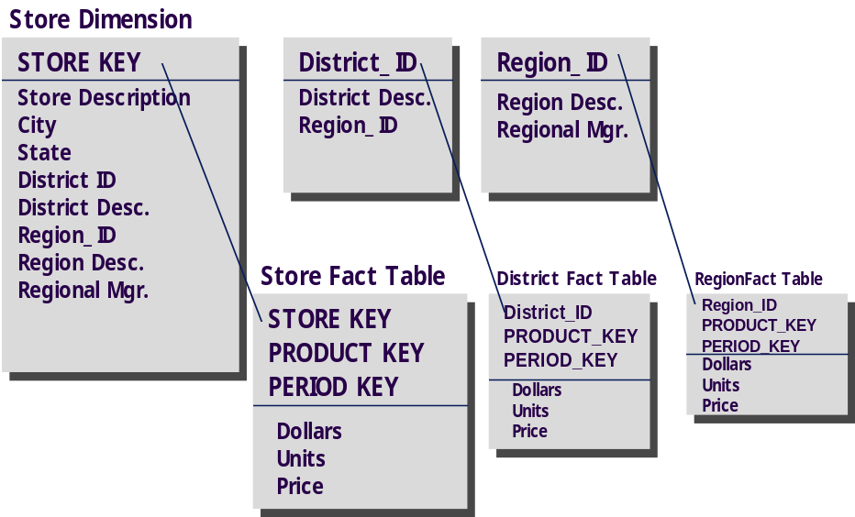
The
Aggregations using “Snowflake” Schema and Multiple Fact Tables
No LEVEL in dimension tables
Dimension tables are normalized by decomposing at the attribute level
Each dimension table has one key for each level of the dimensionís hierarchy
The lowest level key joins the dimension table to both the fact table and the lower level attribute table
How does it work?
The best way is for the query to be built by understanding which summary levels exist, and finding the proper snowflaked attribute tables, constraining there for keys, then selecting from the fact table.
Notes:
14

Slide 19
Aggregation Contd …
Advantage: Best performance when queries involve aggregation
Disadvantage: Complicated maintenance and metadata, explosion in the number
of tables in the database
Notes:
15

Slide 20
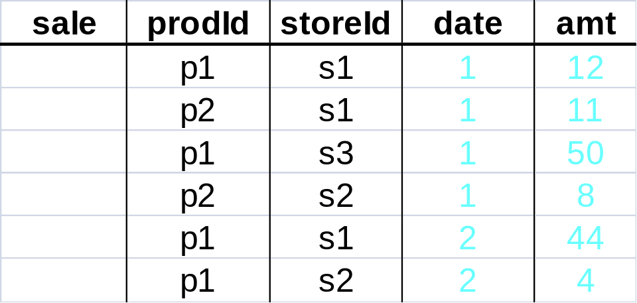
Aggregates
Add up amounts for day 1
In SQL: SELECT sum(amt) FROM SALE
WHERE date = 1
81

Slide 21
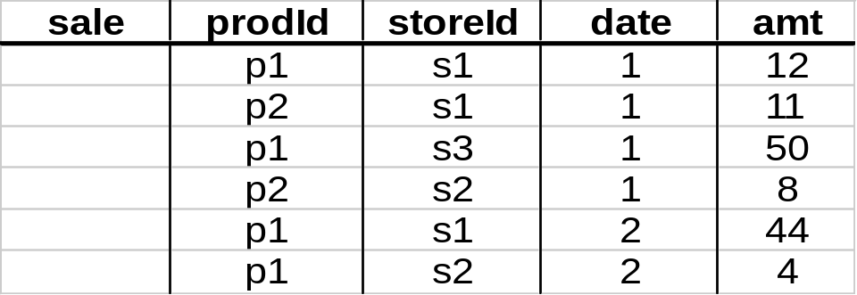
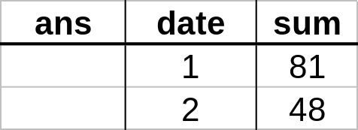
Aggregates
Add up amounts by day
In SQL: SELECT date, sum(amt) FROM SALE
GROUP BY date

Slide 22
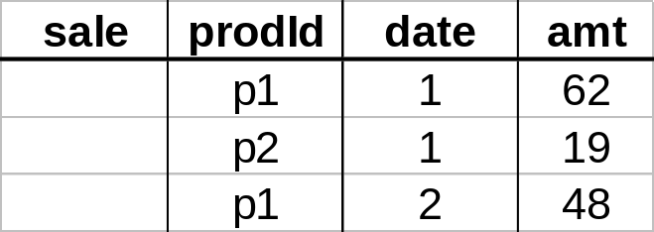
Another Example
Add up amounts by day, product
SQL: SELECT prodid, date, sum(amt) FROM SALE
GROUP BY date, prodId
rollup
drill-down

Slide 23
Points to be noticed about ROLAP
Defines complex, multi-dimensional data with simple model
Reduces the number of joins a query has to process
Allows the data warehouse to evolve with rel. low maintenance
Can contain both detailed and summarized data.
ROLAP is based on familiar, proven, and already selected technologies.
BUT!!!
SQL for multi-dimensional manipulation of calculations.

Slide 24
MOLAP: Dimensional Modeling Using the Multi Dimensional Model
MDDB: a special-purpose data model
Facts stored in multi-dimensional arrays
Dimensions used to index array
Sometimes on top of relational DB
Products
  Pilot, Arbor Essbase, Gentia

Slide 25
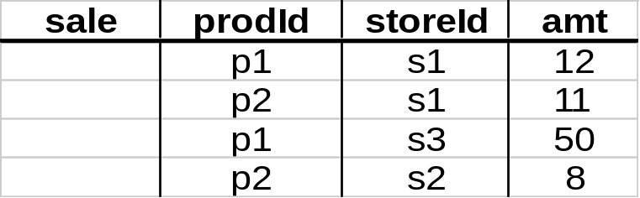
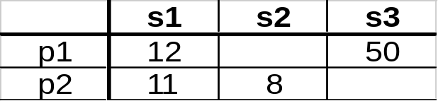
The MOLAP Cube
Fact table view:
Multi-dimensional cube:
dimensions = 2

Slide 26
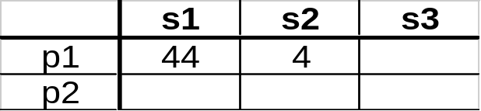
3-D Cube
Fact table view:
Multi-dimensional cube:
day 2
day 1
dimensions = 3

Slide 27
Example
roll-up to region
Dimensions:
Time, Product, Store
Attributes:
Product (upc, price, …)
Store …
…
Hierarchies:
Product → Brand → …
Day → Week → Quarter
Store → Region → Country
NY
Store
SF
roll-up to brand
LA
Juice
Milk
Coke
Cream
Soap
Bread
10
34
56
32
12
56
Product
roll-up to week
M T W Th F S S
Time
56 units of bread sold in LA on M

Slide 28
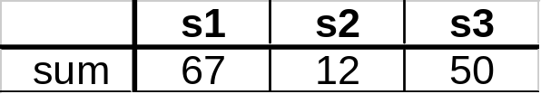
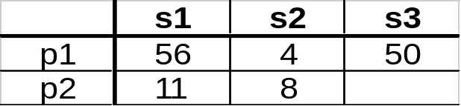
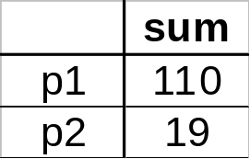
Cube Aggregation: Roll-up
Example: computing sums
day 2
. . .
day 1
129
rollup
drill-down

Slide 29
Cube Operators for Roll-up
day 2
. . .
day 1
sale(s1,*,*)
129
sale(s2,p2,*)
sale(*,*,*)

Slide 30
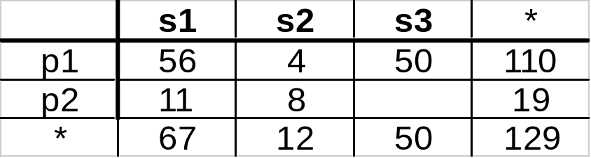
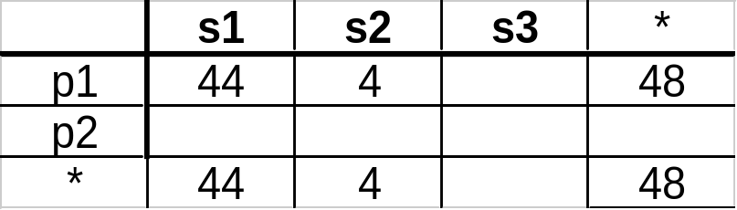
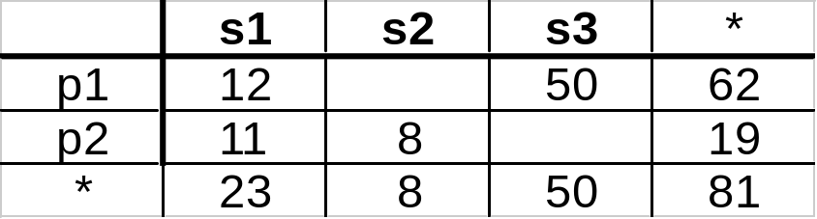
Extended Cube
*
day 2
sale(*,p2,*)
day 1

Slide 31
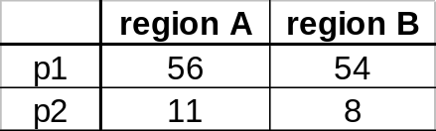
Aggregation Using Hierarchies
day 2
store
day 1
region
country
(store s1 in Region A;
stores s2, s3 in Region B)

Slide 32
Points to be noticed about MOLAP
Pre-calculating or pre-consolidating transactional data improves speed.
BUT
Fully pre-consolidating incoming data, MDDs require an enormous amount of overhead both in processing time and in storage. An input file of 200MB can easily expand to 5GB
MDDs are great candidates for the <50GB department data marts.
Rolling up and Drilling down through aggregate data.
With MDDs, application design is essentially the definition of dimensions and calculation rules, while the RDBMS requires that the database schema be a star or snowflake.

Slide 33
Hybrid OLAP (HOLAP)
HOLAP = Hybrid OLAP:
  Best of both worlds
  Storing detailed data in RDBMS
  Storing aggregated data in MDBMS
  User access via MOLAP tools

Slide 34
Data Flow in HOLAP
RDBMS Server
MDBMS Server
Client
Multi-dimensional access
SQL-Read
Multidimensional Viewer
User
data
Multi-
dimensionaldata
Meta data
Derived
data
SQL-Reach Through
Relational
Viewer
SQL-Read

Slide 35
When deciding which technology to go for, consider:
1) Performance:
    How fast will the system appear to the end-user?
    MDD server vendors believe this is a key point in their favor.
  2) Data volume and scalability:
    While MDD servers can handle up to 50GB of storage, RDBMS servers can handle hundreds of gigabytes and terabytes.

Slide 36
An experiment with Relational and the Multidimensional models on a data set
The analysis of the author’s example illustrates the following differences between the best Relational alternative and the Multidimensional approach.
* This may include the calculation of many other derived data without any additional I/O.
Reference: http://dimlab.usc.edu/csci599/Fall2002/paper/I2_P064.pdf
 | relational | Multi-dimensional | Improvement
Disk space requirement (Gigabytes) | 17 | 10 | 1.7
Retrieve the corporate measures Actual Vs Budget, by month (I/O’s) | 240 | 1 | 240
Calculation of Variance Budget/Actual for the whole database (I/O time in hours) | 237 | 2* | 110*

Slide 37
What-if analysis
IF
A. You require write access
B. Your data is under 50 GB
C. Your timetable to implement is 60-90 days
D. Lowest level already aggregated
E. Data access on aggregated level
F. You’re developing a general-purpose application for inventory movement or assets management
THEN
Consider an MDD /MOLAP solution for your data mart
IF
A. Your data is over 100 GB
B. You have a "read-only" requirement
C. Historical data at the lowest level of granularity
D. Detailed access, long-running queries
E. Data assigned to lowest level elements
THEN
Consider an RDBMS/ROLAP solution for your data mart.
IF
A. OLAP on aggregated and detailed data
B. Different user groups
C. Ease of use and detailed data
THEN
Consider an HOLAP for your data mart

Slide 38
Examples
ROLAP
  Telecommunication startup: call data records (CDRs)
  ECommerce Site
  Credit Card Company
MOLAP
  Analysis and budgeting in a financial department
  Sales analysis
HOLAP
  Sales department of a multi-national company
  Banks and Financial Service Providers

Slide 39
Tools available
ROLAP:
  ORACLE 8i
  ORACLE Reports; ORACLE Discoverer
  ORACLE Warehouse Builder
  Arbors Software’s Essbase
MOLAP:
  ORACLE Express Server
  ORACLE Express Clients (C/S and Web)
  MicroStrategy’s DSS server
  Platinum Technologies’ Plantinum InfoBeacon
HOLAP:
  ORACLE 8i
  ORACLE Express Serve
  ORACLE Relational Access Manager
  ORACLE Express Clients (C/S and Web)

Slide 40
Conclusion
ROLAP: RDBMS -> star/snowflake schema
MOLAP: MDD -> Cube structures
ROLAP or MOLAP: Data models used play major role in performance differences
MOLAP: for summarized and relatively lesser volumes of data (10-50GB)
ROLAP: for detailed and larger volumes of data
Both storage methods have strengths and weaknesses
The choice is requirement specific, though currently data warehouses are predominantly built using RDBMSs/ROLAP.

Slide 41
References
http://dimlab.usc.edu/csci599/Fall2002/paper/I2_P064.pdf
  OLAP, Relational, and Multidimensional Database Systems, by George Colliat, Arbor Software Corporation
http://www.donmeyer.com/art3.html
  Data warehousing Services, Data Mining & Analysis, LLC
http://www.cs.man.ac.uk/~franconi/teaching/2001/CS636/CS636-olap.ppt
  Data Warehouse Models and OLAP Operations, by Enrico Franconi
http://www.promatis.com/mediacenter/papers
- ROLAP, MOLAP, HOLAP: How to determine which to technology is appropriate, by Holger Frietch, PROMATIS Corporation

