Slide 1
OLAP in the Data Warehouse
Sambhaji M Shedole

Slide 2
Contents
OLAP in the Data Warehouse:
Demand for Online analytical processing,
need for multidimensional analysis,
OLAP definitions and rules,
OLAP characteristics,
major features and functions,
general features, dimensional analysis,

Slide 3
Hypercubes OLAP models,
Overview of variations,
The MOLAP model,
The ROLAP model,
ROLAP versus MOLAP,
OLAP implementation.

Slide 4
Outline
Introduction
OLAP definition
Major features and functions
Hypercubes
OLAP models

Slide 5
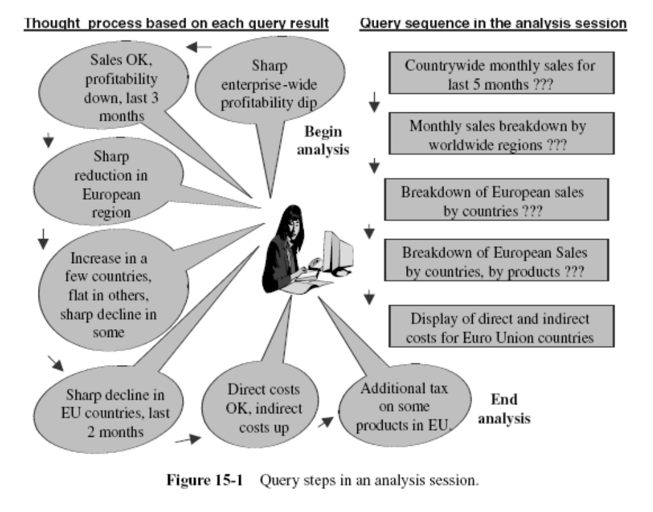

Slide 6
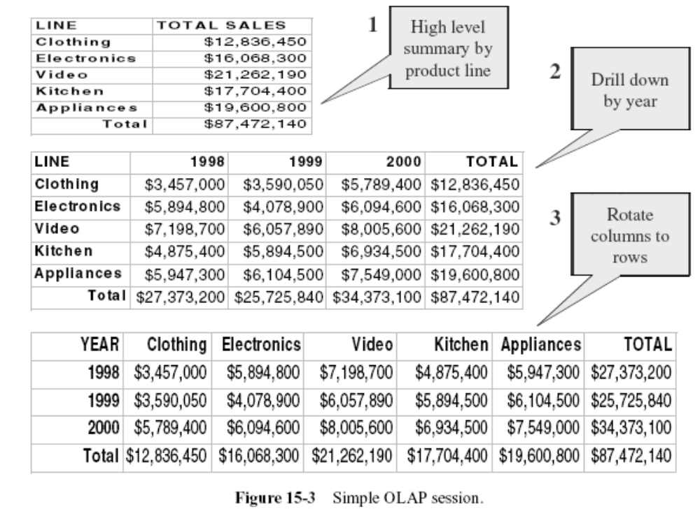

Slide 7
OLAP Definitions and Rules
The term OLAP was introduced in a paper entitled “Providing On-Line Analytical Processing to User Analysts,” by Dr. E. F. Codd
Paper defined 12 rules or guidelines for an OLAP system

Slide 8
Definition
On-Line Analytical Processing (OLAP) is a category of software technology that enables analysts, managers and executives to gain insight into data through fast, consistent, interactive access in a wide variety of possible views of information that has been transformed from raw data to reflect the real dimensionality of the enterprise as understood by the user.

Slide 9
Twelve guidelines for an OLAP system
Multidimensional Conceptual View.
Transparency.
Accessibility.
Consistent Reporting Performance.
Client/Server Architecture.
Generic Dimensionality.
Dynamic Sparse Matrix Handling.
Multiuser Support.
Unrestricted Cross-dimensional Operations.
Intuitive Data Manipulation.
Flexible Reporting.
Unlimited Dimensions and Aggregation Levels.

Slide 10
1. Multidimensional Conceptual View
Provide a multidimensional data model that is intuitively analytical and easy to use. Business users’ view of an enterprise is multidimensional in nature. Therefore, a multidimensional data model conforms to how the users perceive business problems.

Slide 11
2. Transparency
Make the technology, underlying data repository, computing architecture, and the diverse nature of source data totally transparent to users. Such transparency, supporting a true open system approach, helps to enhance the efficiency and productivity of the users through front-end tools that are familiar to them.

Slide 12
3. Accessibility
Provide access only to the data that is actually needed to perform the specific analysis, presenting a single, coherent, and consistent view to the users. The OLAP system must map its own logical schema to the heterogeneous physical data stores and perform any necessary transformations.

Slide 13
4. Consistent Reporting Performance
Ensure that the users do not experience any significant degradation in reporting performance as the number of dimensions or the size of the database increases. Users must perceive consistent run time, response time, or machine utilization every time a given query is run.

Slide 14
5. Client/Server Architecture
Conform the system to the principles of client/server architecture for optimum performance, flexibility, adaptability, and interoperability. Make the server component sufficiently intelligent to enable various clients to be attached with a minimum of effort and integration programming.

Slide 15
6. Generic Dimensionality
Ensure that every data dimension is equivalent in both structure and operational capabilities. Have one logical structure for all dimensions. The basic data structure or the access techniques must not be biased toward any single data dimension.

Slide 16
7. Dynamic Sparse Matrix Handling
Adapt the physical schema to the specific analytical model being created and loaded that optimizes sparse matrix handling. When encountering a sparse matrix, the system must be able to dynamically deduce the distribution of the data and adjust the storage and access to achieve and maintain consistent level of performance.

Slide 17
8. Multiuser Support
Provide support for end users to work concurrently with either the same analytical model or to create different models from the same data. In short, provide concurrent data access, data integrity, and access security.

Slide 18
9. Unrestricted Cross-dimensional Operations
Provide ability for the system to recognize dimensional hierarchies and automatically perform roll-up and drill-down operations within a dimension or across dimensions. Have the interface language allow calculations and data manipulations across any number of data dimensions, without restricting any relations between data cells, regardless of the number of common data attributes each cell contains.

Slide 19
10. Intuitive Data Manipulation
Enable consolidation path reorientation (pivoting), drill-down and roll-up, and other manipulations to be accomplished intuitively and directly via point-and-click and drag-and-drop actions on the cells of the analytical model. Avoid the use of a menu or multiple trips to a user interface.

Slide 20
11. Flexible Reporting
Provide capabilities to the business user to arrange columns, rows, and cells in a manner that facilitates easy manipulation, analysis, and synthesis of information. Every dimension, including any subsets, must be able to be displayed with equal ease.

Slide 21
12. Unlimited Dimensions and Aggregation Levels
Accommodate at least fifteen, preferably twenty, data dimensions within a common analytical model. Each of these generic dimensions must allow a practically unlimited number of user-defined aggregation levels within any given consolidation path.

Slide 22
Requirements, not all distinctly specified by Dr. Codd
Drill-through to Detail Level. Allow a smooth transition from the multidimensional, preaggregated database to the detail record level of the source data warehouse repository.
OLAP Analysis Models. Support Dr. Codd’s four analysis models: exegetical (or descriptive), categorical (or explanatory), contemplative, and formulaic.
Treatment of Nonnormalized Data. Prohibit calculations made within an OLAP system from affecting the external data serving as the source.
Storing OLAP Results. Do not deploy write-capable OLAP tools on top of transactional systems.
Missing Values. Ignore missing values, irrespective of their source.
Incremental Database Refresh. Provide for incremental refreshes of the extracted and aggregated OLAP data.
SQL Interface. Seamlessly integrate the OLAP system into the existing enterprise environment.

Slide 23
MAJOR FEATURES AND FUNCTIONS

Slide 24
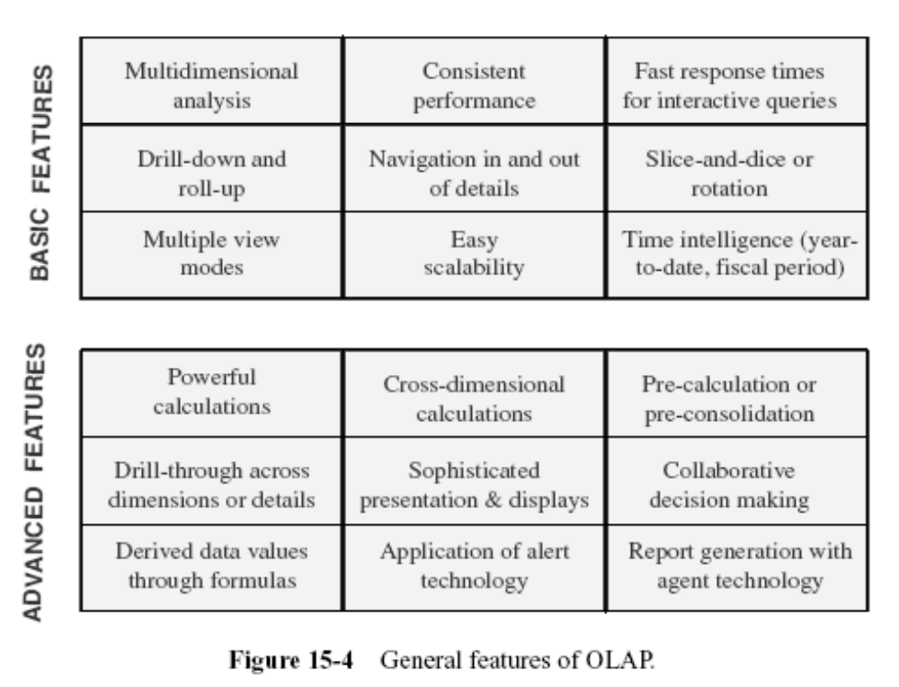

Slide 25
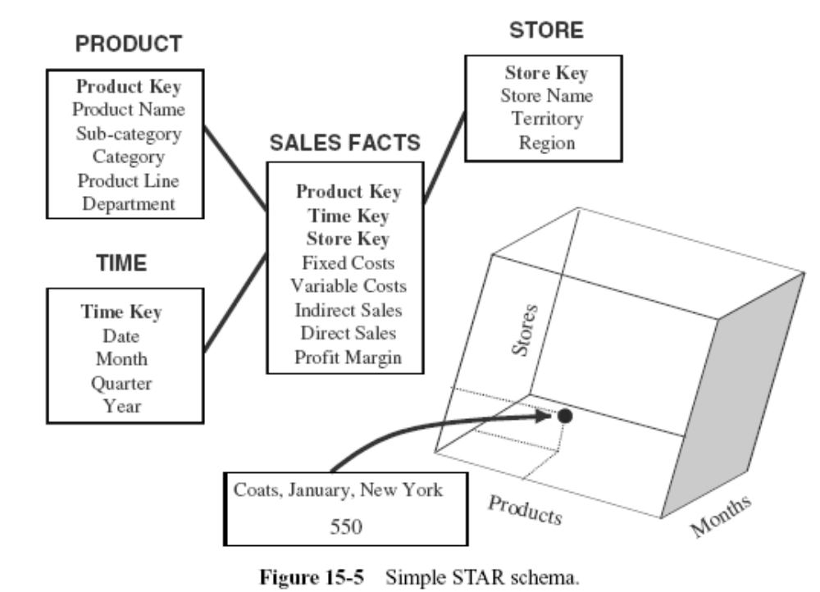
Dimensional Analysis

Slide 26
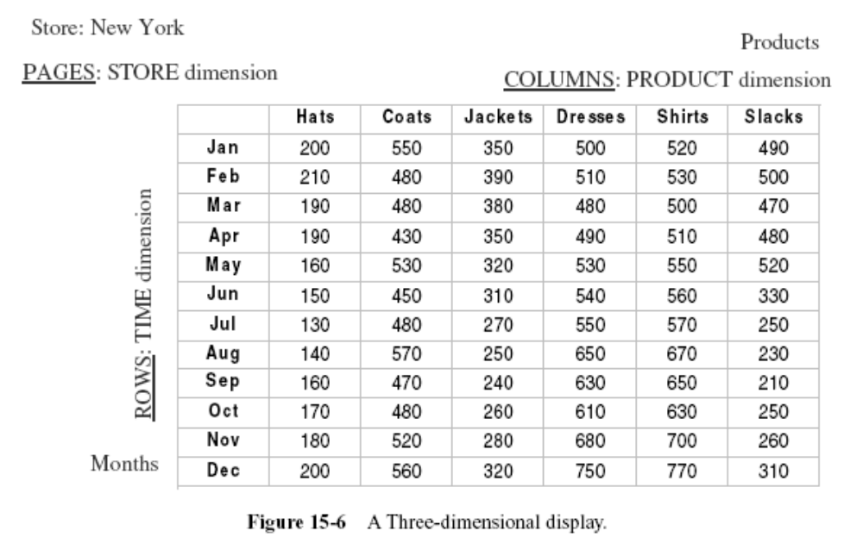

Slide 27
Hypercubes

Slide 28
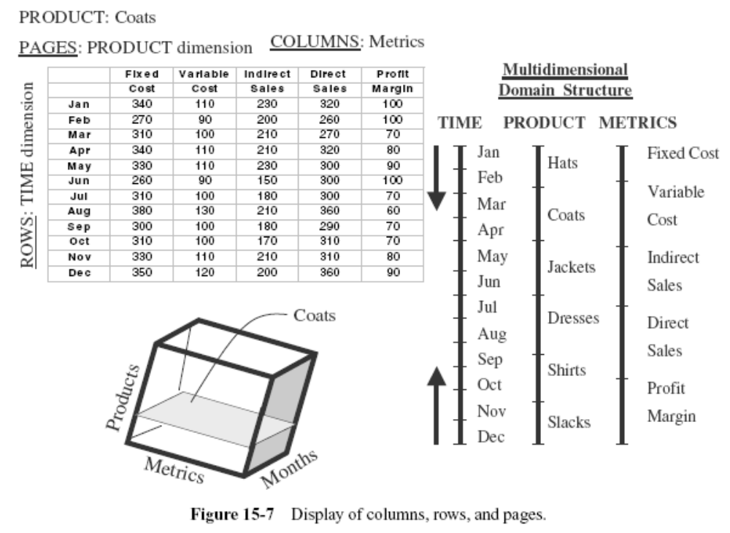

Slide 29
In the figure, note the three straight lines, two of which represent the two business dimensions and the third, the metrics. You can independently move up or down along the straight lines.
Some experts refer to this representation of a multidimension as a multidimensional domain structure (MDS).

Slide 30
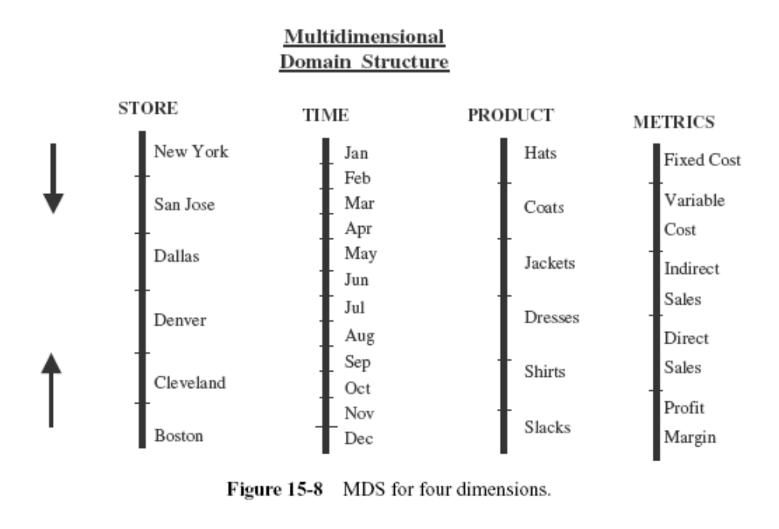

Slide 31
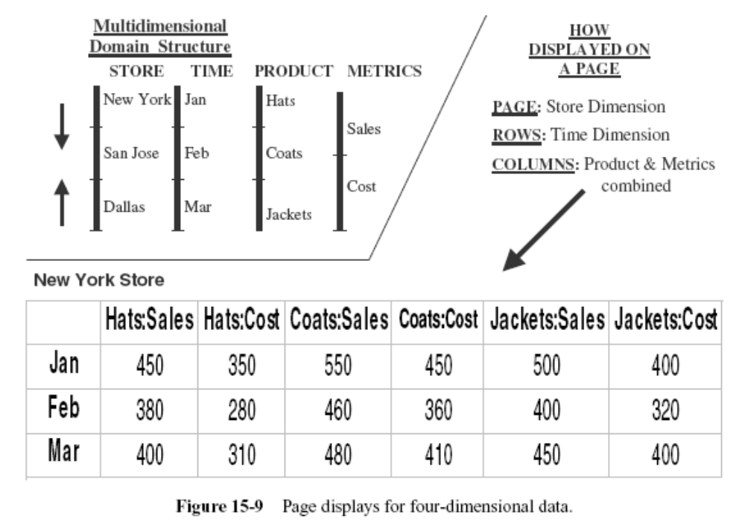

Slide 32
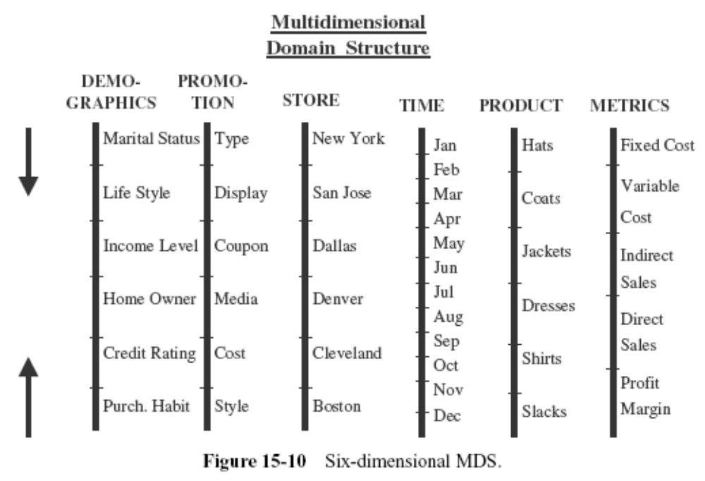

Slide 33
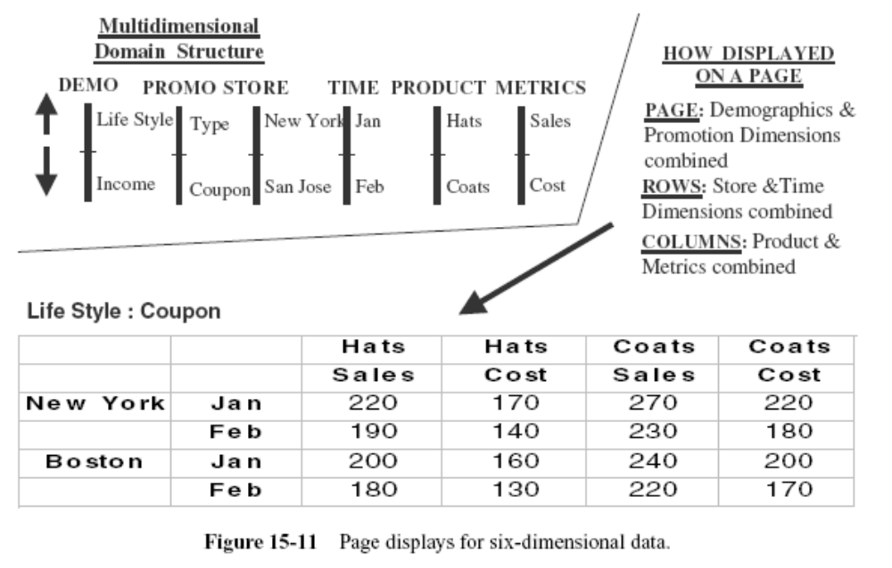

Slide 34
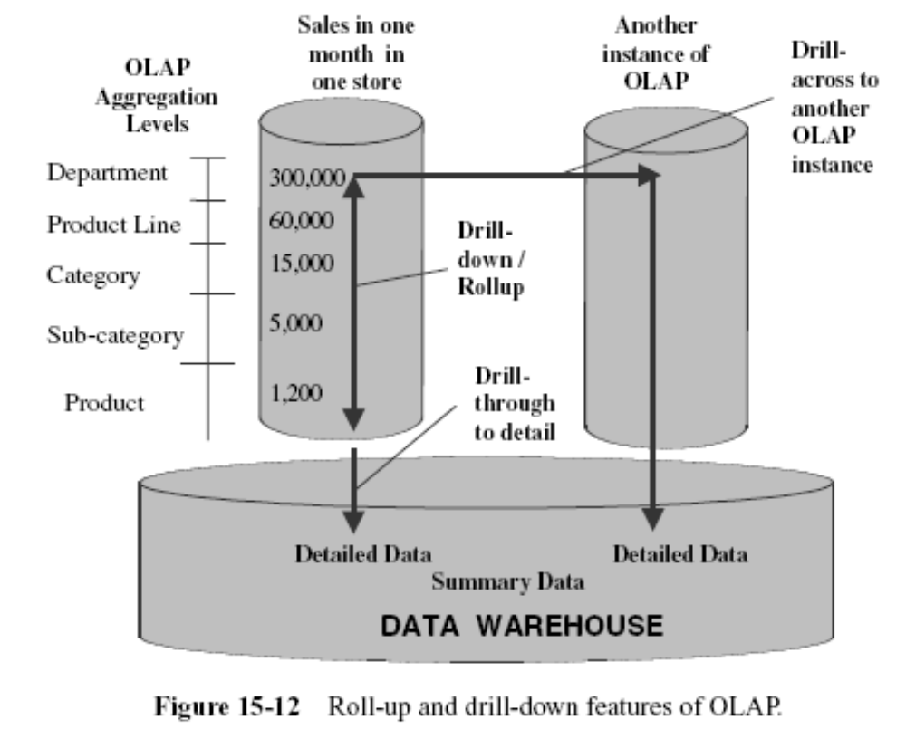
Drill-Down and Roll-Up

Slide 35
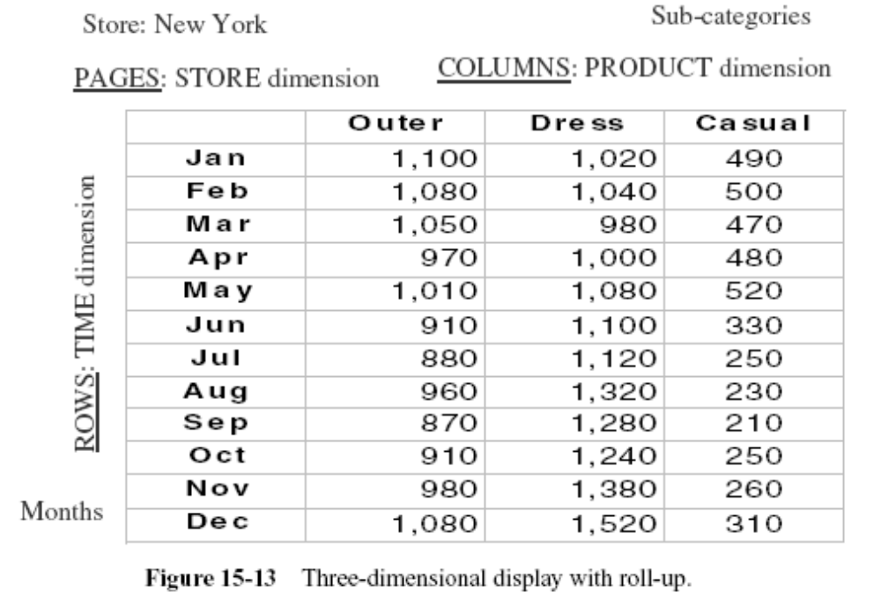
Example of roll-up

Slide 36
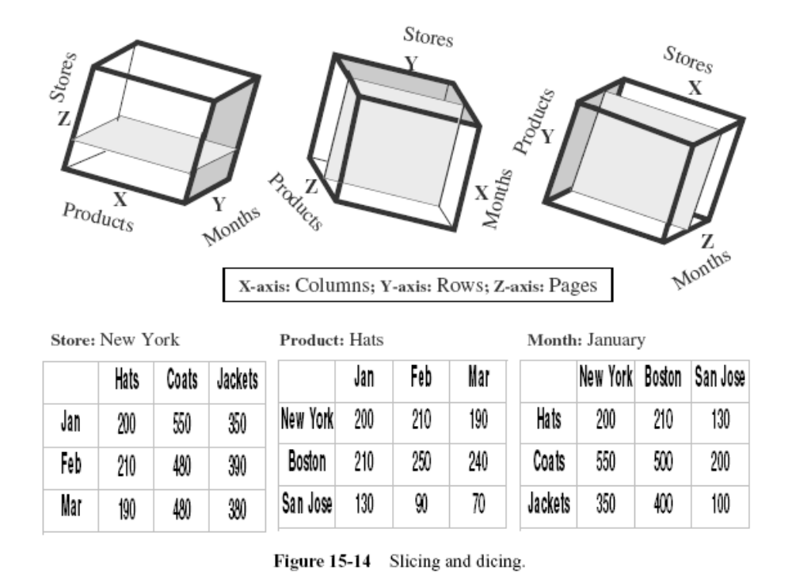
Slice-and-Dice or Rotation

Slide 37
OLAP MODELS

Slide 38
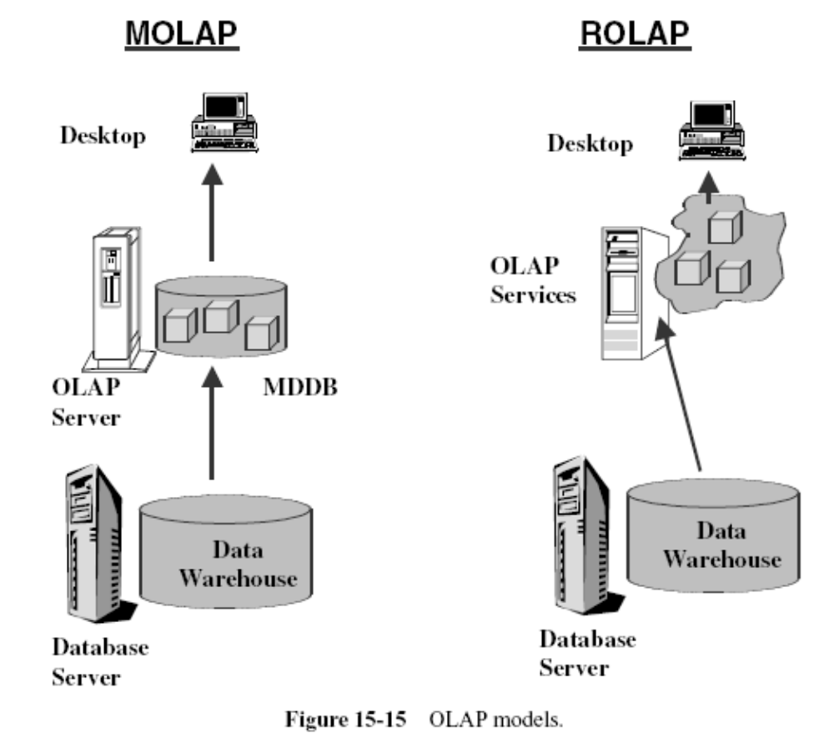

Slide 39
Approaches to OLAP Servers
Three possibilities for OLAP servers
(1) Relational OLAP (ROLAP)
  Relational and specialized relational DBMS to store and manage warehouse data
  OLAP middleware to support missing pieces
(2) Multidimensional OLAP (MOLAP)
  Array-based storage structures
  Direct access to array data structures
(3) Hybrid OLAP (HOLAP)
  Storing detailed data in RDBMS
  Storing aggregated data in MDBMS
  User access via MOLAP tools

Slide 40
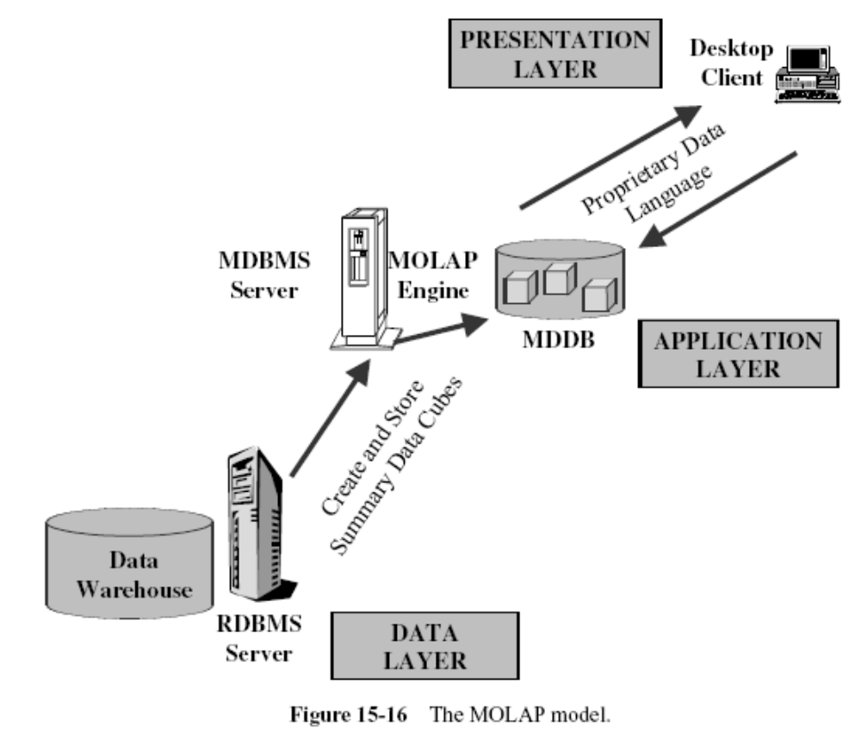

Slide 41
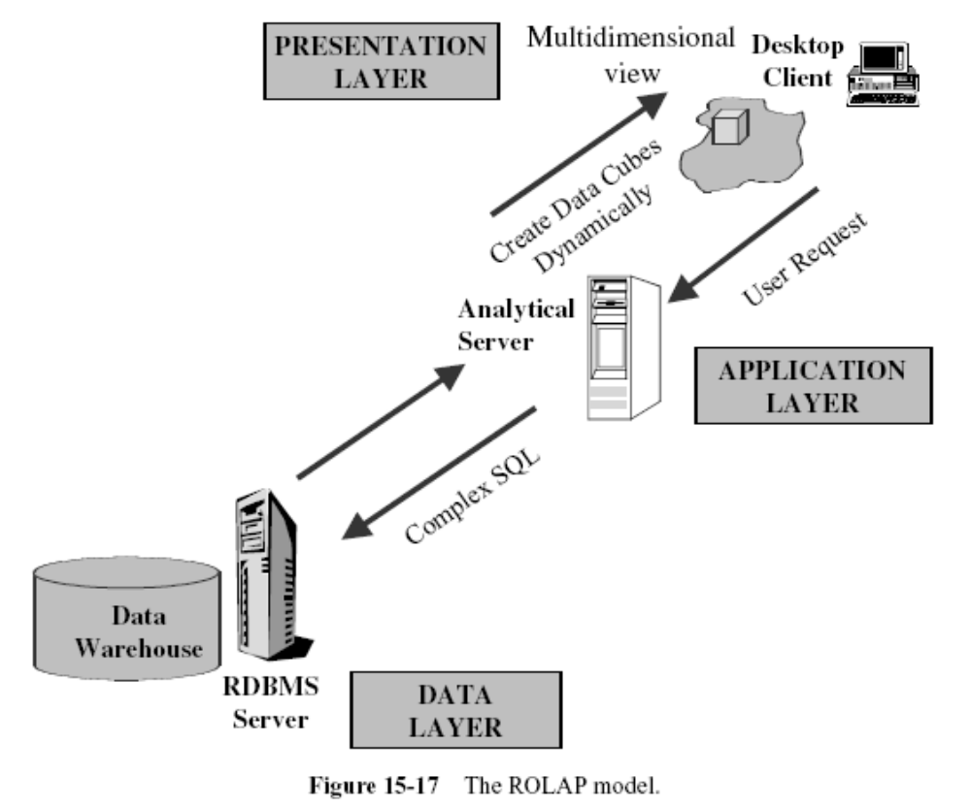

Slide 42
Examples
ROLAP
  Telecommunication startup: call data records (CDRs)
  ECommerce Site
  Credit Card Company
MOLAP
  Analysis and budgeting in a financial department
  Sales analysis
HOLAP
  Sales department of a multi-national company
  Banks and Financial Service Providers

Slide 43
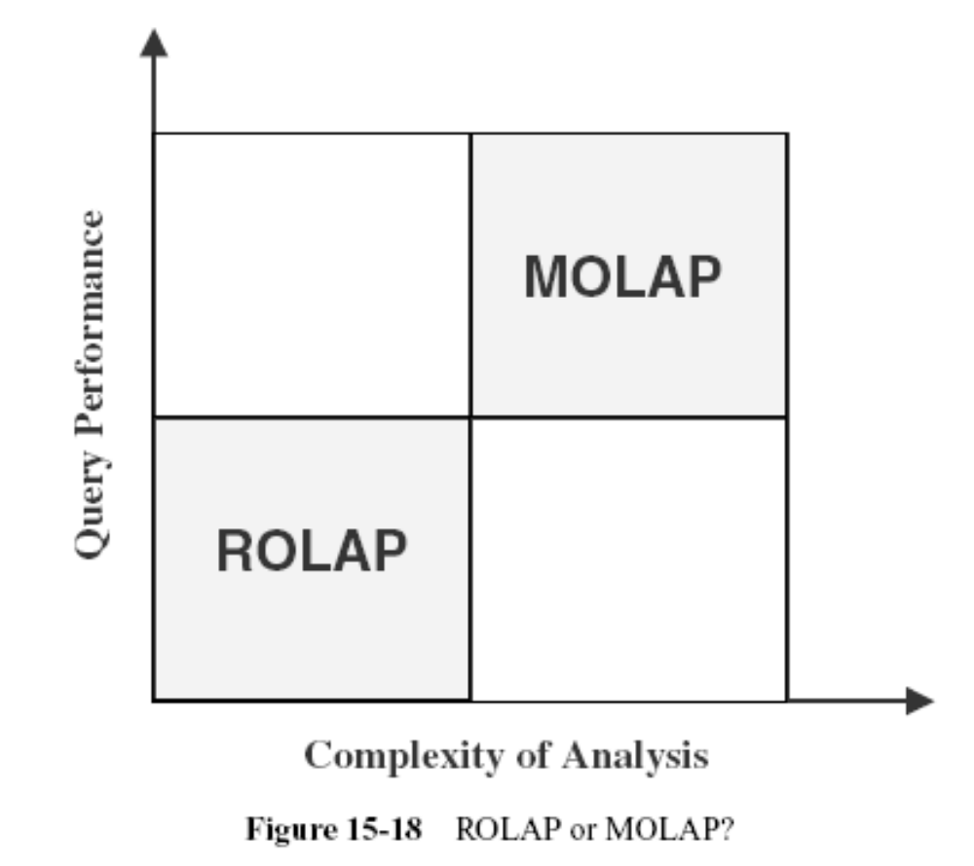
ROLAP VERSUS MOLAP

Slide 44
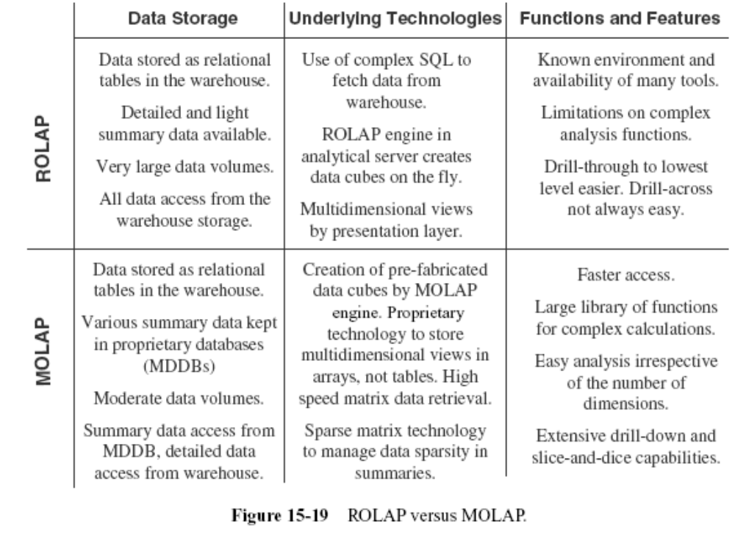

Slide 45
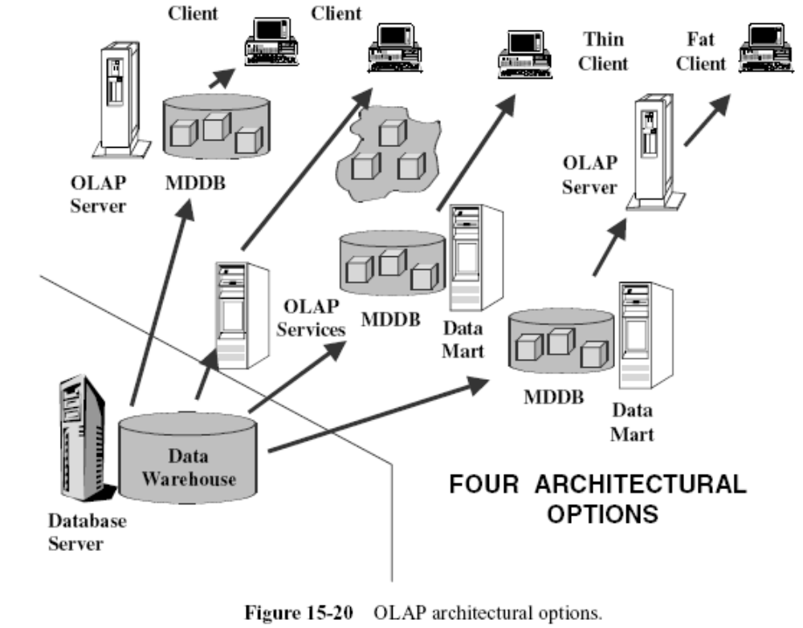
OLAP IMPLEMENTATION CONSIDERATIONS

Slide 46
Questions?

