Slide 1
UNIT 5 Business Intelligence Architecture
Prof. S M Shedole

Slide 2
Contents
Introduction to Business Intelligence Architecture –
Overview of Business Intelligence Operations-
Evaluating Operational Costs and Risks-
Business Intelligence Applications like Balanced Scorecard,
Fraud Detection, Click stream Mining,
Market Segmentation,
retail industry,
telecommunications industry,
banking & finance etc

Slide 3
What is Business Intelligence (BI)
Definitions:
Business Intelligence (BI) refers to skills, processes, technologies, applications and practices used to support decision making.
Systems that provide directed background data and reporting tools to support and improve the decision-making process.
A popularized, umbrella term used to describe a set of concepts and methods to improve business decision making by using fact-based support systems. The term is sometimes used interchangeably with briefing books and executive information systems.

Slide 4
Business Intelligence is a broad category of applications and technologies for gathering, storing, analyzing, and providing access to data to help clients make better business decisions.
A system that collects, integrates, analyses and presents business information to support better business decision making.
Business Intelligence is an environment in which business users receive information that is reliable, secure, consistent, understandable, easily manipulated and timely...facilitating more informed decision making

Slide 5
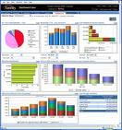


What is Business Intelligence?
Business Intelligence enables the business to make intelligent, fact-based decisions
Aggregate Data
Present
Data
Enrich
Data
Inform a Decision
Database, Data Mart, Data Warehouse, ETL Tools, Integration Tools
Reporting Tools, Dashboards, Static Reports, Mobile Reporting, OLAP Cubes
Add Context to Create Information, Descriptive Statistics, Benchmarks, Variance to Plan or LY
Decisions are Fact-based and Data-driven

Slide 6
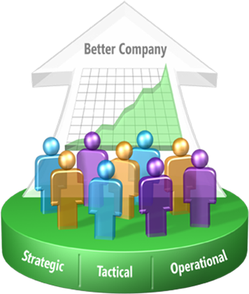
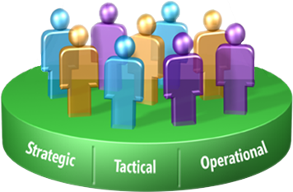
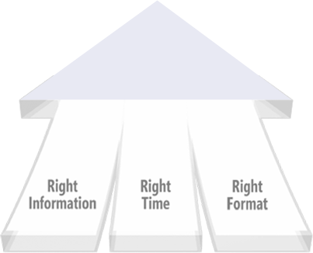
What is BI (continued)
Improving organizations by providing business insights to all employees leading to better, faster, more relevant decisions

Slide 7
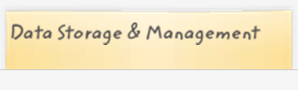
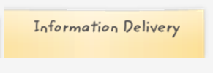


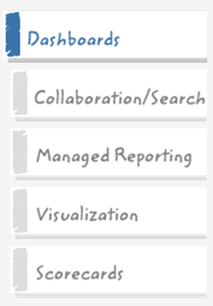
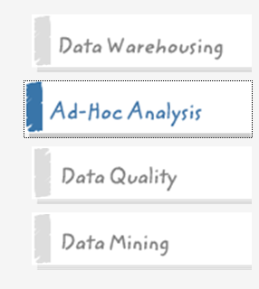
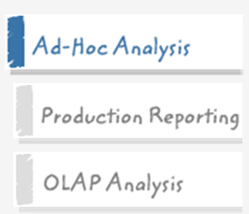


Core Capabilities of BI

Slide 8
Benefits of Business Intelligence
Improve Management Processes
planning, controlling, measuring and/or changing resulting in increased revenues and reduced costs
Improve Operational Processes
fraud detection, order processing, purchasing.. resulting in increased revenues and reduced costs
Predict the Future

Slide 9
Managing Organizations Informed decision making as a prerequisite for success
Vision
Organizational Context
Mission
Values, Purpose, Structure, Politics, Environment, etc.
Givens
Strategic
Direction
Policies, Goals, and Objectives
Decision
Making
What should be done ?
Analytics, Decision Making
When and how ??
Implementation
Project Management
Action

Slide 10
Managerial Decision Making Information Technology Solutions for Improving Effectiveness
Complexity
What does it add up to?
Uncertainty
What can happen?
MODELS
DATA
INTELLIGENCE
DESIGN
Structuring Relationships
Problem Representation
Generation of Alternatives
Variables (Measures and Estimates)
Probabilities and Estimates
CHOICE
Decision Analysis and Influence Diagrams for Visualizing Models and Choices
Spreadsheet Models
for managing complex relationships and detail

Slide 11
Components of a DSS Creating Information Under Conditions of Uncertainty and Complexity
Information Technology for Enterprise Strategic Systems
DATA BASE
MODEL BASE
Enterprise
Data
Application
Models
DBMS
MBMS
DATA WAREHOUSING
ON LINE ANALYTICAL PROCESSING
Business Reporting

Slide 12
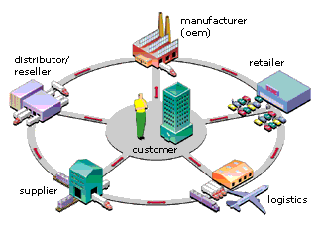
Customer-Centric Intelligent eBusiness
White Paper: Customer-centric intelligent eBusiness from I2

Slide 13
CPU – Content, Performance, Usability
Content
The business determines the “what”, BI enables the “how”
Performance
Minimize report creation and collection times (near zero)
Usability
Delivery Method →Push vs Pull
Medium → Excel, PDF, Dashboard, Cube, Mobile Device
Enhance Digestion → “A-ha” is readily apparent, fewer clicks
Tell a Story → Trend, Context, Related Metrics, Multiple Views

Slide 14

Why is Business Intelligence So Important?
Time
Data
Opinion
(aka Best Professional Judgment)
Making Business Decisions is a Balance
In the absence of data, business decisions are often made by the HiPPO.
With Business Intelligence, we can get data to you in a timely manner.

Slide 15
Major BI Trends
Mobile
Cloud
Social Media
Advanced Analytics

Slide 16

Demand Planning
Demand Planning
Intense competition, changing customer expectations and highly volatile market developments are making demand planning increasingly difficult – yet increa-singly important.
Now imagine having real-time demand data...
..collated from historical sales development, from your customers and your supply chain partners, including POS data. The SAP APO Demand Planning module adjusts figures dynamically and alerts you automatic-ally to sudden shifts in demand patterns. Multidimen-sional data models and analysis functions allow you to view and scrutinize the information available in many different ways. And you can combine this module with the powerful analysis features of the SAP BW. You can even simulate the impact of new marketing strategies on demand.

Slide 17
Enterprise Wide Decisions
Goals/Strategy
Pricing
Promotion
Loyalty
Marketing
Demand
Consumers
Capacity
Labor
Materials
Production
Quantity
Suppliers
Cash flow
Debt/Equity
Investments
Revenues
Finance
Investors

Slide 18
Business Applications in the Extended Enterprise
Suppliers
Customers
Strategic Apps.
Tactical Apps.
Consumers
Materials/Components
SCM Applications
ERP Applications
CRM Applications
Business Intelligence

Slide 19
Business Analytics
Decision Making
Business Intelligence
Business Modeling
“Actionable” Information
Data Warehouse
And
Data Marts
Report Warehouse
And
Document Mart
Data Analysis and Data Mining
Knowledge Management
PROJECT MANAGMENT

Slide 20
Thank You

