Slide 1
Business Intelligence (BI)
Overview and Trends
Matt Schwartz
March 31, 2011

Slide 2
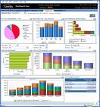


What is Business Intelligence?
Business Intelligence enables the business to make intelligent, fact-based decisions
Aggregate Data
Present
Data
Enrich
Data
Inform a Decision
Database, Data Mart, Data Warehouse, ETL Tools, Integration Tools
Reporting Tools, Dashboards, Static Reports, Mobile Reporting, OLAP Cubes
Add Context to Create Information, Descriptive Statistics, Benchmarks, Variance to Plan or LY
Decisions are Fact-based and Data-driven

Slide 3
CPU – Content, Performance, Usability
Content
  The business determines the “what”, BI enables the “how”
Performance
  Minimize report creation and collection times (near zero)
Usability
  Delivery Method →Push vs Pull
  Medium → Excel, PDF, Dashboard, Cube, Mobile Device
  Enhance Digestion → “A-ha” is readily apparent, fewer clicks
  Tell a Story → Trend, Context, Related Metrics, Multiple Views

Slide 4
How Important is BI?
Top 10 Business and Technology Priorities for 2011:
1. Cloud computing
2. Virtualization
3. Mobile technologies
4. IT Management
5. Business Intelligence
6. Networking, voice and data communications
7. Enterprise applications
8. Collaboration technologies
9. Infrastructure
10. Web 2.0
Source: Gartner’s 2011 CIO Agenda (aka “Reimagining IT: The 2011 CIO Agenda”)._x000b_

Slide 5
The July 2010 Forrester report “Technology Trends That Retail CIOs Must Tap to Drive Growth” identified the following technologies that retail CIOs should be considering as part of an overall architecture strategy:
  Mobile
  Cloud
  Social Computing
  Supply Chain
  Micropayments
  Business Intelligence/Analytics

Slide 6

Why is Business Intelligence So Important?
Time
Data
Opinion
(aka Best Professional Judgment)
Making Business Decisions is a Balance
With Business Intelligence, we can get data to you in a timely manner.
In the absence of data, business decisions are often made by the HiPPO.

Slide 7
Major BI Trends
Mobile
Cloud
Social Media
Advanced Analytics

Slide 8
Executive Summit – August 2010
What BI technologies will be the most important to your organization in the next 3 years?
Predictive Analytics
Visualization/Dashboards
Master Data Management
The Cloud
Analytic Databases
Mobile BI
Open Source
Text Analytics

Slide 9
Advanced Analytics / Predictive Analytics
Data Mining
Regression
Monte Carlo Simulation
“Statistically Significant”
Predicting Customer Behavior
  Churn/Attrition
  Purchases
  Profiling

Slide 10
BI Today vs Tomorrow
“BI today is like reading the newspaper”
  BI reporting tool on top of a data warehouse that loads nightly and produces historical reporting
BI tomorrow will focus more on real-time events and predicting tomorrow’s headlines

Slide 11
Collegiate Admissions Criteria
Test Scores: SAT, ACT, AP Exams
Grade Point Average
Class Rank
High School “Strength”
Extracurricular Activities: Band/Choir, Clubs, Sports
Non-School Activities: Work, Volunteer, Community Groups
Area of Focus – Intended Major
Family legacy
Home State or Country
Regression Outcome = Graduation (binary) + GPA (linear)

Slide 12
Retail Analytics
Market Basket Analytics
Text Analytics
Customer Segmentation/Clustering
Tailored Product Assortments
Inventory Forecasting

Slide 13

Amazon.com and NetFlix
Collaborative Filtering tries to predict other items a customer may want to purchase based on what’s in their shopping cart and the purchasing behaviors of other customers

Slide 14
What Is Text Analytics?
…turning unstructured customer comments into actionable insights
…finding nuggets of insight in text data that will improve our business
From Wikipedia:
… a set of linguistic, statistical, and machine learning techniques that model and structure the information content of textual sources for business intelligence, exploratory data analysis, research, or investigation

Slide 15


Unstructured Text Processing
Facebook Page
Twitter
Page
Customer Sat Survey Comments
Call
Center
Notes,
Voice
Services
Quality
Cost
Friendliness
Competitors’ Facebook
Pages
Public Web Sites,
Discussion Boards, Product Reviews
Email
Blogs
Alerts,
Real-time Action
Adhoc Feedback

Slide 16
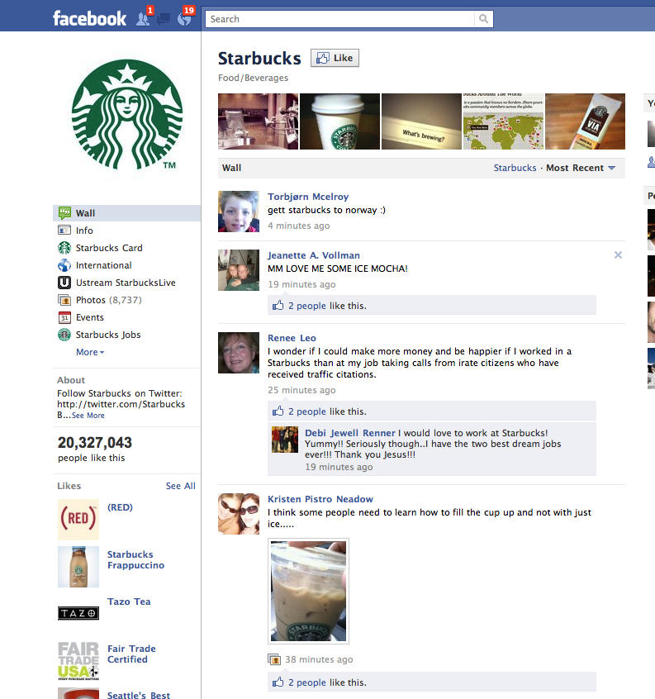

Slide 17
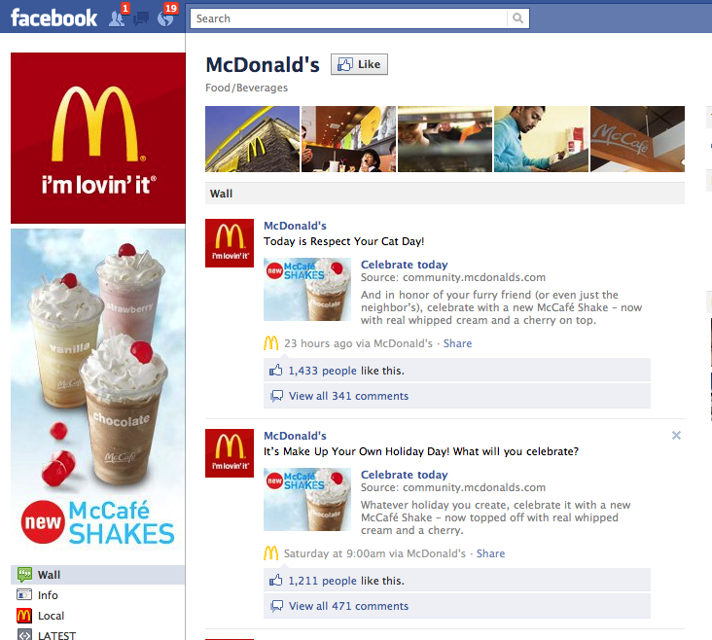

Slide 18
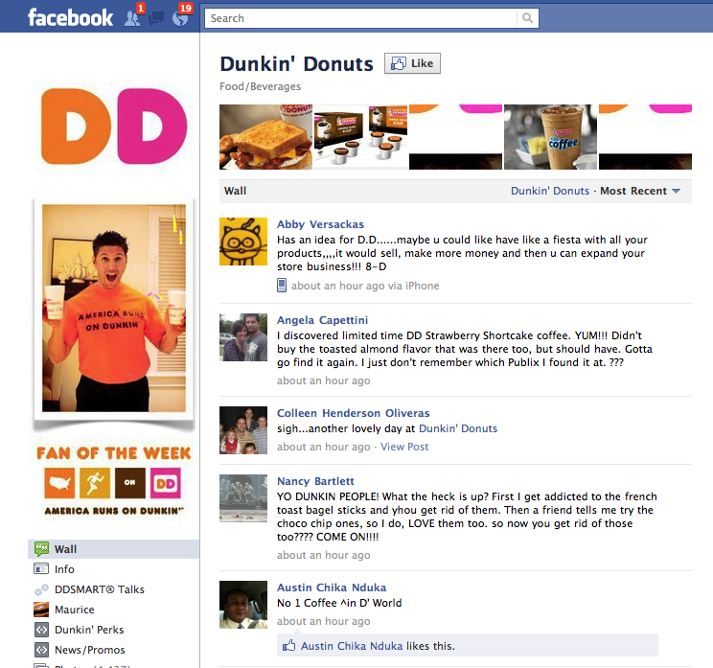

Slide 19

What is Information Governance?
Information Governance
PREVENTS
Garbage In
Garbage Out
BY ENCOMPASSING
Data Stewardship
  Data Quality
Data Governance
  Master Data Management
  Data Stewards for Master Data “Hubs”
  Customer, Vendor, Product, Location, Employee, G/L Accounts
Report Governance
Metric Governance
CREATING SIGNIFICANT BUSINESS VALUE

Slide 20
BI Technologies
Analytic Databases
BI is a consolidating industry
  Oracle: Siebel, Hyperion, Brio, Sun
  SAP: Business Objects, Sybase
  IBM: Cognos, SPSS, Coremetrics, Unica, Netezza
  EMC: Greenplum
  HP: Vertica
  Teradata: Aster Data
Independent vendors: MicroStrategy, Informatica, SAS
Reporting standards determined mainly by Microsoft, Apple and Adobe
DB2
Oracle
SQL Server
Teradata
Netezza
Vertica
Aster Data
Par Accel
Greenplum
Semantic Databases
(TIDE)

Slide 21
BI Technologies (cont’d)
If you want to learn more about Analytic Databases:
http://hosted.mediasite.com/mediasite/Viewer/?peid=120d6b7ba227498b96a8c0cd01349a791d
If you want to learn more about BI in the Cloud:
http://hosted.mediasite.com/mediasite/Viewer/?peid=e6d91148a71a47969824c22b3b20d6221d

Slide 22
Recommended Reading List
Outliers -- Malcolm Caldwell
Moneyball -- Michael Lewis
The Black Swan -- Nassim Nicholas Taleb
Competing on Analytics -- Tom Davenport
How to Lie with Statistics -- Darrell Huff
Bringing Down the House -- Ben Mezrich
Super Crunchers -- Ian Ayres
Priceless -- William Poundstone
Drilling Down -- Jim Novo
The New Rules of Marketing -- Fred Newell

Slide 23
Thank You
Q&A

