Slide 1
Managing Organizations
Informed decision making as a prerequisite for success
Organizational Context
Vision
Mission
Values, Purpose, Structure, Politics, Environment, etc.
Givens
Strategic
Direction
Policies, Goals, and Objectives
Decision
Making
What should be done ?
Analytics, Decision Making
When and how ??
Implementation
Project Management
Action

Slide 2





Managerial Decision Making
Information Technology Solutions for Improving Effectiveness
Complexity
What does it add up to?
Uncertainty
What can happen?
MODELS
DATA
INTELLIGENCE
DESIGN
Structuring Relationships
Problem Representation
Generation of Alternatives
Variables (Measures and Estimates)
Probabilities and Estimates
CHOICE
Decision Analysis and Influence Diagrams for Visualizing Models and Choices
Spreadsheet Models
for managing complex relationships and detail

Slide 3
Components of a DSS
Creating Information Under Conditions of Uncertainty and Complexity
Information Technology for Enterprise Strategic Systems
DATA
BASE
MODEL
BASE
Enterprise
Data
Application
Models
DBMS
MBMS
DATA WAREHOUSING
ON LINE ANALYTICAL PROCESSING
Business Reporting

Slide 4
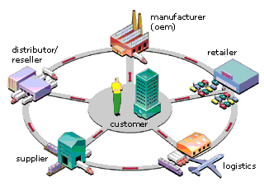
Customer-Centric Intelligent eBusiness
White Paper: Customer-centric intelligent eBusiness from I2

Slide 5

Demand Planning
Demand Planning
Intense competition, changing customer expectations and highly volatile market developments are making demand planning increasingly difficult – yet increa-singly important.
Now imagine having real-time demand data...
..collated from historical sales development, from your customers and your supply chain partners, including POS data. The SAP APO Demand Planning module adjusts figures dynamically and alerts you automatic-ally to sudden shifts in demand patterns. Multidimen-sional data models and analysis functions allow you to view and scrutinize the information available in many different ways. And you can combine this module with the powerful analysis features of the SAP BW. You can even simulate the impact of new marketing strategies on demand.
More Information
Functions in Detail Demand Planning (PDF, 1.3 KB)

Slide 6
Enterprise Wide Decisions
Goals/Strategy
Pricing
Promotion
Loyalty
Marketing
Demand
Consumers
Capacity
Labor
Materials
Production
Quantity
Suppliers
Cash flow
Debt/Equity
Investments
Revenues
Finance
Investors

Slide 7


Business Applications in the Extended Enterprise
Suppliers
Customers
Strategic Apps.
Tactical Apps.
Consumers
Materials/Components
SCM Applications
ERP Applications
CRM Applications
Business Intelligence

Slide 8
Business Analytics
Decision Making
Business
Intelligence
Business Modeling
“Actionable” Information
Data Warehouse
And
Data Marts
Report Warehouse
And
Document Mart
Data Analysis and Data Mining
Knowledge Management
PROJECT MANAGMENT

Slide 9
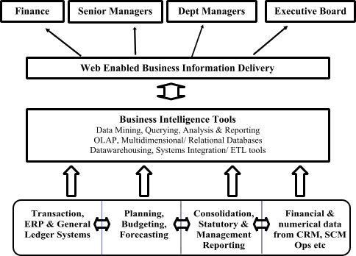

What Is Business Intelligence?
• Originally a term coined by the Gartner Group in 1993, Business Intelligence (BI) is a broad range of software and solutions aimed at collection, consolidation, analysis and providing access to information that allows users across the business to make better decisions.
• The technology includes software for database query and analysis, multidimensional databases or OLAP tools, data warehousing and data mining, and web enabled reporting capabilities.
• Applied across disciplines but especially in Customer Relationship Management (CRM), Supply Chain Management (SCM) Enterprise Resource Planning
Provide better, faster and more accessible reports

Slide 10
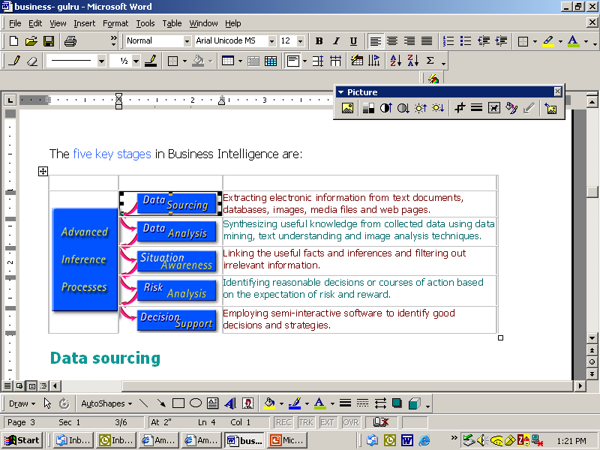
Stages in Business Intelligence

