Slide 1
UNIT 1: Introduction To Databases
Prof. Sambhaji M Shedole
SIT, Lonavala

Slide 2
History of Database Systems
1950s and early 1960s:
Data processing using magnetic tapes for storage
Tapes provided only sequential access
Punched cards for input
Late 1960s and 1970s:
Hard disks allowed direct access to data
Network and hierarchical data models in widespread use
Ted Codd defines the relational data model
Would win the ACM Turing Award for this work
High-performance (for the era) transaction processing
Notes:
2

Slide 3
History (cont.)
1980s:
Research relational prototypes evolve into commercial systems
SQL becomes industrial standard
Parallel and distributed database systems
Object-oriented database systems
1990s:
Large decision support and data-mining applications
Large multi-terabyte data warehouses
Emergence of Web commerce
Early 2000s:
XML and XQuery standards
Automated database administration
Later 2000s:
Giant data storage systems
Google BigTable, Yahoo PNuts, Amazon, ..
Notes:
3

Slide 4
Unit points
Database Concepts
Data Models
Legacy relational model-R-Model
E-R modeling
Normalization
Introduction To SQL

Slide 5
1. Database Concepts
What is Data
Database
DBMS
Purpose/need of DBMS
Architecture
Advantages
Disadvantages
Applications

Slide 6
How you Gather, manage and use information will determine whether you win or lose.
A positive and rational information can lead to extraordinary success.

Slide 7
Processed Data is information
Data:-: Known facts that can be recorded and have an implicit meaning.
Data is collection of facts from which conclusion can be made
In computer world-data is anything in a form suitable for use with a computer.
Information at one level can be a data at another level.
Required for carry transactions in organization.
Eg:- stud_id, marks is data to find grade information.

Slide 8
Database
A database is an organized collection of related information which facilitates easy access and operation.
A shared collection of logically related data and a description of this data designed to meet the information need of an organization.
Example:-StudentDetails db contaions data
Rollno.
Studname
DOB
Address
Phone etc……

Slide 9
Common Databases
Telephone Directory
Yellow pages
Address Book
Phone Books
Ledgers
Employee records in a company

Slide 10
DBMS-Data Base Management System
An organization has to handle a large amount of data. This data must be effectively managed,classified,captured,stored,retrived,maintained,validate,transcripted,transmitted for successful operation.
DBMS is a software system that enables users to define, create, maintain and control access to the database.

Slide 11
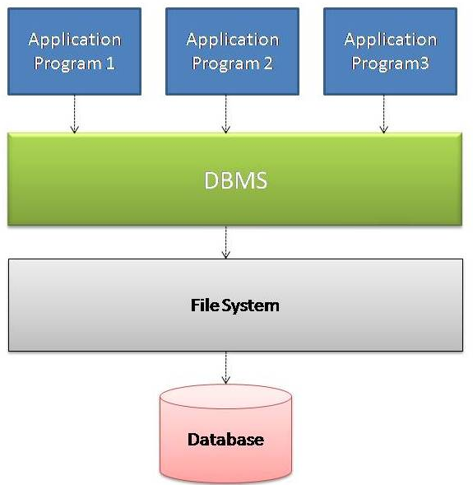
DBMS System

Slide 12
Purpose/need of DBMS
In the early days, database applications were built directly on top of file systems
Drawbacks of using file systems to store data:
Data redundancy and inconsistency
Data redundancy : Same data stored multiple times, duplication of information in different files
Data inconsistency : Several copies of same data my not agree with each other over a time period.
Difficulty in accessing data
Need to write a new program to carry out each new task
Data isolation — multiple files and formats

Slide 13
Purpose/need of DBMS
Integrity problems
Integrity constraints (e.g. account balance > 0) become “buried” in program code rather than being stated explicitly
Hard to add new constraints or change existing ones
Atomicity of updates
Failures may leave database in an inconsistent state with partial updates carried out
Example: Transfer of funds from one account to another should either complete or not happen at all
Concurrent access by multiple users
Concurrent accessed needed for performance
Uncontrolled concurrent accesses can lead to inconsistencies
Example: Two people reading a balance and updating it at the same time
Security problems
Hard to provide user access to some, but not all, data
Database systems offer solutions to all the above problems

Slide 14
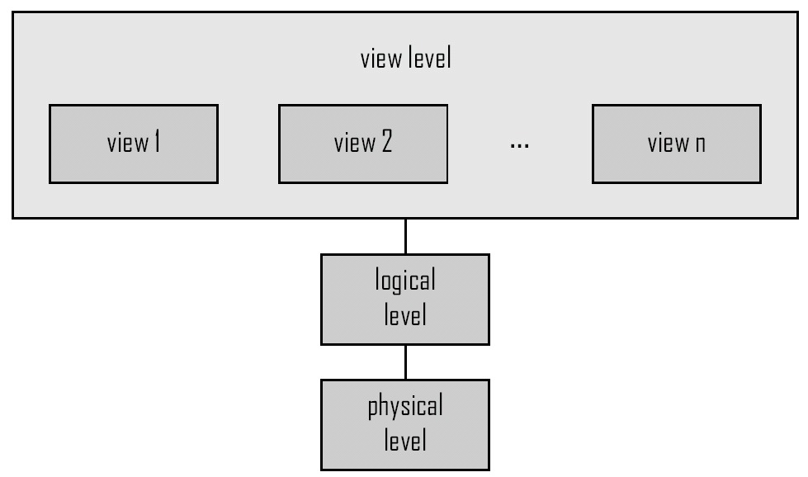
DBMS Architecture
View of required
information
Type definition
Storage blocks

Slide 15
Levels of Abstraction
Physical level: describes how a record (e.g., customer) is stored.
Logical level: describes data stored in database, and the relationships among the data.
type customer = record
customer_id : string; customer_name : string; customer_street : string; customer_city : integer;
end;
View level: application programs hide details of data types. Views can also hide information (such as an employee’s salary) for security purposes

Slide 16
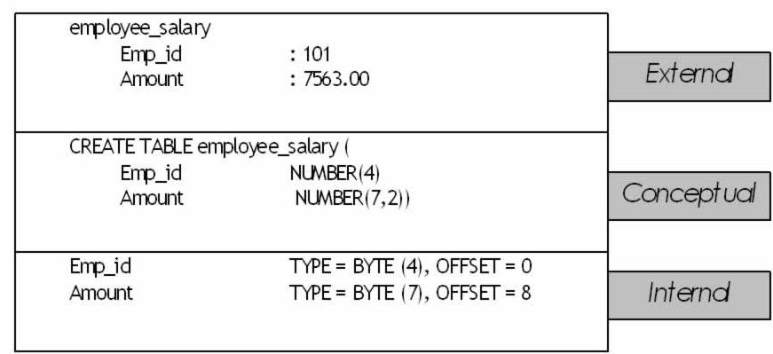
An example of three levels

Slide 17
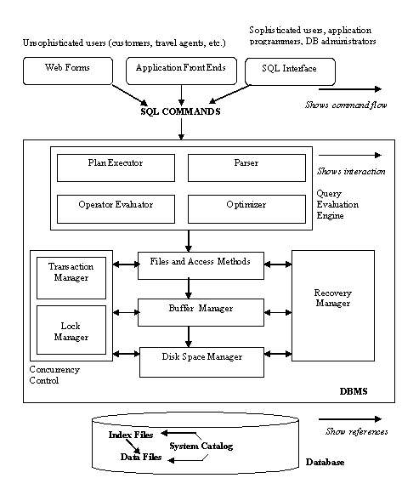
Architecture Of DBMS

Slide 18
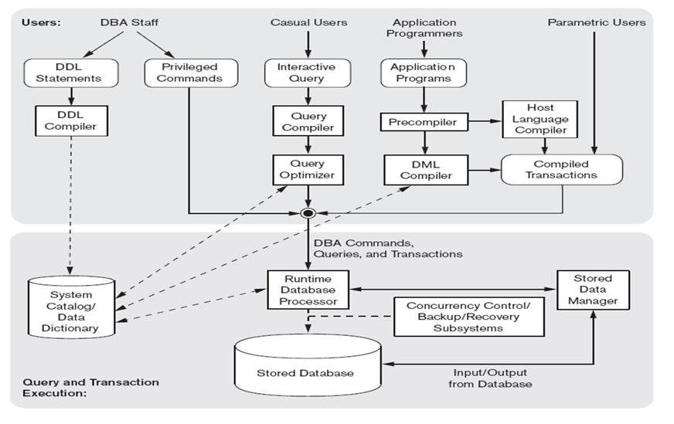
Overall Structure Of DBMS

Slide 19
Advantages
Data independence
Reduced data redundancy
Increased security
Better flexibility
Effective data sharing
Enforces integrity constraints
Enables backup and recovery

Slide 20
Disadvantages
Cost of Hardware and Software
Cost of Data Conversion
Cost of Staff Training
Appointing Technical Staff
Database Damage

Slide 21
Applications
Banking: transactions
Airlines: reservations, schedules
Universities: registration, grades
Sales: customers, products, purchases
Online retailers: order tracking, customized recommendations
Manufacturing: production, inventory, orders, supply chain
Human resources: employee records, salaries, tax deductions

Slide 22
2. Data Models
Define data model
Types
Examples of types

Slide 23
Data Models
A collection of tools for describing
Data
Data relationships
Data semantics
Data constraints
Record Based model
Relational
Network
Hierarchical
Entity-Relationship data model (mainly for database design)
Object-based data models (Object-oriented and Object-relational)
Semistructured data model (XML)
Notes:
23

Slide 24
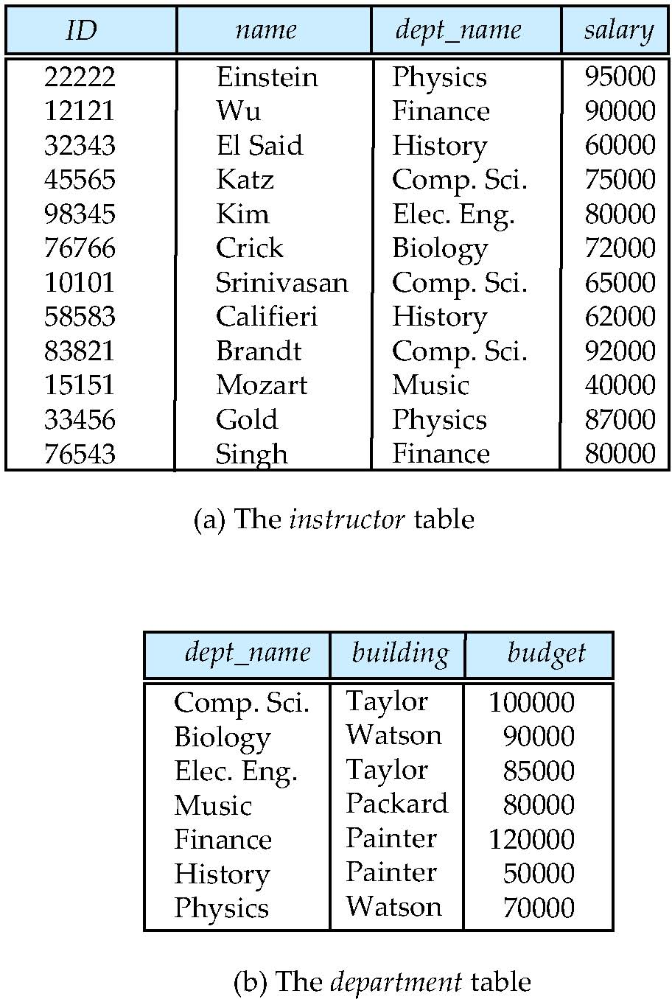
Relational Model
Relational model :-
Rows=tuples columns=attributes
Example of tabular data in the relational model
Columns
Rows
Notes:
24

Slide 25
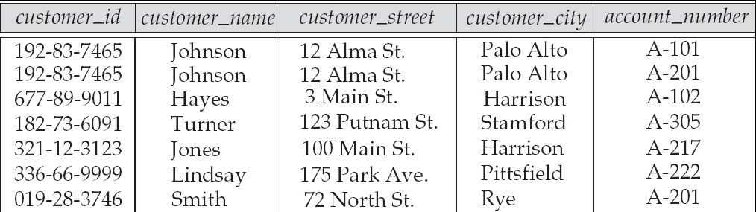
A Sample Relational Database
Attributes
Customer table
Notes:
25

Slide 26
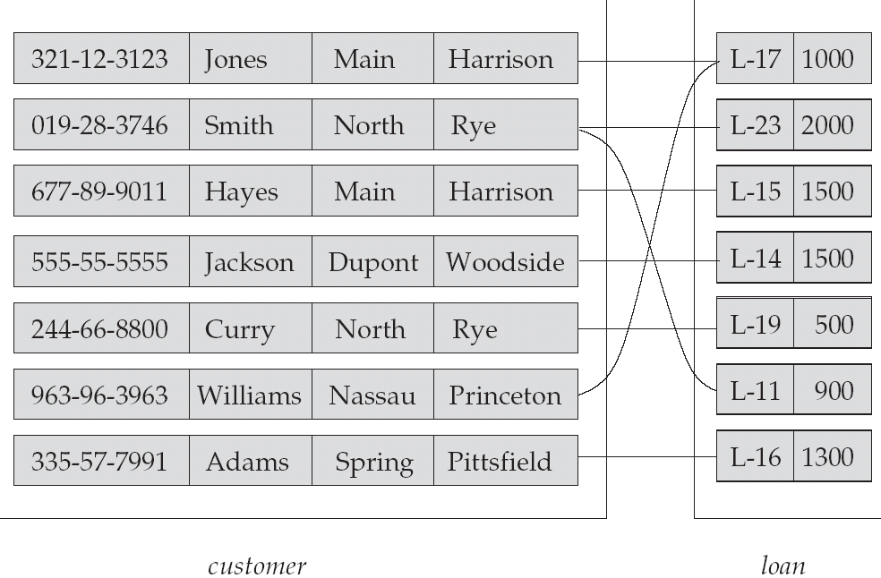
Network model: graph

Slide 27
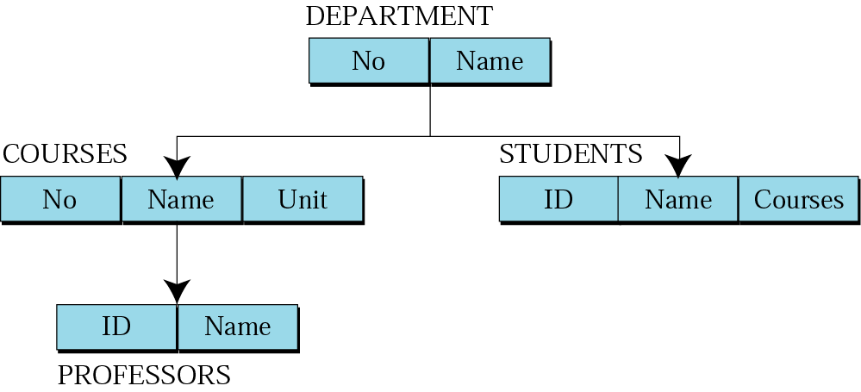
Hierarchical Model-
Parent-child relationship:
one-to-one
one-to-many

Slide 28
Object-Relational Data Models
Extend the relational data model by including object orientation and constructs to deal with added data types.
Allow attributes of tuples to have complex types, including non-atomic values such as nested relations.
Preserve relational foundations, in particular the declarative access to data, while extending modeling power.
Provide upward compatibility with existing relational languages.

Slide 29
3.Legacy Relational model-R-model

Slide 30
4.E-R modeling
E-R model definition
Symbols used in diagram
Example

Slide 31
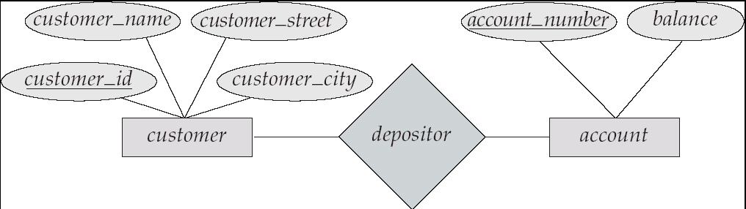
E-R Diagram
Models an enterprise as a collection of entities and relationships
Entity: a “thing” or “object” in the enterprise that is distinguishable from other objects
Described by a set of attributes
Relationship: an association among several entities
Represented diagrammatically by an entity-relationship diagram:

Slide 32
Modeling
An entity set is a set of entities of the same type that share the same properties.
Example: set of all persons, companies, trees, holidays
A database is a collection of entity sets, each of which contains entities of same type
32

Slide 33
Relationship Sets (Cont.)
The association between entity sets is referred to as participation
The entity sets E1, E2, … En participate in the relation
A relationship instance is an E-R schema that represents an association between the named entities in the real world enterprise, that is being modeled.
Example : “Hayes” – “borrows” a loan numbered “ A-102”
33

Slide 34
E-R diagrams Symbol
Entity
Relationship
Attribute
34

Slide 35
E-R diagrams Symbol
Key Attribute
Composite Attribute
Derived Attribute
35

Slide 36
E-R diagrams Symbol
partial
Total
E1
R
E2
E1
1
R
N
E2
Cardinality Ratio
36

Slide 37
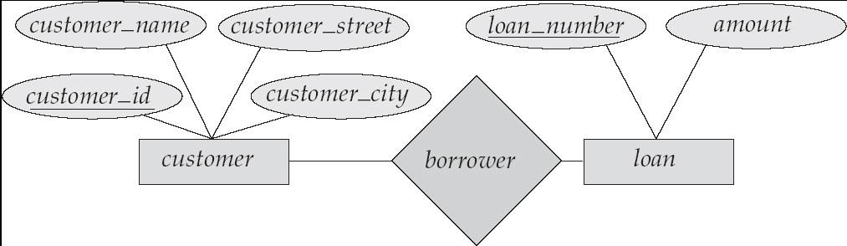
E-R Diagrams
Rectangles represent entity sets.
Diamonds represent relationship sets.
Lines link attributes to entity sets and entity sets to relationship sets.
37

Slide 38
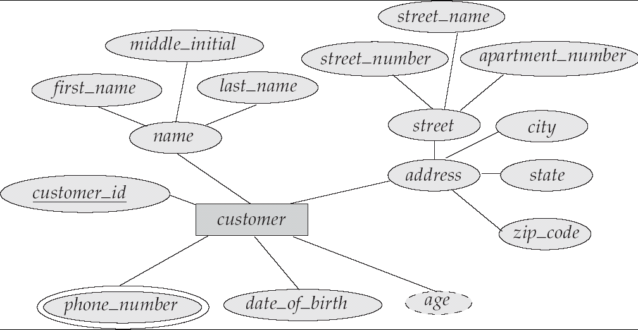
E-R Diagram With Composite, Multivalued, and Derived Attributes
Composite Attribute
Primary Key
Multi-valued attribute
Derived Attribute
38

Slide 39
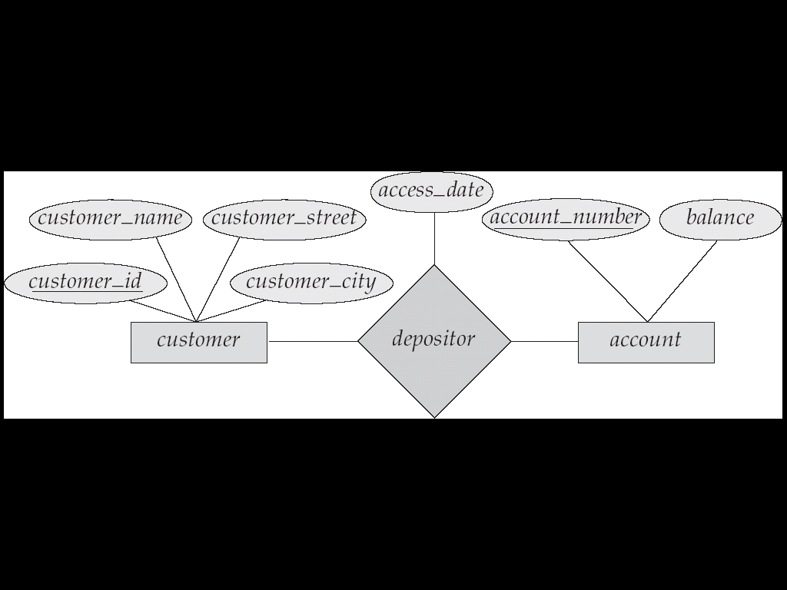
Relationship Sets with Attributes
39

Slide 40
Key Constraints
Superkey of R:
Is a set of attributes SK of R with the following condition:
No two tuples in any valid relation state r(R) will have the same value for SK
That is, for any distinct tuples t1 and t2 in r(R), t1[SK] ≠ t2[SK]
This condition must hold in any valid state r(R)
Key of R:
A "minimal" superkey
That is, a key is a superkey K such that removal of any attribute from K results in a set of attributes that is not a superkey (does not possess the superkey uniqueness property)

Slide 41
Key Constraints(Contd)
Example: Consider the CAR relation schema:
CAR(State, Reg#, SerialNo, Make, Model, Year)
CAR has two keys:
Key1 = {State, Reg#}
Key2 = {SerialNo}
Both are also superkeys of CAR
{SerialNo, Make} is a superkey but not a key.
In general:
Any key is a superkey (but not vice versa)
Any set of attributes that includes a key is a superkey
A minimal superkey is also a key

Slide 42
Key Constraints(Contd)
If a relation has several candidate keys, one is chosen arbitrarily to be the primary key.
The primary key attributes are underlined.
Example: Consider the CAR relation schema:
CAR(State, Reg#, SerialNo, Make, Model, Year)
We chose SerialNo as the primary key
The primary key value is used to uniquely identify each tuple in a relation
Provides the tuple identity
Also used to reference the tuple from another tuple
General rule: Choose as primary key the smallest of the candidate keys (in terms of size)
Not always applicable – choice is sometimes subjective

Slide 43
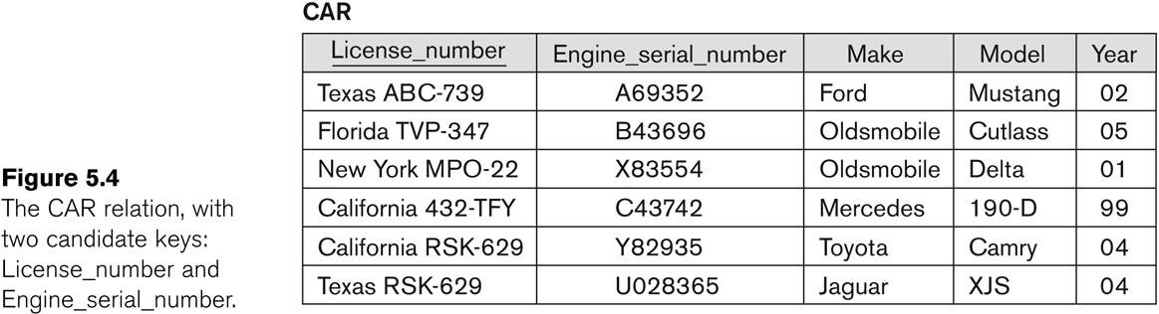
CAR table with two candidate keys chosen as Primary Key

Slide 44
THANK YOU

Slide 45
References
Text Books:
Silberschatz A., Korth H., Sudarshan S., "Database System Concepts", 5th Edition, McGraw Hill Publishers, 2002, ISBN 0-07-120413-X
Elmasri R., Navathe S., "Fundamentals of Database Systems", 4* Edition, Pearson Education, 2003, ISBN 8129702282
Reference Books:
Connally T., Begg C., "Database Systems", 3rd Edition, Pearson Education, 2002, ISBN 81-7808-861-4
Date C., "An Introduction to Database Systems", 7th Edition, Pearson Education, 2002, ISBN 81 -7808-231- 4
SQl,PL/SQL by Evan Bayross
SCOE - DBMS -MPW
45
45

Slide 46
Database Design
The process of designing the general structure of the database:
Logical Design – Deciding on the database schema. Database design requires that we find a “good” collection of relation schemas.
Business decision – What attributes should we record in the database?
Computer Science decision – What relation schemas should we have and how should the attributes be distributed among the various relation schemas?
Physical Design – Deciding on the physical layout of the database
Notes:
46

Slide 47
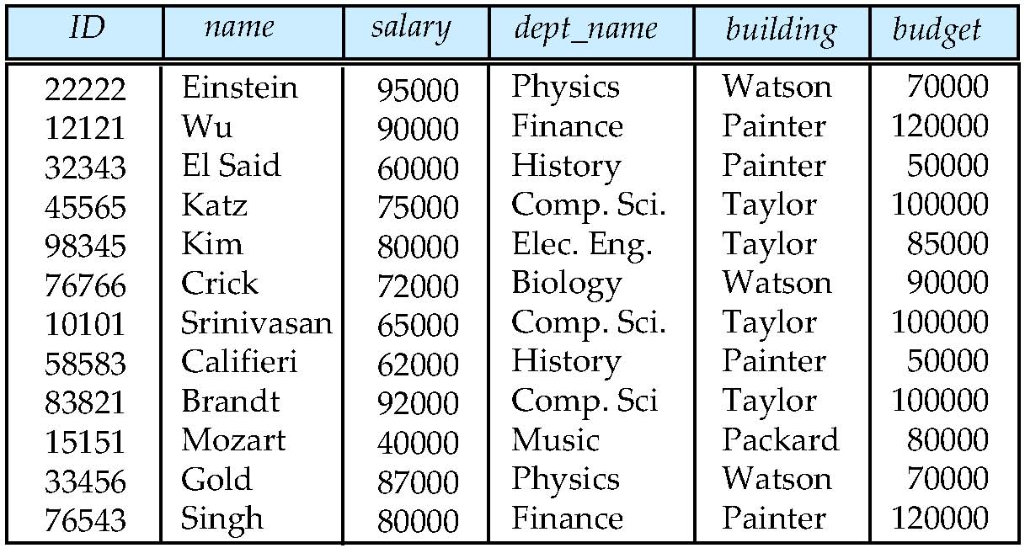
Database Design?
Is there any problem with this design?
Notes:
47

Slide 48
Design Approaches
Normalization Theory
Formalize what designs are bad, and test for them
Entity Relationship Model
Models an enterprise as a collection of entities and relationships
Entity: a “thing” or “object” in the enterprise that is distinguishable from other objects
Described by a set of attributes
Relationship: an association among several entities
Represented diagrammatically by an entity-relationship diagram:
Notes:
48

Slide 49
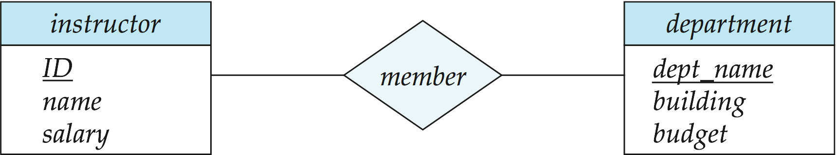
The Entity-Relationship Model
Models an enterprise as a collection of entities and relationships
Entity: a “thing” or “object” in the enterprise that is distinguishable from other objects
Described by a set of attributes
Relationship: an association among several entities
Represented diagrammatically by an entity-relationship diagram:
What happened to dept_name of instructor and student?
Notes:
49

Slide 50
Object-Relational Data Models
Relational model: flat, “atomic” values
Object Relational Data Models
Extend the relational data model by including object orientation and constructs to deal with added data types.
Allow attributes of tuples to have complex types, including non-atomic values such as nested relations.
Preserve relational foundations, in particular the declarative access to data, while extending modeling power.
Provide upward compatibility with existing relational languages.
Notes:
50

Slide 51
XML: Extensible Markup Language
Defined by the WWW Consortium (W3C)
Originally intended as a document markup language not a database language
The ability to specify new tags, and to create nested tag structures made XML a great way to exchange data, not just documents
XML has become the basis for all new generation data interchange formats.
A wide variety of tools is available for parsing, browsing and querying XML documents/data
Notes:
51

Slide 52
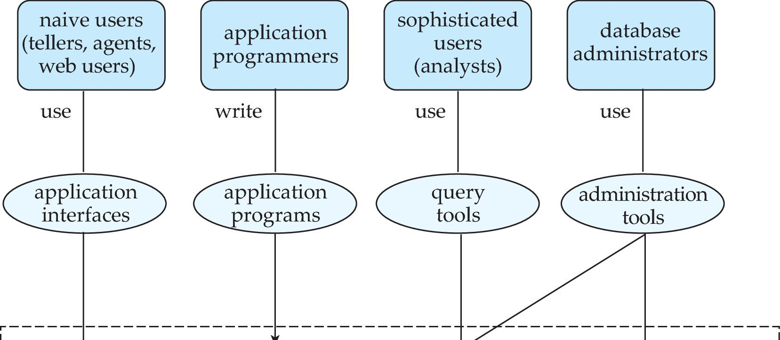
Database Users and Administrators
Database
Notes:
52

Slide 53
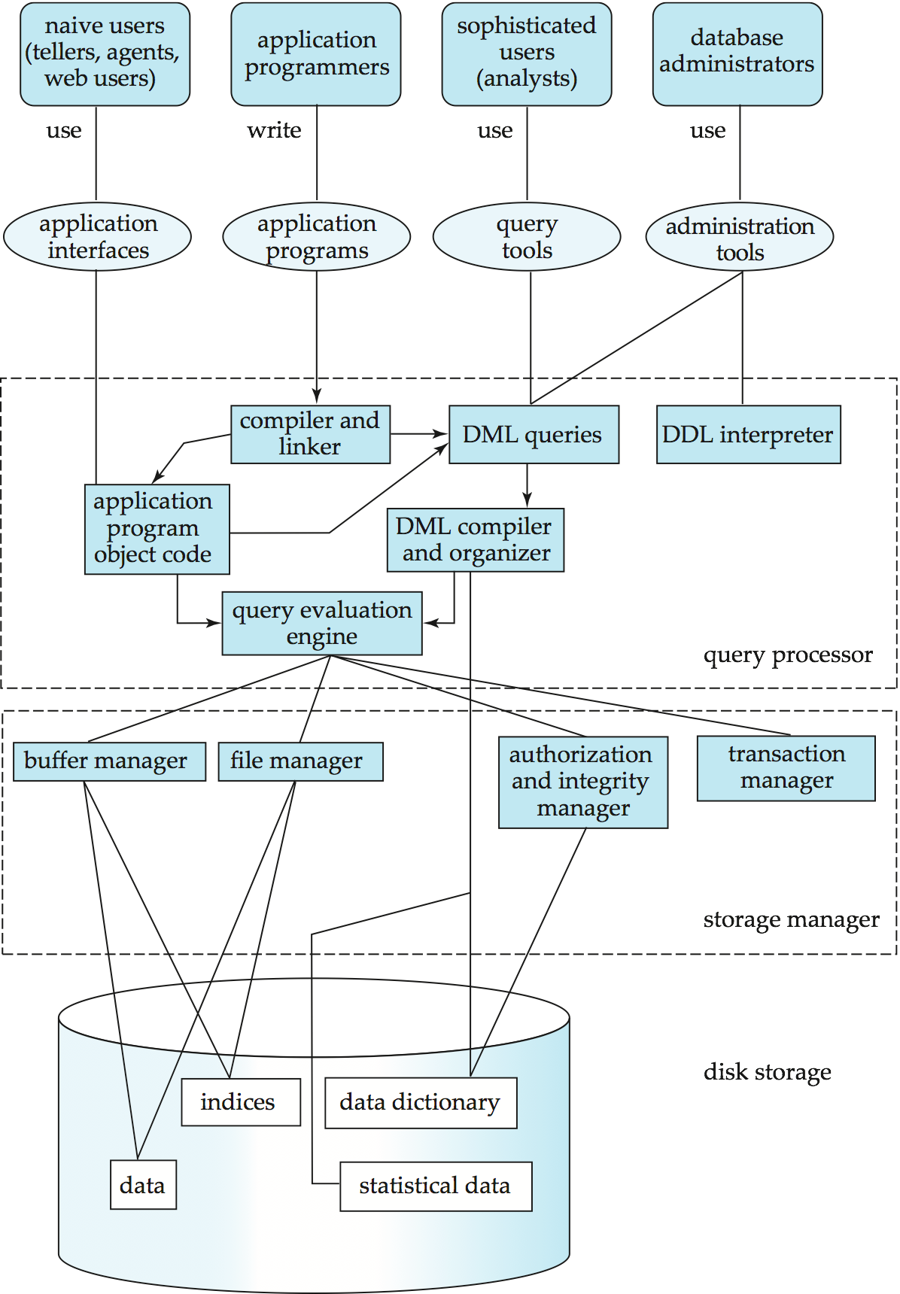
Database System Internals
Notes:
53

Slide 54

Figure 1.02
Notes:
54

Slide 55
Figure 1.04
Notes:
55

Slide 56
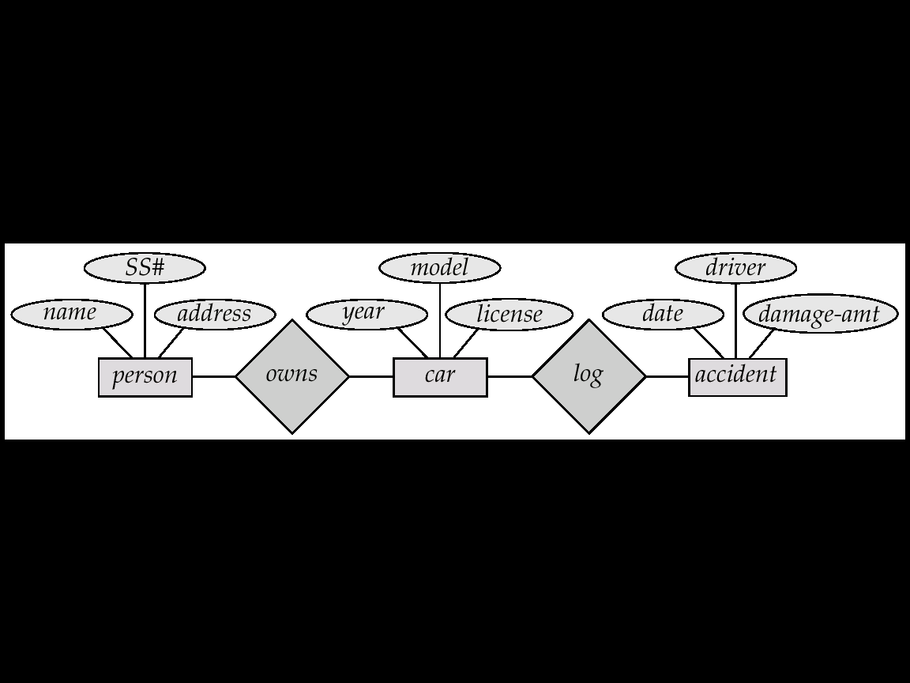
Car-Insurance E-R diagram

Slide 57
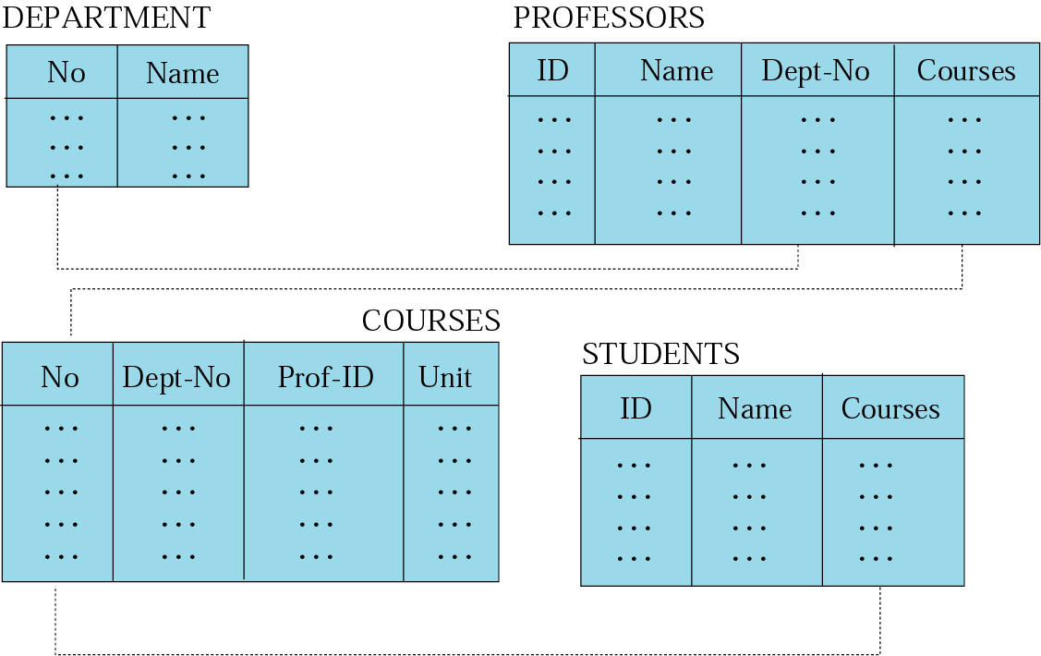
Relational Model Example

Slide 58
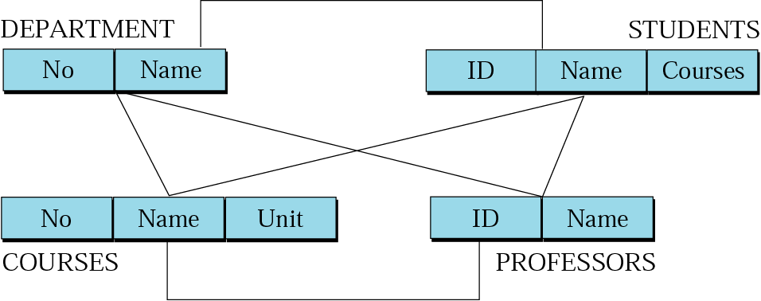
Network Model

Slide 59
Hierarchical Model

