Slide 1
DBMS

Slide 2
UNIT 2: Relational Database Design
Prof. Sambhaji M Shedole
SIT, Lonavala

Slide 3
NORMALIZATION
Basic Concepts:
Functional Dependencies
Normalization For Relational databases up to BCNF

Slide 4
Functional Dependencies
Important concept associated with normalization.
Functional dependency describes relationship between attributes.
For example, if A and B are attributes of relation R, B is functionally dependent on A (denoted A → B), if each value of A in R is associated with exactly one value of B in R.

Slide 5
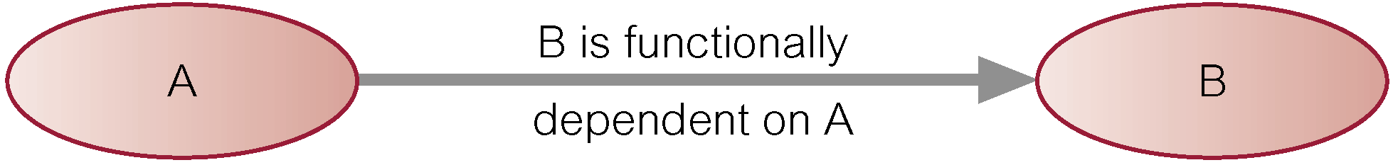
Characteristics of Functional Dependencies
Property of the meaning or semantics of the attributes in a relation.
Diagrammatic representation.
The determinant of a functional dependency refers to the attribute or group of attributes on the left-hand side of the arrow.

Slide 6
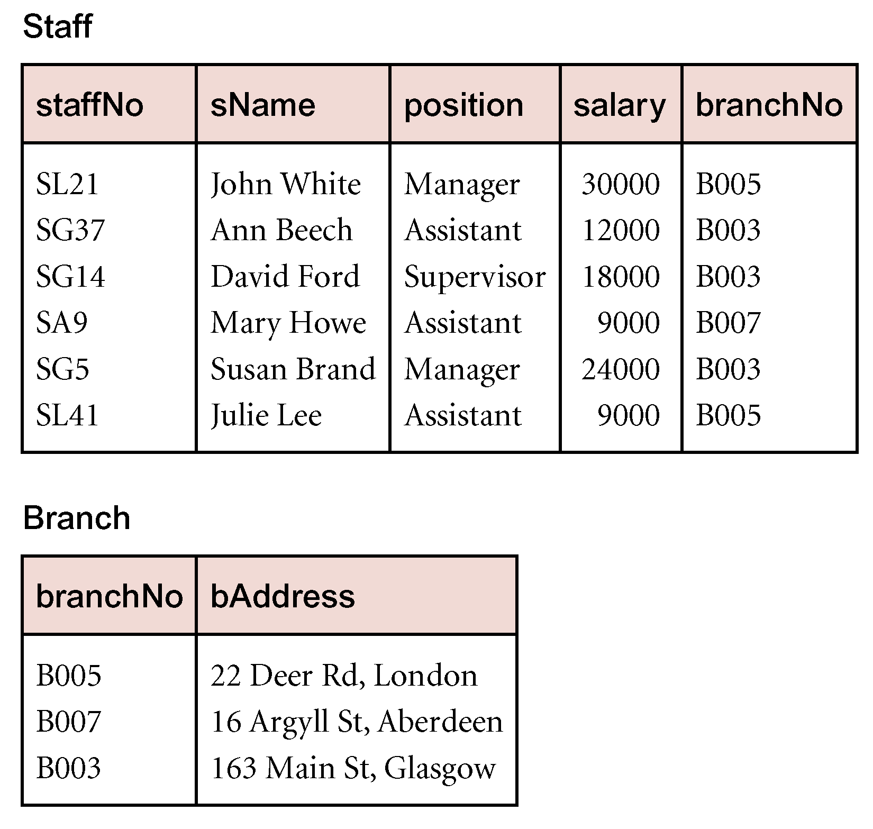
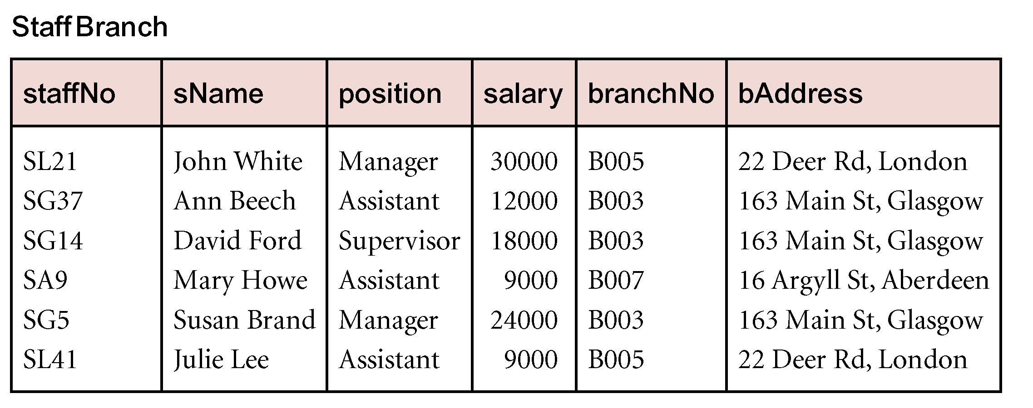
Example

Slide 7
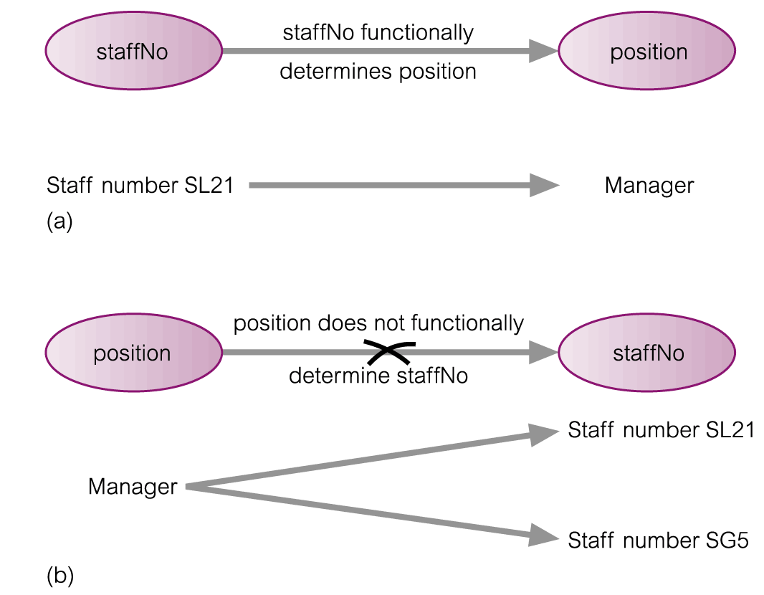
An Example Functional Dependency

Slide 8
Example Functional Dependency that holds for all Time
Consider the values shown in staffNo and sName attributes of the Staff relation
Based on sample data, the following functional dependencies appear to hold.
staffNo → sName
sName → staffNo

Slide 9
Example Functional Dependency that holds for all Time
However, the only functional dependency that remains true for all possible values for the staffNo and sName attributes of the Staff relation is:
staffNo → sName

Slide 10
Characteristics of Functional Dependencies
Determinants should have the minimal number of attributes necessary to maintain the functional dependency with the attribute(s) on the right hand-side.
This requirement is called full functional dependency.

Slide 11
Characteristics of Functional Dependencies
Full functional dependency indicates that if A and B are attributes of a relation, B is fully functionally dependent on A, if B is functionally dependent on A, but not on any proper subset of A.

Slide 12
Example Full Functional Dependency
Exists in the Staff relation
staffNo, sName → branchNo
True - each value of (staffNo, sName) is associated with a single value of branchNo.
However, branchNo is also functionally dependent on a subset of (staffNo, sName), namely staffNo. Example above is a partial dependency.

Slide 13
Characteristics of Functional Dependencies
Main characteristics of functional dependencies used in normalization:
There is a one-to-one relationship between the attribute(s) on the left-hand side (determinant) and those on the right-hand side of a functional dependency.
Holds for all time.
The determinant has the minimal number of attributes necessary to maintain the dependency with the attribute(s) on the right hand-side.

Slide 14
Inference Rules for FDs
Given a set of FDs F, we can infer additional FDs that hold whenever the FDs in F hold
Armstrong's inference rules:
IR1. (Reflexive) If Y subset-of X, then X -> Y
IR2. (Augmentation) If X -> Y, then XZ -> YZ
(Notation: XZ stands for X U Z)
IR3. (Transitive) If X -> Y and Y -> Z, then X -> Z
IR1, IR2, IR3 form a sound and complete set of inference rules
These are rules hold and all other rules that hold can be deduced from these

Slide 15
Transitive Dependencies
Important to recognize a transitive dependency because its existence in a relation can potentially cause update anomalies.
Transitive dependency describes a condition where A, B, and C are attributes of a relation such that if A → B and B → C, then C is transitively dependent on A via B (provided that A is not functionally dependent on B or C).

Slide 16
Example Transitive Dependency
Consider functional dependencies in the StaffBranch relation
staffNo → sName, position, salary, branchNo, bAddress
branchNo → bAddress
Transitive dependency, branchNo → bAddress exists on staffNo via branchNo.

Slide 17
The Process of Normalization
Formal technique for analyzing a relation based on its primary key and the functional dependencies between the attributes of that relation.
Often executed as a series of steps. Each step corresponds to a specific normal form, which has known properties.

Slide 18
NORMALIZATION AND NORMAL FORMS
Normalization: The process of decomposing unsatisfactory "bad" relations by breaking up their attributes into smaller relations
Normal form: Condition using keys and FDs of a relation to certify whether a relation schema is in a particular normal form

Slide 19
The Process of Normalization
Formal technique for analyzing a relation based on its primary key and the functional dependencies between the attributes of that relation.
Often executed as a series of steps. Each step corresponds to a specific normal form, which has known properties.

Slide 20
NORMALIZATION AND NORMAL FORMS
Normalization: The process of decomposing unsatisfactory "bad" relations by breaking up their attributes into smaller relations
Normal form: Condition using keys and FDs of a relation to certify whether a relation schema is in a particular normal form

Slide 21
NORMALIZATION
1NF
a relation in BCNF, is also in 3NF
a relation in 3NF is also in 2NF
a relation in 2NF is also in 1NF
2NF
3NF
BCNF

Slide 22
First Normal Form (1NF)
A table is considered to be in 1NF if all the fields contain
only scalar values (as opposed to list of values).
Example (Not 1NF)
ISBN
Title
AuName
AuPhone
PubName
PubPhone
Price
0-321-32132-1
Balloon
Sleepy, Snoopy, Grumpy
321-321-1111, 232-234-1234, 665-235-6532
Small House
714-000-0000
$34.00
0-55-123456-9
Main Street
Jones, Smith
123-333-3333, 654-223-3455
Small House
714-000-0000
$22.95
0-123-45678-0
Ulysses
Joyce
666-666-6666
Alpha Press
999-999-9999
$34.00
1-22-233700-0
Visual Basic
Roman
444-444-4444
Big House
123-456-7890
$25.00
Author and AuPhone columns are not scalar
Notes:
Having scalar values also means that all instances of a record type must contain the same number of fields.
A table not in first normal form is called un normalized

Slide 23
1NF - Decomposition
Place all items that appear in the repeating group in a new table
Designate a primary key for each new table produced.
Duplicate in the new table the primary key of the table from which the repeating group was extracted or vice versa.
Example (1NF)
ISBN
AuName
AuPhone
0-321-32132-1
Sleepy
321-321-1111
ISBN
Title
PubName
PubPhone
Price
0-321-32132-1
Snoopy
232-234-1234
0-321-32132-1
Balloon
Small House
714-000-0000
$34.00
0-321-32132-1
Grumpy
665-235-6532
0-55-123456-9
Main Street
Small House
714-000-0000
$22.95
0-55-123456-9
Jones
123-333-3333
0-123-45678-0
Ulysses
Alpha Press
999-999-9999
$34.00
0-55-123456-9
Smith
654-223-3455
1-22-233700-0
Visual Basic
Big House
123-456-7890
$25.00
0-123-45678-0
Joyce
666-666-6666
1-22-233700-0
Roman
444-444-4444
Notes:
1. The designated key will be the primary key of the original table concatenated with one or more data items from the new table.
For the first table the primary key is ISBN
For the second table the primary key is ISBN + Author Name

Slide 24
Functional Dependencies
If one set of attributes in a table determines another set of attributes in the table, then the second set of attributes is said to be functionally dependent on the first set of attributes.
Example 1
ISBN
Title
Price
Table Scheme: {ISBN, Title, Price}
Functional Dependencies: {ISBN} → {Title}
{ISBN} → {Price}
0-321-32132-1
Balloon
$34.00
0-55-123456-9
Main Street
$22.95
0-123-45678-0
Ulysses
$34.00
1-22-233700-0
Visual Basic
$25.00
Notes:
Notes to Instructor: Need more rigor in the functional dependencies. With a few examples. May be create a class assignment for functional dependencies.

Slide 25
Functional Dependencies
Example 2
Table Scheme: {PubID, PubName, PubPhone}
Functional Dependencies: {PubId} → {PubPhone}
{PubId} → {PubName}
{PubName, PubPhone} → {PubID}
PubID
PubName
PubPhone
1
Big House
999-999-9999
2
Small House
123-456-7890
3
Alpha Press
111-111-1111
Example 3
AuID
AuName
AuPhone
Table Scheme: {AuID, AuName, AuPhone}
Functional Dependencies: {AuId} → {AuPhone}
{AuId} → {AuName}
{AuName, AuPhone} → {AuID}
1
Sleepy
321-321-1111
2
Snoopy
232-234-1234
3
Grumpy
665-235-6532
4
Jones
123-333-3333
5
Smith
654-223-3455
6
Joyce
666-666-6666
7
Roman
444-444-4444

Slide 26
FD – Example
Database to track reviews of papers submitted to an academic conference. Prospective authors submit papers for review and possible acceptance in the published conference proceedings. Details of the entities
Author information includes a unique author number, a name, a mailing address, and a unique (optional) email address.
Paper information includes the primary author, the paper number, the title, the abstract, and review status (pending, accepted,rejected)
Reviewer information includes the reviewer number, the name, the mailing address, and a unique (optional) email address
A completed review includes the reviewer number, the date, the paper number, comments to the authors, comments to the program chairperson, and ratings (overall, originality, correctness, style, clarity)

Slide 27
FD – Example
Functional Dependencies
AuthNo → AuthName, AuthEmail, AuthAddress
AuthEmail → AuthNo
PaperNo → Primary-AuthNo, Title, Abstract, Status
RevNo → RevName, RevEmail, RevAddress
RevEmail → RevNo
RevNo, PaperNo → AuthComm, Prog-Comm, Date, Rating1, Rating2, Rating3, Rating4, Rating5

Slide 28
Second Normal Form (2NF)
For a table to be in 2NF, there are two requirements
The database is in first normal form
All nonkey attributes in the table must be functionally dependent on the entire primary key
Note: Remember that we are dealing with non-key attributes
Example 1 (Not 2NF)
Scheme → {Title, PubId, AuId, Price, AuAddress}
Key → {Title, PubId, AuId}
{Title, PubId, AuID} → {Price}
{AuID} → {AuAddress}
AuAddress does not belong to a key
AuAddress functionally depends on AuId which is a subset of a key

Slide 29
Second Normal Form (2NF)
Example 2 (Not 2NF)
Scheme → {City, Street, HouseNumber, HouseColor, CityPopulation}
key → {City, Street, HouseNumber}
{City, Street, HouseNumber} → {HouseColor}
{City} → {CityPopulation}
CityPopulation does not belong to any key.
CityPopulation is functionally dependent on the City which is a proper subset of the key
Example 3 (Not 2NF)
Scheme → {studio, movie, budget, studio_city}
Key → {studio, movie}
{studio, movie} → {budget}
{studio} → {studio_city}
studio_city is not a part of a key
studio_city functionally depends on studio which is a proper subset of the key
Notes:
Let us consider the problems with the movie studio database:
Redundancy – City Population is repeated many times
Insertion anomaly – Whenever we add a new record we have to add unnecessary information. We can not add record until we know information about the city population
Deletion anomaly – Whenever we delete a record, useful information is deleted.
Update anomaly – The City Population needs to be updated in more than one location if it changes.

Slide 30
2NF - Decomposition
If a data item is fully functionally dependent on only a part of the primary key, move that data item and that part of the primary key to a new table.
If other data items are functionally dependent on the same part of the key, place them in the new table also
Make the partial primary key copied from the original table the primary key for the new table. Place all items that appear in the repeating group in a new table
Example 1 (Convert to 2NF)
Old Scheme → {Title, PubId, AuId, Price, AuAddress}
New Scheme → {Title, PubId, AuId, Price}
New Scheme → {AuId, AuAddress}
Notes:
If there is a table with columns A,B,C,D with Primary Key (A,B) & D is dependant on A (alone) then to be 2NF, you should reduce (split) tables as:
Table with columns A,D with Primary Key (A)
Table with columns A,B,C with Primary Key (A,B)

Slide 31
2NF - Decomposition
Example 2 (Convert to 2NF)
Old Scheme → {Studio, Movie, Budget, StudioCity}
New Scheme → {Movie, Studio, Budget}
New Scheme → {Studio, City}
Example 3 (Convert to 2NF)
Old Scheme → {City, Street, HouseNumber, HouseColor, CityPopulation}
New Scheme → {City, Street, HouseNumber, HouseColor}
New Scheme → {City, CityPopulation}

Slide 32
Third Normal Form (3NF)
This form dictates that all non-key attributes of a table must be functionally dependent on a candidate key i.e. there can be no interdependencies among non-key attributes.
For a table to be in 3NF, there are two requirements
The table should be second normal form
No attribute is transitively dependent on the primary key
Example (Not in 3NF)
Scheme → {Title, PubID, PageCount, Price }
Key → {Title, PubId}
{Title, PubId} → {PageCount}
{PageCount} → {Price}
Both Price and PageCount depend on a key hence 2NF
Transitively {Title, PubID} → {Price} hence not in 3NF
Notes:
In the Book Schema Third Normal Form is violated since a non-key field is dependent on another non-key field and is transitively dependent on the primary key.

Slide 33
Third Normal Form (3NF)
Example 2 (Not in 3NF)
Scheme → {Studio, StudioCity, CityTemp}
Primary Key → {Studio}
{Studio} → {StudioCity}
{StudioCity} → {CityTemp}
{Studio} → {CityTemp}
Both StudioCity and CityTemp depend on the entire key hence 2NF
CityTemp transitively depends on Studio hence violates 3NF
Example 3 (Not in 3NF)
Scheme → {BuildingID, Contractor, Fee}
Primary Key → {BuildingID}
{BuildingID} → {Contractor}
{Contractor} → {Fee}
{BuildingID} → {Fee}
Fee transitively depends on the BuildingID
Both Contractor and Fee depend on the entire key hence 2NF
BuildingID
Contractor
Fee
100
Randolph
1200
150
Ingersoll
1100
200
Randolph
1200
250
Pitkin
1100
300
Randolph
1200
Notes:
Let us consider the problems with the movie studio database:
Redundancy – City Population is repeated many times
Insertion anomaly – Whenever we add a new record we have to add unnecessary information. We can not add record until we know information about the city population
Deletion anomaly – Whenever we delete a record, useful information is deleted.
Update anomaly – The City Population needs to be updated in more than one location if it changes.

Slide 34
3NF - Decomposition
Move all items involved in transitive dependencies to a new entity.
Identify a primary key for the new entity.
Place the primary key for the new entity as a foreign key on the original entity.
Example 1 (Convert to 3NF)
Old Scheme → {Title, PubID, PageCount, Price }
New Scheme → {PubID, PageCount, Price}
New Scheme → {Title, PubID, PageCount}
Notes:
If there is a table with columns A,B,C with Primary Key (A) and C is dependant on B (B → C) then to be 3NF, the tables become
Table with columns B,C with Primary Key (B)
Table with fields A,B with Primary Key ( A), and Foreign Key (B)

Slide 35
3NF - Decomposition
Example 2 (Convert to 3NF)
Old Scheme → {Studio, StudioCity, CityTemp}
New Scheme → {Studio, StudioCity}
New Scheme → {StudioCity, CityTemp}
Example 3 (Convert to 3NF)
Old Scheme → {BuildingID, Contractor, Fee}
New Scheme → {BuildingID, Contractor}
New Scheme → {Contractor, Fee}
BuildingID
Contractor
Contractor
Fee
100
Randolph
Randolph
1200
150
Ingersoll
Ingersoll
1100
200
Randolph
Pitkin
1100
250
Pitkin
300
Randolph

Slide 36
Boyce-Codd Normal Form (BCNF)
BCNF does not allow dependencies between attributes that belong to candidate keys.
BCNF is a refinement of the third normal form in which it drops the restriction of a non-key attribute from the 3rd normal form.
Third normal form and BCNF are not same if the following conditions are true:
The table has two or more candidate keys
At least two of the candidate keys are composed of more than one attribute
The keys are not disjoint i.e. The composite candidate keys share some attributes
Example 1 - Address (Not in BCNF)
Scheme → {City, Street, ZipCode }
Key1 → {City, Street }
Key2 → {ZipCode, Street}
No non-key attribute hence 3NF
{City, Street} → {ZipCode}
{ZipCode} → {City}
Dependency between attributes belonging to a key
Notes:
The second and third normal forms assume that all attributes not part of the candidate keys depend on the candidate keys but does not deal with dependencies within the keys. BCNF deals with such dependencies.
Under third normal form all non-key columns must be functionally dependent on a candidate key. Under BCNF, even columns that are part of a candidate key must be dependent on another candidate key, if they have a dependency at all.
For most tables third normal form and BCNF are the same. Third normal form does not cover some specific cases for which BCNF was created. Third normal form and BCNF are not same if the following conditions are true:
The table has two or more candidate keys
At least two of the candidate keys are composed of more than one attribute
The keys are not disjoint i.e. The composite candidate keys share some attributes

Slide 37
Boyce Codd Normal Form (BCNF)
Example 2 - Movie (Not in BCNF)
Scheme → {MovieTitle, MovieID, PersonName, Role, Payment }
Key1 → {MovieTitle, PersonName}
Key2 → {MovieID, PersonName}
Both role and payment functionally depend on both candidate keys thus 3NF
{MovieID} → {MovieTitle}
Dependency between MovieID & MovieTitle Violates BCNF
Example 3 - Consulting (Not in BCNF)
Scheme → {Client, Problem, Consultant}
Key1 → {Client, Problem}
Key2 → {Client, Consultant}
No non-key attribute hence 3NF
{Client, Problem} → {Consultant}
{Client, Consultant} → {Problem}
Dependency between attributess belonging to keys violates BCNF
Notes:
A management consulting firm has several clients and consultants. A client can have several problems and the same problem can be an issue for several clients. Each consultant specializes in only one problem type (e. g marketing, production) but several consultants could advise on one problem. For each problem, the client is advised by only one consultant.

Slide 38
BCNF - Decomposition
Place the two candidate primary keys in separate entities
Place each of the remaining data items in one of the resulting entities according to its dependency on the primary key.
Example 1 (Convert to BCNF)
Old Scheme → {City, Street, ZipCode }
New Scheme1 → {ZipCode, Street}
New Scheme2 → {City, Street}
Loss of relation {ZipCode} → {City}
Alternate New Scheme1 → {ZipCode, Street }
Alternate New Scheme2 → {ZipCode, City}
Notes:
If there is a table with columns A,B,C with Primary Key (A) and C is dependant on B (B → C) then to be 3NF, the tables become
Table with columns B,C with Primary Key (B)
Table with fields A,B with Primary Key ( A), and Foreign Key (B)

Slide 39
Decomposition – Loss of Information
If decomposition does not cause any loss of information it is called a lossless decomposition.
If a decomposition does not cause any dependencies to be lost it is called a dependency-preserving decomposition.
Any table scheme can be decomposed in a lossless way into a collection of smaller schemas that are in BCNF form. However the dependency preservation is not guaranteed.
Any table can be decomposed in a lossless way into 3rd normal form that also preserves the dependencies.
3NF may be better than BCNF in some cases
Use your own judgment when decomposing schemas

Slide 40
BCNF - Decomposition
Example 2 (Convert to BCNF)
Old Scheme → {MovieTitle, MovieID, PersonName, Role, Payment }
New Scheme → {MovieID, PersonName, Role, Payment}
New Scheme → {MovieTitle, PersonName}
Loss of relation {MovieID} → {MovieTitle}
New Scheme → {MovieID, PersonName, Role, Payment}
New Scheme → {MovieID, MovieTitle}
We got the {MovieID} → {MovieTitle} relationship back
Example 3 (Convert to BCNF)
Old Scheme → {Client, Problem, Consultant}
New Scheme → {Client, Consultant}
New Scheme → {Client, Problem}

Slide 41
Dr. E. F. Codd's 12 rules (For defining a fully relational database)
A relational database management system (RDBMS) is a database management system (DBMS) that is based on the relational model as introduced by E. F. Codd. Most popular commercial and open source databases currently in use are based on the relational model.
A short definition of an RDBMS may be a DBMS in which data is stored in the form of tables and the relationship among the data is also stored in the form of tables.

Slide 42
E. F. Codd's 12 rules
E.F. Codd, the famous mathematician has introduced 12 rules for the relational model for databases commonly known as Codd's rules. The rules mainly define what is required for a DBMS for it to be considered relational, i.e., an RDBMS. There is also one more rule i.e. Rule00 which specifies the relational model should use the relational way to manage the database. The rules and their description are as follows:-

Slide 43
E. F. Codd's 12 rules
Rule 0: Foundation Rule
A relational database management system should be capable of using its relational facilities (exclusively) to manage the database.
Rule 1: Information Rule
All information in the database is to be represented in one and only one way. This is achieved by values in column positions within rows of tables.

Slide 44
E. F. Codd's 12 rules
Rule 2: Guaranteed Access Rule
All data must be accessible with no ambiguity, that is, Each and every datum (atomic value) is guaranteed to be logically accessible by resorting to a combination of table name, primary key value and column name.
Rule 3: Systematic treatment of null values
Null values (distinct from empty character string or a string of blank characters and distinct from zero or any other number) are supported in the fully relational DBMS for representing missing information in a systematic way, independent of data type.

Slide 45
E. F. Codd's 12 rules
Rule 4: Dynamic On-line Catalog Based on the Relational Model
The database description is represented at the logical level in the same way as ordinary data, so authorized users can apply the same relational language to its interrogation as they apply to regular data. The authorized users can access the database structure by using common language i.e. SQL.

Slide 46
E. F. Codd's 12 rules
Rule 5: Comprehensive Data Sublanguage Rule
A relational system may support several languages and various modes of terminal use. However, there must be at least one language whose statements are expressible, per some well-defined syntax, as character strings and whose ability to support all of the following is comprehensible:
data definition
view definition
data manipulation (interactive and by program)
integrity constraints
authorization
Transaction boundaries (begin, commit, and rollback).

Slide 47
E. F. Codd's 12 rules
Rule 6: View Updating Rule
All views that are theoretically updateable are also updateable by the system.
Rule 7: High-level Insert, Update, and Delete
The system is able to insert, update and delete operations fully. It can also perform the operations on multiple rows simultaneously.

Slide 48
E. F. Codd's 12 rules
Rule 8: Physical Data Independence
Application programs and terminal activities remain logically unimpaired whenever any changes are made in either storage representation or access methods.
Rule 9: Logical Data Independence Application programs and terminal activities remain logically unimpaired when information preserving changes of any kind that theoretically permit unimpairment are made to the base tables.

Slide 49
E. F. Codd's 12 rules
Rule 10: Integrity Independence
Integrity constraints specific to a particular relational database must be definable in the relational data sublanguage and storable in the catalog, not in the application programs.
Rule 11: Distribution Independence The data manipulation sublanguage of a relational DBMS must enable application programs and terminal activities to remain logically unimpaired whether and whenever data are physically centralized or distributed.

Slide 50
E. F. Codd's 12 rules
Rule 12: Non subversion Rule
If a relational system has or supports a low-level (single-record-at-a-time) language, that low-level language cannot be used to subvert or bypass the integrity rules or constraints expressed in the higher-level (multiple-records-at-a-time) relational language.

Slide 51
THANK YOU

