Slide 1
DBMS

Slide 2
Unit 2: THE RELATIONAL DATA MODEL
Basic Concepts:
Relational algebra and calculus
Relational constraints
Introduction To SQL,PL/SQL
Relational database standard
E.R to relational mapping – E.F.Codd rules

Slide 3
History
IBM Sequel language developed as part of System R project at the IBM San Jose Research Laboratory
Renamed Structured Query Language (SQL)
ANSI and ISO standard SQL:
SQL-86, SQL-89, SQL-92
SQL:1999, SQL:2003, SQL:2008
Commercial systems offer most, if not all, SQL-92 features, plus varying feature sets from later standards and special proprietary features.

Slide 4
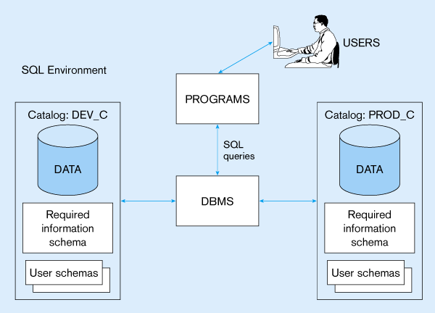

Slide 5
SQL Environment
Catalog
A set of schemas that constitute the description of a database
Schema
The structure that contains descriptions of objects created by a user (base tables, views, constraints)
Data Definition Language (DDL)
Commands that define a database, including creating, altering, and dropping tables and establishing constraints
Data Manipulation Language (DML)
Commands that maintain and query a database
Data Control Language (DCL)
Commands that control a database, including administering privileges and committing data

Slide 6
Domain Types in SQL
String types
CHAR(n) – fixed-length character data, n characters long Maximum length = 2000 bytes
VARCHAR2(n) – variable length character data, maximum 4000 bytes
LONG – variable-length character data, up to 4GB. Maximum 1 per table
Numeric types
NUMBER(p,q) – general purpose numeric data type
INTEGER(p) – signed integer, p digits wide
FLOAT(p) – floating point in scientific notation with p binary digits precision
Date/time type
DATE – fixed-length date/time in dd-mm-yy form

Slide 7
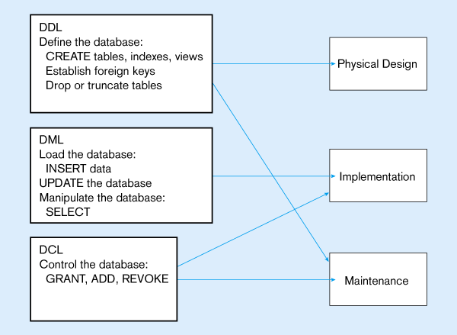

Slide 8
DDL,DML,DCL COMMANDS
DDL Commands: Create, Alter,Drop, Truncate, Rename
DML Commands: Insert,Update,Delete,Select
DCL Commands: Grant,Revoke.

Slide 9
DDL
The SQL data-definition language (DDL) allows the specification of information about relations, including:
The schema for each relation.
The domain of values associated with each attribute.
Integrity constraints

Slide 10
SQL Database Definition
Data Definition Language (DDL)
Major CREATE statements:
CREATE SCHEMA – defines a portion of the database owned by a particular user
CREATE TABLE – defines a table and its columns
CREATE VIEW – defines a logical table from one or more views

Slide 11
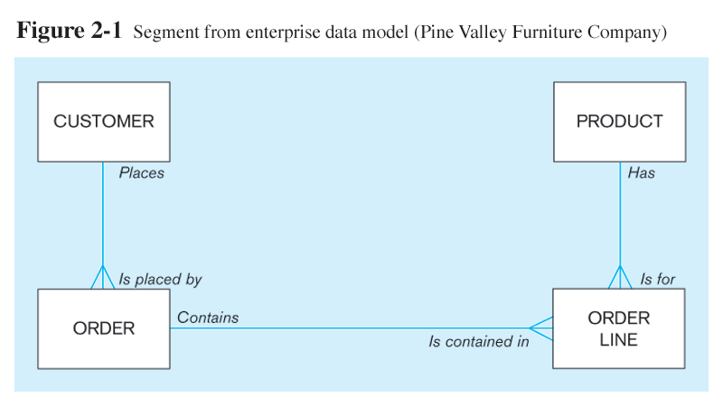
The following slides create tables for this enterprise data model

Slide 12
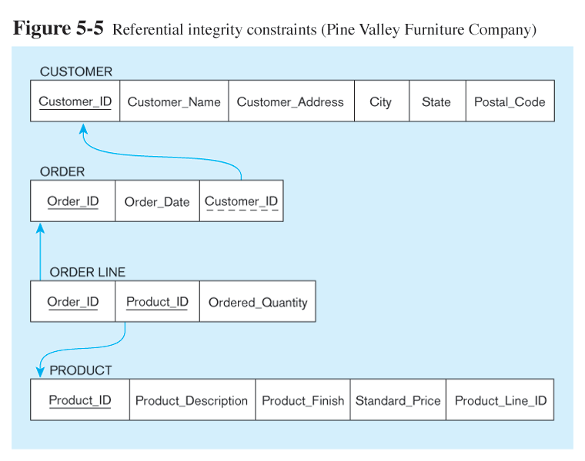
Relational Data Model

Slide 13
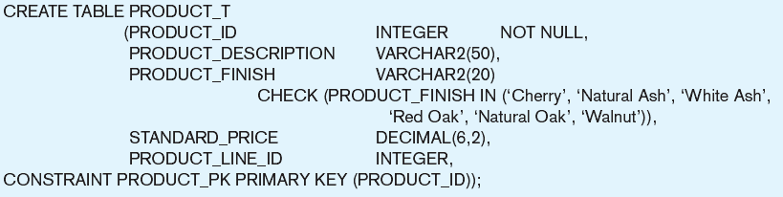
Create PRODUCT table
Non-nullable specification
Primary keys can never have NULL values
Identifying primary key

Slide 14
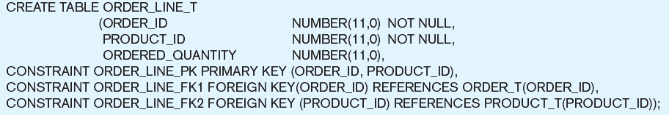
Create order table
Non-nullable specifications
Primary key
Some primary keys are composite – composed of multiple attributes

Slide 15
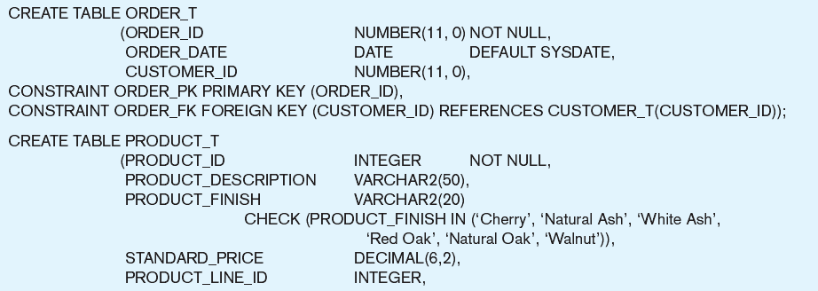
Controlling the values in attributes
Default value
Domain constraint

Slide 16
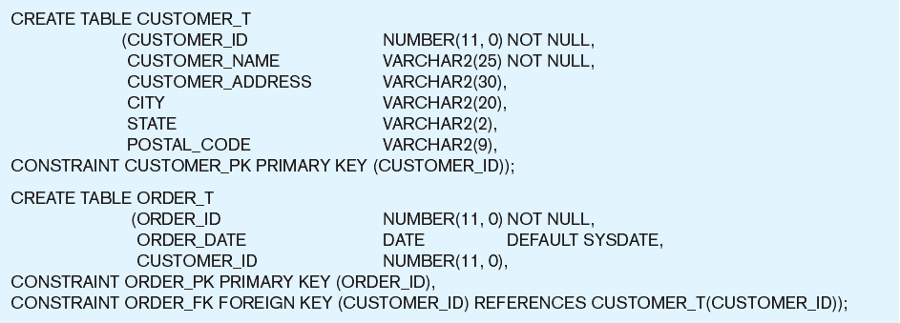
Identifying foreign keys and establishing relationships
Primary key of parent table
Foreign key of dependent table

Slide 17
Data Integrity Controls
Referential integrity – constraint that ensures that foreign key values of a table must match primary key values of a related table in 1:M relationships
Restricting:
Deletes of primary records
Updates of primary records
Inserts of dependent records

Slide 18
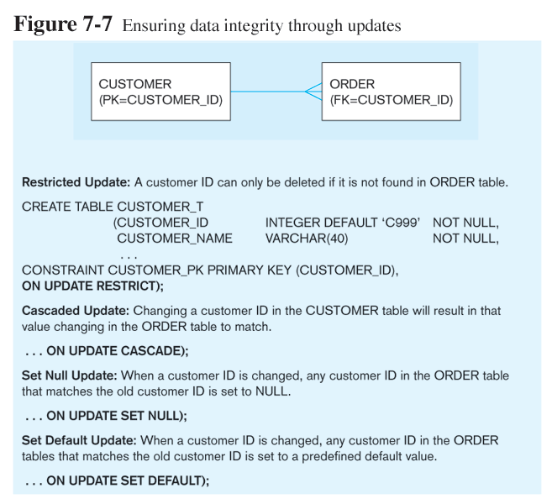

Slide 19
Using and Defining Views
Views provide users controlled access to tables
Base Table – table containing the raw data
Dynamic View
A “virtual table” created dynamically upon request by a user
No data actually stored; instead data from base table made available to user
Based on SQL SELECT statement on base tables or other views
Materialized View
Copy or replication of data
Data actually stored
Must be refreshed periodically to match the corresponding base tables

Slide 20
Sample CREATE VIEW
CREATE VIEW EXPENSIVE_STUFF_V AS
SELECT PRODUCT_ID, PRODUCT_NAME, UNIT_PRICE
FROM PRODUCT_T
WHERE UNIT_PRICE >300
WITH CHECK_OPTION;
View has a name
View is based on a SELECT statement
CHECK_OPTION works only for updateable views and prevents updates that would create rows not included in the view

Slide 21
Advantages of Views
Simplify query commands
Assist with data security (but don't rely on views for security, there are more important security measures)
Enhance programming productivity
Contain most current base table data
Use little storage space
Provide customized view for user
Establish physical data independence

Slide 22
Disadvantages of Views
Use processing time each time view is referenced
May or may not be directly updateable

Slide 23
Changing and Removing Tables(ddl commands)
ALTER TABLE statement allows you to change column specifications:
ALTER TABLE CUSTOMER_T ADD (TYPE VARCHAR(2))
DROP TABLE statement allows you to remove tables from your schema:
DROP TABLE CUSTOMER_T

Slide 24
DML commands
Insert Statement
Adds data to a table
Ex: Inserting a record with all fields
INSERT INTO CUSTOMER_T VALUES (001, ‘Contemporary Casuals’, 1355 S. Himes Blvd.’, ‘Gainesville’, ‘FL’, 32601);

Slide 25
Delete Statement
Removes rows from a table
Delete certain rows
DELETE FROM CUSTOMER_T WHERE STATE = ‘HI’;
Delete all rows
DELETE FROM CUSTOMER_T;

Slide 26
Update Statement
Modifies data in existing rows
UPDATE PRODUCT_T SET UNIT_PRICE = 775 WHERE PRODUCT_ID = 7;

Slide 27
SELECT Statement
Used for queries on single or multiple tables
Clauses of the SELECT statement:
SELECT
List the columns (and expressions) that should be returned from the query
FROM
Indicate the table(s) or view(s) from which data will be obtained
WHERE
Indicate the conditions under which a row will be included in the result
GROUP BY
Indicate columns to group the results
HAVING
Indicate the conditions under which a group will be included
ORDER BY
Sorts the result according to specified columns

Slide 28
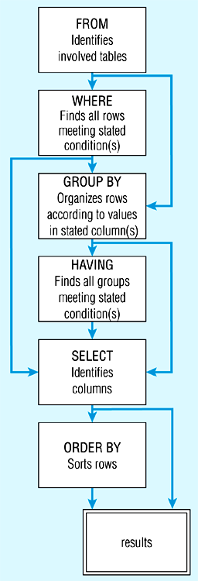
SQL statement processing order

Slide 29
SELECT Example
Find products with standard price less than $275
SELECT PRODUCT_NAME, STANDARD_PRICE
FROM PRODUCT_V
WHERE STANDARD_PRICE < 275;

Slide 30
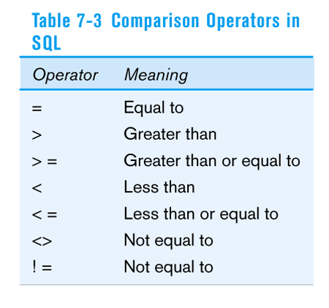

Slide 31
SELECT Example using Alias
Alias is an alternative column or table name
SELECT CUST.CUSTOMER AS NAME, CUST.CUSTOMER_ADDRESS
FROM CUSTOMER_V CUST
WHERE NAME = ‘Home Furnishings’;

Slide 32
SELECT Example Using a Function
Using the COUNT aggregate function to find totals
Aggregate functions: SUM(), MIN(), MAX(), AVG(), COUNT()
SELECT COUNT(*) FROM ORDER_LINE_V
WHERE ORDER_ID = 1004;

Slide 33
SELECT Example – Boolean Operators
AND, OR, and NOT Operators for customizing conditions in WHERE clause
SELECT PRODUCT_DESCRIPTION, PRODUCT_FINISH, STANDARD_PRICE
FROM PRODUCT_V
WHERE (PRODUCT_DESCRIPTION LIKE ‘%Desk’
OR PRODUCT_DESCRIPTION LIKE ‘%Table’)
AND UNIT_PRICE > 300;
Note: the LIKE operator allows you to compare strings using wildcards. For example, the % wildcard in ‘%Desk’ indicates that all strings that have any number of characters preceding the word “Desk” will be allowed

Slide 34
SELECT Example – Sorting Results with the ORDER BY Clause
Sort the results first by STATE, and within a state by CUSTOMER_NAME
SELECT CUSTOMER_NAME, CITY, STATE
FROM CUSTOMER_V
WHERE STATE IN (‘FL’, ‘TX’, ‘CA’, ‘HI’)
ORDER BY STATE, CUSTOMER_NAME;
Note: the IN operator in this example allows you to include rows whose STATE value is either FL, TX, CA, or HI. It is more efficient than separate OR conditions

Slide 35
SELECT Example – Categorizing Results Using the GROUP BY Clause
SELECT STATE, COUNT(STATE)
FROM CUSTOMER_V
GROUP BY STATE;
Note: you can use single-value fields with aggregate functions if they are included in the GROUP BY clause

Slide 36
SELECT Example – Qualifying Results by Categories Using the HAVING Clause
For use with GROUP BY
SELECT STATE, COUNT(STATE)
FROM CUSTOMER_V
GROUP BY STATE
HAVING COUNT(STATE) > 1;
Like a WHERE clause, but it operates on groups (categories), not on individual rows. Here, only those groups with total numbers greater than 1 will be included in final result

Slide 37
DCL Commands
Data Control Language(DCL) is used to control privilege in Database. To perform any operation in the database, such as for creating tables, sequences or views we need privileges.
DCL defines two commands,
Grant : Gives user access privileges to database.
Revoke : Take back permissions from user.

Slide 38
Dcl commands
Syntax To Allow a User to create Table
grant create tableto username;
Synatax To Grant all privilege to a User
grant sysdba to username
Synatx To take back Permissions
revoke create table from username

Slide 39
joins
SQL Join is used to fetch data from two or more tables, which is joined to appear as single set of data. SQL Join is used for combining column from two or more tables by using values common to both tables.
Join Keyword is used in SQL queries for joining two or more tables. Minimum required condition for joining table,is(n-1) where n, is number of tables. A table can also join to itself known as, Self Join.

Slide 40
Types of join
The following are the types of JOIN that we can use in SQL.
Inner
Outer
Left
Right

Slide 41
Cross JOIN or Cartesian Product
This type of JOIN returns the cartesian product of rows of from the tables in Join. It will return a table which consists of records which combines each row from the first table with each row of the second table.
Cross JOIN Syntax is,
SELECT column-name-list from table-name1 CROSS JOIN table-name2;

Slide 42
Cross JOIN or Cartesian Product
Syntax:
SELECT column-name-list from table-name1 CROSS JOIN table-name2;
Ex: The class table,
ID | NAME
1 | abhi
2 | adam
4 | alex
The class_info table,
ID | NAME
1 | abhi
2 | adam
4 | alex

Slide 43
Cross join
Cross JOIN query will be,
SELECT * from class, cross JOIN class_info;
The result table will look like,
ID | NAME | ID | Address
1 | abhi | 1 | DELHI
2 | adam | 1 | DELHI
4 | alex | 1 | DELHI
1 | abhi | 2 | MUMBAI
2 | adam | 2 | MUMBAI
4 | alex | 2 | MUMBAI
1 | abhi | 3 | CHENNAI
2 | adam | 3 | CHENNAI
4 | alex | 3 | CHENNAI

Slide 44
INNER Join or EQUI Join
This is a simple JOIN in which the result is based on matched data as per the equality condition specified in the query.
Inner Join Syntax is,
SELECT column-name-list from table-name1 INNER JOIN table-name2 WHERE table-name1.column-name = table-name2.column-name;

Slide 45
Example for INNER Join
The class table,
ID | NAME
1 | abhi
2 | adam
3 | alex
4 | anu
The class_info table,
ID | Address
1 | DELHI
2 | MUMBAI
3 | CHENNAI
ID | Address

Slide 46
Example for INNER Join
Inner JOIN query will be,
SELECT * from class INNER JOIN class_info on class.id = class_info.id;
The result table will look like,
ID | NAME | ID | Address
1 | abhi | 1 | DELHI
2 | adam | 2 | MUMBAI
3 | alex | 3 | CHENNAI

Slide 47
Natural JOIN
Natural Join is a type of Inner join which is based on column having same name and same datatype present in both the tables to be joined.
Natural Join Syntax is,
SELECT * from table-name1 NATURAL JOIN table-name2;

Slide 48
Natural join
The class table,
The class_info table,
ID | NAME
1 | abhi
2 | adam
3 | alex
4 | anu
ID | Address
1 | DELHI
2 | MUMBAI
3 | CHENNAI

Slide 49
Example of natural join
Natural join query will be,
SELECT * from class NATURAL JOIN class_info;
The result table will look like,
ID | NAME | Address
1 | abhi | DELHI
2 | adam | MUMBAI
3 | alex | CHENNAI
Note: In the above example, both the tables being joined have ID column(same name and same data type), hence the records for which value of ID matches in both the tables will be the result of Natural Join of these two tables.

Slide 50
Outer join
Outer Join is based on both matched and unmatched data. Outer Joins subdivide further into,
Left Outer Join
Right Outer Join
Full Outer Join

Slide 51
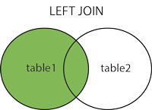
Left outer join
The left outer join returns a result table with the matched data of two tables then remaining rows of the left table and null for the right table's column.
Left Outer Join syntax is,
SELECT column-name-list from table-name1 LEFT OUTER JOIN table-name2 on table-name1.column-name = table-name2.column-name; (or)
select column-name-list from table-name1, table-name2 on table-name1.column-name = table-name2.column-name(+);

Slide 52
Example of Left Outer Join
The class table,
ID | NAME
1 | abhi
2 | adam
3 | alex
4 | anu
5 | ashish
The class_info table,
ID | Address
1 | DELHI
2 | MUMBAI
3 | CHENNAI
7 | NOIDA
8 | PANIPAT

Slide 53
Example of Left Outer Join
Left Outer Join query will be,
SELECT * FROM class LEFT OUTER JOIN class_info ON (class.id=class_info.id);
The result table will look like,
ID | NAME | ID | Address
1 | abhi | 1 | DELHI
2 | adam | 2 | MUMBAI
3 | alex | 3 | CHENNAI
4 | anu | null | null
5 | ashish | null | null

Slide 54
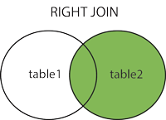
Right Outer Join
The right outer join returns a result table with the matched data of two tables then remaining rows of the right table and null for the left table's columns.
Right Outer Join Syntax is,
select column-name-list from table-name1 RIGHT OUTER JOIN table-name2 on table-name1.column-name = table-name2.column-name; (or)
select column-name-list from table-name1, table-name2 on table-name1.column-name(+) = table-name2.column-name;

Slide 55
Example of Right Outer Join
The class table,
ID | NAME
1 | abhi
2 | adam
3 | alex
4 | anu
5 | ashish
The class_info table,
ID | Address
1 | DELHI
2 | MUMBAI
3 | CHENNAI
7 | NOIDA
8 | PANIPAT

Slide 56
Example of Right Outer Join
Right Outer Join query will be,
SELECT * FROM class RIGHT OUTER JOIN class_info on (class.id=class_info.id);
The result table will look like,
ID | NAME | ID | Address
1 | abhi | 1 | DELHI
2 | adam | 2 | MUMBAI
3 | alex | 3 | CHENNAI
null | null | 7 | NOIDA
null | null | 8 | PANIPAT

Slide 57
Full Outer Join
The full outer join returns a result table with the matched data of two table then remaining rows of both left table and then the right table.
Full Outer Join Syntax is,
select column-name-list from table-name1 FULL OUTER JOIN table-name2 on table-name1.column-name = table-name2.column-name;

Slide 58
Example of Full outer join
The class table,
ID | NAME
1 | abhi
2 | adam
3 | alex
4 | anu
5 | ashish
The class_info table,
ID | Address
1 | DELHI
2 | MUMBAI
3 | CHENNAI
7 | NOIDA
8 | PANIPAT

Slide 59
Example of Full outer join
Full Outer Join query will be like,
ID | NAME | ID | Address
1 | abhi | 1 | DELHI
2 | adam | 2 | MUMBAI
3 | alex | 3 | CHENNAI
4 | anu | null | null
5 | ashish | null | null
null | null | 7 | NOIDA
null | null | 8 | PANIPAT

Slide 60
Thank You

