Slide 1
UNIT 5 Parallel and Distributed Databases
Prof. S M Shedole
Sinhgad Institute of Technology, Lonavala

Slide 2
Contents
Introduction to Database Architectures:
Multi-user DBMS Architectures,
Case study- Oracle Architecture.
Parallel Databases: Speedup and Scale up,
Architectures of Parallel Databases.

Slide 3
Contents
Distributed Databases:
Architecture of Distributed Databases,
Distributed Database Design,
Distributed Data Storage,
Distributed Transaction: Basics,
Failure modes, Commit Protocols,
Concurrency Control in Distributed Database.

Slide 4
Centralized Systems
Run on a single computer system and do not interact with other computer systems.
General-purpose computer system: one to a few CPUs and a number of device controllers that are connected through a common bus that provides access to shared memory.
Single-user system (e.g., personal computer or workstation): desk-top unit, single user, usually has only one CPU and one or two hard disks; the OS may support only one user.
Multi-user system: more disks, more memory, multiple CPUs, and a multi-user OS. Serve a large number of users who are connected to the system vie terminals. Often called server systems.

Slide 5
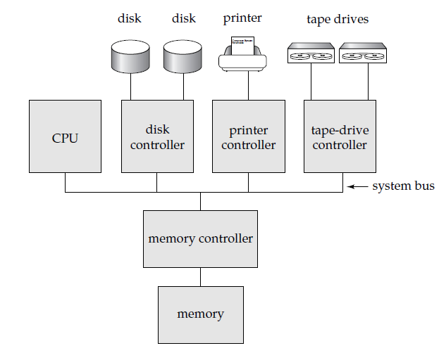
Centralized System

Slide 6
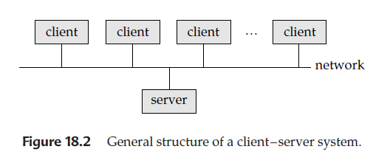
Client-Server Systems
Server systems satisfy requests generated at m client systems, whose general structure is shown below:

Slide 7
Client-Server Systems (Cont.)
Database functionality can be divided into:
Back-end: manages access structures, query evaluation and optimization, concurrency control and recovery.
Front-end: consists of tools such as forms, report-writers, and graphical user interface facilities.
The interface between the front-end and the back-end is through SQL or through an application program interface.

Slide 8
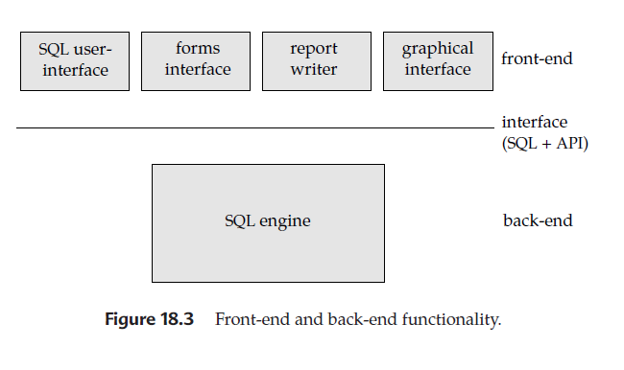
Client-Server Systems (Cont.)

Slide 9
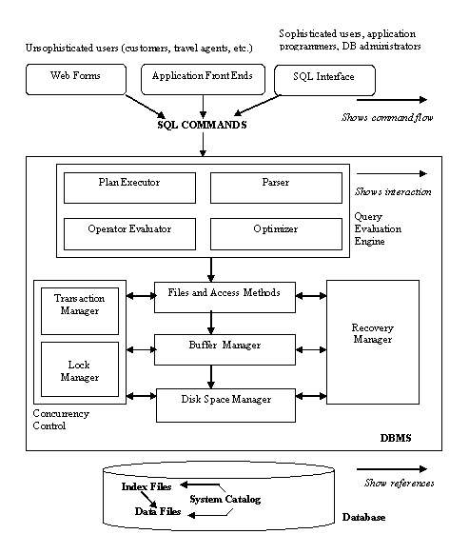
Architecture Of DBMS

Slide 10
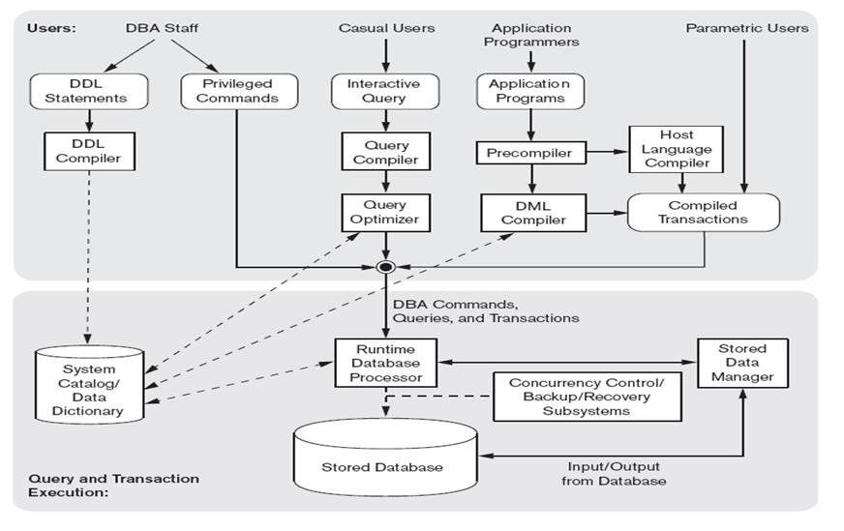
Overall Structure Of DBMS

Slide 11
Parallel Systems
Parallel database systems consist of multiple processors and multiple disks connected by a fast interconnection network.
A coarse-grain parallel machine consists of a small number of powerful processors
A massively parallel or fine grain parallel machine utilizes thousands of smaller processors.
Two main performance measures:
throughput --- the number of tasks that can be completed in a given time interval
response time --- the amount of time it takes to complete a single task from the time it is submitted

Slide 12
Speed-Up and Scale-Up
Speedup: a fixed-sized problem executing on a small system is given to a system which is N-times larger.
Measured by:
speedup = small system elapsed time
large system elapsed time
Speedup is linear if equation equals N.
Scaleup: increase the size of both the problem and the system
N-times larger system used to perform N-times larger job
Measured by:
scaleup = small system small problem elapsed time
big system big problem elapsed time
Scale up is linear if equation equals 1.

Slide 13
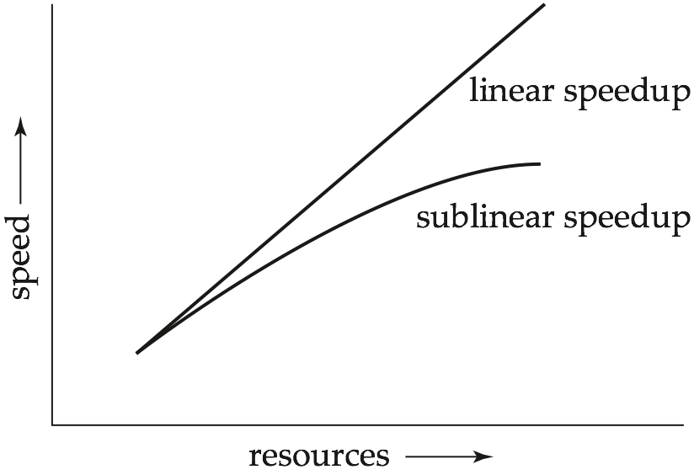
Speedup

Slide 14
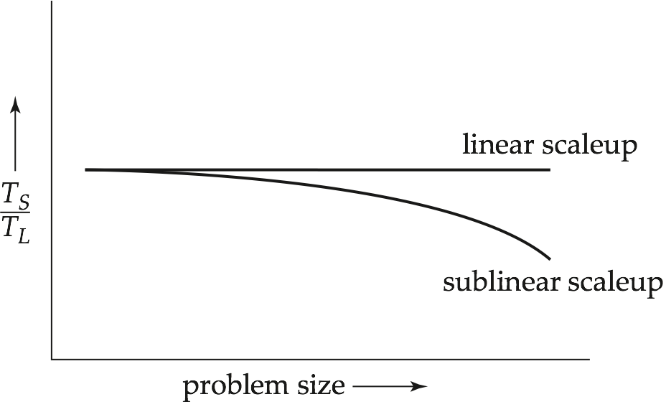
Scaleup

Slide 15
Batch and Transaction Scaleup
Batch scaleup:
A single large job; typical of most decision support queries and scientific simulation.
Use an N-times larger computer on N-times larger problem.
Transaction scaleup:
Numerous small queries submitted by independent users to a shared database; typical transaction processing and timesharing systems.
N-times as many users submitting requests (hence, N-times as many requests) to an N-times larger database, on an N-times larger computer.
Well-suited to parallel execution.

Slide 16
Factors Limiting Speedup and Scaleup
Speedup and scaleup are often sublinear due to:
Startup costs: Cost of starting up multiple processes may dominate computation time, if the degree of parallelism is high.
Interference: Processes accessing shared resources (e.g., system bus, disks, or locks) compete with each other, thus spending time waiting on other processes, rather than performing useful work.
Skew: Increasing the degree of parallelism increases the variance in service times of parallely executing tasks. Overall execution time determined by slowest of parallely executing tasks.

Slide 17
Interconnection Network Architectures
Bus. System components send data on and receive data from a single communication bus;
Does not scale well with increasing parallelism.
Mesh. Components are arranged as nodes in a grid, and each component is connected to all adjacent components
Communication links grow with growing number of components, and so scales better.
But may require 2√n hops to send message to a node (or √n with wraparound connections at edge of grid).
Hypercube. Components are numbered in binary; components are connected to one another if their binary representations differ in exactly one bit.
n components are connected to log(n) other components and can reach each other via at most log(n) links; reduces communication delays.

Slide 18
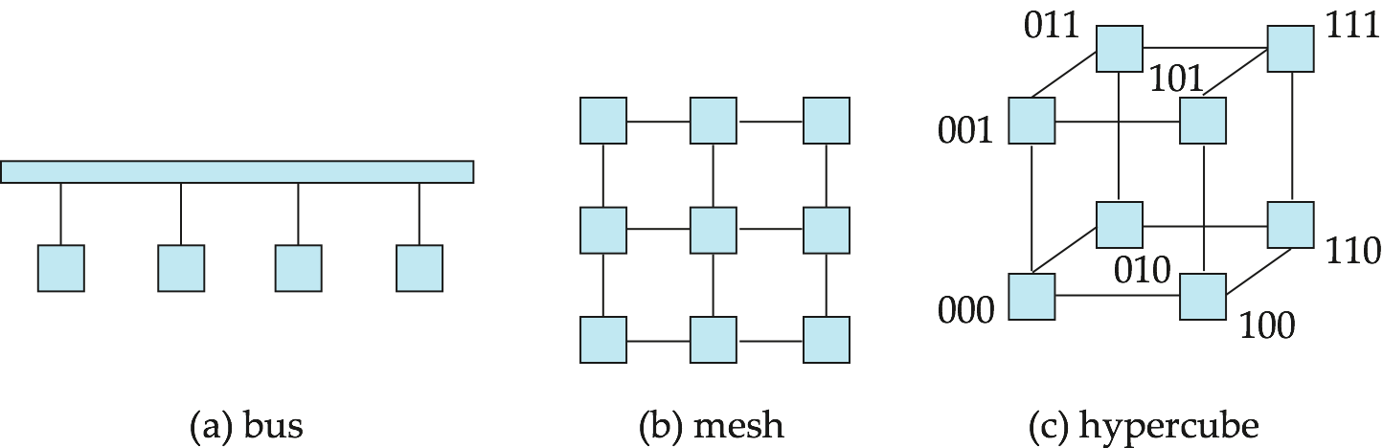
Interconnection Architectures

Slide 19
Parallel Database Architectures
Shared memory -- processors share a common memory
Shared disk -- processors share a common disk
Shared nothing -- processors share neither a common memory nor common disk
Hierarchical -- hybrid of the above architectures

Slide 20
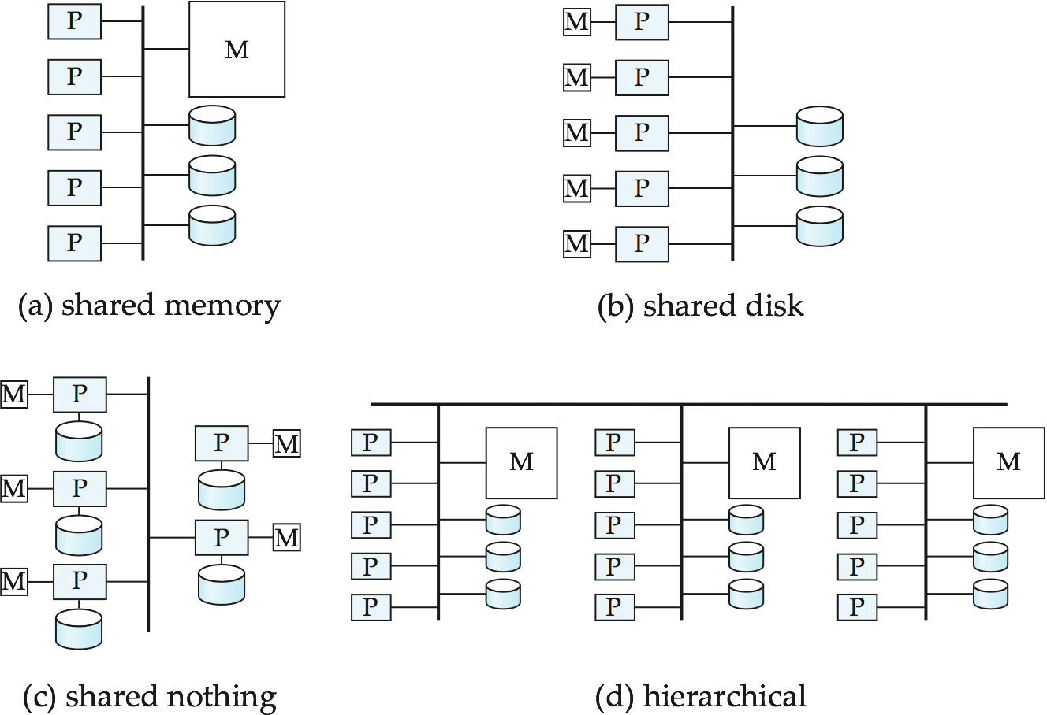
Parallel Database Architectures

Slide 21
Shared Memory
Processors and disks have access to a common memory, typically via a bus or through an interconnection network.
Extremely efficient communication between processors — data in shared memory can be accessed by any processor without having to move it using software.
Downside – architecture is not scalable beyond 32 or 64 processors since the bus or the interconnection network becomes a bottleneck
Widely used for lower degrees of parallelism (4 to 8).

Slide 22
Shared Disk
All processors can directly access all disks via an interconnection network, but the processors have private memories.
The memory bus is not a bottleneck
Architecture provides a degree of fault-tolerance — if a processor fails, the other processors can take over its tasks since the database is resident on disks that are accessible from all processors.
Examples: IBM Sysplex and DEC clusters (now part of Compaq) running Rdb (now Oracle Rdb) were early commercial users
Downside: bottleneck now occurs at interconnection to the disk subsystem.
Shared-disk systems can scale to a somewhat larger number of processors, but communication between processors is slower.

Slide 23
Shared Nothing
Node consists of a processor, memory, and one or more disks. Processors at one node communicate with another processor at another node using an interconnection network. A node functions as the server for the data on the disk or disks the node owns.
Examples: Teradata, Tandem, Oracle-n CUBE
Data accessed from local disks (and local memory accesses) do not pass through interconnection network, thereby minimizing the interference of resource sharing.
Shared-nothing multiprocessors can be scaled up to thousands of processors without interference.
Main drawback: cost of communication and non-local disk access; sending data involves software interaction at both ends.

Slide 24
Hierarchical
Combines characteristics of shared-memory, shared-disk, and shared-nothing architectures.
Top level is a shared-nothing architecture – nodes connected by an interconnection network, and do not share disks or memory with each other.
Each node of the system could be a shared-memory system with a few processors.
Alternatively, each node could be a shared-disk system, and each of the systems sharing a set of disks could be a shared-memory system.
Reduce the complexity of programming such systems by distributed virtual-memory architectures
Also called non-uniform memory architecture (NUMA)

Slide 25
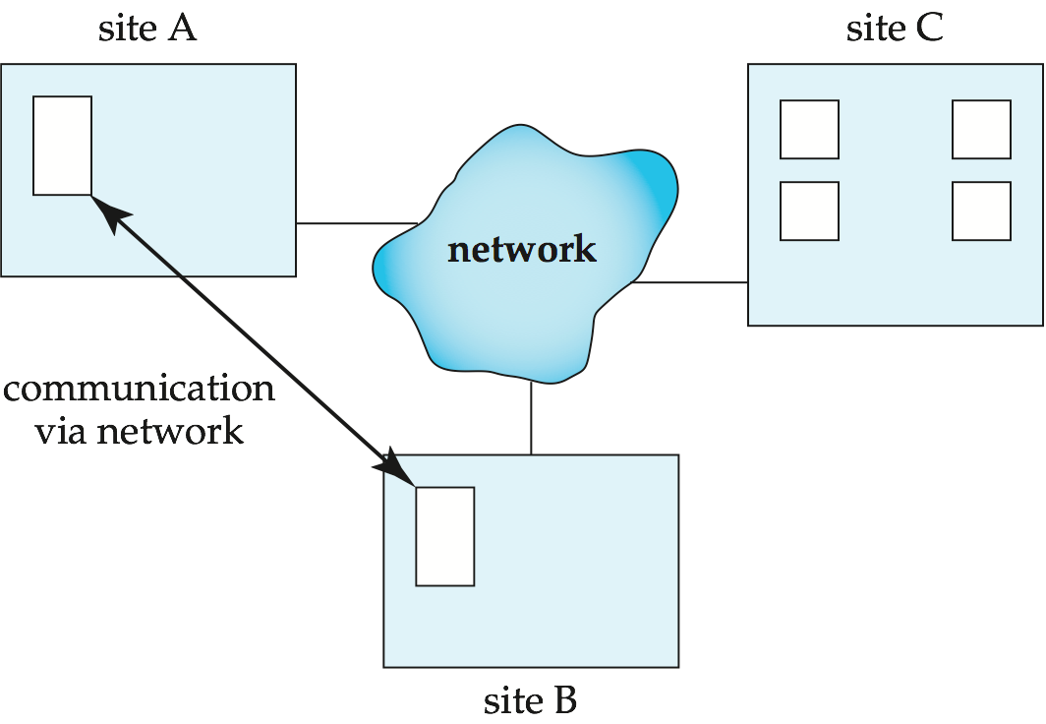
Distributed Systems
Data spread over multiple machines (also referred to as sites or nodes).
Network interconnects the machines
Data shared by users on multiple machines

Slide 26
Distributed Databases
Homogeneous distributed databases
Same software/schema on all sites, data may be partitioned among sites
Goal: provide a view of a single database, hiding details of distribution
Heterogeneous distributed databases
Different software/schema on different sites
Goal: integrate existing databases to provide useful functionality
Differentiate between local and global transactions
A local transaction accesses data in the single site at which the transaction was initiated.
A global transaction either accesses data in a site different from the one at which the transaction was initiated or accesses data in several different sites.

Slide 27
Trade-offs in Distributed Systems
Sharing data – users at one site able to access the data residing at some other sites.
Autonomy – each site is able to retain a degree of control over data stored locally.
Higher system availability through redundancy — data can be replicated at remote sites, and system can function even if a site fails.
Disadvantage: added complexity required to ensure proper coordination among sites.
Software development cost.
Greater potential for bugs.
Increased processing overhead.

Slide 28
Homogeneous Distributed Databases
In a homogeneous distributed database
All sites have identical software
Are aware of each other and agree to cooperate in processing user requests.
Each site surrenders part of its autonomy in terms of right to change schemas or software
Appears to user as a single system
In a heterogeneous distributed database
Different sites may use different schemas and software
Difference in schema is a major problem for query processing
Difference in software is a major problem for transaction processing
Sites may not be aware of each other and may provide only limited facilities for cooperation in transaction processing

Slide 29
Data Replication
A relation or fragment of a relation is replicated if it is stored redundantly in two or more sites.
Full replication of a relation is the case where the relation is stored at all sites.
Fully redundant databases are those in which every site contains a copy of the entire database.

Slide 30
Data Replication (Cont.)
Advantages of Replication
Availability: failure of site containing relation r does not result in unavailability of r is replicas exist.
Parallelism: queries on r may be processed by several nodes in parallel.
Reduced data transfer: relation r is available locally at each site containing a replica of r.
Disadvantages of Replication
Increased cost of updates: each replica of relation r must be updated.
Increased complexity of concurrency control: concurrent updates to distinct replicas may lead to inconsistent data unless special concurrency control mechanisms are implemented.
One solution: choose one copy as primary copy and apply concurrency control operations on primary copy

Slide 31
Data Storage Fragmentation
Division of relation r into fragments r₁, r₂, …, r_{n} which contain sufficient information to reconstruct relation r.
Horizontal fragmentation: each tuple of r is assigned to one or more fragments
Vertical fragmentation: the schema for relation r is split into several smaller schemas
All schemas must contain a common candidate key (or superkey) to ensure lossless join property.
A special attribute, the tuple-id attribute may be added to each schema to serve as a candidate key.
Example : relation account with following schema
Account = (account_number, branch_name , balance )

Slide 32
Horizontal Fragmentation of account Relation
account_number
branch_name
balance
A-305
A-226
A-155
Hillside
Hillside
Hillside
500
336
62
account₁ = σ_{branch_name=“Hillside”} (account )
account_number
branch_name
balance
A-177
A-402
A-408
A-639
Valleyview
Valleyview
Valleyview
Valleyview
205
10000
1123
750
account₂ = σ_{branch_name=“Valleyview”} (account )

Slide 33
Vertical Fragmentation of employee_info Relation
branch_name
customer_name
tuple_id
Hillside
Hillside
Valleyview
Valleyview
Hillside
Valleyview
Valleyview
Lowman
Camp
Camp
Kahn
Kahn
Kahn
Green
1
2
3
4
5
6
7
deposit₁ = Πbranch_name, customer_name, tuple_id (employee_info )
account_number
balance
tuple_id
A-305
A-226
A-177
A-402
A-155
A-408
A-639
500
336
205
10000
62
1123
750
1
2
3
4
5
6
7
deposit₂ = Πaccount_number, balance, tuple_id (employee_info )

Slide 34
Distributed Transactions
Transaction may access data at several sites.
Each site has a local transaction manager responsible for:
Maintaining a log for recovery purposes
Participating in coordinating the concurrent execution of the transactions executing at that site.
Each site has a transaction coordinator, which is responsible for:
Starting the execution of transactions that originate at the site.
Distributing subtransactions at appropriate sites for execution.
Coordinating the termination of each transaction that originates at the site, which may result in the transaction being committed at all sites or aborted at all sites.

Slide 35
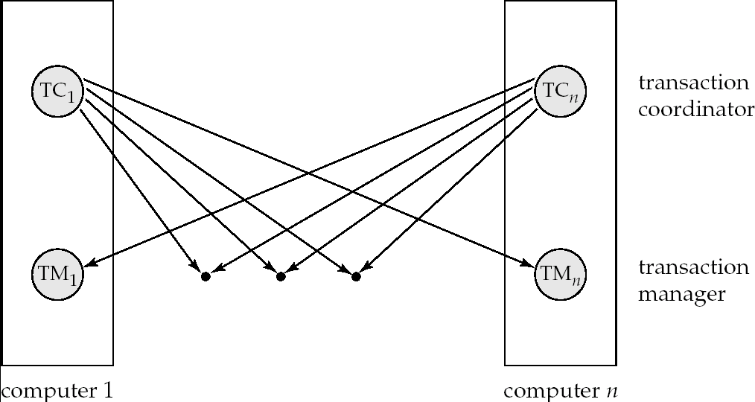
Transaction System Architecture

Slide 36
System Failure Modes
Failures unique to distributed systems:
Failure of a site.
Loss of massages
Handled by network transmission control protocols such as TCP-IP
Failure of a communication link
Handled by network protocols, by routing messages via alternative links
Network partition
A network is said to be partitioned when it has been split into two or more subsystems that lack any connection between them
Note: a subsystem may consist of a single node
Network partitioning and site failures are generally indistinguishable.

Slide 37
Commit Protocols
Commit protocols are used to ensure atomicity across sites
a transaction which executes at multiple sites must either be committed at all the sites, or aborted at all the sites.
not acceptable to have a transaction committed at one site and aborted at another
The two-phase commit (2PC) protocol is widely used
The three-phase commit (3PC) protocol is more complicated and more expensive, but avoids some drawbacks of two-phase commit protocol. This protocol is not used in practice.

Slide 38
Two Phase Commit Protocol (2PC)
Assumes fail-stop model – failed sites simply stop working, and do not cause any other harm, such as sending incorrect messages to other sites.
Execution of the protocol is initiated by the coordinator after the last step of the transaction has been reached.
The protocol involves all the local sites at which the transaction executed
Let T be a transaction initiated at site S_{i}, and let the transaction coordinator at S_{i} be C_{i}

Slide 39
Phase 1: Obtaining a Decision
Coordinator asks all participants to prepare to commit transaction T_{i}.
C_{i} adds the records <prepare T> to the log and forces log to stable storage
sends prepare T messages to all sites at which T executed
Upon receiving message, transaction manager at site determines if it can commit the transaction
if not, add a record <no T> to the log and send abort T message to C_{i}
if the transaction can be committed, then:
add the record <ready T> to the log
force all records for T to stable storage
send ready T message to C_{i}

Slide 40
Phase 2: Recording the Decision
T can be committed of C_{i} received a ready T message from all the participating sites: otherwise T must be aborted.
Coordinator adds a decision record, <commit T> or <abort T>, to the log and forces record onto stable storage. Once the record stable storage it is irrevocable (even if failures occur)
Coordinator sends a message to each participant informing it of the decision (commit or abort)
Participants take appropriate action locally.

Slide 41
Handling of Failures - Site Failure
When site S_{i} recovers, it examines its log to determine the fate of
transactions active at the time of the failure.
Log contain <commit T> record: site executes redo (T)
Log contains <abort T> record: site executes undo (T)
Log contains <ready T> record: site must consult C_{i} to determine the fate of T.
If T committed, redo (T)
If T aborted, undo (T)
The log contains no control records concerning T
implies that S_{k} failed before responding to the prepare T message from C_{i}
S_{k} must execute undo (T)

Slide 42
Handling of Failures- Coordinator Failure
If coordinator fails while the commit protocol for T is executing then participating sites must decide on T’s fate:
If an active site contains a <commit T> record in its log, then T must be committed.
If an active site contains an <abort T> record in its log, then T must be aborted.
If some active participating site does not contain a <ready T> record in its log, then the failed coordinator C_{i} cannot have decided to commit T.
Can therefore abort T.
If none of the above cases holds, then all active sites must have a <ready T> record in their logs, but no additional control records (such as <abort T> of <commit T>).
In this case active sites must wait for C_{i} to recover, to find decision.
Blocking problem: active sites may have to wait for failed coordinator to recover.

Slide 43
Handling of Failures - Network Partition
If the coordinator and all its participants remain in one partition, the failure has no effect on the commit protocol.
If the coordinator and its participants belong to several partitions:
Sites that are not in the partition containing the coordinator think the coordinator has failed, and execute the protocol to deal with failure of the coordinator.
No harm results, but sites may still have to wait for decision from coordinator.
The coordinator and the sites are in the same partition as the coordinator think that the sites in the other partition have failed, and follow the usual commit protocol.
Again, no harm results

Slide 44
Recovery and Concurrency Control
In-doubt transactions have a <ready T>, but neither a <commit T>, nor an <abort T> log record.
The recovering site must determine the commit-abort status of such transactions by contacting other sites; this can slow and potentially block recovery.
Recovery algorithms can note lock information in the log.
Instead of <ready T>, write out <ready T, L> L = list of locks held by T when the log is written (read locks can be omitted).
For every in-doubt transaction T, all the locks noted in the <ready T, L> log record are reacquired.
After lock reacquisition, transaction processing can resume; the commit or rollback of in-doubt transactions is performed concurrently with the execution of new transactions.

Slide 45
Alternative Models of Transaction Processing
Notion of a single transaction spanning multiple sites is inappropriate for many applications
E.g. transaction crossing an organizational boundary
No organization would like to permit an externally initiated transaction to block local transactions for an indeterminate period
Alternative models carry out transactions by sending messages
Code to handle messages must be carefully designed to ensure atomicity and durability properties for updates
Isolation cannot be guaranteed
but code must ensure no inconsistent states result due to concurrency
Persistent messaging systems are systems that provide transactional properties to messages
Messages are guaranteed to be delivered exactly once
Will discuss implementation techniques later

Slide 46
Alternative Models (Cont.)
Motivating example: funds transfer between two banks
Two phase commit would have the potential to block updates on the accounts involved in funds transfer
Alternative solution:
Debit money from source account and send a message to other site
Site receives message and credits destination account
Messaging has long been used for distributed transactions (even before computers were invented!)
Atomicity issue
once transaction sending a message is committed, message must guaranteed to be delivered
Guarantee as long as destination site is up and reachable, code to handle undeliverable messages must also be available
e.g. credit money back to source account.
If sending transaction aborts, message must not be sent

Slide 47
Error Conditions with Persistent Messaging
Code to handle messages has to take care of variety of failure situations (even assuming guaranteed message delivery)
E.g. if destination account does not exist, failure message must be sent back to source site
When failure message is received from destination site, or destination site itself does not exist, money must be deposited back in source account
Problem if source account has been closed
get humans to take care of problem
User code executing transaction processing using 2PC does not have to deal with such failures
There are many situations where extra effort of error handling is worth the benefit of absence of blocking
E.g. pretty much all transactions across organizations

Slide 48
Persistent Messaging and Workflows
Workflows provide a general model of transactional processing involving multiple sites and possibly human processing of certain steps
E.g. when a bank receives a loan application, it may need to
Contact external credit-checking agencies
Get approvals of one or more managers
and then respond to the loan application
We study workflows in Chapter 25
Persistent messaging forms the underlying infrastructure for workflows in a distributed environment

Slide 49
Concurrency Control
Modify concurrency control schemes for use in distributed environment.
We assume that each site participates in the execution of a commit protocol to ensure global transaction automicity.
We assume all replicas of any item are updated
Will see how to relax this in case of site failures later

Slide 50
Single-Lock-Manager Approach
System maintains a single lock manager that resides in a single chosen site, say S_{i}
When a transaction needs to lock a data item, it sends a lock request to S_{i} and lock manager determines whether the lock can be granted immediately
If yes, lock manager sends a message to the site which initiated the request
If no, request is delayed until it can be granted, at which time a message is sent to the initiating site

Slide 51
Single-Lock-Manager Approach (Cont.)
The transaction can read the data item from any one of the sites at which a replica of the data item resides.
Writes must be performed on all replicas of a data item
Advantages of scheme:
Simple implementation
Simple deadlock handling
Disadvantages of scheme are:
Bottleneck: lock manager site becomes a bottleneck
Vulnerability: system is vulnerable to lock manager site failure.

Slide 52
Distributed Lock Manager
In this approach, functionality of locking is implemented by lock managers at each site
Lock managers control access to local data items
But special protocols may be used for replicas
Advantage: work is distributed and can be made robust to failures
Disadvantage: deadlock detection is more complicated
Lock managers cooperate for deadlock detection
More on this later
Several variants of this approach
Primary copy
Majority protocol
Biased protocol
Quorum consensus

Slide 53
Primary Copy
Choose one replica of data item to be the primary copy.
Site containing the replica is called the primary site for that data item
Different data items can have different primary sites
When a transaction needs to lock a data item Q, it requests a lock at the primary site of Q.
Implicitly gets lock on all replicas of the data item
Benefit
Concurrency control for replicated data handled similarly to unreplicated data - simple implementation.
Drawback
If the primary site of Q fails, Q is inaccessible even though other sites containing a replica may be accessible.

Slide 54
Majority Protocol
Local lock manager at each site administers lock and unlock requests for data items stored at that site.
When a transaction wishes to lock an unreplicated data item Q residing at site S_{i}, a message is sent to S_{i} ‘s lock manager.
If Q is locked in an incompatible mode, then the request is delayed until it can be granted.
When the lock request can be granted, the lock manager sends a message back to the initiator indicating that the lock request has been granted.

Slide 55
Majority Protocol (Cont.)
In case of replicated data
If Q is replicated at n sites, then a lock request message must be sent to more than half of the n sites in which Q is stored.
The transaction does not operate on Q until it has obtained a lock on a majority of the replicas of Q.
When writing the data item, transaction performs writes on all replicas.
Benefit
Can be used even when some sites are unavailable
details on how handle writes in the presence of site failure later
Drawback
Requires 2(n/2 + 1) messages for handling lock requests, and (n/2 + 1) messages for handling unlock requests.
Potential for deadlock even with single item - e.g., each of 3 transactions may have locks on 1/3rd of the replicas of a data.

Slide 56
Biased Protocol
Local lock manager at each site as in majority protocol, however, requests for shared locks are handled differently than requests for exclusive locks.
Shared locks. When a transaction needs to lock data item Q, it simply requests a lock on Q from the lock manager at one site containing a replica of Q.
Exclusive locks. When transaction needs to lock data item Q, it requests a lock on Q from the lock manager at all sites containing a replica of Q.
Advantage - imposes less overhead on read operations.
Disadvantage - additional overhead on writes

Slide 57
Quorum Consensus Protocol
A generalization of both majority and biased protocols
Each site is assigned a weight.
Let S be the total of all site weights
Choose two values read quorum Q_{r} and write quorum Q_{w}
Such that Q_{r} + Q_{w} > S and 2 * Q_{w} > S
Quorums can be chosen (and S computed) separately for each item
Each read must lock enough replicas that the sum of the site weights is >= Q_{r}
Each write must lock enough replicas that the sum of the site weights is >= Q_{w}
For now we assume all replicas are written
Extensions to allow some sites to be unavailable described later

Slide 58
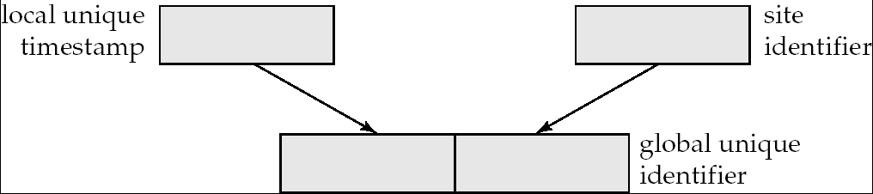
Timestamping
Timestamp based concurrency-control protocols can be used in distributed systems
Each transaction must be given a unique timestamp
Main problem: how to generate a timestamp in a distributed fashion
Each site generates a unique local timestamp using either a logical counter or the local clock.
Global unique timestamp is obtained by concatenating the unique local timestamp with the unique identifier.

Slide 59
Timestamping (Cont.)
A site with a slow clock will assign smaller timestamps
Still logically correct: serializability not affected
But: “disadvantages” transactions
To fix this problem
Define within each site S_{i} a logical clock (LC_{i}), which generates the unique local timestamp
Require that S_{i} advance its logical clock whenever a request is received from a transaction Ti with timestamp < x,y> and x is greater that the current value of LC_{i}.
In this case, site S_{i} advances its logical clock to the value x + 1.

Slide 60
Replication with Weak Consistency
Many commercial databases support replication of data with weak degrees of consistency (I.e., without a guarantee of serializabiliy)
E.g.: master-slave replication: updates are performed at a single “master” site, and propagated to “slave” sites.
Propagation is not part of the update transaction: its is decoupled
May be immediately after transaction commits
May be periodic
Data may only be read at slave sites, not updated
No need to obtain locks at any remote site
Particularly useful for distributing information
E.g. from central office to branch-office
Also useful for running read-only queries offline from the main database

Slide 61
Replication with Weak Consistency (Cont.)
Replicas should see a transaction-consistent snapshot of the database
That is, a state of the database reflecting all effects of all transactions up to some point in the serialization order, and no effects of any later transactions.
E.g. Oracle provides a create snapshot statement to create a snapshot of a relation or a set of relations at a remote site
snapshot refresh either by recomputation or by incremental update
Automatic refresh (continuous or periodic) or manual refresh

Slide 62
Multimaster and Lazy Replication
With multimaster replication (also called update-anywhere replication) updates are permitted at any replica, and are automatically propagated to all replicas
Basic model in distributed databases, where transactions are unaware of the details of replication, and database system propagates updates as part of the same transaction
Coupled with 2 phase commit
Many systems support lazy propagation where updates are transmitted after transaction commits
Allows updates to occur even if some sites are disconnected from the network, but at the cost of consistency

Slide 63
Deadlock Handling
Consider the following two transactions and history, with item X and transaction T₁ at site 1, and item Y and transaction T₂ at site 2:
T₁: write (X)
write (Y)
T₂: write (Y)
write (X)
X-lock on X
write (X)
X-lock on Y
write (Y)
wait for X-lock on X
Wait for X-lock on Y
Result: deadlock which cannot be detected locally at either site

Slide 64
Centralized Approach
A global wait-for graph is constructed and maintained in a single site; the deadlock-detection coordinator
Real graph: Real, but unknown, state of the system.
Constructed graph:Approximation generated by the controller during the execution of its algorithm .
the global wait-for graph can be constructed when:
a new edge is inserted in or removed from one of the local wait-for graphs.
a number of changes have occurred in a local wait-for graph.
the coordinator needs to invoke cycle-detection.
If the coordinator finds a cycle, it selects a victim and notifies all sites. The sites roll back the victim transaction.

Slide 65
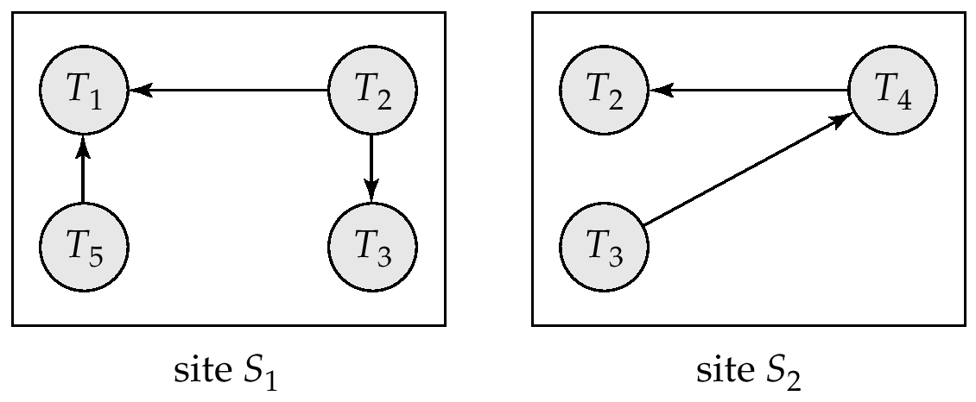
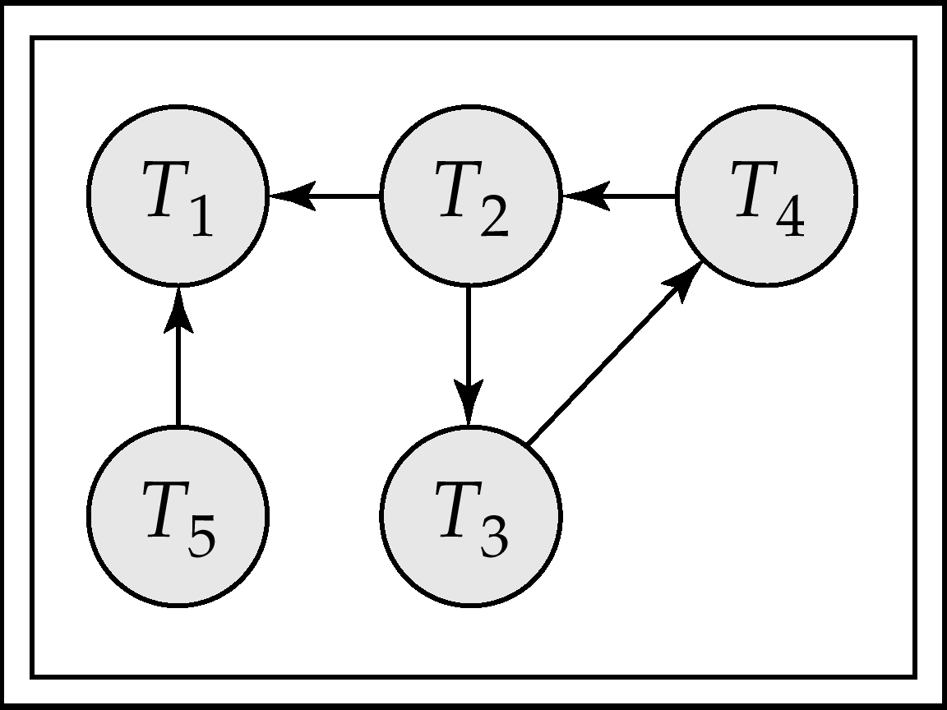
Local and Global Wait-For Graphs
Local
Global

Slide 66
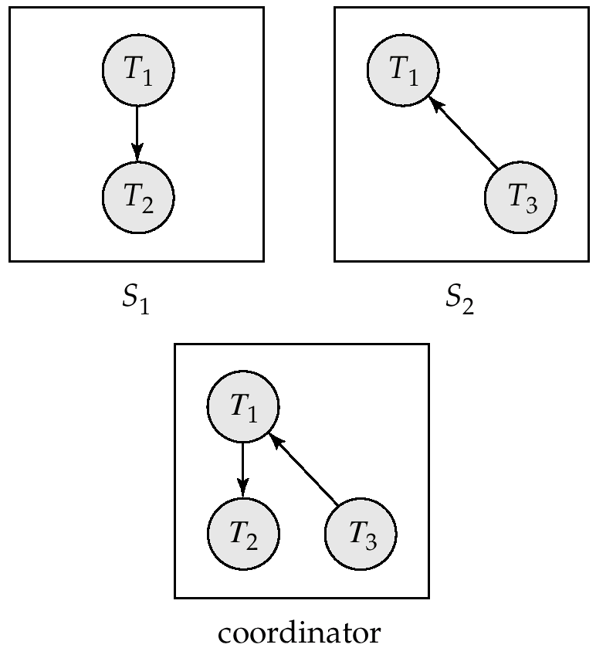
Example Wait-For Graph for False Cycles
Initial state:

Slide 67
False Cycles (Cont.)
Suppose that starting from the state shown in figure,
1. T₂ releases resources at S₁
resulting in a message remove T₁ → T₂ message from the Transaction Manager at site S₁ to the coordinator)
2. And then T₂ requests a resource held by T₃ at site S₂
resulting in a message insert T₂ → T₃ from S₂ to the coordinator
Suppose further that the insert message reaches before the delete message
this can happen due to network delays
The coordinator would then find a false cycle
T₁ → T₂ → T₃ → T₁
The false cycle above never existed in reality.
False cycles cannot occur if two-phase locking is used.

Slide 68
Unnecessary Rollbacks
Unnecessary rollbacks may result when deadlock has indeed occurred and a victim has been picked, and meanwhile one of the transactions was aborted for reasons unrelated to the deadlock.
Unnecessary rollbacks can result from false cycles in the global wait-for graph; however, likelihood of false cycles is low.

Slide 69


THANK YOU!!!

