Slide 1
Web Service and Service-Oriented Architecture
Prof. S M Shedole

Slide 2
Service-OrientedArchitecture
Contents
Introduction to Services - Bind, Publish, Find – Framework for SOA – Web Services (A Realization of SOA) - Web Services Architecture (Transport Services, Messaging Services, Service Description, Discovery Services, Quality of Service), Interoperability – REST (Representational State Transfer) Services

Slide 3
Agenda
A little history
What is Service-Oriented Architecture?
How do you build a Service-Oriented Architecture Solution?
What is an Enterprise Service Bus?
Summary

Slide 4
A Little History

Slide 5
In the Beginning …
Computers were the domain of scientists for scientists
Business and Government discovered the value of computing
Business requirements needed to be captured and programmed

Slide 6
Some Past Attempts …
COBOL – It was designed to be business-problem oriented, machine-independent, and capable of continuous change and development.
SQL – The SQL "language" allows anyone with a computer terminal to access and use relational databases. Originally thought to be an end-user tool.
SAD – Structured Analysis and Design (Yourdon/DeMarco)
IE – Information engineering (design by pictures) James Martin
OOAD – Object-Oriented Analysis and Design

Slide 7
Revolution …
Revolution
  COBOL
  Basic programming language
  C programming language
  SQL
  Structured analyses and design
  Electronic data exchange
Evolution
  Web Services
  Information Engineering
  CASE
  C++
  Java
  Object-Oriented Analysis and Design
  HTML
  Common Record (XML)
Ecosystem
  Standards
  SOA

Slide 8
What is Service-Oriented Architecture?

Slide 9
What is Service-Oriented Architecture?
Service-Oriented Architecture (SOA) is an architectural style. Applications built using an SOA style deliver functionality as services that can be used or reused when building applications or integrating within the enterprise or trading partners.

Slide 10
SOA
Uses open standards to integrate software assets as services
Standardizes interactions of services
Services become building blocks that form business flows
Services can be reused by other applications

Slide 11
What is a Service?
A service is a reusable component that can be used as a building block to form larger, more complex business-application functionality.
A service may be as simple as “get me some person data,” or as complex as “process a disbursement.”

Slide 12
What is a Service?
A service provides a discrete business function that operates on data. Its job is to ensure that the business functionality is applied consistently, returns predictable results, and operates within the quality of service required.

Slide 13
What is a Service?
How the service is implemented, and how a user of the service accesses it, are limited only by the SOA infrastructure choices of the enterprise.
From a theory point of view, it really doesn’t matter how a service is implemented.

Slide 14
Characteristics of a Service
Supports open standards for integration: Although proprietary integration mechanisms may be offered by the SOA infrastructure, SOA’s should be based on open standards. Open standards ensure the broadest integration compatibility opportunities.

Slide 15
Characteristics of a Service
Loose coupling: The consumer of the service is required to provide only the stated data on the interface definition, and to expect only the specified results on the interface definition. The service is capable of handling all processing (including exception processing).

Slide 16
Characteristics of a Service
Stateless: The service does not maintain state between invocations. It takes the parameters provided, performs the defined function, and returns the expected result. If a transaction is involved, the transaction is committed and the data is saved to the database.

Slide 17
Characteristics of a Service
Location agnostic: Users of the service do not need to worry about the implementation details for accessing the service. The SOA infrastructure will provide standardized access mechanisms with service-level agreements.

Slide 18
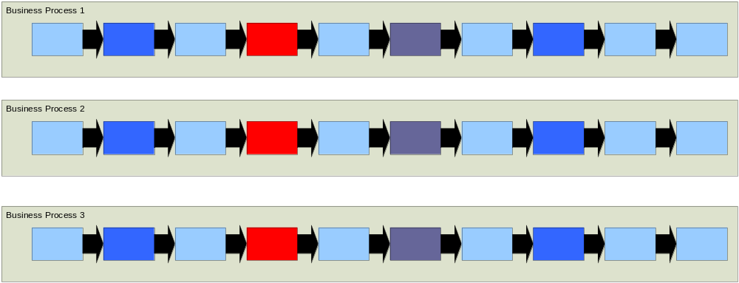
Legacy Business Process

Slide 19
Architectural Choke Point
Monolithic
Extremely complex
Very tightly coupled
Difficult to find clean integration points
Lack of standards makes it difficult to integrate
Rigid architecture makes even small changes complex and costly

Slide 20
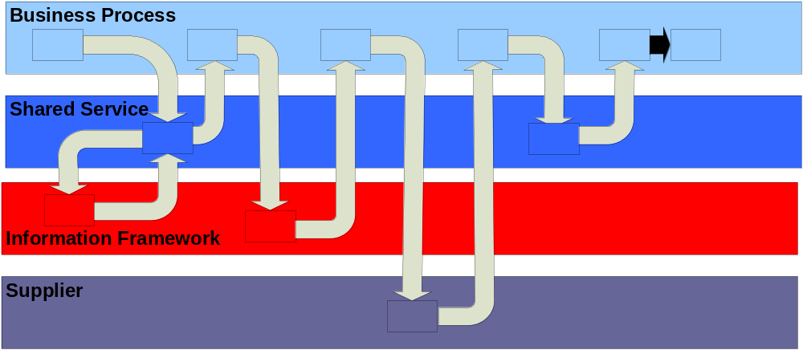
SOA Business Process

Slide 21
How Do You Build a Service-Oriented Architecture Solution?

Slide 22
IT Infrastructure is an Ecosystem
COBOL
C++
Java
J2EE
Networks
TCP/IP
Web Service
Mid-Tier Servers
.NET
Messaging
HTML
Operating Systems
CICS
Routers
Databases
Mainframes

Slide 23
Managing the Ecosystem
Technology Management
Product duplication
Standards
Product/Vendor lock-in
Support skill sets
Version Management
Managed Evergreening
Limited versions in production

Slide 24
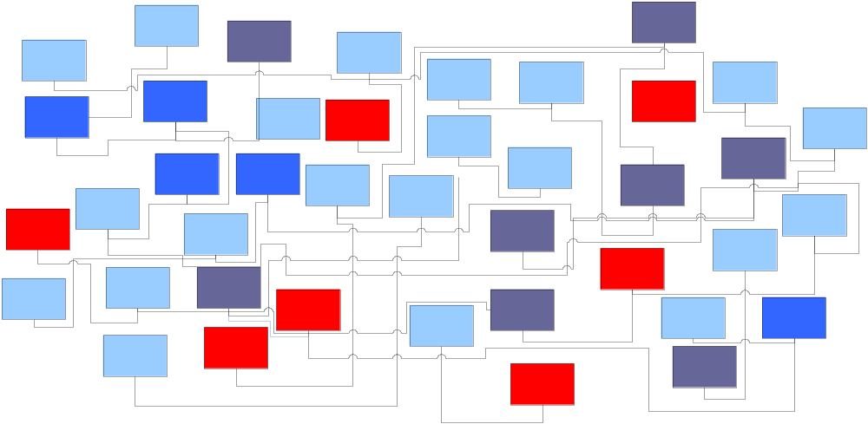
Legacy Integration

Slide 25
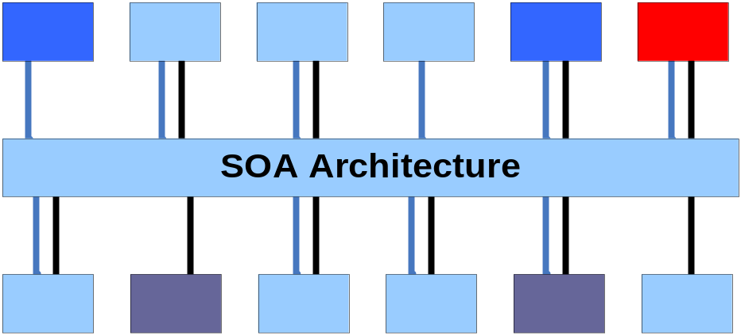
SOA Integration

Slide 26
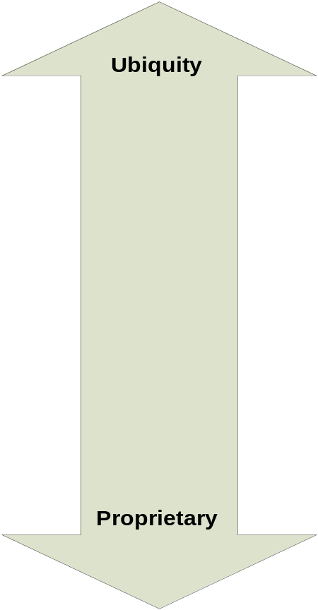
Integration Stack
Industry Standards
Language Standards
Custom API’s
Native Interfaces

Slide 27
Enterprise Service Bus

Slide 28
What is an Enterprise Service Bus (ESB)?
An enterprise service bus is an infrastructure used for building compound applications
The enterprise service bus is the glue that holds the compound application together
The enterprise service bus is an emerging style for integrating enterprise applications in an implementation-independent fashion
An enterprise service bus can be thought of as an abstraction layer on top of an Enterprise Messaging System

Slide 29
Key Characteristics of an ESB
Streamlines development
Supports multiple binding strategies
Performs data transformation
Intelligent routing
Real time monitoring
Exception handling
Service security

Slide 30
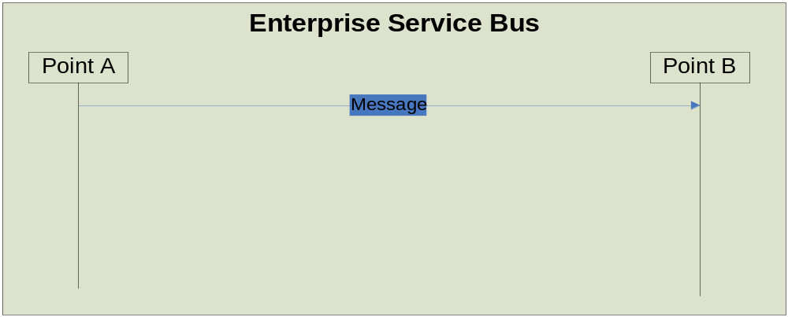
What is an ESB?
In its simplest form:
  An ESB delivers a message from one point to another.
Don’t EAI’s already do this?

Slide 31
EAI Limitations
An EAI can be a tightly coupled solution
An EAI can be location-specific
An EAI can be based on proprietary transport technology

Slide 32
Let’s Walk Through the ESB
Get Person Data
Use Standard Student Identification Method (SSIM) identifiers to find the person
Return the Person Data
This is a fictional-use case, and is only intended to illustrate how an ESB would provide a service.

Slide 33
The ESB Boundaries
The ESB (in its simplest form) is responsible for getting a message from point A to point B.

Slide 34
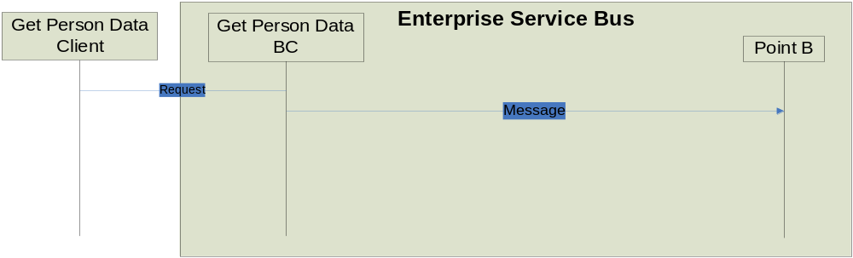
Get the Message on the Bus
A binding component “speaks” the service’s protocol, which happens to be SOAP over JMS.

Slide 35
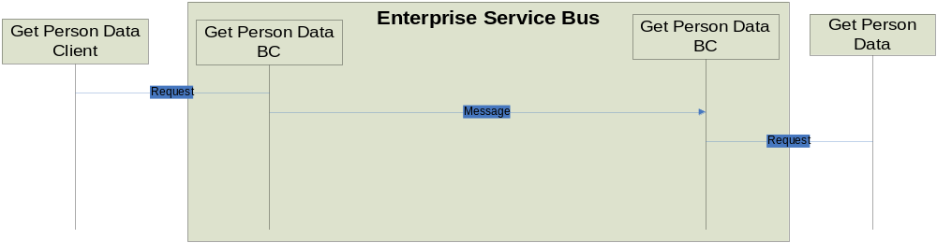
Perform the Person Read
The request is now routed to the Get Person Data Service, which will perform the business logic.

Slide 36
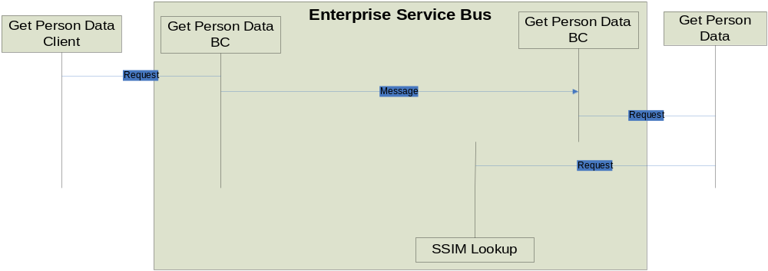
Do the SSIM Lookup
A call is made to the SSIM service to perform a lookup of the Student Identifier (SID). The SSIM service lives inside the bus.
Note: The SSIM binding components are not shown so the diagram can remain simple.

Slide 37
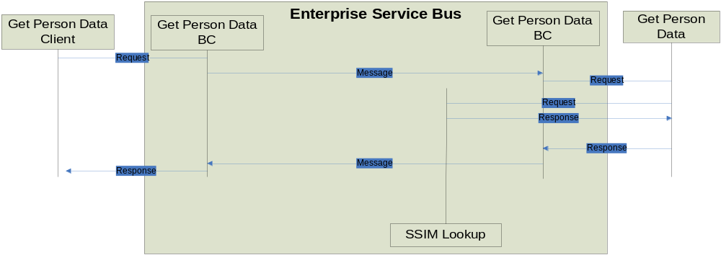
Return the Person Data
The process is reversed, returning the response to the requester.

Slide 38
ESB Summary
Loose Coupling
Location Transparency
Transport Neutral

Slide 39
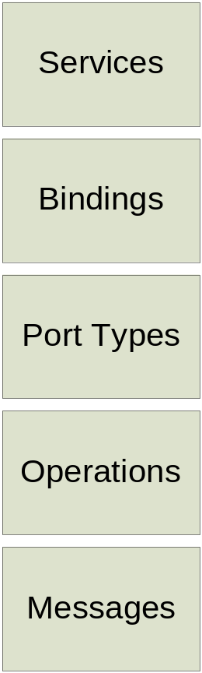
Defining the Message
Web Services Description Language
Open Standard for describing Interfaces to Services (http://www.w3.org/TR/wsdl)
Characteristics
  Describes data expected to be sent and received
  Describes what the service can do
  Describes how to reach the service
WSDL description is an XML document

Slide 40
Message-Exchange Patterns
One-way. The endpoint receives a message.
Request-response. The endpoint receives a message, and sends a correlated message.
Solicit-response. The endpoint sends a message, and receives a correlated message.
Notification. The endpoint sends a message.

Slide 41
Building a Compound Application

Slide 42
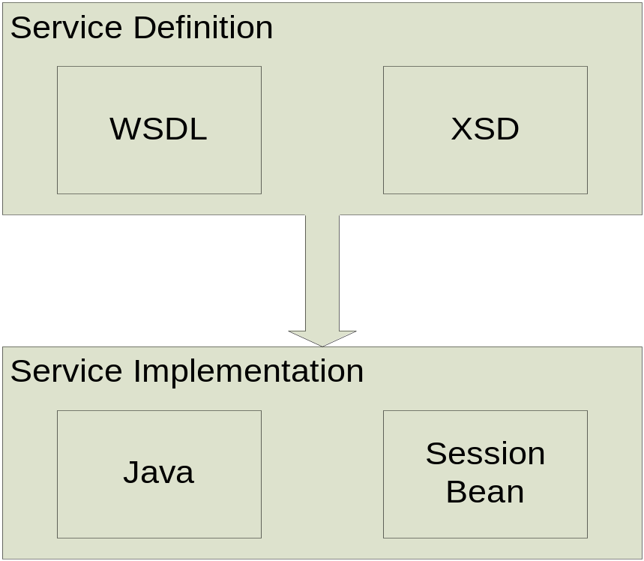
The Ingredients

Slide 43
Business Processes Flow
Business processes are a set of activities, supported by services, that support a particular business activity.
Business processes are business services built using other business services.
Business Process Execution Language (BPEL) is a specification for describing business processes in a portable XML format. BPEL is widely supported in both commercial and open source products.
BPEL defines how services interact to form complex business process. It provides a unit of work context, fault handling, and compensation (transaction rollback).

Slide 44
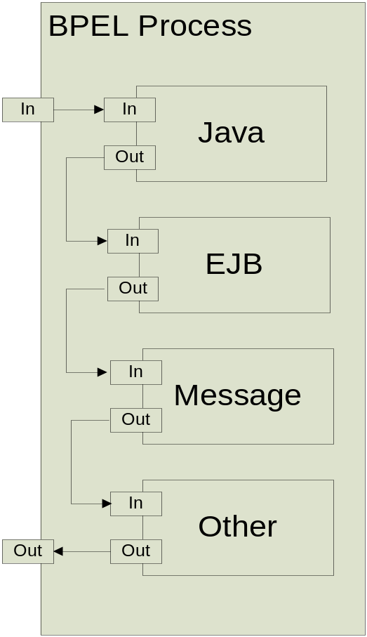
BPEL

Slide 45
What BPEL does …
BPEL binds services together to form larger complex business services
Control Flow (branch, loop, parallel)
Asynchronous correlation
Transaction support, Units of Work
Compensation

Slide 46
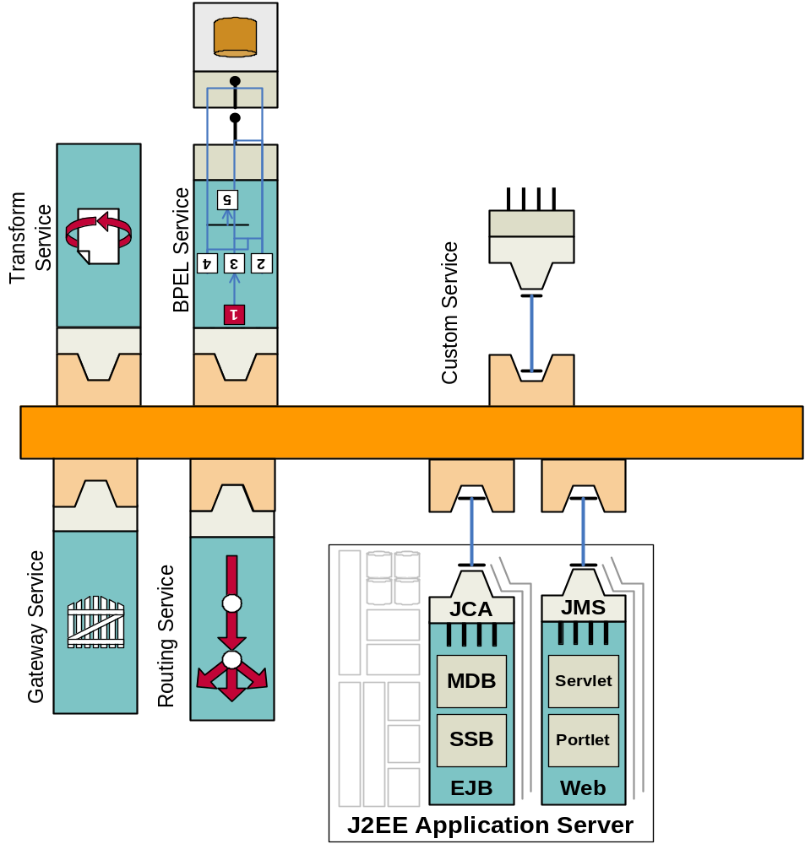
Sample ESB
Custom Services
Transformation Services
Orchestration
Routing
Application Server

Slide 47
Summary
What is Service-Oriented Architecture?
How do you build a Service-Oriented Architecture solution?
What is an Enterprise Service Bus?

Slide 48
Contact Information
We appreciate your feedback and comments. We can be reached at:
Phone: 202 377 3023
Email: Terry.Woods@ed.gov

