Slide 1
NoSQL - MongoDB
May 09, 2020
By: Sambhaji and Nilam

Slide 2
Agenda
1. Introduction to NoSQL Database
2. Comparative study of SQL and NoSQL
3. NoSQL Database Types
4. Benefits of NoSQL
5. NoSQL and MongoDB
6. Core MongoDB Operations
7. Querying, Aggregation, Indexing

Slide 3

What is NoSQL Database ?
1. Alternative to traditional relational databases in which data is placed in tables and data schema is carefully designed before the database is built.
2. NoSQL Database is an approach to database design that can accommodate a wide variety of data models, including key-value, document, columnar and graph formats.
3. An approach to database design that can accommodate a wide variety of data models, including key-value, document, columnar and graph formats.

Slide 4
Characteristics of NoSQL Database
1. It’s more than rows in tables
2. Free of joins
3. Schema-free
4. Works on many processors
5. Supports linear scalability
6. Easy replication support

Slide 5
NoSQL Database Types
1. Key-value stores : Every item in the database is stored as an attribute name (or "key") together with its value.
2. Wide-column stores : store data together as columns instead of rows and are optimized for queries over large datasets.
3. Document database : pair each key with a complex data structure known as a document. Documents can contain many different key-value pairs, or key-array pairs, or even nested documents.
4. Graph database : are used to store information about networks, such as social connections.

Slide 6
The Benefits of NoSQL Database
1. Dynamic Schemas : NoSQL databases are built to allow the insertion of data without a predefined schema. That makes it easy to make significant application changes in real-time, without worrying about service interruptions – which means development is faster, code integration is more reliable, and less database administrator time is needed.
2. Auto-Sharding : Spreading data across an arbitrary number of servers, without requiring the application to even be aware of the composition of the server pool.

Slide 7
Comparison Between SQL & NOSQL
 | SQL Databases | NoSQL Databases
Types | One type (SQL database) with minor variations | Many different types including key-value stores, document databases, wide-column stores, and graph databases
Development History | Developed in 1970s to deal with first wave of data storage applications | Developed in 2000s to deal with limitations of SQL databases, particularly concerning scale, replication and unstructured data storage
Examples | MySQL, Postgres, Oracle Database | MongoDB, Cassandra, HBase, Neo4j
Data Storage Model | Individual records (e.g., "employees") are stored as rows in tables, with each column storing a specific piece of data about that record (e.g., "manager," "date hired," etc.), much like a spreadsheet. Separate data types are stored in separate tables, and then joined together when more complex queries are executed. For example, "offices" might be stored in one table, and "employees" in another. When a user wants to find the work address of an employee, the database engine joins the "employee" and "office" tables together to get all the information necessary. | Varies based on database type. For example, key-value stores function similarly to SQL databases, but have only two columns ("key" and "value"), with more complex information sometimes stored within the "value" columns. Document databases do away with the table-and-row model altogether, storing all relevant data together in single "document" in JSON, XML, or another format, which can nest values hierarchically.

Slide 8
Comparison Between SQL & NOSQL
Schemas | Structure and data types are fixed in advance. To store information about a new data item, the entire database must be altered, during which time the database must be taken offline. | Typically dynamic. Records can add new information on the fly, and unlike SQL table rows, dissimilar data can be stored together as necessary. For some databases (e.g., wide-column stores), it is somewhat more challenging to add new fields dynamically.
Scaling | Vertically, meaning a single server must be made increasingly powerful in order to deal with increased demand. It is possible to spread SQL databases over many servers, but significant additional engineering is generally required. | Horizontally, meaning that to add capacity, a database administrator can simply add more commodity servers or cloud instances. The database automatically spreads data across servers as necessary
Development Model | Mix of open-source (e.g., Postgres, MySQL) and closed source (e.g., Oracle Database) | Open-source

Slide 9
Comparison Between SQL & NOSQL
Supports Transactions | Yes, updates can be configured to complete entirely or not at all | In certain circumstances and at certain levels (e.g., document level vs. database level)
Data Manipulation | Specific language using Select, Insert, and Update statements, e.g. SELECT fields FROM table WHERE… | Through object-oriented APIs
Consistency | Can be configured for strong consistency | Depends on product. Some provide strong consistency (e.g., MongoDB) whereas others offer eventual consistency (e.g., Cassandra)

Slide 10
Document Store
1. MongoDB
API: BSON, Protocol: C, Query Method: dynamic object-based language & MapReduce, Replication: Master Slave & Auto-Sharding, Written in: C++, Concurrency: Update in Place. Misc: Indexing, GridFS, Freeware + Commercial License
2. Elastic
API: REST and many languages, Protocol: REST, Query Method: via JSON, Replication + Sharding : automatic and configurable, written in: Java, Misc: schema mapping, multi tenancy with arbitrary indexes

Slide 11
Document Store
3. CouchDB
API: JSON, Protocol: REST, Query Method: MapReduceR of JavaScript Funcs, Replication: Master Master, Written in: Erlang, Concurrency: MVCC
4. ToroDB
API: MongoDB API and SQL, Protocol: MongoDB Wire Protocol / MongoDB compatible, Query Method: dynamic object-based language & SQL, Replication: RDBMS Backends' Replication System & Support for replication from MongoDB's Replica Set, Written in: Java, Concurrency: MVCC.

Slide 12
Document Store
5. RevenDB
Multi-Model: Document, Key-Value, Graph, Distributed Counters, Attachments. Fully Transactional (ACID) across database and throughout the cluster. Multiplatform: C#, Node.js, Java, Python, Ruby, Go. Multisystem: Windows, Linux, Mac OS, Docker, Raspberry Pi. Native GUI
6. Terrastore
API: Java & http, Protocol: http, Language: Java, Querying: Range queries, Predicates, Replication: Partitioned with consistent hashing, Consistency: Per-record strict consistency, Misc: Based on Terracotta

Slide 13
MongoDB
1. MongoDB is an open-source document database that provides high performance, high availability, and automatic scaling.
2. Characteristics
Fast querying & In-place updates
Full Secondary Index Support
Replication & High Availability
Auto-Sharding
3. Currently used in a number of different applications like Craigslist, ebay, New York Times, Shutterfly, Chicago Tribune, Github, Disney…

Slide 14
Sample Document
mydoc = {
_id: 1,
name: { first: “John”, last: “Backus” },
birthyear: integer,
contribs: [ “Fortran”, “ALGOL”, “Backus-Naur Form”, “FP” ],
awards: [ { award_id: “NMS001”,
year: 1975 },
{ award_id: “TA99”,
year: 1977} ]
}
> db.people.insert(mydoc)
Always indexed. Can be any BSON data type other than an array
Array of documents

Slide 15
Core MongoDB Operations
CRUD: create, read, update, and delete
Insert
One at a time: db.people.insert(mydoc)
Batch insert (size limitation: less than 16 MB)
3. Delete
All documents in a collection: db.mydb.remove()
Documents that match some predicate, e.g. to remove the document just added: db.mydb.remove({“_id”: 1})
Remove a collection (faster): db.people.drop()

Slide 16
Querying
Use find/findOne functions and a query document
Ranges, set inclusion, inequalities using $ conditionals
Complex queries using $where clause
Queries return a database cursor
Meta-operations on cursor include skipping some number of results, limiting the number of results returned, sorting results.

Slide 17
Querying
In MongoDB a query targets a specific collection of documents. Queries specify criteria, or conditions, that identify the documents that MongoDB returns to the clients. A query may include a projection that specifies the fields from the matching documents to return. You can optionally modify queries to impose limits, skips, and sort orders.
In the following diagram, the query process specifies a query criteria and a sort modifier:

Slide 18
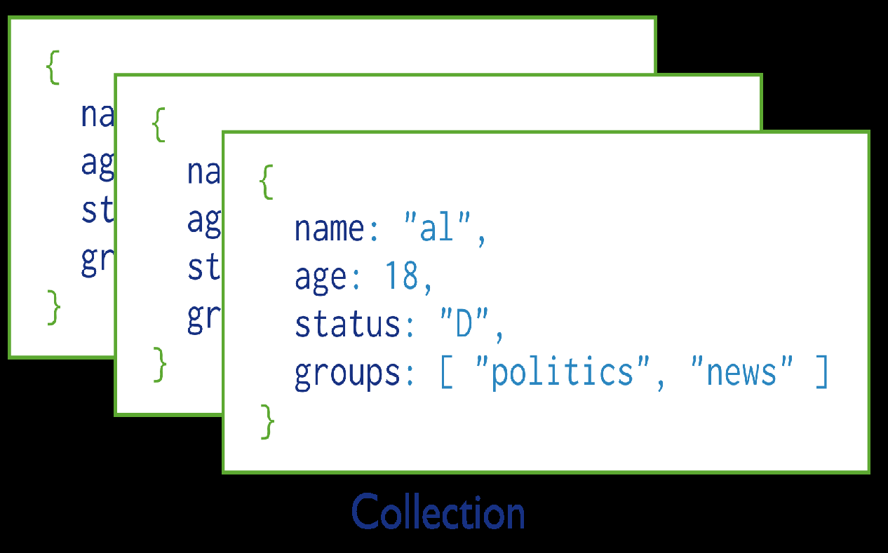
Querying
Fig. Collection of MongoDb Documents

Slide 19
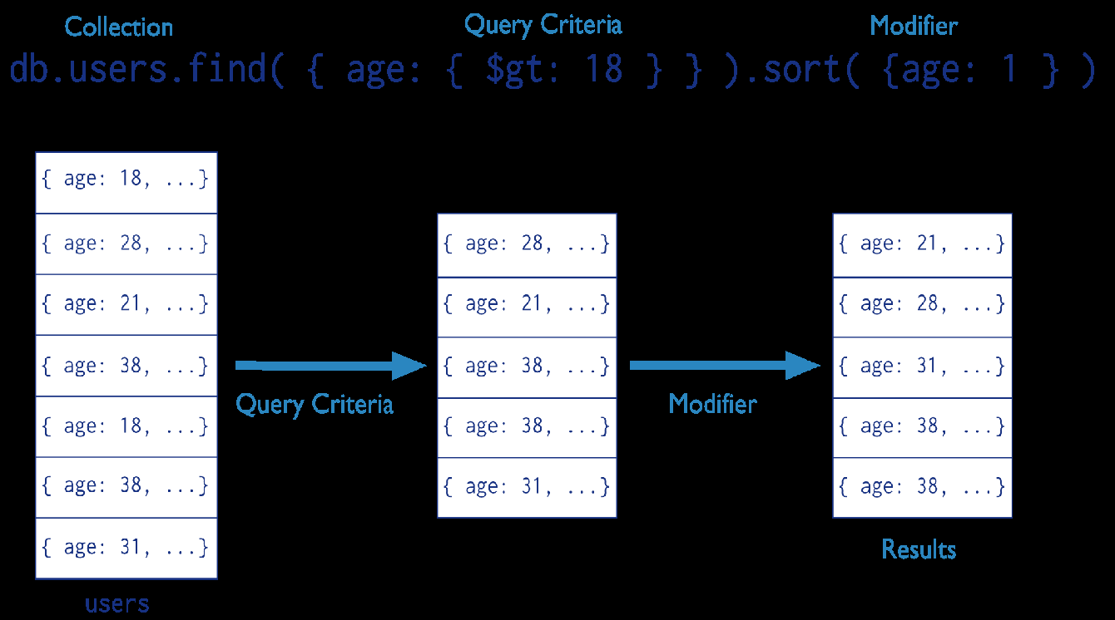
Querying
Fig. The stages of a MongoDB query with a query criteria and a sort modifier.

Slide 20
Querying
d={
_id : ObjectId(“4c4ba5c0672c685e5e8aabf3”),
author : “Kevin”,
date : new Date(“February 2, 2012”),
text : “About MongoDB...”,
birthyear: 1980,
tags : [ "tech", "databases" ]
}
> db.posts.insert(d)

Slide 21
Find
db.posts.find() : returns entire collection in posts
db.posts.find({“author”: “Kevin”, “birthyear”: 1980})
{
_id : ObjectId("4c4ba5c0672c685e5e8aabf3"),
author : "Kevin",
date : Date(“February 2, 2012”),
birthyear: 1980,
text : "About MongoDB...",
tags : [ "tech", "databases" ]
}

Slide 22
Specifying Which Keys To Return
db.mydoc.find({}, {“name”, “contribs”})
{
_id: 1,
name: { first: “John”, last: “Backus” },
contribs: [ “Fortran”, “ALGOL”, “Backus-Naur Form”, “FP” ]
}
db.mydoc.find({}, {“_id”:0, “name”:1})
{
name: { first: “John”, last: “Backus” }
}

Slide 23
Renges, Negation, OR-clauses
Comparison operators: $lt, $lte, $gt, $gte
db.posts.find({“birthyear”: {“$gte”: 1970, “$lte”: 1990}})
Negation: $ne
db.posts.find({“birthyear”: {“$ne”: 1982}})
Or queries: $in (single key), $or (different keys)
db.posts.find({“birthyear”: {“$in”: [1982, 1985]}})
db.posts.find({“$or”: [{“birthyear”: 1982}, {“name”: “John”}]})

Slide 24
Arrays
db.posts.find({“tags”: “tech”})
Print complete information about posts which are tagged “tech”
db.posts.find({“tags”: {$all: [“tech”, “databases”]},{“author”:1, “tags”:1})
Print author and tags of posts which are tagged with both “tech” and “databases” (among other things)
Contrast this with:
db.posts.find({“tags”: [“databases”, “tech”]})

Slide 25
Querying Embedded Documents
db.people.find({“name.first”: “John”})
Finds all people with first name John
db.people.find({“name.first”: “John”, “name.last”: “Smith”)
Finds all people with first name John and last name Smith.
Contrast with (order is now important):
db.people.find({“name”: {“first”: “John”, “last”: “Smith”}})

Slide 26
Limits, skips, sort, count
b.posts.find().limit(3)
Limits the number of results to 3
db.posts.find().skip(3)
Skips the first three results and returns the rest
db.posts.find().sort({“author”:1, “title”: -1})
Sorts by author ascending (1) and title descending (-1)
db.people.find(…).count()
Counts the number of documents in the people collection matching the find(…)

Slide 27
Unwind
db.article.aggregate( { $project : { author : 1, tags : 1 }}, { $unwind : "$tags" } )
{ "result" : [ { "_id" : ObjectId("4e6e4ef557b77501a49233f6"),
"author" : "bob",
"tags" : "fun" },
{ "_id" : ObjectId("4e6e4ef557b77501a49233f6"),
"author" : "bob",
"tags" : "good" },
{ "_id" : ObjectId("4e6e4ef557b77501a49233f6"),
"author" : "bob",
"tags" : “jun" } ],
"OK" : 1 }
Unwind : Deconstructs an array field from the input documents to output a document for each element

Slide 28
Unwind
Query to insert
db.inventory.insertOne({ "_id" : 1, "item" : "ABC1", sizes: [ "S", "M", "L"] })
db.inventory.aggregate( [ { $unwind : "$sizes" } ] )
The operation returns the following results:
{ "_id" : 1, "item" : "ABC1", "sizes" : "S" }
{ "_id" : 1, "item" : "ABC1", "sizes" : "M" }
{ "_id" : 1, "item" : "ABC1", "sizes" : "L" }

Slide 29
Group
Every group expression must specify an _id field.
For example, suppose you wanted to print the number of people born in each year
> db.people.aggregate( { $group :
{ _id : "$birthyear", birthsPerYear : { $sum : 1}} )
{ "result" : [ { "_id" : 1924, "count" : 1 } ], "ok" : 1 }

Slide 30
Thank You !!!

